Slide 1
Working Remotely
TIMES
Special Edition Tips and Tricks
March 31 2020
Notes:
Welcome to our special edition Tips and Tricks Webinar on working remotely. Hopefully we will give you come good ideas to help you through these stranger times indeed.

Slide 2
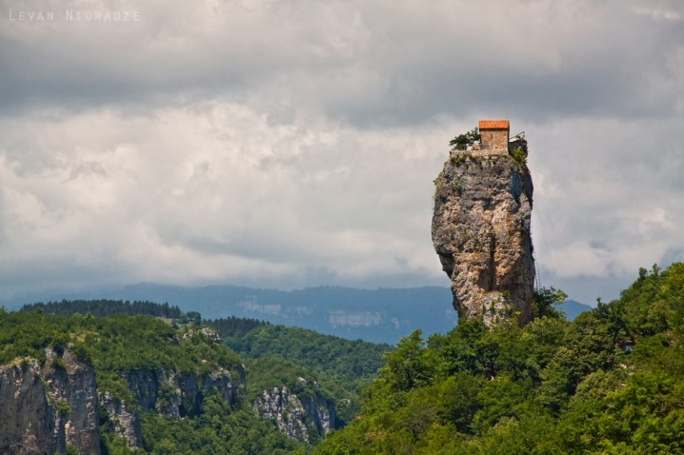
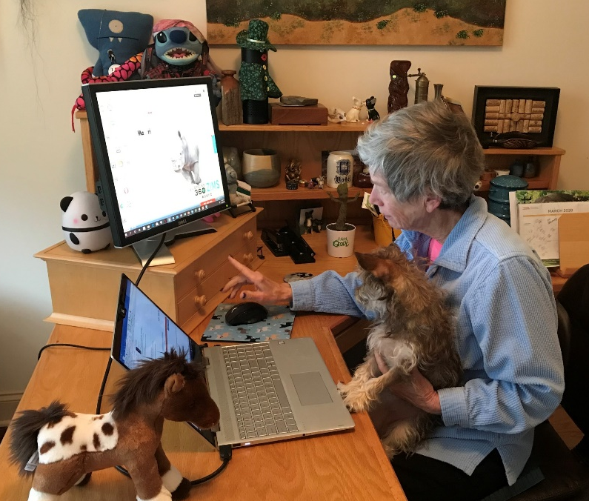
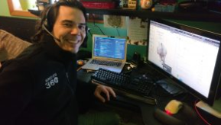
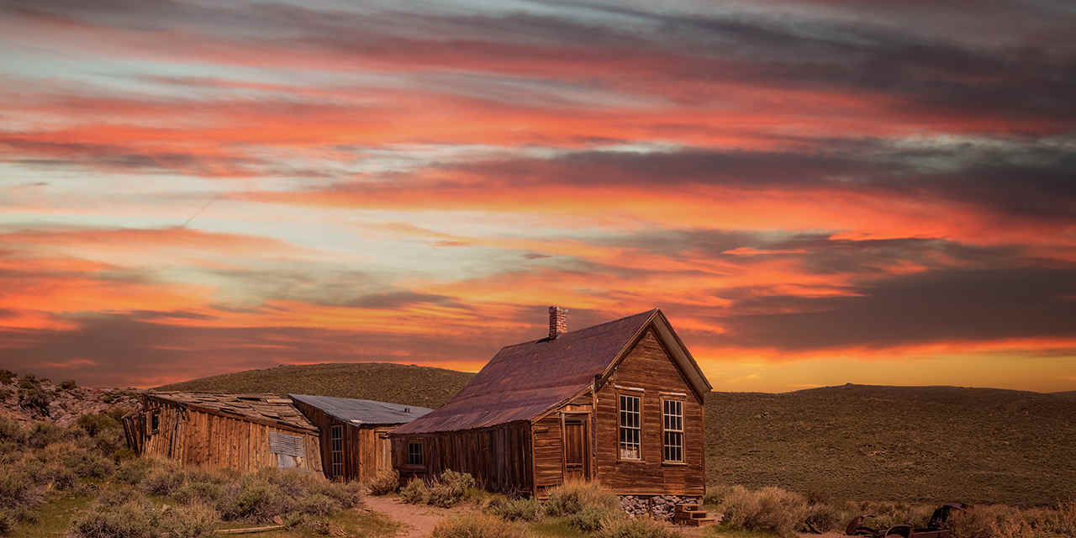
Notes:
In this time of the COVID-19 virus many of you are now working remotely from home. Hopefully you are not quite this remote.
>> Josh and I have been working remotely from home for many years, me for over 10 and Josh for 6 years. We wanted to share some tips for doing this successfully, share what some of you are experiencing and then look at ways that ZIMS can help make your remote work easier.

Slide 3
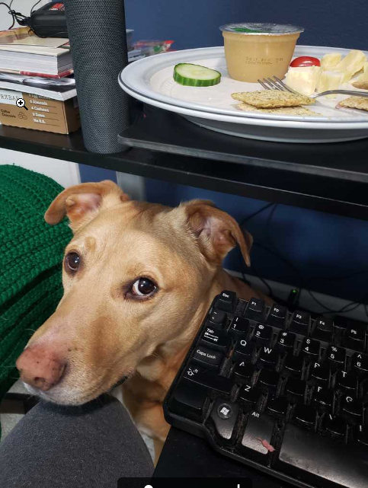
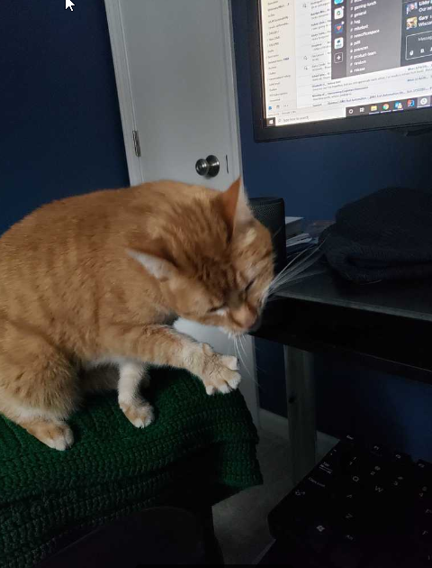
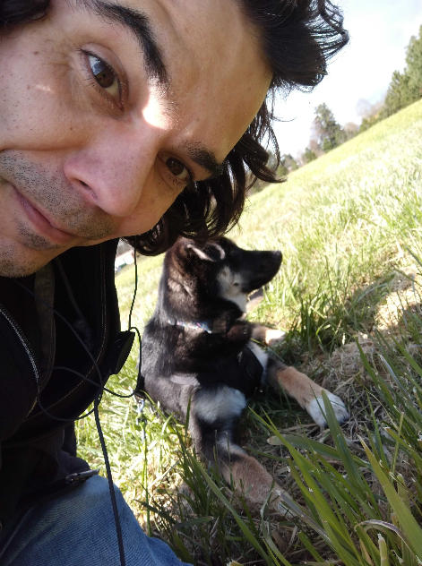
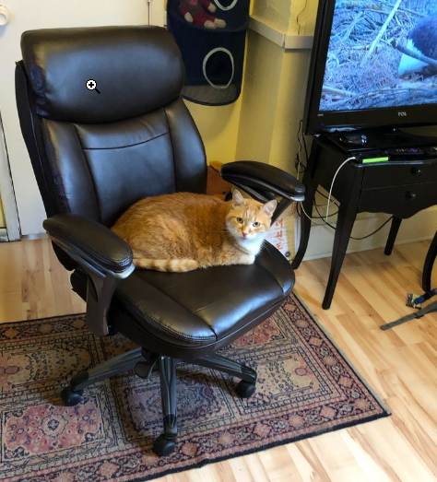
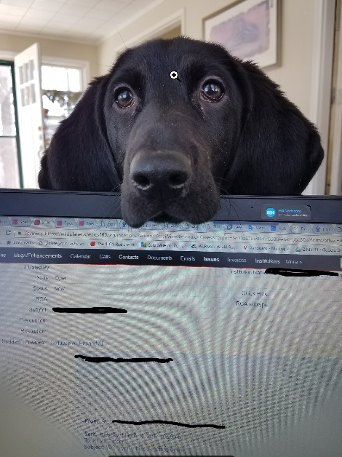
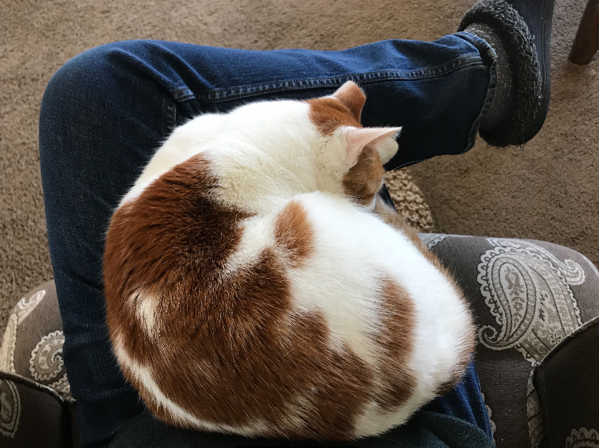
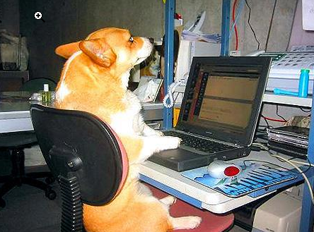
Some Challenges Advantages – Pets!
Notes:
Although the Species360 Staff often took the opportunity to work from home off and on, we have all been working from home 100% of the time for several weeks now. There are some inherent challenges that everyone who works from home face. Most of us have pets as family members and on the whole they were thrilled to have their humans home all day every day. Many of them took the opportunity to help as much as they could. If not help to demand your attention. But the benefits of our pets far outweighs the challenges. These are all Species360 family members helping with ZIMS development and support.

Slide 4
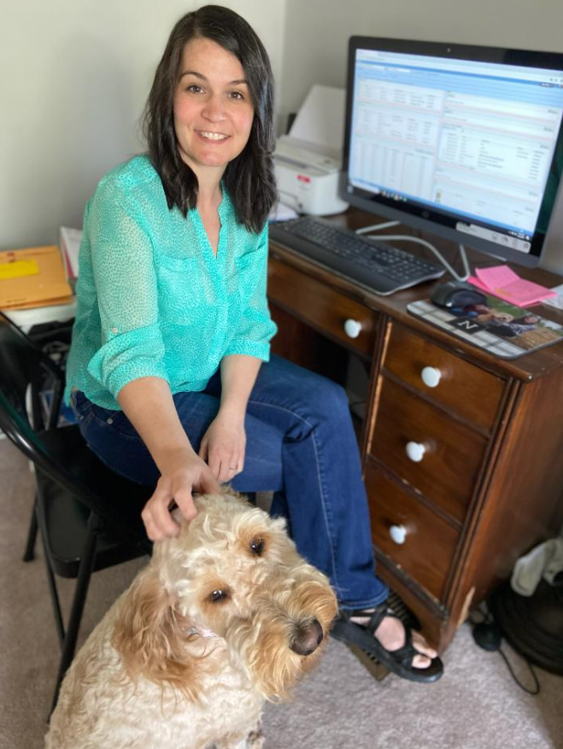
Christina Newman, Tennessee
Aquarium, has a furry office
mate. “At this point I have
not faced any challenges yet
working remotely with ZIMS.
ZIMS has always been so great
at being able to be accessed
from anywhere. Now, I have
other issues, like I really miss
my work scanner!”

Slide 5
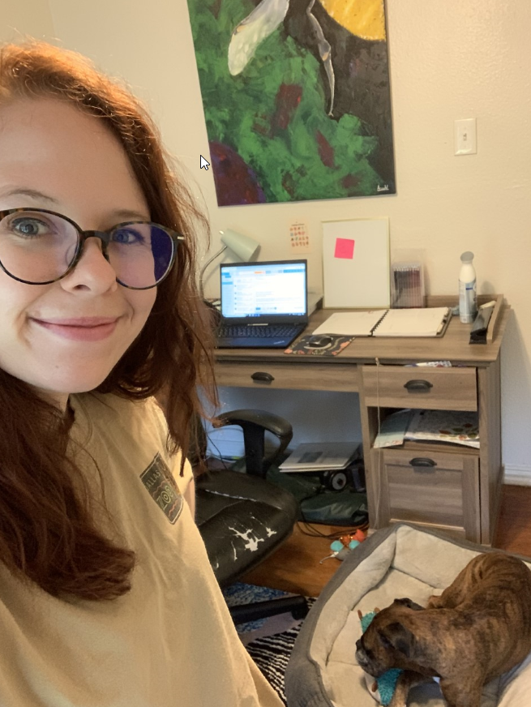
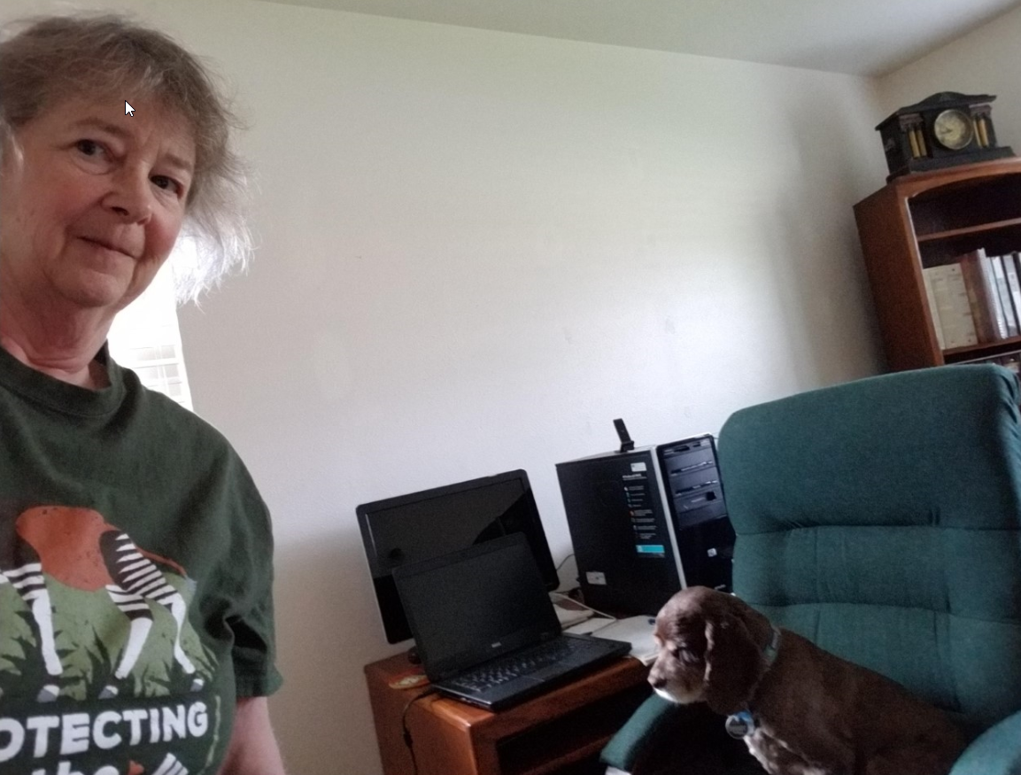
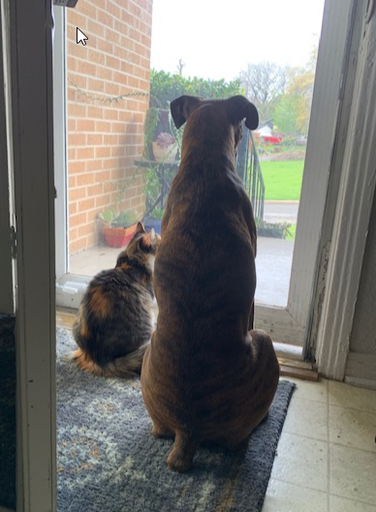
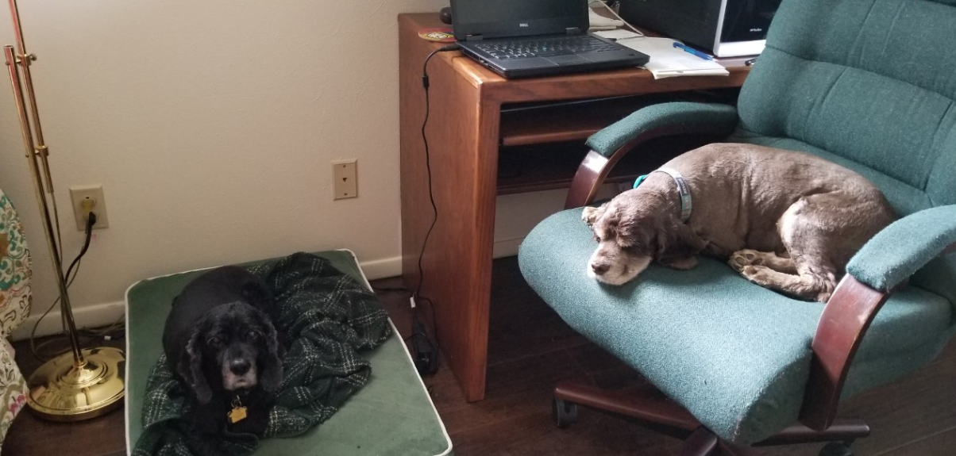
Ali Rackley and Lisa Fitzgerald, Dallas Zoo, are
finding their new office mates very helpful
and easy to get along with. They are finding
their work at home time very productive.
At least it was until Lisa’s internet access
failed! She works in the evening and early
morning and takes a walk during peak hours
when the home schoolers are on.

Slide 6
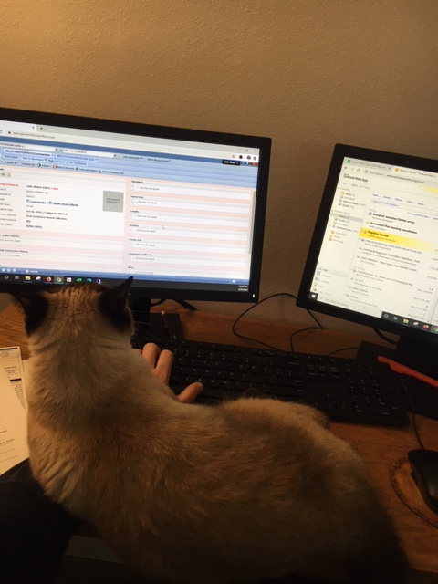
Katie Kisner, Florida
Aquarium, says “I’m
not sure how I will
return back to work
without a cat on my
lap!”

Slide 7
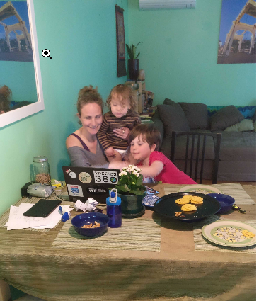
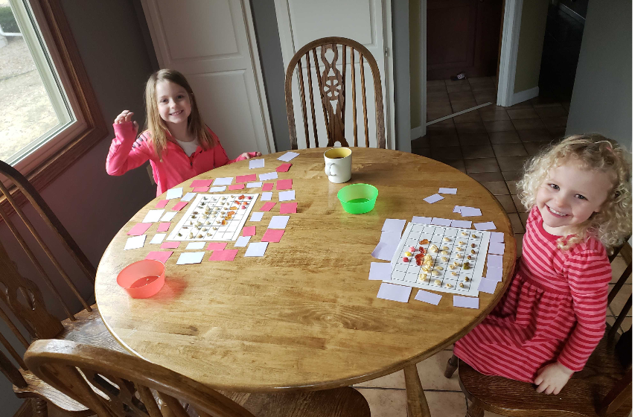
Some Challenges - Family
Notes:
With so many schools and businesses closed or their staff also working at home, so much close family time can be a challenge. Children may not understand that although their parents are home there will be times when they cannot give their undivided attention. Creative ideas have resulted for finding ways to keep your children, or your significant other, occupied. Josh’s family is having some shared computer time on the left and Rachel’s Thompson’s girls are graphing their snacks.

Slide 8
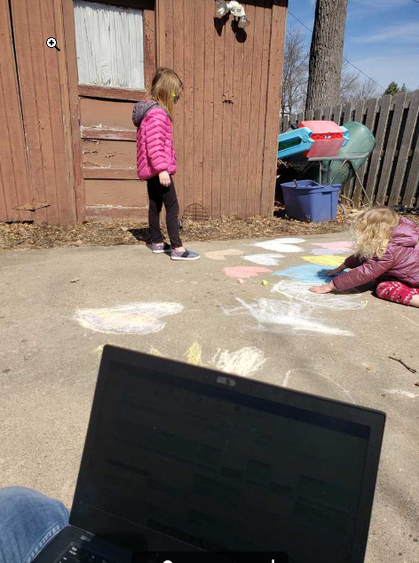
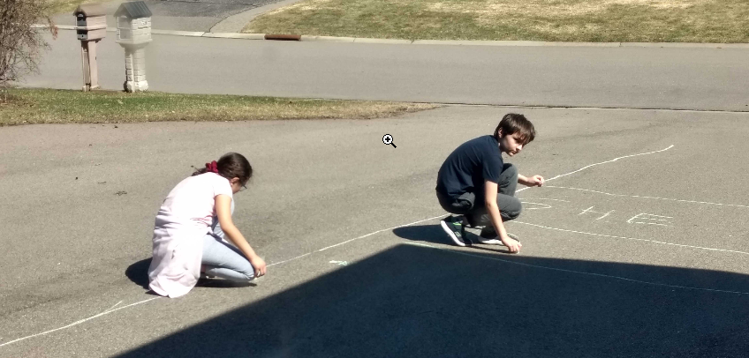
Keeping the Kids Busy
Chalk art is very popular in Florida – and Minnesota!
Notes:
I was told that in Florida chalk art has become very popular especially to help occupy time for the younger set. If you are hesitant to closely interact with your neighbors, encourage them and their children to take up chalk art. It makes your neighborhood walks fun to see what others have created and you can talk with them at a distance about their accomplishments. It will also keep your kids (or significant other) occupied while you work. On the left are Rachel’s girls quietly occupied while mom is on a conference call. On the right are Nannette’s children creating a game with numbers and letters while Nannette was in a meeting. She said they were having a blast!

Slide 9
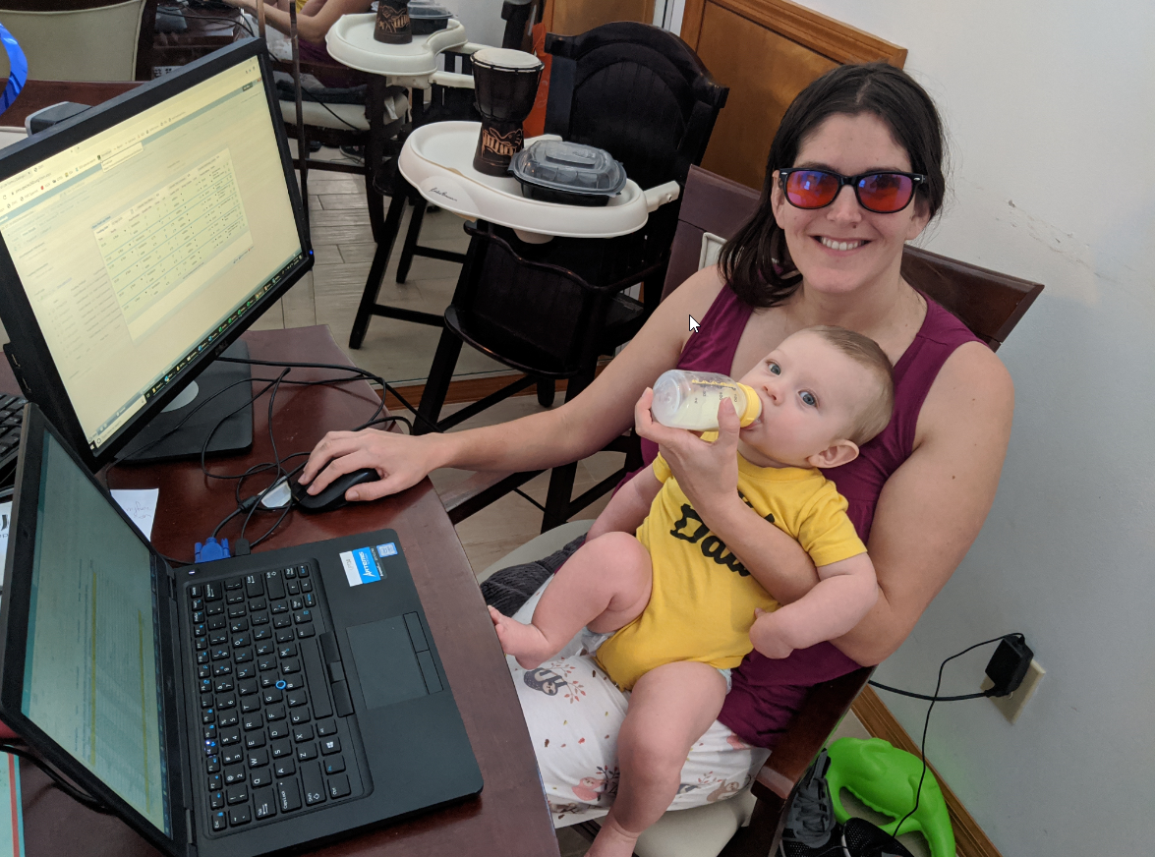
Sharon Meola, Brevard Zoo,
with 6 month old Ronan. She
also has a 3 and a 4 year old!
“Lots of fun trying to juggle
working from home and
providing enough attention
to them all” 😊

Slide 10
Challenges - Isolation
Notes:
At the other side of the spectrum is the feeling of isolation for those who don’t have family at home. Humans by nature are social animals so it can be difficult. If you don’t already play interactive games on line that involve other people this is a good way to get “virtual” socialization. I have never played so many Words with Friends in the 5 years that I have been playing. Pick up the phone even! We will give you some ideas for staying connected in a remote world in a bit.

Slide 11
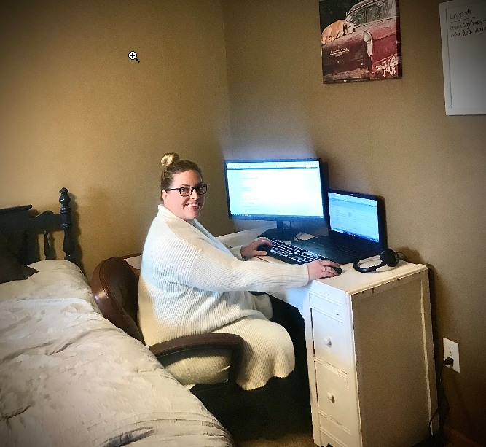
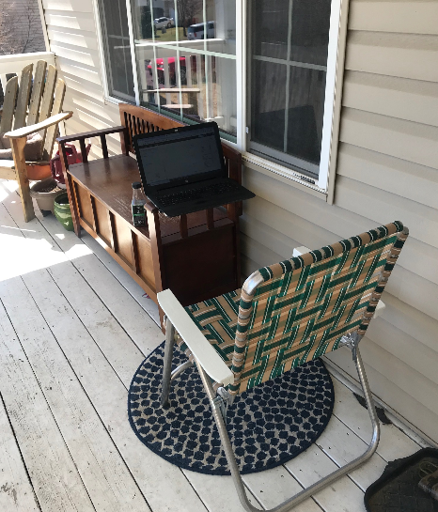
Some Challenges - Space
Notes:
Although I bought my house knowing that we needed one room dedicated as an office, many did not anticipate working out of their home. Kim started her remote life from her daughter’s bedroom because that was the only room with a desk. She has since upgraded to her new digs in her bedroom with a desk brought in from the garage. She also has a fabulous outdoor office set up to watch her son play outside.
Try to make it work for you. If you have a standing desk at work, figure out how to set one up at home. I imagine many people are working from the dining room table while their children take remote classes from the other side.
Josh recommends that you may want to splurge and get yourself a good chair. Adding back pain to this scenario can cause misery.
The folding chair didn’t work very long for Kim.

Slide 12
Some Hints for Normalcy
Get dressed!
Unless you normally wear a uniform or a suit, dress as if you would be going to work
Set hours when you can’t be disturbed
By kids and significant others
Work normal hours
For some it’s easy to keep working into the night
For others it’s hard to get going
But be willing to adjust these hours, too!
Unplug when you are done working for the day. If you normally would not check your phone or computer at night, don’t do it now!
Notes:
There are some things you can do to try to feel “normal” during this temporary time. First get up and get dressed! It will be tempting to stay in your pajamas but try not to. Unless you wear a uniform or a suit, try to dress like you normally would to go to work. Try to set hours when your children and significant other (there’s not much you can do about your pets unless you lock them out) know that they cannot disturb you. People respond to self-motivation differently. Some will not be able to shut it off and work many more hours than they normally would. Others will find it hard to even get going. If possible, try to work the hours that you normally would work in the office, but also be prepared to be flexible if needed. Remember to unplug when you are done for the day. If in real life you would not check messages at night, don’t do it now.

Slide 13
Take a Break!
Use the time of your normal commute to take a walk or exercise
Get up frequently – eat your lunch under a tree instead of at your desk – don’t work 5-6 hours without a break. Lisa from Dallas notes that furry co-workers are great at reminding you to get up.
Use your break times to incorporate housekeeping tasks – maybe you can take the weekend off from laundry
Notes:
It’s important to take breaks. Did you have a half hour commute? Use that time to take a walk or to exercise. Make sure you get up frequently. In the office you would probably be getting up to talk to someone in another office. Don’t eat your lunch at your desk. It’s not good for your keyboard or your soul. Furry co-workers are great at reminding you to get up. Use your break times to get some housekeeping done and you may be able to take the weekend off.

Slide 14
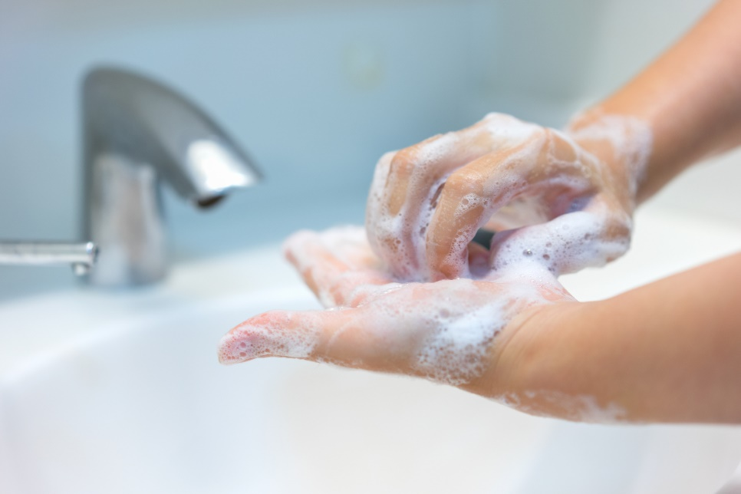
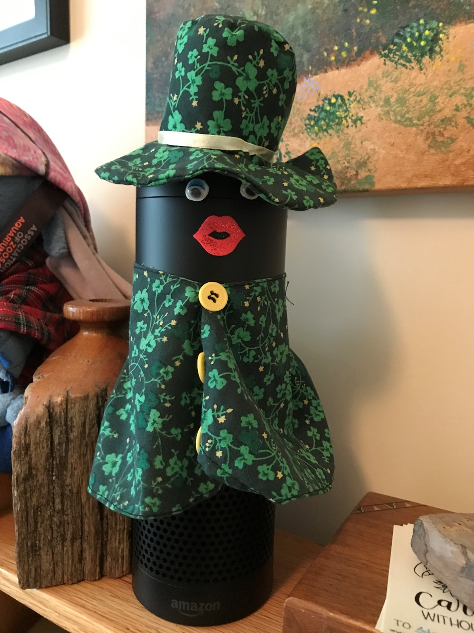
Set Alarms
Notes:
If you have trouble remembering meetings or making sure to take a break, set alarms. You can use Outlook or other scheduling options. Alexa/Echo is also very good to do this. Did you know if you ask her to sing a 20 second song she sings one about scrubbing up with soap. Great to make sure your kids are washing long enough or you if you get bored. Plus you can dress her up! Mine has a new outfit for every month.

Slide 15
Keep Your Exercise Up
Notes:
It’s proven that exercise can boost your immune system, obviously very important right now. Don’t stop if your gym is closed. There are plenty of on line classes if you need the help of a trainer. If the work out calls for weights or equipment there are plenty of household items that you can use.

Slide 16
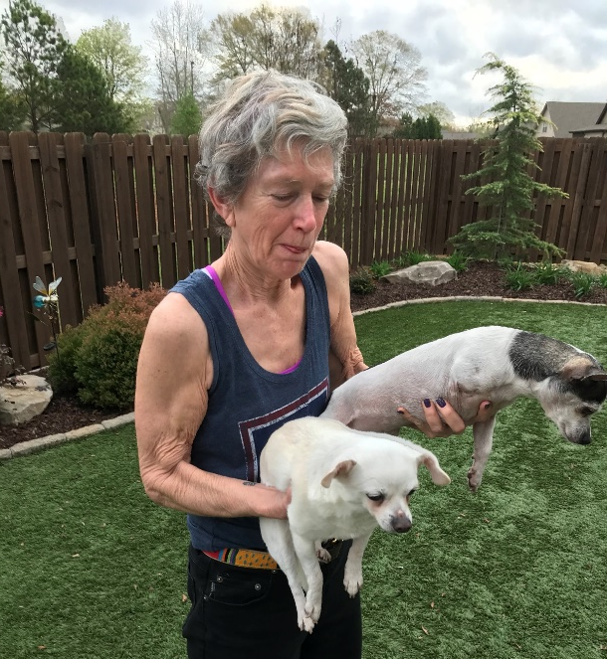
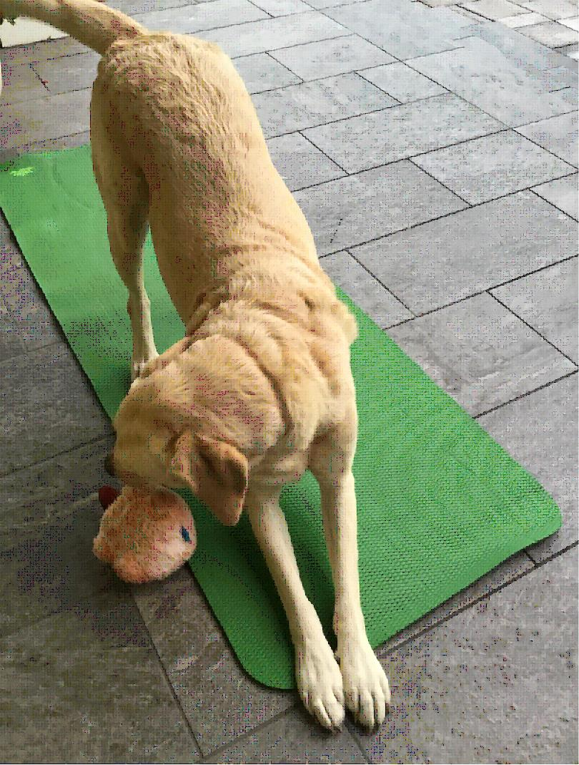
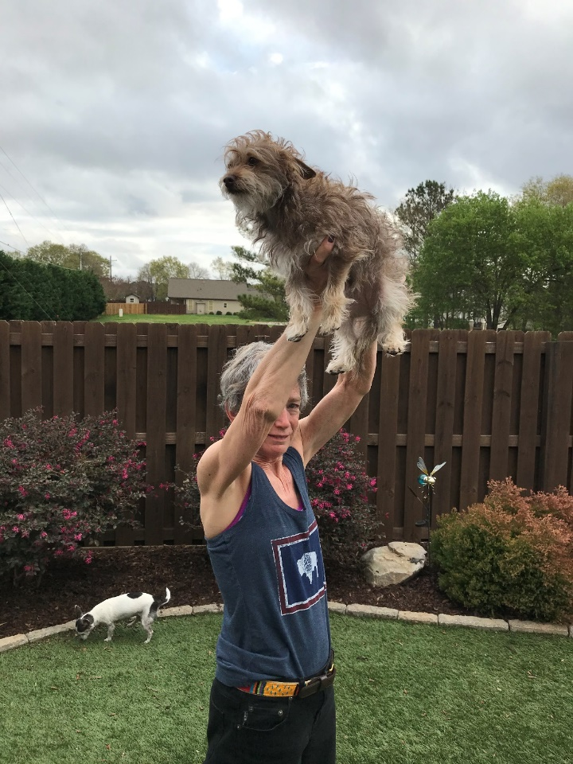
Keep Your Exercise Up
Notes:
My household items are 6 and 8 pound Chihuahuas for weights. Heather Eberhart from Disney does yoga with her dog who specializes in a perfect downward dog.

Slide 17
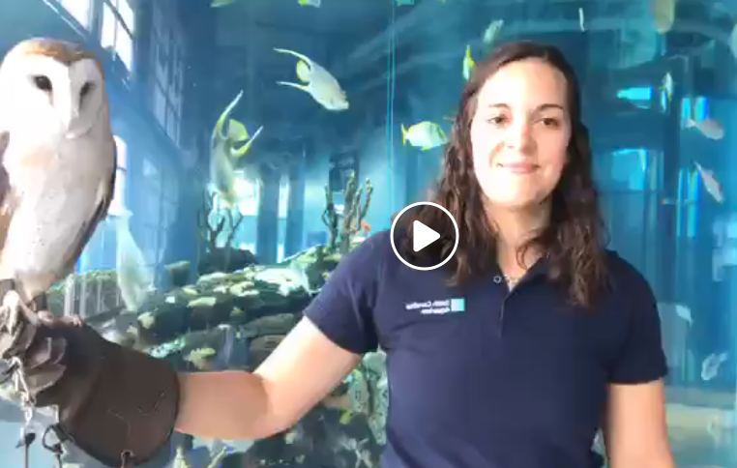
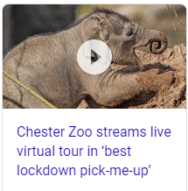
Get Your Animal Fix
Watch the videos being posted!
https://www.facebook.com/scaquarium/videos/2588188781447994
https://www.facebook.com/reena.sibley/videos/10104901779915879
Search for zoo (or aquarium) live streaming
Many institutions that are closed are live streaming their animals
Notes:
Many institutions are getting very clever with posting videos to help get your animal fix and also provide a laugh. These links are tours of aquariums hosted by their animals. Many zoos and aquariums that are closed are live streaming some of their animals.

Slide 18
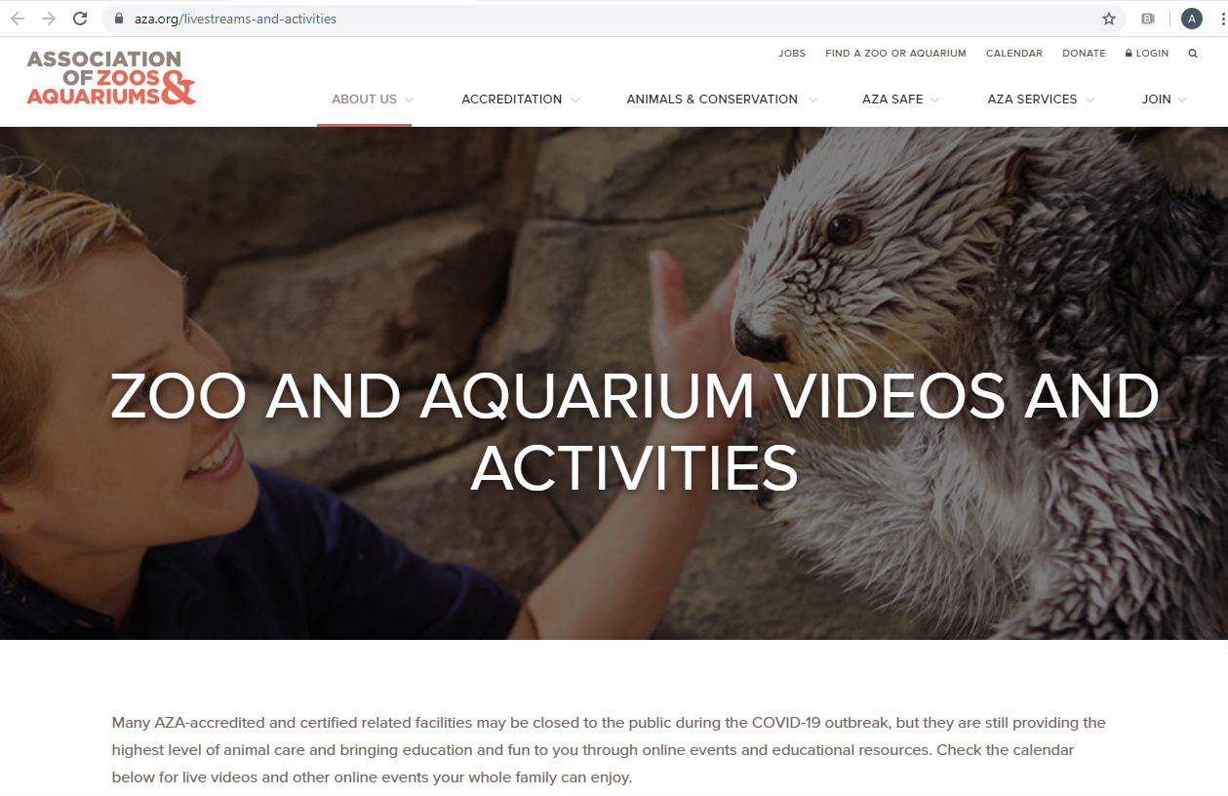
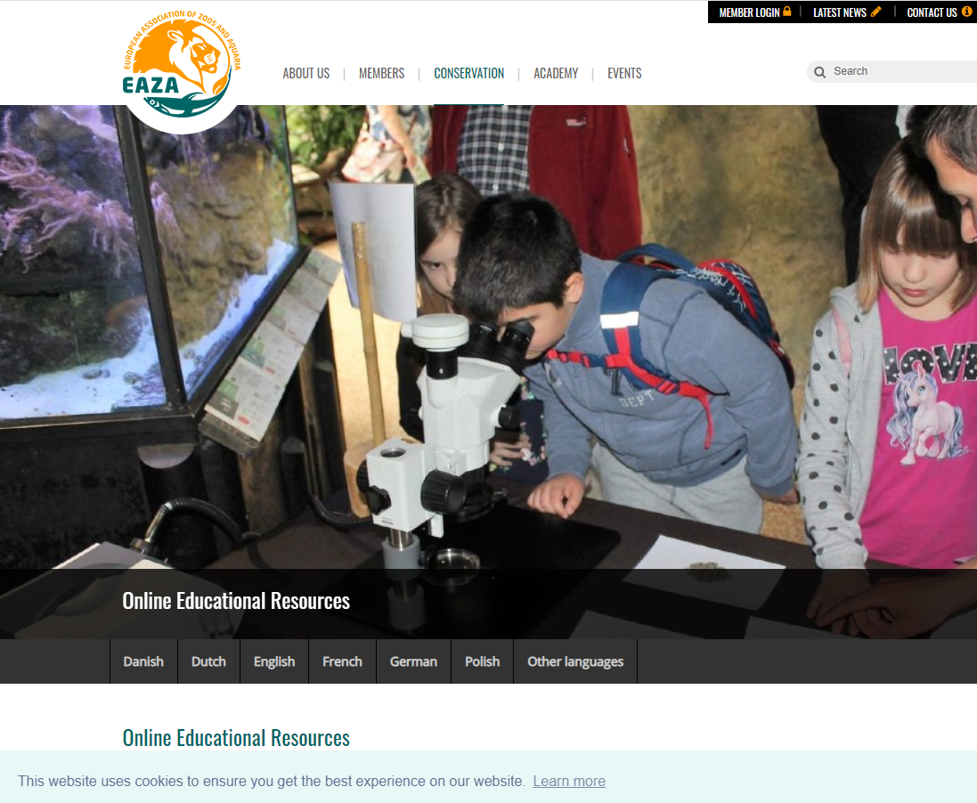
Check What Your Regional Associations are Doing
https://www.aza.org/livestreams-and-activities
https://www.eaza.net/conservation/education/online-educational-resources/
Notes:
Check out what your Regional Associations are doing to help you get your animal fix. AZA has a site that captures virtual tours, talks, animal encounters and streaming Webcams. These are great for all ages to keep in touch.
EAZA also has a site for interactives and educational resources.
And if your institution is doing some of these it will help make you feel more connected while you are remote.

Slide 19
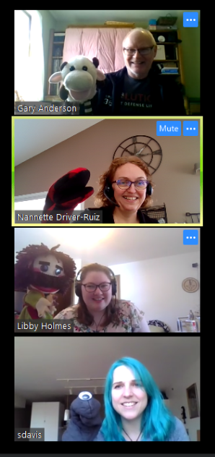
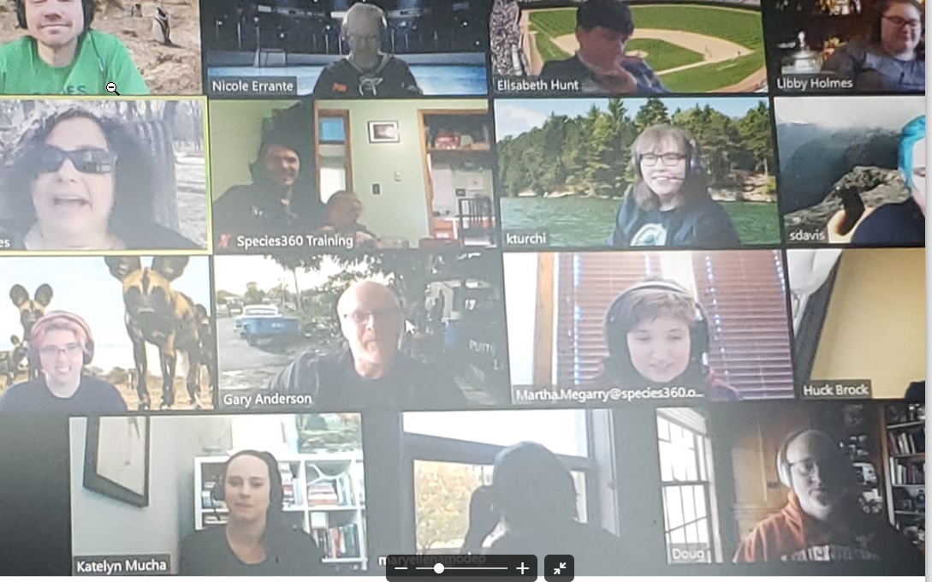
Some Ideas for Connecting
Social distancing is not easy for many of us social animals
Visual is important!
Set up face to face meetings (Zoom, Skype, Blue Jean, Face Time) and turn on your video during meetings and conference calls to see familiar faces
Make them fun – Disney staff often wear mouse ears or other character attire, bring a puppet!
Notes:
Humans are social animals and don’t take well to the whole social distancing concept. But there are some things you can do to not feel isolated. I’ve noticed that in our meetings now everyone turns on their video streaming during meetings and conference calls. It helps to see familiar faces. Disney staff has been wearing Mickey ears or other character attire during their calls. One of our product teams brought puppets to their last meeting.

Slide 20
Some Ideas for Connecting
Create Slack/Skype/WhatsApp chat groups
Zoom became popular overnight (600,00 new Users in a week) and has a free version for your meetings and calls
Use your listservs
It’s important that everyone uses the same tools for the best connecting
Over communicate! It is easy to misunderstand something face-to-face never mind remotely
Notes:
If you are not on Slack/Skype/WhatsApp or another chatting type group join one. You can easily share photos and keep up on the little (and big) things that are happening in your co-workers lives. When we first started working from home we shared photos of our quickly created home office spaces. Zoom became very popular quickly for conference calls and meetings and it has a free version. Use your listservs to remain updated on significant happenings. The main thing is for everyone to use the same tools for the best connecting. Be sure that you over communicate! Misunderstandings happen even face-to-face. You may need to communicate via written options as well as have virtual meetings.

Slide 21
Learn How to Conference Call!
Since you will probably now have meetings via conference calls, watch these “Conference Call in Real Life” videos
https://www.youtube.com/watch?v=DYu_bGbZiiQ
https://www.youtube.com/watch?v=JMOOG7rWTPg

Slide 22
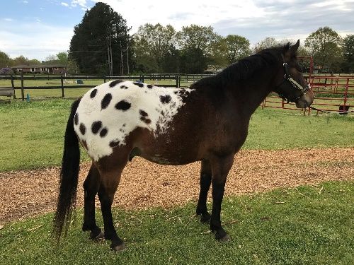
Virtual Normalcy
Notes:
Species360 has started having Happy Hours sometimes at the end of the workday via Zoom. We grab our favorite beverages and snacks and turn on our video. Work topics are taboo. Family and pets are encouraged to join. Find other ways to try to do “normal” things. I just entered a picture of my horse in a “Seclusion Showdown Online Horse Show”. It actually gave me the same rush of excitement, without the trailering, time and expense involved in a real horse show. Can’t wait to hear back from the judges!
Netflix, Amazon, Hulu, Disney+ and YouTube have the ability to virtually watch and multiple people can share a movie together often with text chat, video chat and emoji reactions.

Slide 23
Some Local Admin Options
Many are catching up on those “rainy day” projects
Clear your Post Office!
Develop a list of Keywords
Enter your Permits and assign them to Animals and/or Enclosures
Update your documents if that is one of your responsibilities
Update your Staff list
Fix your Data Quality errors
Notes:
Many Local Administrators are taking advantage of parts of their jobs slowing down, such as shipments, to catch up on some ZIMS housekeeping.
Some are clearing their Post Office boxes! Others tasks include finally developing and distributing that list of Keywords. Enter your permits into ZIMS and get them assigned to the appropriate animals or enclosures. Update those outdated documents such as transaction confirmations and breeding loans that have not been touched for a decade. Check your Staff list and mark Obsolete as appropriate, double check their Staff details and ZIMS Role access. And use the Data Quality chart to find and fix any data quality warnings or errors.

Slide 24
Getting Other Staff Involved
You may have to turn off IP restrictions temporarily or add new ones
You may have to grant other Staff access such as Eye On ZIMS or add Add/Edit access to Staff with Search/View access
Activate Provisional Data if you haven’t already
Lets other staff enter data but requires your approval before it goes into the actual database
Activate Advanced Access Management
Restricts entries by Animals, Taxonomy or Enclosures
Contact support@species360.org for our COVID-19 AAM special if you are interested
Notes:
Many institutions are taking this time to get more Staff involved with direct data entry into ZIMS. There are some things to think about here. First, if you have restricted Staff only to the institution IP address you may need to remove or update that restriction. You may need to upgrade access from Search/View only to Add and Edit access. Other Staff members may need search access such as Eye on ZIMS given to them. Provisional Data entry is perfect for these times, so if you haven’t activated it you may want to. Remember the ZIMS Global Admin has to turn it on for your facility first. You may want to think about activating Advanced Access Management. This option can restrict data entry by Animals, Taxonomy or Enclosures so people new to data entry can enter data only on the animals that they are responsible for. If you are interested contact support@species360. This is a premium product that normally involves a fee but right now we have a COVID-19 AAM special being offered!

Slide 25
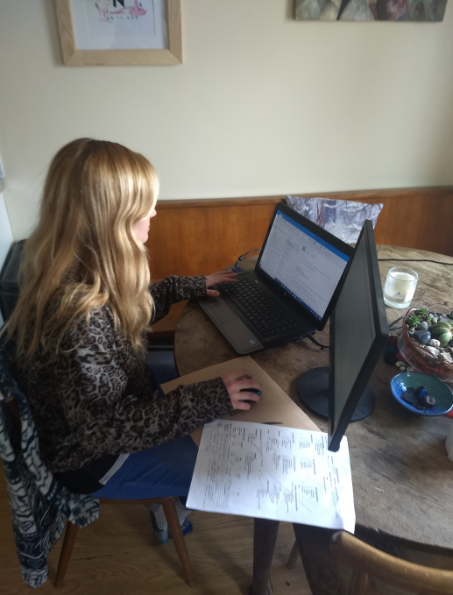
Getting Other Staff Involved
Laura Graham, Bristol Zoo
“With the occasional keeper in self-isolation; we’re trying to keep them going where we can with the joy of ZIMS! As part of this we’ve got them adding historical hand-rearing data that we’ve always wanted on ZIMS but never
had the time/resources to add until now, as well as other bits and bobs that were historically recorded on paper records. The strangest of times; great for data entry, not so great for just about every other aspect of life!”

Slide 26
Getting Other Staff Involved
Lisa Fitzgerald, Dallas Zoo
“Because most of these Staff are non-exempt, I prepared a simple plan with a 6 PM
curfew to keep us compliant with the Fair Labor Standards Act. (Note from me: I
never would have thought of that!) One of our Lead Zoologists has already used her
time at home to develop a Husbandry Log Template for her area.
It is worth noting that DocuSign has saved our bacon in this scenario! A lot of our
processes are able to keep running smoothly since we don’t have to make contact to
get approval for things.
And one pro of remote work – my 2 hour commute is now 2 minutes!”

Slide 27
Getting Other Staff Involved
Shelly Roach, Columbus Zoo
“I am working 3 or 4 days in our Australasia regions helping out (Note from me:
remember the comment to be flexible? ☺). Being able to use a database that is
accessible to the internet has helped me keep on top of our animal records
(accession births, record deaths, shipping isn’t occurring now). That way the
keepers are staying on top of direct entry for the newest members of our
collection. Nothing has changed with data entry since our staff does direct data
entry.
For me the hardest part was not having two monitors set up at home and not
having my hard files in reach is frustrating.”
Aletha Kinser, Sedgewick County Zoo, let me know “you can get a USB port monitor
to attach to your laptop for less than $100 from Amazon. My boss bought me one
and had it sent directly to my house. It’s an AOC, folds completely flat and comes
with a carrying sleeve for ~$85.00. If my boss hadn’t bought it for me, I would have
done so myself.” Nice boss!

Slide 28
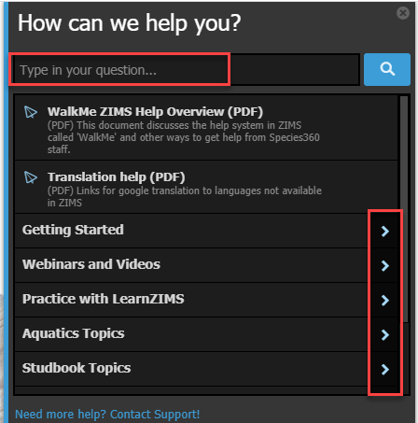
Make Sure Everyone Knows How to Access the Help Docs
From Laura Graham at Bristol: “All of your training documents have been a Godsend when trying to explain things from home instead of face to face.”
Our Help documents are for everyone using ZIMS. Select Help Menu in the upper right corner of all ZIMS screens. You can type in a topic or expand general topics for a list of Help documents available.
Notes:
When you do have others doing data entry, make sure everyone knows how to access the Help docs.

Slide 29
Support is for Everyone!
Make sure that your Staff using ZIMS knows that our Support Staff is available for them, not just for Local Admins
Contact support@Species360.org
Your support representative (or their very helpful cat or dog) will be happy to assist them!

Slide 30
Be Safe! Be Healthy! Be Distanced! But Stay Connected!
Remote Life as it is in these Stranger Times
On to Josh and some ZIMS options for you………….

