Slide 1
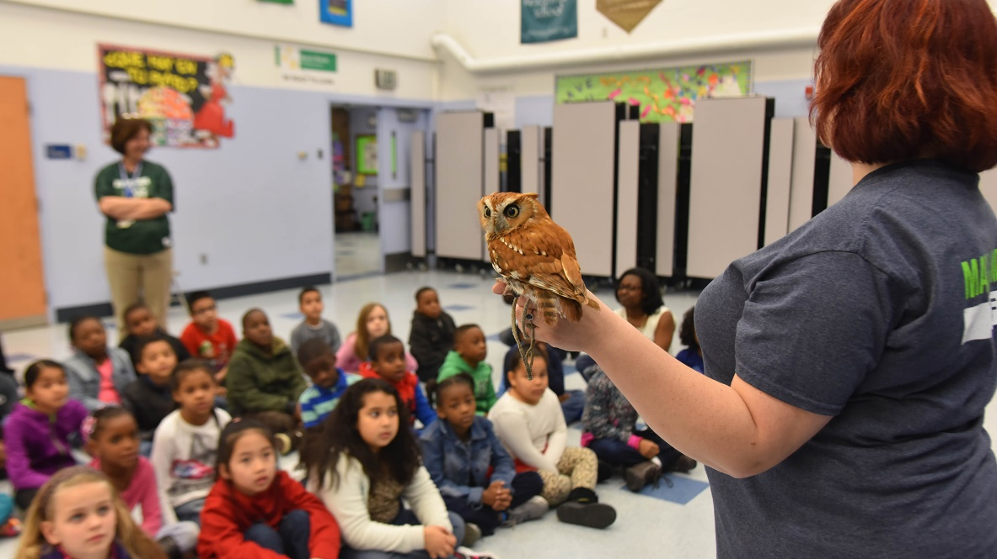
ZIMS and Educators
A Perfect Match!
March 2020 Tips and Tricks

Slide 2
There’s More than Data Entry!
Although most Educators do not do data entry into ZIMS, getting information out is actually what ZIMS is all about!
Educators can use ZIMS to:
Find out what species are in an exhibit
Find the history of an animal you are highlighting
Find who holds a species of interest
Track down the history of your animal biofacts
Case Studies from the Minnesota Zoo!

Slide 3
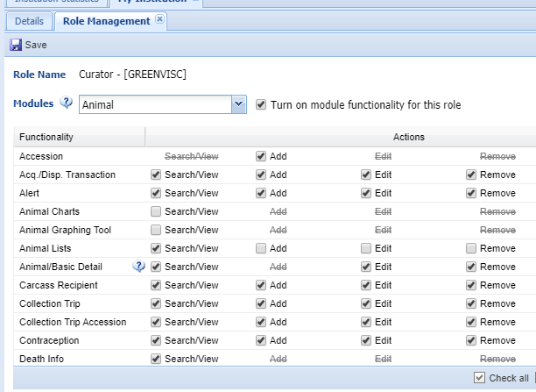
Some Things About ZIMS Access
Access is assigned by Roles
Usually by your Local Admin
Access is given by
Search/View
Add
Edit
Remove
Species360 Template Roles
Automatically updated with new functionality
Cannot edit
Custom Roles
Institution must update
Endless options for customized access

Slide 4
Where to Start
Make a date with your Local Admin
Let them know what information you would like to be able to find
Bring a list of topics!
Institutional policies may affect what you can see
Discuss Roles
You will probably be given Search/View access
Read Only (Species360) Role – Search/View all
Custom Role – Search/View only what you need
Ask them to give you a tour of ZIMS
How you get where you want to go

Slide 5
Meet James and Bob
You are spending some time at the orangutan exhibit hoping to interact with some guests. A young boy is fascinated by a male orangutan sitting close to the viewing window. You ask if he would like to know anything about the primate. “What is his name?” is the first thing he asks.

Slide 6
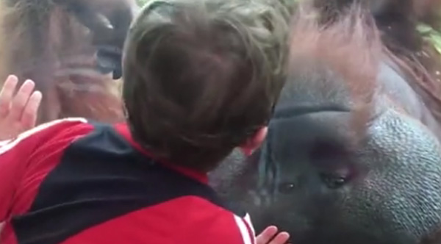
A Curious Mind
His name is “Bob” you reply, happy to answer his question
James then asks
How old is he?
How much does he weigh?
Where was he born?
What does he eat?
Who are his parents?
Do other zoos have these?
Where would he live in the wild?
Who are the other orangutans in the enclosure?
Has he lived anywhere else?
“Uhhhh” you say

Slide 7
You Will Find Out!
James looks disappointed but says he will be back to the zoo next Saturday
You promise him that you will be able to answer his questions then
You run to your office and open ZIMS!!

Slide 8
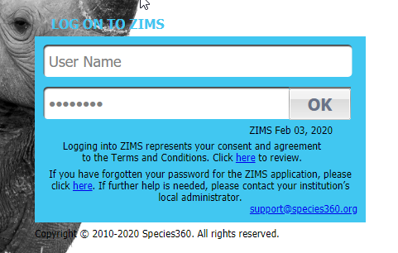
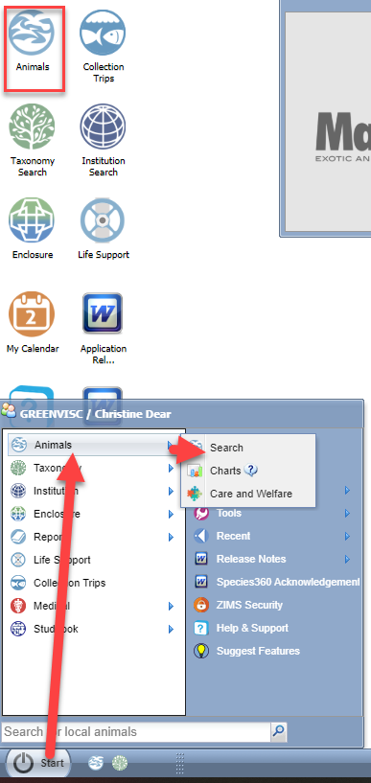
ZIMS Navigation
To start using ZIMS you will need to log in.
The Local Admin will create your User Name
and Password (above). Navigation can be
from the Start menu or by selecting desktop
icons (right). Here we are opening the
Animals module.

Slide 9
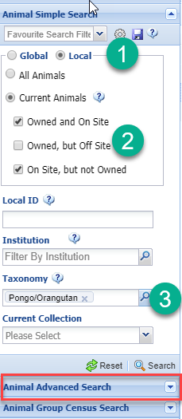
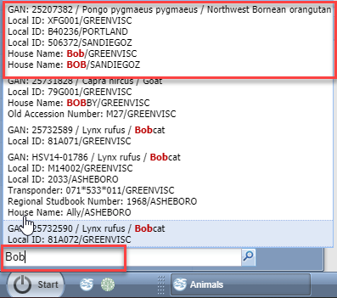
Finding an Animal
If you know the animal’s House Name, Local ID,
GAN (we’ll cover these numbers later), taxonomy
or other identifier you can enter it in the search
above the Start button (above). Or you can use the
expandable left hand search screen (right). You will
probably want to select the Local button (animals
you hold or own) (1), select only animals on site (2)
and enter the taxonomy you are looking for (3). You can
use Advanced Animal search for many more search
options.

Slide 10
Search Results Grid
Selecting from the Start search will open the record directly. If you use the left hand
search a results grid will appear for records that match the filters used in the search.
Some columns of interest include:
1-The GAN (Global accession Number) is assigned by the ZIMS application and it
cannot be edited
2-The Preferred ID is selected by the institution and is the identifier that they prefer
to use, often this is the Local ID (a number assigned to the animal by each institution
holding or owning it) or the House Name
3-The sex is displayed
4-This is a quick way to find out a Birth/Hatch Date
5-The Enclosure the animal is currently occupying

Slide 11
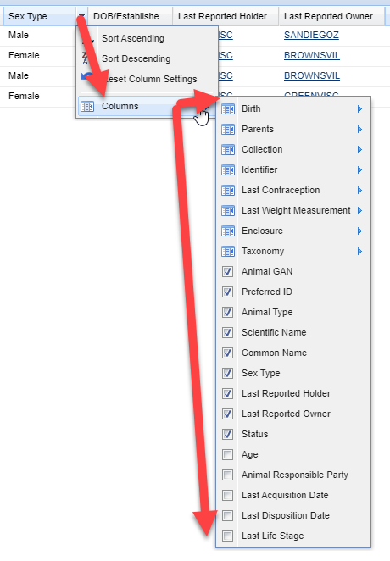
Column Customization
You can customize what is displayed
in these results grids so you see only
the information that you want to.
Select the down arrow to the right
of any column header. Select columns
and then check or uncheck the desired
topics.

Slide 12
Column Customization
Below we used customization to create a results grid that displays only what we want to see
We recommend not removing the GAN column as that is a hyperlink into the record
The column order can also be changed by dragging the column to where you want it to be
To open Bob’s record select the GAN hyperlink

Slide 13
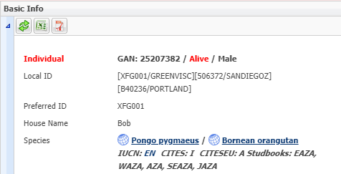
How Old is Bob and Where Was He Born?
The Basic Info grid can tell
you a lot about the animal.
You can see that he was
captive born at the Greenville
Zoo on 23 January 2006. You
can also see that IUCN lists the
species as Endangered and
CITES considers them a “I”.
There are also studbooks in
many regions for the species.
Although Bob lives at the
Greenville Zoo he is owned by
the San Diego Zoo.

Slide 14
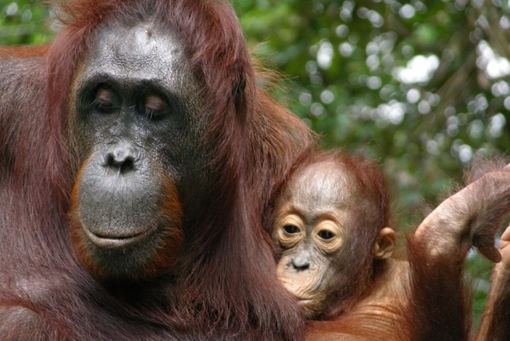
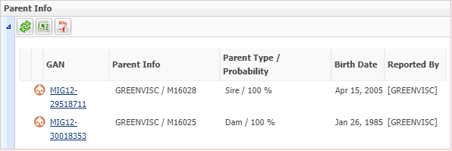
Who are His Parents?
Opening the Parent grid you find Bob’s parents. Selecting the GAN hyperlink will
take you into their records. Bob’s sire was named Kumar and he was born at the
Gladys Porter Zoo. His dam was named Lana and she was born at the Audubon Zoo.
You find this information by looking in the Identifiers grid (Details tab > Identifiers)
and the Event Location grid (More Details tab > Event Locations).

Slide 15
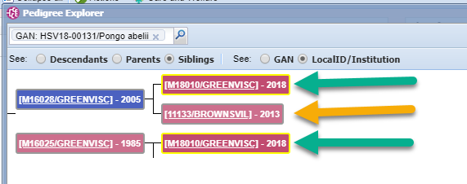
Does He Have Any Brothers or Sisters?
Using Pedigree Explorer you can find Bob’s siblings. Go to Start > Tools > Pedigree Explorer. Bob has one 1 ½ year old full sister still living at
Greenville (green arrows - full siblings are produced from both parents) and one 7 year old half sister living at the Gladys Porter Zoo (gold arrow - half siblings are produced from only one parent).

Slide 16
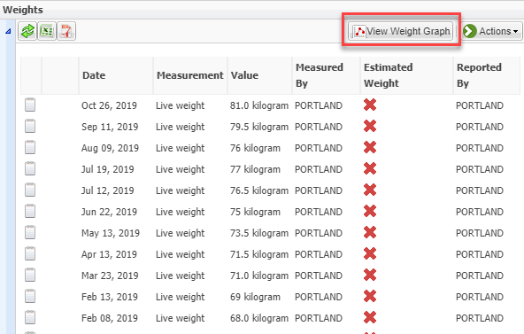
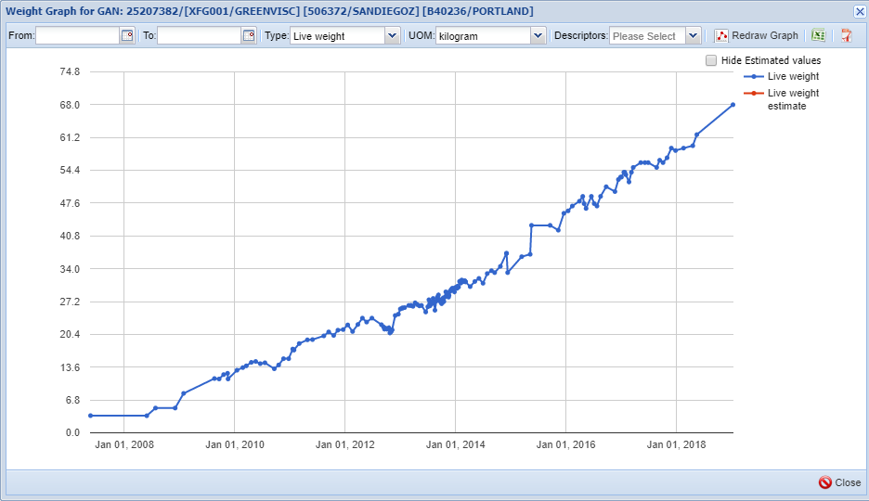
What Does Bob Weigh?
Going to the Weight grid in the Details tab you see
Bob has 9 pages of weights recorded! Selecting to View
Weight Graph lets you easily see how he has grown!
Bob’s most recent weight is 81 kilograms and taken on
16 October 2019.

Slide 17
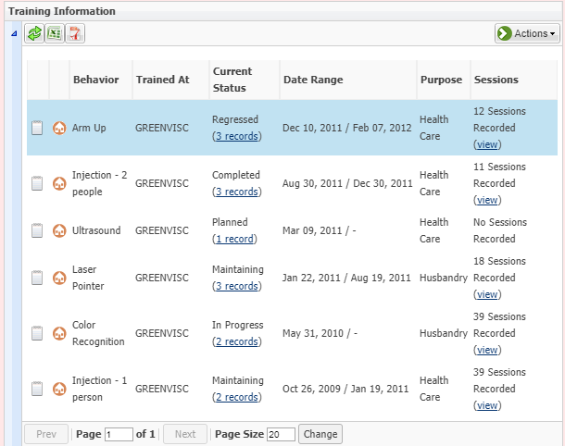
Does He Do Any Tricks?
Years ago zoo staff may have trained
some animals to do “tricks” to entertain
the visitors. Today we do training to
improve health care and often to stimulate
the mental or physical health of the animal.
Bob has been trained to hold his arm up,
receive injections and have an ultrasound
to make his health care easier and
procedures done without restraint. For
stimulation he has been taught to
recognize colors and follow a laser pointer
around his enclosure. You can view the
sessions by selecting the View link in the
Sessions column.

Slide 18
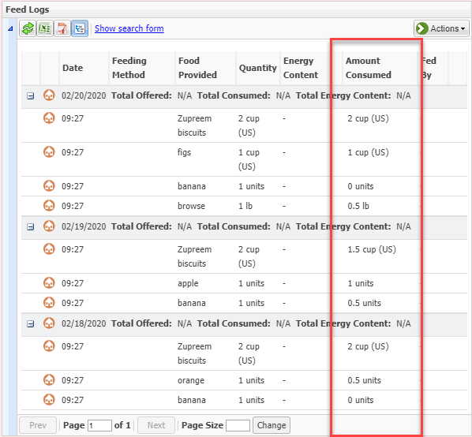
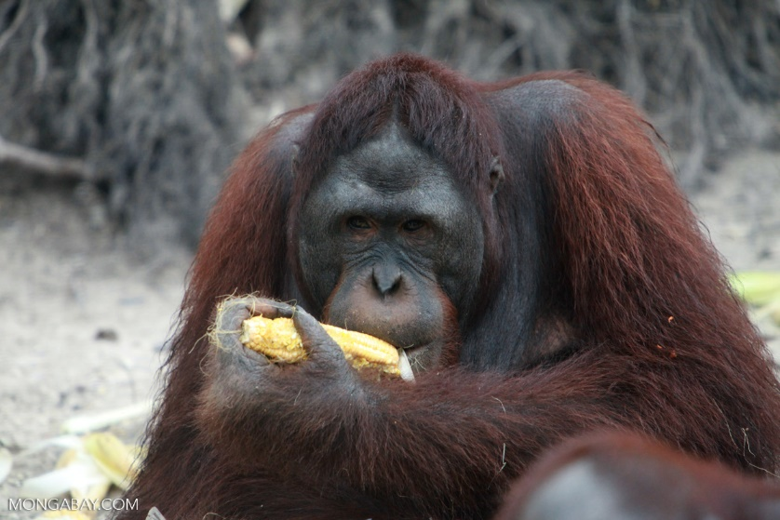
What Does He Eat?
Looking at the Feed Log under More
Details, you can track what Bob eats.
He gets Zupreem primate biscuits
every day and a rotating variety of
fruits, with browse offered every
few days. He apparently is not fond
of bananas as you can see in the
Amount Consumed column, but he
does like figs and apples.

Slide 19
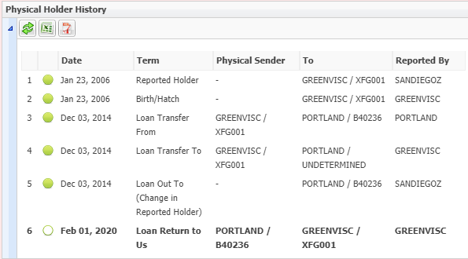
Has Bob Lived Anywhere Else?
Looking at the Physical Holder
History in the Details tab lets
you know that Bob was born
at the Greenville Zoo, went to
the Oregon Zoo (PORTLAND) on
December 3, 2014, and
returned to the Greenville Zoo
on February 1, 2020. You may
want to meet with your Local
Admin to help you learn how
to correctly read and interpret
this grid.

Slide 20
Who Else is in the Exhibit With Bob?
You can find what Enclosure Bob is in by opening the Enclosures grid under the Details
tab (above). If you have chosen to display Current Enclosure in a search results grid it will
also display there (below). The advantage of going from a search results grid is the
enclosure is a hyperlink right into the enclosure record.

Slide 21
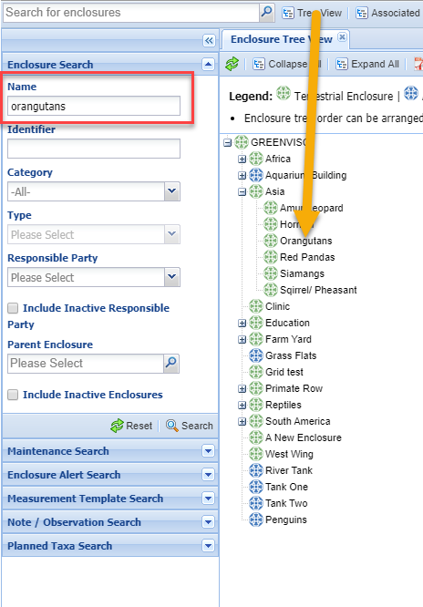
Finding the Enclosure
Another way to find an enclosure
record is to open the Enclosure
module and either use the left
hand search to find it, or open the
Enclosure Tree View and select it
from the list.

Slide 22
Occupants Tab
Selecting the Occupants tab brings up a list of all the current animals in
the enclosure. Bob is on exhibit with 3 females named Adira, Sheila and
Brianna. Selecting the Preferred ID hyperlink will take you right into their
records.

Slide 23
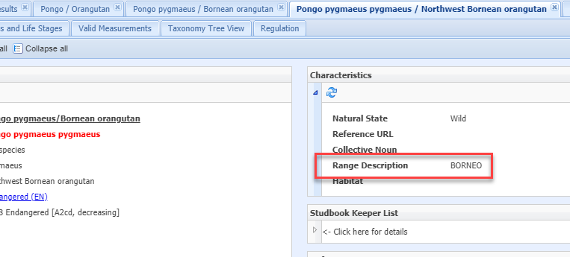
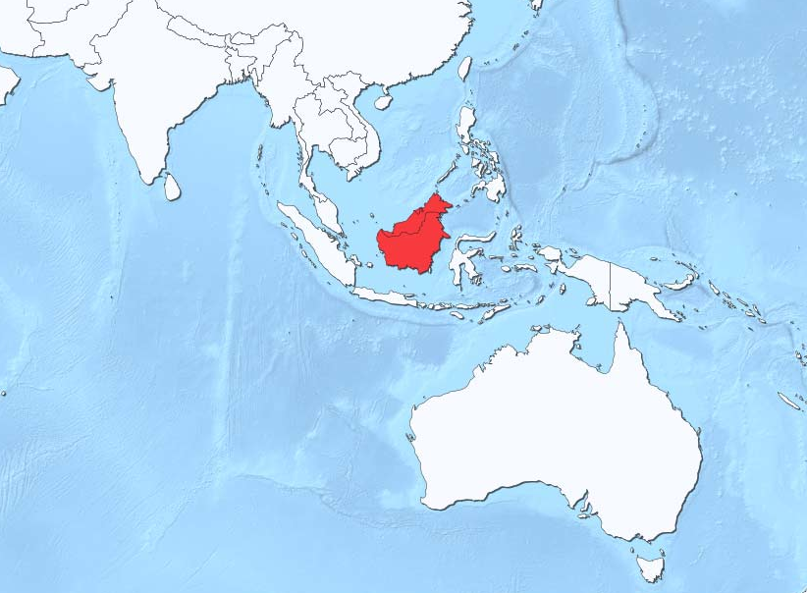
If Bob Were Wild Where Would He Live?
Open the Taxonomy module and search for Bob’s species by Common or Scientific name. The Characteristics grid lets you know that if Bob were wild he would live in Borneo. You look up Borneo and find it is halfway between Australia and India, but that is something you are going to let James find out on his own!
Here’s a hint for finding taxonomy – you don’t have
to type the entire name! Type the first few letters of
the Genus and the first few letters of the Species!
ZIMS will find it!

Slide 24
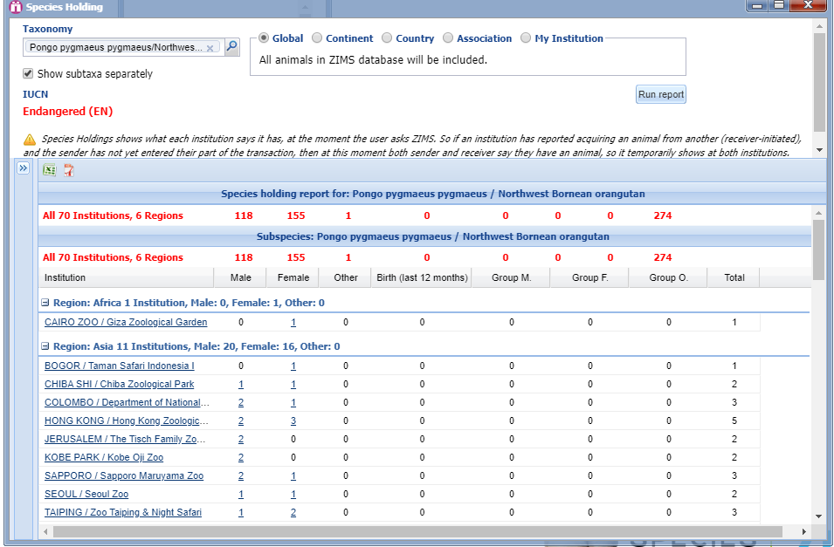
Who Else Holds Orangutans?
The institution name is a link to
the institution record and the
numbers will link you to the
global animal record view!
To answer this question you open Species Holdings,
an icon on your desktop. Enter Bob’s sub-species and
run the report at the Global level. You find there are
70 institutions in 6 regions of the world that hold this
Sub-species of orangutans. You could run this report
at the Country level to find only animals in your country,
or at the Genus level to find all orangutans.

Slide 25
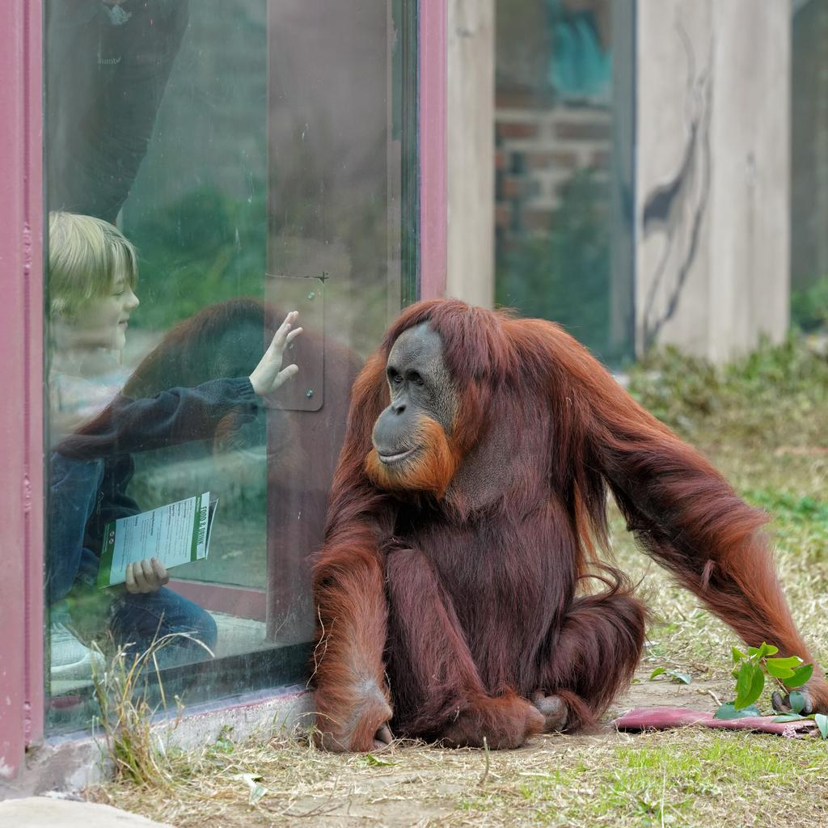
James gets his Answers!
You meet James at the orangutan
exhibit on Saturday. He has brought
his younger brother with him to meet
the orangutans, along with a notebook
to capture and remember all the
information about Bob that you have
found out.
This time he leaves the zoo happy and
with a smile on his face. He is going to
use the information you gave him to
complete a school assignment.
And you have a smile on your face too
knowing you have sparked the interest
of one of tomorrow’s conservationists!

Slide 26
Mobile Friendly Modules!
ZIMS is becoming more mobile friendly so you can answer most of these questions from your mobile device!
We still recommend using a desktop to enter data
All data can be viewed on mobile devices!
Next time James won’t have to wait for his answers!

Slide 27
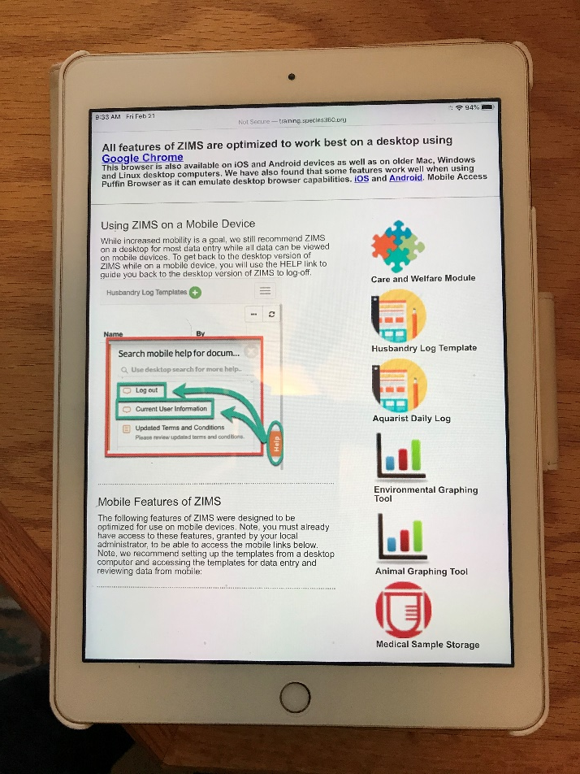
Mobile Optimized!
Now you always try to
remember to bring a mobile
device with you when you
are out on zoos grounds
You found that some of the
ZIMS functionalities are
optimized to work very well
on mobile devices
Go to http://training.species360.org/Mobile/

Slide 28
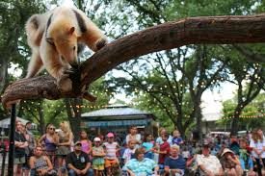
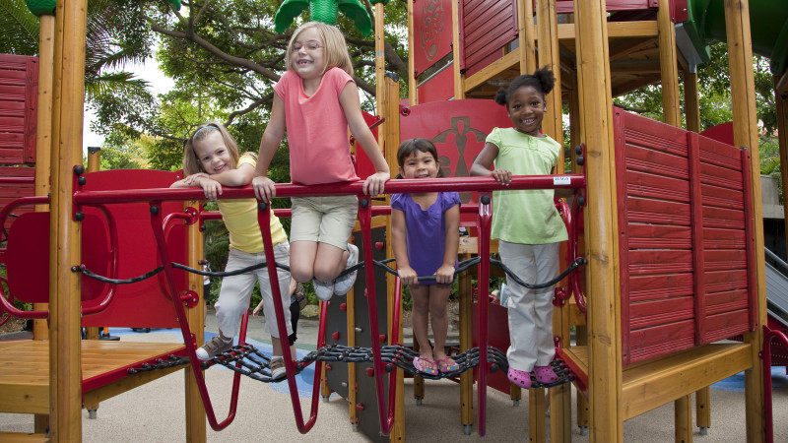
Meet Lily and Lilac
You find Lily on the playground
equipment next to the anteater
exhibit trying to move across the
bars like the anteaters move
across the tree limbs. “What are
their names?” she asks. “The female
is Lilac and the male is Jimmy” you
tell her. “How much do they weigh?”
Lily then asks. Ah ha! You pull out
your iPad and open the Animal
Graphing Tool.

Slide 29
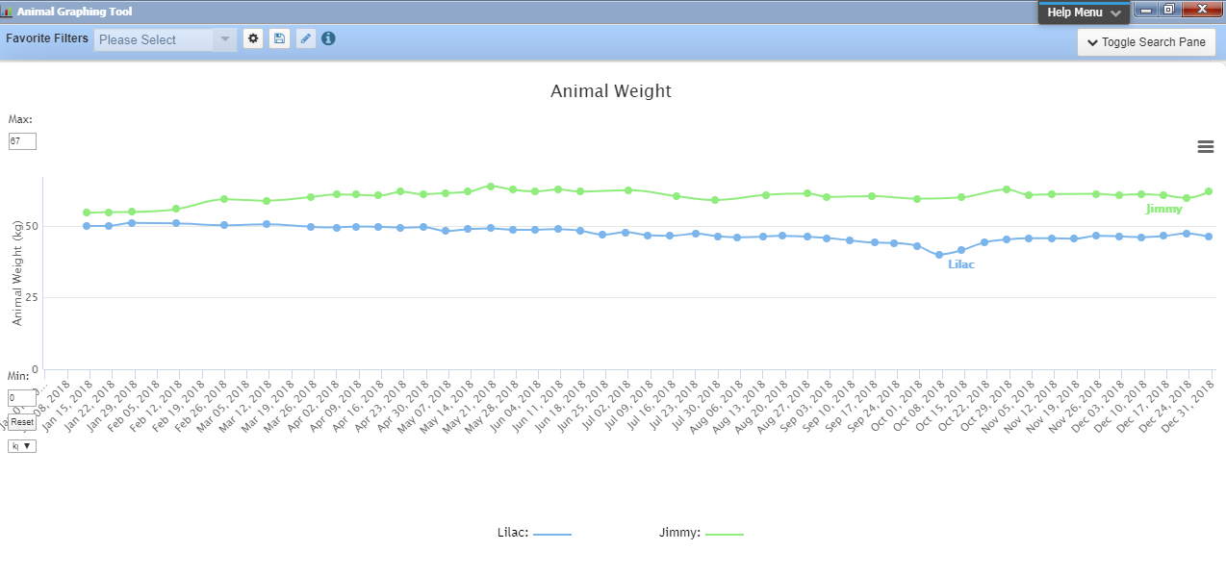
Comparing Weights
The Animal Graphing Tool allows you to compare multiple measurements for multiple
animals. For example, you could compare Feed Log entries with Weights. You pull up
the Weights for Lilac and Jimmy. “Wow you take a lot of weights!” Lily says. You tell her
that zoo animals are routinely weighed to help track their health and to make sure they
are growing properly. The anteaters are trained to get on a scale and the keepers try to
weigh them every week.

Slide 30
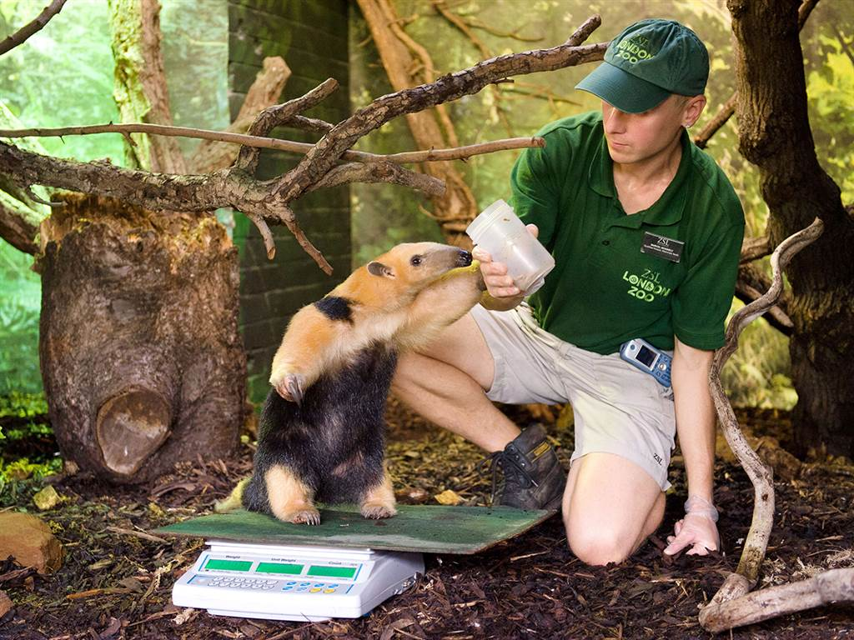
Monitoring Health
Lily notices a point in time when
Lilac’s weight dropped by several
kilograms. “What happened?” she
asks. You select to go to Desktop
ZIMS on your iPad and open Lilac’s
record. You search in Notes and
Observations for dates around the
time of the weight loss. You find a
Clinical Medical Note recorded by
the Veterinarians on Oct 7, 2018.
Lilac had a splinter in her mouth!
Lily can’t wait to tell her class how
the zoo animal’s health is so
closely monitored.

Slide 31
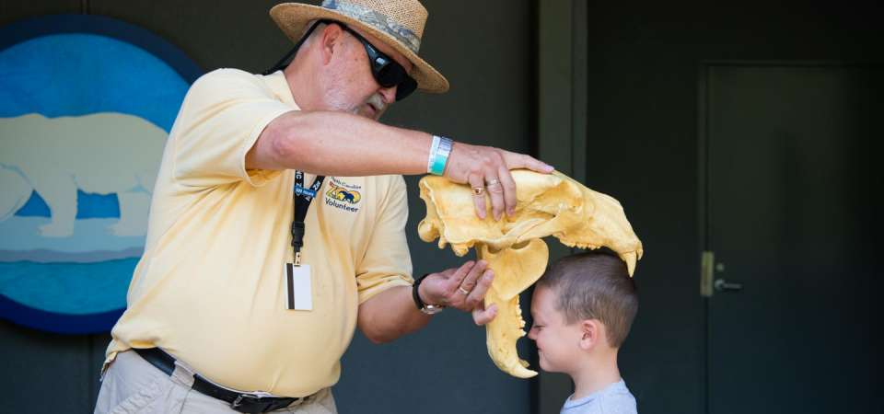
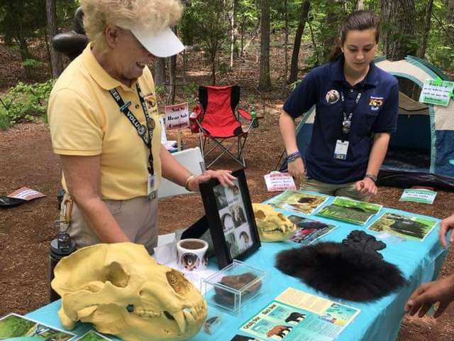
ZIMS and Biofacts
Those are just a couple
examples of how you can
use ZIMS to make your guest
experience even better.
But you can also use ZIMS
to increase the “value” of
your biofacts by helping your
guests to make a connection
with the animals they came
from.

Slide 32
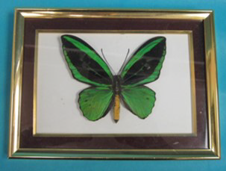
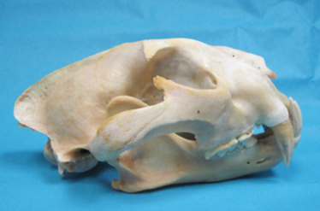
Minnesota Zoo Case Studies!
Thanks to Christine Ness, Zoomobile Interpretive Naturalist
Animal biofacts have been used for teaching since the zoo opened in 1978
Collection is between 4,000-5,000 individual items
Shells, small skulls and eggs to large and heavy skulls and full fur pelts
PAST PERFECT software to help catalog the collection
Just as for animal records, data entry inconsistencies over the years has caused difficulties

Slide 33
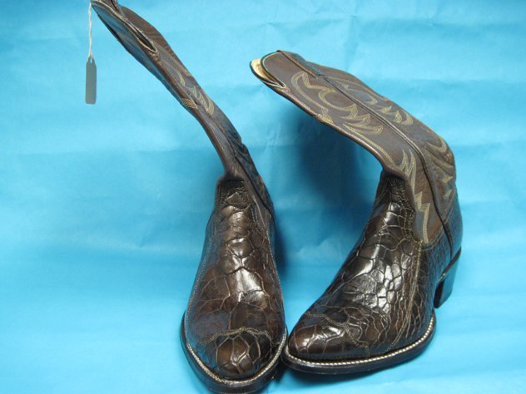
Now and Going Forward…….
Find the biofact
In storage, offices, classrooms and on display
Try to find an original accession number
Enter the number into the database
Make a note of its location
Make a note of its condition
Take multiple photographs
Full record created later
Sounds like researching an animal record!

Slide 34
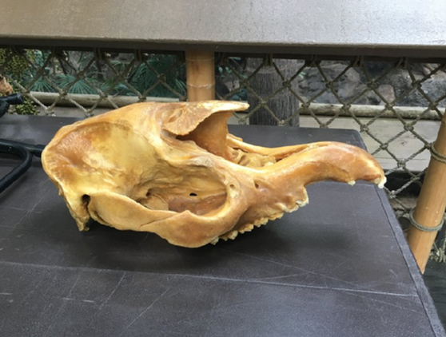
What Does ZIMS Have to do With It?
Case Study #1
When the Monorail closed in 2013, there were many biofacts displayed there that needed to go back to storage
One was a tapir skull with the number #340 written on the bottom
The original ledger noted “Asiatic tapir” and an accession date of the skull of 18 June 1982.
So………..

Slide 35
Into ZIMS
They decided to look at their ZIMS data
Started looking for a tapir that passed away prior to 1981. Why?
This was a real skull, not a replica. It was unlikely the zoo would have sought out and purchased a real skull.
Taxidermy takes awhile.
In the original ledger they tended to do large amounts of accessions at a time, meaning they waited until they had a good amount to do before they sat down and entered them.

Slide 36
What They Found
The zoo had not held “Asiatic tapirs” but they had held Malayan tapirs
They identified an 11 year old female born at the San Diego Zoo to wild caught parents. She died at the Minnesota Zoo in 1979. This was probably the tapir!
She had 2 male offspring while at San Diego and 1 male offspring at Minnesota
She had 4 full siblings and 10 half siblings
She has 6 great-great-great-great grand offspring still alive in Florida, Denmark and the Czech Republic
They now had a story to tell about the skull, making it much more valuable as a biofact and more interesting as a tale

Slide 37
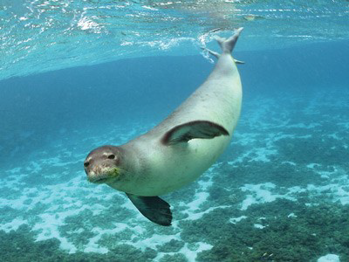
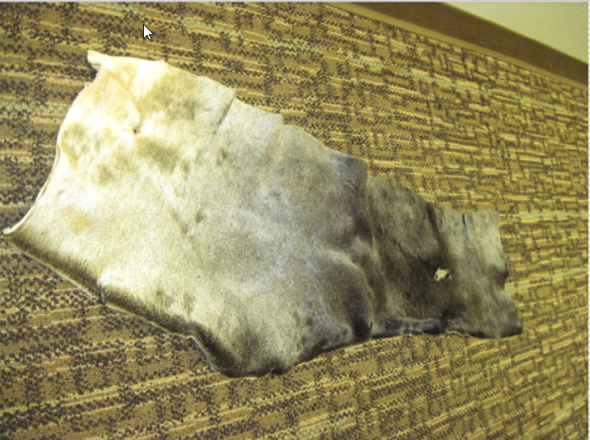
Another Biofact Made Valuable by ZIMS
Case Study #2
A Hawaiian monk seal named “Nani” passed away at the zoo in 2019
The decision was made to preserve her pelt.
What they can tell people about Nani:
She was euthanized due to failing health in her old age
She was 23 years and 10 months old when she died
She weighed 428 pounds
She was collected on July 18 1995 from the French Frigate Shoals – the largest Atoll in the NW Hawaiian Islands
She lived at Sea World Texas before moving to the Minnesota Zoo in 2015
She liked fishsicles, music and scents for enrichment

Slide 38
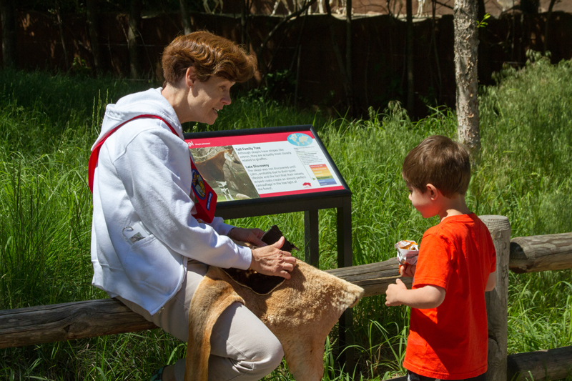
From Christine
“As zoological institutions try to impart empathy into our guests,
having this information helps give the guests a greater
connection to the piece they are seeing and touching.
It ceases to be “just a piece of fur.”

Slide 39
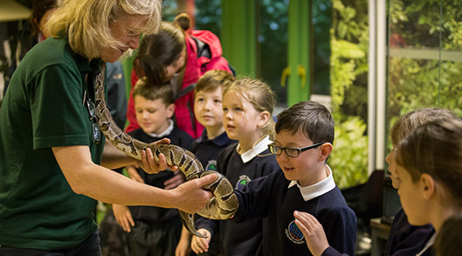
ZIMS and Educators
A Perfect Match!

