Slide 1
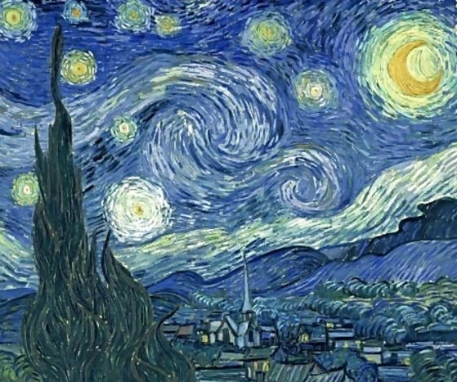
Painting Pictures with ZIMS Data
Graphs and Visuals in ZIMS
October 2019 TNT
With the help of
Vincent Van Gogh

Slide 2
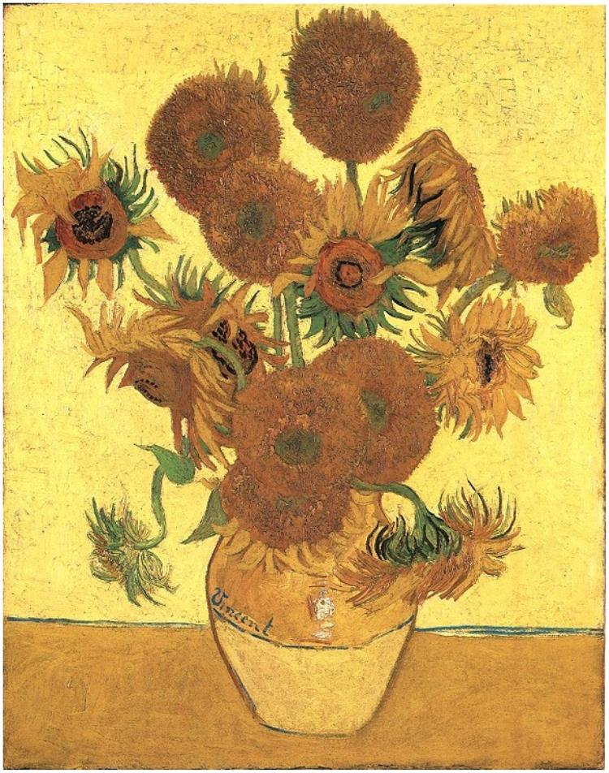
Data, data, data. All those years
of entering data into ZIMS, or
previously into ARKS, provides
you with a lot of useful information.
But how do you quickly interpret
nine pages of weights on Bob your
orangutan? And the ins and outs of
your walking stick group have you
befuddled. ZIMS provides many
visuals via graphs and charts that help
you quickly understand all that data.
There are also some visuals that
incorporate data entered by other
institutions for easy comparison.

Slide 3
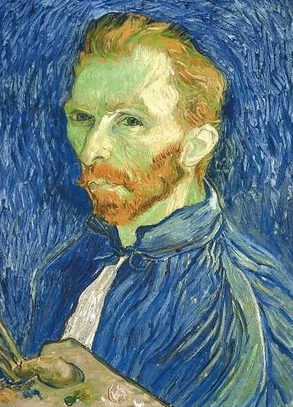
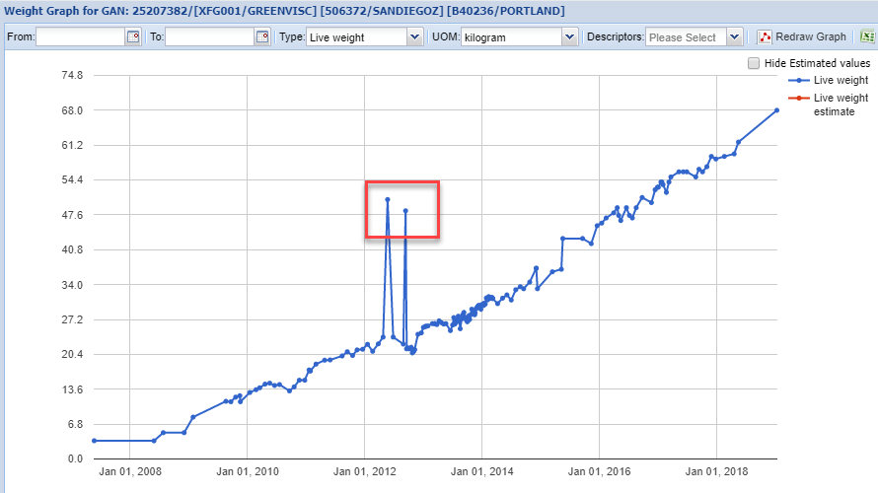
Single Measurements
We have 9 pages of weights on Bob,
an orangutan, recorded by 2 facilities,
ours and where we sent him. We’d like
to see if Bob is continuing to grow.
A quick view of his weight graph shows
us that he is gaining weight as he should.
But what are these weights?

Slide 4
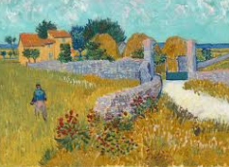
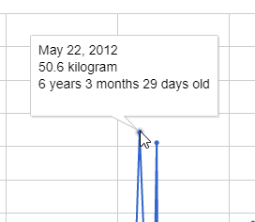
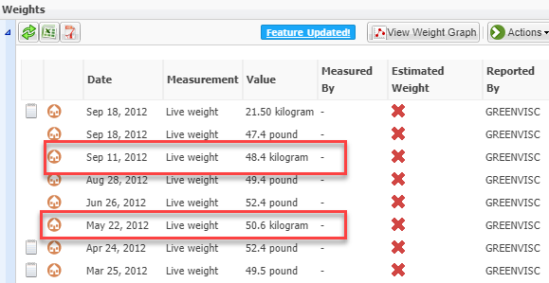
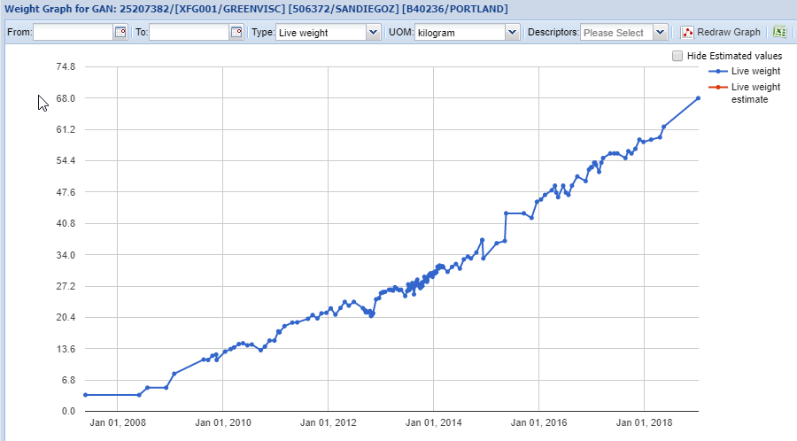
Fix the Data!
Hovering over the dots
on the graph will give us
the dates those weights
were recorded and the UOM.
Looking at the weight grid we
find that on those days the
weights were recorded in
kilograms and not pounds.
We fix them and rerun the
graph. Now that looks a
lot better!
Painting pictures can help
you correct data entry
mistakes!

Slide 5
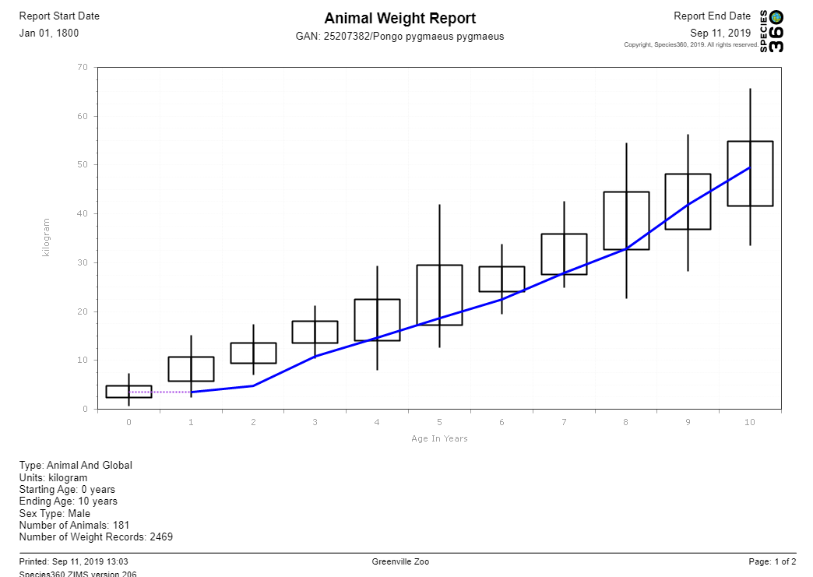
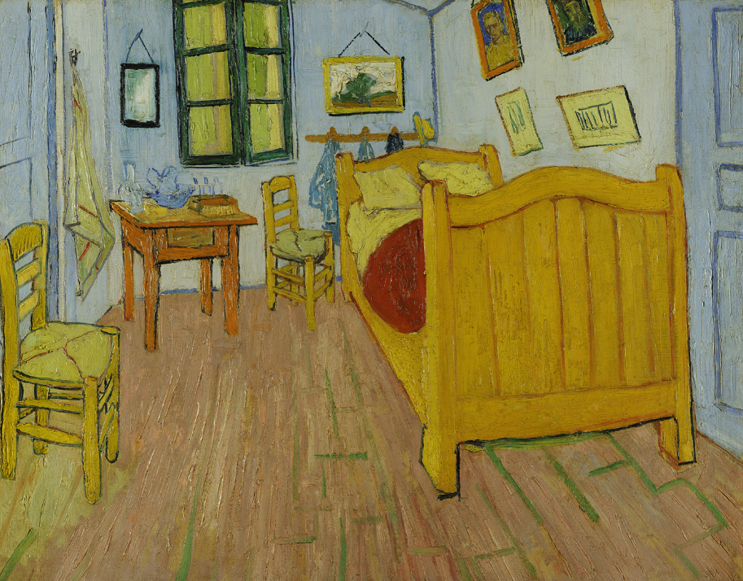
Weight Comparison
Bob had always been on
the thin side when you
had him and you are
wondering if, as he got
older, he was able to catch
up with average weights
for other males. Comparing
Bob’s weight with global
data, you are happy to see
that Bob is now right in
the middle of what other
male orangutans of his age
weigh.
Painting pictures can set your
mind at ease.

Slide 6
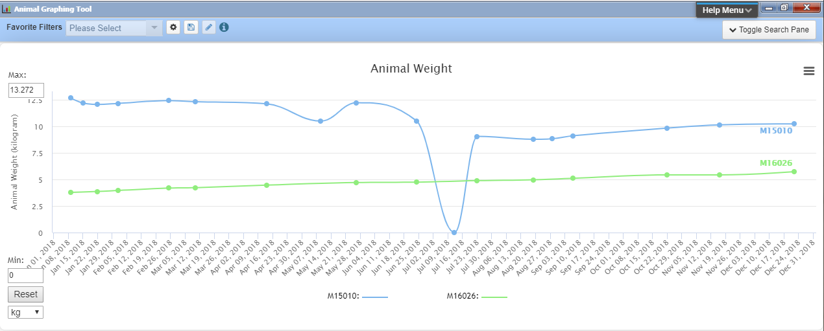
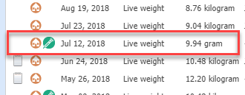
Animal Graphing Tool
The Animal Graphing Tool allows you to compare multiple animals and multiple measurement
types (weights, lengths, Feed Log info). Above we are comparing the weights of two colobus records and find the same data entry error. However, this one was entered in the Medical module so it must be corrected from there. But the graph does show that something was going on with M15010 that was not going on with M16026.

Slide 7
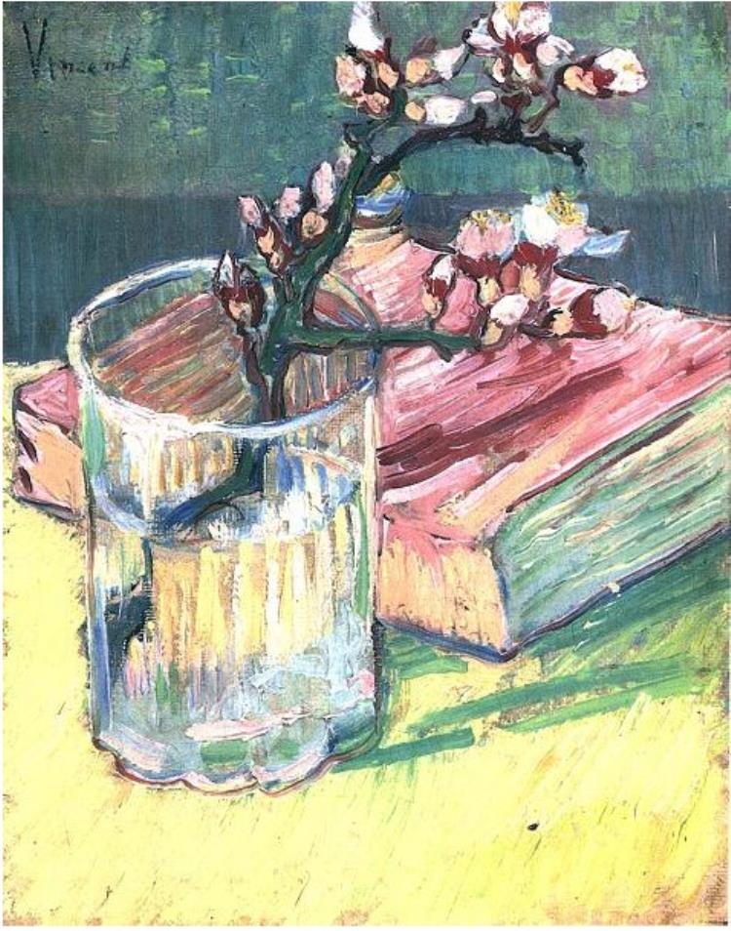
Animal Graphing Tool
Reviewing the Notes around the time
she began losing weight you see that
her six month old offspring had recently
died. The offspring had been sickly for
the prior month. Caring for a compromised
offspring and then experiencing its loss
explains the weight loss indicated on the
graph.
Painting pictures can show you indicators
that further research is needed!

Slide 8
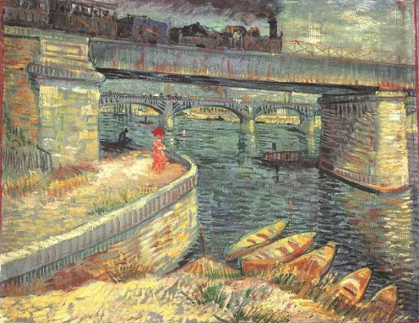
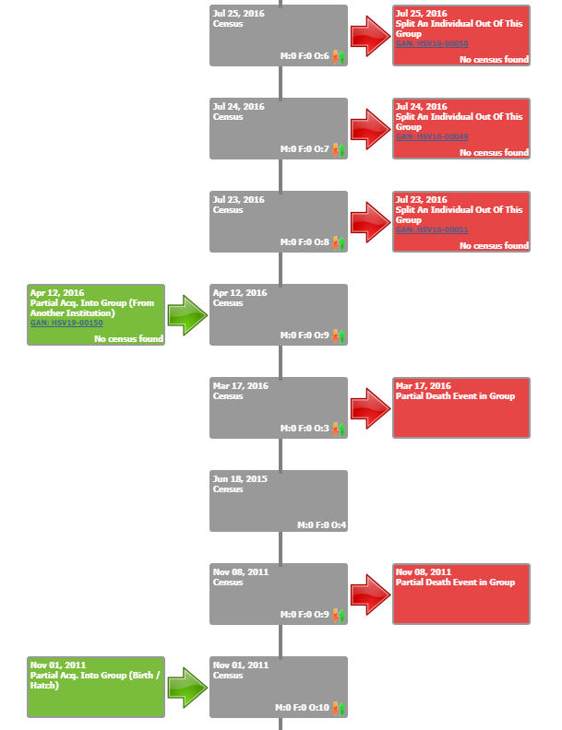
Group Explorer
The long My Transactions stream
for your group of grey tree frogs
has you quite confused. So many
comings and goings it is hard to
sort them out. By pulling the
group up in Group Explorer it is
easy to see the incoming (left side)
and the outgoing (right side) activity
in the group.
Painting pictures helps you see
clearly now.

Slide 9
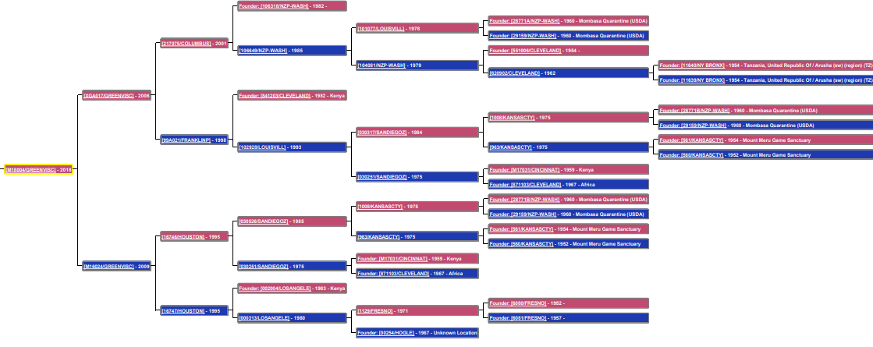
Pedigree Explorer
Pedigree Explorer can be viewed from the animal record or from Tools. You can select
to view Parents, Descendants and Siblings for the animal in focus. Above we are looking
at Parents for a giraffe.
Painting pictures can be a family affair!

Slide 10
Environmental Quality Graph
The Environmental Quality Graphs let you graph single measurements on a single
exhibit, multiple measurements on a single exhibit, single measurements on multiple
exhibits and multiple measurements on multiple exhibits! Below we are looking at
three pools and two measurements (1). The y axis shows the separate measurements (2).
It is easy to see that for all exhibits, the higher the water temperature is the lower the pH.
Painting pictures helps you quickly spot trends to help you better care for your animals!

Slide 11
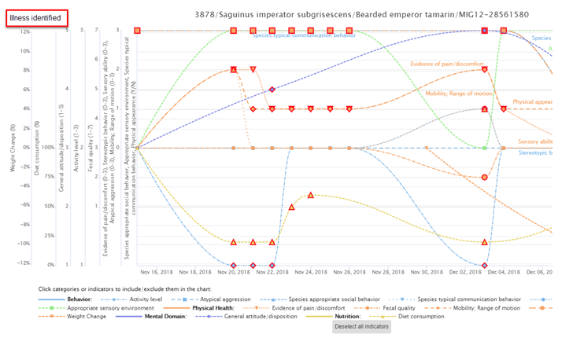
Care & Welfare
The Care and Welfare module
helps you monitor the mental
and physical welfare of your
animals. You configure welfare
Indicators as you wish and
create Templates for
animals that you want to
quickly capture that data on.
You can then graph the data
for easy interpretation of the
welfare status of the animal.
The Como Zoo used Care and
Welfare module to help them
identify an illness in one of
their bearded emperor
tamarins.

Slide 12
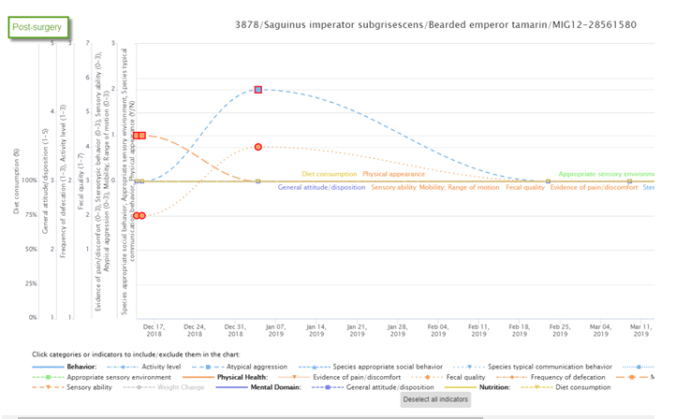
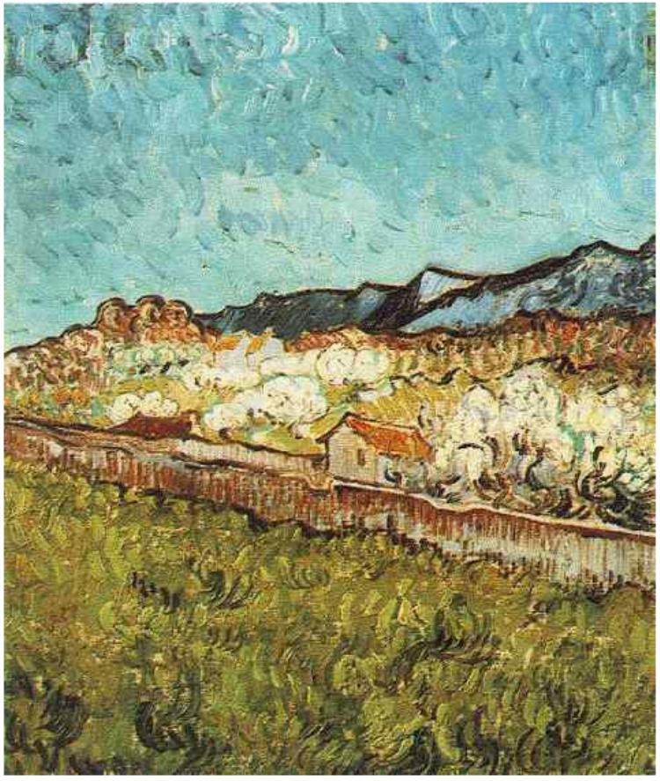
Care & Welfare
This is the Care and Welfare
graph post surgery. The graphs
make it easy to see when things
have gone awry and when things
are back to normal.
Painting pictures lets you
quickly catch trends in the
welfare of your animals!

Slide 13
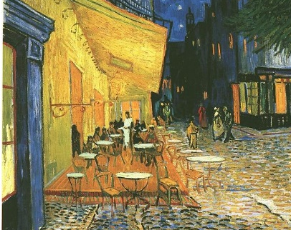
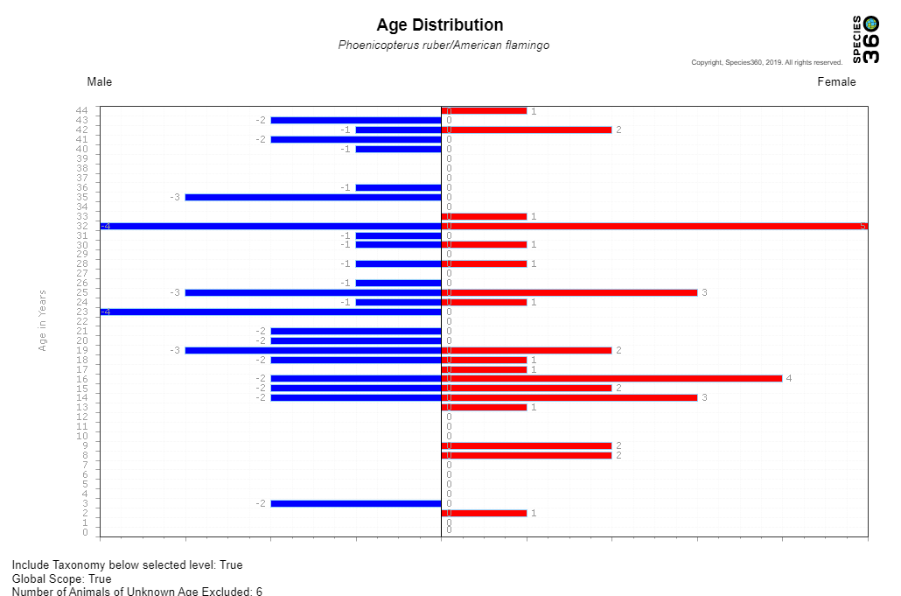
Age Distribution
You are wondering if your flamingo colony will be able to continue to reproduce in the coming years. Looking at an Age Distribution chart you note that you only have 7 birds under the age of 12 in your flock of over 80 birds. It appears that your older flock has not been producing
enough recent offspring to maintain the flock in the future.
You decide to look in to acquiring some younger animals to increase the breeding activity or
determine why the reproduction is low.
Painting pictures can help you predict the future.

Slide 14
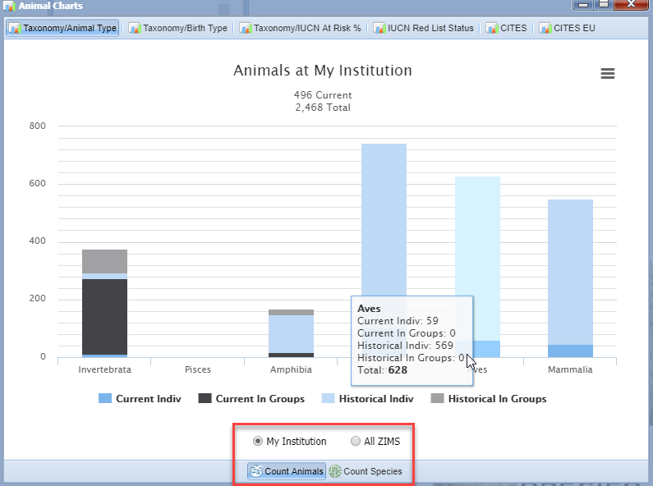
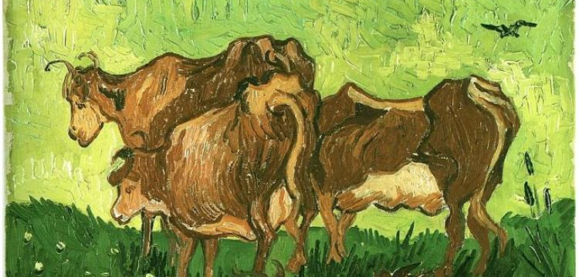
Animal Charts
The Animal Charts found under Start > Animals > Charts let you look at your
collection or all of ZIMS by Taxonomy / Animal or Birth Type and IUCN/CITES
status. The Taxonomy / Animal Type tab displays a bar graph by My Institution or All ZIMS by Animal Count or Species Count.
Painting pictures can give you a quick visual to see what taxa are over or under represented if you desire a balanced collection.

Slide 15
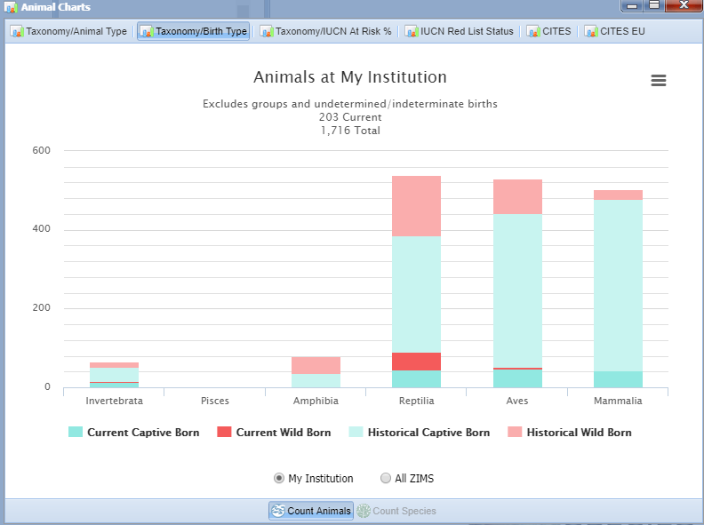
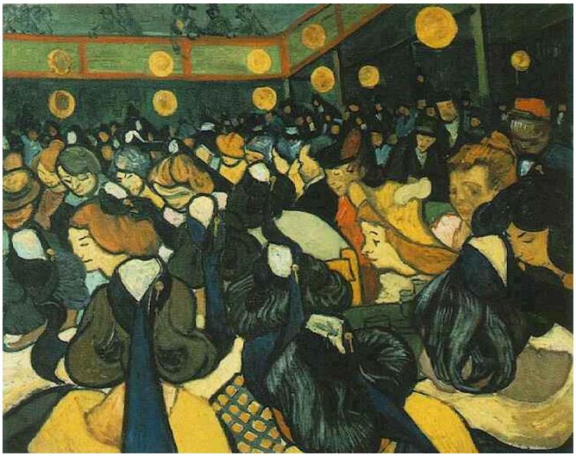
Animal Chart
The graph by Taxonomy / Birth
Type provides a comparison of
Animal Counts (Species Counts is
not available here) for Wild
versus Captive Births divided
into your Current and Historical
collection.
Painting pictures can show how
your institution maintains
captive bred animals rather
than depending on wild captures.

Slide 16
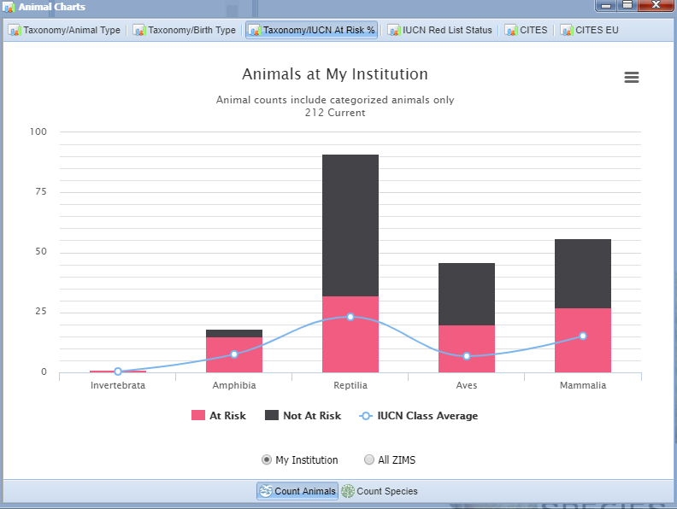
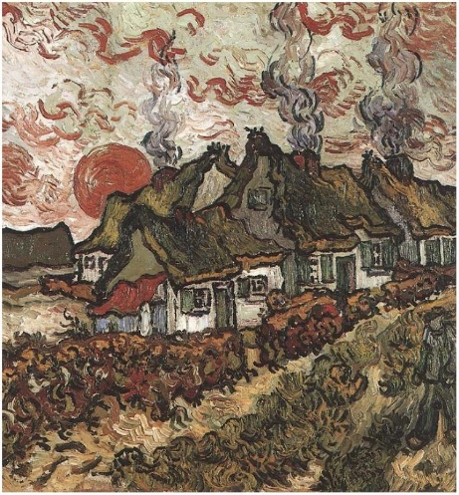
Animal Charts
The remaining four Charts graph
by IUCN and CITES status. The
IUCN At Risk graph displays how
your collection compares with
others in managing species that
are At Risk. This institution has
a high number of IUCN At Risk
species in its collection.
Painting pictures can show you
how involved you are with
helping endangered and
threatened species!

Slide 17
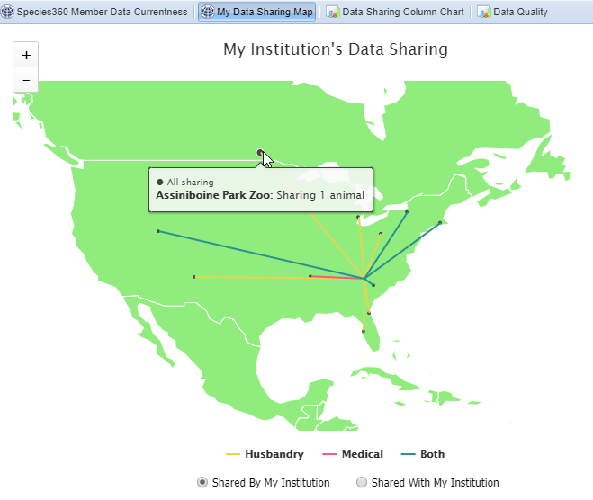
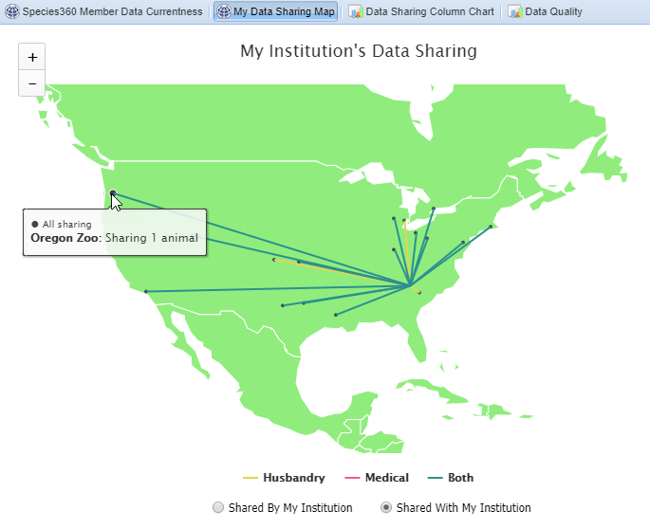
Data Sharing
The Data Sharing Maps found under Institution > Data Management give you a quick view of the institutions you are sharing records with (left) and the other institutions that are sharing their records with you (right). Hovering over the dot will display the institution name and number of records shared. Clicking on any of the lines will bring up a list of the institutions.
Painting pictures lets you see that Sharing is Caring.

Slide 18
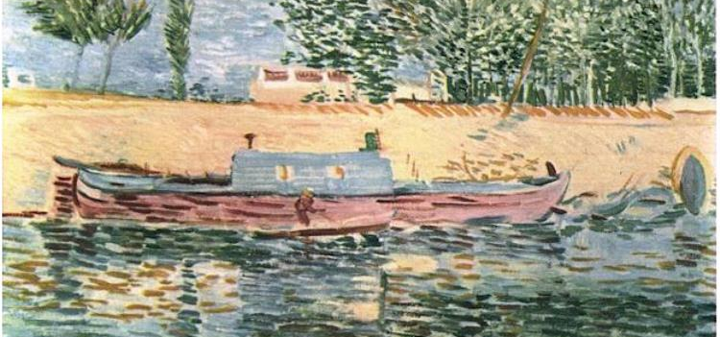
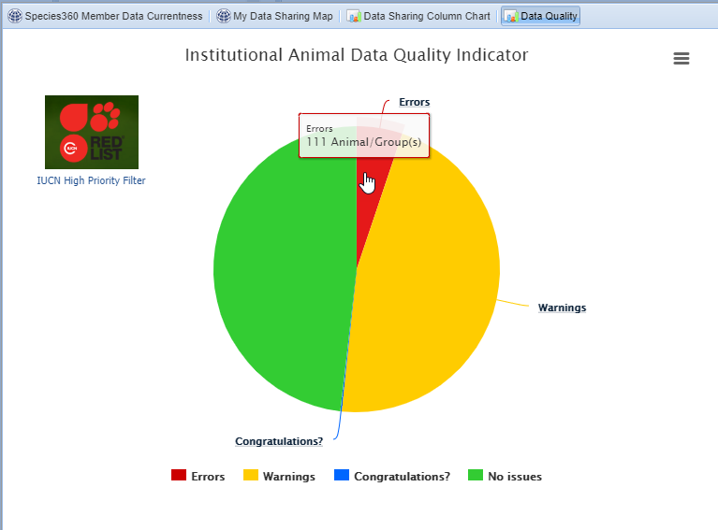
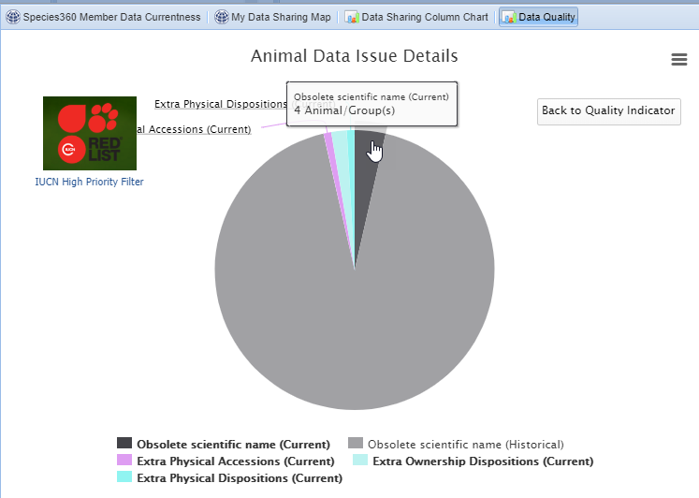
Data Quality
Another tab under Data Management
that can really help you out is Data
Quality. This pie chart indicates records
with no Data Quality issues (great!) , those
records with Warnings (data should be
corrected when possible) and those with
actual Errors (these records need help!).
Drilling down through the pie slices will
lead you to a list of records that contain
that type of Warning or Error. You can make
sure you are addressing the records in the
right order by limiting the graph to IUCN
Priority Filters.
Painting pictures helps ensure that your
ZIMS records are of the highest quality!

Slide 19
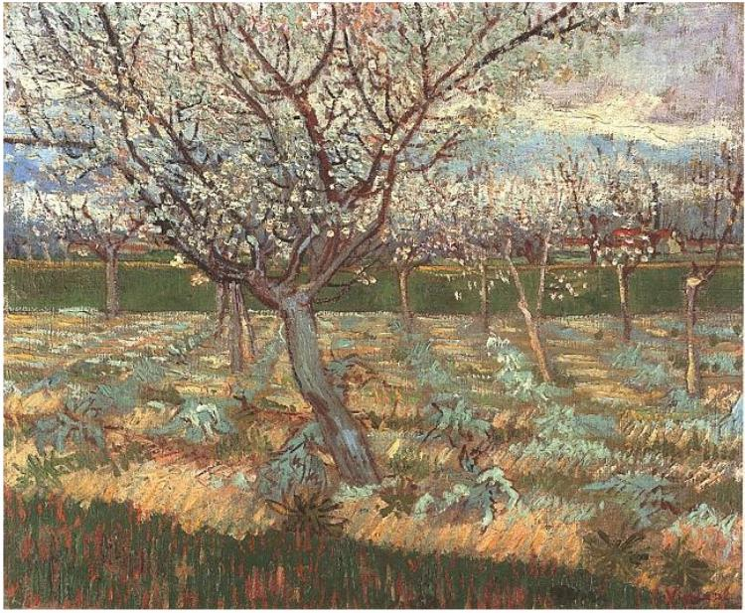
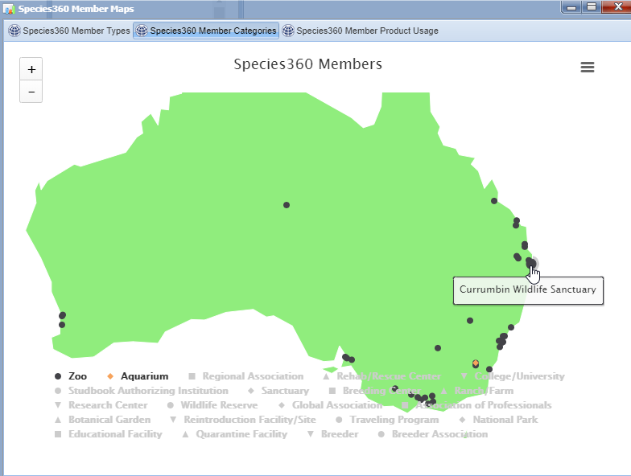
Species360 Members
ZIMS visuals often display
information about our
member institutions and not
just their animal collections. Look
for member maps under Start >
Institution > Member Maps.
You have booked a car for your
Australian adventure and want
to visit as many Australian
zoos and aquariums as you can.
Using the Species360 Member
Categories limited to Zoos and
Aquariums, you get a quick view
of what institutions you can visit
in the area you will be visiting.
Painting pictures helps you plan
your vacation!

Slide 20
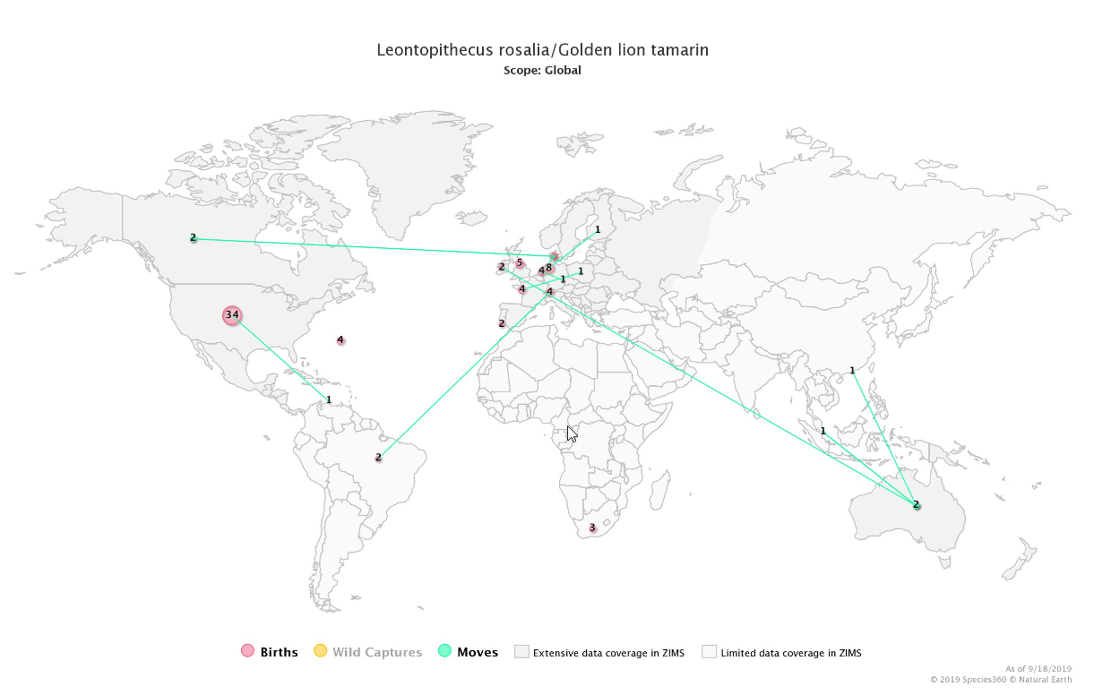
Species Event History
Have some popcorn and
want to do some binge
watching? Go to Reports >
Species Event History and
type in your favorite species.
A year by year visualization
of Births/Hatches, Wild
Captures and Moves will
display. You can select by
scope from Global down to
your institution.
Painting pictures has some
movie options!

Slide 21
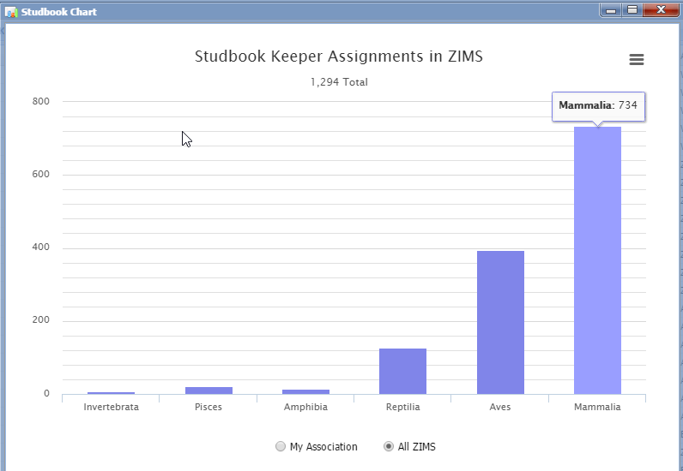
Studbook Charts
The Studbook Charts
will display the number
of Studbook Keeper
assignments in ZIMS
by Class. If you are a
Regional Association ZIMS
User, you can also see
the chart by Studbook
Keeper Assignments for
your Association. Clicking
on the bars will bring up
a list of the assigned
species, the Studbook
Keeper and their institution.
Painting pictures keeps you
studbook savvy.

Slide 22
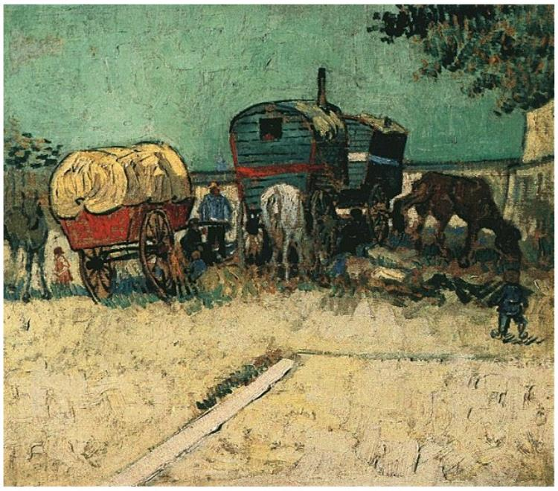
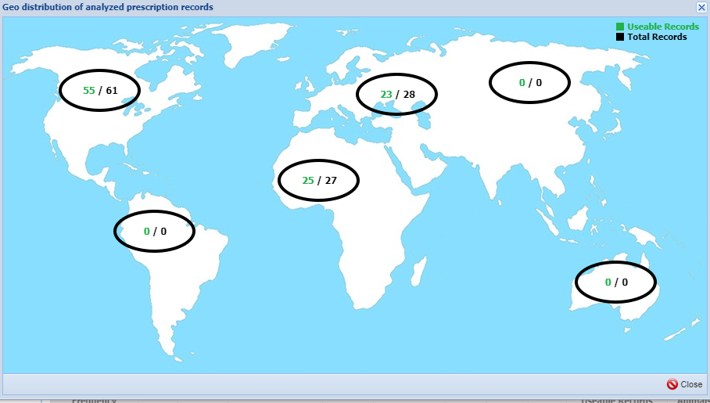
Drug Usage Extract
Some of the ZIMS Global Resources also have options for visualizing the data presented.
In the Drug Usage Extract select to View Distribution for a global representation of where
the data came from. Above is for the use of injectable Ivermectin in cheetahs. This
visualization is also available in Anesthesia Summaries.
Painting pictures can let you see what drugs are used in your region.

Slide 23
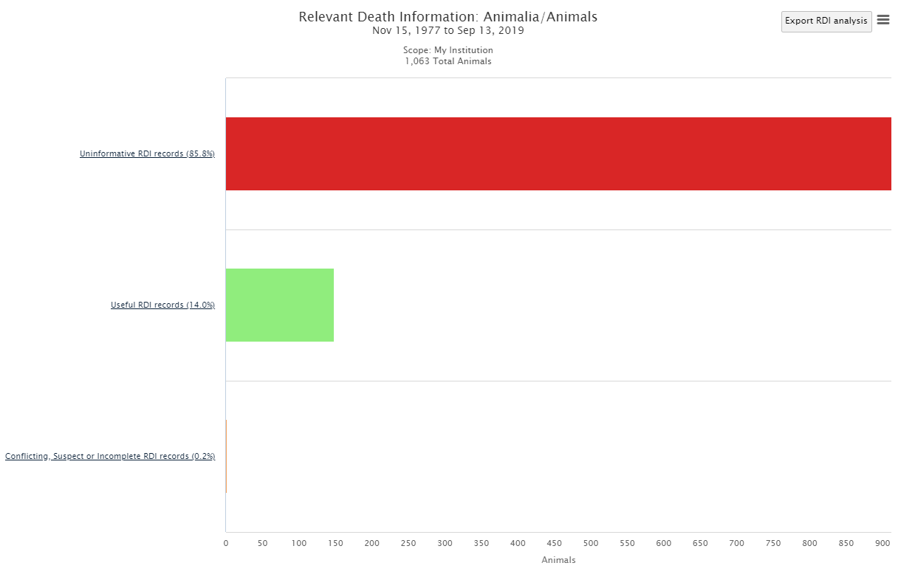
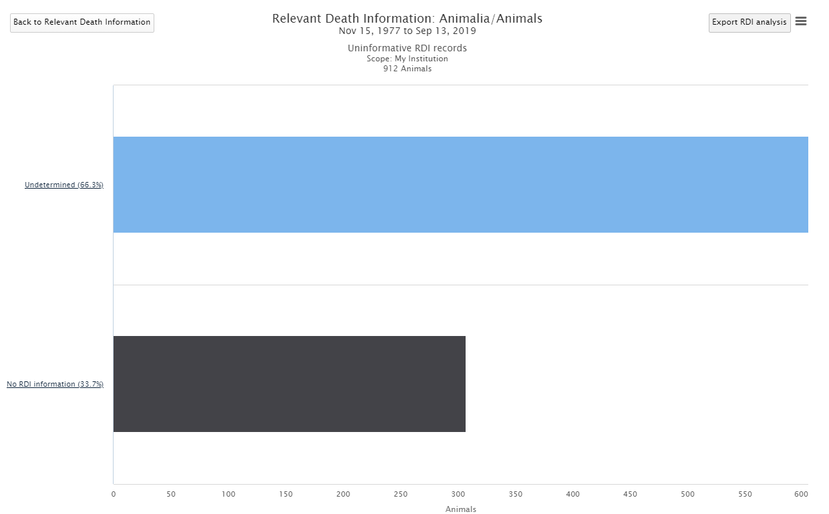
Relevant Death Information
Running the Global Medical Resource of Morbidity & Mortality for Relevant Death
Information and selecting My Institution will produce bar graphs that allow you to
drill down in your records and find any RDI records that are incomplete, conflicting or
suspicious. Once you reach the final bar graph a results grid will display with the
records in question.
Painting pictures lets you complete that final record on your animals.

Slide 24
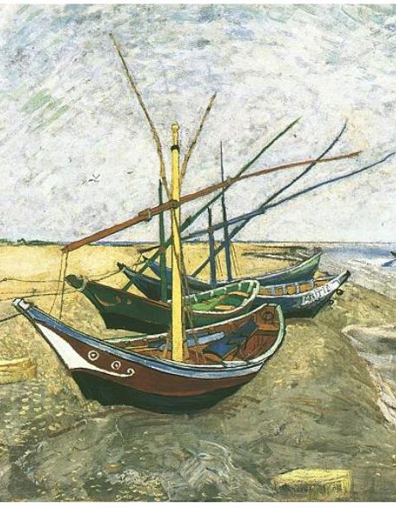
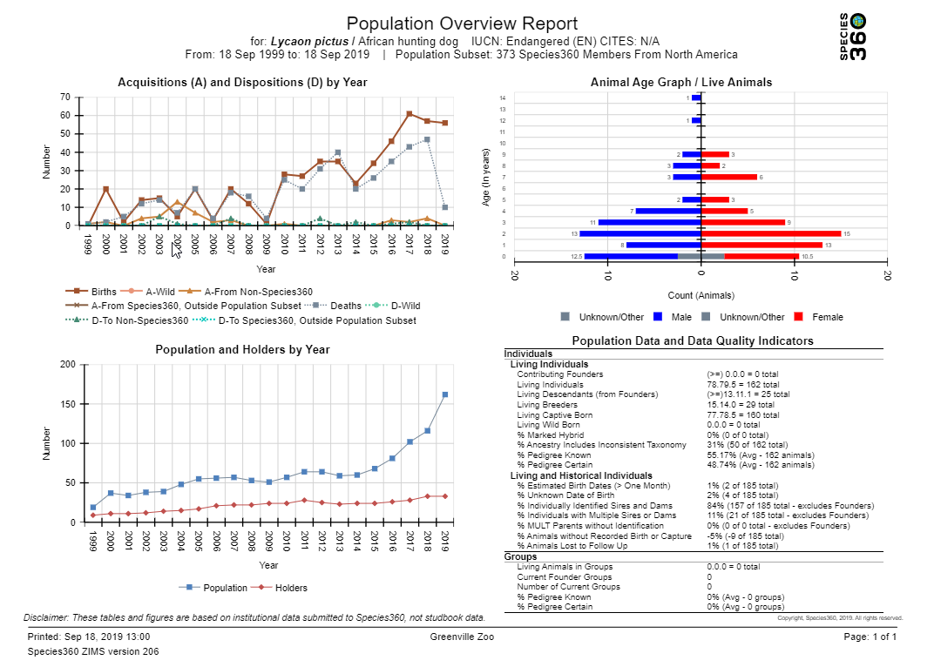
Population Overview
One very popular ZIMS visualization is the
Population Overview resource. This resource
has been used by population managers to help
make species decisions. This resource has three
visuals: 1) Transactions by Year, 2) Population and
Holders by Year and 3) Age Graph.
Painting a picture of the status of a species can
help make population management easier.

Slide 25
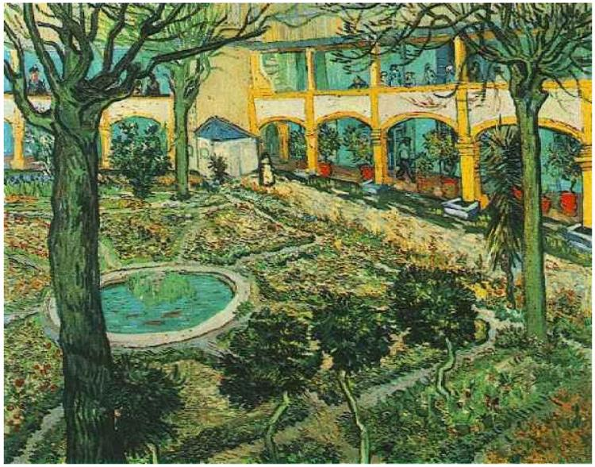
Painting Pictures in ZIMS!
Visualize Your Data!

