Slide 1
The Best of 2018!
Tips & Tricks January 2019

Slide 2
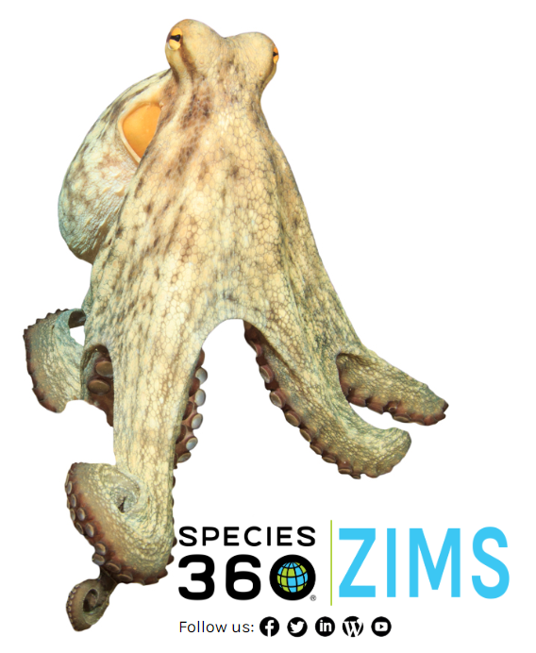
2018 in ZIMS
ZIMS had quite a few changes in 2018
in all the modules - Husbandry, Medical
and Studbook. Some of these changes
were the addition of completely new
functionality. Some of them changed
the way the User Interface (what you
see and how you use ZIMS) appeared
and functioned for easier use. And
some of them you can’t see but can
appreciate, like increased speed for
calculations and results and increased
accuracy of the results.

Slide 3
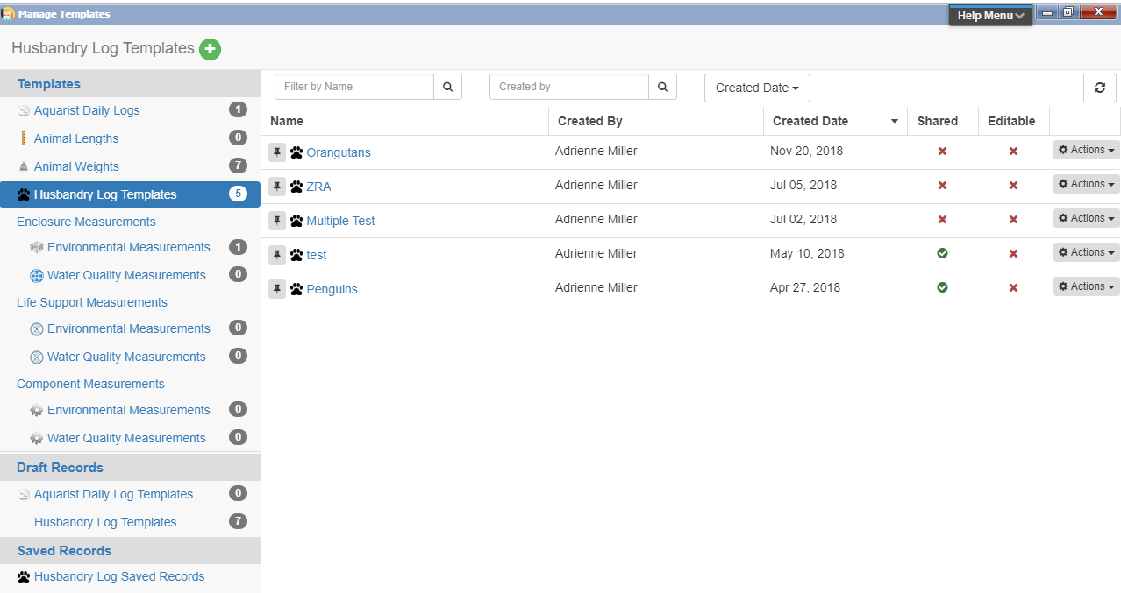
Husbandry - Manage Templates
One change involved putting all of your Templates (except for
Note and Measurement Range Templates) in one easy to manage
area. You can reach the Manage Templates area from Start > Tools >
Manage Template or from tabs within the Animal and Enclosure
modules. From this screen you can add Templates, edit them, delete
them and use them without having to go into the various modules
to find them.

Slide 4
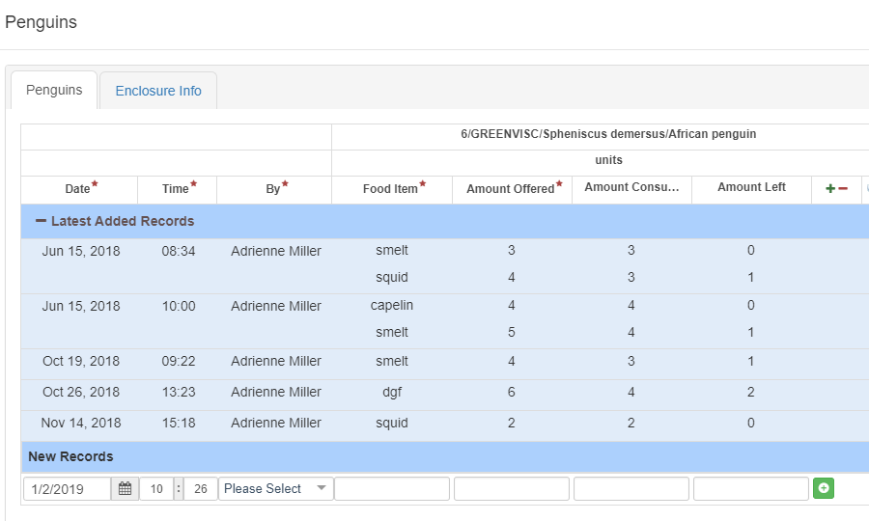
Husbandry – Husbandry Log Templates
A new Template that rolled out in
2018 was the Husbandry Log
Template. This Template allows you
to capture information on the
Animals as well as the Enclosures
and Life Supports you are responsible
for. To learn how to create and use
the HLT use the ZIMS Help Menu:
A Walk Me that walks you through
from start to finish
A pdf Help document
A PowerPoint
June Tips and Tricks recorded
Webinar

Slide 5
Husbandry – Environmental Quality Graphs
You can now view graphs of Environmental Quality Measurements for a single
entity and single measurement, single entity and multiple measurements, multiple
entities and single measurements and multiple entities and multiple measurements.
When viewing a single entity and single measurement, if you have created a
Measurement Range Template for the entity and the measurement, if you check the
Toggle measurement range areas box (1), the graph will indicate any out of range
measurements (2 and 3).

Slide 6
Husbandry – Environmental Quality Graphs
When viewing multiple entities and multiple measurements, each entity will have its
own color (1) and the various Units of Measure will display on the Y axis(2). For help
in using the Environmental Quality Graphs, find the following information in the
ZIMS Help menu:
A Walk Me
A pdf Help document
A PowerPoint

Slide 7
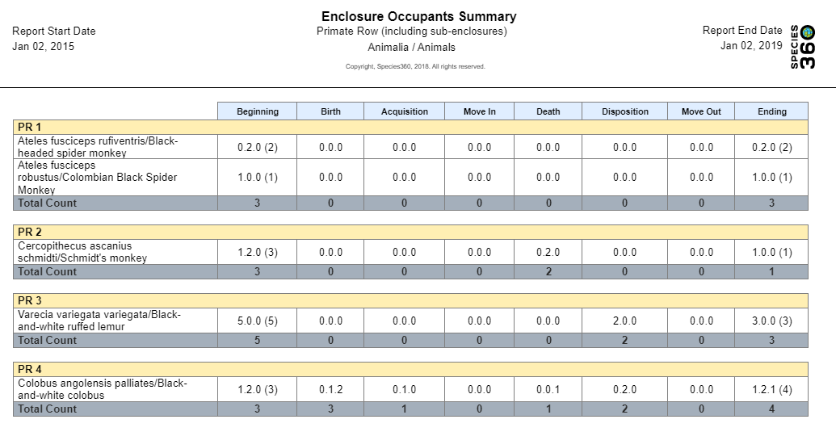
Husbandry – Enclosure Occupants Summary Report
This new Report produces a grid of species and numbers that
have occupied an enclosure , including sub-enclosures. A single
or multiple enclosures can be selected or an enclosure list used.
The report can be exported to raw Excel before running it, and
multiple formats after running it. Individual animals are not
identified, just the total count.

Slide 8
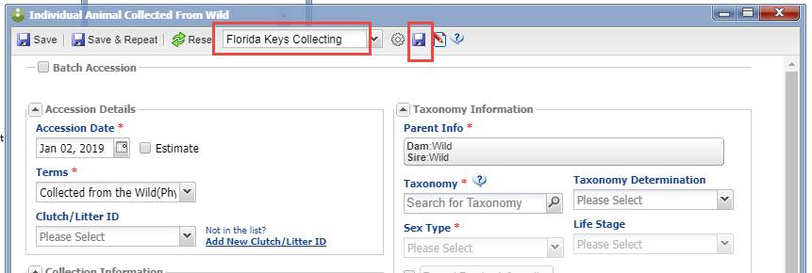
Husbandry – Saved Favorite Accessions
If you do a lot of similar accessions (in this example we do a lot of collecting from the Florida Keys),
you can now save data entry time by creating Favourite Accession Templates. On the Accessions
screen enter the data that is common to these accessions and select the Save icon. Give it a name
that will help you find it again and it will appear in the dropdown list for Favourite Accessions. These
Templates are displayed only under the Entity and Transaction where they were saved. So this Florida
Keys Collecting template will only display under an accession type of Individual Animal > Collected
From Wild. It will not display under Group of Animals > From Another Institution.

Slide 9
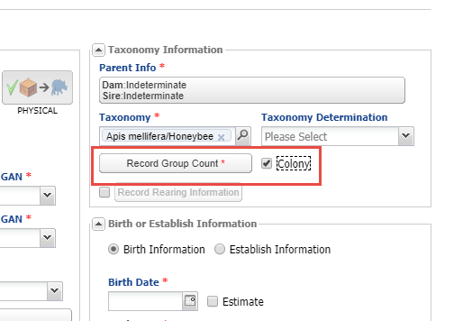
Husbandry – Easier Colony Accessions
Previously, if you were accessioning
a Colony, you had to first accession a
group and then mark it as a Colony.
You can now mark it as a Colony from
the initial accession screen. You will
still need to record a Group Count in
order to save the accession. This can be
an estimate of the numbers, or what
you have selected as your default count
for Colonies.

Slide 10
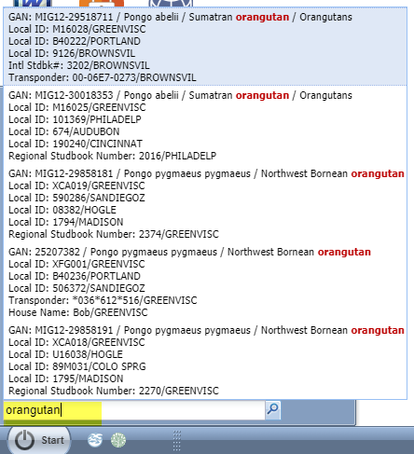
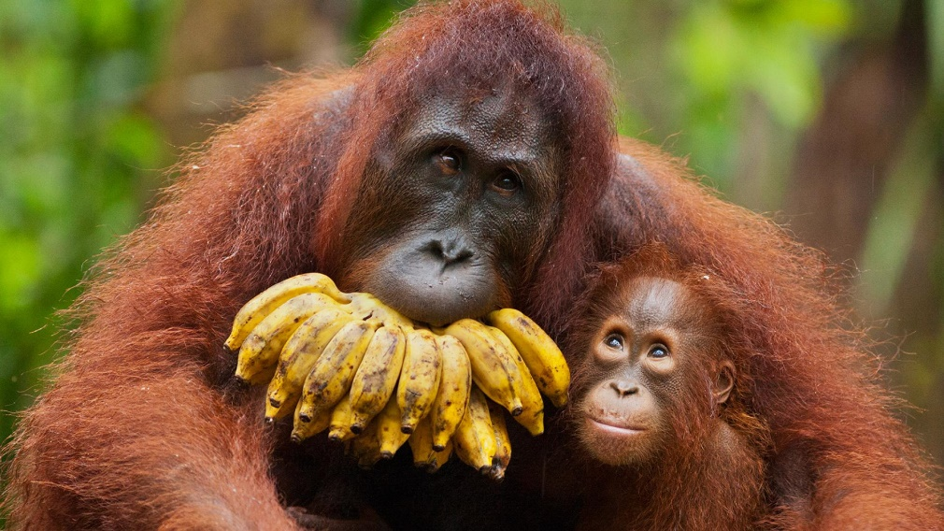
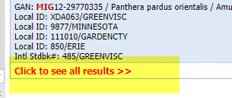
Husbandry – Quick Search by Taxonomy
In the Start menu “quick” search (only Local
animals), you can now search by Taxonomy.
As for other searches, the top 10 results will
display. If there are more than 10 results,
scroll to the bottom and select “Click to see
all results”. This will bring up a results grid
that displays all the possibilities.

Slide 11
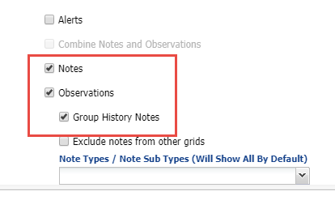
Husbandry – Group History Notes
As groups are Split and Merged you now have the option
to view any Notes/Observations entered on any other
group the individual/group in focus has been associated
with. In the individual record above we have checked the
“Show Group History” box. The highlighted entries were
recorded on the groups that the individual had previously
been a member of. The source record is indicated on the
right. In a Specimen Report you can also indicate if you want
to include Group History Notes in the report.

Slide 12
Husbandry – Care and Welfare
Care and Welfare was the biggest new functionality deployed in 2018
This feature must be activated in Institution Preferences
You first configure Indicators for Behavior, Environment, Mental Domain, Nutrition and Physical Health as desired.
Each institution configures their own Indicators
Numeric Value
Percentage
Numeric Scale
Binary
You then create Templates using these Indicators using individual Animals, Animal Lists, Enclosures or Taxonomy

Slide 13
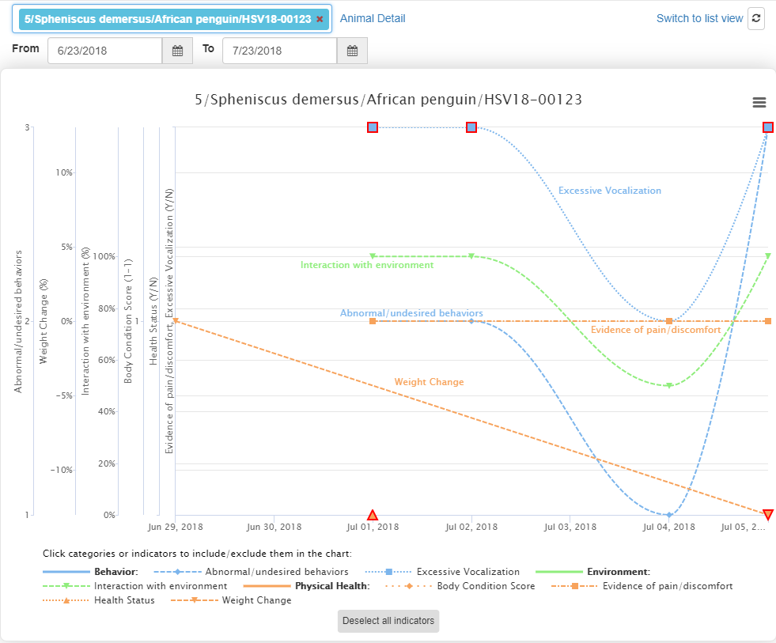
Husbandry – Care and Welfare
The ability to create Charts from the
information recorded makes it very
easy to interpret the data. In this
chart we can quickly see that
Excessive Vocalization, Interaction
with the Environment and
Abnormal/undesired Behaviors are
somehow tied together. To help you
use the Care and Welfare module, in
the ZIMS Help Menu you will find:
A pdf Help document
A PowerPoint

Slide 14
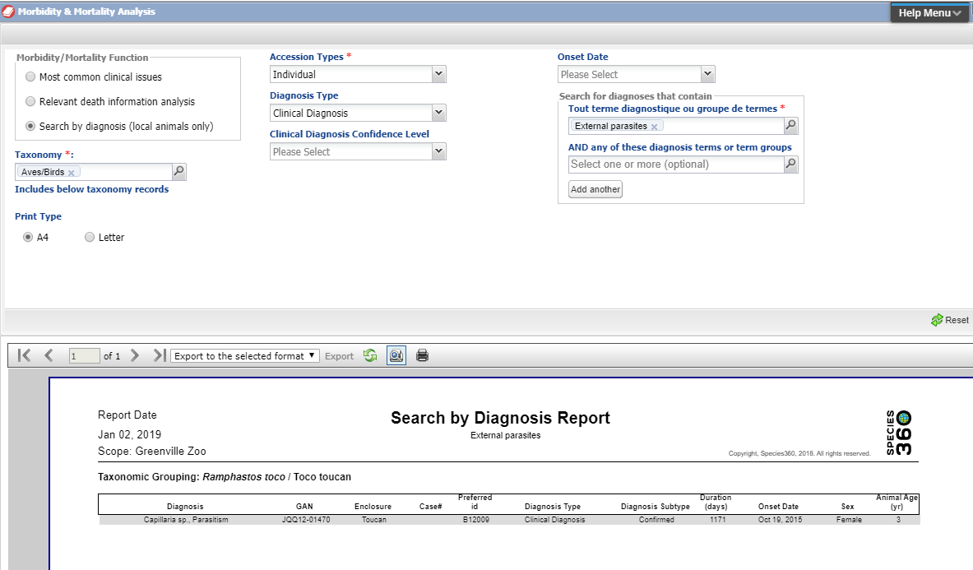
Medical – Search by Diagnosis
The ability to do a search by Diagnosis is now available under the Global Resource of Morbidity and Mortality. However, this is a Local data only
search.

Slide 15
Medical – Necropsy Lock
You now have the ability to
“lock” a Necropsy record by
selecting Sign Off. Locking
means that it cannot be edited
by anyone other than the
person who locked it. If
someone else tries to edit the
record they will receive a
message that it is locked and
they cannot proceed with their
edits. The Audit Trail grid tracks
by who and when a Necropsy
was locked.

Slide 16
Medical – Improvements to Prescription/Treatment Module
Previously, if the Dose Calculator was used, only the Dose and Dosage were updated in the main Prescription screen, Administered Dose Quantity was not. Now all three correctly update!
If the User does NOT use the Dose Calculator and instead directly enters data into the main Prescription screen, ZIMS will now display “Not Calculable” instead of displaying an incorrect Administered Dose Quantity.

Slide 17
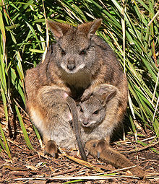
Studbooks - Overlays
Studbook Overlays allow you to add assumptive data to your master (true) studbook to assist
with analysis. They are sometimes called “hypothetical” studbooks. The most common
use is to record possible parents for UND (undetermined) parents or limit to a single animal when MULT parents are listed. They allow
you to answer the “What if?” questions you may have about your studbook data. Overlays are most commonly used by Population Managers but Studbook Keepers can benefit from them also.

Slide 18
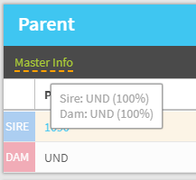
Studbooks - Overlays
You can tell when you are in a Studbook Overlay by the
orange banner at the top. If any data in a record has been
changed, Master Info will display at the top of the grid.
When you hover over it the data in the “true” studbook
will be shown. To learn how to create and use a Studbook
Overlay check out the Help Menu:
A pdf Help document
A PowerPoint
A video
A Blog posting

Slide 19
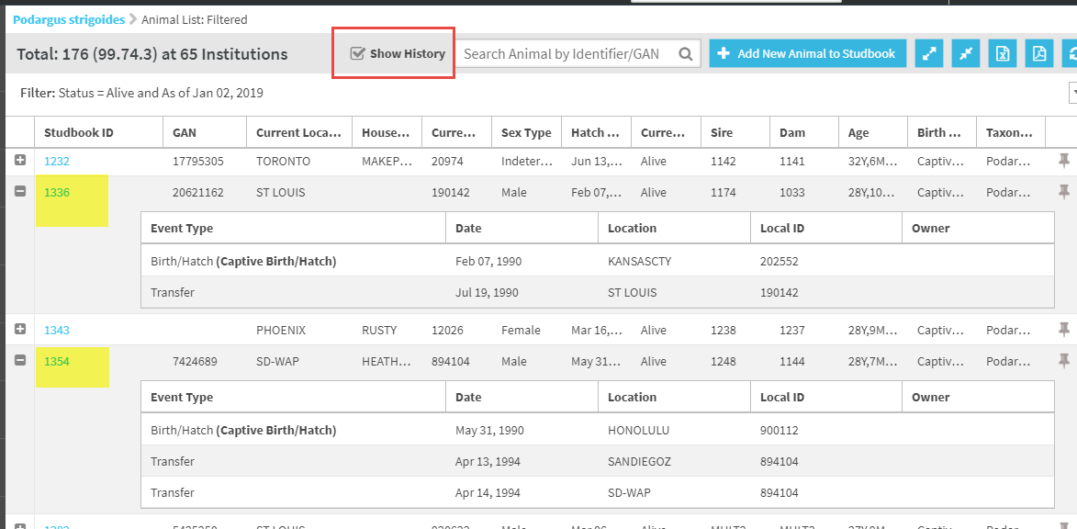
Studbooks – View Animal History
You can now view the history of an animal from a results grid by checking the “Show
History” box. Here we have expanded two studbook records to show the transaction
history.

Slide 20
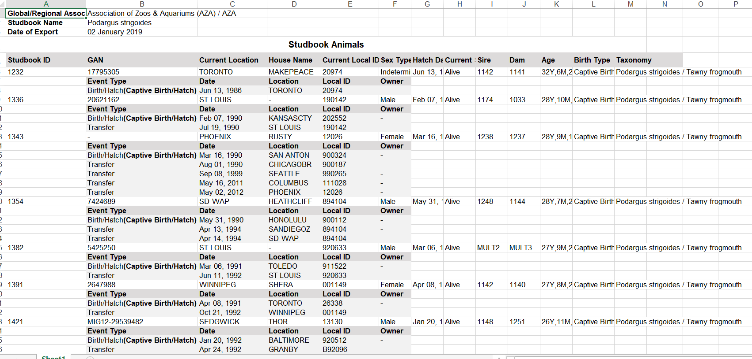
Studbooks – View Animal History as a Studbook Report
This option also functions as “Studbook Report”. When
the Show History box is checked, all the transactions
for the animal will display in the export to Excel or pdf.

Slide 21
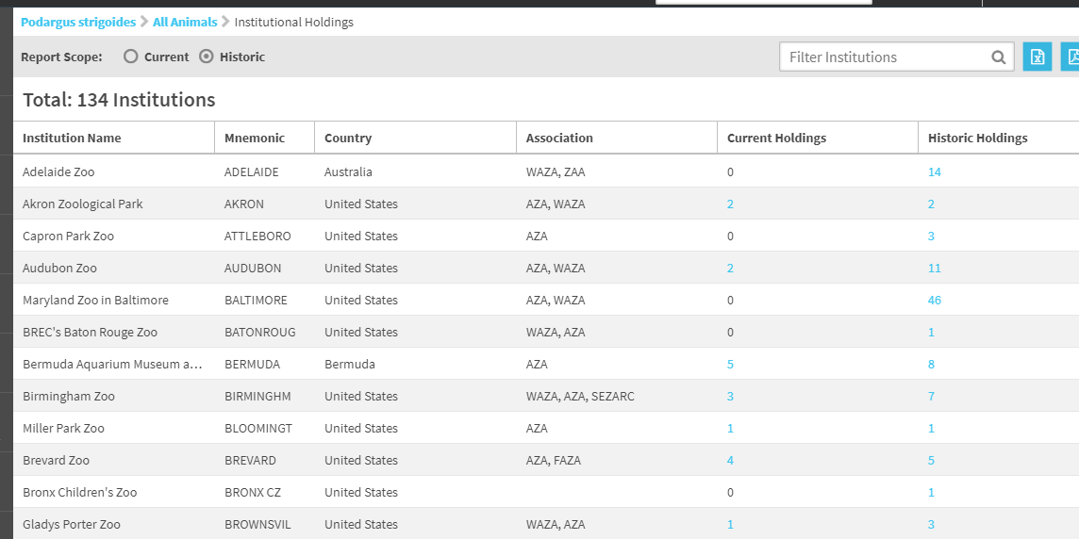
Studbooks – Institutional Holdings
Under Tools you can now find a list of Institutional Holdings. The Current/Historical Holdings will take you to a list with hyperlinks into the studbook record.

Slide 22
Studbooks – Accept Updates
More options have been added to the Pending Updates information
NEW! You can Accept the update with Edits
You can edit the update immediately and not have to remember to go back into the record and do so
NEW! You can Accept All Parents with one click
NEW! If the animal has been at only one institution you can Accept All the updates with one click and not have to go into each grid to do so.

Slide 23
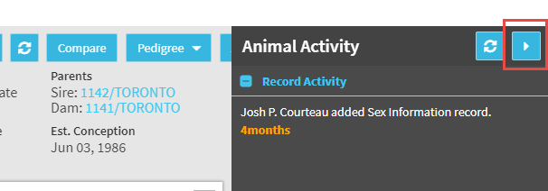
Studbooks – Activity Stream in Animal Details
In addition to finding recent activity across your studbook by looking at the
Studbook Activity found in the expandable box on the right hand side of the
Studbook Dashboard, each individual record now has its own right hand
expandable box to display any recent activity within that specific record.

Slide 24
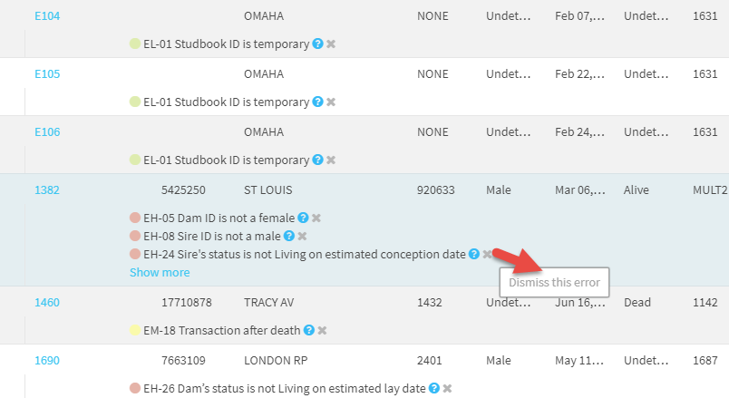
Studbooks – Dismiss Data Quality Errors
You now have the ability to dismiss Data Quality Errors
and Warnings. Sometimes ZIMS perceives a data entry
error that is not actually an error because of species
biology. A common cause for this is delayed implantation
and embryonic diapause where the sire may be long
deceased on the estimated conception date. Selecting the
“x” allows you remove these errors from view. There is a
“Display Dismissed Errors” checkbox should you wish to
see them again.

Slide 25
That is the Best of 2018!
In ZIMS

