Slide 1
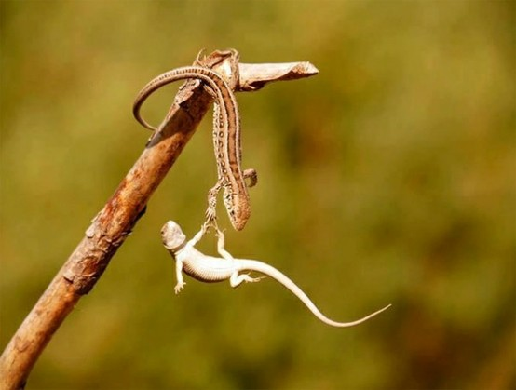
ZIMS Help!
Tips & Tricks June 2017

Slide 2
Help Made Fast and Easy
Hopefully everyone gets help with their ZIMS questions, but why do some seem to get answers faster than others?
This session will provide some hints to help avoid potential roadblocks and make getting ZIMS help swift and easy for you

Slide 3
Check the Site
ZIMS is being soooooo very slow
You can check if the site is having problems or if it is at your end
Go to http://training.species360.org/zimsdown/
It will let you know if it is really down or if it is at your end

Slide 4
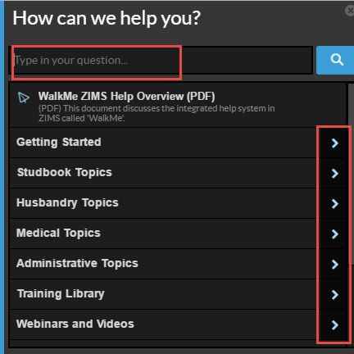
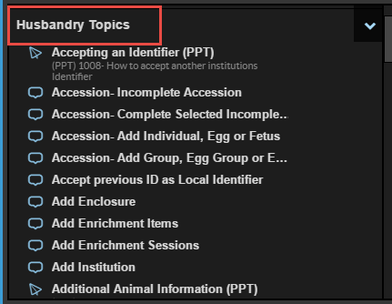
Try the Help Menu
Maybe you do not know the steps for what you need to do or you may be trying to do something in a way that ZIMS is not designed for
Try finding the topic in the Help Menu
You can type your topic into the search box or expand the various Topics
Here we have expanded the Husbandry Topics

Slide 5
Help Menu icons
WalkMe
ZIMS will guide you through the actual steps to accomplish your task
Document
Written help documents on the topic or a PPT
Video
A short instructional audio video

Slide 6
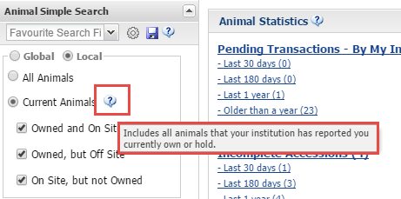
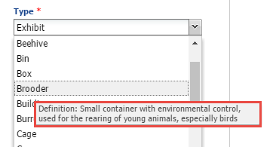
Some More Help Options
Hover over the “?”
Read the Data Standard Definitions

Slide 7
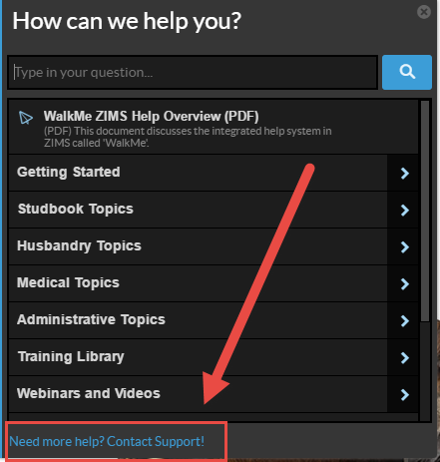
Quick Support Contact
A quick way to contact support should you need additional help or clarification of something in the Help Menu is found right at the bottom of the Help Menu
This will open an email already addressed to support
Remember to give a brief description of your question in the subject line

Slide 8
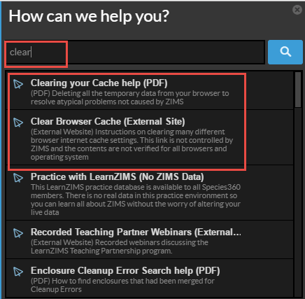
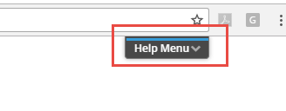
Clear Your Cache!
ZIMS is misbehaving! It could be that it is confused
Clearing Your Cache will clear ZIMS thinking
To find out how go to the Help Menu and type Clear in the search field
There is a pdf and an external link to guide you through the process
We are looking in to why clearing your cache fixes issues, so hopefully this is just a temporary need.

Slide 9
Maybe You Have a Bug
So you have:
Checked the ZIMS Site
Followed the Help instructions
Cleared Your Cache
And it still doesn’t work!
You probably have a Bug

Slide 10
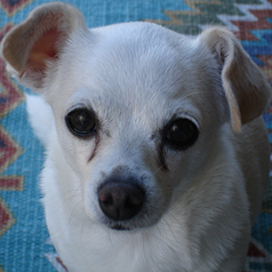
What is a Bug?
A good Bug is my Chihuahua named Bug
A bad Bug is:
Something that is broken or does not work properly in ZIMS
Stops you from performing part of your data entry or reporting tasks in ZIMS
Our goal is to have no Bugs and we try to fix Bugs as soon as possible

Slide 11
Who Do I Send a Bug To?
Send an email to support@Species360.org
Do NOT send directly to your Support person’s personal email
This may delay a response due to high volume
Sending to Support assists with tracking and passing on to the development team to be fixed
Institutions are also auto-assigned to their Support person so they will receive it in a timely manner
If your Support person is out others check and take their issues to get them started without delay

Slide 12
Sending to Listservs
What if I just send to one of the records listservs for an answer?
Does help you to know if others are experiencing the same issue
However, this will not get the Bug fixed!!
Species360 staff are on the listservs but not always monitoring them
Misinformation can be quickly spread!!!
The quickest way to get assistance with a Bug is to submit to your Support person
They will create a ticket and track

Slide 13
What do I Put in the Subject Line?
The main module that the Bug is in
Husbandry
Medical
Studbooks
The sub-module it is found in (Animal, Enclosure, Treatments, Institution, Reports, etc.)
The title of the screen the Bug is found in
Brief description of the Bug
This helps Support to quickly identify related Bugs that have been previously submitted so they can be associated together

Slide 14
Examples of Subject Lines
THE BAD: Add New Enclosure is busted
THE GOOD: Husbandry, Enclosure module, Add New will not Save
THE BAD: Can’t add a Prescription
THE GOOD: Medical, Add Quick Prescription, Batch Prescription checkbox not working

Slide 15
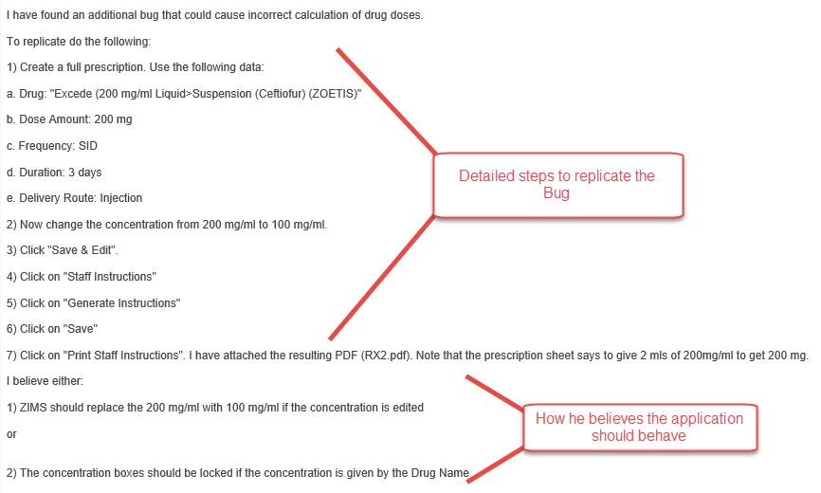
Record the Steps to Recreate the Bug

Slide 16
Be Careful with Screen Shots
Sometimes arrow/box/circle formatting is not correct when received
MS Paint is free and may be an option
Snag It can be trialed and purchased
Image in signature can interfere with interpreting screen shots
Often they are too small to read
If referencing a screen shot include the name of the file and what to look at

Slide 17
Including an Email Chain
You can include an email chain as supportive documentation only, especially if several institutions are involved
You still need to provide exactly what the issue is in your description, including replication steps
If your Bug cannot be replicated by support it cannot be forwarded to developers for fixing
It will slow down response time considerably if Support has to read through a dozen emails to get what the Bug is, plus they may misinterpret what you are actually asking for!

Slide 18
Some More Helpful Hints
If the Bug is Animal related, type out the GAN
Allows for quick cut and paste option for support
If you have Parent/Child institution relationships reference which institution the problem is occurring in
If dates are part of your Bug write the month and year out, 03/07/99 could be anything from 7 March 1899 (yes we have ZIMS records going back that far!) to 3 July 1999
Include your Log In information as sometimes Support needs to pretend they are you! If they cannot replicate the Bug for the developers, it makes it very difficult to fix it
Include what Browser you are using
Support will let you know when the Bug is fixed
Check ZIMS and let Support know your findings– they cannot Close the issue otherwise

Slide 19
Life Cycle of a Bug
4.Support notifies the User the Bug is fixed. User tests and reports back to Support so the
issue can be Closed
1.Bug is identified
by a User and
submitted to
Support
3.The Development
Team fixes the Bug
2.Support tests to replicate
and submits to the
Development Team

Slide 20
How to Submit a Data Standard Addition
Often Users find that they need a new term added to a Data Standard
This can also be submitted to support@Species360.org
Include the data entry screen title
Include the field title the Data Standard is in
Include the Term you desire
Always include a definition of the Term
Slows the process as we have to go back to you
Makes sure we are interpreting correctly
An idea of how often it would be used by yourself and others
Support will notify you if rejected or implemented
Please check and let Support know that all is well – they cannot Close the issue otherwise

Slide 21
What is a Data Fix?
A Data Fix means that Species360 is needed to make the corrections
Common Examples
Local ID needs to be edited
Splitting/Copying records
Info from one into another
Pending Transaction Loops
Records Merges

Slide 22
How to Get Help for a Data Fix
Submit to Support
Include the GAN if appropriate
For Local ID edit identify the current Local ID and the correct one desired
Communicate with other institution if appropriate
Can copy them in Species360 email
For splitting/copying information export a Specimen Report and highlight information you want copied
For Pending loops include the GAN and which transaction is the problem
For Inventory miscounts include the taxonomy, the report parameters, any changing/evolving numbers and the count you are expecting

Slide 23
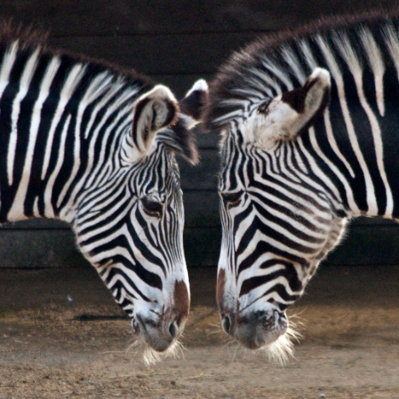
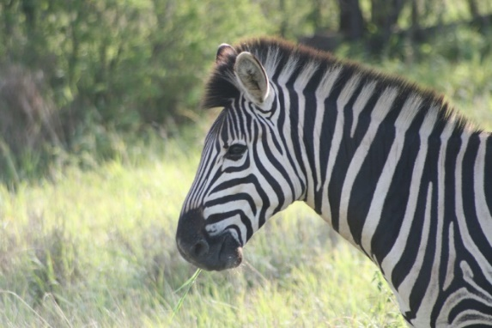
How to Request a Merge
Two animals in the database and should be only one
Confirmation is usually required from all institutions
Two approaches
Communicate with other institution then submit to Species360
Communicate with other institution and Species360 simultaneously
Include BOTH GANs !!!
Usually the original GAN, or that of the first holder, is kept.
The other is redirected to the retained record as an Old Accession Number identifier
No confirmation needed if the following match:
Taxonomy
Date of Birth
Sex
Birth Location
And one of these:
House Name
Studbook number
Transponder
Let Support know all is well after the merge
Merge is correct
All info is there

Slide 24
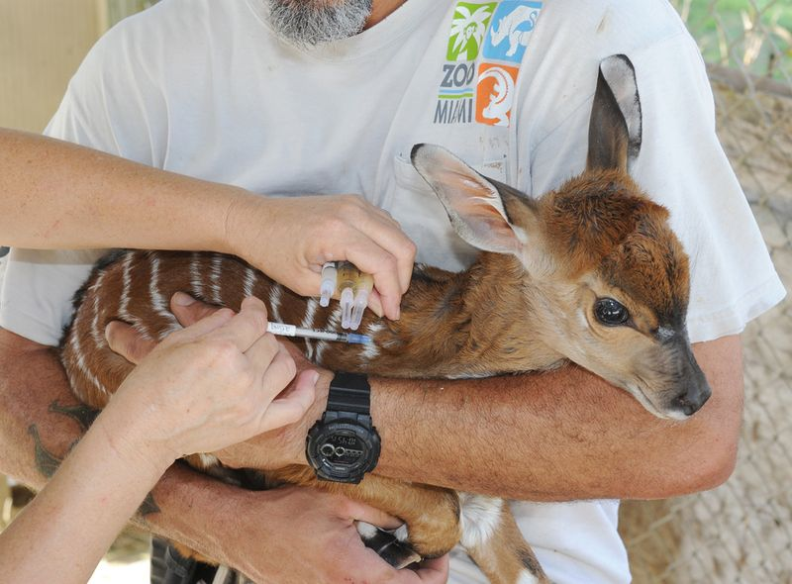
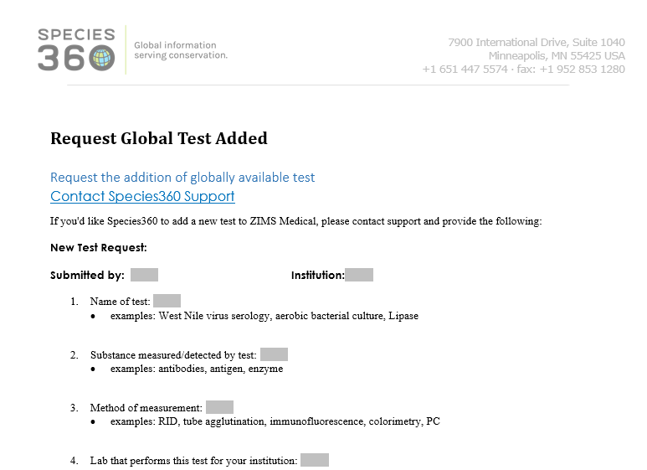
Requesting Tests
If you want to request a new test in the Medical module use the Help Menu to get the Request Global Test form
Complete and submit to Support

Slide 25
Working with Someone Other Than Your Regular Support Rep?
If working with someone who ISN’T your regular Support person on an issue that came in while they were out, DO put ATTN: “Name of not your Support person” in the subject line
Include the issue number in the subject line
Be especially specific. Do not say "been playing with that thing from last week and this is happening now“. Your Support person may not know what you are talking about as someone else helped you out

Slide 26
A Help Review
Check if the site is active
Use the Help Menu
Clear your cache on a daily basis
Minimal prior to Bug Submission
If you do have a Bug
Submit to support@species360.org
Do not send directly to your support person’s personal email
Always include the GAN if Animal related
Subject line should be helpful
Don’t say I want it to work better, provide details on how you actually want it to work.
Include your login details
Include the Browser you are using
Once submitted no need to re-submit
Reply to original issue if you have questions, do not submit a new issue
Confirm to Support that the Bug is fixed

Slide 27
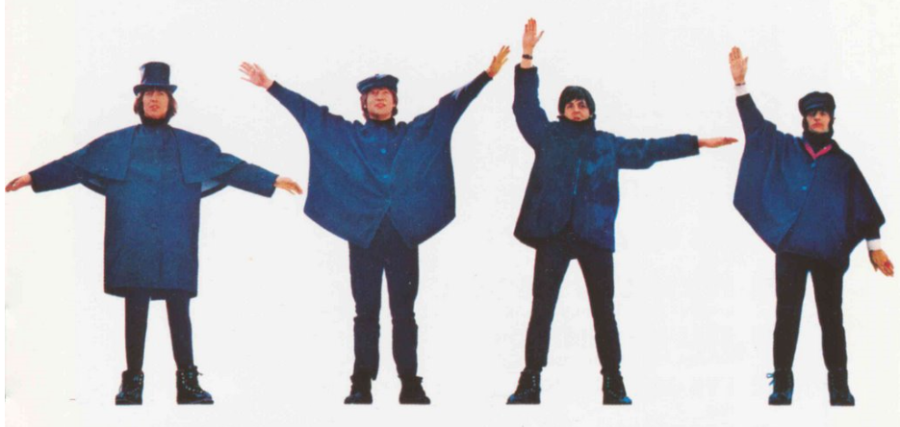
Any Questions?
On Getting Help

