Slide 1
February 2017 Tips & Tricks
ZIMS Release January 30, 2017

Slide 2
Email Notifications
For Out of Range Environmental and Water Quality Measurements

Slide 3
Role Requirements
You must have Search/View access to Enclosure and/or Life Support Measurements to receive an email
To edit the Email notifications contact list you must have Edit access to Enclosure and/or Life Support Measurements

Slide 4
Other Requirements
Emails will be sent to your Communications email – make sure it is up-to-date!
You must have a Measurement Range Template created for the Enclosure/Life Support
This is the template created under Start>Tools> Measurement Range Template. It is not a Batch Measurement Template.

Slide 5
Email Notification Activation
If you have not recorded any measurements the
Email Notification will not be activated (top).
Once you record at least
one measurement you
will see the Set Email
Notification option (bottom).

Slide 6
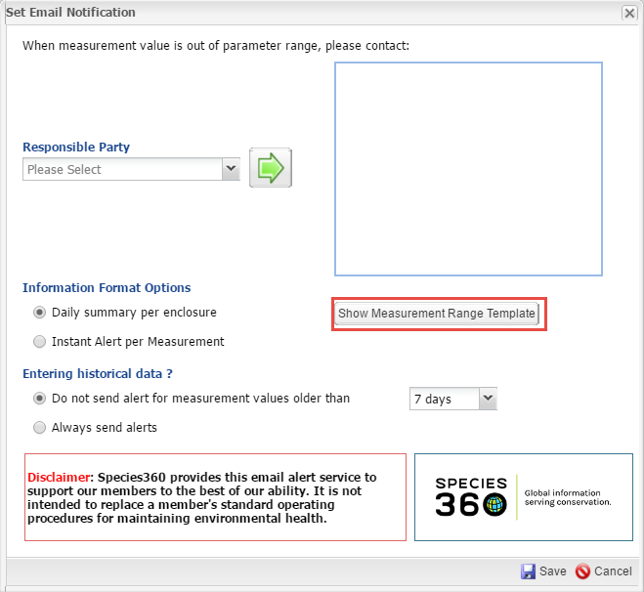
Show Measurement Template
As mentioned, you have to have
a Measurement Range Template
set for the Enclosure/Life Support.
If Show Measurement Range
Template is displayed you already
have a template created. Selecting
that button will take you to a list of
all your range templates if you want
to check it.

Slide 7
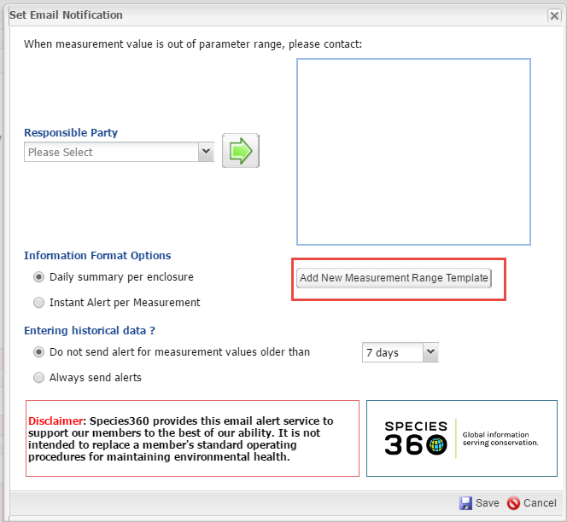
Add New Range Template
If you do not have a Range Template
set up for the Enclosure/Life Support
the button will be Add New
Measurement Range Template.
Selecting that will take you into the
screen to create the required
Range Template.

Slide 8
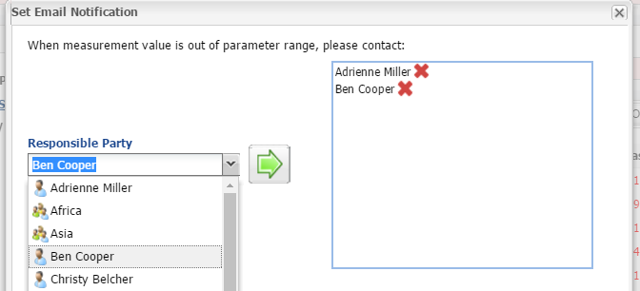
Select the Email Contact
You first need to select the staff member(s) who will receive the Email. Only Staff with access to at least Search/View Enclosures will display in the list. Currently if you select a Team none of the members receive an email as we are working on Business Rules as Team members may have
varying access. Right now select only individuals.

Slide 9
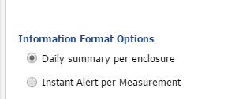
Information Format Options
You then select the Information
Format that you want. Daily
Summary will send an email at
noon your time zone for any
reading outside the desired range in
the last 24 hours. Noon was picked
because that will allow your staff
to take measurements in the
morning and you can take steps to
correct in the afternoon. If you
want to receive the emails at a
different time you can adjust your
Time Zone in Preferences. Instant
Alert will send an email within 5
minutes for each measurement
recorded that is out of range.
One thing to note: what is selected in
this Format Options affects all the contacts assigned to receive notifications for this Enclosure. One staff person cannot receive Daily Summaries and the other receive Instant Notifications.

Slide 10
Entering Historical Data
You then have the option to select if you do not want to receive notifications for measurements taken in a previous time frame. If you are catching up on older readings you will not be bombarded with notifications that are out of date. You can chose not to have alerts sent of measurements that are older than 7, 14 or 30 days. Or, you can request to always send alerts. Just as in the previous slide, this selection applies to all staff members listed for notification for the Enclosure.

Slide 11
Disclaimer
The Disclaimer is simply a reminder that Species360 cannot be
tasked with making sure your operating procedures are good.
We can only give you the information for you to decide what
actions you want to take, if any.

Slide 12
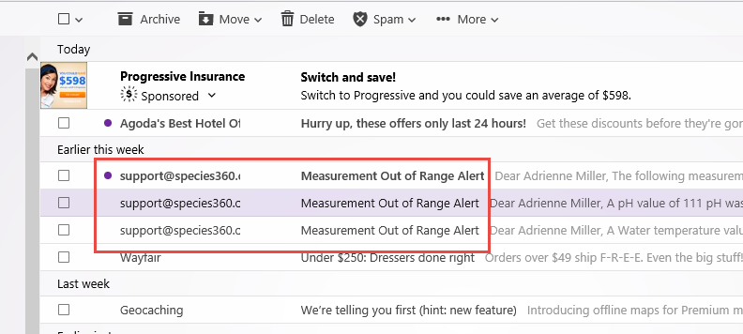
The Email
When you receive an Email notification
it will be from support@species360.org.
The topic will be Measurement Out of
Range Alert. Please make sure your email is configured to accept emails from a species360.org address.

Slide 13
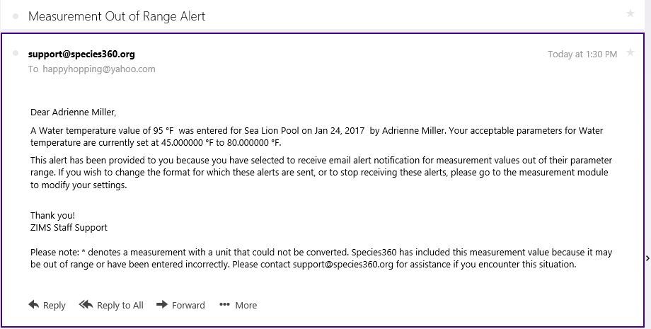
Instant Notification View
The Instant Notification View will display as above. The measurement, the reading, the Enclosure, the date, who was Responsible (or who
recorded the measurement if no Responsible Party was indicated),
and the desired range are noted.

Slide 14
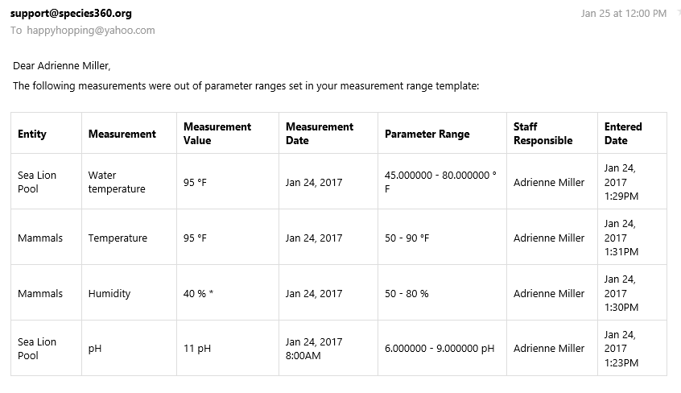
Daily Summary View
The Daily Summary View displays as
a grid with the same information.

Slide 15
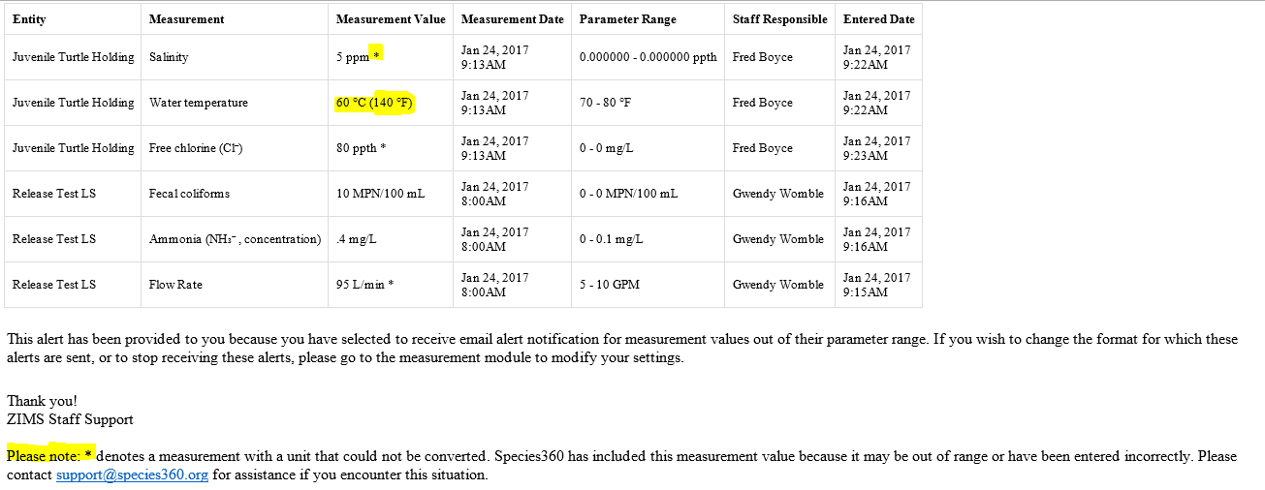
UOM Conversions
When measurements are entered with a UOM that is different from the UOM selected in the measurement range template, ZIMS will convert them if possible. Any measurements that are not converted will be included in the alert to highlight the entry for possible errors or valid out of range measurements.

Slide 16
Any Questions?
On Email Notifications

Slide 17
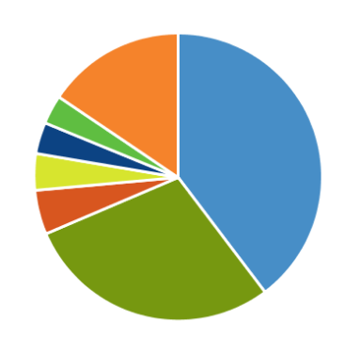
New Charts and Data Quality Features

Slide 18
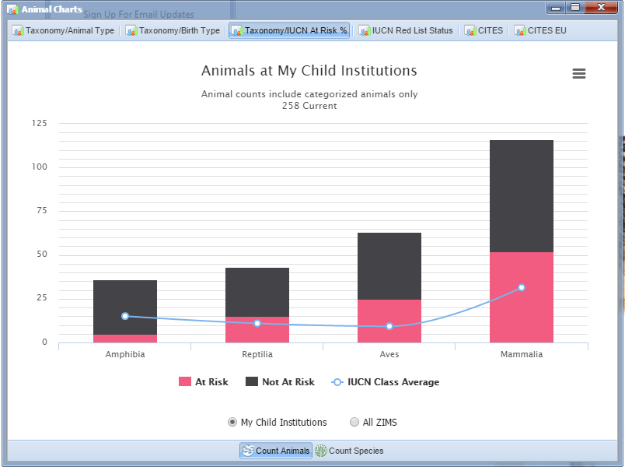
Taxonomy/IUCN at Risk %
Found under Start>Animals>
Charts we have added a tab for
Taxonomy/IUCN At Risk %. If your
collection is representing the
average, your red would be the
same as the IUCN average. The
higher yours is, relative to the
average, the more your collection
represents at risk animals or
species. This collection houses a
higher than average number of
birds and mammals that are At
Risk than the average. This can be
graphed by your Institution or All
ZIMS and by Animals or Species

Slide 19
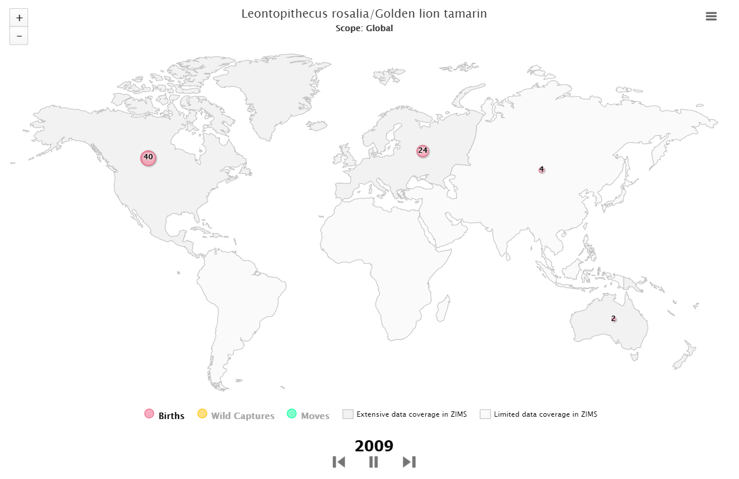
Species Event History Movie
Found under Reports,
the Species Event History
Movie is a graphic display
by year of Births, Wild
Captures and Moves.
Please read the Limitations document found when you set your filters for the Movie to better understand the display. This screen shows the number of Births in 2009.

Slide 20
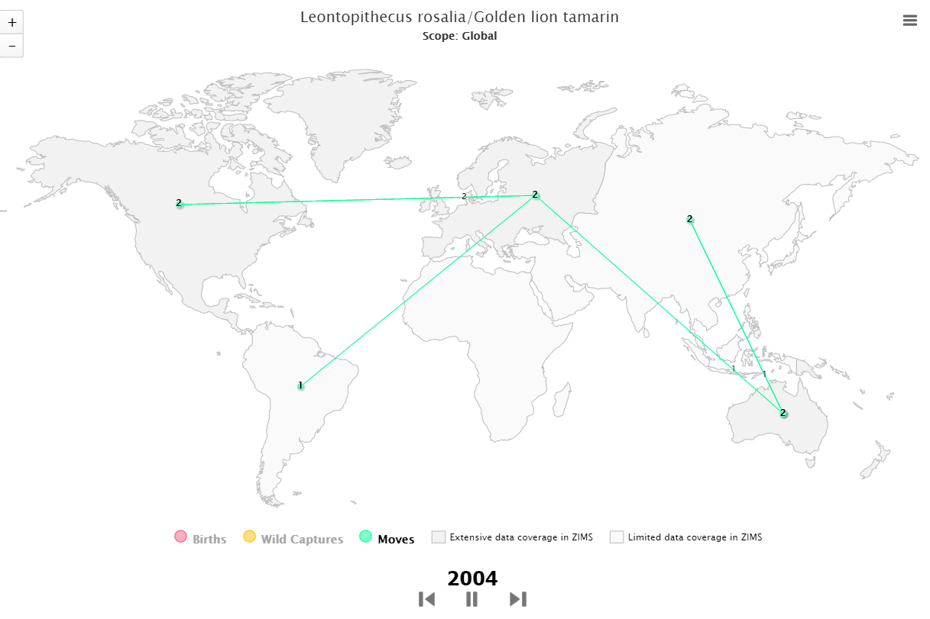
Species Event History Movie
Regions with extensive data
in ZIMS are darker grey than
those regions with limited
data in ZIMS. You can filter
this report by various scopes
(Global to My Institution) and
Taxonomy. This capture shows
the Moves in 2004. Pick your
favorite species, grab
some popcorn and watch
a few!

Slide 21
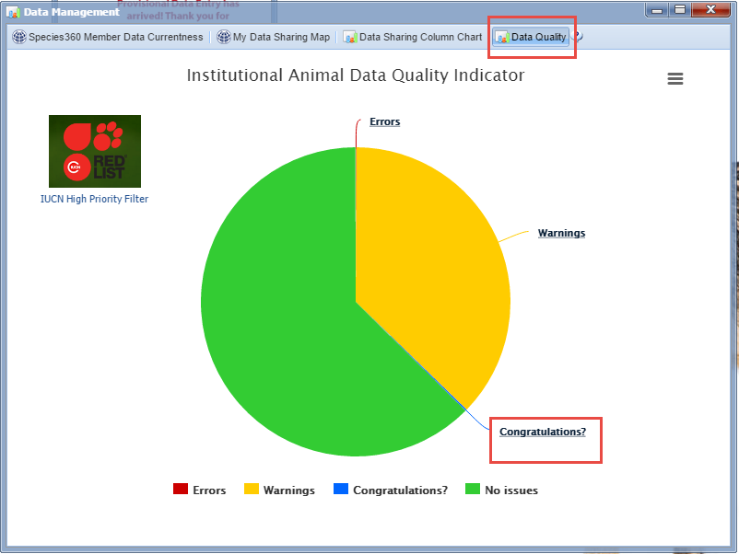
Data Quality “Congratulations?”
Found under Start>Institution>
Data Management>Data
Quality we have added a piece
of the pie for possible
Congratulations! for holding
the oldest animal of a species.

Slide 22
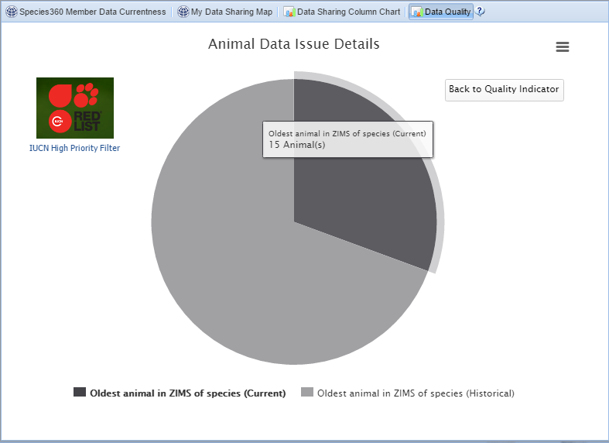
Congratulations?
Selecting the Congratulations?
hyperlink will take you to a
new pie displaying the number
of records currently or
historically. This institution is
currently holding what may be
15 of the oldest animals for their
species.

Slide 23
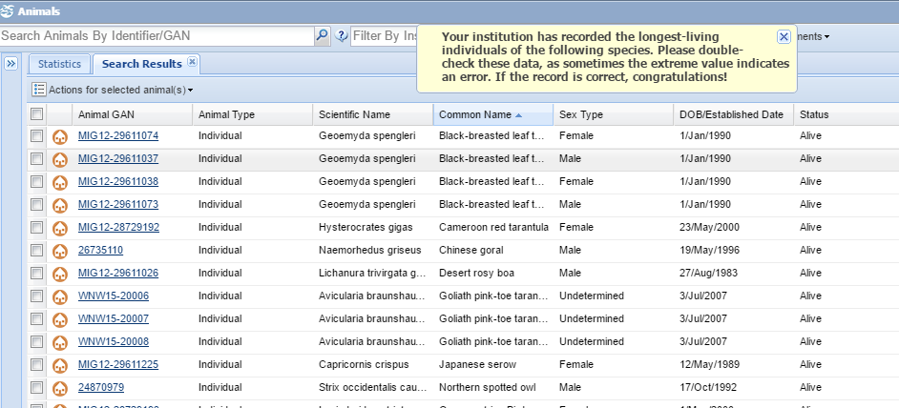
Congratulations?
Double clicking the piece of the pie
will display a results grid with the
animals and a message to please
check the records and correct if
appropriate.

Slide 24
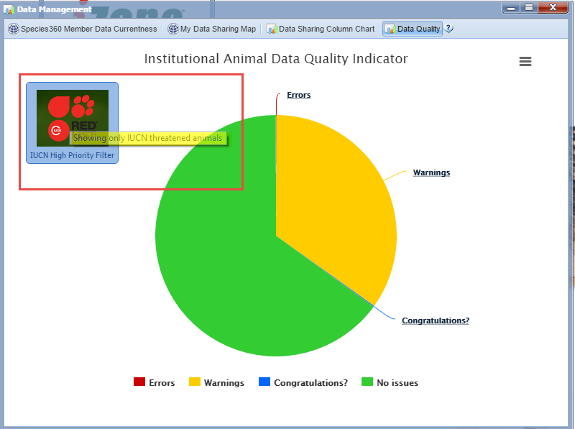
Data Quality for IUCN Red List
You can also filter your
Data Quality issues to
only those species of
High Priority to IUCN.
This may help you decide
which data quality issues
you want to address first.

Slide 25
Data Consistency Warnings
Health status and Clinical Diagnosis records are separate but related
information. When you have an animal in focus that may have a possible
conflict between the two you are given a warning and the opportunity
to resolve the conflict. This animal has a normal health status but also
an active medical problem. You can choose to continue on or go right
into Health Status and update it.

Slide 26
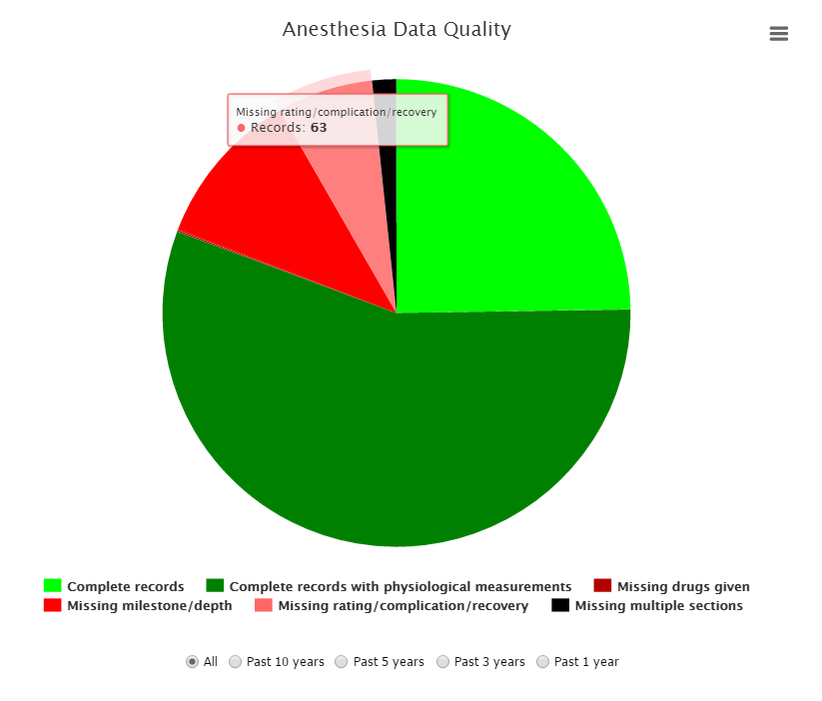
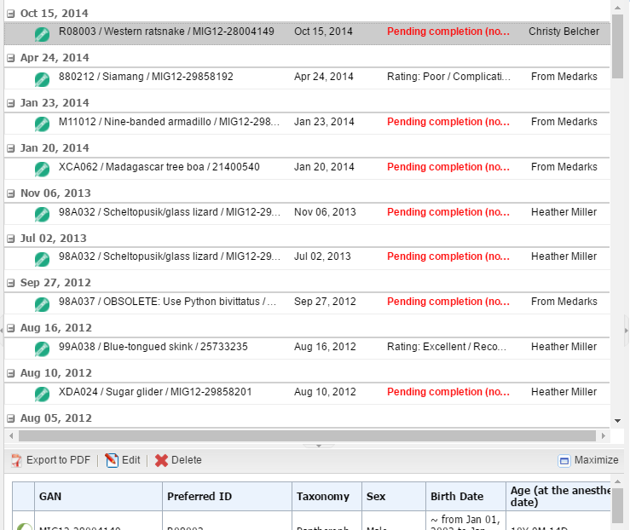
Anesthesia Data Quality
In Medical Records>Anesthesia
there is a new tool that allows
you to easily find your partially
completed anesthesia records
to finish data entry. Clicking on
the pie piece will display a list
of the appropriate records.

Slide 27
Any Questions?
On the new charts and data quality features

Slide 28
New Medical Resources
Including IMLS Grant Funded Resources

Slide 29
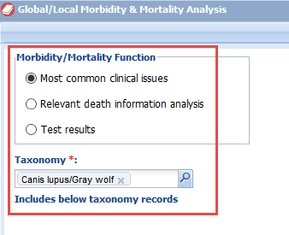
Mortality and Morbidity Analysis
A new Medical Resource feature funded by IMLS.
You can filter by:
Most common clinical issues
Relevant death information analysis
Test results
Taxonomy (including taxonomy below)

Slide 30
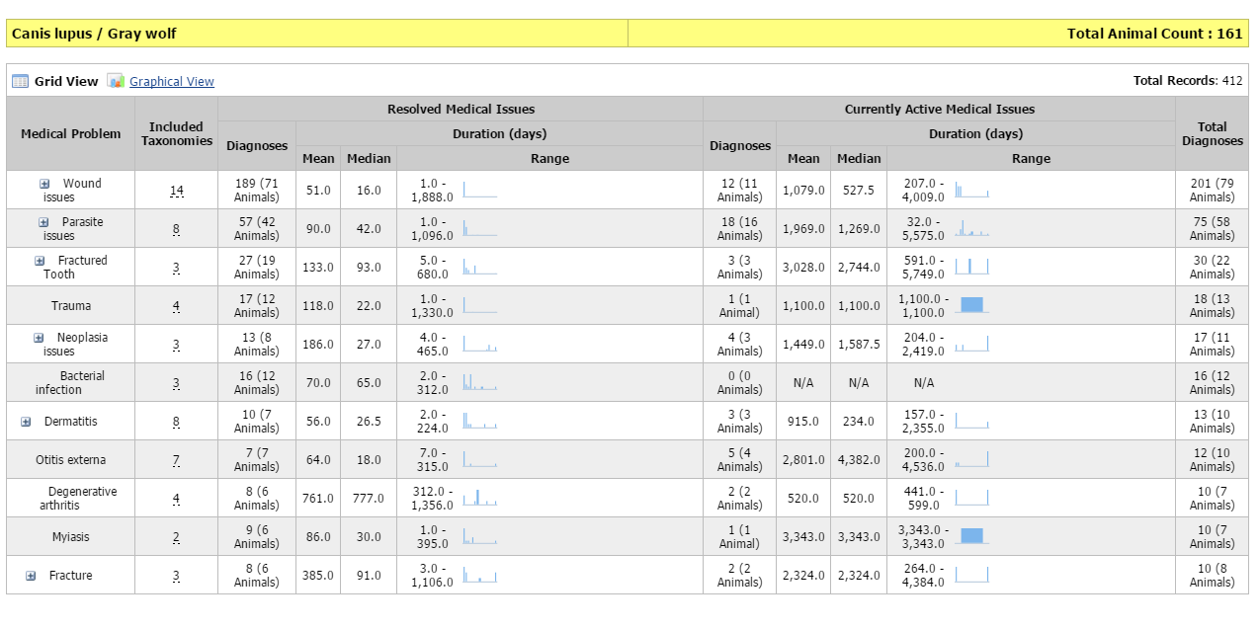
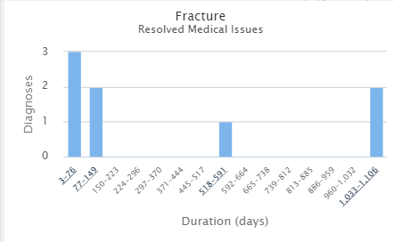
M & M – Most Common Clinical Issues
Most Common Clinical Issues is a summary of the most commonly reported medical problems for a species along with duration data for each clinical issue. The information is extracted from member clinical diagnosis records. The number of resolved cases and the number of active cases are indicated. The graphs can be expanded by hovering over.

Slide 31
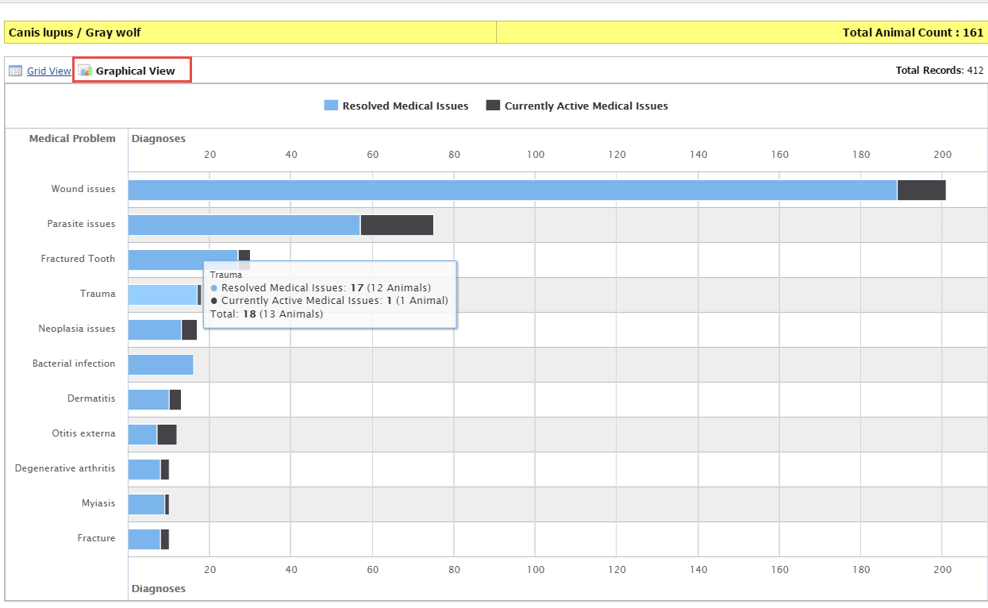
M & M – Most Common Clinical Issues
You can also view this information
in a Graphical View.

Slide 32
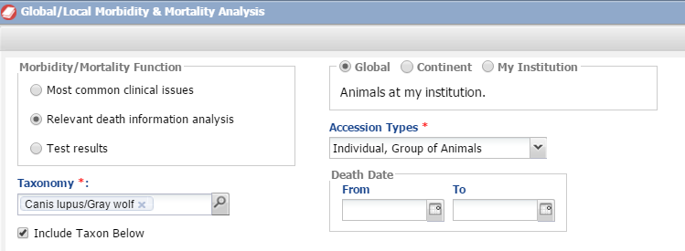
M & M – Relevant Death Info
Relevant Death Information performs real-time analysis on the Relevant Death
Information associated with the Husbandry death records. There are more filtering
options for this analysis. In addition to Taxonomy you can chose the scope, what
entities you want to include, and a date of death range.

Slide 33
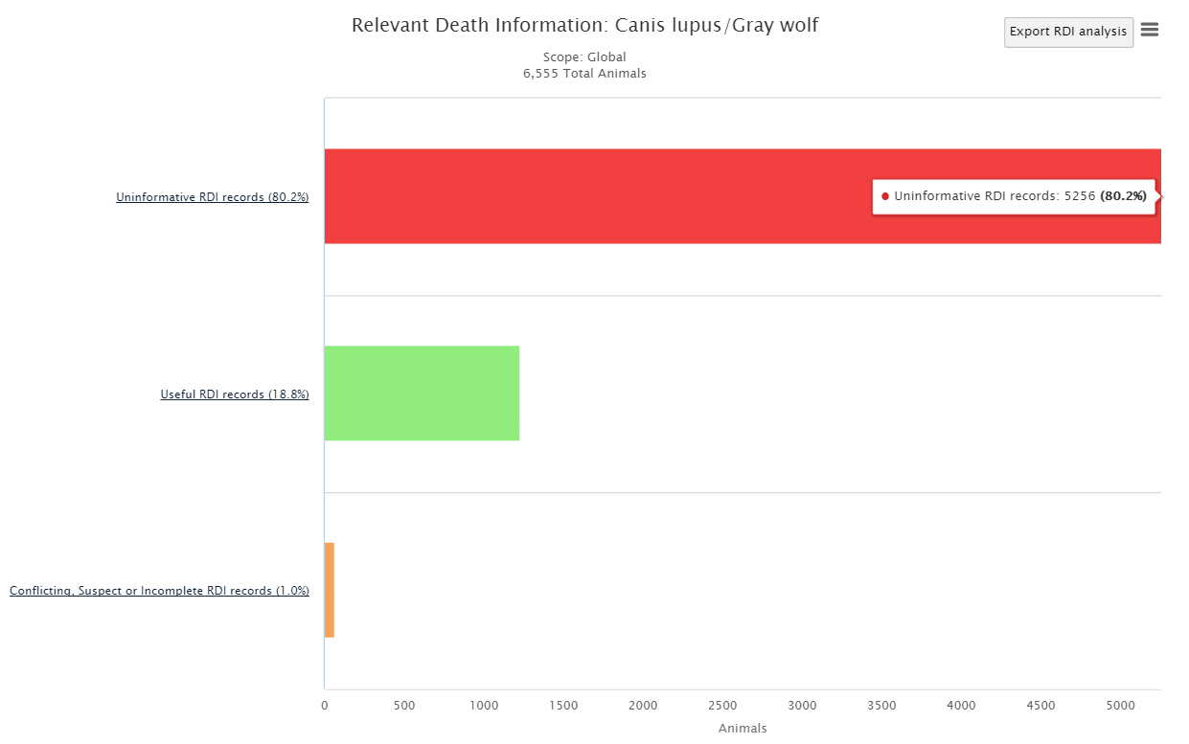
M & M – Relevant Death Info
The analysis output is an interactive bar
graph that starts at the highest analysis level.
This first graph displays the numbers of records
that have Uninformative RDI records, Useful
RDI records and Conflicting, Suspect or
Incomplete RDI records. If the label for the bar
is underlined, clicking on the bar…….

Slide 34
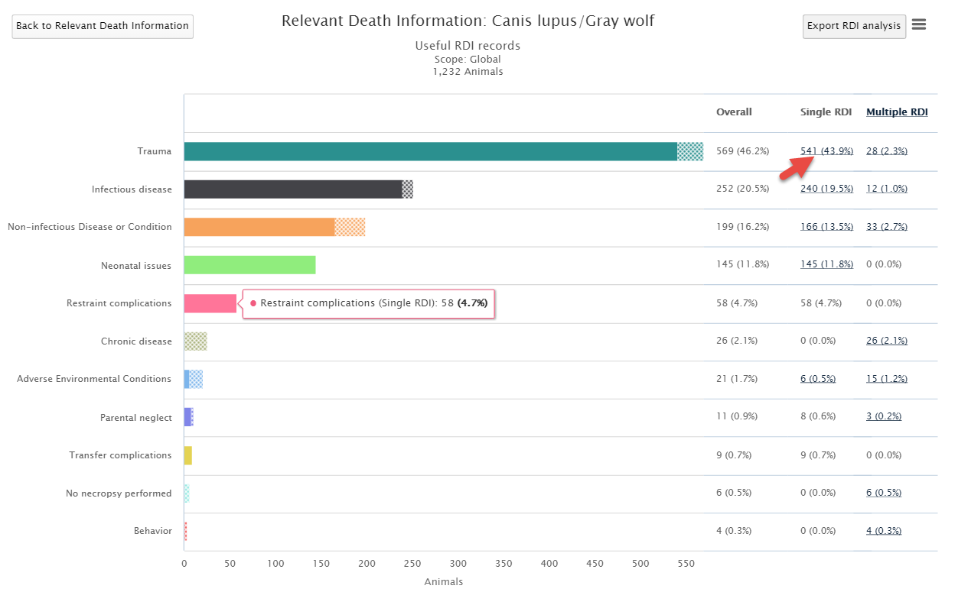
M & M –Relevant Death Info
…opens a new graph showing the finer resolution
data that was used to create the previous bar.
Here it displays a screen with the various causes of
death. Trauma appears to be the number one cause
of death for gray wolves. Any numbers that
are underlined are hyperlinks to……….

Slide 35
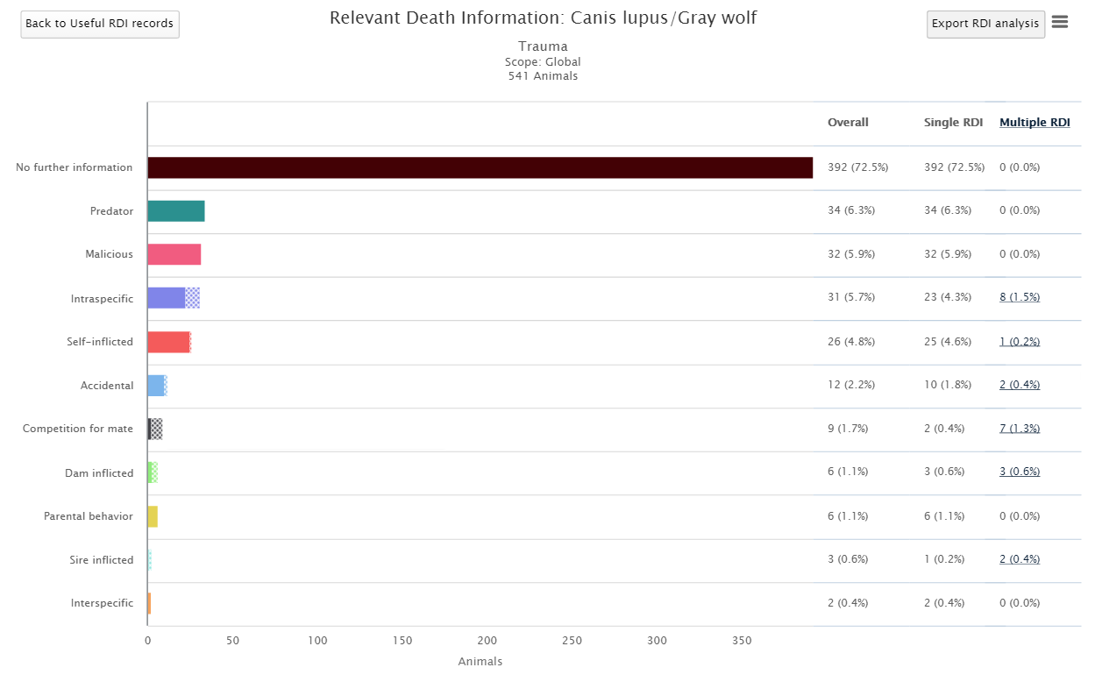
M & M – Relevant Death Info
… further details regarding that cause
of death. Every level has a back button
(upper left) to return to the previous
Analysis level.

Slide 36
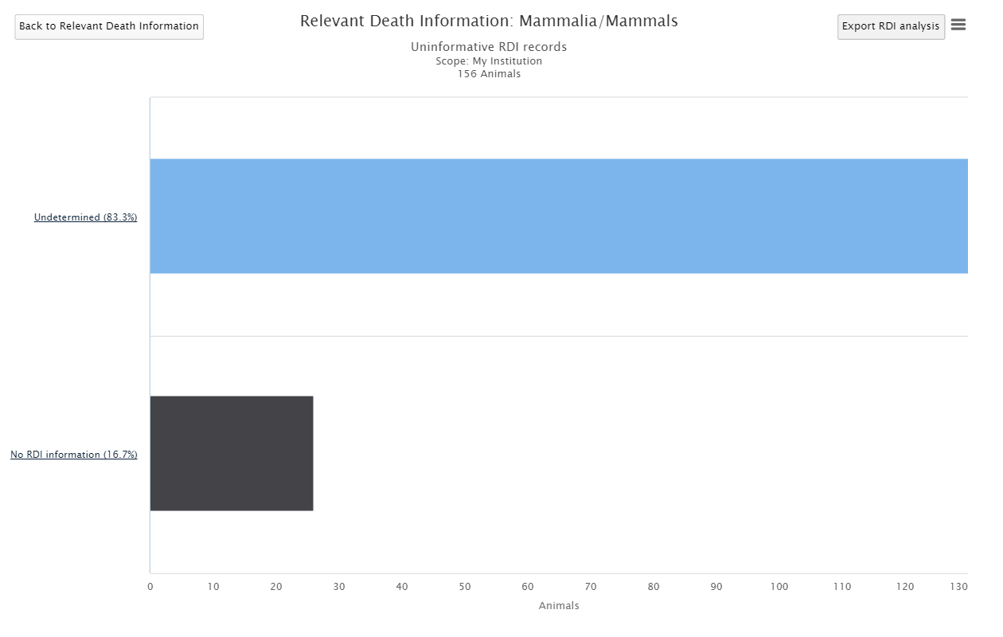
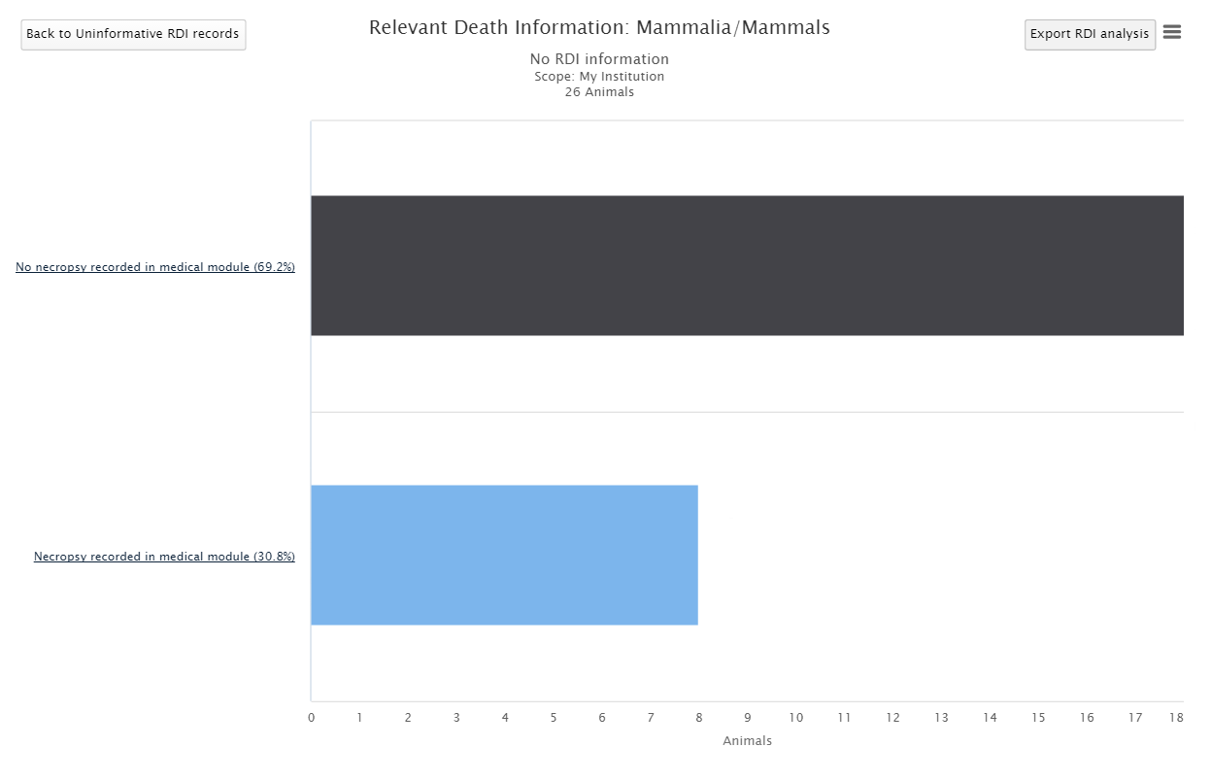
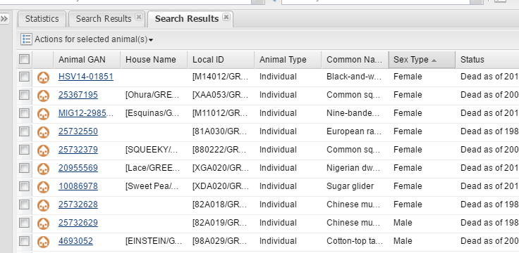
M & M – Relevant Death Info
Running this feature at the
My Institution level can help
you clean up your RDI records!

Slide 37
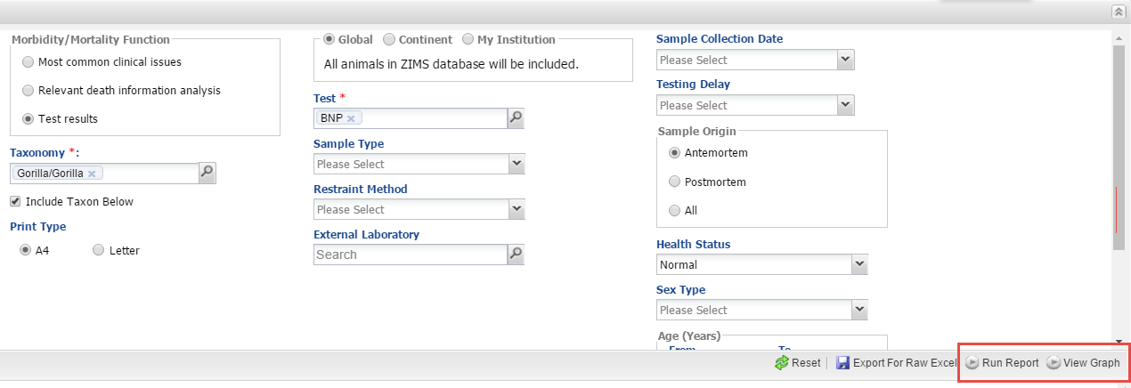
M & M – Test Results
If you select the Test Results search you have even more filters available. The requirements
for display on the Test Results report/graph are not as stringent as they are to be shown
in the Global Reference Intervals. This new, anonymous reporting function provides some
access to the rest of the ZIMS test results data. You have just measured your first B-type
natriuretic peptide (BNP) level in a gorilla and you want to see what related information
has been entered.

Slide 38
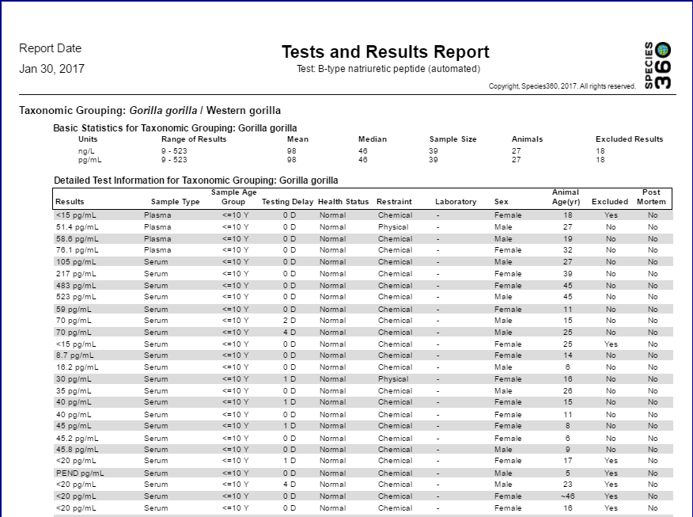
M & M – Tests Results Report
You can select to view
the information in a
Report form.

Slide 39
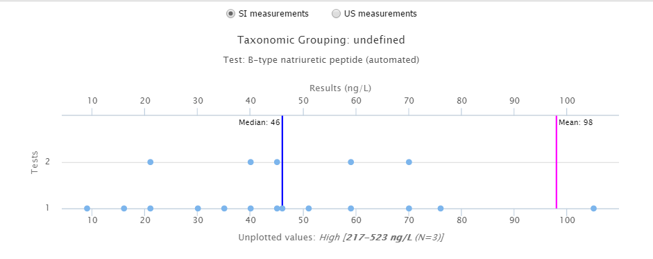
M & M – Tests Results Graph
Or, you can chose to create a graph of the information.

Slide 40
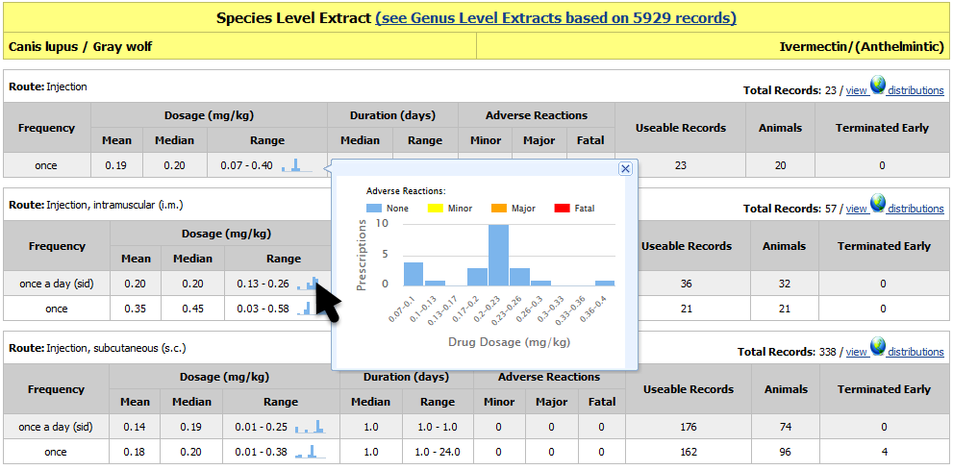
Drug Usage Extract
In addition to providing users with the range of drug dosages, the
Global Drug Usage Extract now also displays the distribution of those
dosages by hovering over the Range.

Slide 41
Global Anesthesia Summaries
Three new features have been added to the Global Anesthesia Summary.
First, you can now search by the drug in addition to search by Taxonomy.
This helps you find existing protocols as new anesthetic drugs become
available.

Slide 42
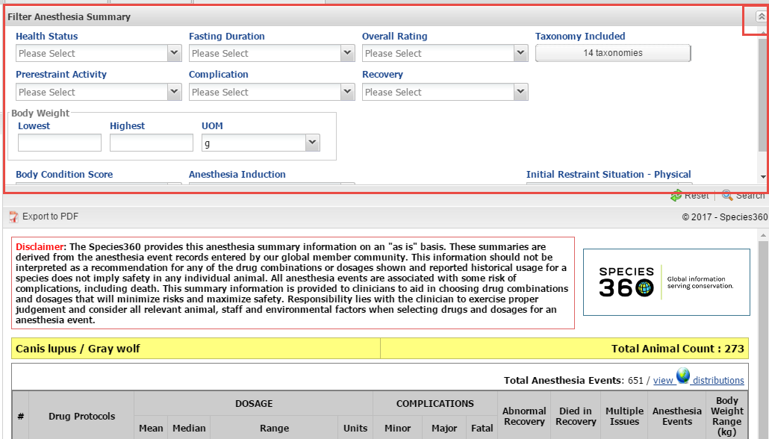
Filter Anesthesia Summary
The overall summary protocols displayed for a species can be refined by selecting
additional filter options within the “Filter Anesthesia Summaries” panel above the
report (panel may be collapsed).

Slide 43
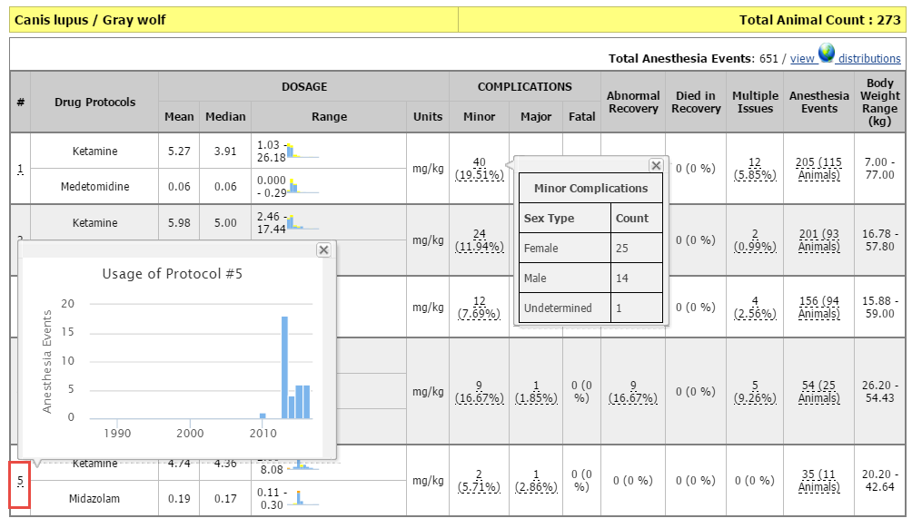
Global Anesthesia Summaries
By hovering over the Drug Protocol number you can view a histogram of the usage
over the past 30 years and evaluate whether the protocol is gaining or waning in
use. This drug combination is fairly recent. Hovering over any data that is under-
lined will display additional information.

Slide 44
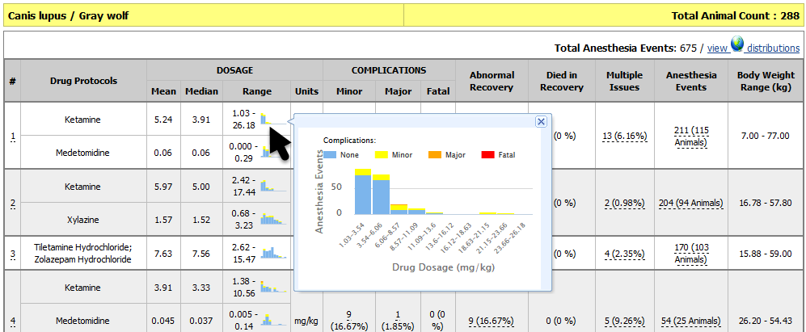
Global Anesthesia Summaries
You can also hover over the histogram for the drug dosage and see the
distribution of that drug dosage.

Slide 45
Any Questions?
On the new Medical features

Slide 46
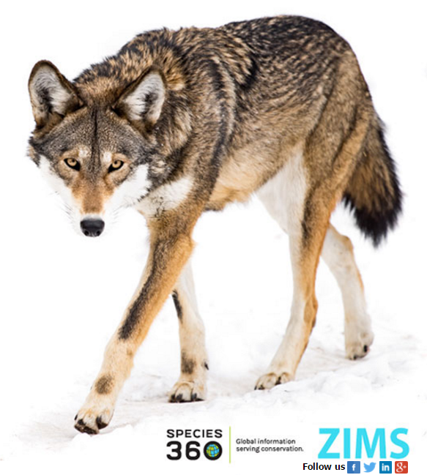
Thank You!

