Slide 1
Tips and Tricks April 2015
I’m Lost!!
Successful Searches in ZIMS

Slide 2
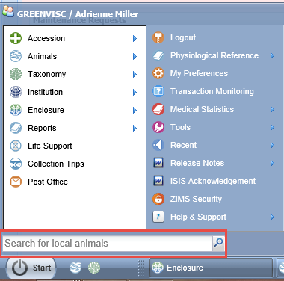
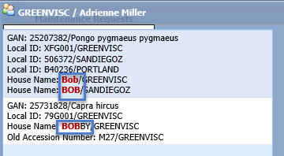
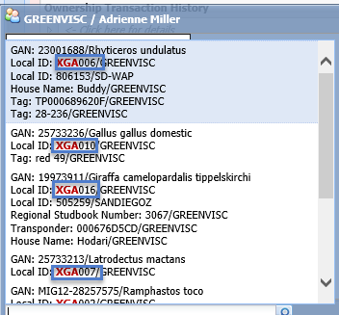
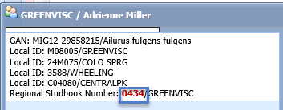
Start Menu
Usually the quickest way to search for
your animals (animals you have recorded
as owning or holding at some time) is
to use the “Search For Local Animals”
option under the Start menu. It is quicker
because it has to look only Locally and
not Globally. It will start looking as soon
as you start typing and display possible
matches. Above we found by House Name. Below we found by Local ID or Studbook Number. In this search you do not indicate what identifier you are looking for.

Slide 3
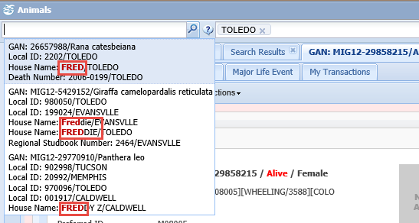
Search Animals
A quick way to look for animals
at other facilities is to use the
Search Animals By Identifier/GAN
box in the upper left hand corner.
You can further filter this field by
selecting a specific institution.
Here we are looking for an animal
named Fred at the Toledo Zoo.
This search will return results for
your animals but they may not be
at the top of the list, making them
harder to find.

Slide 4
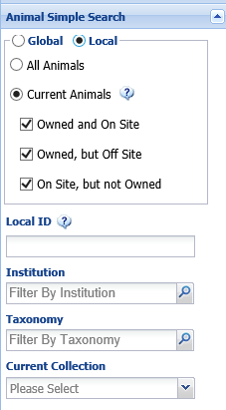
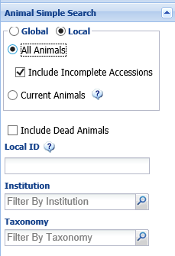
Local Animal Simple Search – Current versus All
The Animal Simple Search is
probably the most common search tool used. In a Local search Current animals will find all animals your institution has reported that you currently hold and/or own.
All animals will find all animals
that you ever reported as owning
or holding. All Animals allows you to
include Incomplete Accessions
(default) and any dead animals.
Include Dead Animals is NOT the
default and is often overlooked.
Note that if you select All Animals
you do not have the option to
search by Current Collection.

Slide 5
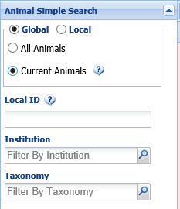
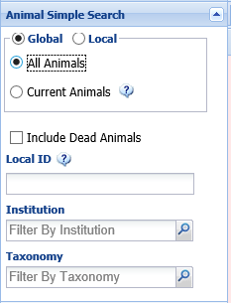
Global Animal Simple Search – Current versus All
The meaning of a Current Animal
search when Global search is
selected is slightly different. For
a Global search this will find all
animals currently held or owned by
Species360 members or those animals
In Transit between facilities. Note
that for Global searches there is
no option to search by Current
Collection.
Selecting All Animals will bring up the
option to Include Dead Animals
which again is not the default and
often overlooked.

Slide 6
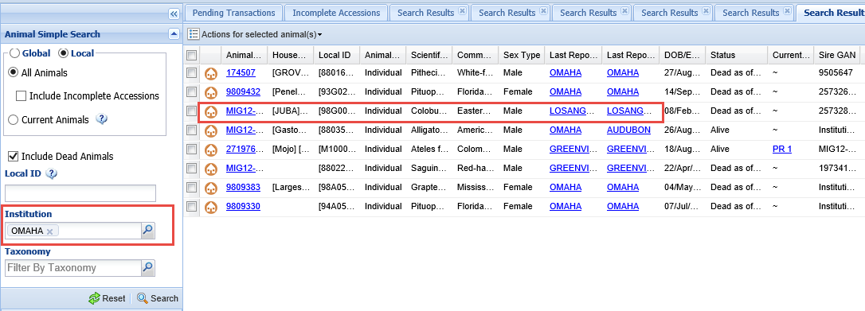
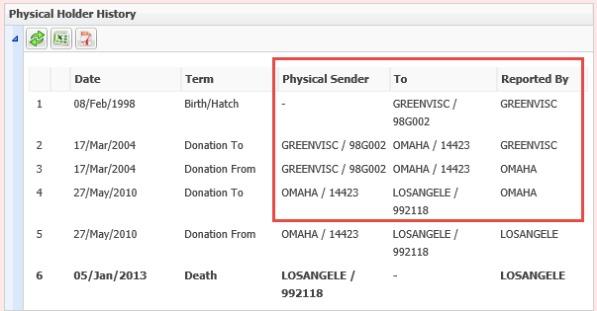
Institution Filter in Local Search
Filtering by an Institution in a Local Search will give you results
for animals that have either come from or gone to that facility.
Here we are searching for animals involving Omaha’s Henry Doorly
Zoo. There is a Colobus monkey whose last owner and holder was
Los Angeles.
Opening that record and looking at the Physical Holder grid you can
see that it was born at Greenville, went to Omaha and then to Los
Angeles.

Slide 7
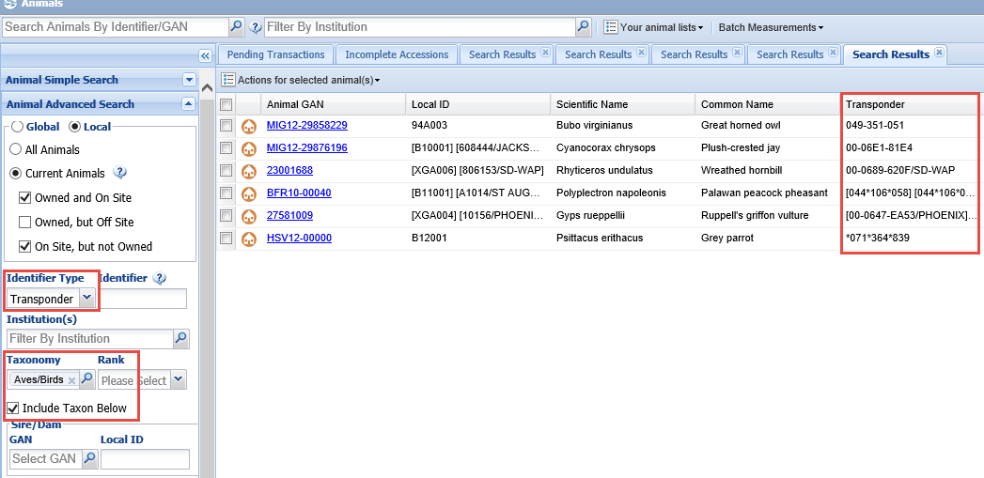
Animal Advanced Search -Identifiers
Animal Advanced Search opens up almost a limitless
Ability to search your animal collection. Your Bird Curator
Wants all birds to have transponders. You can easily find
Which ones have them already by doing on open search
by Identifier Type = Transponder and Identifier = blank.
If selecting a high level of taxonomy such as Aves remember
To check the Include Taxon Below checkbox. Your results
Grid displays all birds who currently have transponders.

Slide 8
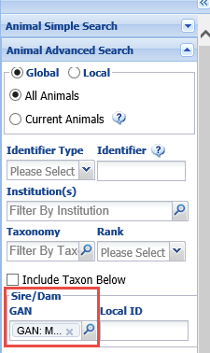
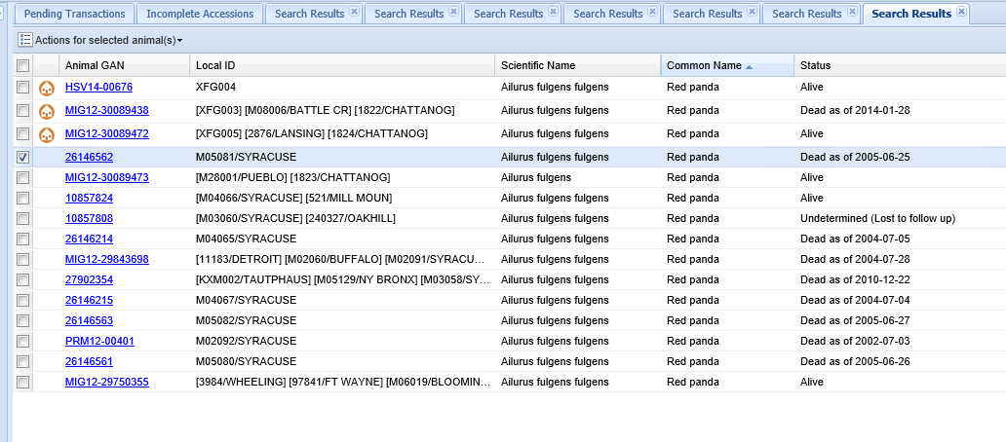
Animal Advanced Search – Sire/Dam
You can also search by Sire/Dam to find any
offspring. The results are filtered by whether
you have chosen Local (Current or All) or
Global (Current or All). Here we are looking
for all the offspring from this animal that
are recorded in the global database.

Slide 9
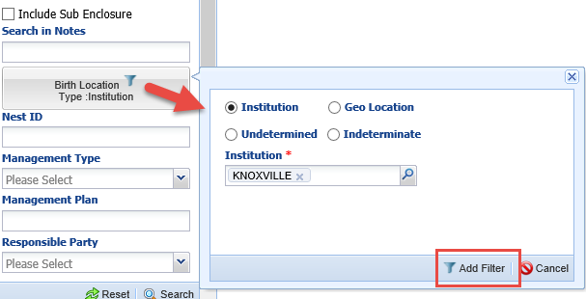
Advanced Animal Search – Birth Location
You can also search for animals born
at a specific location, either an institution
or a geographic area. Here we found all
of our Current animals that were born at
Knoxville Zoo. This screen does not have
a Save button, you need to select Add
Filter to create the filter.

Slide 10
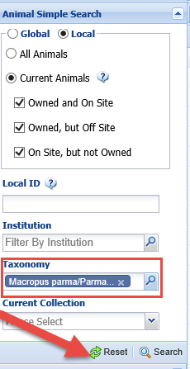
Remember to Reset!
For all of the searches from the left hand search box
REMEMBER TO RESET before doing another search
if you have not closed the Animals module
between searches. Your filters will remain (unless
you edit them) and you may get the No Animal
Found message or incorrect search results.

Slide 11
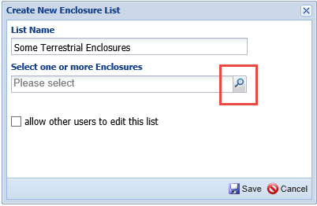
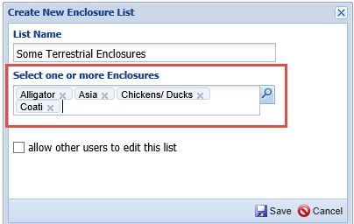
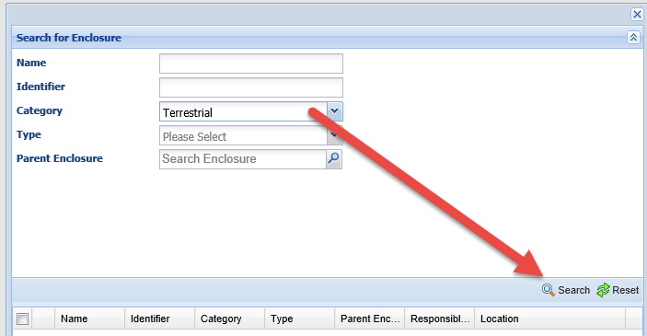
Lookup Assistance
Wherever there is a magnifying glass it is a Lookup
Assistant. Here we are creating a new Enclosure List
for Some Terrestrial Enclosures. Selecting the magnifying
Glass will bring up a screen where you can enter the
filters desired and then Search.
The results will display. Check the appropriate items
and then Select.
Your selections will fill into the field where you
started your search.

Slide 12
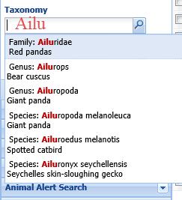
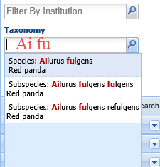
Type Ahead Shortcuts
Many fields are Type Ahead lookups and will
start offering possible selections as you type.
Here we are looking for a taxonomy and have
typed in “Ailu”.
You can find things faster by typing in the
beginning of the words. Here we have typed in
“Ai fu” and our results are quickly further filtered
to what we were looking for.

Slide 13
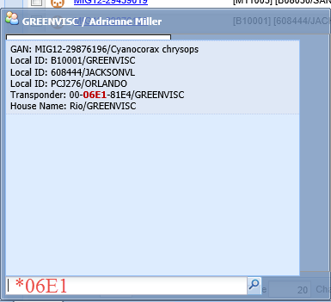
Wild Card
Many searches have Wild Card functionality.
If you do not know the entire entry (here we
are looking at identifiers) you can preface
what you do know with an asterisk (*). Above
we used Animal Advanced Search to find bands
with the number “58” in them. On the left we
used the Start search to find a transponder
that included “06E1”

Slide 14
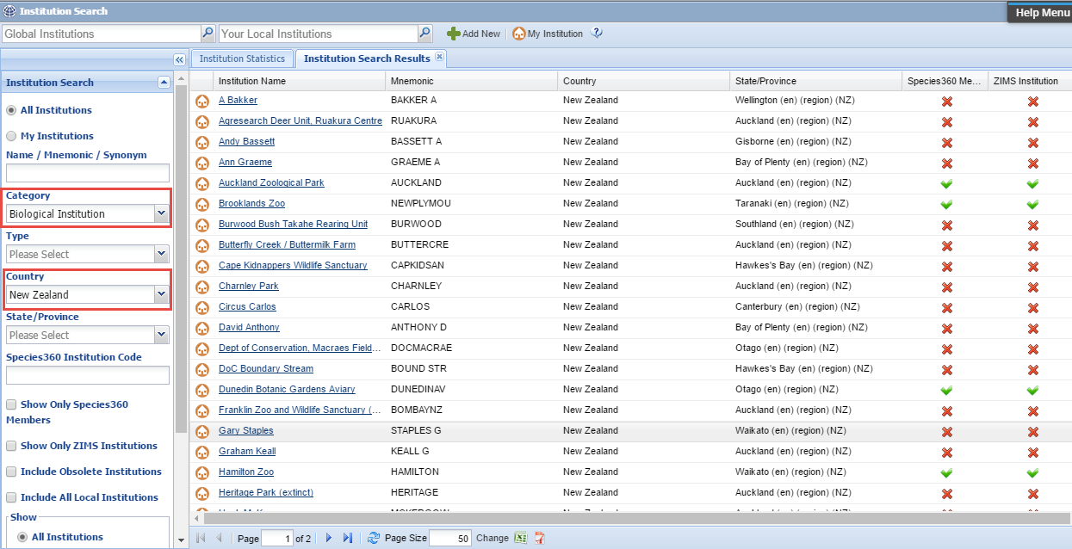
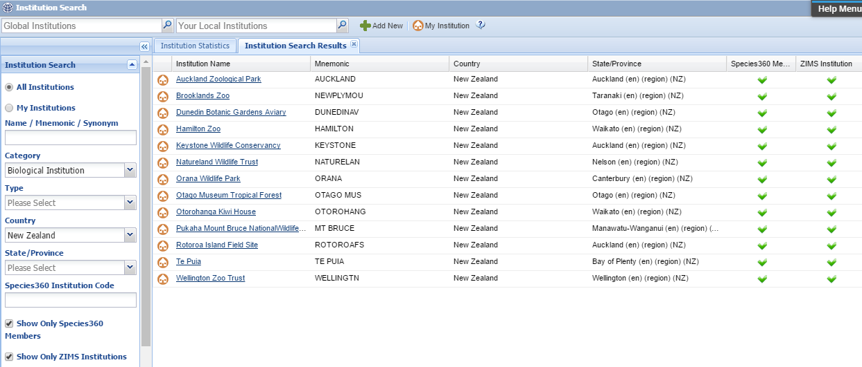
Institution Related Searches – All Institutions
Searching by All Institutions will provide results for globally added facilities and those locally added ones that you may have created. Here we have searched for all Biological Institutions in New Zealand.
If you want to only find those New Zealand institutions using ZIMS you can further refine your search by checking the Species360 Members and ZIMS institution boxes.

Slide 15
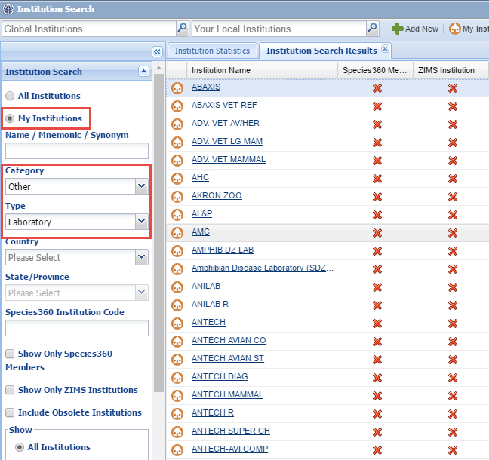
Institution Related Searches – My Institutions
Searching for My Institutions
will find only those local
institutions that you have
added. These are commonly
laboratories or local people
you have animal transactions
with. Here we have searched
all of our locally added
laboratories

Slide 16
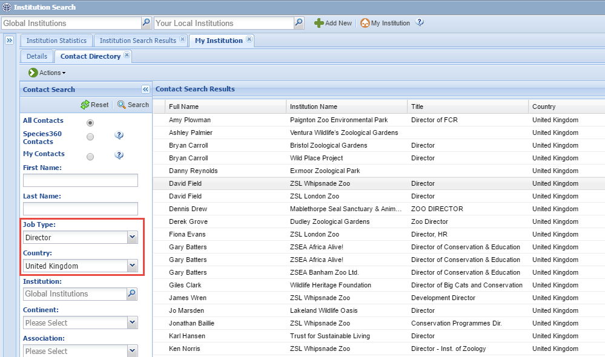
Contact Directory
Searching the Contact Directory under My Institution can save you considerable
time finding colleagues. Selecting Species360 Contacts will find people marked as Visible
Outside My Institution and are maintained by the institutions recording them.
My Contacts are people who have been entered by you and not marked as Visible.
They are visible only to your institution.

Slide 17
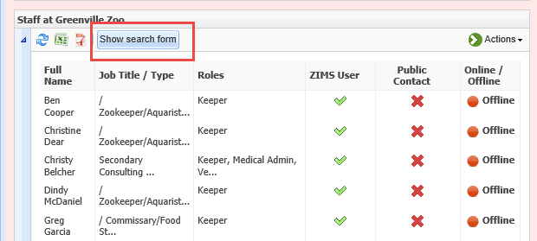
Institution Related Searches – Who has what Role
The Staff Search Form allows you to find
a lot of information regarding your staff.
Should you want to find everyone who has
been assigned a specified Role this is where
you would go. You can also find staff that have
been marked as Obsolete and restore them
as Active. You can also search for what staff
Members are currently logged into ZIMS.

Slide 18
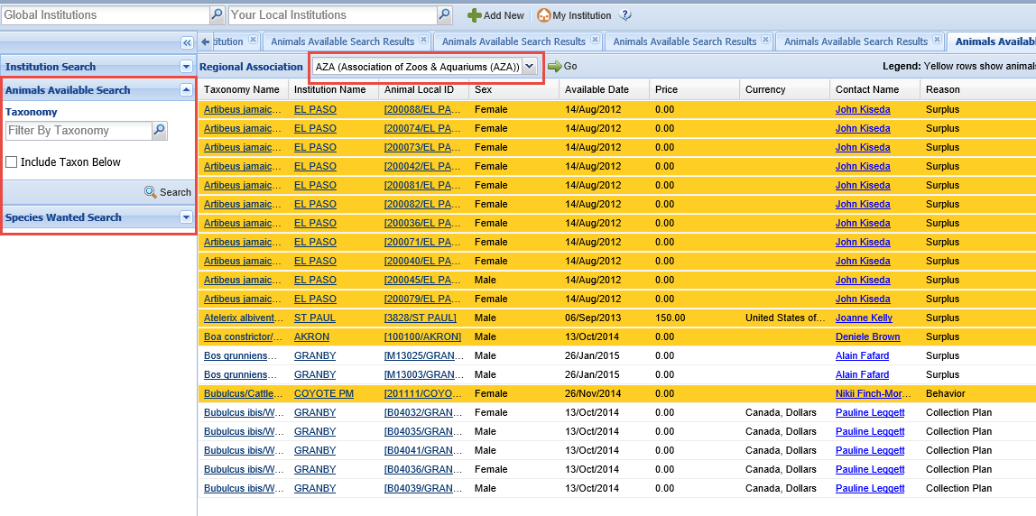
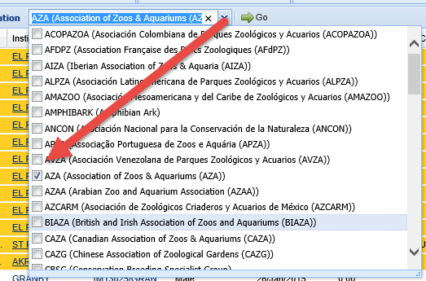
Institution Related Searches – Animals Available/Species Wanted
The default for the Animal Available and Species Wanted searches is the Regional
Association that your institution is a member of. Any animals in your region will
display in orange highlight. To change Associations or clear the filter use the down
arrow and select or unselect as desired. If nothing is checked ALL will display.

Slide 19
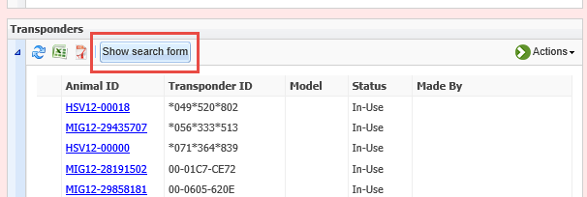
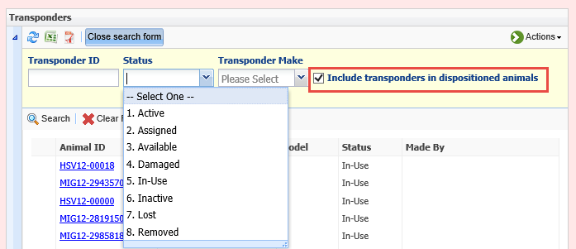
Institution Related Searches -Transponder
From within the Transponders grid in My Institution you can search by many more
options than you can in the Advanced Animal Search box. You can search for all
transponders with a specific status or by a specific maker. One thing that is very
important to get the correct results is to check the Include Transponders in
Dispositioned Animals if you are looking for one that may still be in an animal that
is no longer at your facility or deceased.

Slide 20
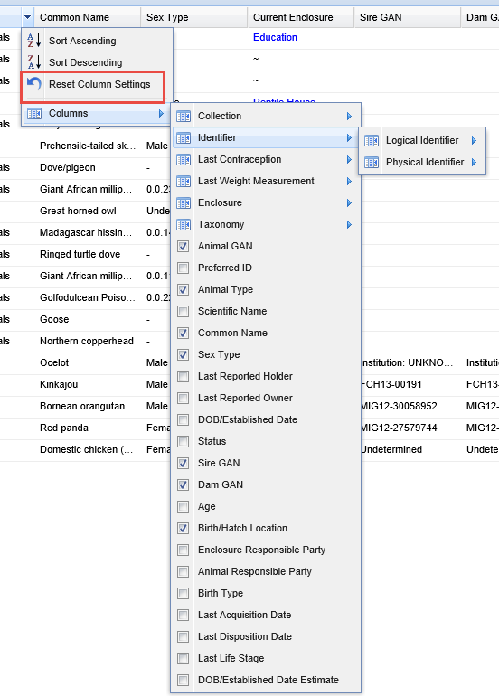
Column Customization
The results of your searches usually
display in results grids. All of these
grids are customizable to some degree.
What columns are set should be retained
when you close the module, so your Keepers
and Curators can each set their own columns
as they need. If you ever want to go
back to the default columns simply
select the Reset Column Settings option.
You can also resize the columns widths
but at this time this does not hold when
the module is closed.

Slide 21
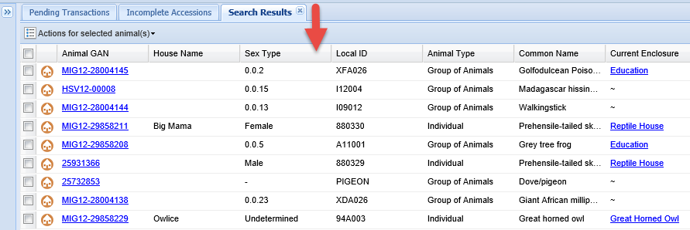
Column Order
The order of the columns can also be changed simply
by dragging and dropping as desired.
This change in order does hold when the module is closed.

Slide 22
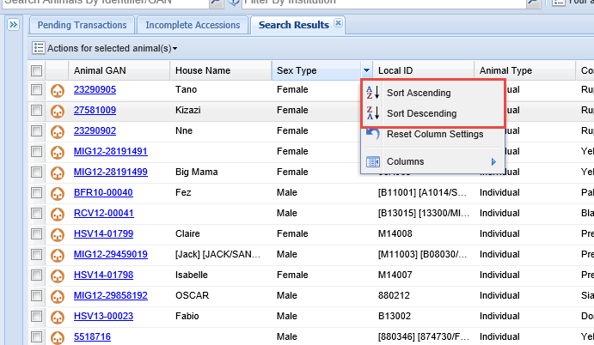
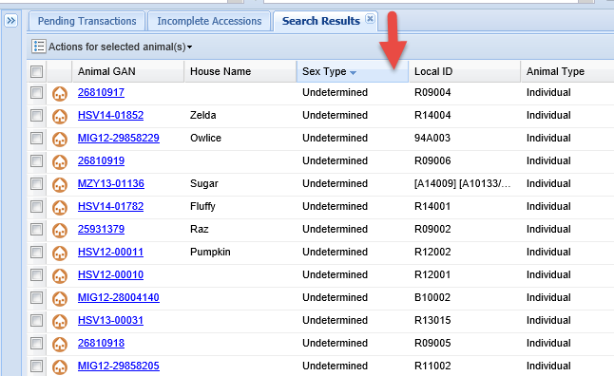
Column Sorting
All columns can also be sorted by
Ascending or Descending Order.
This sort order change does hold when the module is closed.

Slide 23
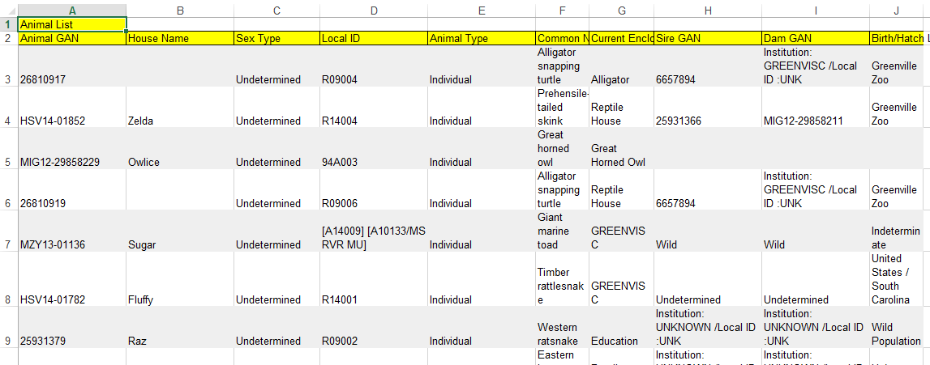
Export Search Results
All results grids can be exported to Excel or pdf. Although both exports will ask you to name the file, you are not required to name it.

Slide 24
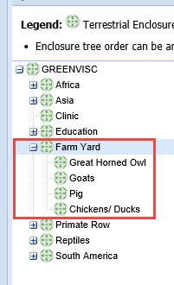
Enclosure Occupants
If you have set up your Enclosure Tree with Parent enclosures that you don’t actually put animals into, when you look at the Occupants tab there will be No Record Found. This is correct.

Slide 25
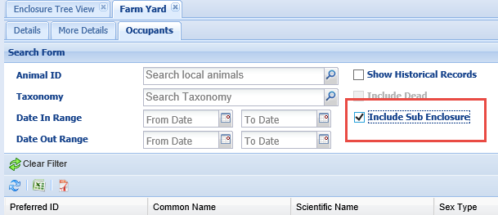
Include Sub Enclosure
What you will need to do is to open the search box using the double
arrows to the right. If you are looking for specific taxonomy or date
ranges complete that information. Then remember to check the
Include Sub Enclosure checkbox.

Slide 26
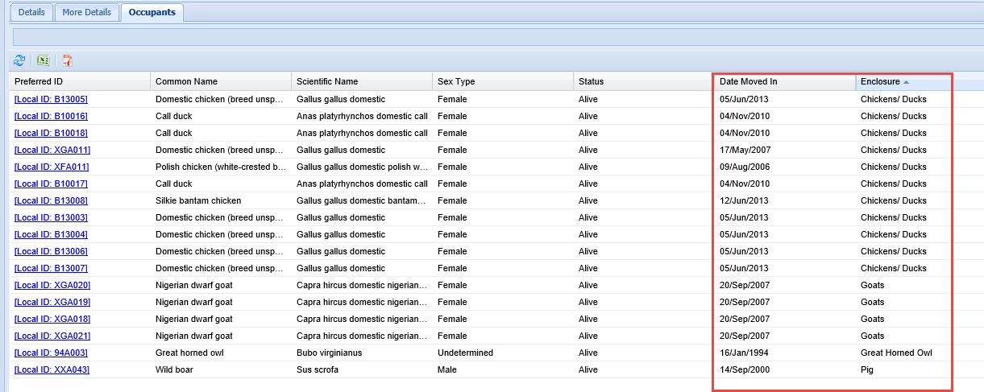
Current Occupants
Your results will display the current occupants of all the Sub Enclosures.
Sorting alphabetically will put them in order.

Slide 27
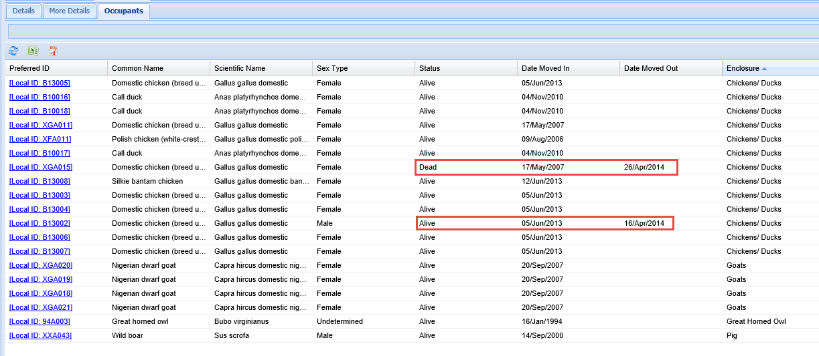
Enclosure Historical Occupant
To find Historical Occupants go back to the search screen
and check the Show Historical Records. If you want to see any deceased animals also check the Include Dead
checkbox. There are two chickens that had been in the
enclosure but are no longer. One is deceased but the
other is still alive.

Slide 28
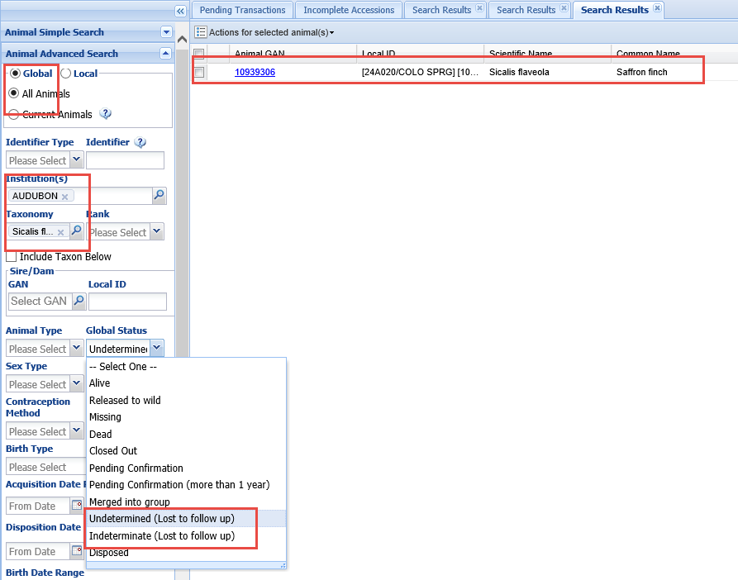
New Animal Search
Sometimes you may receive an animal from a non-Species360 member
but you either know or suspect that it may have been at a Species360
member previously. If you have an identifier to go on it is
easy to do a search for the animal so you do not create a second
record in the ZIMS database. However, sometimes you have less
to go on. In this situation you have received a Saffron finch from
a non-Species360 member. They kindly let you know it had previously
been at a Species360 member institution. We used the following filters
to locate the animal:
Global
All Animals
Institution (if known)
Taxonomy
Global Status of Und or Ind (Lost to follow up)

Slide 29
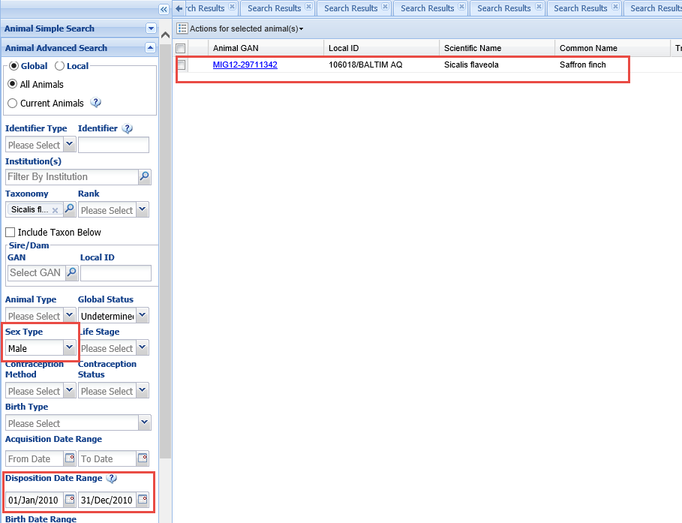
New Animal Search
In this example we do not know the Species360 member institution
that previously held the bird but we have added a couple new
filters to find it:
Sex
Disposition Date Range (the non-Species360 member received it
sometime in 2010 so the Species360 member probably would have
dispositioned it in that year)
In both situations you should confirm with the Species360 member
that you have the correct animal.

Slide 30
Any Questions?
On Successful Searches in ZIMS

