Slide 1
ZIMS Tips and Tricks February 2015
Managing Your Staff
and
My Institution

Slide 2
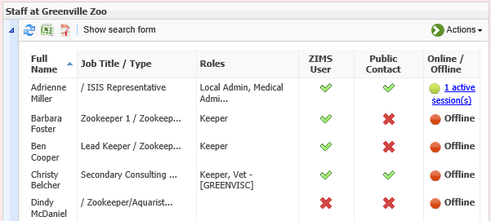
The Staff Grid
The Staff grid displays the full name of the Staff member, the Job Title at your facility,
the Species360 data standard Job Type and any Roles assigned to the Staff member. A green check
in the ZIMS User column indicates that Staff member has been assigned a Role and is a
ZIMS User, a red check means they have not. A green check in the Public Contact column
means they will display Globally for others looking at your institution and they can be found
using the Contact Directory. Any Staff actively using ZIMS will display as Active in the
Online/Offline column.

Slide 3
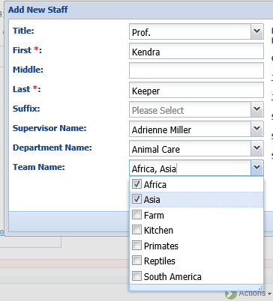
Adding Staff Members
To add a new Staff member select Add New Staff
under the Actions button in the Staff grid.
It can be tempting to only enter the mandatory fields (First and Last Name), but there is a lot of other information that can be recorded that can help you to better manage your staff. Both the Department and Team fields are multiple select, allowing a staff member to be assigned to more than one. Both Teams and Departments can also be assigned from their respective grids in My Institution.

Slide 4
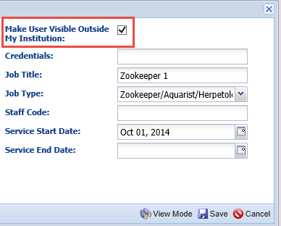
Adding Staff Members
If you check the Make User Visible
Outside My Institution box then others
will be able to find them in the Contact
Directory. It is up to your institution
to determine who they want visible,
but it makes it easy for your colleagues
to find contacts at your institution. Also,
if this box is checked the Staff member
will display on the Global level at your
facility in the Staff grid. The Job Title is a
free text field to enter the various titles
at your facility. The Job Type is a multiple
select data standard. The Staff Code may
be used but it is not a searchable field.
The Start and End Date may be useful as
human resources functionality. Adding
an End Date does not automatically
lock the Staff member out of ZIMS and
their name continues to appear in lists
for Recorded By and Responsible Party.

Slide 5
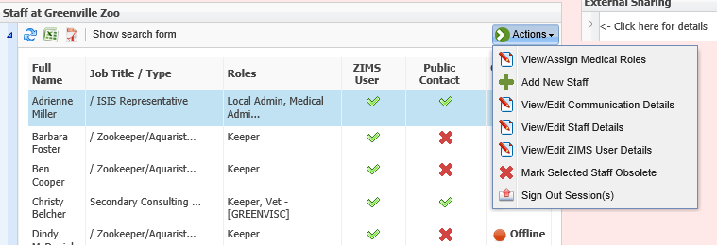
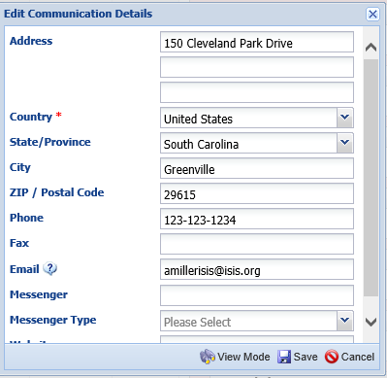
Communication Details
From within the Staff grid there are many
actions you can perform. You can add
Communications details for your Staff to
make it easier for others to contact them.

Slide 6
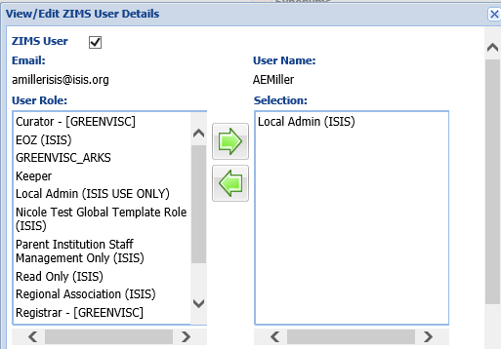
ZIMS User Details - Assigning Roles
View/edit ZIMS User Details is
where you assign the ZIMS Role(s)
to the Staff member. The ZIMS User box must be checked to activate this screen. The email and the User Name must be unique within ZIMS. The email can be edited but the User Name cannot. Any Role with (Species360) at the end is an Species360 template Role and cannot be edited. A Role without (Species360) at the end is a custom Role that has been created at your facility. These can be edited.
To assign a Role simply double click on the Role in the left box, or highlight it and use the arrow to move to the right box. The Role(s) that remain in the right box will be assigned to the Staff member.

Slide 7
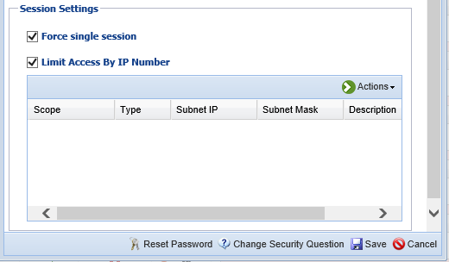
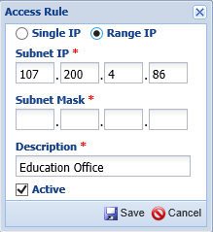
ZIMS User Details – Staff Security
In the bottom half of that screen you can
select to Force Single Session.
This restricts the User from logging
into ZIMS from more than one
computer at a time. This can also be
set at the institution level for all
Staff using Institution Preferences.
You can also limit access by IP Number
using Single IP or a Range. You will
usually get this information from your
IT person. If it is Active remember to
check the box. IP addresses can also
be restricted for all staff at the institution
level using Institution Preferences.
However, THIS IS NOT RECOMMENDED
as there is too high a possibility that
you may actually be locked out of ZIMS
should it change.

Slide 8
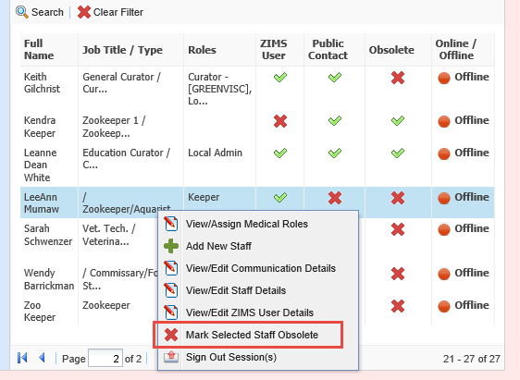
Making Staff Members Obsolete
For those circumstances when you do NOT want the Staff member to continue to have access to ZIMS or have their name appear
in drop down lists you will need to mark them as Obsolete using the Actions button selections. You can also stop access to ZIMS by removing their Role.
To find Staff marked Obsolete you can use the Search Form and check the Include Marked Obsolete box.

Slide 9
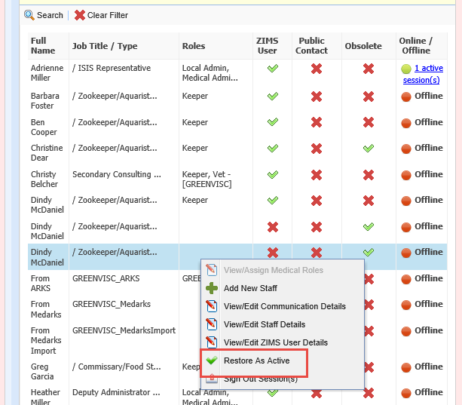
Obsolete Staff
When you Include Obsolete
in your search results a new
column “Obsolete” will appear.
You can see that three Staff
members are marked Obsolete.
You can make them Active again
by selecting the Restore as
Active option.

Slide 10
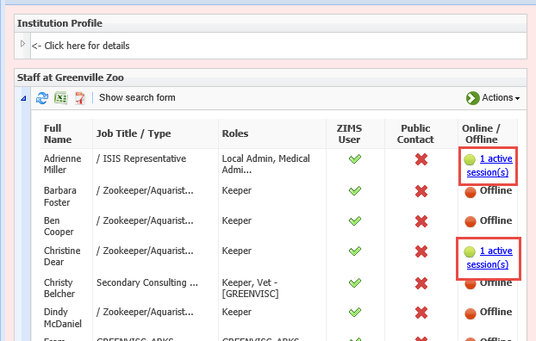
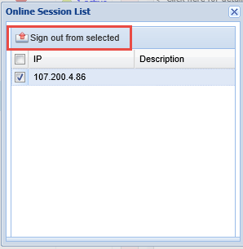
Active Sessions
In the Staff grid you can
view who is currently
using ZIMS. Both Adrienne and Christine are using ZIMS. Selecting the Active Sessions hyperlink you can see
the IP address where they
are signed in. By selecting
Sign Out From Selected you can actually end their
session. If you do NOT sign out and just close ZIMS, your session will remain as Active.

Slide 11
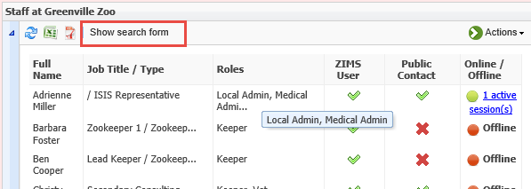
Staff Search
You can search for your Staff
members using the Show
Search Form selection at the
top of the Staff list. You can
search by Staff Name, Job
Title (this includes searching
by Job Type), ZIMS Role,
Department and Team.
Here we are searching for
all our Staff members who
have been assigned the
ZIMS Role of Keeper.
Selecting Include Marked
Obsolete can expand your
search and selecting Show
Online Users Only will
restrict it only to Staff
Members who are logged
into ZIMS.

Slide 12
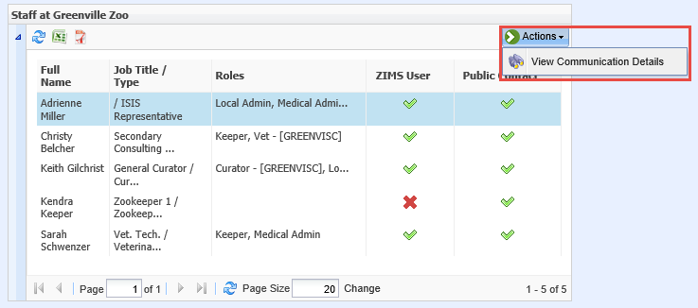
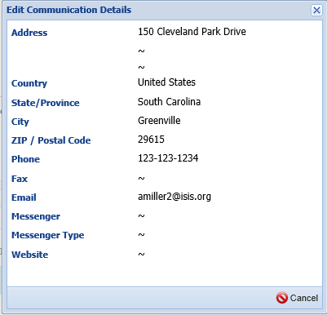
Global Staff Grid
If you have marked a Staff member as visible outside
your institution they will appear in the Staff grid in
the Global view of that facility.
Selecting View Communications Details will open a
screen with the information you have entered, making
it easy for colleagues to find and contact each other.

Slide 13
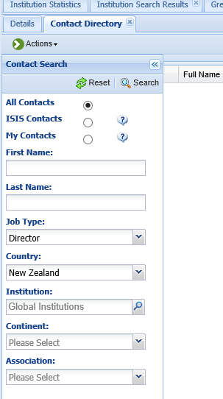
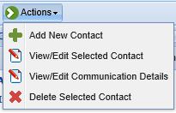
Contact Directory
Another way to find Staff that are marked as visible
outside their institutions is by using the Contact
Directory in My Institution. Selecting All Contacts will
find all appropriate contacts in your directory. Species360
Contacts are visible to all Species360 community and
maintained by the Institutions that created the
record. My Contacts are visible only to your institution.
You would add a Local contact by using the Add New Contact option under the Actions button. This is also where you can Edit any Local Contacts or View Communication Details for a selected Contact.

Slide 14
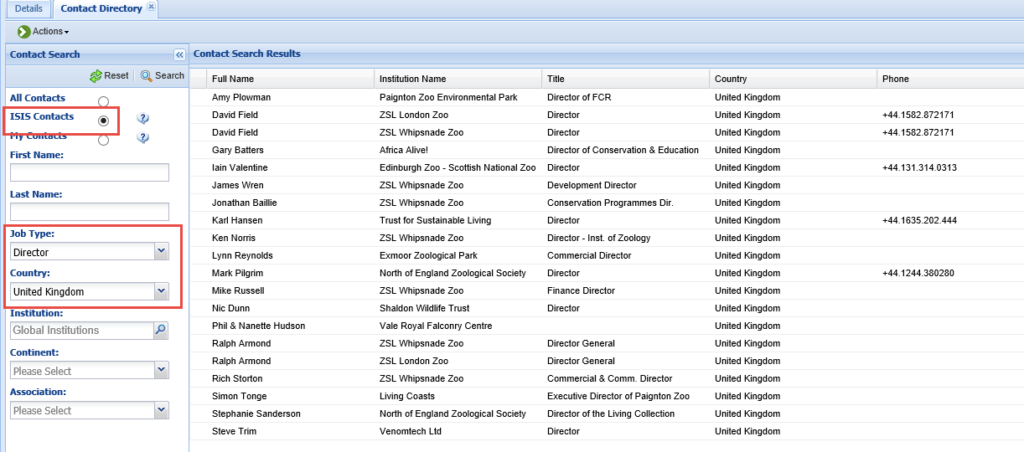
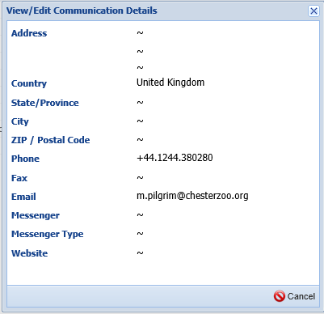
Searching Contacts
Above we have searched for all Species360 Contacts who are Directors in the United Kingdom.
To find further details we can select to View Communications Details where we can find email addresses. The Contact Directory helps colleagues connect quickly.

Slide 15
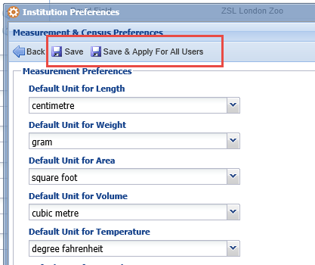
Institution Preferences – Impact on Your Staff
In Institution Preferences you have the option to Save or Save and Apply to all Users. It is important to understand the difference between these two options. When new Staff are added their preferences will default to
what is recorded under Institution
Preferences until they go into My
Preferences and select their own which will
over-ride what was set in Institution Preferences. If The Local Admin changes the Institution Preferences and selects Save, no preferences set by your Staff in My Preferences will be changed. HOWEVER!! If they select Save & Apply For All Users the Institution Preferences will over-ride any My
Preferences set by your Staff. Be careful how
you use this Save option!

Slide 16
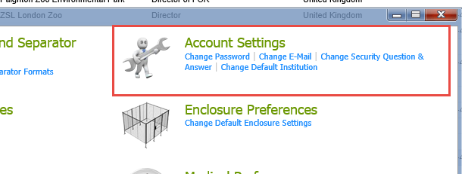
My Preferences for Staff
Some of the options in My Preferences will actually help your Staff to manage
themselves. They can change their own Passwords. Unlike when Local Admin
changes their Passwords for them, the Staff will need to know what their current
Password is. This is where you can change your own email address. This cannot be
done from the Staff details screens. For institutions with Parent and Child
relationships and your Staff member has access to several Institutions, they can
change the default institution here.

Slide 17
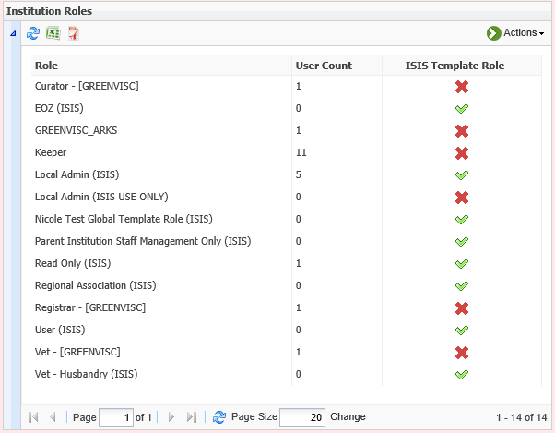
Template versus custom Roles
Your Institution Roles grid
will display all Roles available
at your facility. Any Role with
(Species360) at the end is an Species360
Template Role and cannot be
edited. A Role without (Species360)
at the end is a Custom Role
that has been created at your
facility. These can be edited.
You can also see which are
template roles in the Species360
Template Role column where
Species360 templates have a green
check. When new functionality
becomes available Species360 will
update the appropriate Species360
Template Roles. Your Custom
Roles will have to be updated
by you with any new functionality.

Slide 18
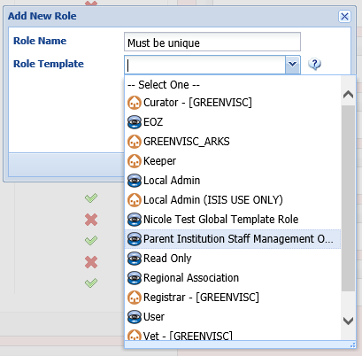
Creating Custom Roles
If the Species360 Template Roles do not meet your
needs for your Staff you will need to create
Custom Roles. Select Add New Role option
under the Actions button. The name must
be unique. You then have two options. One,
you can select a Role already created, either
an Species360 Role or a Local Role. If you select a Role
Template, all of that Role’s functionality will be
copied over into the new Role but can be
edited. Your second option is to not select a
Role Template and instead start with a clean
slate.

Slide 19
Creating Custom Roles
To create your Custom Role you will select Manage Role Access from the
Actions button. View/Edit will allow you to change the Role Name only.
You cannot Delete a Role that has any Users assigned to it. You will need
to first delete that Role from the User before being able to Delete the Role.

Slide 20
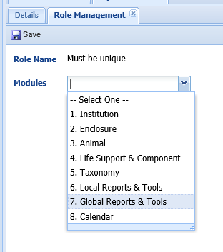
Creating Custom Roles
To create the role you will need to go into
each of the eight modules and select what
access (Search/View, Edit, Add or Remove)
that you want that Role to have.

Slide 21
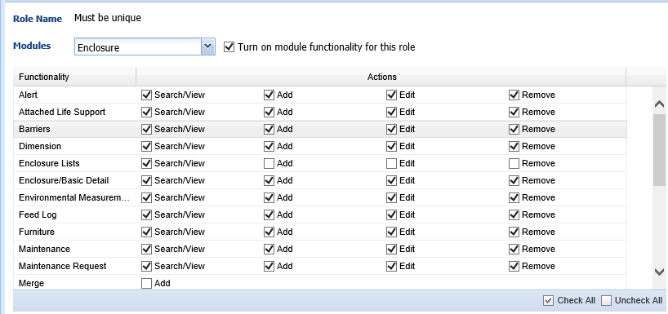
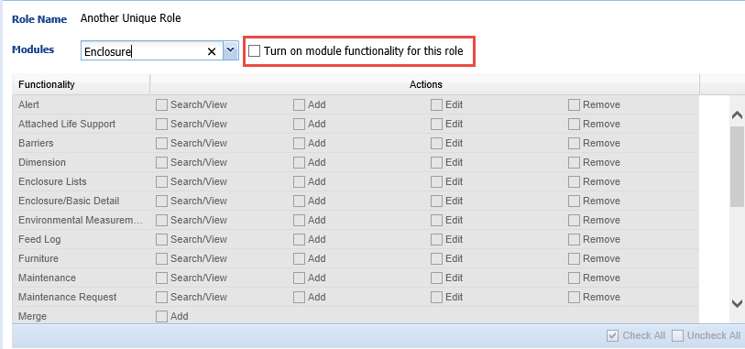
Creating Custom Roles
For the Custom Role in the upper left you have selected a Template to build your new
Role off of. You will check or uncheck as desired. In the Custom Role on the lower right
you have not selected a Template to build your Role off of. You will need to check the
Turn On Module Functionality for this Role to activate the checkboxes. You will then
check access as desired. After you assign this Role to a Staff member it is a good idea
to sign in as them and check that they have access or do not have access correctly.

Slide 22
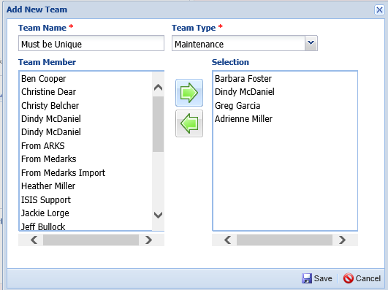
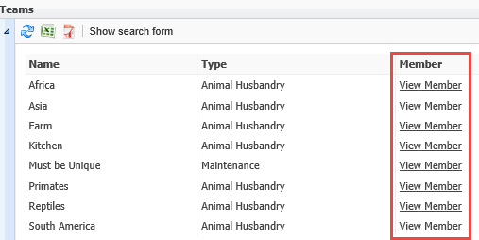
Teams
Creating Teams and Departments
are another way to manage your
Staff by dividing them into units.
The Team Name must be unique.
The Team Type is a data standard
dropdown list. Selecting Team
Members is identical to assigning
Roles. Simply select the name from
the left Box and move to the
right box.
The Teams will display in the Team
Grid. To see the Team members
select the View Member hyperlink.
Staff can also be added to a Team
using the Staff Details screen from
the Staff grid.

Slide 23
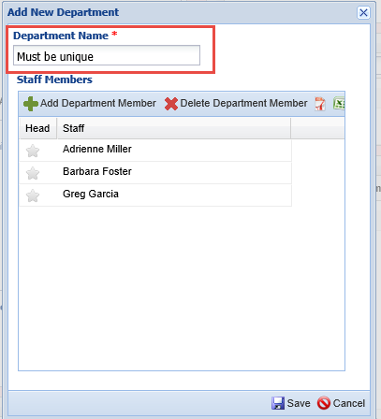
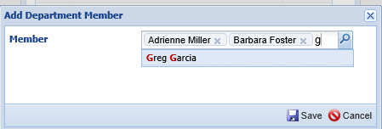
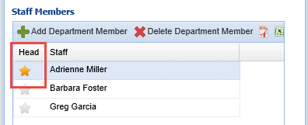
Departments - Members
For Departments you simply name them and record the members, there is no Type for Departments.
Adding Members is similar to
creating lists, just type the name and select it, then type the next name and select.
You can indicate the Head of a Department by simply clicking on the star to the left. If you are using Advanced Access Management (AAM), Departments are where you
would manage Staff access for this additional feature as each
Department is assigned specific
AAM access.

Slide 24
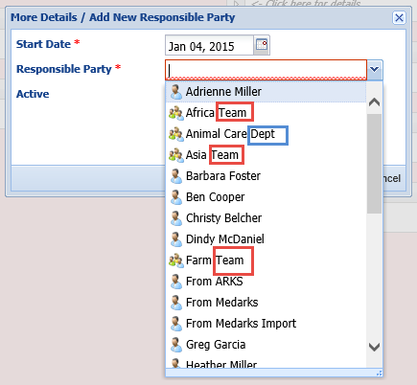
Responsible Party
Individuals, Teams and Departments can all be selected as Responsible Parties. A single person icon is an Individual. A trio is a Team or a Department. Because I added the appropriate term to the end of my Teams and Departments I can tell them apart in this list. How you use Responsible Parties is up to your facility.
Checking , or unchecking the Active box allows you to track how the
Responsible Party has changed over time.

Slide 25
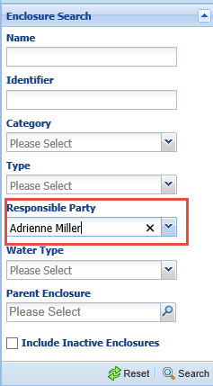
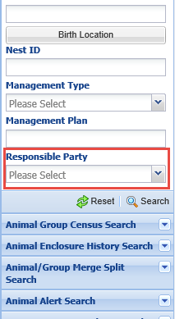
Searching for Responsible Party
You can search for Responsible Party
in any module they can be assigned.
On the left we are using Enclosure
Search to find all enclosures that
Adrienne Miller is responsible for.
To search in the Animal module you
will need to use the Advanced Animal
Search where it is found at the
bottom as shown on the right. Both
Active and Inactive results will be
found.

Slide 26
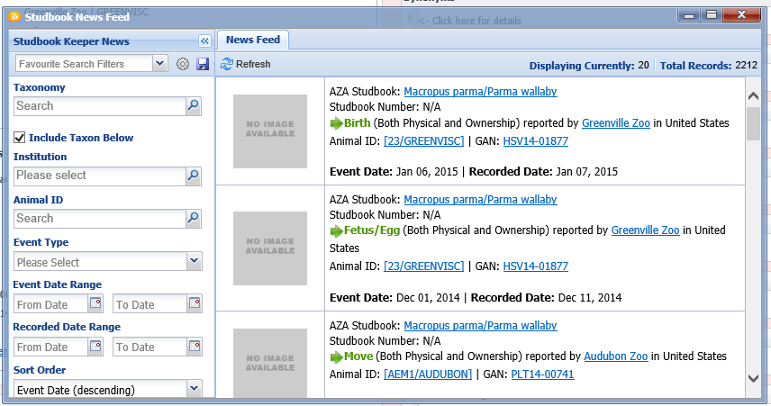
Studbook News Feed
The Studbook Keeper News Feed provides valuable information on their species for those Staff members who are also Studbook Keepers. For a Staff member to get access to the News it is a two step process. First, they must have a ZIMS Role at your facility. An Eye on ZIMS (view only) Role is sufficient for getting access to the News Feed. Second, they must be assigned as a Studbook Keeper at their Regional Association or Global Level. This step is done by either the Regional Association or Species360 staff. If the Studbook Keeper is recorded as a staff member but not a ZIMS User, the studbook can still be assigned to them and their name will display in the Studbook Keeper grid in the Taxonomy module, but they will NOT have access to the News without a Role.

Slide 27
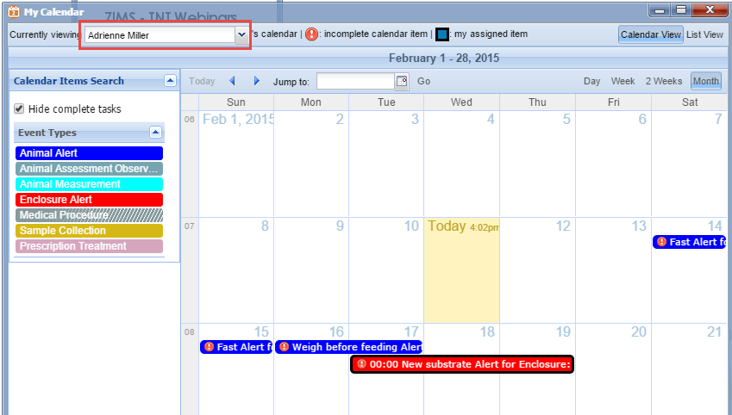
Scheduling Tasks - Calendar
You can also help manage your Staff’s time and activity by using Alerts from within the
Animal or Enclosure modules or from within the My Calendar itself. Above we are looking
at Alerts for Adrienne Miller who is part of the Animal Care Department and the Africa
Team. The Enclosure Alert was assigned directly to her. The Fasting Alert was assigned
to the Africa Team and the Weigh Alert was assigned to the Animal Care Department.
When viewing her Alerts she will view all associated with her.

Slide 28
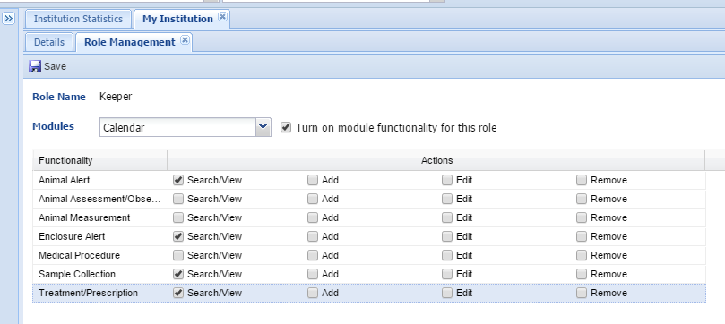
Calendar Access
Access to what is viewed in the Calendar can be controlled via the Calendar
module in Roles. This Role can only view Animal and Enclosure Alerts, Sample
Collection and Treatment/Prescription. Other medical related Alerts are not
visible to anyone assigned this Role.

Slide 29
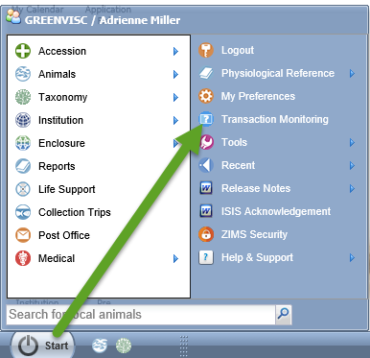
Transaction Monitoring
You can monitor your Staff’s ZIMS activity
using Transaction Monitoring found under
the Start menu.
The Session History will display the User,
the Start and End Date and Time, how long
they were in ZIMS, if they performed any
Transactions (additions, edits or deletions)
and from what IP address they had signed in.

Slide 30
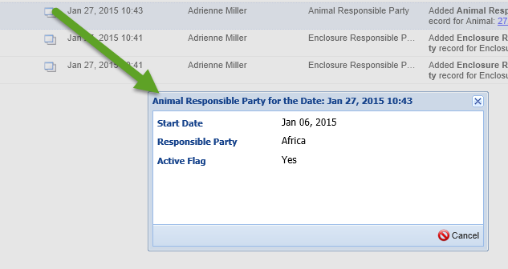
Transaction Count Hyperlinks
The Transaction Counts are hyperlinks that will open the screen to let you see
what was recorded. During this session I edited a Role, changed some User
Preferences and added some Responsible Parties for both Animals and
Enclosures.
Double left clicking on the left side notebook icon will display the details. For
the Animal I added the Africa Team as a Responsible Party.

Slide 31
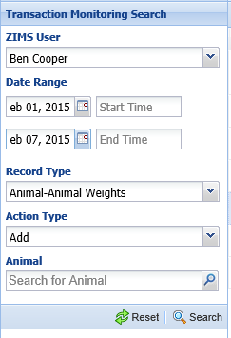
Transaction Monitor Search
Using the left hand Search box you can
filter your search to find specific actions
(record types) or find what certain
Staff members have been recording.
Here we are seeing if any weights were
added by Ben Cooper during a week’s
range. This is handy to find if specific
tasks, such as recording monthly weights,
have been accomplished.

Slide 32
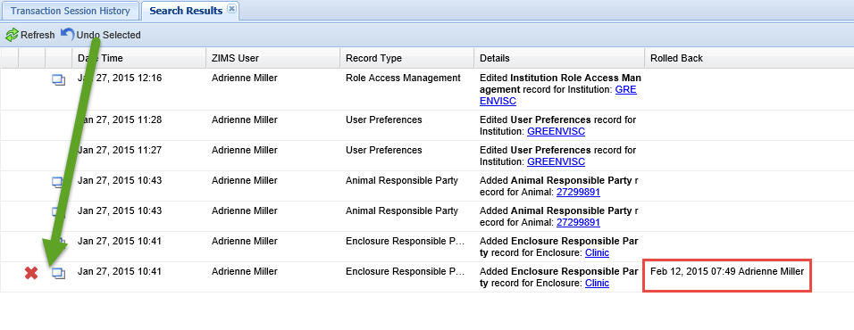
Roll Back (Undo Selected)
Should something have been entered incorrectly you can select to Undo
Selected. This will remove the transaction from ZIMS and record when
and who Rolled it back in the grid. Be VERY CAREFUL! You do not get a
Warning and Rolled Back actions cannot be undone.

Slide 33
Any questions?
On Managing Your Staff in ZIMS

