Slide 1
ZIMS 2.1 Update October 2014

Slide 2
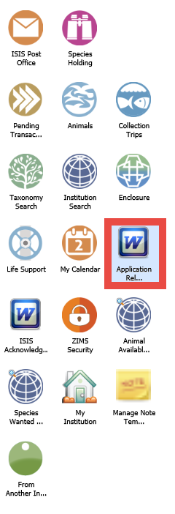
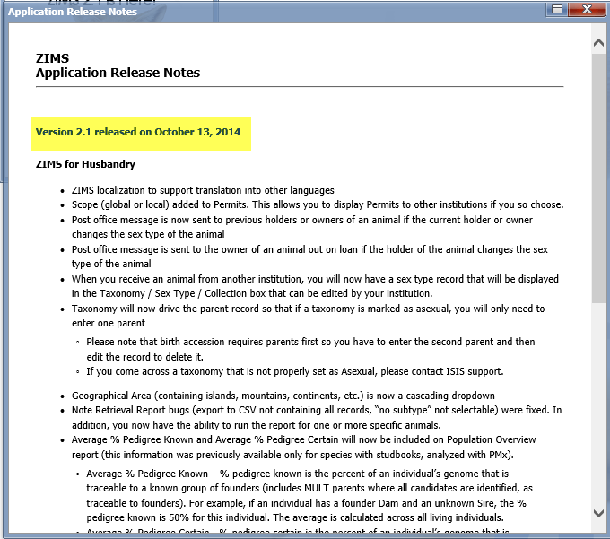
What’s New?
This is the 10th ZIMS update since we rolled out the current version of ZIMS in April 2012!
This release has new functionality for both the Animal Husbandry and Medical modules. Much of the new functions are continuing to get everything that was present in the legacy software of ARKS and MedARKS incorporated.
In addition, several enhancements that have been popular requests are included.
As always, your first step should be to read the Application Release Notes which will detail what is new so you don’t miss anything.

Slide 3
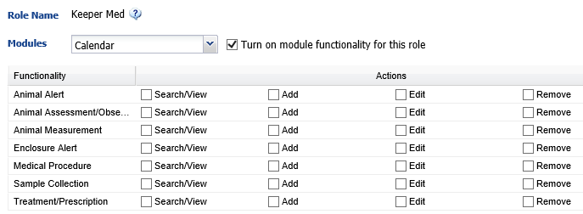
Check Your Roles
The second thing you should do is check the accesses of your Roles. For the Species360 template Roles we will add access for new functionality to the best of our knowledge for what the Role typically should have. If for some reason you do not want that access given to someone with a template Role you may need to create a custom Role. For any custom Roles the new functionality will not be added and you will need to do that yourself. For example, the Species360 template Role of Medical Admin (top) has been automatically updated with the new Calendar functionality to be discussed later. The custom Keeper Med Role (bottom) will need to be updated as appropriate.

Slide 4
ZIMS Localization for Translation for Husbandry and Medical
ZIMS is being translated into Spanish!
Thanks to Myriam Salazar, Species360 Regional Coordinator Latin America and Spain and volunteers:
Carolina Holguín, Africam Safari
Erika Servín Zamora, Chapultepac Zoo and Wildlife and Zoos main office in Mexico City
Angélica Moreno, Piscizoo
Erendira Real, Zoológico de Morelos

Slide 5
Husbandry Updates

Slide 6
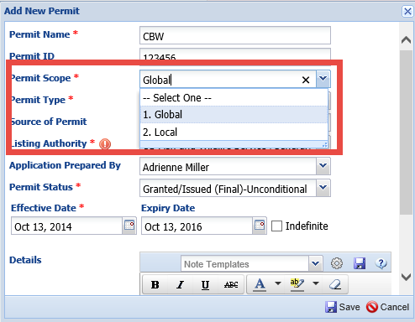
Permit Scope
The ability to select a Local or
a Global scope for your permits
has been added. If a permit scope
is Local it will display only in the
Permits grid for your facility. If it
is marked with a Global scope
then it can be viewed by others
from the permit grid when they
are viewing your institution
information. This saves time in
waiting for this information to be
received from other facilities.

Slide 7
New Post Office Messages
Sent to previous Holders or Owners of an animal if the current Holder or Owner changes the Sex Type
Sent to the Owner of an animal out on loan if the Holder of the animal changes the Sex Type
Older animals are usually easier to sex
No actions are required, just FYIs as you may now see a red conflict
If you DO decide to change your record confirm WHY the institution changed it

Slide 8
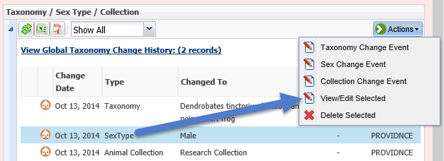
Editable Sex
When you receive an animal from another Institution you will now have a Sex Type record that can be edited by your facility. Previously there was no Sex recorded by your
facility as the receiving institution.
This lead to confusion about how to
change it if incorrect.

Slide 9
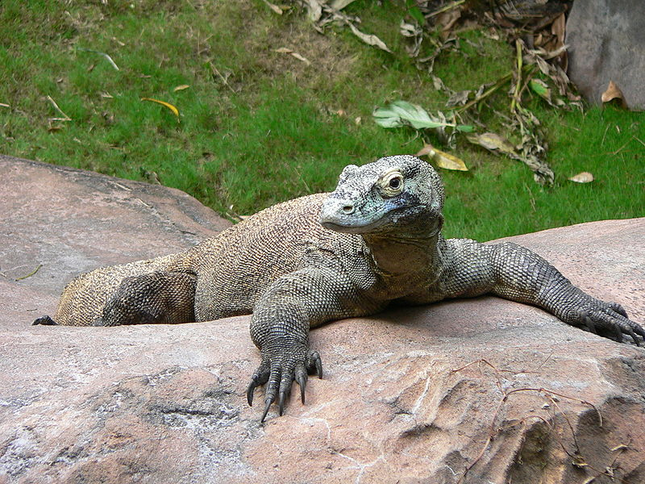
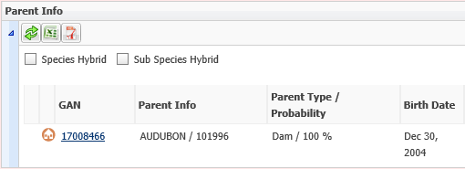
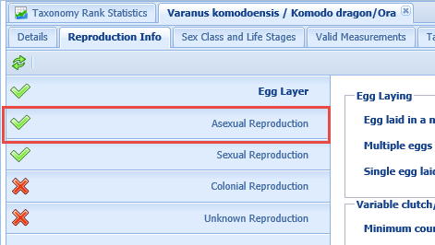
Asexual Taxonomy
If taxonomy is Asexual you will only need to enter one parent. Formerly the Business Rule was that all animals needed to have at least one Sire and one Dam recorded
Birth Accession requires parents first so you will need to enter second parent (the same animal)and then edit the record to delete it
Contact Species360 if you find one improperly set

Slide 10
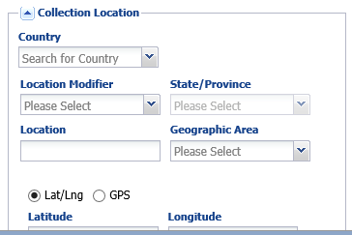
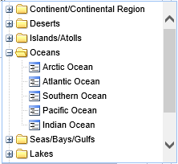
Geographic Area is Cascading
Geographic Area is now a
cascading dropdown. This
allows you to select from and
stop at the higher levels such
as Deserts, Islands, or Oceans,
or expand to select the specific
area.

Slide 11
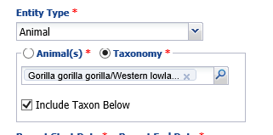
Note Retrieval for Specified Animals
The Note Retrieval Report
is no longer limited by Taxonomy.
You can select one or more
specific records to run it for
by selecting the Animal(s)
radio button. It can still be
run by Taxonomy by selecting
the Taxonomy radio button.

Slide 12
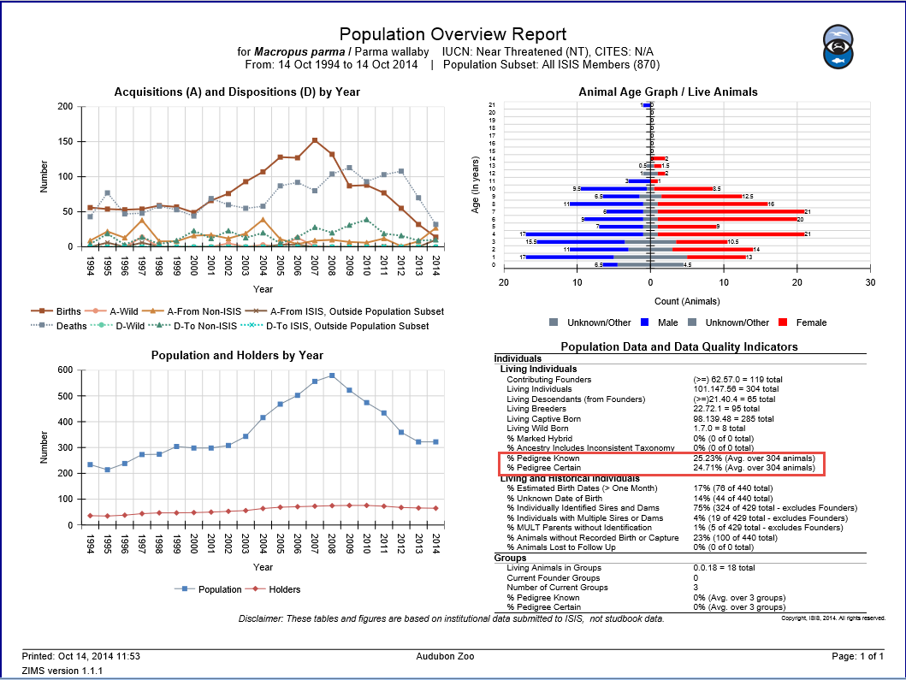
Average % Pedigree Known and % Pedigree Certain
The Average % Pedigree Known
and Average % Pedigree Certain
is now included on the Population
Overview Report.

Slide 13
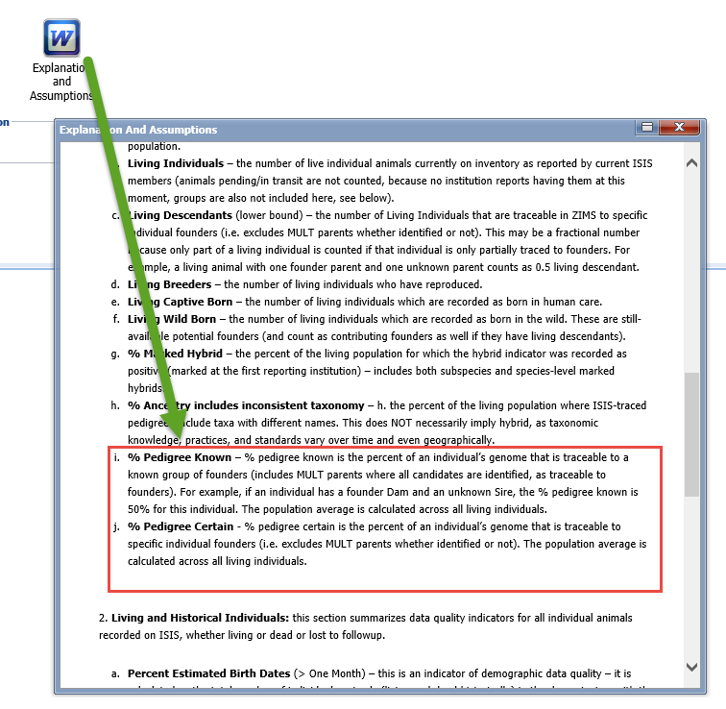
Explanations and Assumptions
To understand what these percentages mean make sure to read the Explanations and Assumptions that help you understand and interpret the
report.

Slide 14
Specimen Report – Ancestry Information
This information is also displayed on the Specimen Report. Looking at Pedigree Explorer for
this animal you can see why the % Known and the % Certain are 75% because the great
Grandparents on the dam’s side are Unknown. Seeing this information on a Specimen
Report may pique interest in trying to clear up unknown pedigrees where possible.

Slide 15
Pending Transactions – Not Recorded in ZIMS
A new option for Pending Transactions
is “Not Recorded in ZIMS”. This means that
you agree the transaction occurred but you
have not recorded or will not record the
animal(s) involved into the ZIMS database.
If an institution you send an animal to
selects this option the status of the animal
will be Undetermined (Lost to Follow Up).
If an institution you have recorded receiving
an animal from selects this option there will
be no records of this transaction in their
Local database.

Slide 16
New Advanced Search Fields
Search by Sire or Dam
Finds offspring regardless of location
Search by Collection
Finds animals currently in the specified Collection(s)
Include Historical checkbox
Search by Nest ID
Finds animals by Nest ID
Search by Management Type
Into/Out Of/Surplus
Search by Management Plan
Free text field

Slide 17
Improvements to AA and SW
Species360 has been working with EAZA to make
improvements to Animals Available and
Species Wanted to allow EAZA to replace
their current animal exchange listings
with the functionality in ZIMS. They now
appear as icons on the ZIMS desktop. If
you do not wish to view them there you
can right click and opt to Remove them.
You can remove any of the default icons
on your desktop as all topics except for
Pending Transactions are also found
under the Start menu.

Slide 18
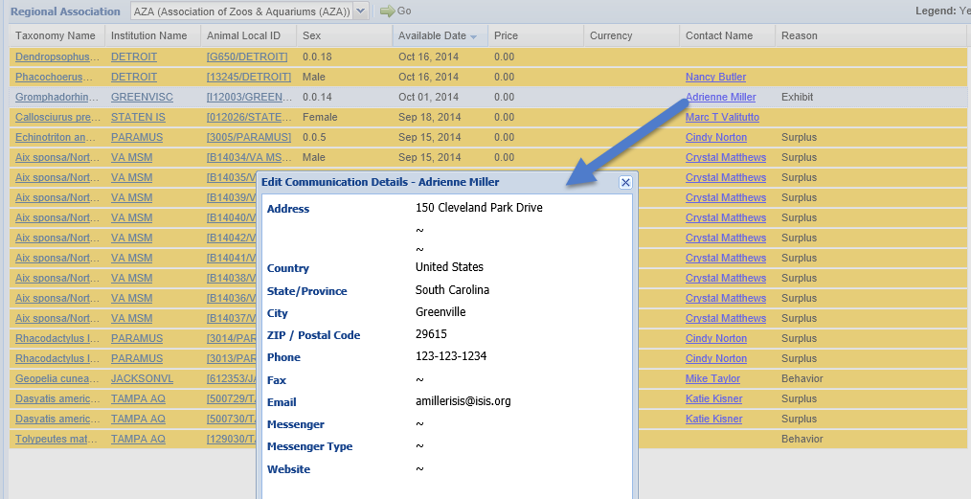
Improvements to AA and SW
The Contact Name is now a hyperlink to the information provided in the
Staff Communications area by the institution. This is another good reason
to complete these screens with as much detail as possible.

Slide 19
Improvements to AA and SW
If a group of animals is advertised as Available the count will display in the
grid.
Should the count of that group change after being recorded as Available the
count will automatically update in the grid. You no longer need to remember
to update it.

Slide 20
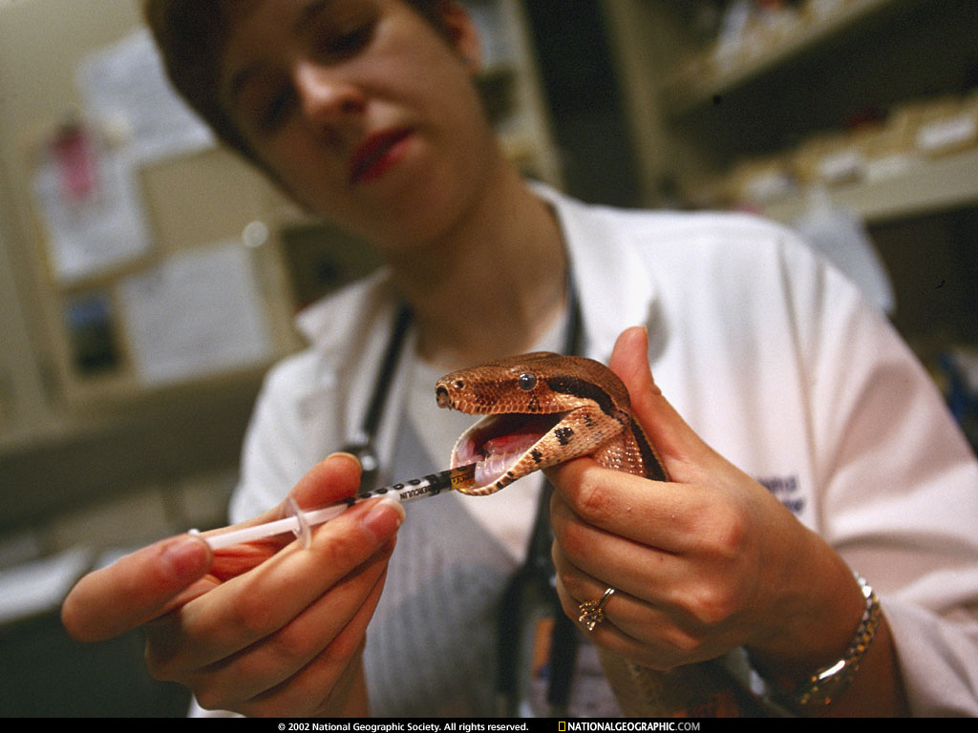
Medical Updates

Slide 21
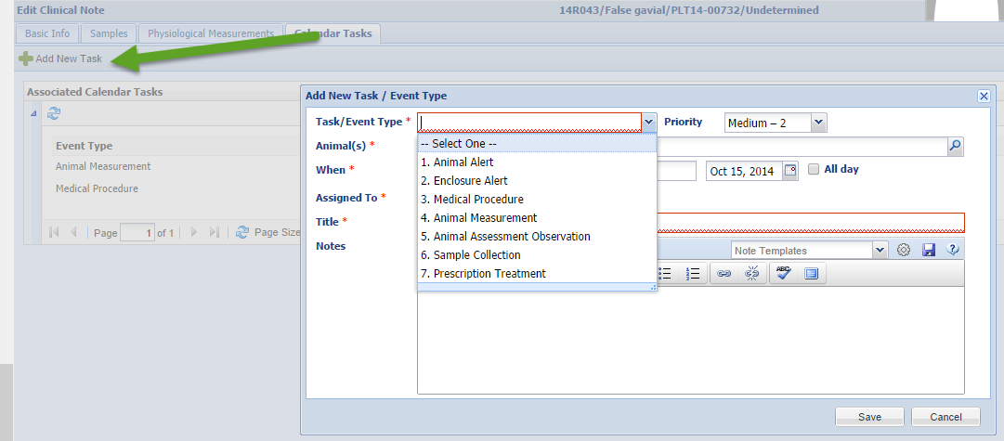
Scheduling Functionality
In the Clinical Notes module by selecting the Calendar Tasks tab you can
schedule multiple topics to display in My Calendar. You can also schedule
Sample Collection from within the Samples module.

Slide 22
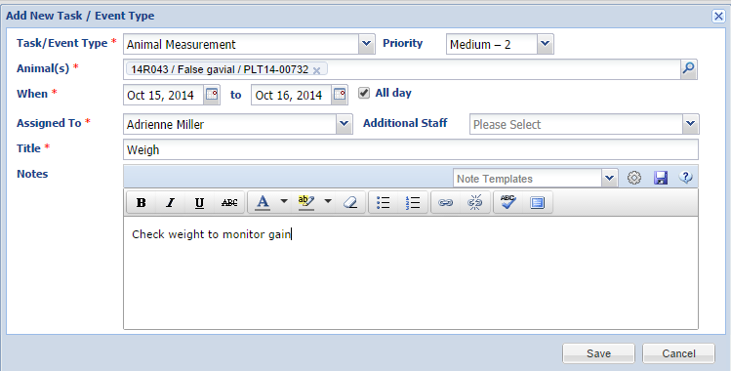
Recording the Details
Selecting the topic will bring up a screen where you can record details such
as the priority, dates, who it is assigned to and additional Notes.

Slide 23
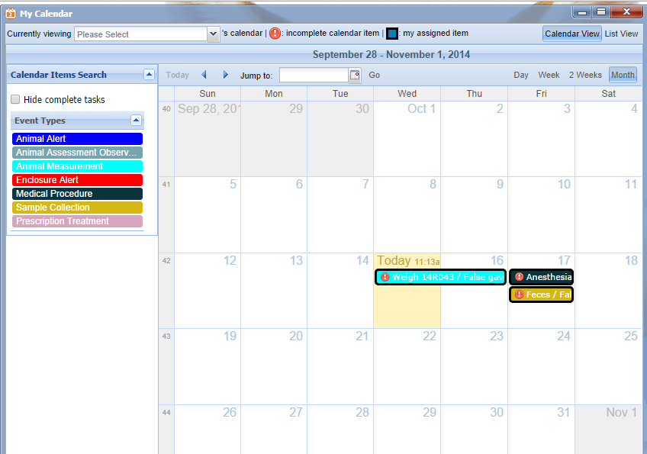
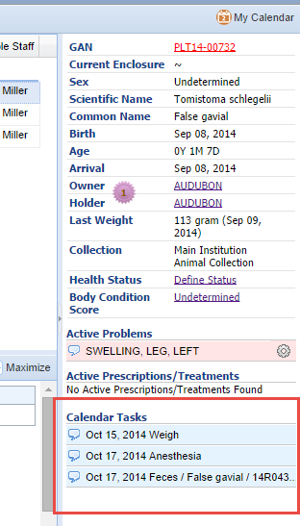
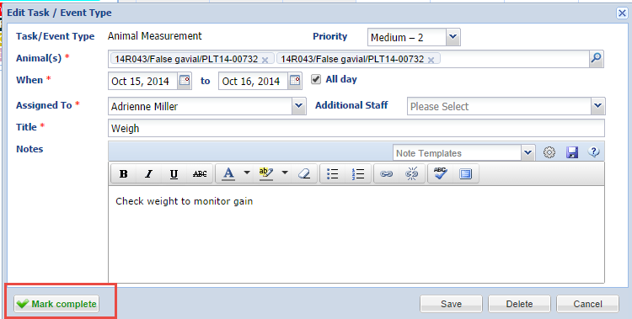
Calendar Display
The scheduled actions will appear in My Calendar. Left clicking will bring up the Details box. Marking as Complete will remove the red “!”
in front of the sample.
The tasks will also display at the bottom of the right hand dashboard in the medical record.

Slide 24
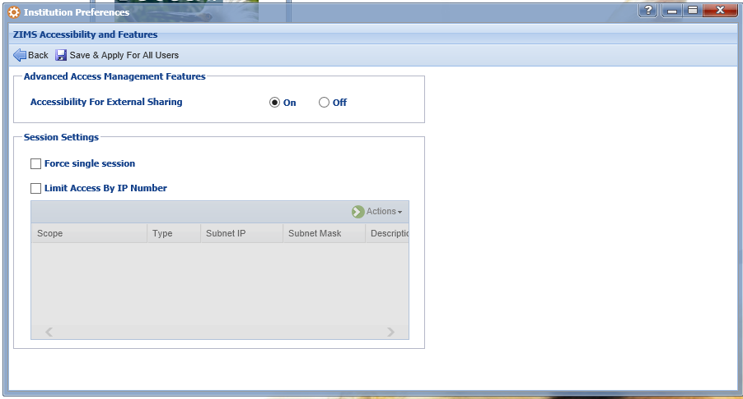
Medical Record Sharing
If you are a ZIMS Local Administrator
you have the option to turn Accessibility
for External Sharing on or off. You do
not have the ability to turn any Medical
Sharing on or off. That ability is found
only under the Medical Admin Role.
Your Medical Admin can create a custom
Role with that ability if they desire.
Medical Record Sharing is found under
the Medical Records module in the
Medical Roles.

Slide 25
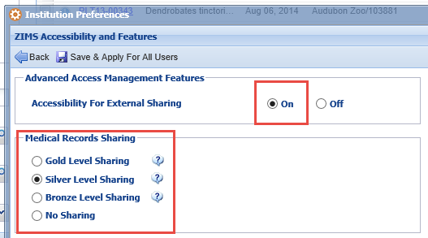
Medical Record Sharing
If you have the Role access you can select to share your medical records by going
into Institutional Preferences>ZIMS Accessibility & Features. You can see that a
new box for Medical Records Sharing is now activated. The Accessibility For
External Sharing must be turned on. You will then select the level of sharing that
you desire. Hover over the “?” to view what medical modules are shared at each
level.

Slide 26
What the Levels Share
Gold Level
All medical records except for Clinical Notes marked as Private
Silver Level
Anesthesia, Physiological Measurements, Medical Issues/Diagnosis, Treatments, Health Status
Bronze Level
Anesthesia, Physiological Measurements
No Sharing
No medical records are shared

Slide 27
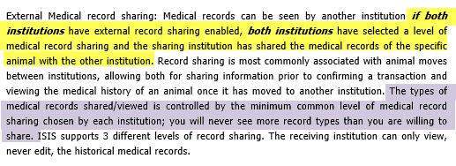
Go For the Gold!
There are three steps to successful medical record sharing:
1.Both institutions must have External Sharing enabled (Local Admin)
2.Both institutions have selected a level of medical sharing (Medical Admin)
3.The sharing institution has selected to share the record with the
other institution.
You will see ONLY the minimum common level of records selected.
Some examples……………………….

Slide 28
Some Examples
Institution A has selected Gold Level sharing. They share a record with Institution B who has also selected Gold Level sharing.
Institution B sees all medical records
Institution C has selected Silver Level sharing. They share a record with Institution D who has selected Bronze Level sharing.
Institution D sees ONLY Anesthesia and Physiological Measurements (the lowest common level of sharing)

Slide 29
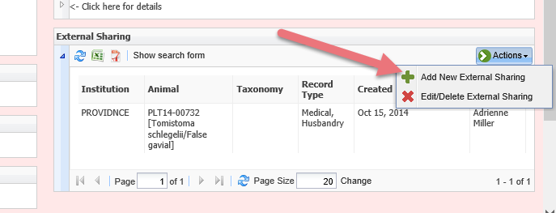
Assigning Sharing
Medical records to be shared are assigned just as Husbandry records to
be shared are. You can do so from the External Sharing grid under My Institution (top) or from within the
Animal record External Sharing grid (bottom).

Slide 30
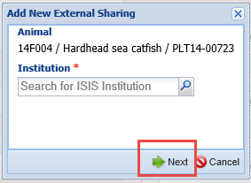
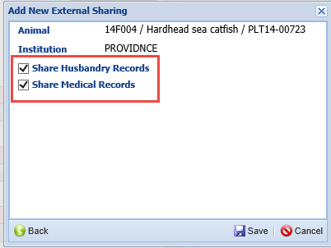
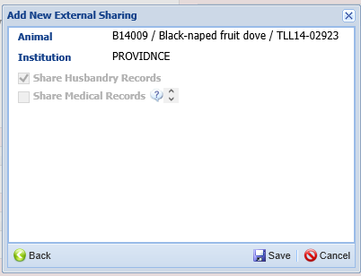
Assigning Sharing
If you are assigning sharing from My Institution,
after you select the Institution you desire to
share the record with you have the option to
share an entire Taxonomy or an individual Animal
record (top left). When assigning from within the
Animal record the sharing will apply only to that
single record (top right).
The Next button will open the screen that allows
you to select to share Husbandry, Medical or Both
records (left).
If you do not have the role access to share Medical
Records it will be greyed out and defaulted to only
Husbandry Records.

Slide 31
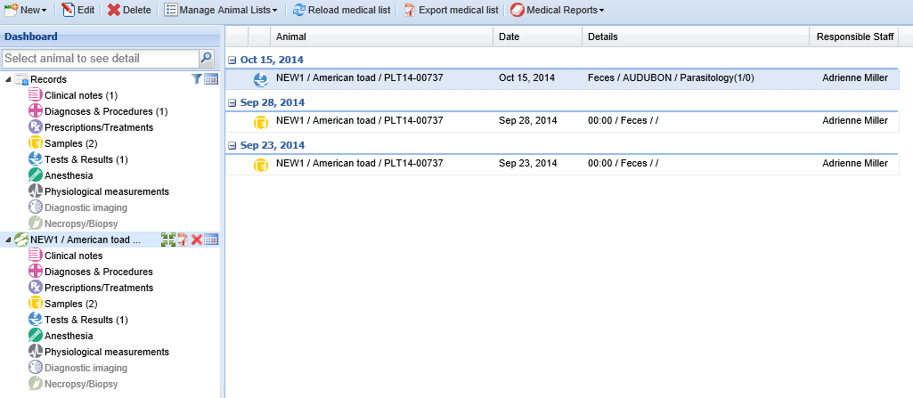
Group View Plus
Group View Plus allows you to view any medical records that may be related to
the group you have in focus. It will display medical records for any members that
were split from or merged into the group you have in focus. In this view we have
only the single group in focus.
By selecting the green arrows icon it will include medical records that may relate
to this group. Here we see records for an individual that was split from this group.

Slide 32
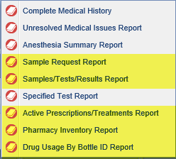
New Medical Reports!
Drug Usage by Bottle ID
ID, Status, Formulation/Ingredients, Notes
Active Prescriptions/Treatments
Date, Drug, Taxonomy, Enclosure, Duration, Prescribed By
Pharmacy Inventory
Current Inventory, various Item Types, Formulation/Ingredients, Regulating Agency, Expiration, Lot #
Samples/Tests/Results
Start and End Date, Animal(s), Laboratory, Test Category, Result Status
Sample Request
Date Range, Sample Type, Taxonomy and Enclosure, Specific Animal(s), Priority and Assigned To

Slide 33
Any Questions?
On the R2.1 Update

