Slide 1
ZIMS Tips and Tricks July 2015
New Husbandry Functionality in the R2.2 Release!

Slide 2
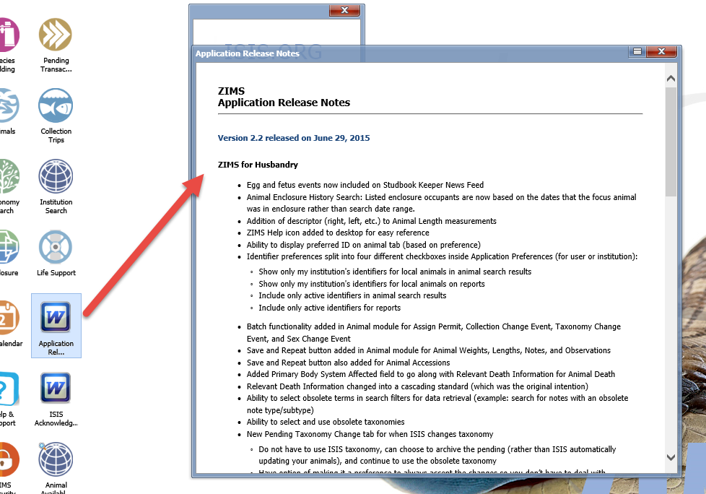
Read Release Notes

Slide 3
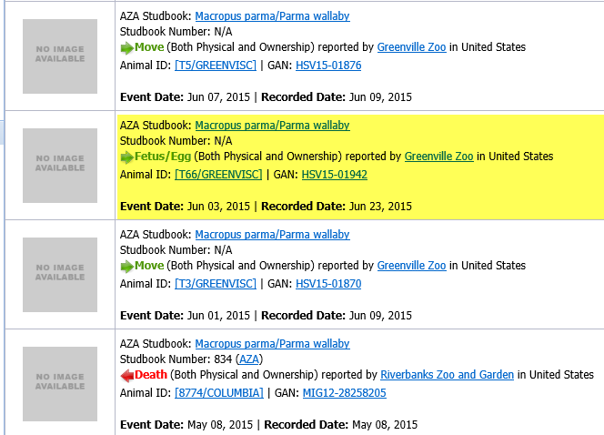
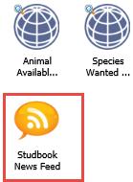
Studbook News Feed
Egg and Fetus events are
now included in the Studbook News Feed. This will include Egg Lay and Fetus Identified information. If any events (Birth/Death) happen to them that information will be found as well as Move information for them.
Some Studbook Keepers
drag the Studbook News
icon to the desktop for
easy access.

Slide 4
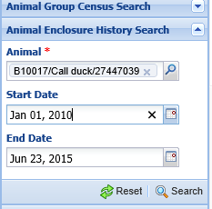
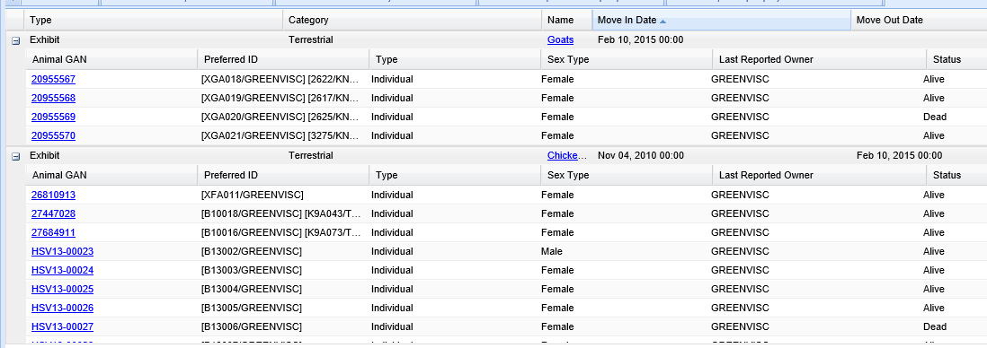
Animal Enclosure History Search
There has been a change in how the application finds animals
in an Animal Enclosure History Search. The listed enclosure
occupants are now based on the dates that the animal in focus
was actually in the enclosure and rather than the date range.
We have entered a call duck with a date range of 1 January 2010
through 23 June 2015. The results show that the duck was in
Chickens between 4 November 2010 and 10 February 2015. The
other enclosure occupants listed will be ONLY those that were also
in the enclosure during that date range and not ones that may
have occupied it during a date that was in the date range selected
but NOT during the time the duck was also there.

Slide 5
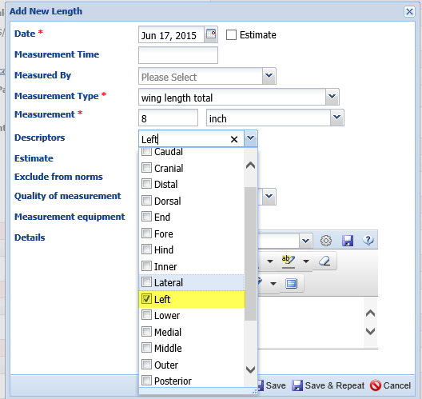
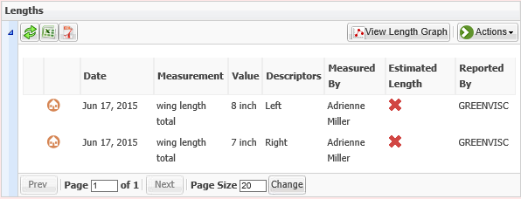
Animal Length Descriptors
A Descriptors field has been added to the
Animal Length grid. This is a multiple
select list that allows you to more clearly
define exactly what you were measuring.
In this example we can now indicate what
the length of each wing is separately.
These Descriptors are also added to the
Batch Measurement Template screens.

Slide 6
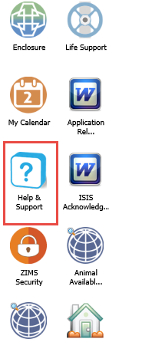
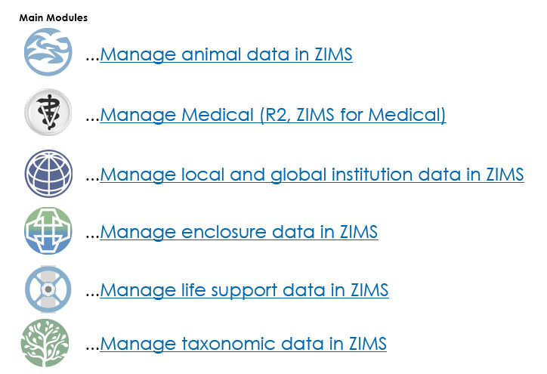
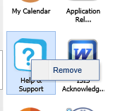
Help & Support Icon
Many Users were missing the opportunity to access the
ZIMS Help Documents from directly within the application
so a Help & Support icon was added to the desktop. This
will take you directly into a list to find the topic you need.
As for all the other icons you can opt to remove it from your
desktop by right clicking and selecting Remove.

Slide 7
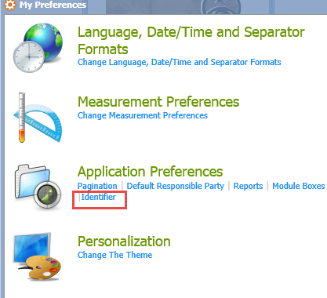
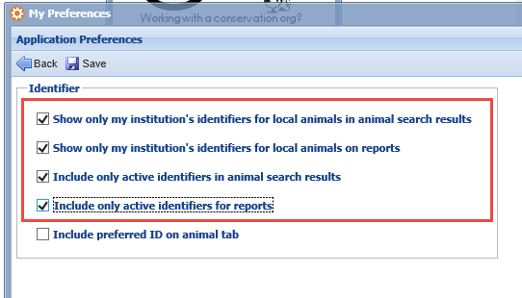
Identifier Preferences

Slide 8
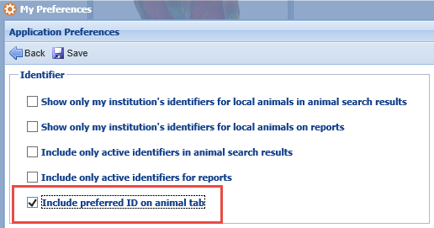
Preferred ID on Tab
In My Preferences you can now
also select if you want your
Preferred ID to display in the Tab
right after the GAN. Since the
Preferred ID is selected by animal
what is displayed is not always
the same identifier. This Chihuahua’s
Preferred ID is a House Name
whereas the call duck’s is a Local
ID. The GAN will always display.

Slide 9
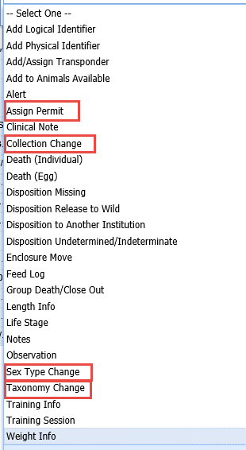
New Batch Functions
Four new Batch Actions have been
added. You can now batch Assign
Permits, record Collection Changes,
change Sex Type and change
Taxonomy.

Slide 10
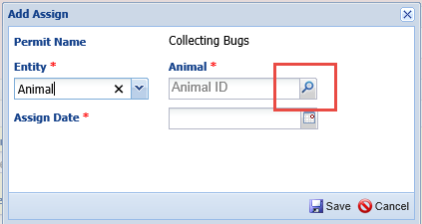
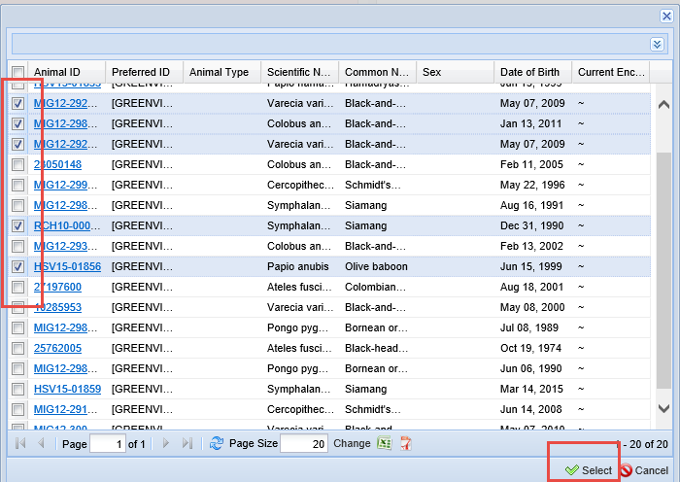
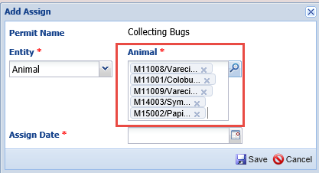
Another Option to Batch Assign Permits
There is now another
option for Batch Assign
permits to animals.
When you select Assign
Permit from the permit
record and use the
Look Up option, the list
is now multiple select.
All selections will prefill
and the permit will be
Assigned when Saved.

Slide 11
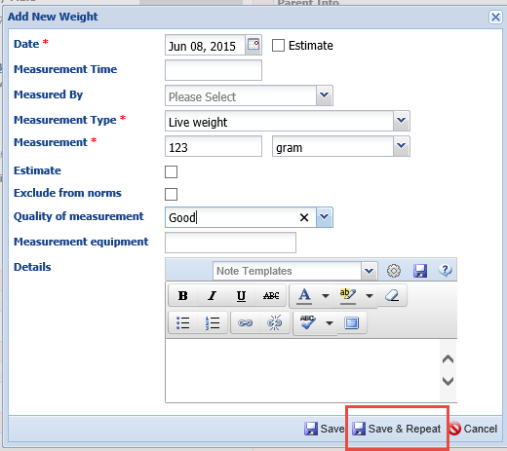
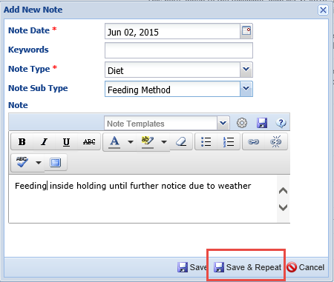
Save & Repeat!
A Save & Repeat option has been added to Animal Measurement
(weights and lengths) and Animal
Notes & Observations. This will be a great time saver when you have a
lot of the same type of information to record on the same animal. When you select to Save & Repeat your entry will be saved but the screen remains open, allowing you to quickly edit as needed without using the Actions button to select Add New. When you are done then select to Save and the data entry screen will Save and close.

Slide 12
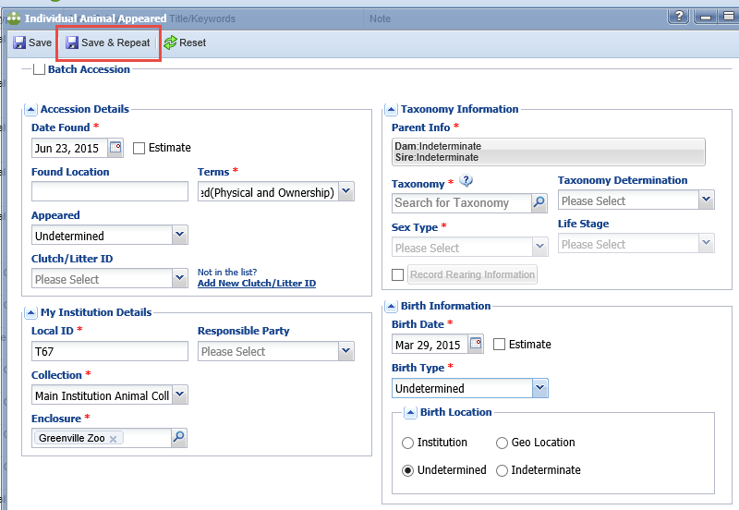
Save & Repeat Accessions!
This Save & Repeat functionality has also been added to the Accession screens. If the information for multiple accessions is the same then you should continue to use the Batch Accessions functionality. Save & Repeat
allows you to save time when adding
multiple animals whose information is not the same. When you select Save & Repeat your accession data will Save but the accession screen remains open where you can edit any fields that you need to. When you get to the last accession simply Save and
the screen will Save and Close. This
functionality saves you from having to
remember to go back and edit any
information in Batch Accessions that may
be different from the initial accession.

Slide 13
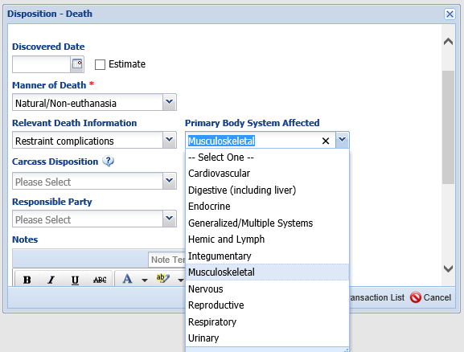
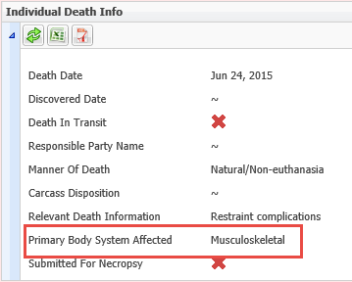
Primary Body System
Primary Body System Affected
field has been added to the
Death screens. This is only
activated if the Relevant Death
Information field is recorded.
Primary Body system Affected
will display in the Death Info
field in the records and on
the Specimen Report.

Slide 14
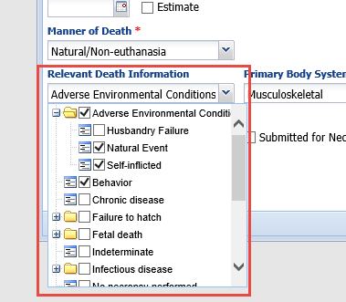
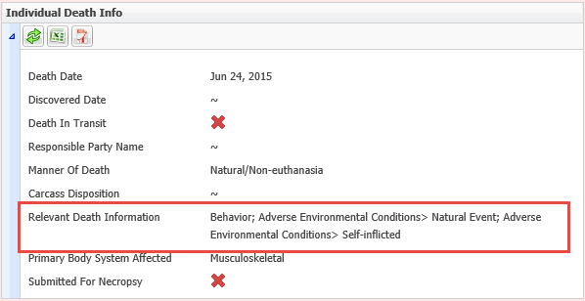
Relevant Death Info Cascading
The Relevant Death Information list is now a cascading and multiple select list as it was originally intended to be. You can make your selections at any point in the list. In this example a Natural Event of Adverse Environmental Conditions lead to death by Self-inflicted Behavior.
The information will display on the Individual Death Info grid and on the Specimen Report.

Slide 15
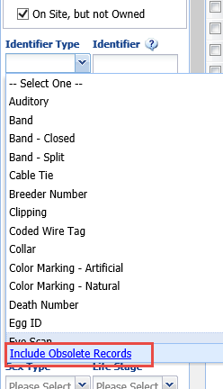
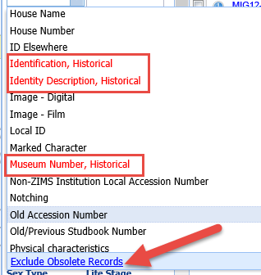
Select Obsolete Terms in Searches
Over time some terms used previously have been marked as Obsolete so they display in your records but they can
no longer be selected for current use. You can now search for these terms in your records should you wish to find them by selecting Include Obsolete Records.
They will display in red and can be searched for. You can then choose to remove them from the search by selecting
Exclude Obsolete Records

Slide 16
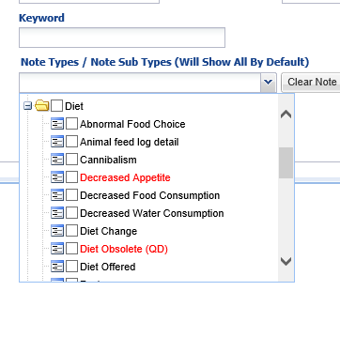
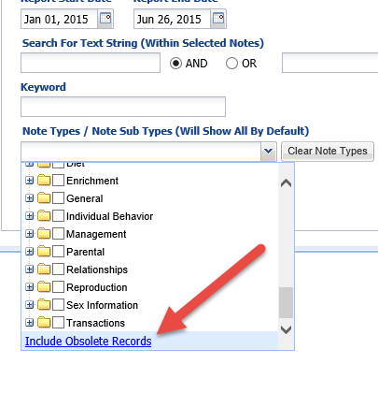
Obsolete Notes
This also works in the Note
Retrieval Report to find any
Notes & Observation sub-
types that have been marked
Obsolete. This can help you
clean up your records so you
have only active Note Types
if desired.

Slide 17
Pending Taxonomy Change Tab
There is a new tab in the Animals module titled Pending Taxonomic Changes.
This grid displays if Species360 has changed the taxonomy (Scientific Name, Common Name
or both) for a species you currently or historically had in your collection. Users
wanted the ability to accept Species360 taxonomic changes OR keep them as they are in
their records. This allows you to do that. Only if you have/had a record for the
species will it display in this grid. In the example above both the Scientific Name and the
Common Name for Chihuahuas and Parma wallaby have been changed by Species360. You
can see that 13 records for Chihuahua and 5 records for Parma wallaby may be
affected by this change.

Slide 18
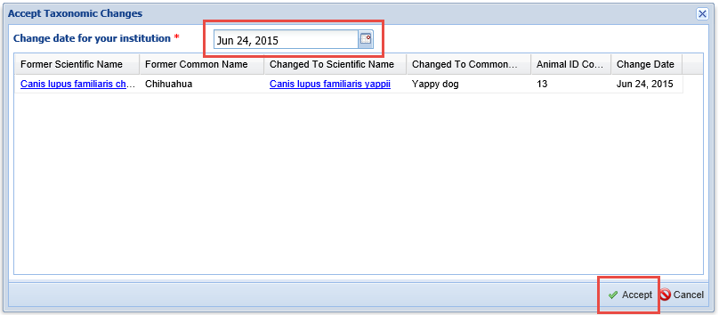
Accept Species360 Taxonomy
Checking the left side box will activate the Accept Species360 Taxonomy button. I am
going to accept the change for Chihuahuas. All 13 records for that species will
be changed. You get a second chance to review it as well as change the date.
The date is simply for your information as the species will be changed historically.

Slide 19
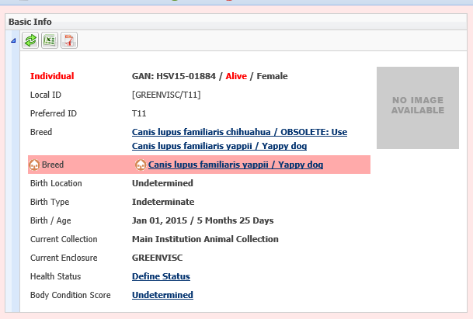
Taxonomy Conflicts
When you select to accept any new taxonomy that Species360 has changed you may see that there is a taxonomy conflict in the Basic Info. This should go away after 15 minutes when the Global taxonomy is re-calculated. For a few minutes you will see this conflict on any of your animals with that taxonomy.

Slide 20
Archive Taxonomy
Should you wish to NOT accept the Species360 taxonomy you can Archive the record to
clear the grid.
Using the checkboxes to the right you can view any Archived records (you may want
to now accept the taxonomy) and any Accepted records. The note will indicate the
date the taxonomy was accepted and who accepted it.

Slide 21
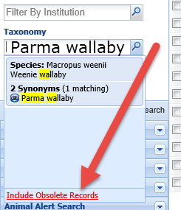
Searching By Obsolete
If you have chosen not to accept the new Species360 taxonomy, the species will be
Obsolete and this affects your searches. To find records of those species you
will need to select Include Obsolete Records. The Obsolete species will
appear in red and you can select it to find your records. The highlighted yellow
indicates matches in your type ahead search.

Slide 22
Institution Preferences
If you want to automatically
accept the Species360 taxonomy
updates you can save time
by selecting Taxonomy in
Application Preferences in
Institution Preferences and
checking the Enable Auto-
Accept for Species360 Taxonomic
Changes. This is not available
as a My Preference. If this is
checked then the Pending
Taxonomic Changes tab grid
should never be populated.

Slide 23
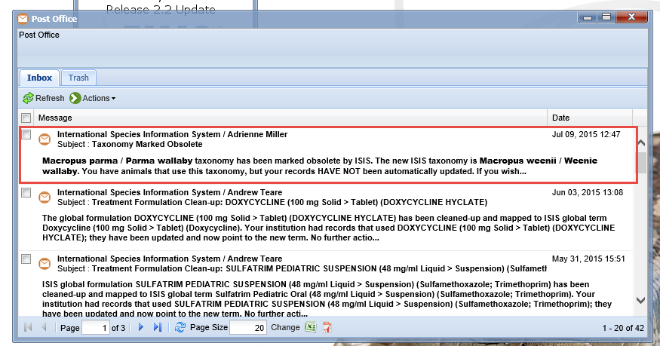
Post Office Message
Whenever a taxonomy is changed you will also receive a Post Office message. This is helpful if you have selected the Preference to automatically accept the Species360 taxonomy changes as they will not appear
in the Pending Taxonomy changes tab unless you select to Include
Accepted Records.

Slide 24
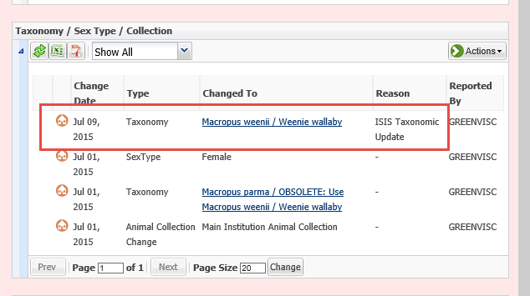
Display in Record
We went back in and accepted the taxonomic change for Parma wallaby.
It will display in your Taxonomy grid with the Change Date being the date
you entered when you accepted the change. Nothing is displayed in the
Specimen Report regarding the change.

Slide 25
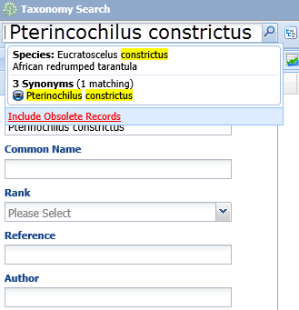
Obsolete in Taxonomy Module
Within the Taxonomy
module if you are searching
for obsolete taxonomy
remember to check the
Include Obsolete or Show
Only Obsolete Records
radio button. Otherwise
the taxonomy will not be
found.
However, if you use the
upper left hand search,
obsolete taxonomy is
found by default.

Slide 26
Incomplete Disposition
There is another new tab titled Incomplete Dispositions. This tab is visible
only if you have the Pending Transactions tab selected. Incomplete
Dispositions are created when someone enters a necropsy record in
the Medical module before a Death is recorded in the Husbandry
module. Although they initiate in the Medical module you will need
to know how to complete them in the Husbandry module.

Slide 27
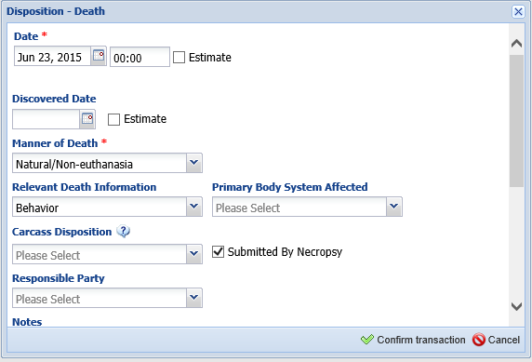
Completing an Incomplete Disposition
When you select the GAN hyperlink in an Incomplete Disposition it takes you into the record where a Pending has been created for the Death. If you go into the record from other than the Incomplete Disposition grid the Pending will also be there. You have the same options for actions on this Pending as you do for other Pendings. However, if you select Deny or No Information you cannot retrieve the Pending like you can other Pendings.
If you choose to Confirm you will be
taken to the Disposition-Death screen
to complete.

Slide 28
No Sire Required for Infertile Eggs
A Sire is still required during the accessioning process of an egg because the
Parentage drives the taxonomy. However, if an egg is determined to be Infertile
the Sire can be successfully deleted as an infertile egg would have no Sire.

Slide 29
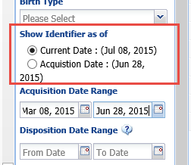
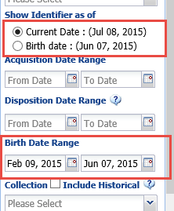
Show Identifier as of Date
There is now the ability to chose what
Identifier you would like displayed in
Advanced Animal Searches. If you enter
an Acquisition or Birth Date Range, new
fields appear that allow you to select
to display the Identifier as of the
Acquisition or Birth Date or as of the
Current Date. The To Date entered will
display after Acquisition or Birth Date.

Slide 30
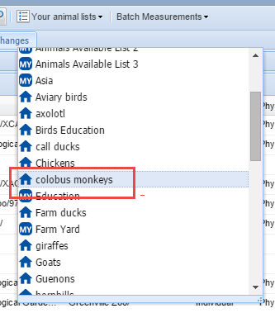
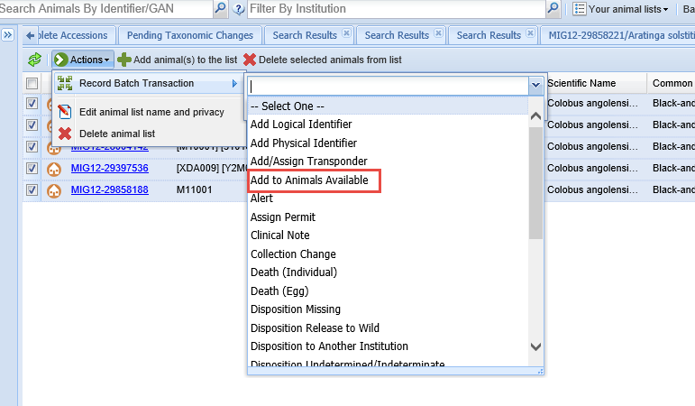
Available Animals from a List
You can now use an Animal List to make Animals Available. The
Animal List must be of the same
species. There are two ways to do this. One way is to select the
List from Your Animal Lists. Then
Record Batch Transaction of Add to Animals Available. This is available only as a Single Entry for all. Here we are adding our
colobus monkey list to Animals
Available.

Slide 31
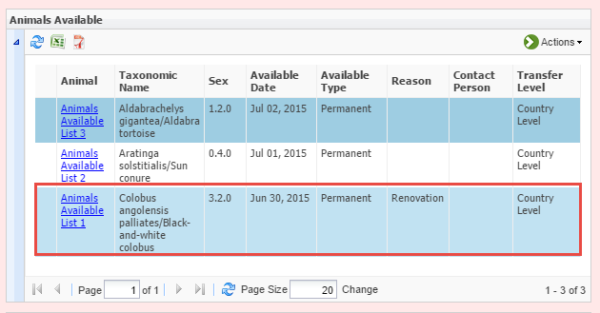
Animals Available From a List
In your Animals Available grid it will be displayed as Animals Available List #. By
selecting the name hyperlink you can view what animals these are. If you go back
into your original Animal List and add or delete animals it will NOT affect what
animals are listed here as available.

Slide 32
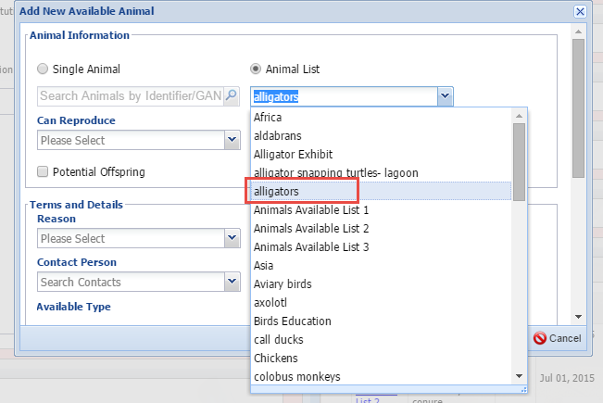
Animals Available From Actions
You can also add an Animal List
from the Available Animal grid
Actions button. You have the option
to select a Single Animal or an Animal
List. Here we are adding our list of
Alligators.
When you add a list this way the grid
will retain the Animal List name that
you gave it and not create a new one.

Slide 33
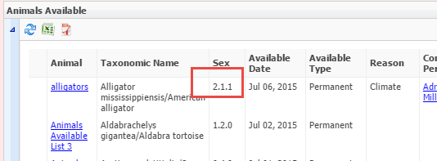
Animals Available From Actions
If you have added an Animal List to Animals Available from the Actions button,
any time you alter that list from Your Animal Lists, such as adding or removing
animals from it, you will get a warning that doing so will impact the animals
listed as Available. The count in the Animals Available grid will adjust to what
the count in your Animal List is.

Slide 34
AA From Animal Lists Review
Add From Your Animal Lists
New name will be created
Changes to Your Animal List will not affect AA, will need to change in the AA grid
Add From AA Actions button
Your Animal List Name is retained
Any changes to Your Animal Lists will be reflected in the AA list

Slide 35
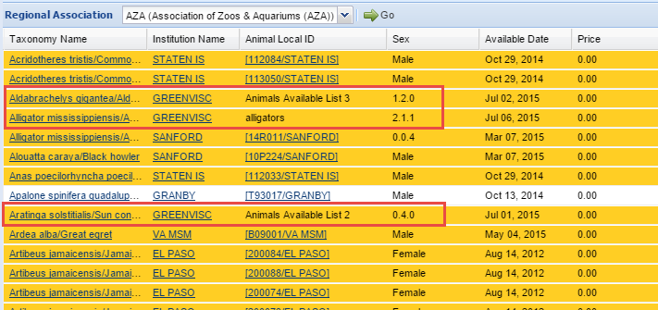
View in Animals Available
In the Animals Available grid the name of the list and the count of animals
will display.

Slide 36
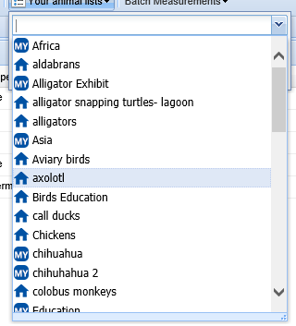
Your Lists/Note Templates
You can now easily tell which Animal
and Enclosure lists you created. The
MY icon means that you created the
list. The house icon means that
someone else at your facility created
it. Note Templates will also now display
as MY if you created them.

Slide 37
Medical Module Impact on Husbandry
Necropsy Information
Death #
Identifier that is editable in Husbandry, will also change Medical entry
If entered on the Husbandry module will prefill into Case Info in the Necropsy module
Necropsy Case Info for Husbandry
Note in Husbandry module that is NOT editable in Husbandry
Death Date
Editable in Husbandry but will NOT change Medical entry
Warning during data entry if different from Medical entry
Date Discovered
Editable in Husbandry but will NOT change Medical entry
Warning during data entry if different from Medical entry
Manner of Death
Editable in Husbandry but will NOT change Medical entry
Warning during data entry if different from Medical entry
Add New Weight (right side panel)
Opens Husbandry Add New screen
Editable from Husbandry module
No indication it was sourced from Medical module

Slide 38
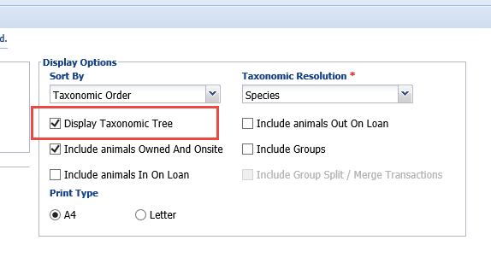
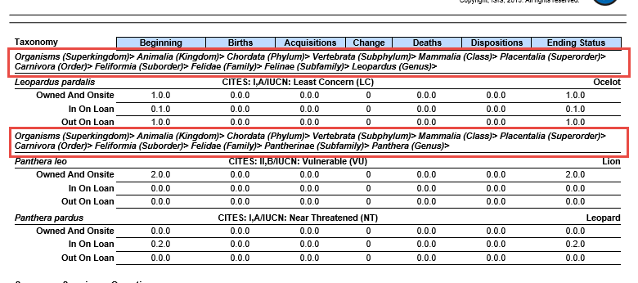
Reports – Inventory Display Taxonomic Tree
In a Detailed Inventory Report you
now have the option to display the
higher taxonomic names by selecting
Display Taxonomic Tree. This is often
helpful when setting up a filing
system.

Slide 39
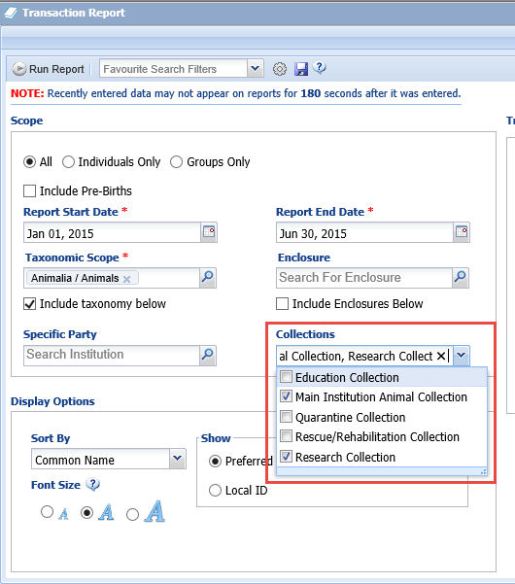
Many Reports – Collection Filter
The ability to filter by Collections
has been added to many of the reports
that did not have that option. This is a
multiple select list so more than one
Collection can be chosen. If the animal
was in the selected Collection(s) at
any time during the selected date range
it will be displayed. By default, all
Collections are checked. If you want you
can create a Favourite Filter with just
the Collections you usually want to
include.

Slide 40
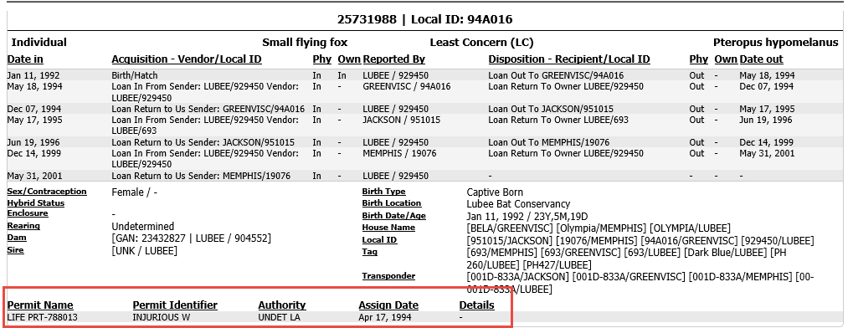
Taxon – Include Permits
The ability to include Permits on
a Taxon Report has been added.
The Permit Name, Identifier, Listing
Authority and Assign Date will display
under the basic details in the report.

Slide 41
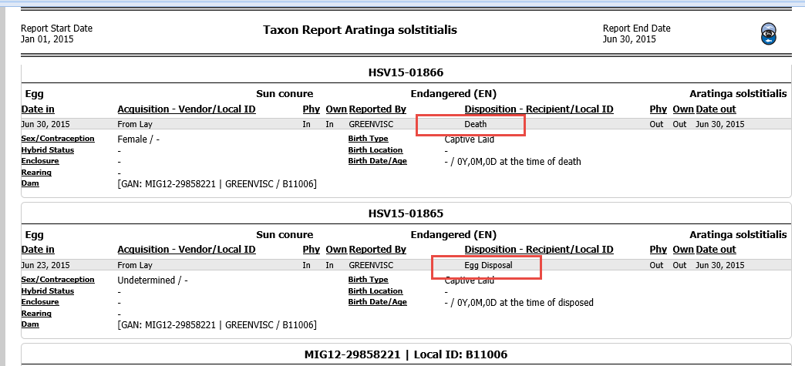
Taxon Report – Egg Death/Disposal
On Taxon Reports the Death of a fertile egg has been separated from a
Disposal of an infertile egg. This is helpful to studbook keepers who want
to see eggs recorded but will not enter infertile eggs into their studbooks.

Slide 42
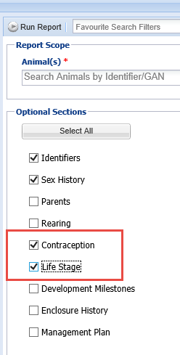
Specimen Report – Include Contraception and Life Stage
Checkboxes have been added to
the Specimen Report to include
Contraception and Life Stages

Slide 43
Specimen Report – Notes & Observation Changes
Combine Notes and Observations checked
Will be displayed together chronologically
Notes checked
Only Notes will be displayed
Observations checked
Only Observations will be displayed
Notes and Observations both checked
Will be displayed separately
Exclude Notes from other grids checked
Notes sourced from other grids will NOT be displayed in the Notes grid
Checkbox is activated if any of above checkboxes are checked

Slide 44
Specimen Report – Select Note Sub-Type
You can now select specific Note/ Observation Sub-types for the Specimen Report as it is a cascading dropdown. The Type and Sub-type will both display in the report.

Slide 45
Specimen Report – Permit ID Displays
If you select to include Permits
on your Specimen Report the
Permit ID now also displays.

Slide 46
Specimen Report – Parent Local ID
Parent Local IDs now display on Specimen Reports in addition to the GAN.
The Global view of the Parent Local ID will display.

Slide 47
Updating Roles
Species360 will update the Species360 Template Roles with the new features as we see appropriate
Recommend that you review the Roles in case you do not agree with the assignments
Since you cannot edit Species360 Template Roles you may need to create new custom Roles
You will need to update any custom Roles you have created
New features will NOT be automatically added
New functionality to current features are automatically updated

Slide 48
Husbandry/Administration Roles
Institution Roles have been renamed Husbandry/Administration Roles.
This change was made in anticipation of the upcoming Population
Management module as those roles will be separate from Husbandry/
Administration and Medical so Institution did not define them accurately.

Slide 49
To Review/Edit Roles
Most of the new features in this update are in the
Medical module. To update the Role select it and
then select Manage Role Access in the Actions button.
Select the module and update as appropriate. Here
we see quite a few new features under Medical Records
and Medical Reports.

Slide 50
Any Questions?
On the new Husbandry functionality
in R2.2

