Slide 1
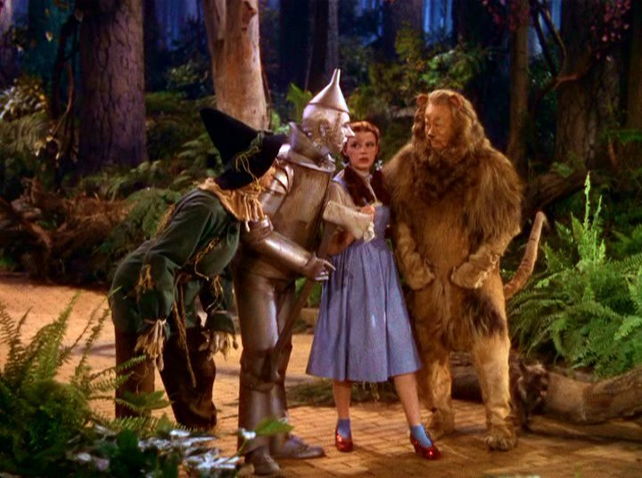
ZIMS Tips and Tricks June 2015
Batches and Templates and Time Saving Tips Oh My!

Slide 2
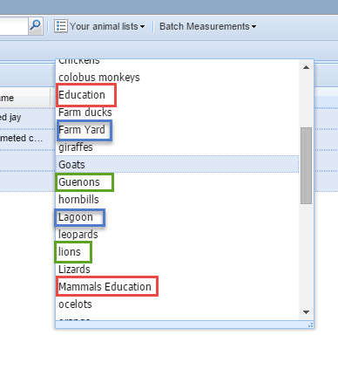
Animal Lists
Taking the time to create lists of
your animals can save you and
your staff valuable time searching
for animals or creating Batch Actions.
Lists can be created by ENCLOSURE
OCCUPANTS, by COLLECTIONS and by
SPECIES. You can even create them by
Animals assigned to specific Teams or
Staff members. There are no restrictions
on how you create your lists.

Slide 3
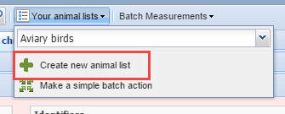
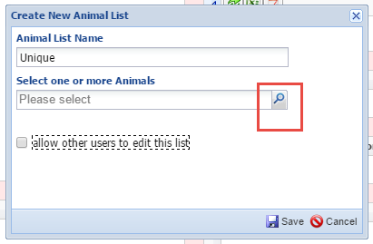
Creating Animal Lists
To create a new list select Create New Animal List. The List Name must be unique within your
facility. You can type in members of the group separately, or use the
Lookup Assistant.
This will allow you to look for groupings of animals such as occupants of specific enclosures,
taxonomy or sex types.
Here we want to find all
animals currently in the
Reptile House.

Slide 4
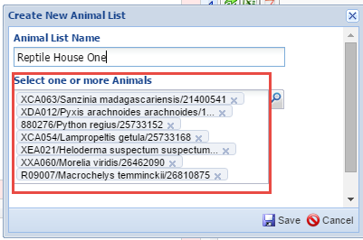
Creating Animal Lists
From the results grid select the desired animals to include in the list. Selecting
the top box will Select All in the list. Then chose Select.
The selected animals will automatically prefill into your Animal List.

Slide 5
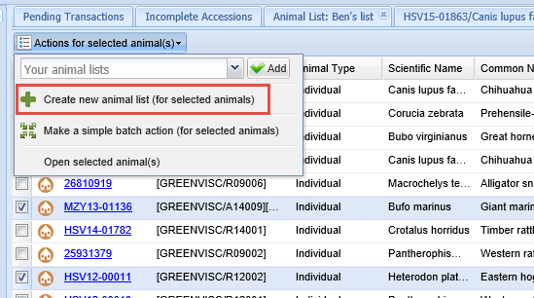
Animal Lists From Search Results Grid
You can also create an Animal List directly from a search results grid.
Simply select the records you want to include and create a new list
under the Actions For Selected Animals button.

Slide 6
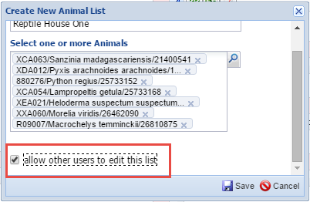
Creating Animal Lists
By default the Allow Other Users to
Edit This List is unchecked. This means
that others can use the list but only the
creator of the list can edit it. If you check
this option then anyone who has access
to Animal Lists can add and delete animals
so you need to be careful when selecting to
check this. However, Local Admin can edit
or delete ALL Animal Lists regardless of who
created them.

Slide 7
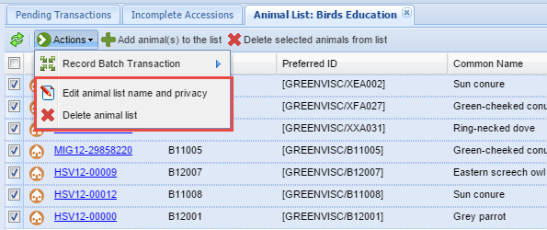
Managing Animal Lists
To manage Animal Lists select one from the dropdown. From the results grid you
can Add and Delete animals from the list. It is important to remember that animals
are not automatically removed from Animal Lists when dispositioned or deceased.
Using the Actions button you can also edit the list name and change if others can
edit it or not. In addition, this is where you would be able to delete the list in its
entirety if you have the rights to do so. Only the Animal List creator or Local Admin
will have these rights, even if the list is checked to allow others to edit it.

Slide 8
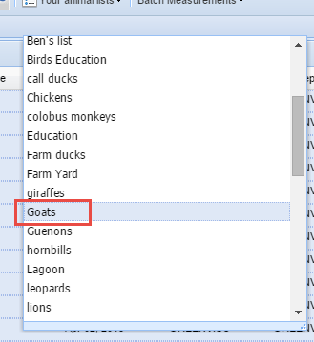
Using Animal Lists to Find Animals
Animal Lists can make finding animals easy for
your Staff. If a list is properly created, many times
searches are not required. You are a Keeper who
wants to enter a weight on one of your goats.
You know she is named after a type of cookie
but cannot remember which cookie. You select
“Goats” in Animal Lists. If it does not already
display you select to include House Name using
column customization. You quickly find a goat
named Ginger Snap. Selecting the GAN hyperlink
takes you right into the record to record the
weight.

Slide 9
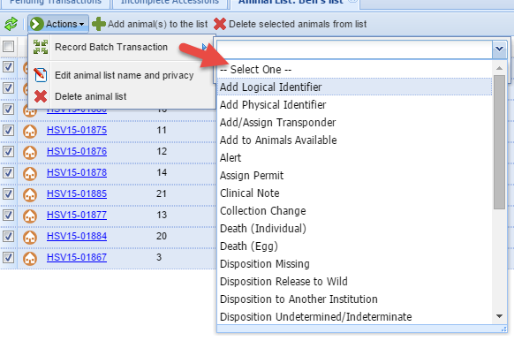
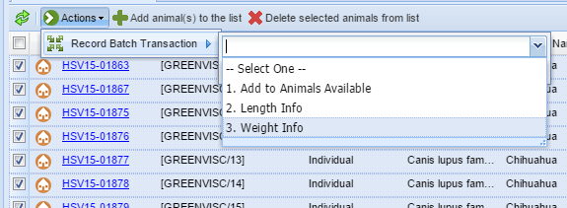
Using Animal Lists to Record Batch Actions
In many cases Animal Lists are
created to help with recording
Batch Actions. What Batch Actions
you can record depend on what
module access you have. The top
screen shows Batch Actions for a
Local Admin Role. The bottom screen
shows Batch Actions for a Keeper Role
where only measurements can be
Recorded, or the animal can be added
to the Animals Available listing.

Slide 10
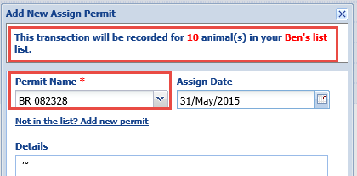
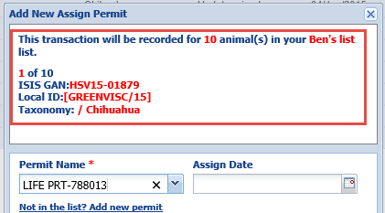
Single versus Custom Entry
You have the option to record a
Single Entry (same information for
all animals) or a Custom Entry (each
record can be edited) for your
Batch Actions.
For a single entry, the number of
animals in your list will be displayed.
For a custom entry the number in
the list, GAN, Local ID and taxonomy
will display for each record.

Slide 11
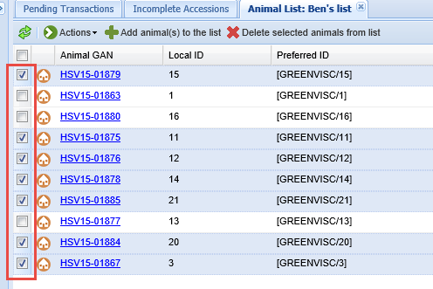
Skipping an Animal
Currently you cannot skip an
animal in an Animal List once
you start the Batch Action. If
you do NOT want your action
applied to all records in the
list you should unselect them
prior to selecting the Batch
Action. Here we have removed
three of the animals from our
list and they will not appear for
data entry.

Slide 12
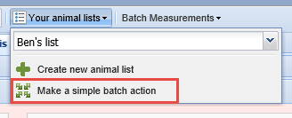
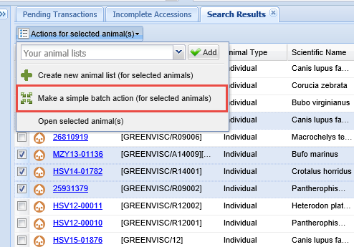
Simple Batch Action from Animal Lists or Search Results Grid
You can also create a Simple
Batch Action from both your
Animal Lists and a search results
grid. This is used when you do
not anticipate having the same
selection of records again that
need a Batch Action done. If
you do you should create an
Animal List to save you time with
future data entry. If recording a
Simple Batch Action by selecting
animals from a results grid, the order
for a custom entry is the order records
are checked.

Slide 13
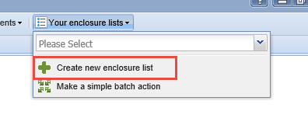
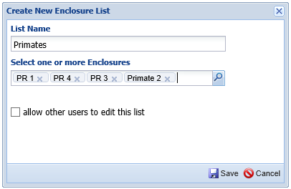
Enclosure Lists
You can also create Enclosure Lists.
The functionality is very similar to
creating Animal Lists. Select Create
New Enclosure List, record a unique
List Name and enter the appropriate
enclosures. Allow Others to Edit as
Desired. These lists might be helpful
to assist any non-animal staff such as
Horticulture or Maintenance with
quickly finding enclosures.

Slide 14
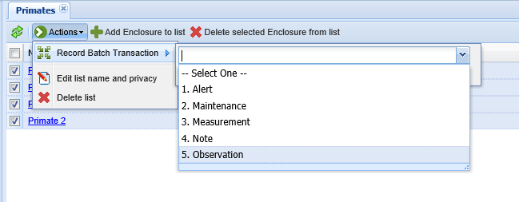
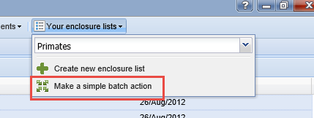
Enclosure Batch Actions
They also make Batch Actions easier to enter. Currently you can enter Alerts,
Maintenance, Measurements, and Notes & Observations using the batch
functionality. You can also make simple batch actions from your Enclosure
Lists or from a search results screen, just as you can for Animals.

Slide 15
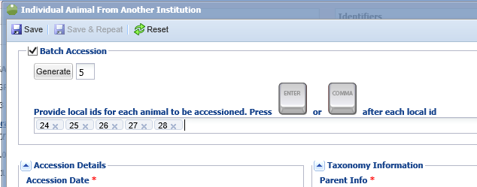
Batch Accessions
Batch Accessions are a great time saver if most of the information is the
same. In this screen shot the institution is using Auto-increment Local ID
so all they need to do is enter the number of records they will be
accessioning and select Generate. If you are not using that Institutional
Preference you will need to manually enter them. One hint, make sure that
you press Enter or Comma after your last Local ID entered, otherwise you
will be short one record. If any information is different you will need to go
into the appropriate record and change it. However………………………

Slide 16
Accessions Save & Repeat Option!

Slide 17
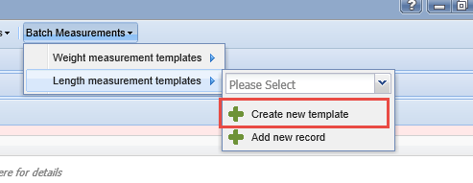
Creating Animal Measurement Templates
If there are common measurements (weights or lengths) that you take
on the same animals over and over you can create a Batch Measurement
Template to save you time. Here we are creating a new Length Measurement
Template.

Slide 18
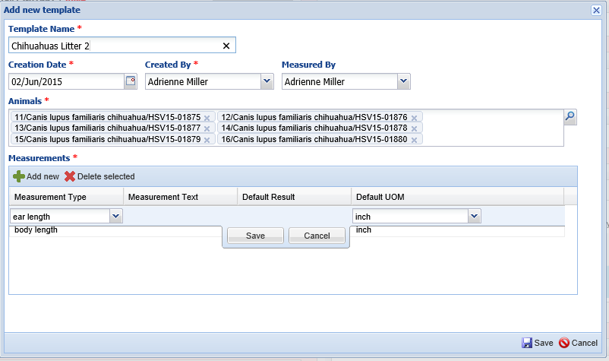
Creating Animal Measurement Template
The Template Name must be unique. This template is for a litter of Chihuahua pups
whose growth we want to track. The Creation Date is simply for information, it does
not affect the date you can record using the Template. If the same person will be
doing the measuring you can save time by entering it here as it will prefill but is
editable. Enter the animals you want this Template related to and add your
measurements, remembering to select Save for each entry.

Slide 19
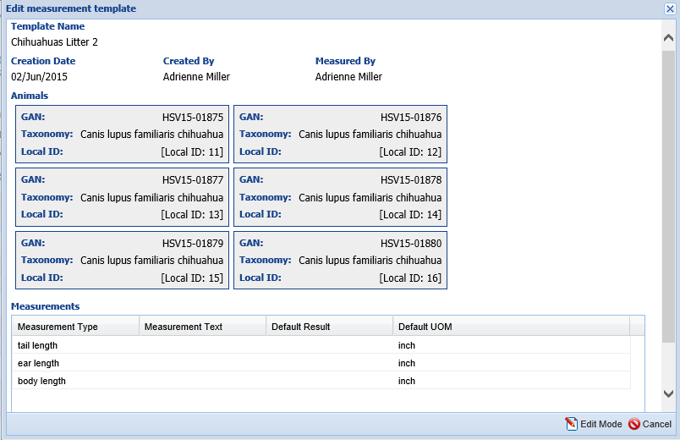
Creating Animal Measurement Template
When you hit Save it will
display a preview of what
you entered for the Template
so you can double check and
edit if required.

Slide 20
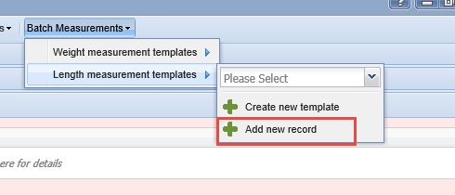
Using Animal Measurement Templates
To use the Templates you have created select Add New Record
For the appropriate measurement type (Weight or Length).

Slide 21
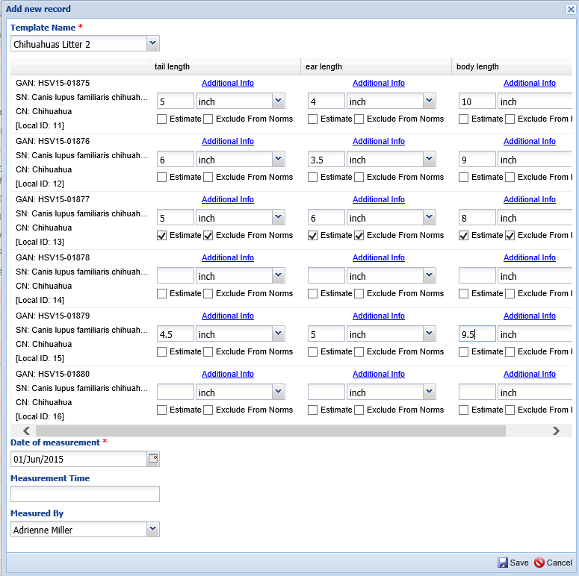
Using Animal Measurement Templates
The Template you have
created will appear in the
Template Name dropdown.
When selected there, the
Template grid will display.
Enter the measurements
you have taken. Measured
By defaults to what was
entered when you created
the Template but it is
editable.

Slide 22
Using Animal Measurement Templates
If you have not recorded data on all of the Template fields you will
receive a message letting you know. Let Me Correct will reopen the
Template to add the information. Go Ahead and Save will save the
information into each record as appropriate.

Slide 23
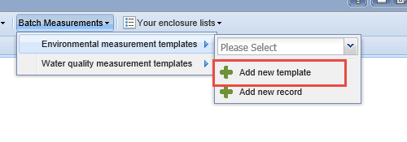
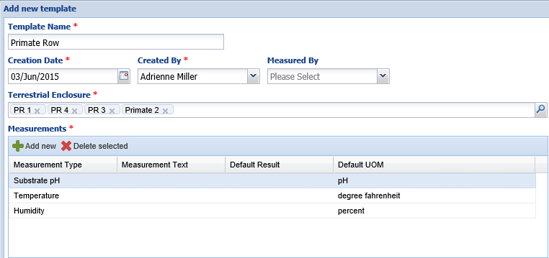
Creating Enclosure/LS Measurement Templates
You can also create Enclosure and Life
Support Measurement Templates to
save data entry time. If you select to
create an Environmental Measurement
Template only terrestrial enclosures can
be selected. If you create a Water Quality
Template only aquatic enclosures can be
selected. You cannot mix the categories
in a template.

Slide 24
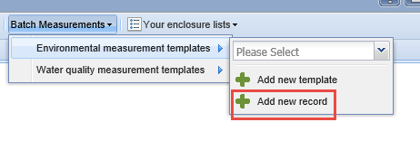
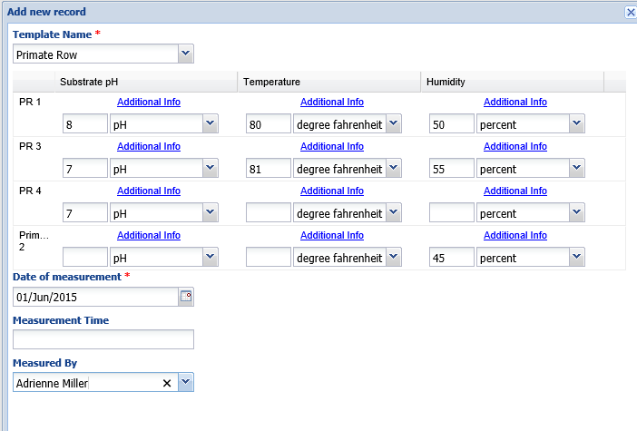
Using Enclosure/LS Measurement Templates
To record data using an Enclosure
Measurement Template select Add
New Record. Select the Template
Name From the dropdown and record
your data. It behaves just as the Animal
Measurement Template in that you do
not have to complete all fields.

Slide 25
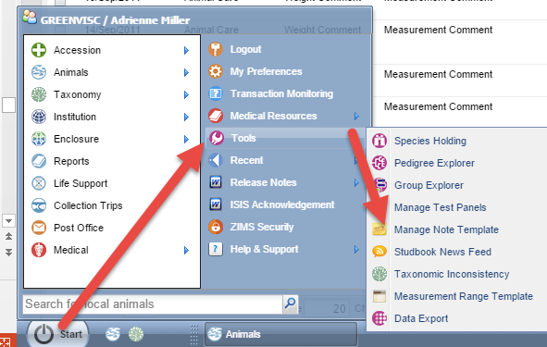
Creating Note Templates
Note Templates can be
created to save considerable
time in entering notes that
may be repetitive over time.
They can either provide you
with prompts regarding what
information you chose to
record, or they may actually
be the complete not itself.
The easiest way to create a
Note Template is from within
Tools in the Start menu. You
can also create a Note Template
from within the Notes module
itself.

Slide 26
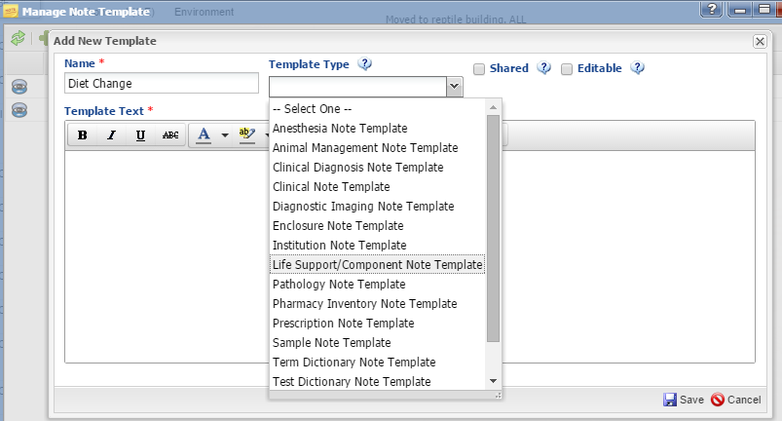
Creating Note Templates
To create a new Note
Template select Add New
Template under Manage
Note Template. The name
must be unique. You then
select the Template Type.
The Note Template will be
available for use ONLY
from within the module
selected. For use in the
Animal Husbandry module
select Animal Management
Note Template. Then decide
if you want the template to
be shared with or editable
by others.

Slide 27
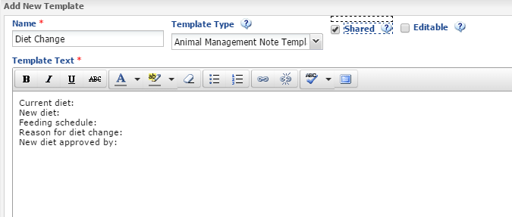
Creating Note Templates
Here we have created a Note Template for a Diet Change. The information
that needs to be recorded is listed. This will help anyone recording a Note
for a diet change to remember all the information that needs to be
recorded. This template is shared with others but can only be edited by
the creator or a Local Admin.

Slide 28
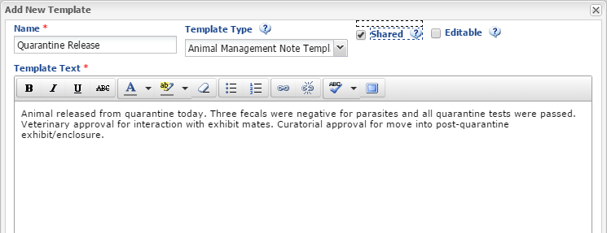
Creating a Note Template
Here we have created a Note Template that is meant to be used as is.
This is a typical note for when an animal is released from quarantine.
All Note Templates are editable when used so if anything is different it
can be changed but the Note Template itself will remain the same.

Slide 29
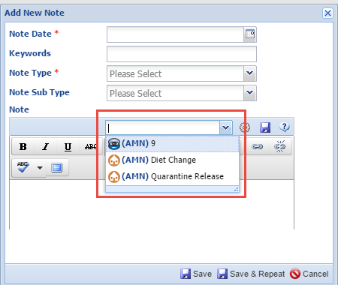
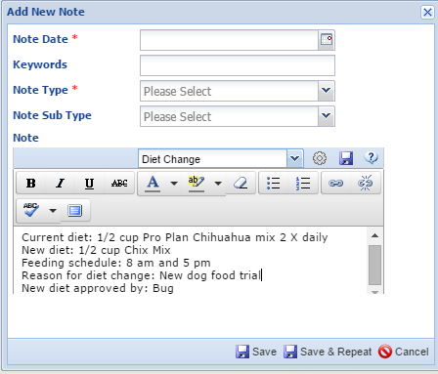
Using a Note Template
To use a Note Template select it from the drop down list when you are Adding a New
Note. Here we selected Diet Change. The information we need to select is displayed
and we completed the note.

Slide 30
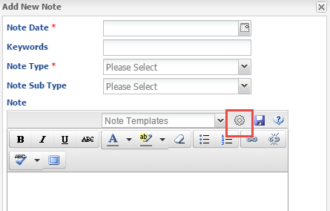
Managing Note Templates
You can manage your Note Templates
from Start > Tools or from within
Add New Note itself by selecting the
wheel icon. Both options will bring
Up the Manage Note Template screen.

Slide 31
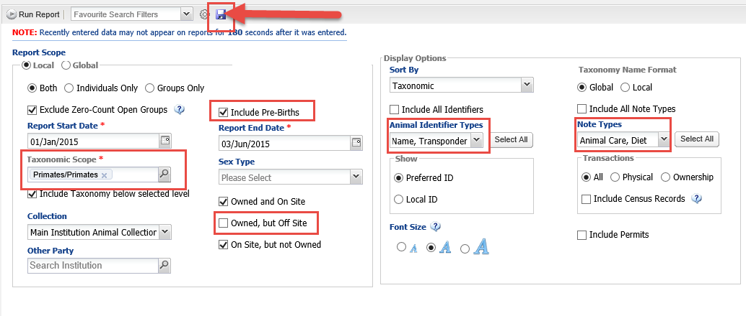
Reports- Creating Favourite Search Filters
If there are reports where you are constantly selecting the same filters that
are different from the default you can save Favourite Search Filters. First,
complete the filter selections as you want. We have selected to Include Pre-births,
Primates as the taxonomic scope, Physical animals only, House Name and Transponder
and two types of Notes as different from the default filters. Then select the Save icon.

Slide 32
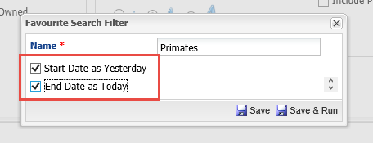
Reports – Creating Favourite Search Filters
As always the filter Name must
be unique. Here you have the
option to set a report default
date as Start Date yesterday and
End Date today. This allows you
to quickly run a report for what
happened yesterday without
continually editing the date
range.

Slide 33
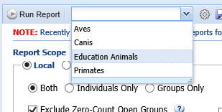
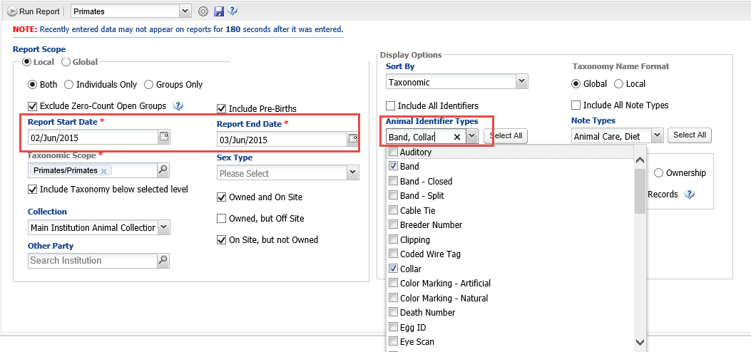
Using Favourite Filters
To use your Report Filter simply select it from
the dropdown list. It will prefill with the filters
you have created. I ran this report on 3 June and
the filter was set to Start Date yesterday and End
Date today so I did not have to edit this to run
the report. I am, however, choosing to edit the
Identifiers I want to see. The report will run as I
selected, but the filter will remain as it was when
it was Saved.

Slide 34
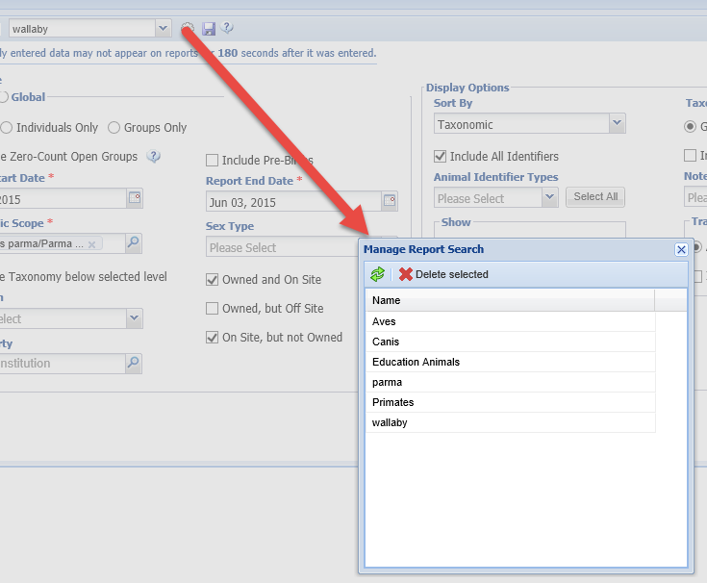
Managing Favourite Filters
To delete a filter you no longer need
Select the wheel icon, select the
Filter and then Delete. If you need
to edit a filter you will need to
Delete the original one and create a
new one with the same name.
If you receive the message to the left
when moving between filters, that simply
means that the report will not be run with
the filters you had on the screen

Slide 35
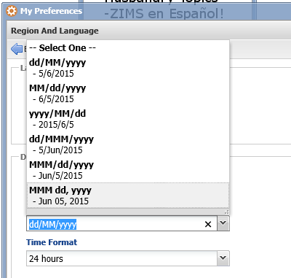
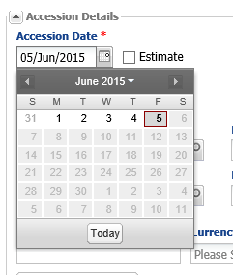
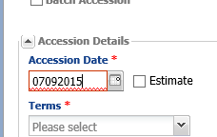
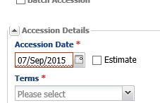
Tips for Entering Dates
There are many ways to speed
up your entry of dates. First,
make sure that your Date Edit
Format Is set as you would like
it to be in My Preferences.
Using a format you prefer will
make things quicker.
If the date you are entering is
in the current month the
Calendar feature can also be
very handy.
If you are entering dates by hand
remember that you do NOT
need to put a “/” between the
day, month, and year

Slide 36
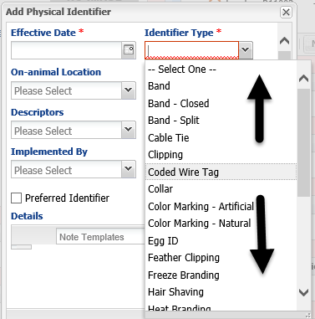
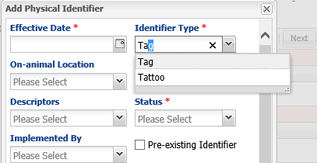
Tips for Data Standards
Instead of using your mouse to
scroll through data standard drop
down lists you have some options.
Your keyboard up and down arrows
will help you move through the list
quicker.
In addition, most data standards
Are type ahead lookups, so if you
start typing the list will become
shortened for easier selection.

Slide 37
Tips for Closing Tabs
If you have been comparing a lot of records and have multiple tabs open
there is an option to closing them one at a time. If you RIGHT click on the
tab you have three choices. 1) Close that single tab just as left clicking
does, 2) Close Other Tabs but leave the record you are in open, and 3) Close
All Tabs, leaving you in the module but with no tabs open other than any that
are open by default.

Slide 38
Tips for My Preferences
Date Edit Format
Default Measurement Preferences
Applies to both Animals and Enclosures
Default Responsible Party or Logged In User
Module Boxes Open as Default
Default Enclosure Category & Type for new Enclosures
Default Enclosure and Collection for Accessions

Slide 39
Any Questions?
On Batch and Templates and Time Saving Tips?
What are some of yours?

