Slide 1
Tips & Tricks
Using the ZIMS Post Office Resetting Passwords
June 2014

Slide 2
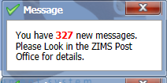
The ZIMS Post Office Is this what you see when you open ZIMS?

Slide 3
Why Bother?
The information is duplicated in Pending Transactions
So many staff members receive the messages that it doesn’t matter what I do, it will be in someone else’s mailbox
I don’t have time to clear up my messages
I have no idea what to do with the messages
This session will help!

Slide 4
The Information is Duplicated in Pending Transactions
NO!!!! Although this previously was true. If something is in the Pending Transactions
grid it DOES NOT display in the Post Office. If something is in the Post Office it DOES
NOT display in the Pending Transactions grid. This change was made with the release
that came out on 24 August 2013, so you may have some duplicates if you have Post
Office messages from before then. SUGGESTION ONE: Please contact Species360 should you
find an example of this not being true and you are receiving both a Pending and a
Post Office message

Slide 5
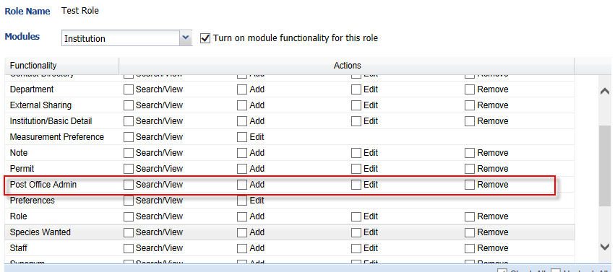
So many staff members receive the messages that it doesn’t matter what I do, it will be in someone else’s mailbox
Access to the Post Office is found under the Institution Module>Post Office Admin. The only Species360 Template Role that has access to the Post Office is Local Admin. Because the Post Office functions as emails do, if several staff members have access to it they will need to manage it on their own. For Example, if three Users have access they will all receive a message. If User 1 marks a message as Read, Done or moves it to trash it does not affect the messages in other User’s mailboxes. SUGGESTION TWO: Access to the Post Office should be given to a limited number of Users whose responsibilities will include making sure that actions, if required, are taken and read and completed messages are sent to the Trash and deleted.

Slide 6
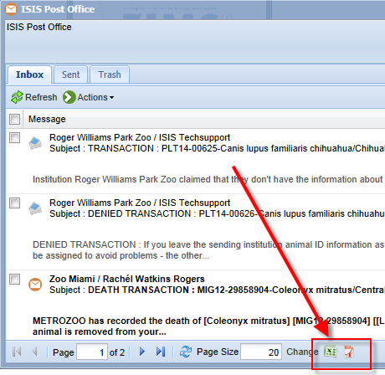
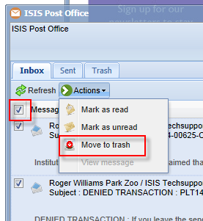
I don’t have time to clear up my messages
As shown in a previous slide, some institutions have hundreds of unread PO messages. In a perfect world the recommendation would be to go through them, take action if needed and delete. However, in our real world, these institutions are never going to do that as it is
overwhelming. Because there is a lot of important information that is sent as a PO message Species360 is recommending that you start using it now and don’t stress about what is
already there. SUGGESTION THREE: Export the messages to a file. In Excel they can be searched to help find ones that can be sent to Trash and Deleted. Or, store the file somewhere you will remember for when you either 1)get the time or 2)someone to go through it. Then send them
all to Trash and Delete Forever. This gives you a clean start and you can now start using the Post Office as it was intended.

Slide 7
I have no idea what to do with the messages
Help is here!
Will review some of the options available for managing the Post Office messages
Will select some messages and show what they mean and what actions you should take in the record, if any are required.

Slide 8
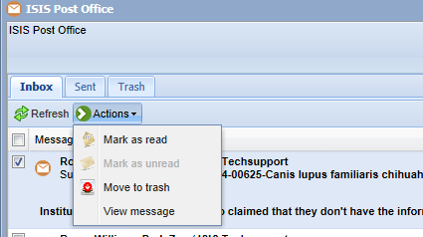
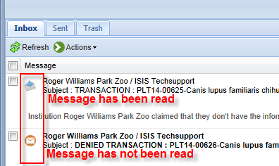
Managing the Post Office
By checking the left side box there are several Actions you can take on the message. Left clicking on the message will automatically check the box. You can Mark as Read and the closed envelope icon will change to an open envelope. You can select to View Message which will bring up a screen with the entire message visible as below. By default, selecting View Message will also automatically mark the message as read.

Slide 9
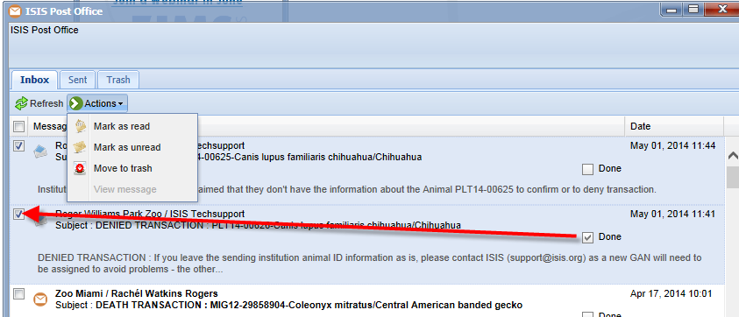
Managing the Post Office
Selecting Done will automatically check the left hand box. Checking the Done
checkbox means that you have taken whatever actions, if any, were required.
Selecting to Move to Trash will remove the message from your Inbox and send to
the Trash.

Slide 10
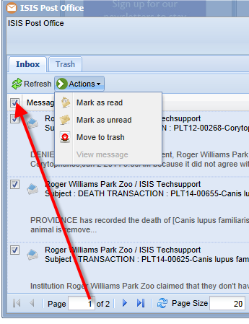
Message Checkbox
If you have more than one page
of messages, checking the Message
checkbox and selecting an Action
will apply only to that page of
messages. You will need to take
appropriate Actions on all pages
to have it apply to all messages.

Slide 11
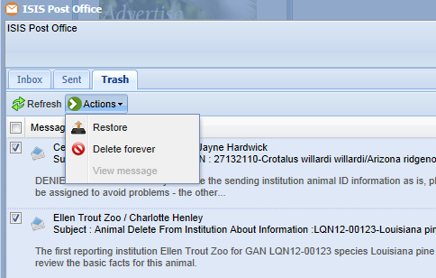
Managing the Trash
You will receive a message
double checking that you do
indeed want to move the message to Trash. Once in Trash you have the Actions to Restore it where it will be moved back into your Inbox or Delete Forever. It is important to note
that Actions taken on Post
Office messages such as Delete Forever are not captured by Transaction Monitoring so they
cannot be Rolled Back. If you do select Delete Forever you
will be given another message
to double check that is what
you really want to do.

Slide 12
EXAMPLE 1: Sender Initiated, Receiver selects Deny
In this example you have recorded sending an animal to another institution. They have selected Deny. Looking in the animal record you can see this by hovering over the red circle. If you agree that you did not send the animal then delete the transaction. If you believe that you did send the animal then leave it as is. In the Post office send the message to Trash and Delete Forever. If the Receiver selected No Information Available your actions would be the same and the circle would be orange instead of red. If you select Deny or No Information Available by mistake it is recommended that you roll it back using Transaction Monitor as that will activate your Pending Transaction again.

Slide 13
EXAMPLE 2: Receiver Initiated, Sender selects No Information Available
In this example of a Receiver Initiated Transaction new accession into ZIMS, the recorded Sender said that they don’t have information regarding a transaction that you recorded with them. Going into the record and My Transactions you can see that you recorded receiving the animal as a Loan Transfer from another institution. Hovering over the orange transaction circle you can see that they selected No Information Available for their Pending Transaction response. There is no action required on your part and this message is simply for your information. Send it to Trash and Delete Forever. Your record will remain intact and unchanged as you believe you did receive it from them. The other institution will have no record of this animal in their records.

Slide 14
EXAMPLE 3: Receiver Initiated, Sender selects Deny
In this example of a Receiver Initiated transaction, the recorded Sender denied the transaction. Looking in My Transactions you can see that you recorded a Loan Transfer From them and the red circle shows it was denied. The reason that a new GAN needs to be created is because the reported sender is saying the animal is still with them (that is they Denied that they sent it) but you are saying the animal is with you. Since there appears to be two animals, ZIMS will need to create a new GAN for the animal that you say you received. You need to take the action of contacting Species360 on this transaction. After the new GAN is created you can then move this message to Trash and Delete Forever.

Slide 15
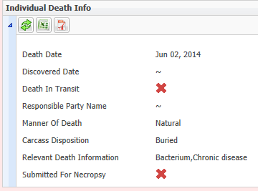
EXAMPLE 4: Animal Out on Loan/Lease dies
In this scenario an animal out on loan to
another Species360 member has been recorded as Dead.
The global record will display as Dead. However,
because you have not yet recorded a death
it will remain in your Owned Inventory. This is
because ZIMS must take what you say about
the animals you have legal title to. You should
record the Death using the information
displayed in the Death Info box that is sourced
from the records of the Holding institution. Then
send the message to Trash and Delete Forever.

Slide 16
EXAMPLE 5: Other Dispositions of Out On Loan/Lease Animals
Post Office messages are also generated for the Owner if the Holder records any of the following Dispositions:
Missing
Escaped
Theft
Disappeared
Historical
Release to Wild
To remove the animal from your Owned Inventory you should record the appropriate Ownership Only Disposition. Then move the message to Trash and Delete Forever.

Slide 17
EXAMPLE 6: Parent Record Deleted by Other Institution
What has happened here is that an animal that was recorded as being a Parent
has been deleted from the system. Here, GAN 19978833 who was recorded as
being a parent of GANs 15730829 and 15730831 has been deleted by the
institution who held that animal. ZIMS has a Business Rule that a parent cannot
be blank. To correct this Species360 has created non-ZIMS parents for the animals using
the Institution and Local ID used for the deleted animal. There is no action for
you to take here, it is strictly for your information only. However, we do recommend
that you can check the parent records and add a note if you want. Then send
the message to Trash and Delete Forever.

Slide 18
EXAMPLE 7: Partial Record Deleted by Other Institution
This is a similar scenario except in this case the animal deleted from the system
had not been recorded as a Parent. Here an institution has deleted their part of
an animal record that you also have records on. Your actions should be to review
your part of the record for accuracy. Then send the message to Trash and
Delete Forever.

Slide 19
EXAMPLE 8: Partial Record Deleted Includes Only Record of Parent
In this example a record was deleted by another facility that included the
only record of the parentage. In other words, you had not also recorded
the parents. The message lets you who the parents had been recorded as
so your actions would be to re-enter them. Or, if you believe otherwise,
record who you think the parents were. Or, accept the Undetermined Sire
and Dam. Then send the message to Trash and Delete Forever.

Slide 20
EXAMPLE 9: Partial Delete of Record That Set the Base Information
Here the first recording institution has deleted a record. Since it was
the first recorder the base information for the animal record was
sourced from their entry. Your action would be to review what you
have for the record and confirm that it is correct. Then send the
message to Trash and Delete Forever.

Slide 21
EXAMPLE 10: Local Medical Term is Made Global
In this example a local medical term that you have created in your Term Dictionary in the Medical module has been promoted to a global term that is available to all. You will also get a message should a locally created medical term become a synonym of another global term. There is no action for you to take and this message is for your information only. You can send the message to Trash and Delete Forever. Species360 is continually monitoring these lists in an attempt to create as much standardization as possible.

Slide 22
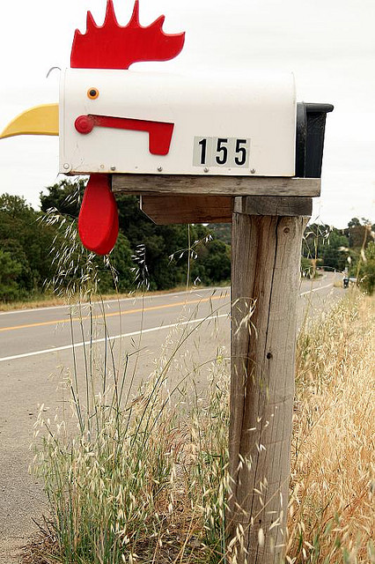
Any Questions?

Slide 23
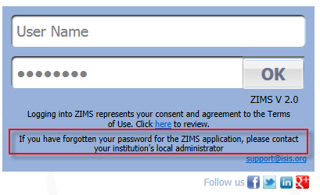
Resetting Passwords
Contact your Local Administrator
Usually the quickest way
They can reset in ZIMS
They can unlock using the
portal
Password Recovery
http://www.ISIS.org/forgotpassword
Sends a new password to your email
Contact support@ISIS.org
May take 12 – 24 hours

Slide 24
Local Admin Reset
When Local Admin resets your Password they
select to ViewEdit ZIMS User Details from the
staff grid in My Institution and selects Reset
Password at the bottom. We recommend that the Password is reset to something requested by the User as they will remember it better and it may not need to be reset again soon. Note that they do not need to know the current Password to reset it.s

Slide 25
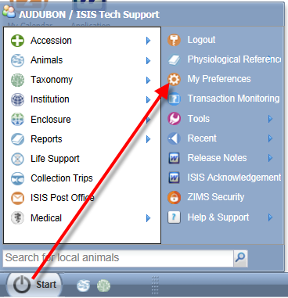
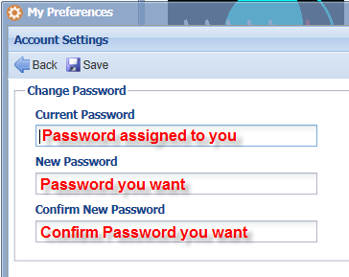
Don’t Lock Yourself Out!
We also recommend that Users be proactive and reset
their own Passwords BEFORE they are locked out. You
may choose to reset a Password that the Local Admin
assigned to you that you do not like or have trouble
remembering. Or, you may chose to reset it should you
believe that its confidentiality has been compromised.
To reset your Password go to Start>My Preferences>
Account Settings>Change Password. To reset your own
Password you do need to know the current Password.

Slide 26
Any Questions?
On the Species360 Post Office or
Resetting Passwords?
The next T & T is on Pending Transactions!

