Slide 1
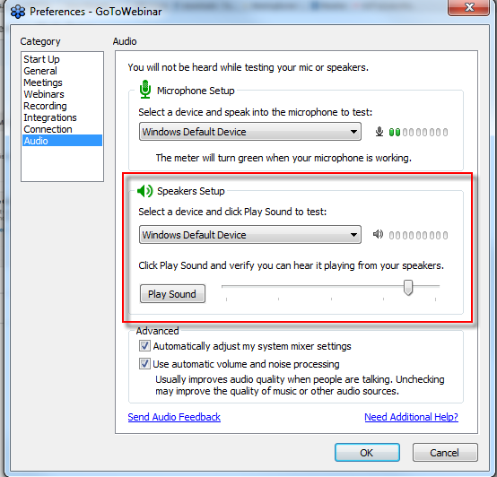
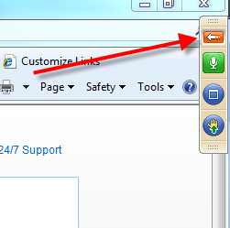
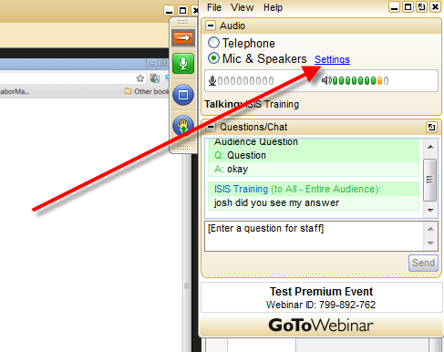
ようこそ！ 以下を参考に音声設定を行ってください
1. バーの一番上にある赤い 矢印のボタンをクリックして 広げます。
3. デバイスを選択してください。
2. Settings（設定）を選択します。
4. しゃべってみましょう

Slide 2
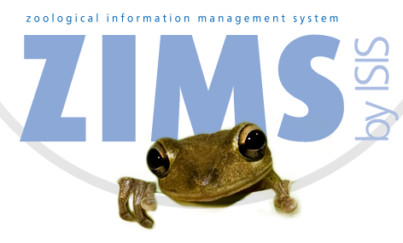
ZIMSのご紹介
その概要およびナビゲーション
Notes:
Welcome to this Introduction to ZIMS. This class is targeted for those Users getting ready to deploy ZIMS. In most cases you will be migrating your data from ARKS into ZIMS. In fewer cases you may be going directly into ZIMS without any migrated data having previously used non-Species360 software to help manage your animals.

Slide 3
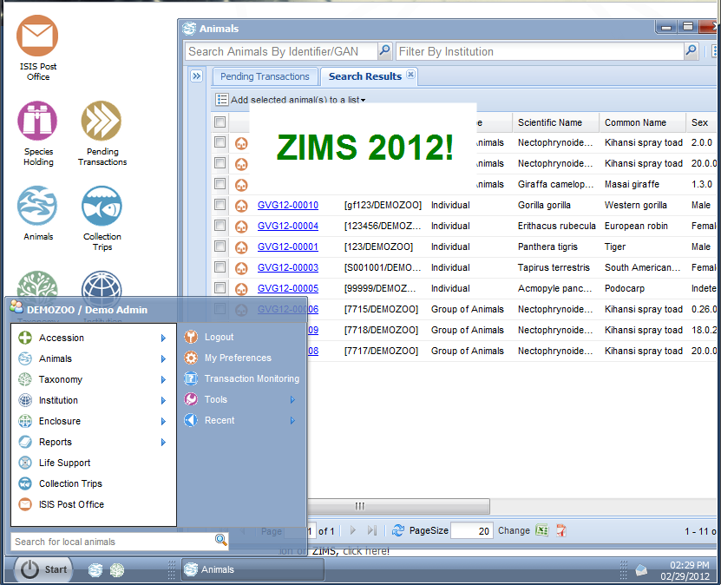
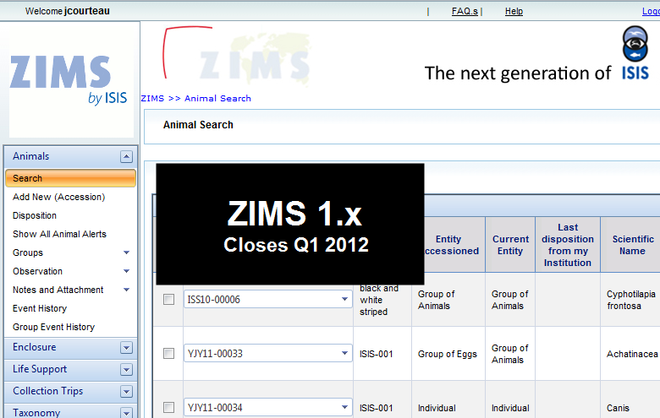
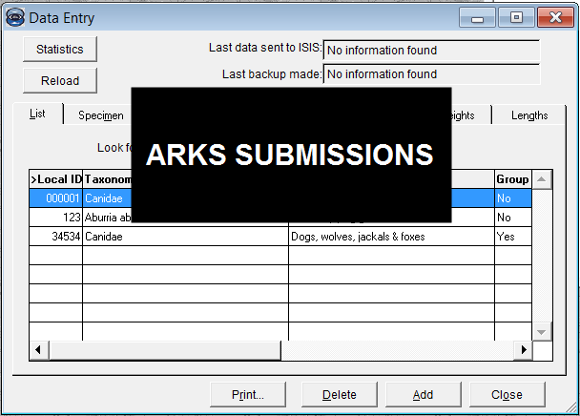
全てのデータが 1カ所に！
Notes:
Speaking of migration, you may have heard that Users of the initial release of ZIMS were missing animals in the migration process. This is because that application had very strict Business Rules that allowed only perfect data to migrate. The current application has relaxed those Business Rules so that all records get migrated. If it is not perfect then a conflict is shown. So all your ARKS data will be there. And for those that migrated from the initial ZIMS application to the current ZIMS, all their data is there.

Slide 4
概念 1 – インターネットベース
どこからでもアクセス可能
瞬間にアップデート
即時に切り替え
Notes:
ZIMS was created using 6 basic concepts. The first concept is that it is internet based. ARKS was local and had to be installed on computers or a network. You could only work in it if the computer you were using had ARKS installed. ZIMS can be accessed from any computer that has internet access. ARKS data had to be submitted in order for it to be seen globally. In ZIMS there is no submission, the global database is updated immediately. In ZIMS as soon as information is saved, other institutions can view it instantly.

Slide 5
概念 2 – 一度きりの追加、ひとつだけの記録
ZIMSへの登録は一度きり、 たったひとつの世界規模での記録
グローバル登録登録番号（GAN）
登録時に自動で割り当てられます
ローカル登録番号
ご自身で割り当てます
入力必須項目です（MedARKSおよびSPARKSのサポートのため）
Notes:
The second concept is that an animal or group is accessioned into ZIMS only once. As it moves from institution to institution Visits are created in the global record, there are no additional accessions that need to be linked.
>When the initial accession is saved, the application assigns a Global Accession Number. This is like a social security number and will never change no matter how many times the animal may be transferred between institutions.
>With each Visit a Local Accession Number is still required to help support MedARKS and SPARKS. This Local ID is assigned by each institution.

Slide 6
概念 3 – ビジネスルール
論理的処理を確かなものに
胎生のものは産卵できません
プログラマーおよび内容領域 専門家による開発
適切なものへと変更
Notes:
As mentioned earlier, ZIMS operates following Business Rules to make sure the User doesn’t do anything that is illogical. For example if you have dispositioned an egg such as discarding it, then you cannot record a hatch.
>These Rules were developed by the programmers to ensure the application functioned technically logically and by Subject Matter Experts to ensure the animal data was logical
>We found that our perfect world anticipated with the initial release of ZIMS is not perfect after all

Slide 7
概念 4 – データ標準
データ標準とは？
すでにリスト化されており、そこから適切なものをお選びいただくことができます
自由に書き込むことによる矛盾を排除します
内容領域専門家により開発されています
jpSuppot@Species360.org
スクリーン名
フィールド名
語彙とその定義
使用頻度
Notes:
Another concept was to avoid the confusion of free text fields as much as possible. Using free text means I can enter the same information differently than others are entering it. This makes searching difficult as it is all different. Data Standards are pre-filled lists which Users select from, meaning that I am using the same terms that you are. These lists were developed by Subject Matter Experts.
>Data Standards are not static and as more facilities deploy, we are finding more terms need to be added. If you feel a term should be added to a Data Standard you can contact support@Species360.org. Provide the screen title, field name, the term and a definition. In addition, providing how often this term may be used is valuable.

Slide 8
概要 5 – 機関内における管理
飼育動物の管理だけではありません
許可
トランスポンダー
収集活動
収容場所
容積、防壁、基質
維持管理
水質および環境測定値
職員
班、課
ZIMSにおける役割
Notes:
ZIMS goes beyond just helping you manage your animal collection. There is additional animal-related functionality such as managing your Permits and Transponder Inventory and creating Collection Trips.
>It also helps you manage your enclosures with the ability to record dimensions, barriers and substrates, keep track of maintenance and record environmental and water quality measurements.
>In additional it helps manage your staff and create teams and departments as well as ZIMS Roles.

Slide 9
概念 6 – 役割に基づくアクセス
ローカルアドミニストレーターによって役割は割り当てられます
Species360テンプレートのもの：編集不可
カスタマイズしたもの：編集可
役割の追加
ご自身の役割によってどの画面へのアクセスができるのかを決定します
各画面における閲覧、編集、追加、削除
Notes:
These ZIMS Roles are the final concept driving ZIMS. These Roles are assigned by your Local Administrator. They can select Species360 Template Roles, which are not editable, or create Custom Roles which are editable.
>These Roles will determine what screen access is available to the Users assigned them. For example, if the Role you are assigned does not have access to add a new enclosure, you will not even see that action.
>Access is provided in four levels – the ability to Search and View, the ability to Edit, to Add or to Remove.

Slide 10
ZIMSにおける 6つの概念
インターネットベース
ひとつだけの記録
論理的
標準化
機関まるごと管理
役割毎のアクセスの相違
Notes:
Those are the six concepts driving ZIMS. Read Slide.

Slide 11
レベルによる閲覧内容の違い ーどんな状態だとなにが見える？
Notes:
As mentioned, ZIMS now allows all of your data in, regardless of how perfect it is. So you may have information that is different from another institution. How this information is displayed depends on if you are looking at a Local view, that is an animal you either physically held or had ownership of, or a Global view of an animal that has never been under your management.

Slide 12
学名、分類群
ローカル
ご自身の機関における最新の学名
選択した異名
グローバル
一番最初にその動物を記録した機関に おける記録
DNA/RNA遺伝学的分析を選択した その後の飼育機関
Notes:
For Taxonomy the Local view displays the most recent taxonomy that you have recorded. In addition, if you have created a synonym and marked it as preferred that will be displayed. So if Species360 calls it a puma, but you call it a cougar, you can create a synonym of cougar and that would show locally.
>In the Global view the taxonomy is shown as per the first reporting institution. If a subsequent holder changes the taxonomy the Global view will only change if the initial recording institution changes it. However, if a subsequent holder selects DNR/RNA Genetic Analysis as the Method for Taxon Determination, then the Global view will default to that taxonomy

Slide 13
性別
ローカル
ご自身が記録した内容
グローバル
過去の飼育機関毎の記録
Notes:
For Sex, the Local view will show whatever you have recorded.
>The Global view will display what the current or last holder entered. This is because as the animal gets older, it is usually easier to determine the sex and the first record may be incorrect.

Slide 14
出生日
ローカル
ご自身が記録した内容
グローバル
最初に報告をした機関の記録
Notes:
The Birth Date for Local view will be whatever you have recorded.
>However, Globally the first reporting institution wins out and that is what will be displayed. Whoever was closest to the Birth probably has the most accurate information.

Slide 15
その他の相違点があった場合は？
全ての記録が表示されます
相違点は赤色で示されます
Notes:
Any conflicts will show in red in the record, allowing you to try to get consensus with the other facilities. As mentioned, everything is accepted, regardless of conflicts.

Slide 16
もちろん、いつでも 編集可能です
ご自身が入力された内容は、編集/削除が可能です
他機関によって入力された内容はいじることができません
しまった！間違えた！という場合は、元に戻すことが 可能です
Notes:
Because the animal or group record is one single global record, there are Rules as to what you can edit and what you cannot. In general, if it is data that your institution entered, it can be edited or removed by your institution. If the information was entered by another facility, you cannot edit or remove it. ZIMS also has built in many fast fixes for those Oops! moments that you may have during data entry. For almost all the screens, once you have saved the entry, you have 30 seconds to say Oops! that was wrong and Undo the entry. An example would be if you entered a record into the wrong animal or added an incorrect identifier.

Slide 17
お役立ちリスト：
トレーニングについて：
training.Species360.org
ZIMSの使い方を練習したい：
demo.Species360.org
バグや今後改善を望むところがあった場合は：
jpSupport@Species360.org
トレーニングに関するご質問は：
jpSupport@Species360.org
Notes:
The following are some addresses and links to help you out. Read slide.

Slide 18
では実際にZIMSを みてみましょう！
ナビゲーション
マルチタスク
複数のウィンドウ
複数のタブ
検索オプション
収容場所に関する機能
役割の作成
Notes:
That’s a brief overview of the concepts driving ZIMS. We’ll get right into the application and look at some navigation. ZIMS allows multi-tasking through multiple windows and tabs. We’ll look at search options, some enclosure functionality and end with creating Roles.

