Slide 1
Weight Comparison Report
Using global data for animal management

Slide 2
ZIMS Updates!
This PowerPoint is up-to-date as of: November 12th 2018
ZIMS is developed in an “agile” method
This means that it is updated every two weeks, sometimes with additional releases in between!
Use the link below to see if there have been any updates to this topic since the date above:
http://training.species360.org/updates/

Slide 3
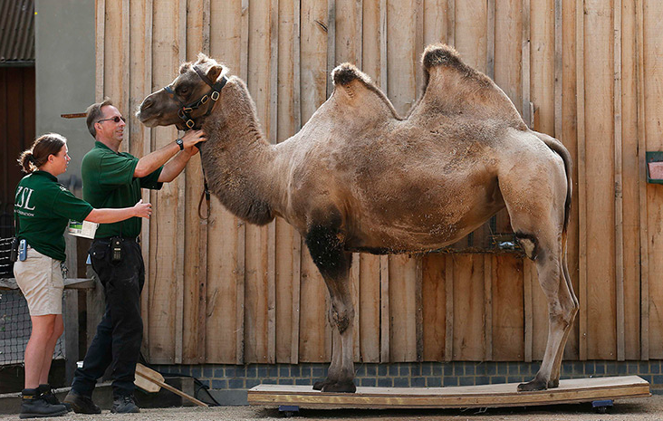
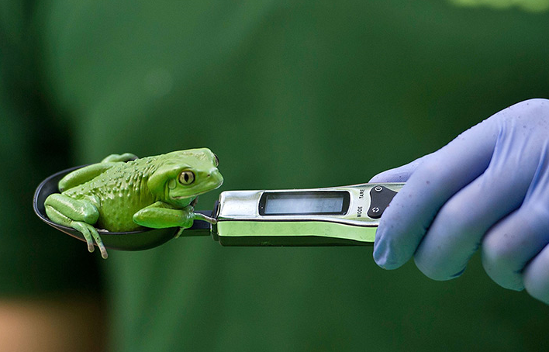
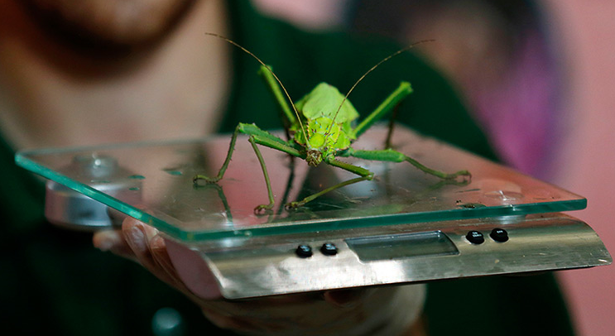
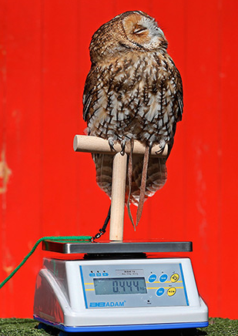
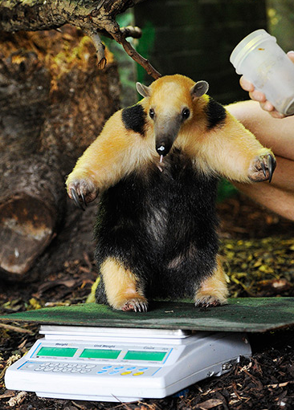
Why it is Important
Taking the data that Species360 has collected
over the years and making it available for member
institutions to better manage their collections is a
main goal of Species360. The Weight Comparison
Report does this exactly. It allows you to compare
your animal weights to those of others of the same
species. This is especially useful for watching the
growth rates of young animals and monitoring
correct weights for your adults. These photos were
taken at the London Zoo.

Slide 4
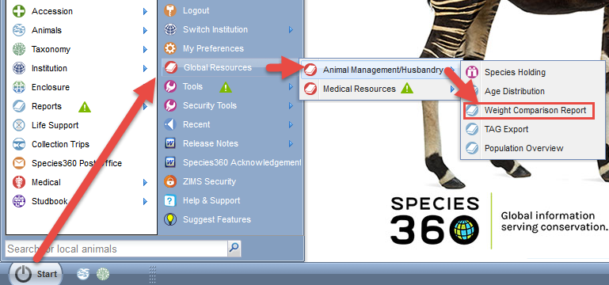
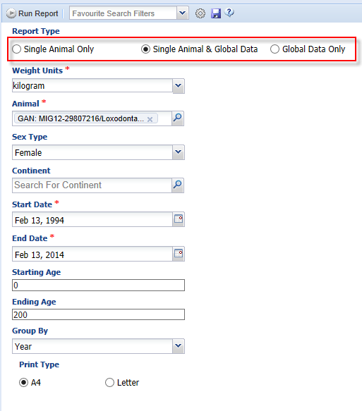
Navigation & Filters
The Weight Comparison Graph is found in Start > Global
Resources > Animal Management/Husbandry. You can
choose to run the report for a single animal, single animal
compared to global data or for global data. If you want to
compare the weight of one of your animals against the
global data you run it for Single Animal & Global Data
as selected here. You can select many filters and options
for the report such as Weight Units, Sex Type,
Continent, Date Range and Starting and Ending Age.

Slide 5
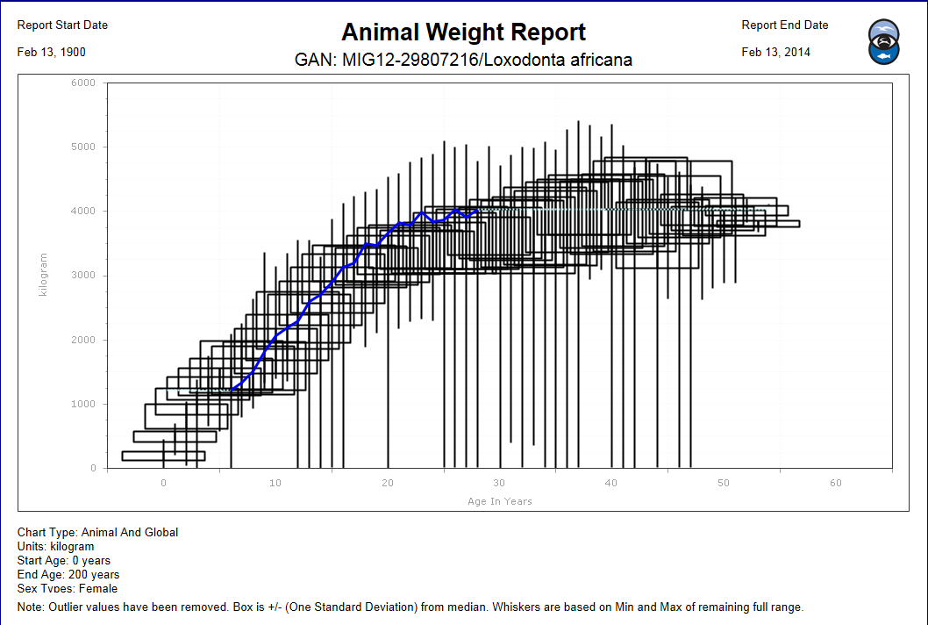
When it’s Ugly (use your filters to make it pretty)
Our first result is rather ugly, we have too
much information to really make a
comparison. Our animal is the blue line.
We can see that we have weights recorded
on it between the ages of 5 and 20 so we
will adjust our filters to get a better graph.
Notes:
Our first result is rather ugly, we have too much information to really make a comparison. Our animal is the blue line. We can see that we have weights recorded on it between the ages of 5 and 20 so we will adjust our filters to get a better graph.

Slide 6
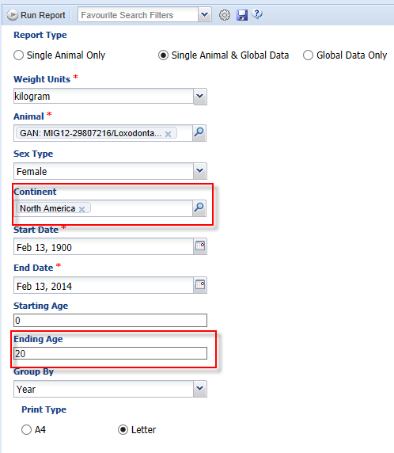
Adding More Filters
To get a nicer graph we have added
some filters. We want to compare
the weights of other female elephants
only in North America. Geographic
location can make a difference in animal
weights so we want to compare apples
to apples here.. We have also chosen to
view weights only up to the ending age
of 20, the age the last weight was taken
on our elephant.

Slide 7
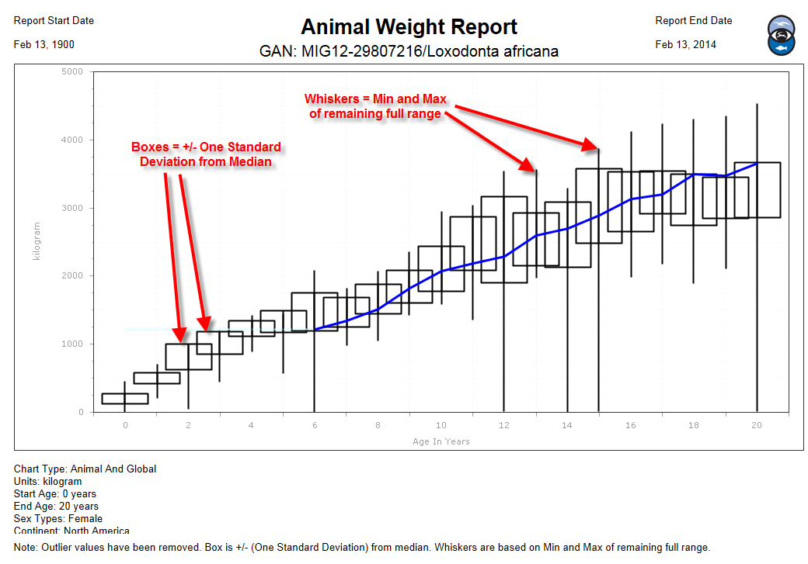
Box and Whiskers Graph
This graph is much easier to read. This type of graph
is called a box and whiskers graph. The Boxes contain
the two quarters of the weights closest to the median.
The Whiskers are the minimum and maximum of the
other two quarters. The whiskers help us identify
“outlier” values to try to have them corrected by the
recording institutions. If the boxes are short it means
most of the values are very similar. If they are long the
Values are more spread out

Slide 8
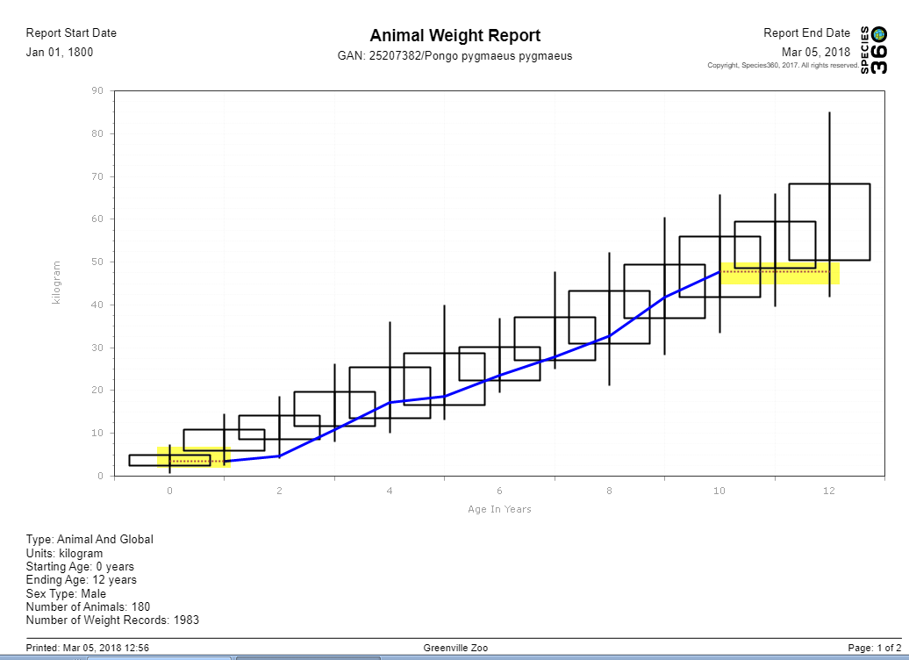
Dotted Lines
If ZIMS does not have data
recorded during the Date
Range selected it will
extrapolate and indicate
this with a dotted line.
There was no data recorded
from 0-1 year of age and
10-12 years of age in this
graph. If there is a long
period with data unrecorded
you may see dotted lines in
the middle of the solid lines
indicating that information
is ZIMS’s best guess.

Slide 9
Weight Comparison Report
One way to use Species360 data to help manage your animals

