Slide 1
ZIMS Studbooks
The Role of Regional Associations
in Managing Studbooks

Slide 2
Regional Associations Have:
Access
To all Studbooks and data contained in them
Responsibilities Include:
Manage Studbook Roles
Includes access to Studbook News Feed
Assign Users and their Roles to Studbooks

Slide 3
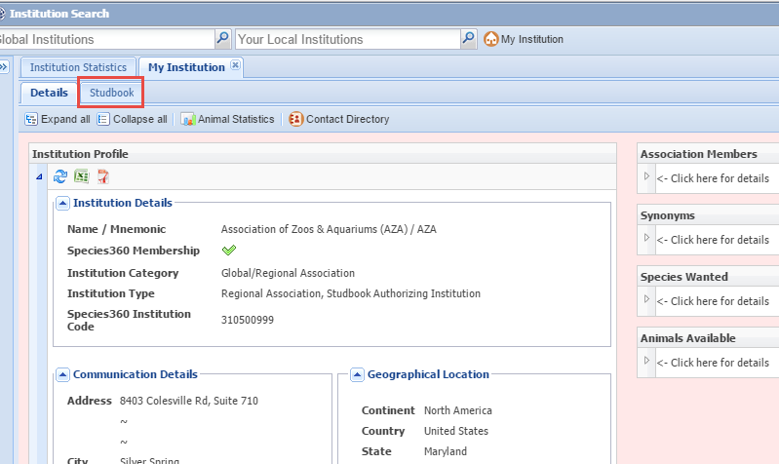
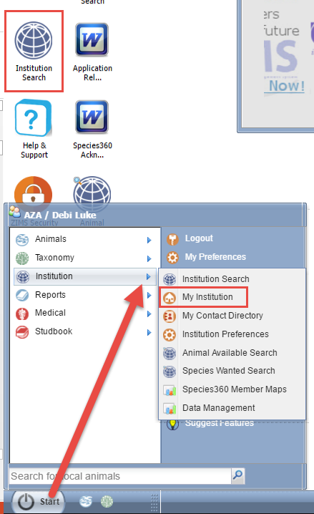
Finding Your Association’s Studbooks
ZIMS considers Regional Associations
as Institutions. To open the module
for your Association either select the
desktop icon for Institution and then
select the My Institution tab, or go to
Start>Institution>My Institution. You
should have access to the “Studbook”
tab.

Slide 4
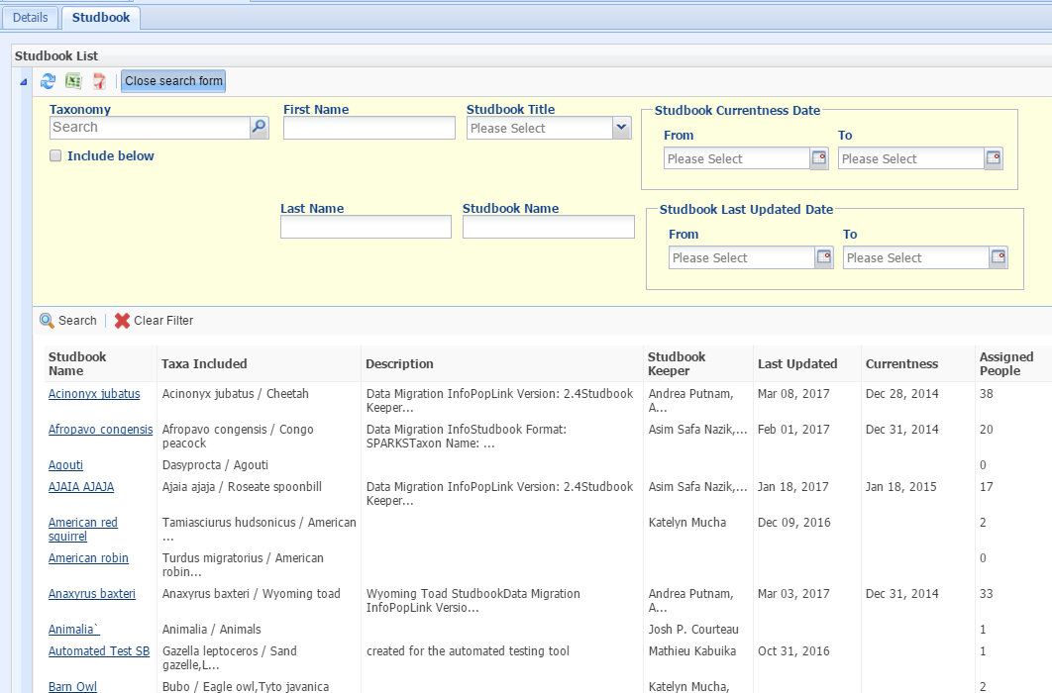
Finding Your Studbooks
This tab will display all of the Studbooks managed by
your Association by default. To search for specific
Studbooks use the Show Search Form tab at the upper
left.

Slide 5
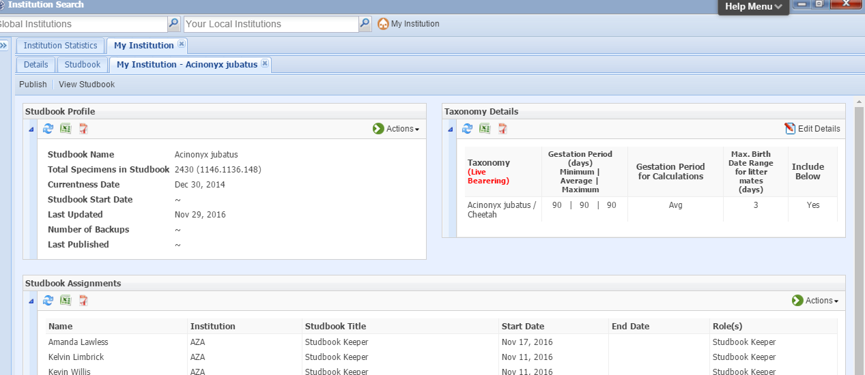
Opening Studbook Details
Selecting the Studbook Name hyperlink will
open the Studbook Details where you can see
a brief overview of the Studbook including
total specimens and gestation/incubation
periods as well as any Studbook Assignments.

Slide 6
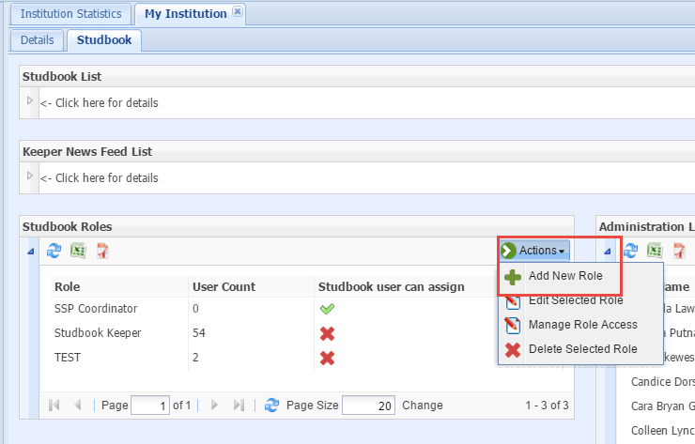
Managing Studbook Roles
Regional Associations are charged with
creating their own Role access for their
Studbooks. These Roles are across the
board for all Studbooks they manage.
To add a Role, under the Studbook tab,
Select Actions>Add New in the Studbook
Roles grid.

Slide 7
Adding a Role
The role Name must be unique for your Association. It may be
easier to name the Role the same as one of the Studbook Title
options available when assigning a User to the Studbook. If the
Allow Studbook User box is checked, then Studbook Users can
assign people to this Role to save the Association from having
to do it for all Studbooks.

Slide 8
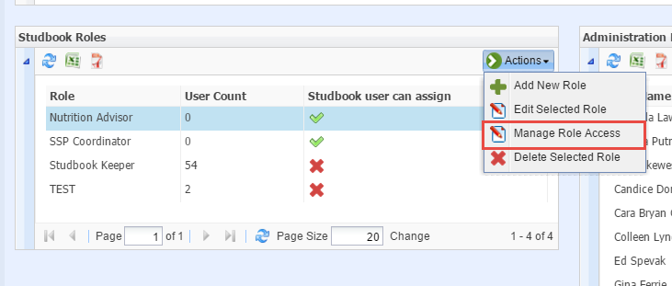
Creating Role Access
You then need to create ZIMS access for this Role.
To do this select Actions>Manage Role access after
you have highlighted the appropriate Role.

Slide 9
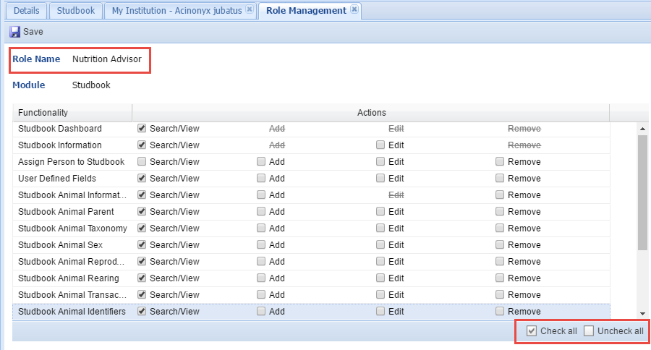
Manage Role Access
Here we are assigning the Role access for
our Nutrition Advisor. Access is provided
by Search/View, Add, Edit and Remove.
We do not want our Nutrition Advisor
Role to be able to add or change any data
so we have given only Search/View access to
the topics we feel are relevant to this
position. The option to quickly check or
uncheck all boxes is available.

Slide 10
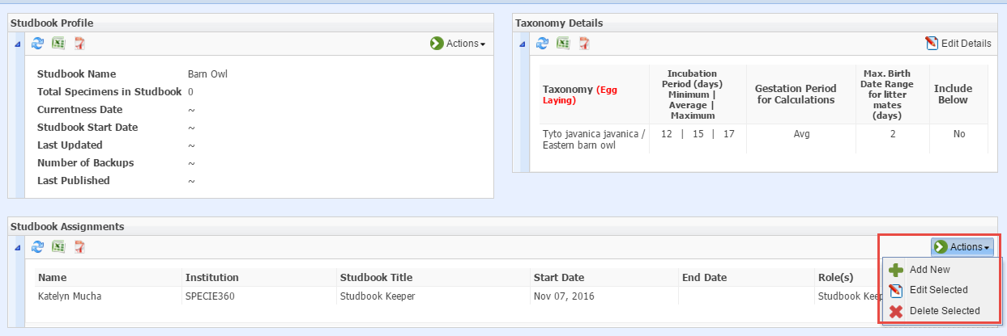
Assign Users to Studbook
When you add a new Studbook you have the option to assign Users
right away. If you have an existing Studbook that you want to
assign people to you can add them in two ways. You can highlight
the appropriate studbook in the list and select Actions>Assign
Person to Studbook. Or, you can use the Studbook Name hyperlink to
open the View Studbook screen and go to Studbook Assignments>
Actions>Add New.

Slide 11
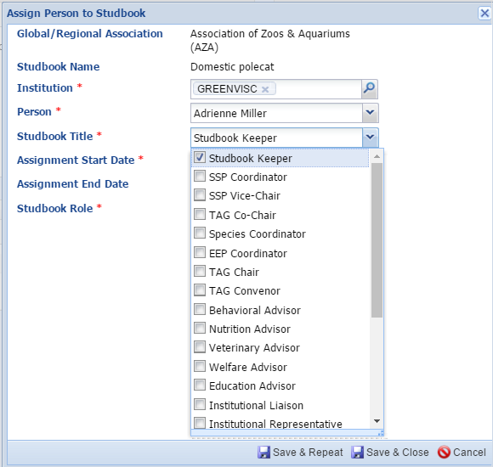
Assign Users to Studbook
The Association and Studbook
Name will default and is not editable.
Only Persons associated with the
institution you enter will display in
that field for selection. There are
many choices for assignment in the
Studbook Title dropdown beyond
the Studbook Keeper title.

Slide 12
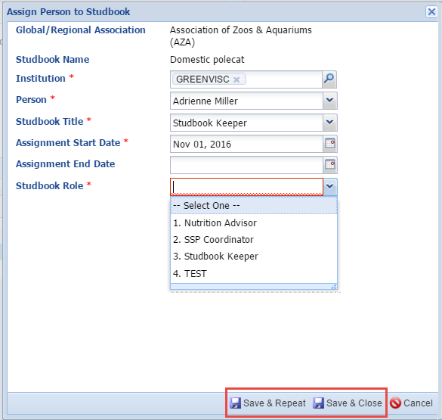
Assign Users to Studbook
The Assignment Start Date
would be the date the Studbook
was approved for the Studbook
Keeper or the date that other
positions were assigned. Any Roles
that you have created will be
available for selection. If you
want to assign multiple persons
select the Save & Repeat option.

Slide 13
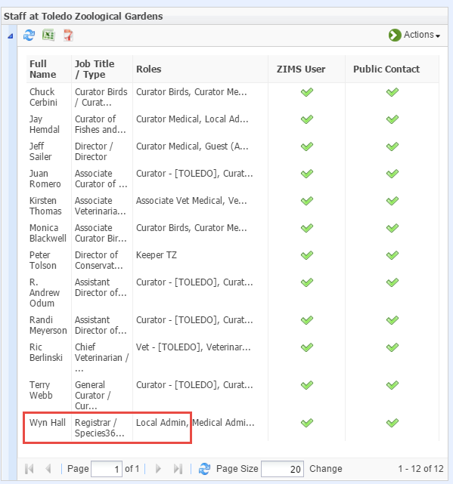
To Find a Local Admin
To find who is the Local
Admin at another
facility you will search
for that institution and
open the Staff grid. Look
for who is assigned the
Role of Local Admin.
Remember that not
all institutions make
their Staff globally
visible.

Slide 14
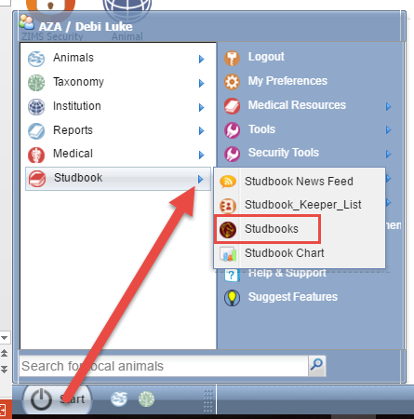
Access to Studbook Data
To look at the actual
Studbook data go to
Start>Studbook>
Studbooks. You can
drag this icon to the
desktop If you find
you are accessing
Studbooks frequently.

Slide 15
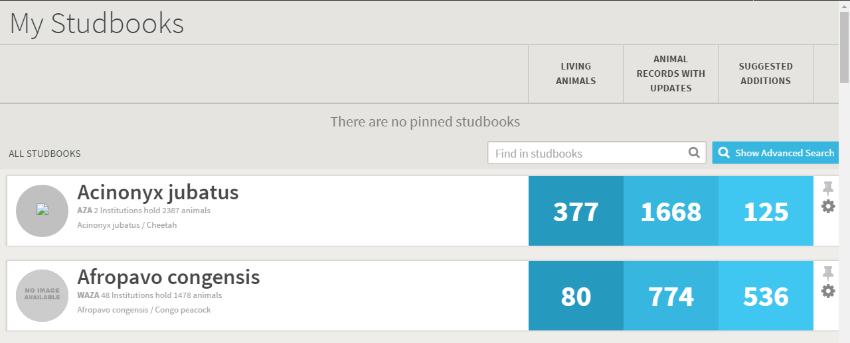
Access to Studbook Data
A list of all of the Studbooks managed by your Regional Association
will display. The number of Living Animals, Animal Records with Updates
(this means the institution has made updates not yet accepted into
The studbook) and Suggested Additions (possible new animals for the
Studbook) is displayed.

Slide 16
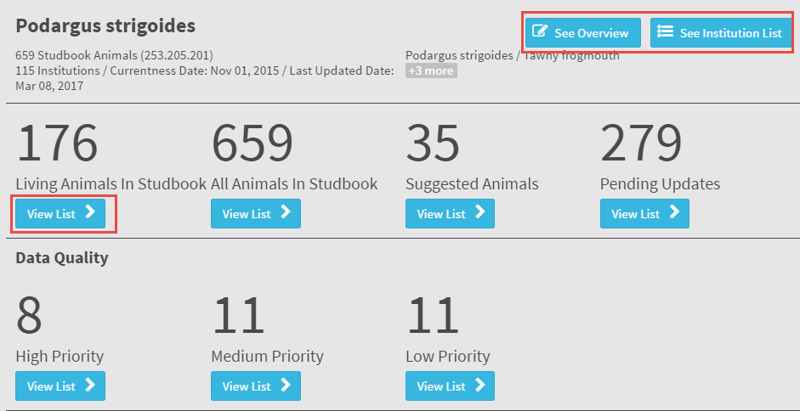
Access to Studbook Data
Selecting the species will take you into the main studbook dashboard.
On the right is recent activity recorded in the Studbook. The See Overview
button displays a brief description of the studbook. The See Institution List
button takes you into the Institution List for that Studbook. You also view
the Data Quality of the Studbook here. Selecting the View List button
will take you into a results grid for the topic.

Slide 17
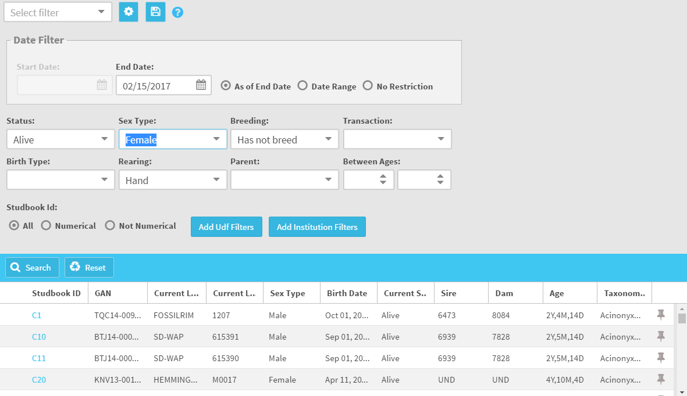
Access to Studbook Data
A list of the studbook animals
will display. Above the list is
an expandable search box to
help you find animals that
match specific filters.

Slide 18
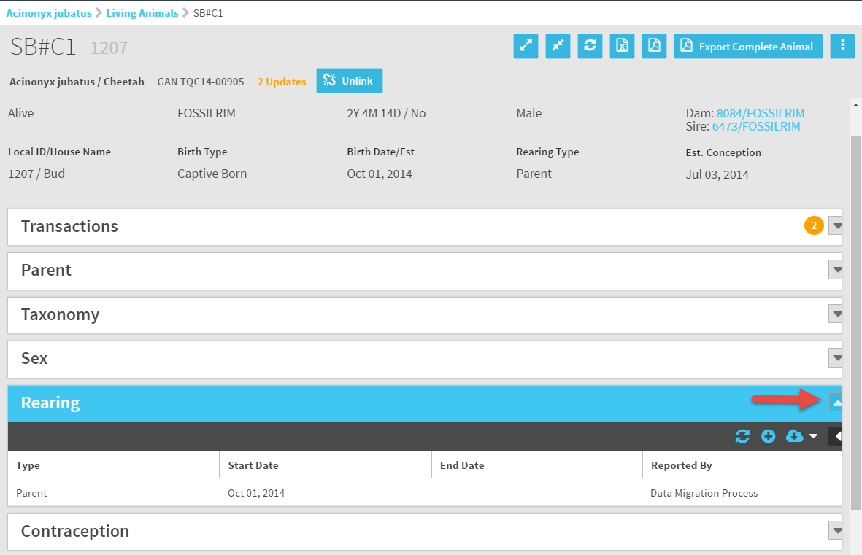
Access to Studbook Data
Selecting the Studbook ID hyperlink will open
the record. Use the arrows to expand the
various grids to view the data recorded.

Slide 19
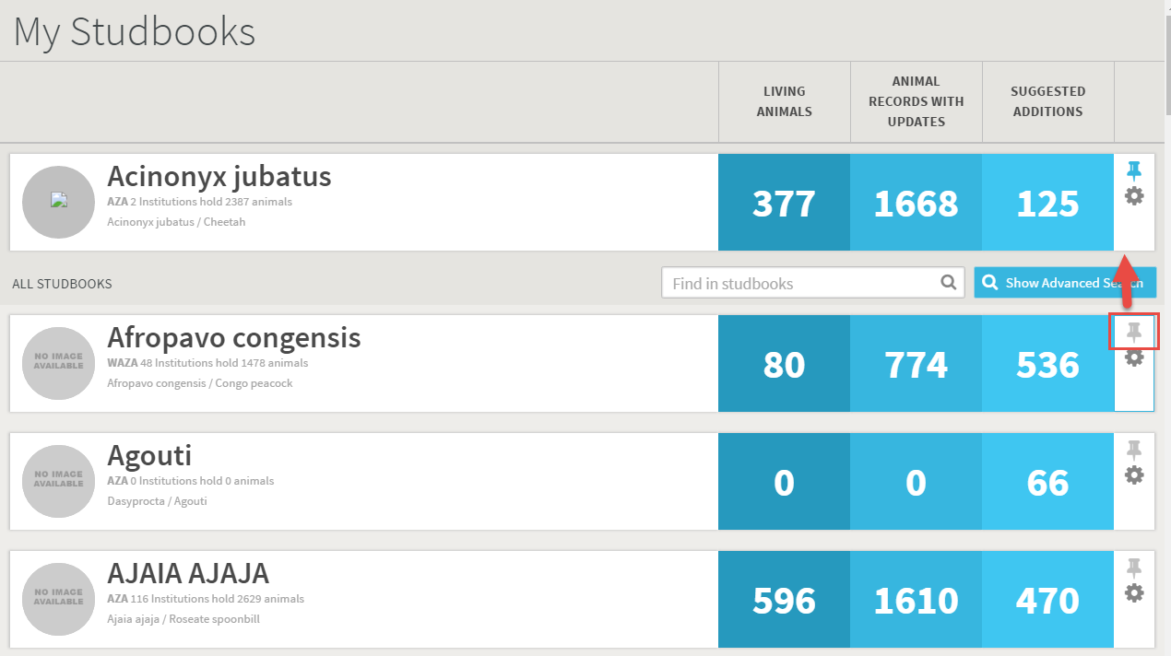
Pinning Studbooks
If there is a Studbook that you access frequently you can “pin” it to the top of the list by selecting the pushpin icon. Pinned Studbooks load faster for your
convenience.

Slide 20
Good News! Things that are not your responsibility!
A Studbook Keeper cannot log into ZIMS
A Studbook Keeper does not have access to the Studbook Keeper List or the Studbook Charts
Tell them to
First: check with their Local Admin as they may not have been assigned the proper Role
Second: check with support@Species360.org

Slide 21
Any Questions?
On the Regional Association Role in
Studbook Management

