Slide 1
5000 – Environmental Quality Graph Tool
Graphing all the Measurements!

Slide 2
What is the Tool?
The Environmental Quality Tool allows Users to:
Graph a single measurement for a single entity (enclosure, life support or component)
Graph multiple measurements for a single entity
Graph a single measurement for multiple entities
Graph multiple measurements for multiple entities

Slide 3
To Use the Tool
Go to Start > Tools > Environmental Quality Graph
or
Open an Enclosure record > Environmental or Water Quality Measurements > View Measurement Graph

Slide 4
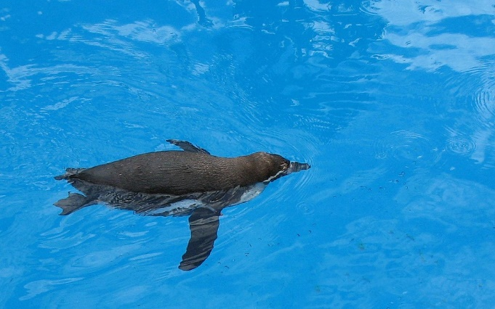
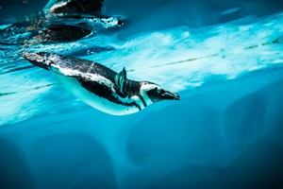
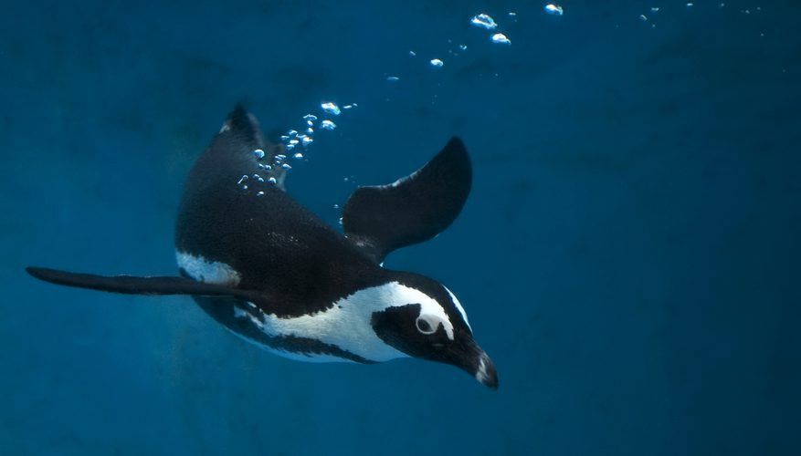
The Scenario
Our scenario here is simple. We have three pools for our penguins – an Exhibit Pool, Holding Pool One and Holding Pool Two. We record pH and water temperature on them weekly.

Slide 5
Graph a Single Measurement for a Single Entity
We want to look at the pH for our exhibit pool for the past three weeks
Select the desired Date Range
Select the Entity
Select the Measurement Type
Select Show Graph

Slide 6
Single Measurement – Single Entity
Hovering over the dots will display the date and measurement recorded
Selecting the hamburger icon will allow you to print the chart

Slide 7
Single Measurement – Single Entity
If you have created a Measurement Range Template for the entity and the measurement, checking the Toggle measurement range areas (1) will provide a visual of any out of range measurements (2 and 3). This is only available for a single entity and single measurement.

Slide 8
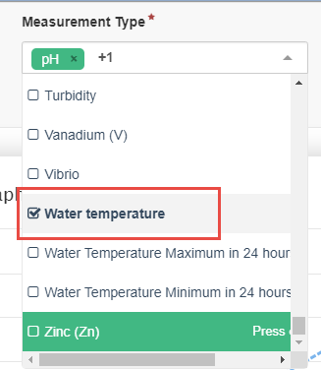
Graph Multiple Measurements for a Single Entity
We want to look at both the pH and the water temperature for our exhibit pool for the past three weeks.
The Date Range and
Enclosure stay the
same but we select
the additional
Measurement Type of
Water Temperature.

Slide 9
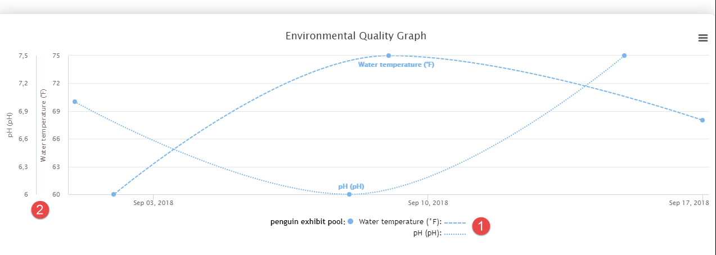
Multiple Measurements for Single Entity
The Water Temperature is displayed by the dashed lines, the pH by the dotted lines
The Y axis displays the numbers relevant to each measurement

Slide 10
Graph Single Measurement for Multiple Entities
We now want to look at the pH measurements for all three of our penguin pools.
We add the two holding pools and remove the Water Temperature from the Measurement Type.

Slide 11
Single Measurement for Multiple Entities
The three pools each have their own color

Slide 12
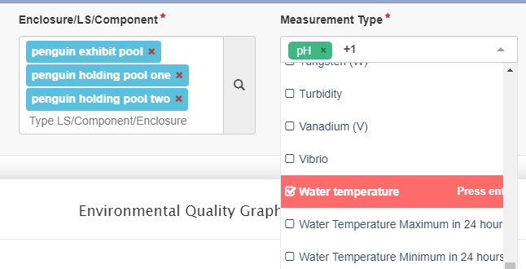
Graph Multiple Measurements for Multiple Entities
We now want to look at both the pH and the Water Temperature in all our pools.
The three Enclosures remain and we added Water Temperature back to our Measurement Types.

Slide 13
Multiple Measurements for Multiple Entities
The three pools each have their own color; the different measurements are displayed by dashed or dotted lines
The Y axis displays the numbers relevant to each measurement

Slide 14
That’s the Environmental Quality Graph Tool!

