Slide 1
5000 ZIMSにおける水族館向け機能
国際種情報システム機構
Notes:
Welcome to ZIMS 5000 - Aquatic and Aquarium Functionality in ZIMS. Many of the features in ZIMS will assist you with managing your aquatic life. These topics are covered in detail with hands on experiences in other sessions. This session is an overview of what ZIMS offers for aquariums. For an actual data entry experience you can select the appropriate classes as noted.

Slide 2
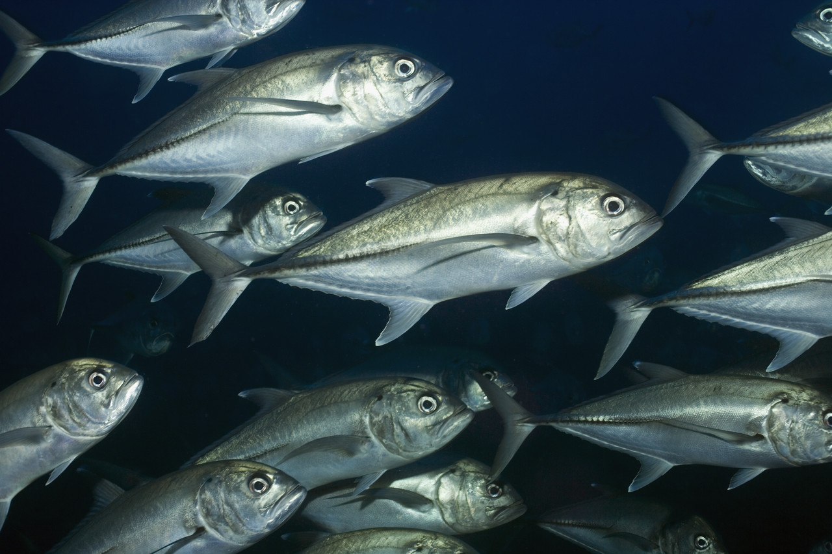
群の管理
Notes:
The first topic covered is Groups. Although aquariums will have Individual animals recorded, the majority will be managed in groups. A group has multiple members, numbers can be actually counted or estimated, the members cannot be individually identified and are usually of the same species.

Slide 3
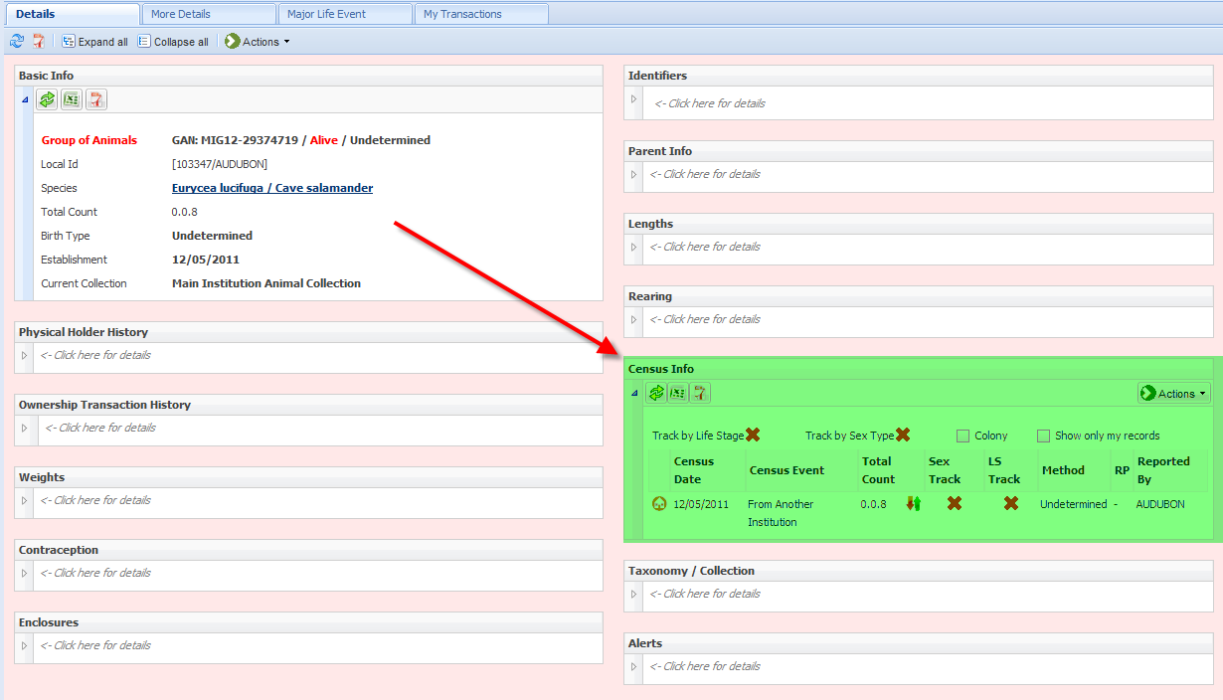
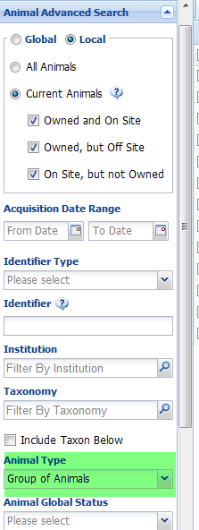
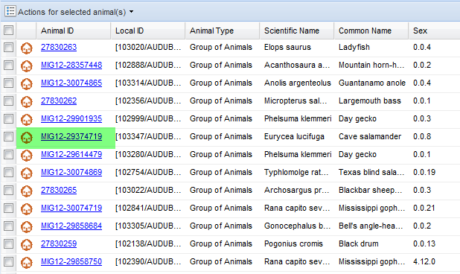
群の管理 – ナビゲーション
Notes:
If you do not know the GAN or Local ID of the group you can search for it. To find a Group select the Animals icon from the desktop. You can also get to Animal Search from the Start menu. >To limit your search select Animal Advanced Search and filter by Group of Animals. You can also further limit your search by filtering by Taxonomy.
>Your results are displayed in a grid. To get into the record select the GAN hyperlink or double left click on the appropriate line of the grid.
>>>>This will take you into the record. The group census records are found on the Details page under Census Info.

Slide 4
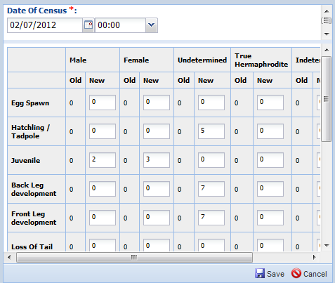
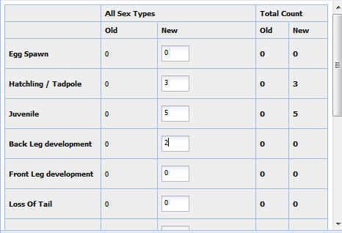
群の管理 – 個体数記録
性別および成長過程による記録
成長過程による記録
性別による記録
単純に員数のみを記録
Notes:
These Groups can be tracked at multiple levels, depending on what information you need to know about the group. Tracking is basically what kind of details you are maintaining on your group numbers. If there is no tracking you are simply recording a census, or the count of the number of members of the Group.
>>>>You can track by Sex Type and record your numbers in the group by the numbers in specific sex classes. This group has 5 males, 8 females and 10 undetermined sexes.
>>>>You can also track by Life Stages and record your members by what stage of life they are in. This group has 3 hatchlings, 5 juveniles and 2 with developing back legs.
>>>>The highest level of tracking is to track by both Sex Type and Life Stage. This group has 5 undetermined sex hatchlings/tadpoles, 2 males and 3 female juveniles, 7 undetermined sex with back legs developing and 7 undetermined sex with front legs developing.

Slide 5
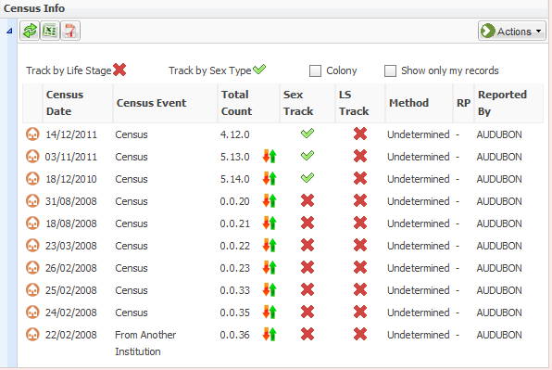
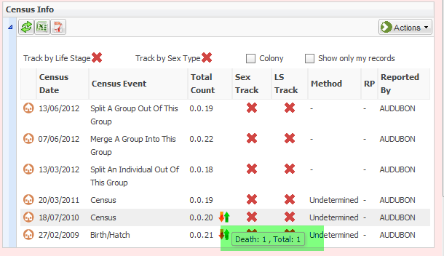
群の管理 – 個体数グリッドを用いた記録
性別による記録
単純に員数のみを記録
Notes:
How your group is being tracked will be displayed in the Census Info grid. This group is being tracked only by a count of the number in the group. If you hover over the up/down arrows you can see why the census changed and here there was a Death in the group. The Census Info grid also shows if there have been members merged or split from the group as the last three entries indicate where we split an individual, merged a group and split a group out of this group. We will cover splits and merges in a couple slides.
>>>>This group started off with no tracking but as of the census taken on 18 December 2011, the group is being tracked by Sex Type. It is easy to change the tracking of a group when you record a census. You are not bound to what tracking you used when you started the group. However, it is not recommended to constantly change your tracking as it makes accurate inventory reports difficult to produce.

Slide 6
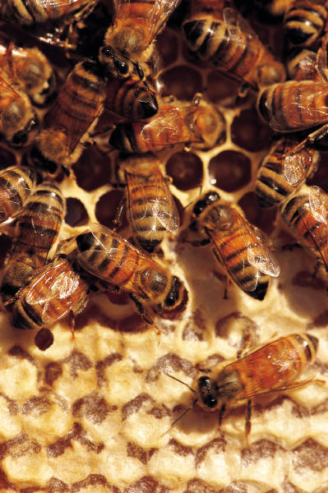
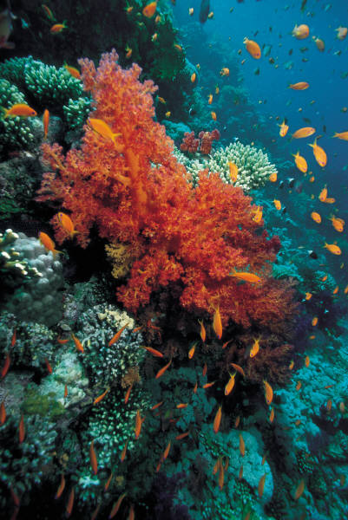
群の管理 – コロニー
Notes:
A colony is a group with too many members to count or record. Examples are honeybees and fire ants. If you entered a group with a count of 20,000 your inventory would be highly impacted. You are not forced to record these as a colony, you just have the option. A colony can also be one entity of many parts or fragments such as corals. In ZIMS you can split your corals into multiple fragments of one.
>To indicate a colony simply check the Colony checkbox in the census info grid.

Slide 7
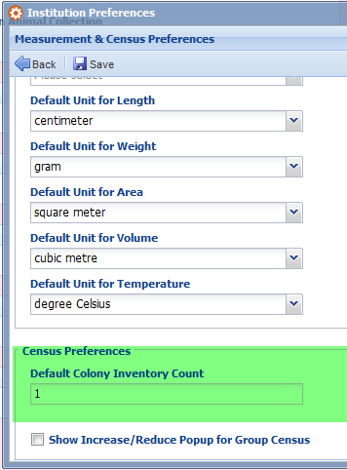
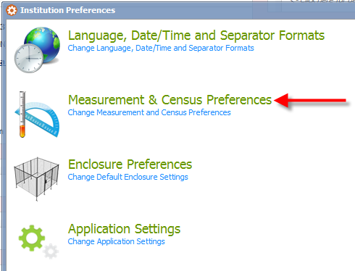
群の管理 – 個体数の単位 機関設定にて設定可能
Notes:
In Institution Preferences your Local Administrator can set what count is desired to be shown in the inventory for your colonies. This is usually “1”. This is the count that will appear on Inventory and Taxon Reports. This Colony Inventory Count is not available as an Individual Preference
>You will find this preference under Measurement & Census preferences.
>Record your desired default in the Default Colony Inventory Count field.

Slide 8
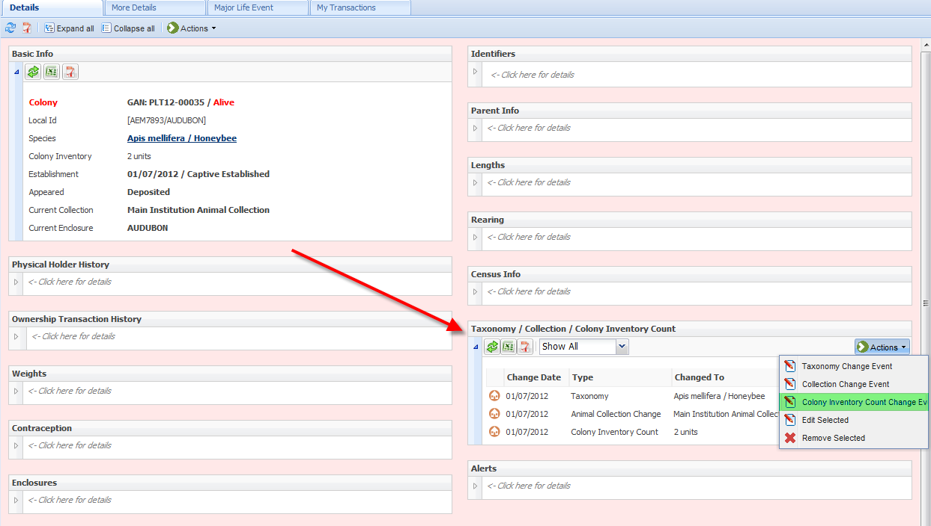
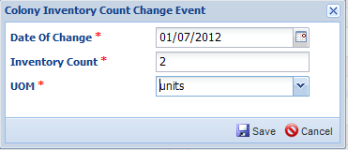
群の管理 – 個体数の単位
記録上での単位変更も可能
Notes:
If you want a specific colony record to have a different inventory count than is recorded in the Institution Preferences, you can change it within the record. After you check the Colony check box in the census grid, a new topic will be added to the Taxonomy/Collection grid called Colony Inventory Count. Under Actions select Colony Inventory Count Change Event.
>Here you will be able to record any inventory count that you want to have represented for this specific record. This will not affect your inventory count preference for any other records.

Slide 9
群の管理 – 実数での個体数調査
群の個体数のリセットが可能。
群の個体数調査には実数を持いる。
以下のように、さまざまな形で個体数は 増減する。
出生/移入/複数の群の統合による増加
死亡/移出/群の分割による減少
この個体数調査に他の内容は影響されない。
個体数は前回の個体数調査への増減を 元に算出される。
Notes:
A True Census of a group is when you actually go in and count them, either an actual or an estimated count. This is considered to be a group count reset.
>If you want to change the tracking in a group you must enter a True Census
>This is the count that will be used by the application to automatically calculate group numbers for any activity that happens in the group after this count such as births and deaths. Births, Acquisitions and Merges will increment the count. Deaths, Dispositions and Splits will decrement the count.
>And anything that happens before this count does not affect the census. The number will be calculated from the previous True Census.

Slide 10
群の管理 – 全て、あるいは部分的な移動
全て
群の個体全てが対象
群作成時
群を空にする時
部分的
群の一部分の個体が対象
新しく個体を群に追加
群から個体を取り除く
Notes:
Under My Transaction for Groups you have the ability to perform Full or Partial Transactions. A Full Transaction involves the entire group. It is the initial acquisition of the entire group, or the final disposition of the entire group.
>A Partial Transaction involves only some members of the group. You are either adding numbers such as births or new acquisitions or merges, or you are removing members such as deaths, disposition of a few members of the group or splitting the group

Slide 11
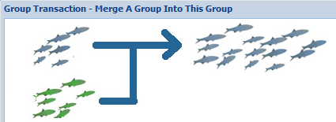
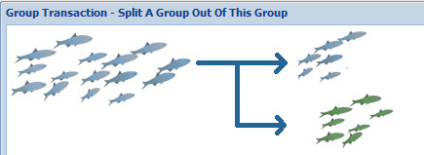
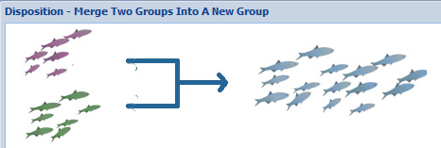
群の管理 – さまざまな対処方法
Notes:
For many of the partial transactions you will see graphics that represent what you are doing to help avoid confusion. Here you are merging an individual into a group.
>Here you are merging a group into an existing group to make it larger.

Slide 12
群の管理 – 有効あるいは無効
有効（Open）
今後も記録を追加可能
報告書上の個体数は0.0.0と記載される
状況（Status）は,、有効（Open）と 記載される
医学的および遺伝学的記録は失われる
無効（Closed）
いかなる記録も追加不可能
無効となった時点以降の期間を 対象とした報告書には記載されない
状況（Status）は、無効（Closed Out） と記載される
Notes:
Another management functionality for groups is the ability to keep them Open or mark them as Closed, usually, but not always, when the count reaches zero. What you select will impact reports and what you can do to the group. For an Open group you can still perform functions on it, such as adding new members and recording new censuses. In reports the count will display as 0.0.0 until the census is changed. In a search for current animals, the group will be found and display as 0.0.0. The status of these groups will be “Open”. An example of why you may want to keep a group whose count is zero Open is for your goldfish pond. You may restock it every year and want to keep the same GAN to represent that goldfish group. It is important to note that if you restock a group all accurate tracking of medical issues or genetics in the group is impacted as it basically starts new with the re-stocking.
>For a group that has been marked as Closed Out you cannot add any members to it or record new censuses. If you need to do this you would have to remove the Close Out action first. If a report is run for a time frame after the group was Closed Out, the group will not display. A Closed Out group will also not be displayed in a search for current animals results grid. The status of the group will be “Closed Out”.

Slide 13
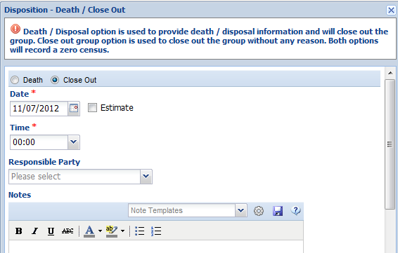
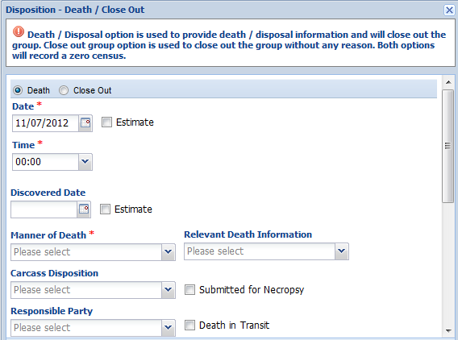
群の管理 – 無効にする
Notes:
You can Close a Group out by Death of the entire group. Or you can simply mark a group as Closed Out. Go to My Transactions, Dispositions, Full Disposition and Death.
>Select the appropriate radio button – Death or Close Out. If you select Death then you have the standard Death information screen to complete.
>If you select Close Out you will simply need to provide a date for the Close Out. This is especially uselful for historical groups with a count of zero. The census of the group does not have to be zero to mark it as Closed Out.

Slide 14
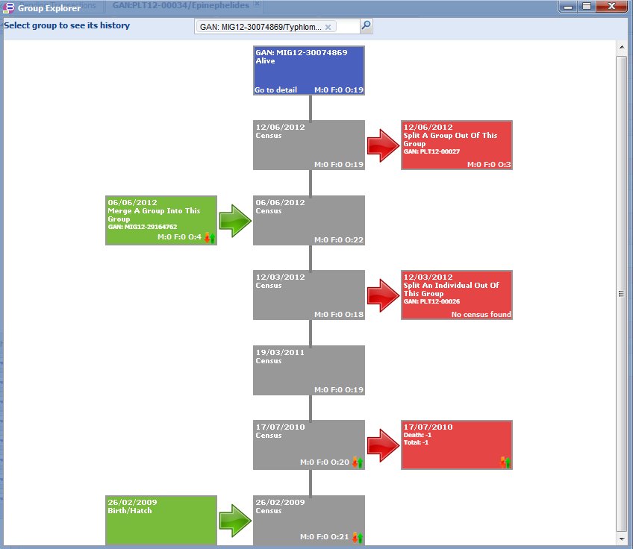
群の管理 – 群の概要（Group Explorer）
各記録へのリンクあり
Notes:
Another feature that allows you a quick look at what has been happening in your groups is Group Explorer. It is a visual of your censuses and Splits and Merges of your groups. Group Explorer is found under the Tools in the Start menu.
>Additions to the group are shown on the left. Removals from the group are shown on the right. For this group we can see it was acquired as a Birth/Hatch of 21 animals. On 17 July 2010 one member died. A census of 19 was taken on 19 March 2011. On 12 March 2012 an individual was removed from the group. On 6 June 2012 a group of 4 was merged into the group. On 12 June a group of 3 was split out of the group. The current census of the group is 19.
>>>>The merges and splits are hyperlinked so you can go directly into the records involved.
>The final census is also a hyperlink so you can go directly into the record for the group in focus.

Slide 15
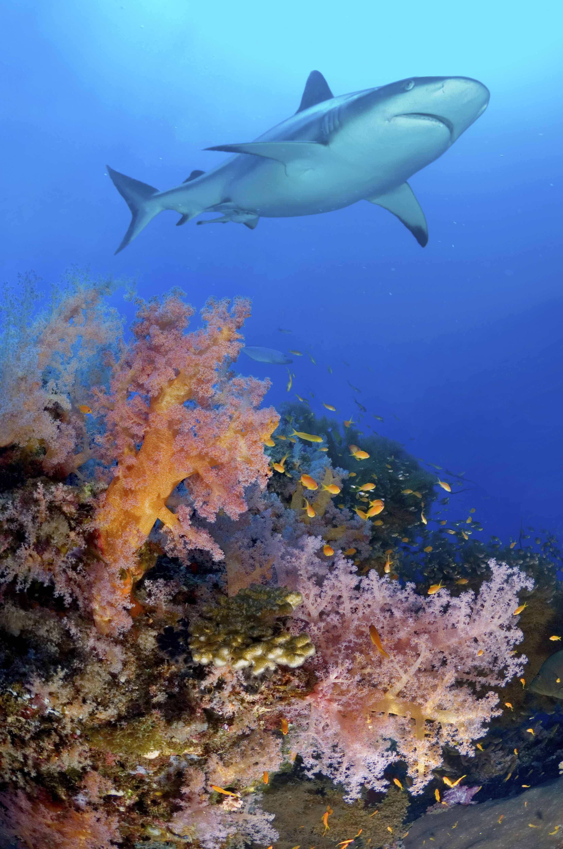
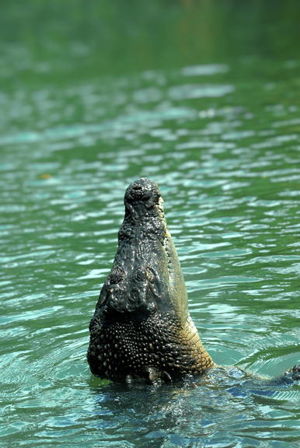
収容場所/水槽
Notes:
ZIMS also allows additional managing of your 収容場所 and 水槽. Most aquarium exhibits are indoors where they can be closely monitored and controlled. But there are also many exhibits that may be outdoors on a permanent or seasonal basis.

Slide 16
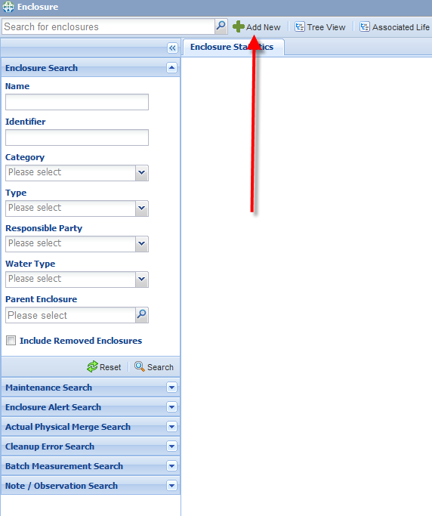
収容場所/水槽- 新規登録
Notes:
Open the Enclosure module from the Enclosure icon on the desktop. You can also open 収容場所 from the Start menu.
>You can search for a previously recorded Enclosure using the filters in the search box, or you can open the Enclosure Tree. To add a new Enclosure select the Add New tab.

Slide 17
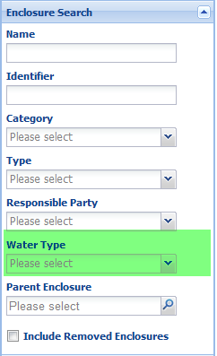
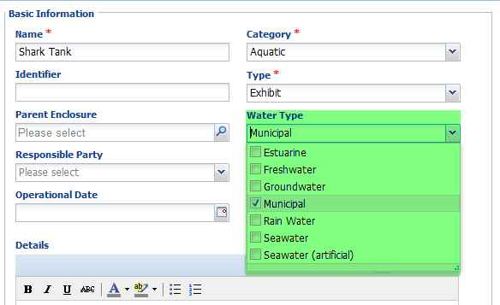
収容場所/水槽- 水の種類
Notes:
When you add a new aquatic enclosure you can record what Water Type it is. This can be edited should it change. It is a multiple select dropdown data standard so should you record a building with multiple 水槽 you can indicate so here.
>This is a searchable field so you can pull up all your 水槽 with a specific water type. For example, if there is an issue with your municipal water you can find all 水槽 with that water type and possibly address the issue.

Slide 18
収容場所/水槽 – 面積と防壁
面積
収容動物に十分な広さがあるか？
十分な高さ/深さがあるか？
移動先として適切か？
防壁
適切な素材か？
強度は十分か？
Notes:
ZIMS also gives you the ability to record dimensions and barriers of your 収容場所/水槽. If you have recorded the dimensions and barriers for your 水槽 and 収容場所 you will not have to re-measure or check should there be any questions. You can quickly see if it meets the requirements for the space needed for the occupants. You can tell if the walls are high enough to keep the occupants in, or the depth deep enough for the health of the inhabitants. And if it is moveable you can quickly see if it will fit where you want to place it.
>If tank inhabitants change and therefore tank requirements change, you can see if the barrier remains an appropriate material. And you can also determine if the barrier is strong enough to contain a new species that may have different requirements than the previous occupants.

Slide 19
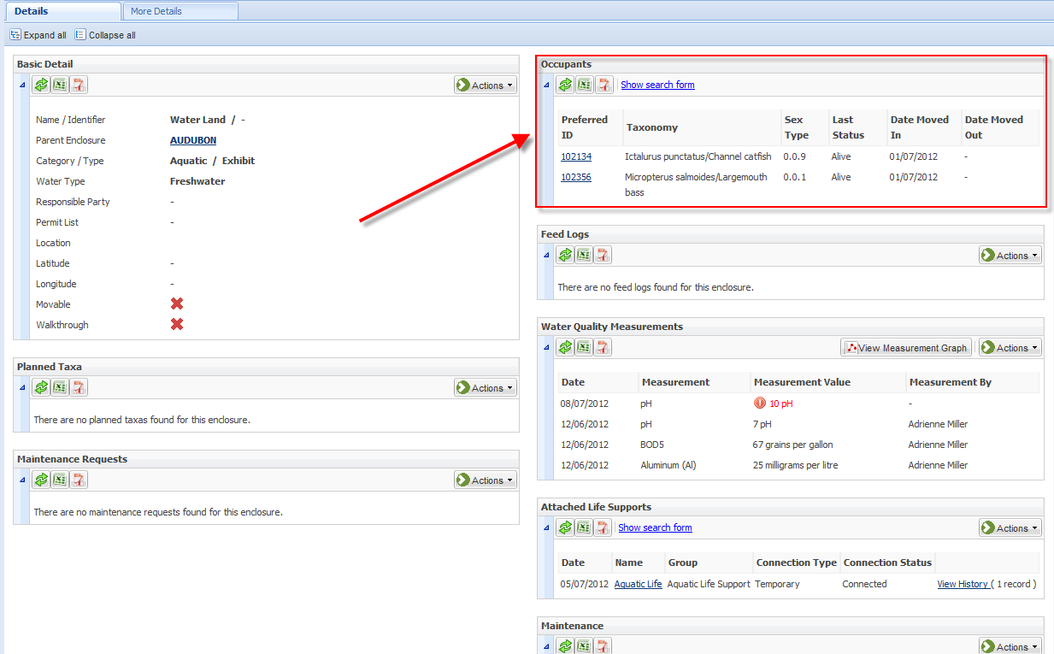
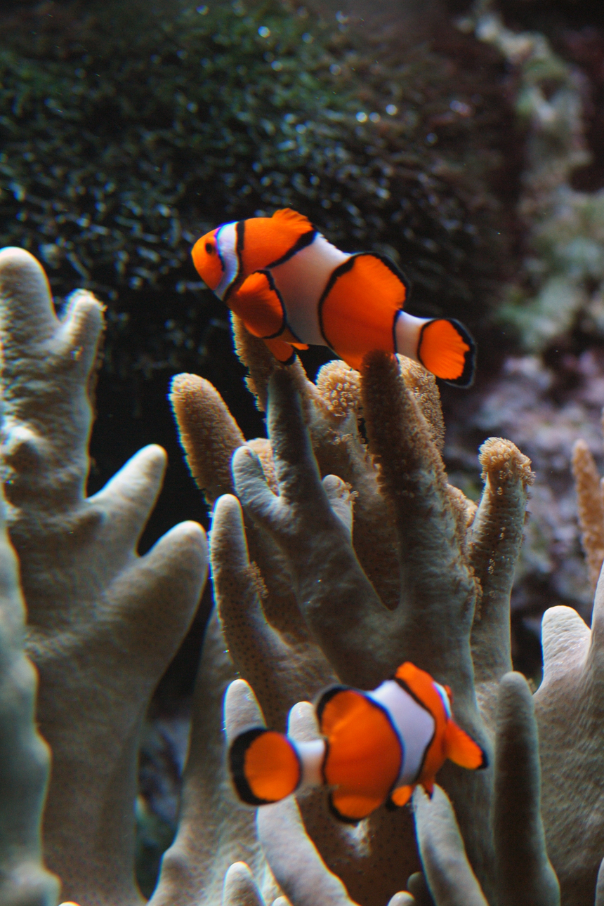
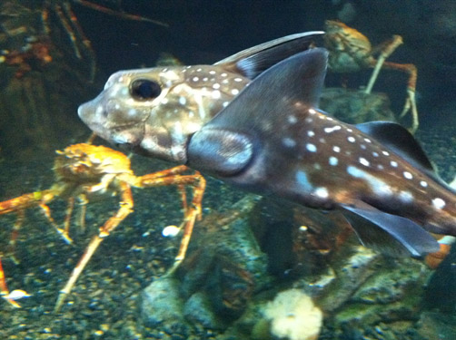
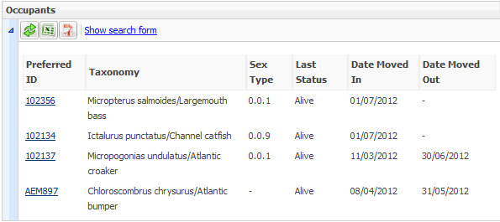
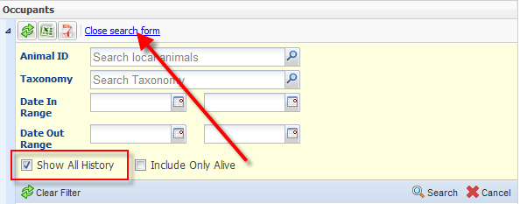
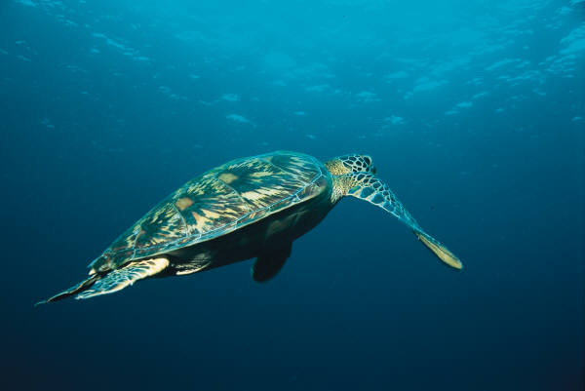
収容場所/水槽 – 収容動物
Notes:
From within the enclosure record you can also tell at a glance what animals are currently occupying the enclosure. Currently this is a fresh water tank with species native to North America. >Using a search form you can find historical occupants by taxonomy and date range. We are selecting to Show All History.
>We can now see that at one time this tank housed species found in the Atlantic Ocean and was probably a seawater tank at that time.
>>>>So today you have sharks in the tank, but last year it held sea turtles
>and previous to that it held clownfish
>and rat fish to name a few possibilities.

Slide 20
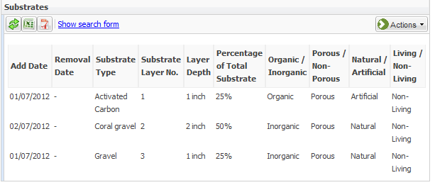
収容場所/水槽 – 基質
Notes:
Knowing what substrates are on the bottom of your 水槽 may impact what you use to treat the water. And knowing when the substrates were added may influence when it is time to remove them and replace with fresh ones. In addition, the grid will note whether these substrates are organic or inorganic, porous or non-porous, natural or artificial and living or non-living. Using the search form you can find any substrates that have been replaced.

Slide 21
収容場所/水槽 – 修繕管理
Notes:
We all know that our 水槽 may have to have maintenance performed off and on. We don’t want our exhibits to be down any longer than necessary. In ZIMS you can track enclosure and tank maintenance. You will be able to track work orders and tell if maintenance is proceeding in a timely manner. You can also track exhibits and 水槽 that are requiring more maintenance than normal.

Slide 22
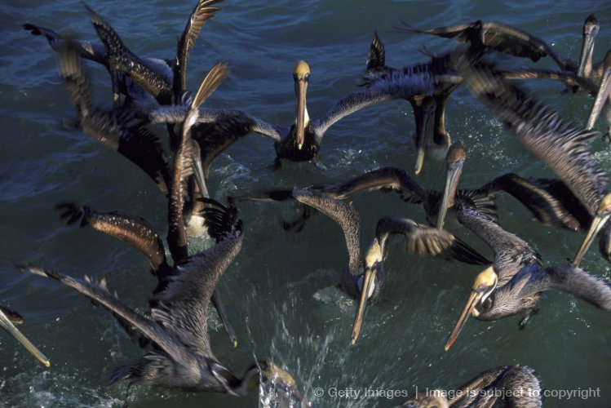
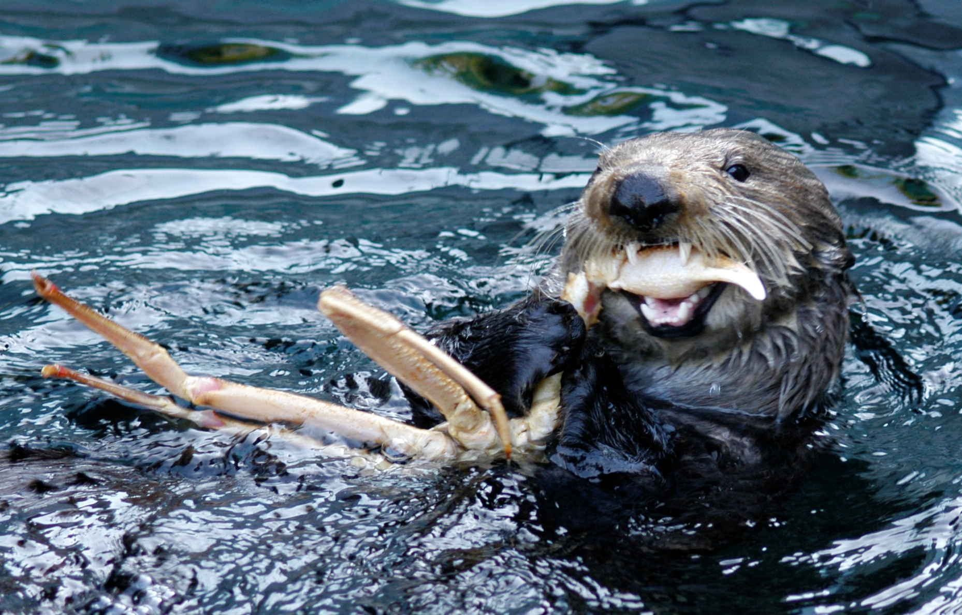
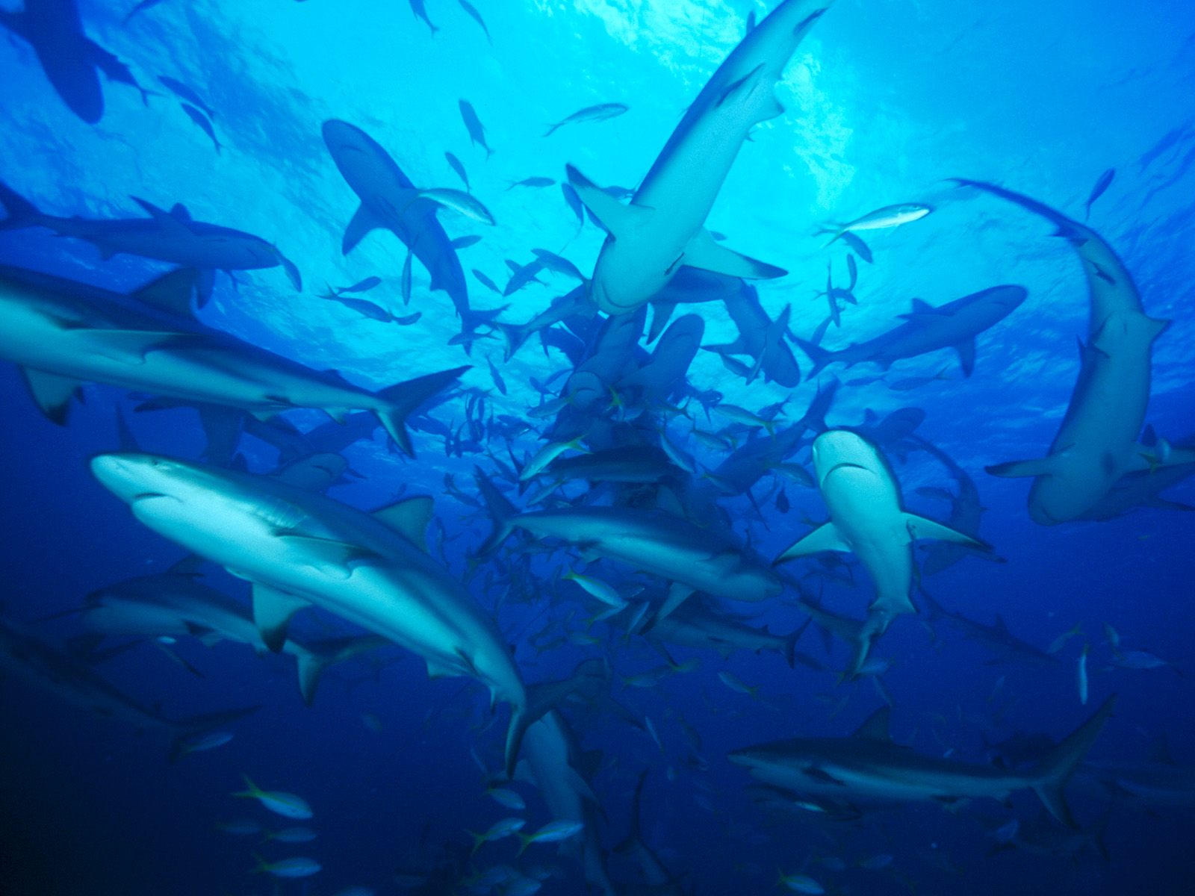
収容場所/水槽 – 食餌ログ 水槽をベースに記録することにより、 収容動物の記録にも反映されます
Above photo courtesy of Seattle Aquarium
Notes:
Within the animal record you have the ability to record a Feed Log against the individual or group. On the right, a sea otter at the Seattle Aquarium is enjoying a crab leg snack. But you can also record a Feed Log against an Enclosure and then apply it to all the occupants within that enclosure at the time. For the feeding frenzies on the left, this may be the easiest approach. You enter what was feed, the time and by whom. You can then record how much was consumed or how much was left over. You only need to enter one, consumed or left over, the other will automatically calculate. If you wish, you can select to apply that feed log record to all current occupants of the enclosure. This will automatically place the record of the feeding into the record of every individual or group currently inhabiting the enclosure.

Slide 23
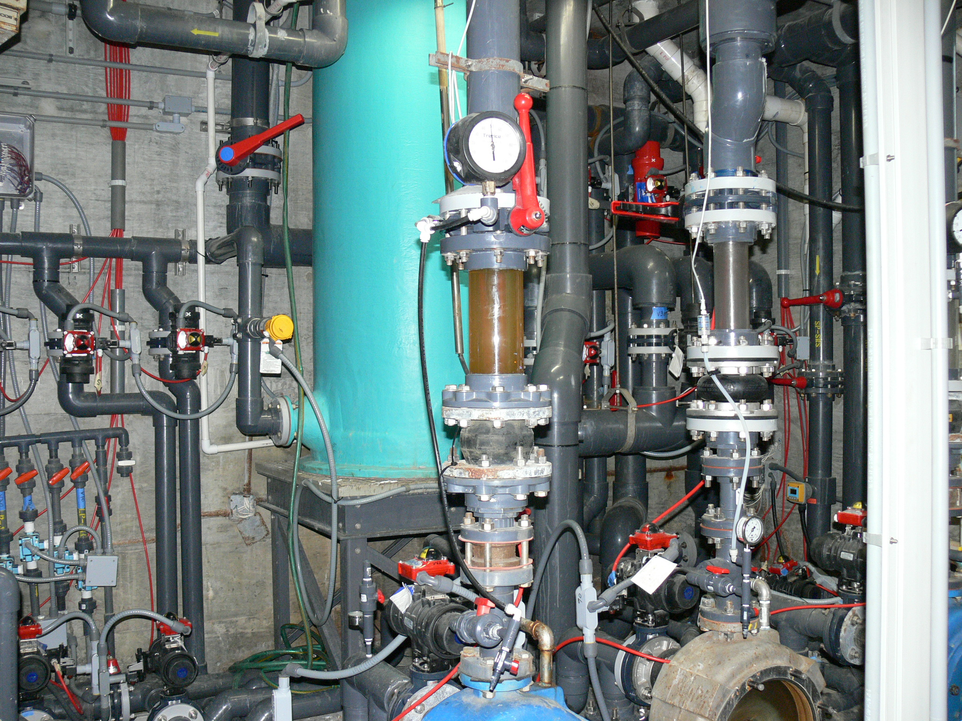
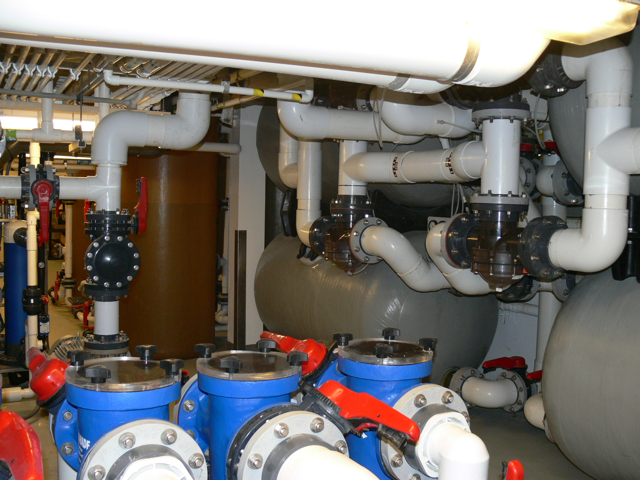
ライフサポート
Photos courtesy of Tennessee Aquarium
Notes:
One topic very important to aquariums and those managing aquatic life is the ability to maintain information on the ライフサポート that keep the animals healthy and happy. Although terrestrial 収容場所 do use ライフサポート, it is the aquatic 収容場所 that rely very heavily on ライフサポート to sustain the life of their animals. These photos are of ライフサポート at the Tennessee Aquarium.

Slide 24
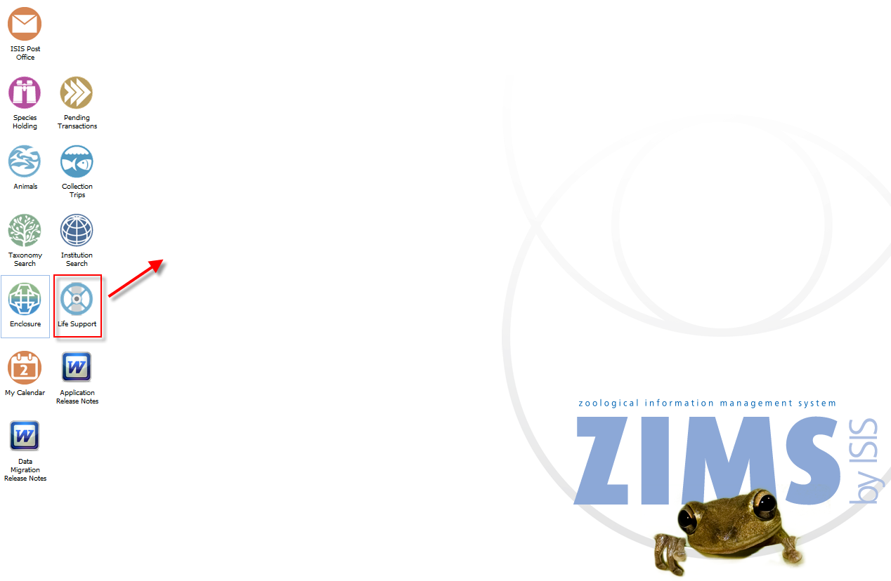
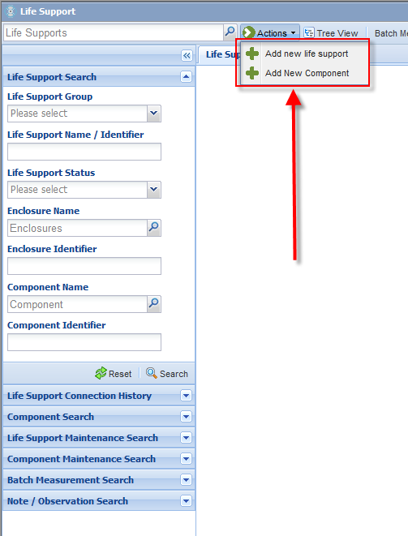
ライフサポート –ナビゲーション
Notes:
To get to the ライフサポート module select the ライフサポート icon on the desktop. You can also get there from the Start menu.
>From within this module you will manage both your ライフサポート and your components that make up the ライフサポート. You can perform searches for both, or add new components or ライフサポート.

Slide 25
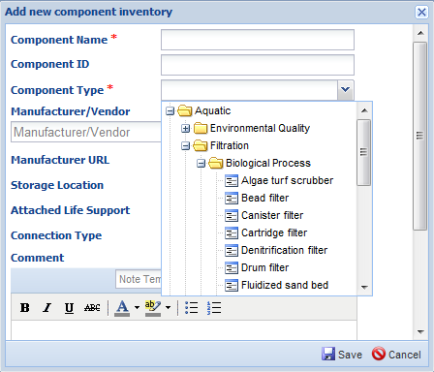
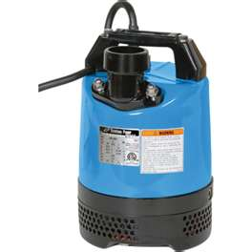
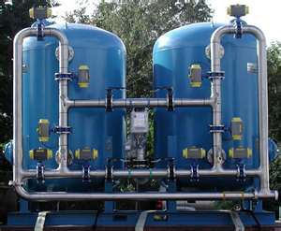
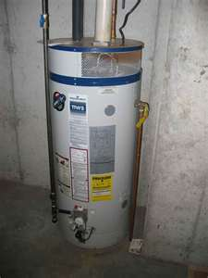
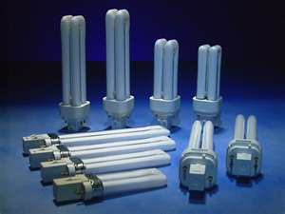
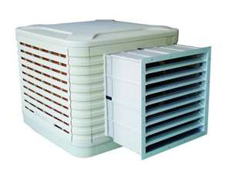
ライフサポート – コンポーネント
Notes:
Your various components that make up your ライフサポート are maintained in an inventory where you can track Make, Model and serial number. These components include items such as pumps, filters, lighting and water and air temperature controllers. You can add your components directly to the inventory or add them from the ライフサポート record itself.
>The component type is a cascading dropdown where you can stop anywhere on the list to select. So you could select simply Filtration or go down to Biological process filtration. If you know the exact type you could select the actual component such as a bead or drum filter.

Slide 26
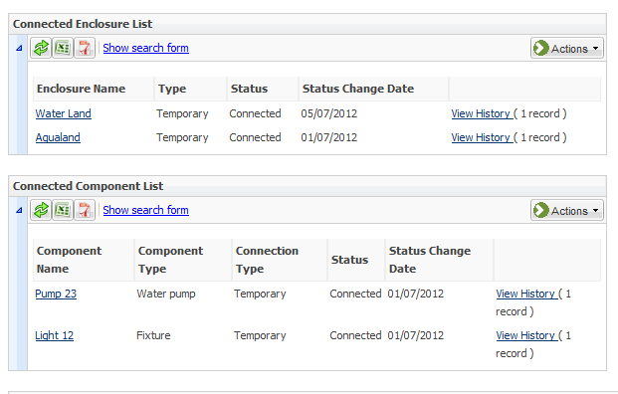
ライフサポート – 付属の収容場所
Notes:
While your components can be physically attached to create only one ライフサポート, one ライフサポート can be physically attached to multiple 収容場所. This ライフサポート is attached to two 収容場所, Water Land and Aqualand. In addition, you can view what components make up the ライフサポート and this ライフサポート has a water pump and a light fixture. You can view any disconnected 収容場所 or component by using the search forms. And you can view connection history by using the View History link.

Slide 27
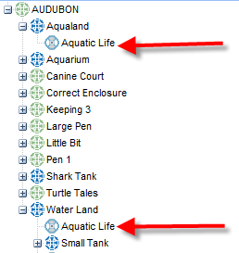
ライフサポート – 関連するライフ サポートを樹形図上で確認
Notes:
Another quick and easy way to see if an enclosure has a ライフサポート attached to it is to view the Associated ライフサポート Tree. Here we can quickly see that the Aquatic Life ライフサポート is attached to the two 収容場所 – Aqualand and Water Land

Slide 28
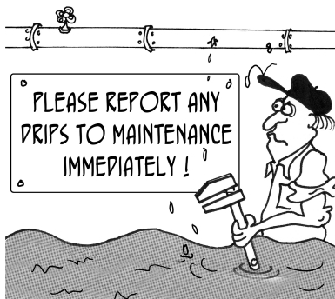
ライフサポート – 修繕管理
Notes:
Keeping ライフサポート and Components in working order is very important. Just as for 収容場所 you can track any maintenance performed on both total ライフサポート and their individual Components. You can track how your Work Orders are progressing by searching for them and reviewing the progress within the record.

Slide 29
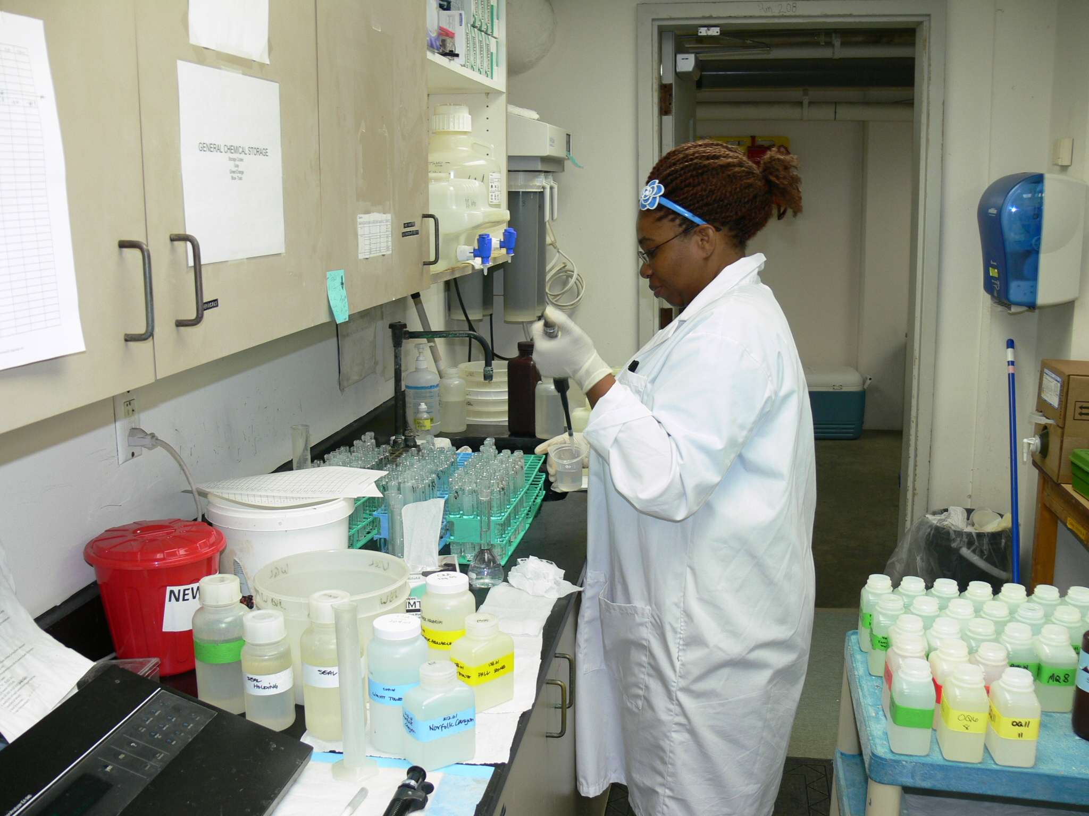
水質
Photo courtesy of Tennessee Aquarium
Notes:
水質 is a large part of your Aquarist’s day, and hugely important in maintaining the health of your animal collection. ZIMS allows you to record 水質 measurements on your 収容場所, ライフサポート and Components. This is the 水質 lab at the Tennessee Aquarium.

Slide 30
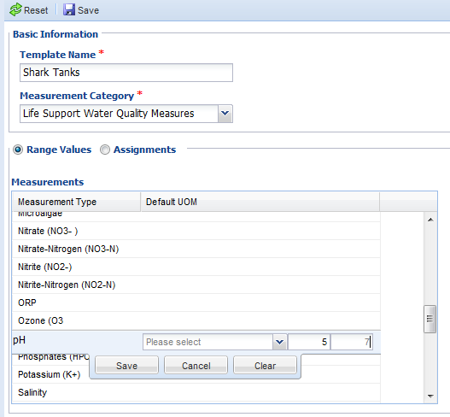
水質測定 – 規定範囲を設定する 適切な最低値および最高値を 予め設定しておくことができます
Notes:
Simply recording measurements on your 収容場所, ライフサポート and components is not usually enough. You usually want to keep the measurements within specific minimum and maximum ranges for the health of the animals. In ZIMS you can record your desired ranges for your 水質 and make these ranges specific to 収容場所, ライフサポート and components.
>>You can select environmental or 水質 measurements for your various entities.
>You then record your desired minimum and maximum measurements.
>You then assign these measurements to the appropriate enclosure, ライフサポート or component.

Slide 31
水質測定 – 自動警告 規定範囲以外の数値が入力された場合に 警告が表示されます
Notes:
If a measurement is outside the range there is a warning regarding this. You can save the measurement anyway, or go back and correct if it was an error. But whoever does the data entry has been given a heads up that this measurement is not a desired one. Future plans have automatic messages being sent to appropriate staff such as Curators and Veterinarians also.
>In addition, in the measurement grids, these out-of–range measurements are displayed predominately in red.

Slide 32
水質測定 – テンプレート 複数の測定値の管理
Notes:
If you don’t have a lot of measurements to take, you can record individual measurements on each tank. However, if you want to save data entry time, you can create measurement templates where you can record multiple measurements on multiple 水槽 in a single screen. This template has been created to record Aluminum and pH on 2 水槽, Aquarium and Water Land.
>This is the data entry screen for that template. All of these measurements will go directly into the appropriate tank records. If you have recorded min/max ranges you will also receive notification if the measurement is outside the desired range. And it will also show in the grid in red.

Slide 33
水質測定 – グラフ 入力された内容を元に、報告書上に 自動的にグラフが作成されます
Notes:
You can also produce a graph of your 水質 measurements.
>By hovering over the dot on the graph you can view the actual date and measurement recorded. This is a graph for the pH measurements recorded for a tank. By adjusting the From and To dates you can expand or limit the range of the graph.

Slide 34
採集活動
Photo courtesy of Seattle Aquarium
Notes:
Although terrestrial animals such as reptiles and birds are often collected on trips specifically organized to do so, aquariums depend highly on organized trips to replenish their exhibits. ZIMS allows you to track your trips with a simplified accession screen for accessioning animals collected, caught and released, or that died in transit. Here the Seattle Aquarium is on a Collecting Trip in Neah Bay off the northwestern coast of the United States.

Slide 35
採集活動 – ナビゲーション
Notes:
To add or search for a Collection Trip select the Collection Trip icon from the desktop. It is also available under the Start menu.
>You can use the search box to search for a previously recorded trip using many different filters. To add a new trip select Add New Collection Trip.
>This takes you to a simple screen to add the basics about the trip. Once you Save this screen you will be taken to a longer screen where you can provide the following details….

Slide 36
採集活動 – 記録内容詳細
関係者
誰が責任者だったのか
誰が参加したのか
場所
国/地理学的地域
緯度/経度あるいはGPS
使用車両
自分たちの所有しているもの
借りたり寄贈されたもの
許可
法的採集許可など
Notes:
You can gather a lot of information about these 採集活動, with a wide range of search fields to retrieve this information at a later date. You can track and retrieve who was the Trip Lead as well as staff members who participated in the trip.
>You can record a general location such as a country or major geographic area, or record the Longitude and Latitude or the GPS co-ordinates.
>You can record if you used an institutional vehicle, a donated one and who donated it, or if you rented one specifically for the trip.
>And tracking the legal aspect of your collecting by associating appropriate permits with your trip gives you easy reference to these documents.

Slide 37
採集活動 ｰ 追加ログ
採集詳細を簡単に記録
採集結果
採集した動物の登録
自動的にGANがつけられる
採集したけれど、リリースしたなど
輸送中死亡
混獲（採集対象ではなかったけれど、 採れてしまったもの）
採集方法
実際の採集活動の日付よりも前に 将来の予定を記録可能
Notes:
In addition to tracking that information, there is an accession log associated with 採集活動. This allows you to search for trips by specific taxonomy collected. Different from the normal accession screen, you have the ability to select 3 different outcomes – Accession, Caught and Released, and Died in Transit. Only those individuals or groups that you record an outcome of accessioned will receive a GAN and actually be accessioned into the ZIMS application. The Caught and Released and Died in Transit will remain in the grid without receiving a GAN.
>You can indicate animals that you caught in addition to those you were specially hoping to catch on the trip by indicating By-catch.
>And you can record the collection method that you used for all of these outcomes.
>And a new feature is that you can associate a previously accessioned animal or group with a Collection Trip.

Slide 38
トレーニング
Photo courtesy of Seattle Aquarium
Photo courtesy of The Seas with Nemo and Friends
Notes:
It has been common for institutions to train their larger vertebrates for husbandry and medical procedures as well as education and public relations. In the last few years this トレーニング has expanded to include almost all species and even amphibians and fish can benefit from it, making their husbandry and medical care easier on keeper staff and veterinarians. On the left the Seattle Aquarium staff applies eye drops to a Northern fur seal. On the right, The Seas with Nemo and Friends staff members are performing an ultrasound on a sting ray to detect possible pregnancy. Both of these actions require that the animal be trained.

Slide 39
トレーニング
行動/手順
手順に名前を付け、それを全個体に使用可能
複数の目的を選択可能
トレーニング状況の変化を追跡可能
トレーニング内容
トレーニング内容を自由記載可能
Notes:
First you record the behavior or routine that you are トレーニング. This is stored as a local list that you can select from for any animal. This assures consistency and that behaviors are not duplicated. You then select the why you are doing the トレーニング. This is a multiple select data standard where you can select as many terms as appropriate. As the トレーニング progresses you are able to track the changing statuses, from Planned, to In-progress, to Regressed, to Completed.
> This snake is being taught to press its nose against the glass. The purpose is for both Education and Husbandry. We can see that there have been 3 status changes
>Selecting the hyperlink allows you to view these status changes. This particular トレーニング only took 10 days to complete.
>You can also track your トレーニング sessions. In the behavior above there were 3 sessions recorded.
>Selecting the hyperlink allows you to view these sessions, with complete details available upon opening the entry.

