Slide 1
Email Notifications
For Out of Range Environmental and Water Quality Measurements

Slide 2
ZIMS Updates!
This PowerPoint is up-to-date as of: March 12 2019
ZIMS is developed in an “agile” method
This means that it is updated every two weeks, sometimes with additional releases in between!
Use the link below to see if there have been any updates to this topic since the date above:
http://training.species360.org/updates/

Slide 3
Role Requirements
You must have Search/View access to Basic Details in the Enclosure and/or Life Support modules to receive an email
You must also have Search/View access to Enclosure and/or Life Support Measurements

Slide 4
Other Requirements
Emails will be sent to your Communications email – make sure it is up-to-date!
You must have a Measurement Range Template created for the Enclosure/Life Support
This is the template created under Start>Tools> Measurement Range Template. It is not a Batch Measurement Template.

Slide 5
Email Notification Activation
If you have not recorded any measurements the
Email Notification will not be activated (top).
Once you record at least
one measurement you
will see the Set Email
Notification option (bottom).

Slide 6
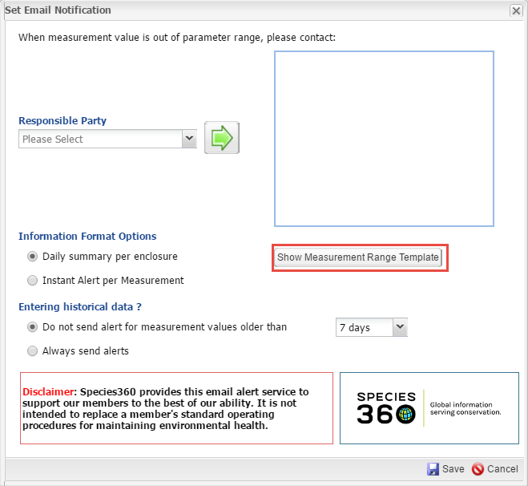
Show Measurement Template
As mentioned, you have to have
a Measurement Range Template
set for the Enclosure/Life Support.
If Show Measurement Range
Template is displayed you already
have a template created. Selecting
that button will take you to a list of
all your range templates if you want
to check it.

Slide 7
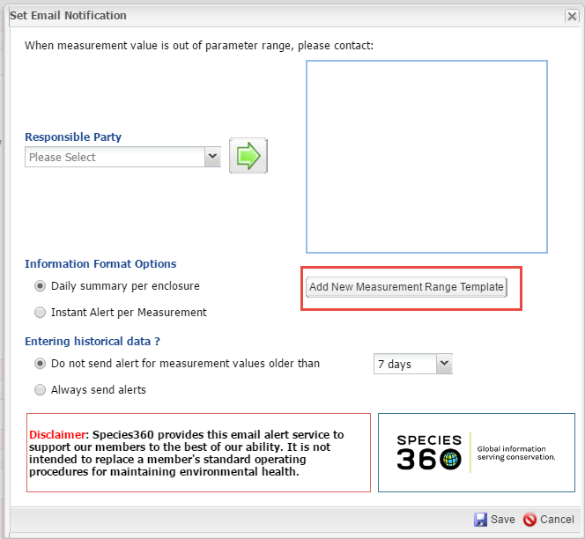
Add New Range Template
If you do not have a Range Template
set up for the Enclosure/Life Support
the button will be Add New
Measurement Range Template.
Selecting that will take you into the
screen to create the required
Range Template.

Slide 8
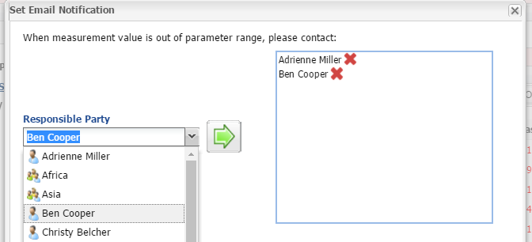
Select the Email Contact
You first need to select the staff member(s) who will receive the Email. Only Staff with access to at least Search/View for Basic Details and Measurements for Enclosures/Life Support/Components will display in the list. We are currently developing Business Rules as to how Teams should function and the current recommendation is to select only individuals if not everyone on a team should receive an email.

Slide 9
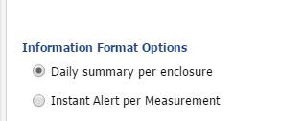
Information Format Options
You then select the Information
Format that you want. Daily
Summary will send an email at
noon your time zone for any
reading outside the desired range in
the last 24 hours. Noon was picked
because that will allow your staff
to take measurements in the
morning and you can take steps to
correct in the afternoon. If you
want to receive the emails at a
different time you can adjust your
Time Zone in Preferences. Instant
Alert will send an email within 5
minutes for each measurement
recorded that is out of range.
One thing to note: what is selected in
this Format Options affects all the contacts assigned to receive notifications for this Enclosure. One staff person cannot receive Daily Summaries and the other receive Instant Notifications.

Slide 10
Entering Historical Data
You then have the option to select if you do not want to receive notifications for measurements taken in a previous time frame. If you are catching up on Older readings you will not be bombarded with notifications that are out of date. You can chose not to have alerts sent of measurements that are older than 7, 14 or 30 days. Or, you can request to always send alerts. Just as in the previous slide, this selection applies to all staff members listed for notification for the Enclosure.

Slide 11
Disclaimer
The Disclaimer is simply a reminder that Species360 cannot be
tasked with making sure your operating procedures are good.
We can only give you the information for you to decide what
actions you want to take, if any.

Slide 12
The Email
When you receive an Email notification it will be from Support. The topic will be the Enclosure/Life Support/Component and Measurement Out of Range Alert for Instant Notifications. For Daily Summary it will just say Measurement Out of Range Alert. Please make sure your email is configured to accept emails from a species360.org address.

Slide 13
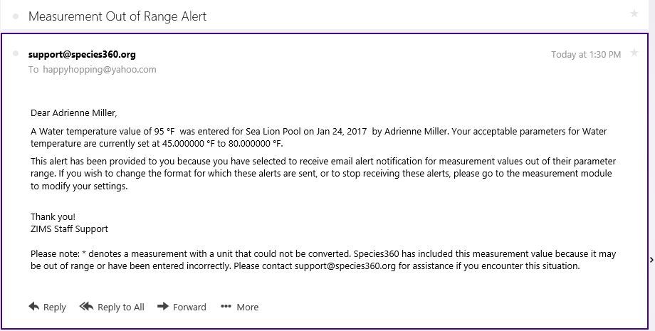
Instant Notification View
The Instant Notification View will display as above. The measurement, the reading, the Enclosure, the date, who was Responsible (or who
recorded the measurement if no Responsible Party was indicated),
and the desired range are noted.

Slide 14
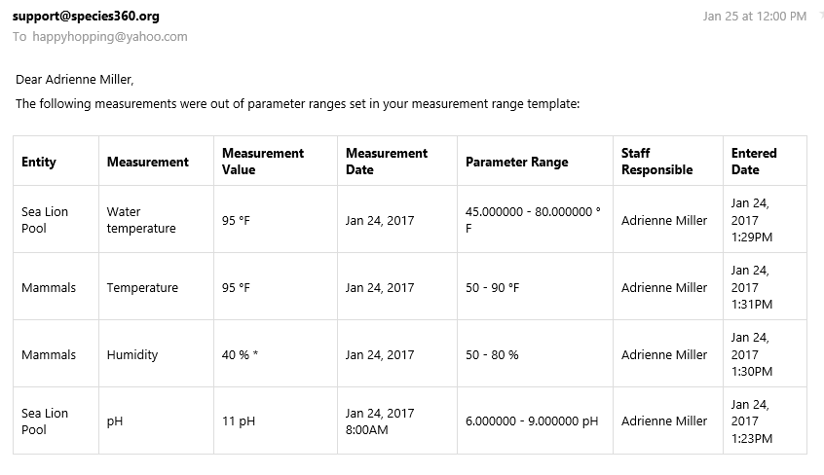
Daily Summary View
The Daily Summary View displays as
a grid with the same information.

Slide 15
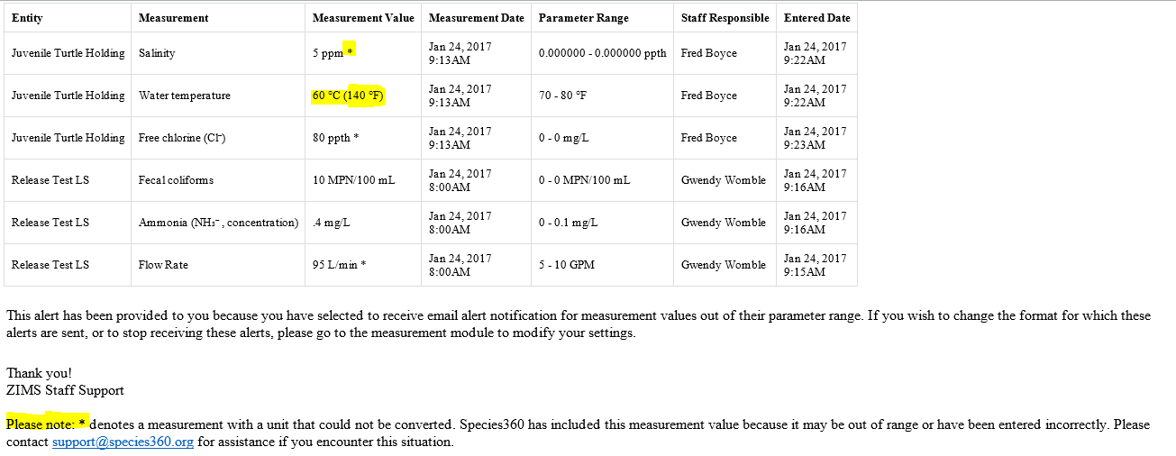
UOM Conversions
When measurements are entered with a UOM that is different from the UOM selected in the measurement range template, ZIMS will convert them if possible. Any measurements that are not converted will be included in the alert to highlight the entry for possible errors or valid out of range measurements.

Slide 16
And That is Email Notification!

