Slide 1
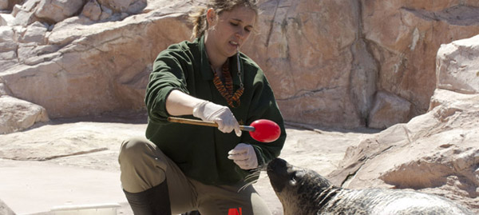
Training in ZIMS

Slide 2
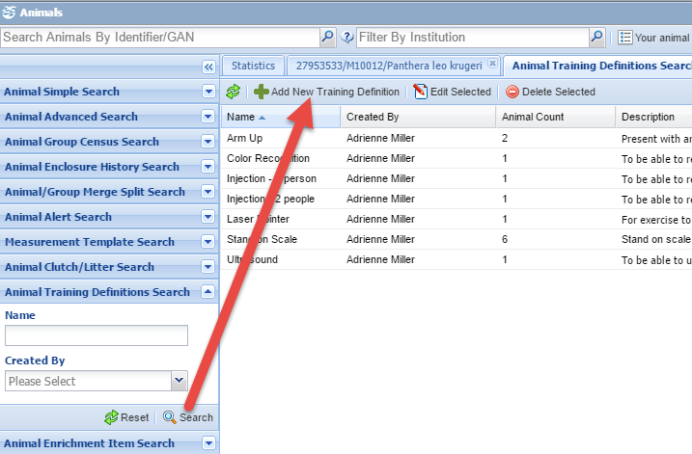
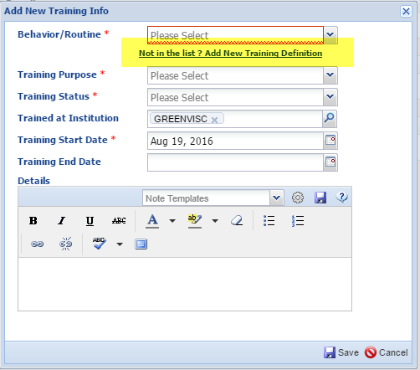
Define the Behavior/Routine
You first need to define the Behavior or Routine
that you wish to train. You can do this by selecting
Add New Training Definition from the Animal Training
Search results grid. Or, you can select Not in the List?
from within the animal record itself.

Slide 3
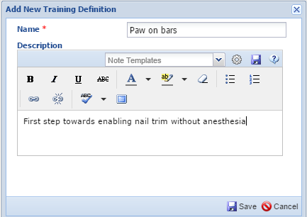
Training Definition
The name of the routine should be short but clearly
defined and must be unique. It is important that the
description states exactly why the routine is being
trained. Here we want to train the animal to put
their paw against the bars as a first step towards
enabling nail trimming without anesthesia.

Slide 4
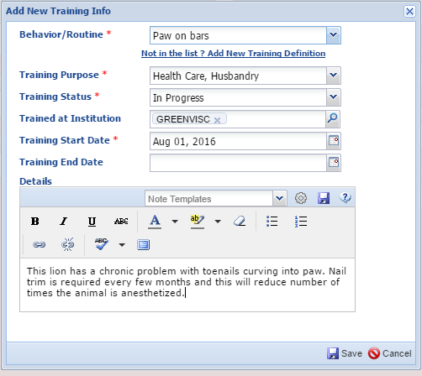
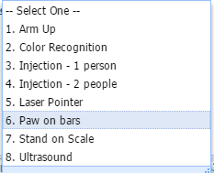
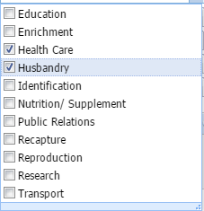
Assign to the Animal
Training Information is found in the More Details tab
of the animal record. Select Actions > Add New to
assign a routine to an animal. All training definitions
will display in the dropdown for Behavior/Routine.
Training Purpose is a multiple select dropdown.
The Status is a single select dropdown where you can
update the status should the animal regress or the
training become completed.

Slide 5
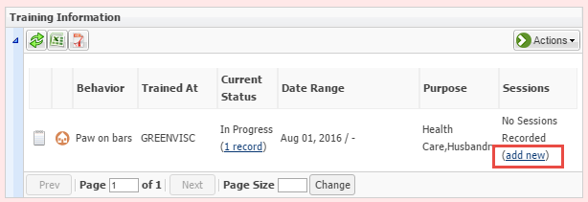
Create a Session
Once assigned, the training will display in the grid. To add a session,
select the Add New hyperlink to open the screen to create a session.

Slide 6
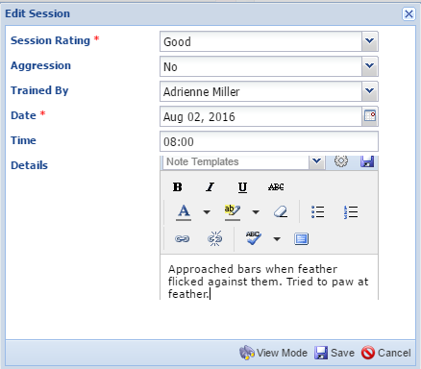
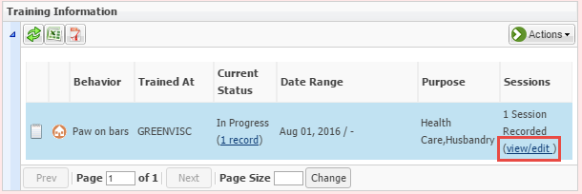
Create a Session
The Session Rating has four options from Excellent to Poor. Aggression is a simple
Yes or No and is not mandatory. Details is where you would describe what was done
and the animal reaction. Once the first session is recorded, the Add New button
becomes a View/Edit button.

Slide 7
Create more Sessions
Selecting the View/Edit hyperlink will take you back into the Training Sessions grid
where you can Add New Sessions or Edit or Delete existing ones.

Slide 8
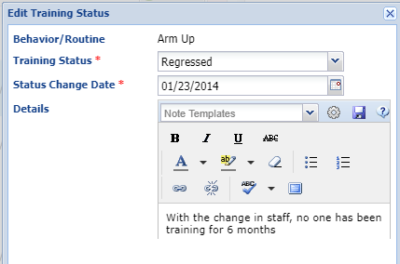
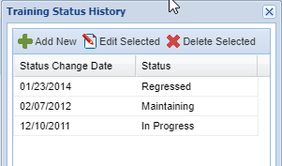
Change Status
To change a Training status, highlight the
appropriate behavior and select Change
Training Status from the Actions menu.
You can also select the hyperlink in the
Current Status column. Remember to
note why the Status changed. The Status
changes are captured in the Training
Status History grid.

Slide 9
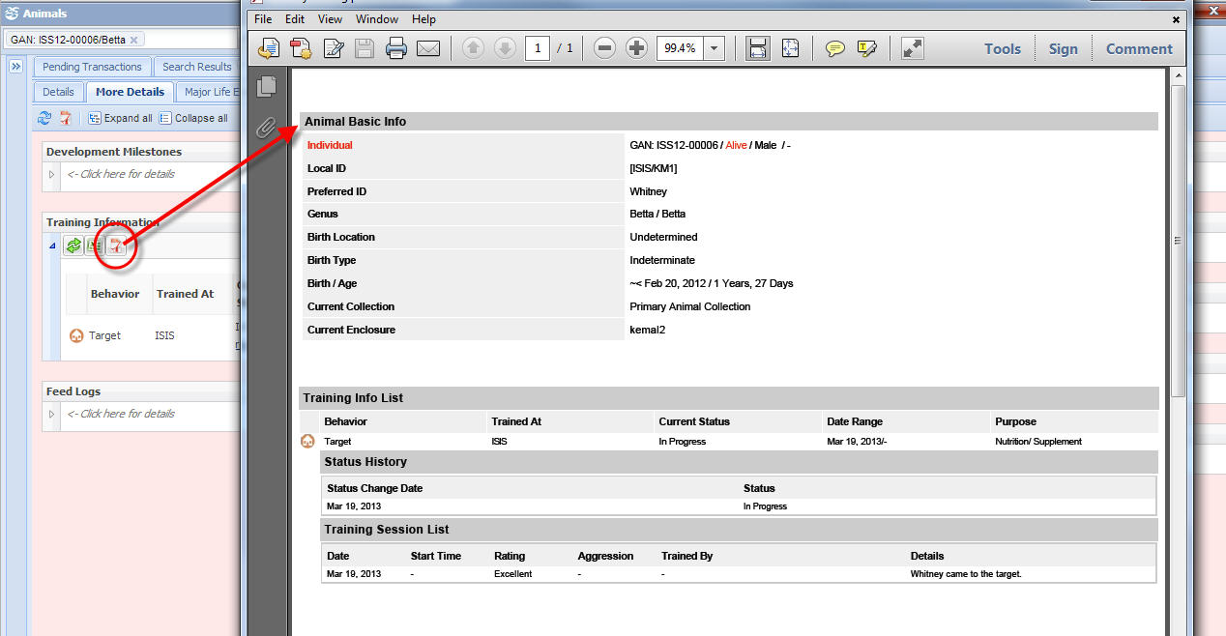
Training Export
By selecting the export option at the top of the Training Information grid,
you get a training report in excel or PDF format for the animal in focus.
It lists each Behavior/Routine and all sessions recorded.

Slide 10
Training in ZIMS!

