Slide 1
A Vet Tech’s Day in ZIMS

Slide 2
ZIMS Updates!
This PowerPoint is up-to-date as of: November 12th 2018
ZIMS is developed in an “agile” method
This means that it is updated every two weeks, sometimes with additional releases in between!
Use the link below to see if there have been any updates to this topic since the date above:
http://training.species360.org/updates/

Slide 3
The Scenario
You are the Lead Vet Tech named Victoria Techie with a full-time assistant
The assistant is in charge of the daily care of any animals in both small and large animal quarantine but you are responsible for recording relevant information into ZIMS
You are charged with maintaining the pharmacy inventory
You may also be called upon to assist the keepers with non-routine care
You are responsible for assistance to the Veterinarian during any procedures
You function under the oversight of the Veterinarian and some of what you enter into ZIMS will be done by the Veterinarian and not yourself
Your ZIMS Role is Medical Admin on the medical module and Vet-Husbandry in the Husbandry module
As we go through your day we will show how you can use ZIMS to capture the information that you need. Today is May 5, 2016.

Slide 4
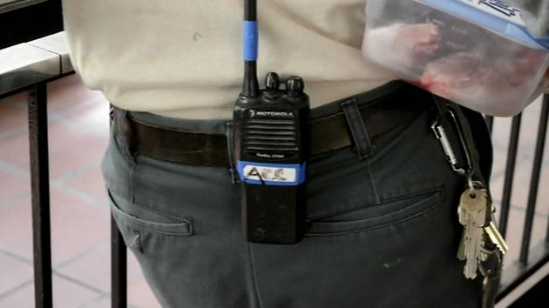
8:00 am - Open Clinic and Grab Your Radio

Slide 5
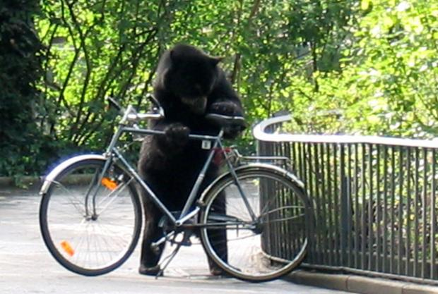
8:05 am - Check Status of Animals in Quarantine/Hospital and Make Sure All are Accounted For or if Anyone Needs Immediate Care

Slide 6
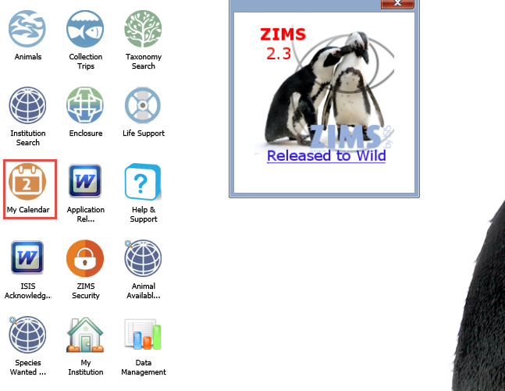
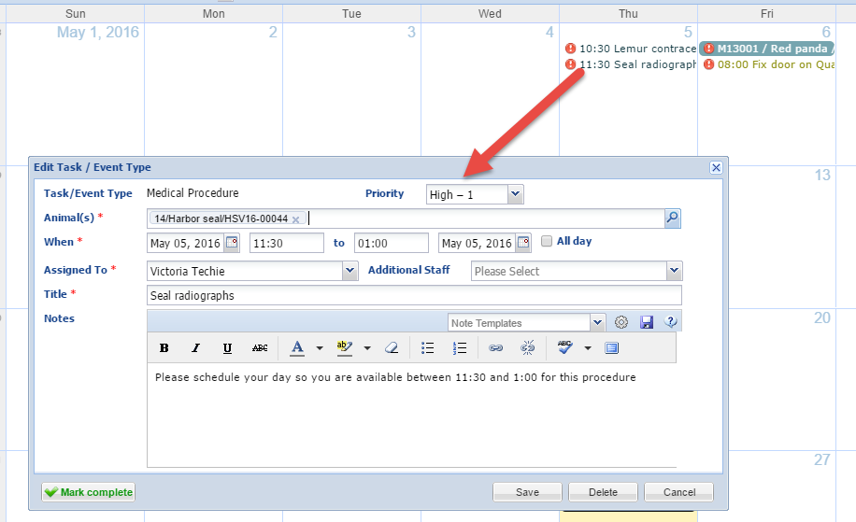
8:10 Check My Calendar
You then check your emails and My Calendar to help you organize your day for any tasks that have been assigned to you. My Calendar is found on the desktop and under the Start Menu>Institution. There are two procedures scheduled for today – a lemur contraception and physical and a seal radiograph. You open each up to view the details.

Slide 7
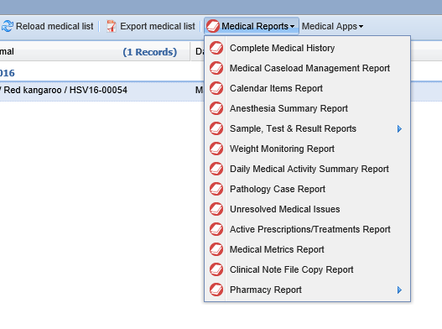
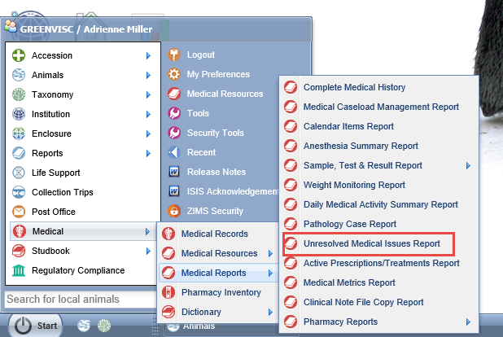
Medical Reports
The Medical Reports are found under
the Start menu>Medical or from the
Medical Reports tab in the Medical
Module.

Slide 8
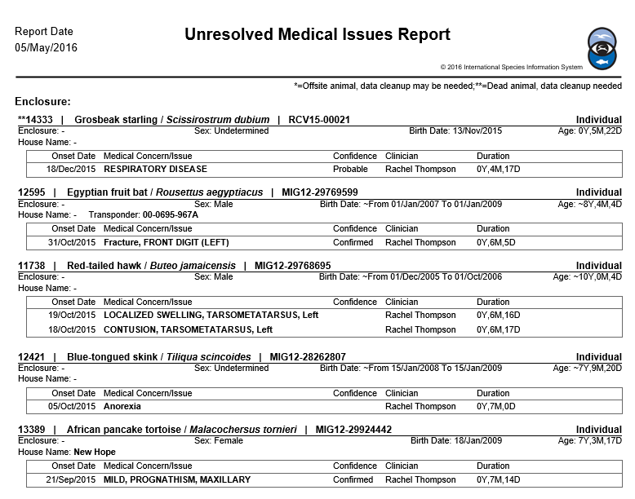
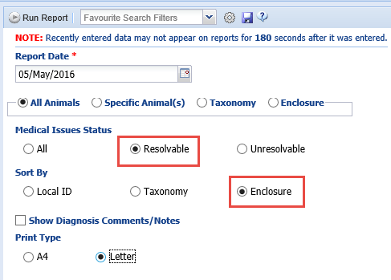
Unresolved Medical Issues
You run an Unresolved Medical
Issues Report for your Vet to use today
during weekly rounds. You select only
those Issues that can be resolved and
select to sort it by Enclosure so he can
easily work through your institution
and know what needs to be addressed
in each enclosure.

Slide 9
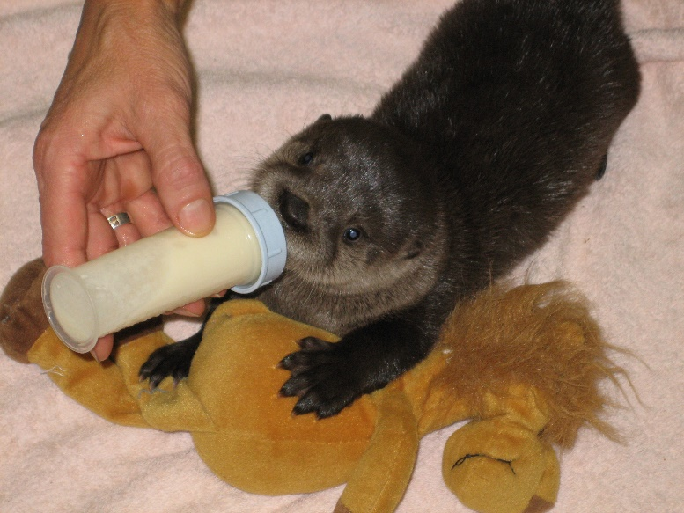
8:20 am – Weigh and Feed Baby Otter

Slide 10
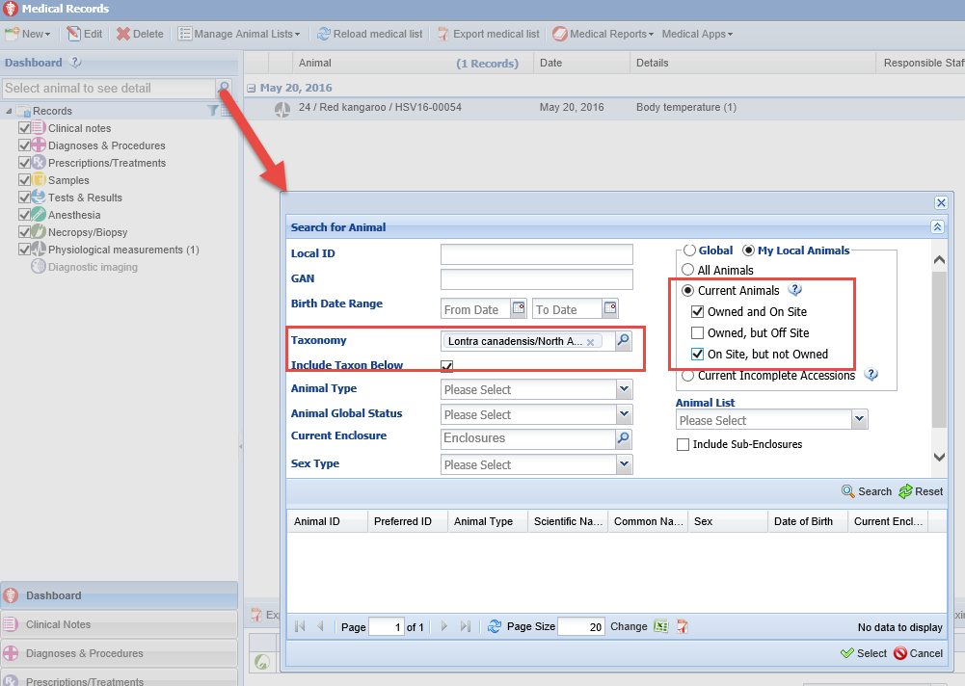
Find the Record
You can’t remember the GAN or
Local ID for the otter, so from
within the Medical records
dashboard you use the Look Up
function to search by taxonomy
and animals physically at your
facility.

Slide 11
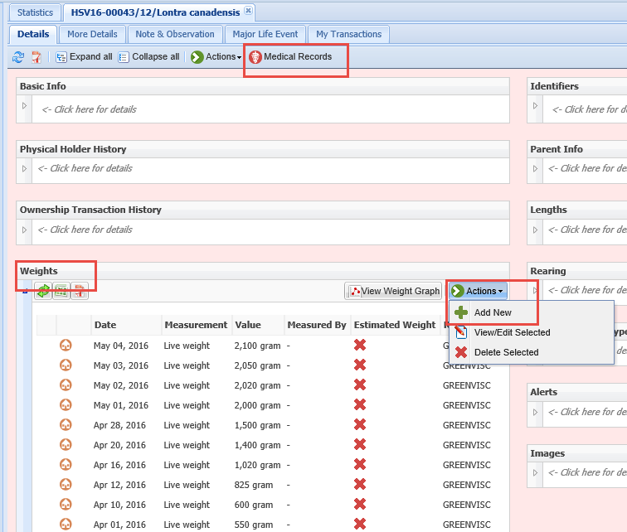
Husbandry Record
Selecting the animal from the
Search results grid will take
you into the Husbandry record
for the otter. You can view the
Medical records from the
tab, but you want to stay in
the Husbandry record because
you want to record a weight.

Slide 12
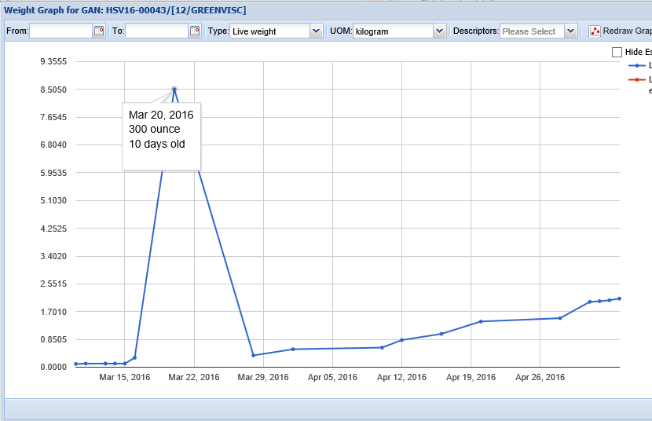
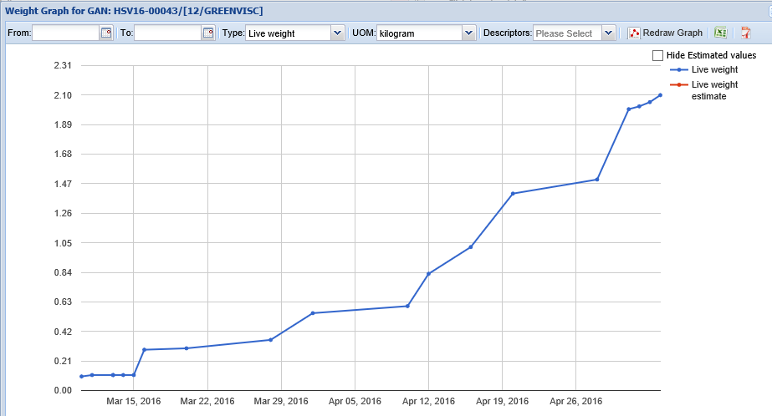
Record Weight and Look at Graph
Her weight today is 2.3 kg.
After recording you look at
the weight graph and get a
surprise as there is a weight
that does not follow the general
weight gain pattern. Hovering
over that weight you see that
it was recorded in ounces and
not grams. You correct the
unit of measure and relook at
the graph which now appears
much more logical.

Slide 13
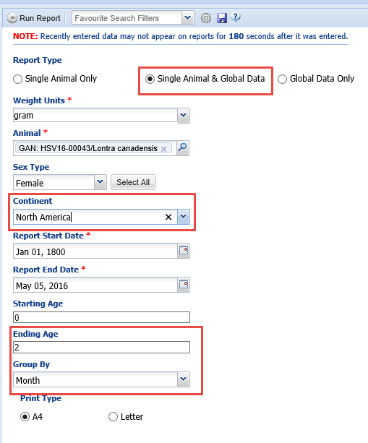
Weight Comparison Graph
You want to know if she is gaining weight properly so you compare her weights to the Global Data using the Weight Comparison Report found under the Start menu>Reports. You select Single Animal & Global Data,
North America for the continent
and a grouping by month since she
is only 2 months old.

Slide 14
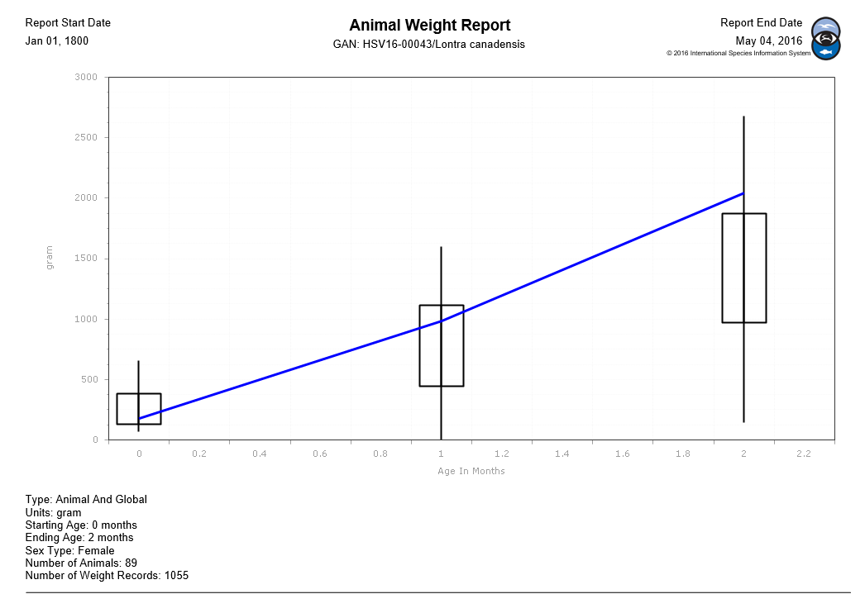
Weight Comparison Graph
Although she started off at the low end of the
weight range she is now above normal weight.
You make a note to discuss this with the Vet and
may consider cutting her formula down a bit.

Slide 15
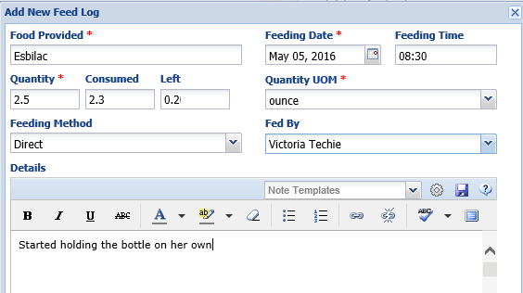
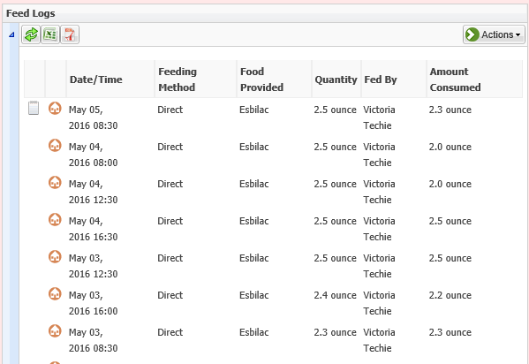
Record Feed Log
After weighing you feed the baby otter.
Staying in the Husbandry record you
record in the Feed Log grid. She does not
consume all that was offered which may
be a good thing since she appears to be
on the heavy side as you found when the
weights were compared. You add a note
that she is starting to grab the bottle on her
own to drink.

Slide 16
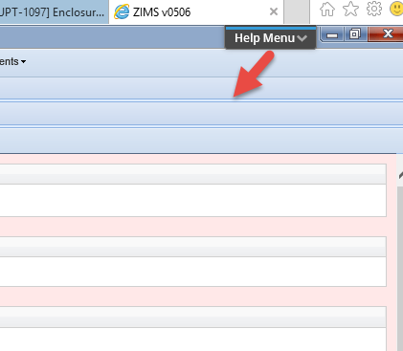
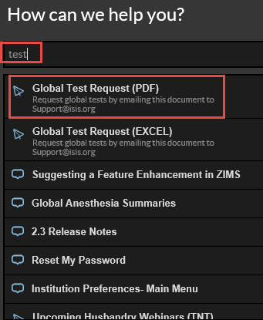
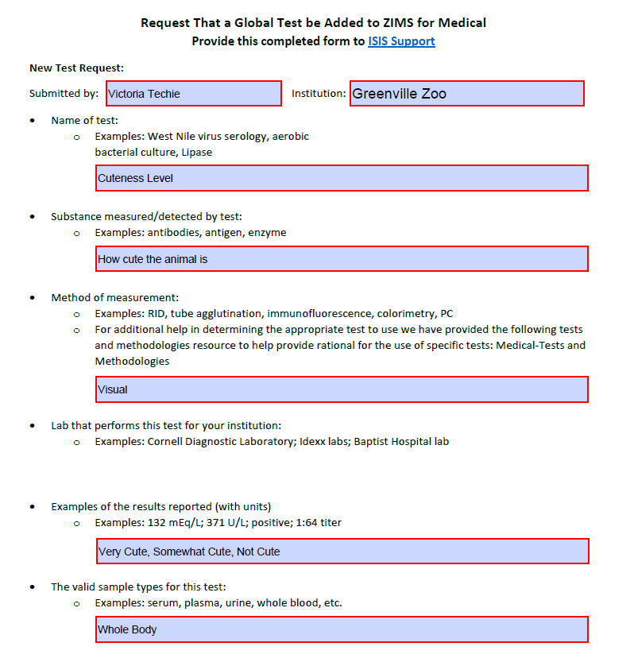
Request a New Test
Because the otter is so very cute you want to request that a new test be added to ZIMS titled “Cuteness
Level”. Using the Help Menu in the upper right corner you type in “test” and select Global Test Request (PDF). You complete the form and
submit to Species360 Support.

Slide 17
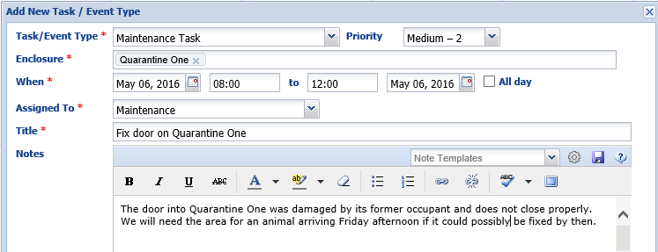
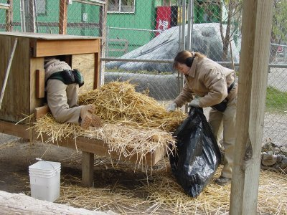
8:45 am – Schedule Maintenance on a Pen
The dumpster team radios you that they are on
their way so you quickly clean out Quarantine One
whose occupant left yesterday afternoon. While
cleaning you notice that the door no longer closes
correctly. Since you are expecting an animal
in two days who will need the area you schedule
maintenance for the door using the Calendar.

Slide 18
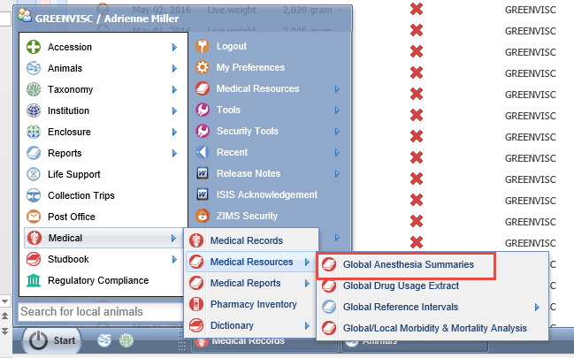
9:00 Run Anesthesia Summaries
In preparation for the lemur contraception procedure, you run an Anesthesia Summary for
for brown lemurs. This is found under the Start menu>Medical Resources

Slide 19
Expand the Search
It is a very small sample size (above) so you re-run at the Genus level
and get many more results (below).

Slide 20
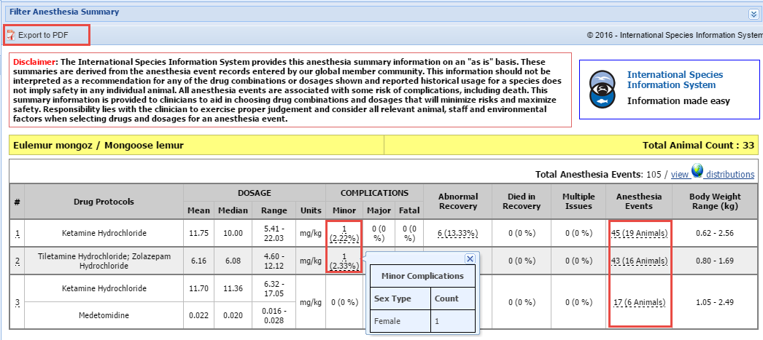
Review the Summaries
You pull up the summaries for Mongoose lemur as that species had three summaries
and compare with the one summary for the brown lemur. Hovering over any data with
a dotted underline will display specifics regarding the data. You export the summary
to pdf and print it.

Slide 21
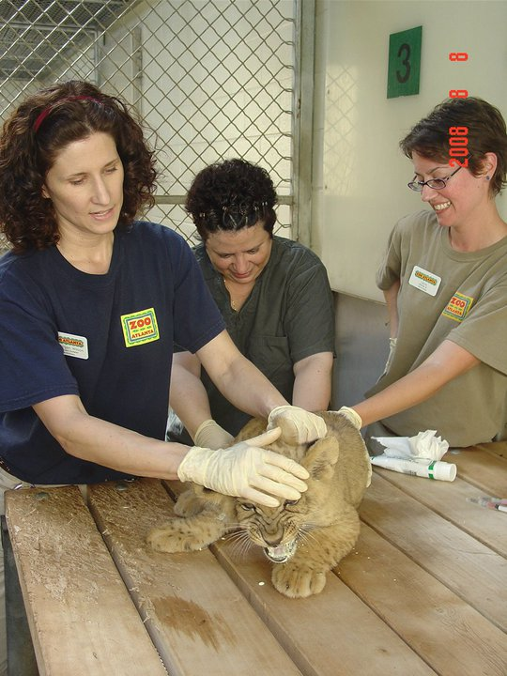
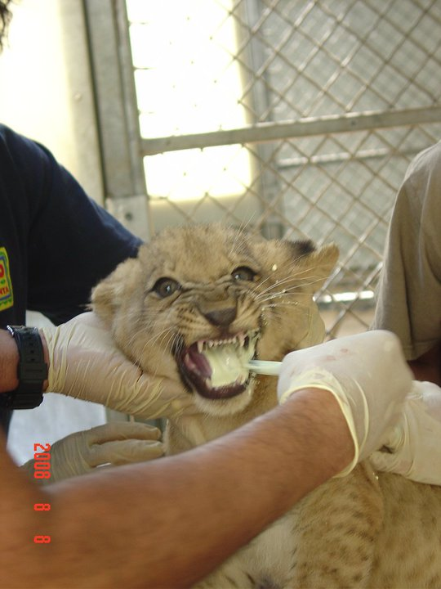
9:15 am – Assist with Deworming Lion Cub

Slide 22
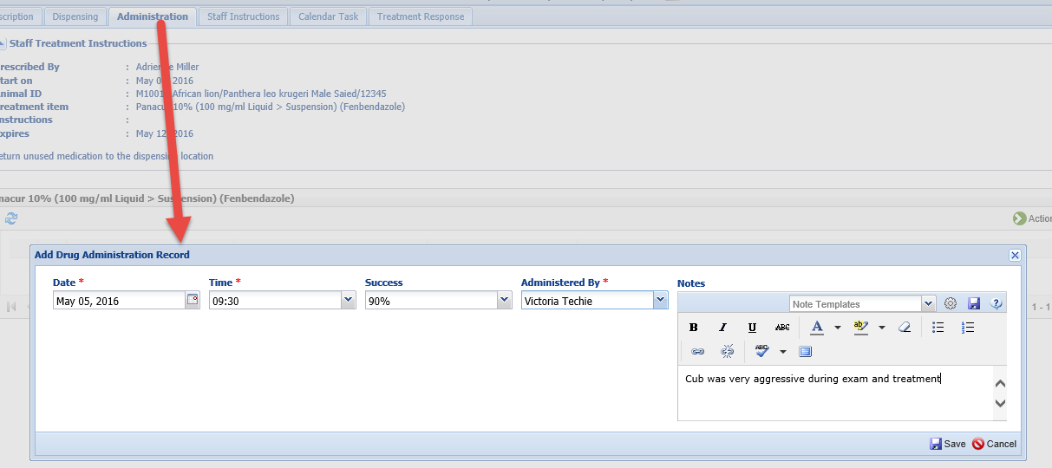
Record De-worming
The Vet office that was going to loan you the mobile equipment for radiographing the seal,
phones you and says they had an emergency need for it and it will not be available until tomorrow. Since that procedure is cancelled for the day, you have time to help the Africa Team and the assistant Vet Tech with de-worming the lion cub. When you are done you use the Administration tab within the prescription record
to record the success and any notes.

Slide 23
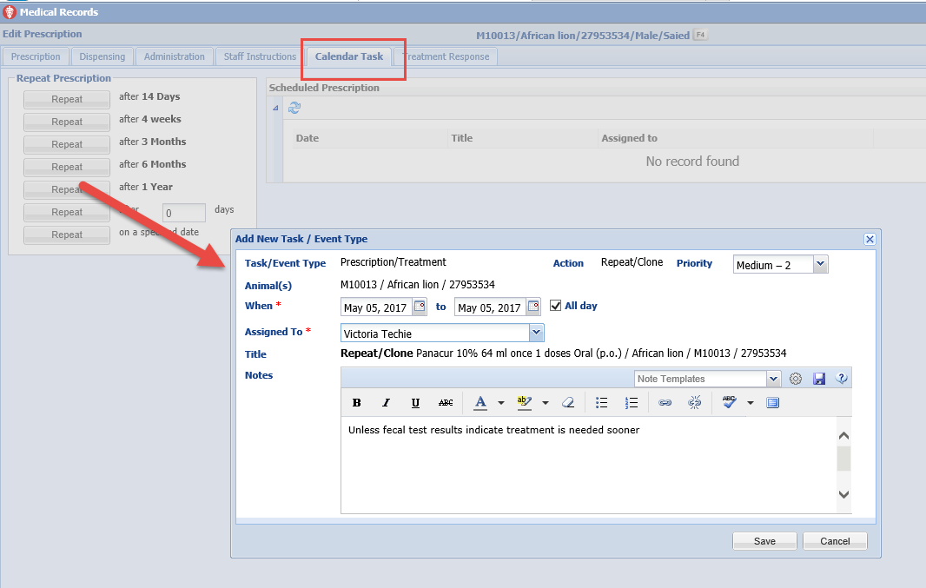
Calendar Task for Next Treatment
Using the Calendar Task tab
in the prescription record, you
schedule the next Panacur
treatment for a year from today.
This goes directly into the
Calendar.

Slide 24
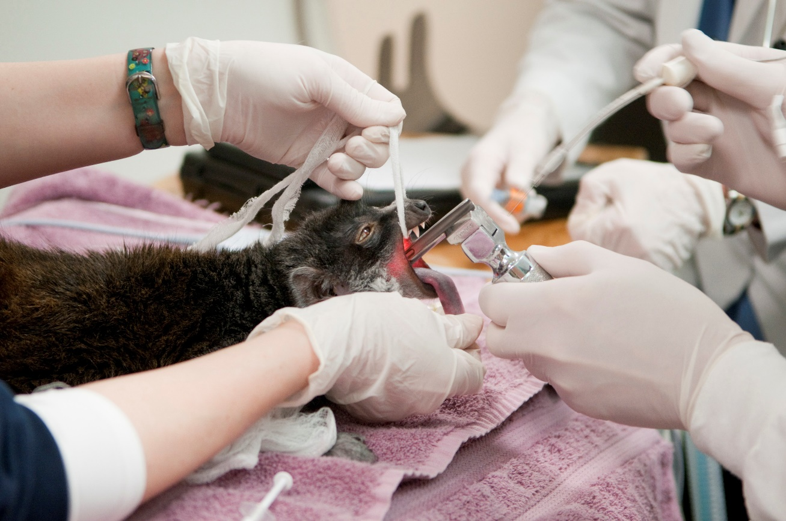
10:15 am – Lemur Contraception and Body Condition Check

Slide 25
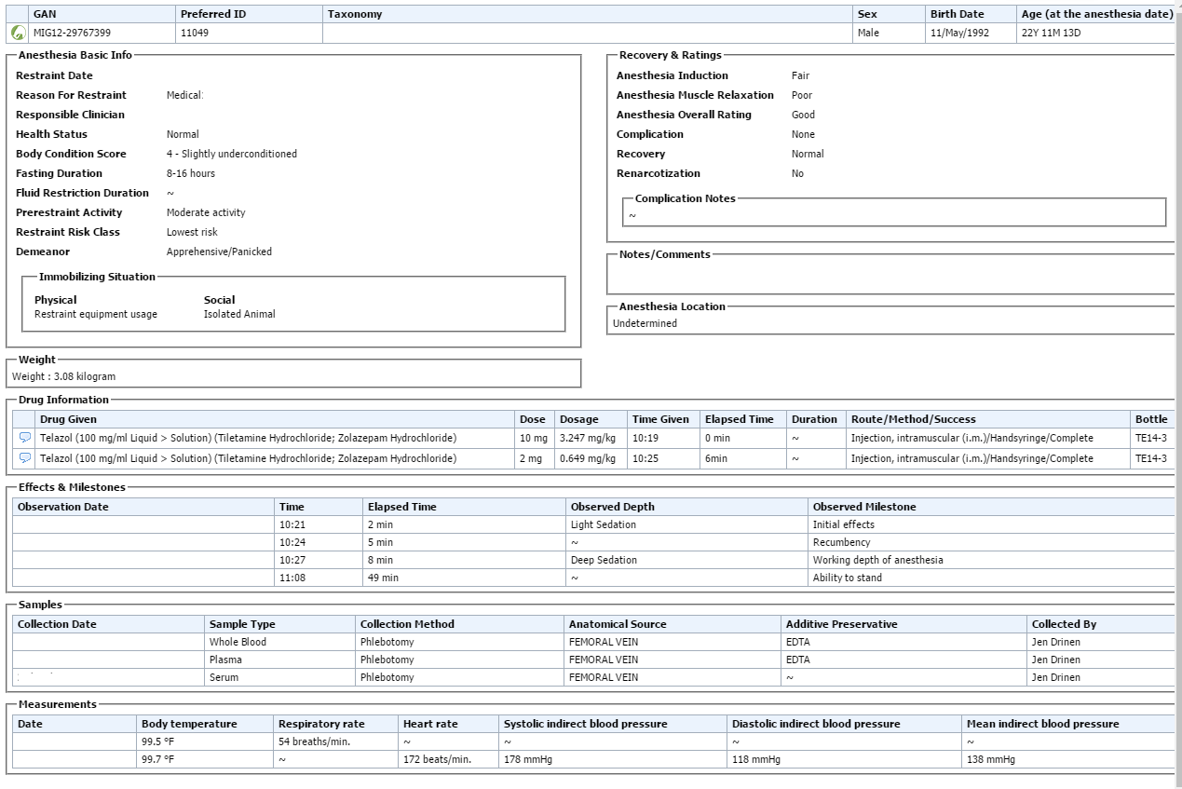
Record the Anesthesia
The Anesthesia module
allows you to track the
drugs used, the effects
and milestones, samples
collected and measurements
taken. As the Veterinarian
performs the anesthesia, you
record the information into
this ZIMS module.

Slide 26
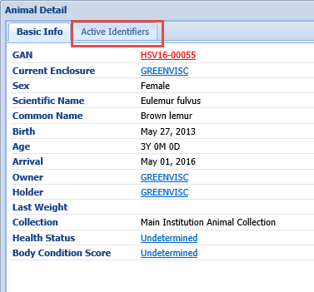
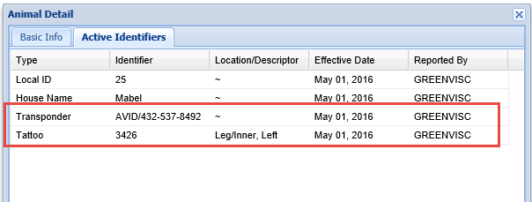
Confirm the Identity
As the lemur is going under, you take the
opportunity to confirm two physical identifiers
that are hard to read on an awake animal. In
addition to making sure the tattoo and transponder
can still be read, this practice assures that you
have the correct animal on the table! From the
Medical module pressing f4 will bring up the
Basic Info screen on the left. Selecting the Active
Identifiers tab will display all identifiers that are
currently active for the animal.

Slide 27
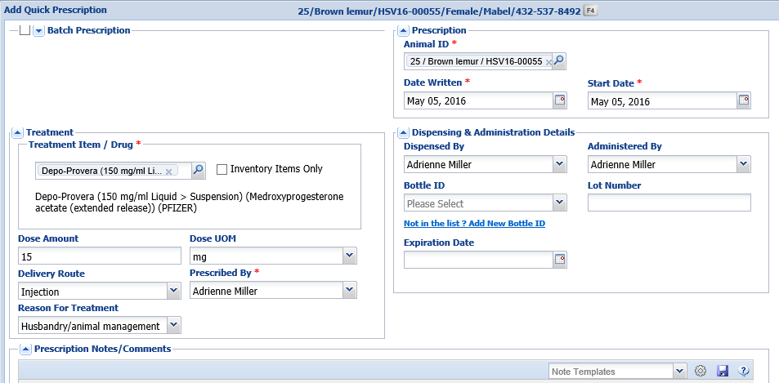
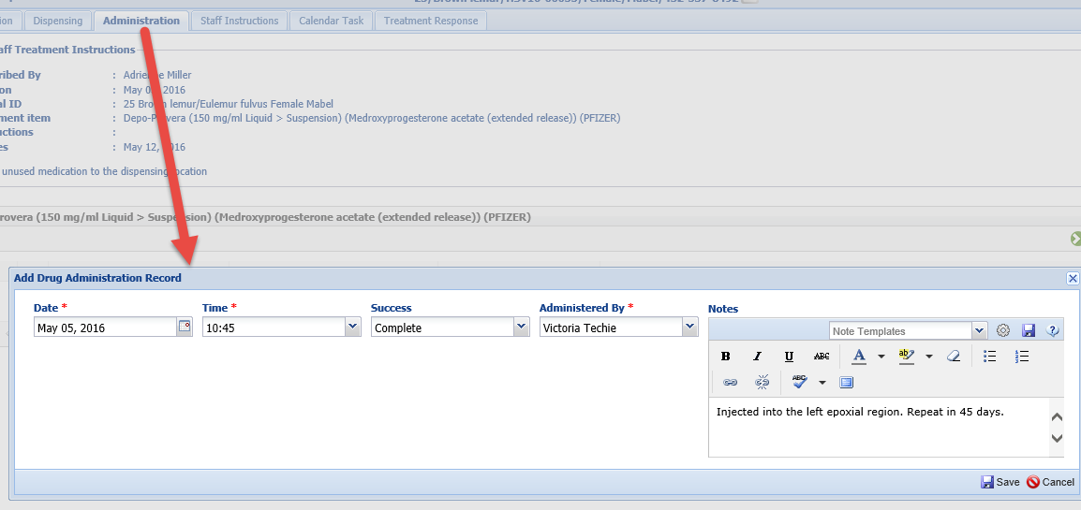
Record Administration
The Vet has recorded a
Quick Prescription for the
Depo-Provera. Using the
Administration tab in the
prescription record, you
record 100% success.

Slide 28
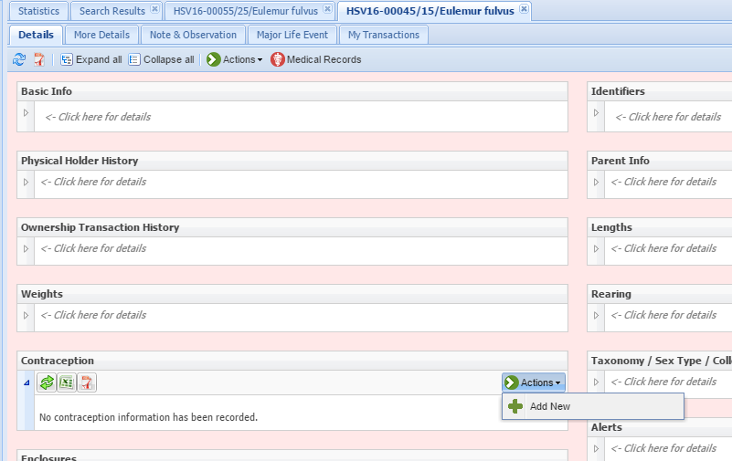
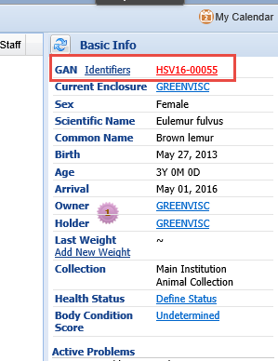
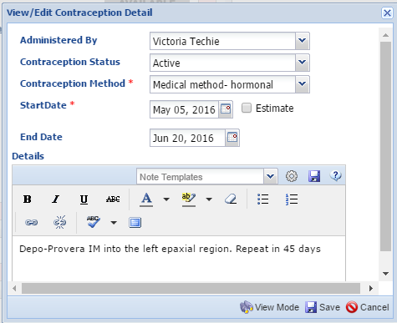
Record the Contraception
The contraception is recorded in the
Contraception grid from within the
Husbandry module. To get into that
module simply select the GAN hyperlink
in the upper right hand corner (left screen).
Then record the Contraception in the grid.

Slide 29
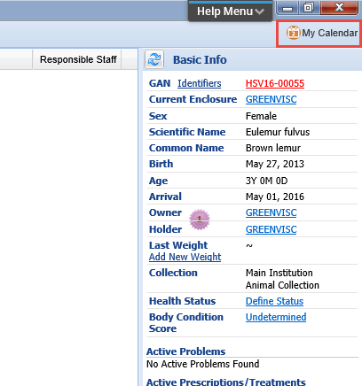
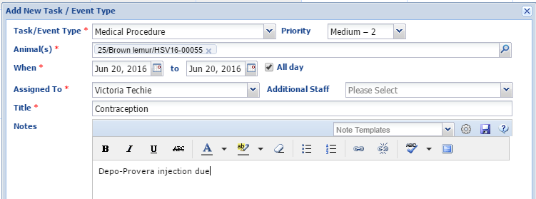
Schedule the Next Contraception
The Depo-Provera is effective for 45 days
so you need to schedule the next dose.
You can get to My Calendar directly from
within the Medical module by selecting
My Calendar in the upper right hand
corner.

Slide 30
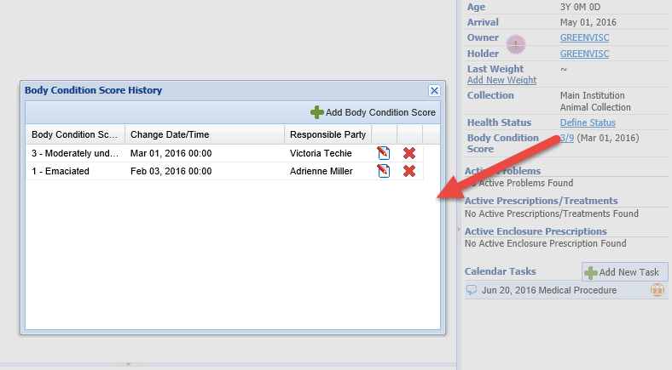
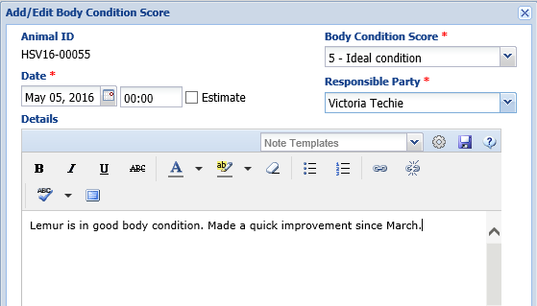
Add Body Condition Score
By selecting the Body Condition Score
Hyperlink, you can add a current
Score. ZIMS uses a 9 point system.
If you prefer a 5 point system, use
only the odd numbers.

Slide 31
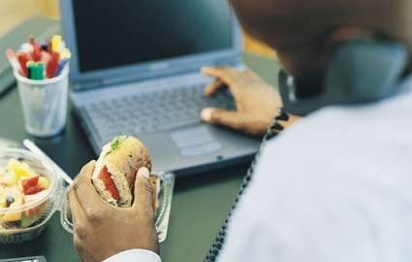
12:00 pm – Lunch!
You use your lunch to
catch up on emails and
make some phones calls.

Slide 32
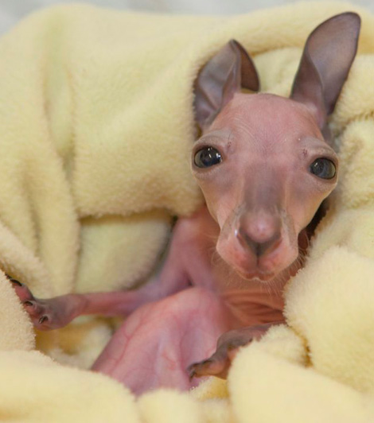
12:30 pm – Deal with a Tossed Joey
Your lunch is cut short when the
Australia keepers radio you that they
found a hairless joey in the kangaroo
yard. No animals were near it so
the dam is currently unknown. You tell
them to bring it down to the hospital
and you set up an incubator just in case.

Slide 33
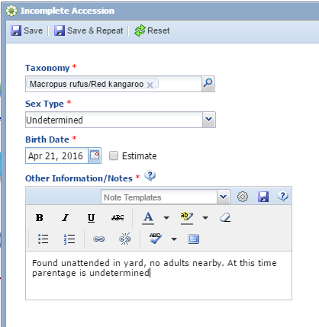
Create an Incomplete Accession
So that you can record your exam
information directly into ZIMS once
the joey arrives, you create an
Incomplete Accession. All information
can be edited when a full accession
is recorded so you don’t need to
worry about getting all the information
correct. The taxonomy is the most
important thing that ZIMS will look for
when it tries to associate a full
accession with an existing Incomplete
Accession. You then check the temperature
and humidity in the incubator.

Slide 34
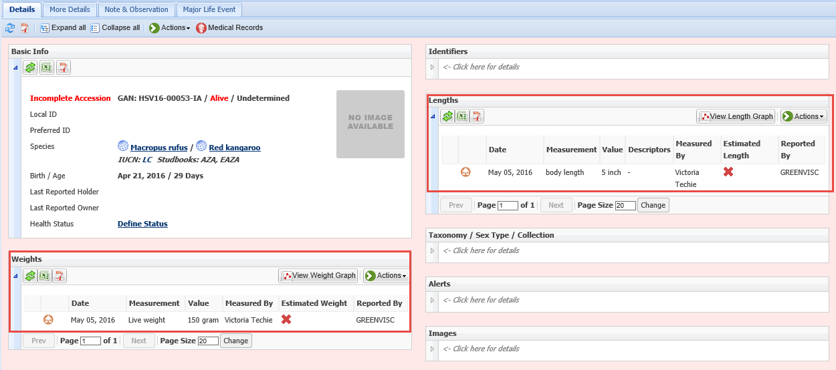
Record Measurements
The keepers arrive with the joey and you start an exam. From within the
Husbandry module you record the weight and length of the joey.

Slide 35
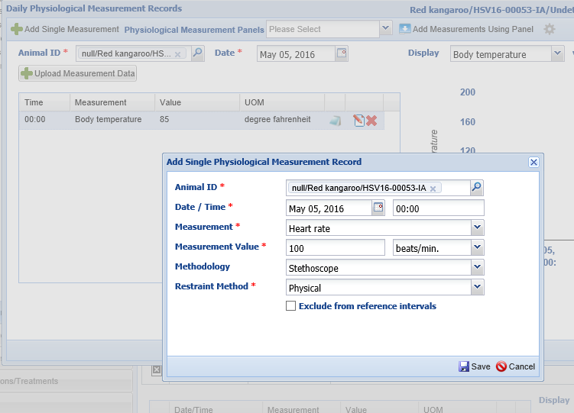
Record Vital Signs
From the Medical module you
record a Body Temperature of
85 degrees F and a Heart Rate
of 100 beats per minute. Both
are indicative of an animal
that needs warmth and quiet.

Slide 36
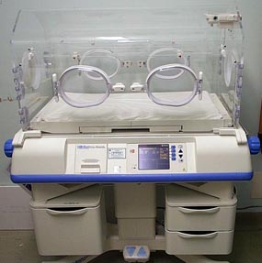
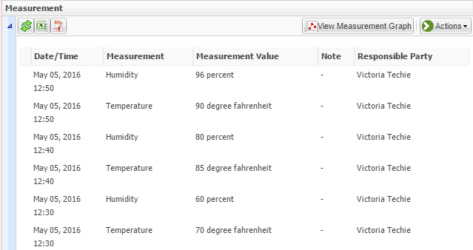
12:50 pm – Incubator is ready
You take a final reading on the incubator and are happy
to see it is ready for the joey – temperature of 90 degrees
and humidity between 95-100%. You set the joey up inside.

Slide 37
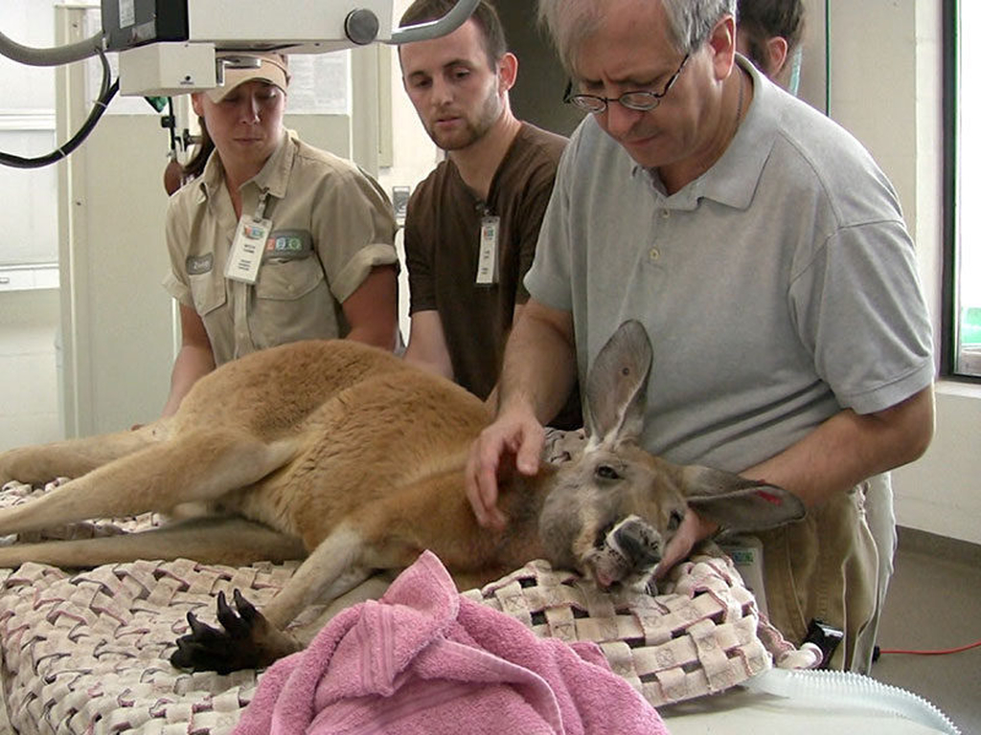
1:00 pm – Treat Female Kangaroo
As you are observing the
joey to make sure it settles
well into the incubator, you
get another call from the
Australia keepers. A female
red kangaroo was found
unresponsive in the holding
pen and they are bringing her
to the hospital.

Slide 38
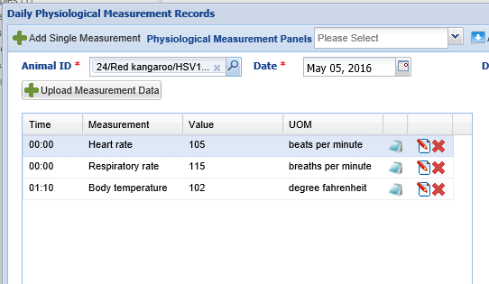
Record Physiological Measurements
The initial exam indicates a
very dehydrated animal who
is quite unresponsive but not
unconscious. You take three
physiological measurements,
all indicating a very stressed
animal. You apply cool, wet
towels to try to lower her
body temperature and start
fluids while the Vet continues
the exam.

Slide 39
Take Samples
You draw blood for analysis. You also check her pouch and its condition indicates
that she is the dam of the joey in the incubator, and her issues are probably why
the joey was tossed.

Slide 40
Record the Test Results
You are able to run an in-house CBC so you can record the results on the kangaroo.
Here we added single tests one by one using the Add New Test option.

Slide 41
Use or Create Test Panels
ZIMS comes with a set of prefilled test panels to save time when you are running
multiple tests. You can also create your own test panels for future use. Selecting the
“i” icon to the right of Test Requests & Test Results or selecting Test Panel Help from
the Help Menu will take you to a video that will walk you through creating and using
Test Panels.

Slide 42
Compare to Physiological Reference Intervals
Viewing the normal
blood results for
red kangaroos using
the Physiological
Reference Intervals,
you see that the red
kangaroo needs some
medical intervention.

Slide 43
Global Drug Usage Extract
These results indicate an infection. You run a Global Drug Usage Extract for red kangaroos
to see what some of your options are. You have Amoxicillin on hand so you select to view
the 46 prescription counts.

Slide 44
View Records
There are 19 records
for oral Amoxicillin
in red kangaroos.
You review the dosage, frequency and weight of the animal.

Slide 45
Create a Treatment
Under the direction of the Vet, you create a prescription for the Amoxicillin. Because
it has been a year since the kangaroo was weighed, you select to record a new weight
for better treatment accuracy.

Slide 46
Print Instructions
You record the instructions for
the staff treatment and print
them out. The number of days
for the treatment defines the
number of rows in the sheet.

Slide 47
2:00 pm - Run Fecals

Slide 48
Record the Test Results
You run the fecals that were
submitted yesterday. Pinworms
were found in many of the
samples.

Slide 49
Write a Quick Prescription
You have been given the responsibility
to write parasite treatment prescriptions.
Because treatment will be a one time
dose with possible follow-up after
recheck, you write a Quick Prescription
for Ivermectin.

Slide 50
2:45 pm – Create an Enclosure Prescription
Your Lead Aquarist calls
and reminds you that
the yearly prescription
for copper treatment in
the tanks will expire in a
few days. You create a
new Aquatic Enclosure
Prescription record
so that copper treatments
can continue to be
captured for the tanks.

Slide 51
Add Drugs to Inventory
While you are creating the prescriptions,
UPS arrives with your shipment of a
dozen bottles of Ketamine. Because it is
a requirement that this drug be tracked,
you enter them into your Pharmacy Inventory.
Using the Save & Copy feature, all you have
to do to record them all is edit the Bottle ID.

Slide 52
3:00 pm – Well Baby Checks on Warthogs

Slide 53
Record Clinical Notes
During the well baby exam, you record the
vitals of the two warthog babies. You also
enter a Clinical Note detailing your findings.
So that the Husbandry staff will also be aware,
you record an Animal Care Staff Medical
Summary Note. What is recorded here will
also display in the Notes & Observations grid
in the animal record on the Husbandry side.

Slide 54
4:30 pm – Mark Tasks Complete
You go into the Calendar to mark the lemur physical
as Complete and re-schedule the seal radiographs for
tomorrow. Once marked as Complete the red “!” will
disappear. When viewing the calendar, you can opt to
hide any tasks that have been marked as Complete.
You can also choose just to view your assignments.

Slide 55
Add Some Calendar Tasks
The last thing you do before heading home is to create a Calendar Task for the
Africa Team to collect fecals on the pair of lions next Monday.

Slide 56
Any Questions?

