Slide 1
ZIMS Workflow Management
My Calendar

Slide 2
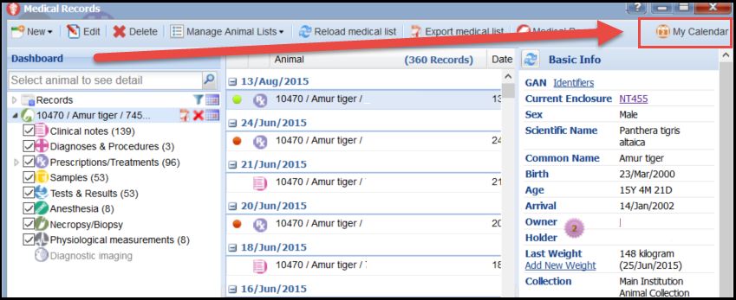
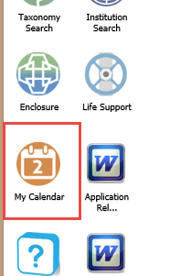
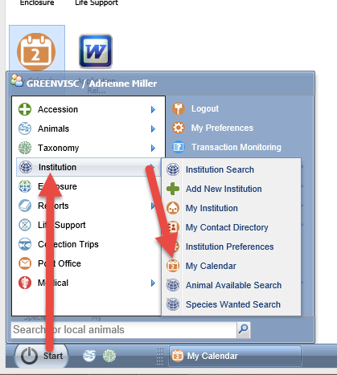
Opening My Calendar
You can get to My Calendar from
the Start menu>Institution> My
Calendar. Or, if you have not
opted to remove it there is a
My Calendar icon on the desktop. It’s also available from the Medical Dashboard.

Slide 3
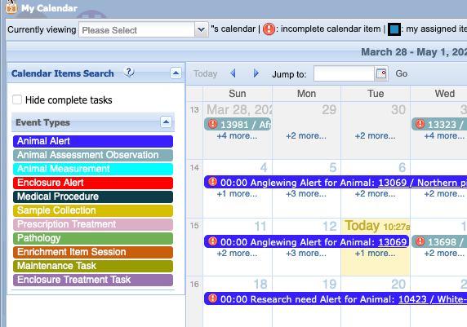
My Calendar
My Calendar allows you and others to schedule 11
different types of tasks. Some can be entered both
directly from the calendar or from within the
appropriate modules. Enclosure and animal alerts are sourced from the specific Animal or Enclosure grids and a few different alerts are sourced directly from the Medical module.

Slide 4
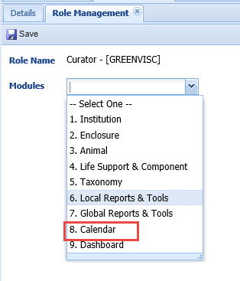
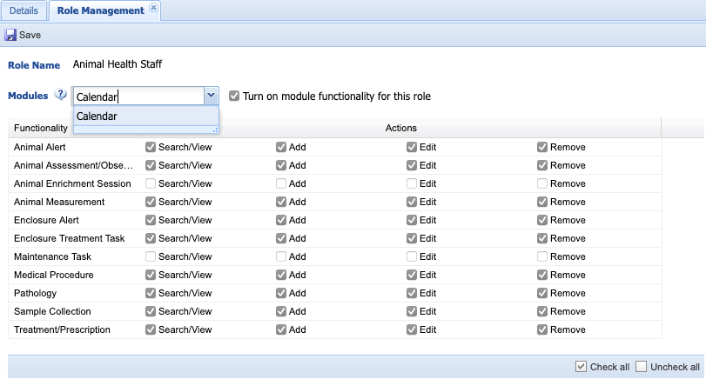
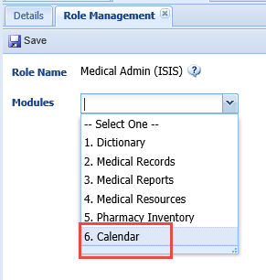
Calendar in Roles
The Calendar is selectable as a module in both Husbandry
and Medical Roles. The custom Role above can view all tasks
but can only Add/Edit or Remove the top four.

Slide 5
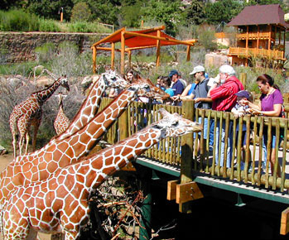
Animal Alert
Animal Alerts can be added
from within the animal’s
record or from the Calendar.
The information will display in
both the record and Calendar
regardless of where it was
entered. In this scenario one
of the giraffes grabbed a camera
from a visitor and gobbled it
down.

Slide 6
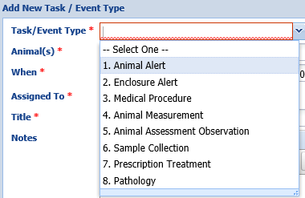
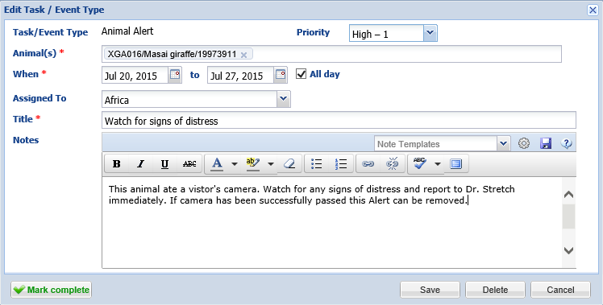
Animal Alert
To add an Animal Alert simply left click anywhere in the Calendar and
select Animal Alert from the Task/Event Type dropdown. Select the
appropriate Priority. The giraffe is to be observed through the entire
day so the All Day box is checked. What is entered into the Title will
display in the Calendar.

Slide 7
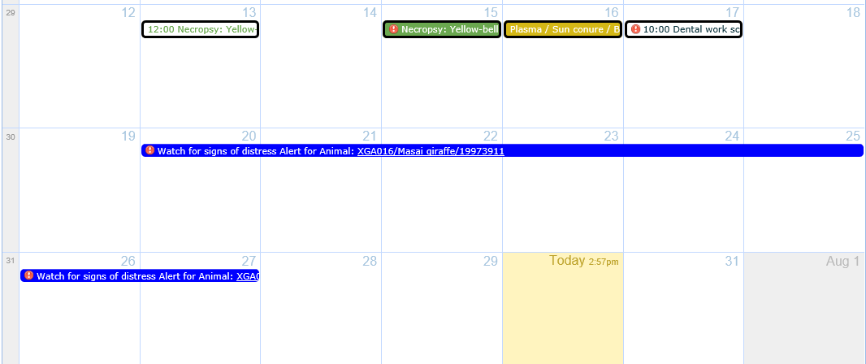
Animal Alert Display
The Animal Alert will display in the Calendar across the dates selected.
It will also display in the Alerts grid in the animal record. If you add the
Animal Alert from within the Alert grid in the animal record it will also
display in the Calendar.

Slide 8
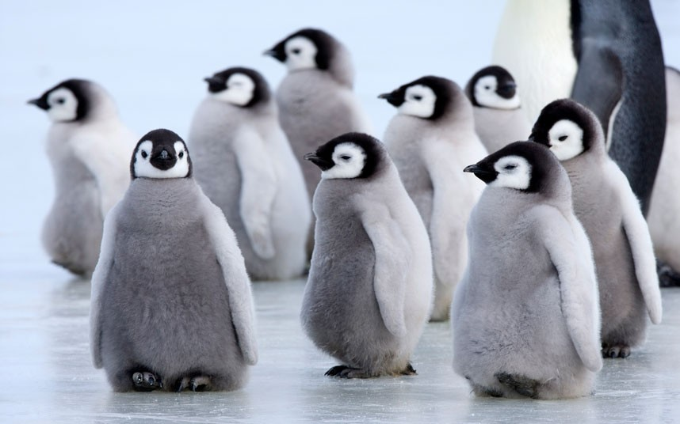
Animal Measurement
Your penguin chicks need to be weighed every week. You can create an
Animal Measurement task to remind you.

Slide 9
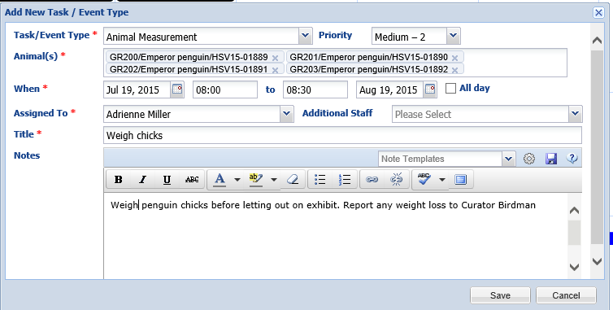
Animal Measurement
Since this task has a time attached – the chicks need to be weighed
before going out on exhibit – you will uncheck the All Day checkbox
and record the appropriate times.

Slide 10
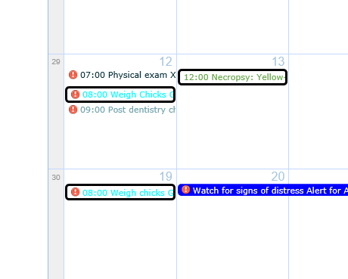
Animal Measurement Display
The task will display in the
Calendar with the start
time in front so you will
see that immediately. If there
are multiple tasks scheduled
for the same day with times
associated with them they
will display in the appropriate
order. Animal Measurements
do not also display in the animal
record as this is a heads up to do
something and the animal is
not directly affected (unless
you forget).

Slide 11
Enclosure Alert
The Safety Inspector is coming to inspect your new commissary addition
and you want the staff to be aware. You place an Enclosure Alert on
the Calendar for the Commissary Team.

Slide 12
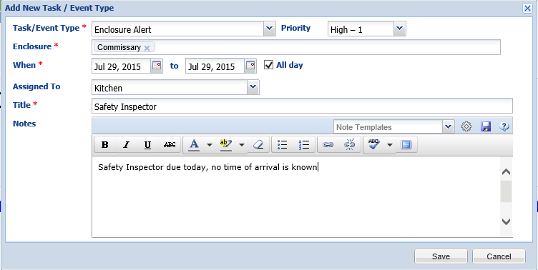
Enclosure Alert
Because you do not know when the inspector is coming you make this
an All Day alert. You assign it to the Kitchen Team so that it will display
for all the members of that Team without having to assign it to multiple
individuals.

Slide 13
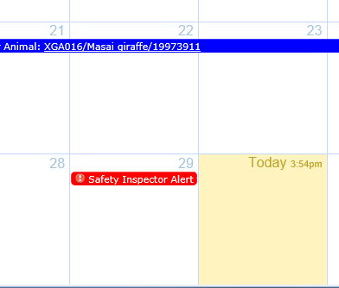
Enclosure Alert Display
The Enclosure Alert will display as
an All Day alert in the Calendar.
In addition, it will display in the
Alerts grid of the Commissary
enclosure. If you added the alert
from the Alerts grid in the
enclosure record it would also
display in the Calendar.

Slide 14
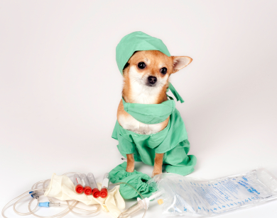
Calendar Tasks Sourced From Medical Module
There are also Calendar Tasks that
are sourced from data entered
into the Medical module.

Slide 15
Medical Alert
Medical Alerts set up under a Clinical Note are visible from the Medical Dashboard, on the right hand details panel

Slide 16
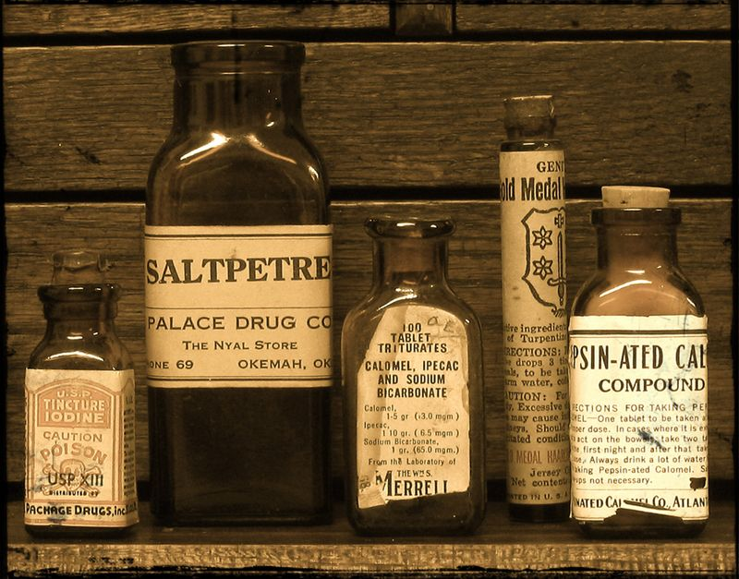
Prescription/Treatment
Your siamang needs to be treated for a possible infection and, in addition
to the printed instructions, you want a Calendar task to remind you.

Slide 17
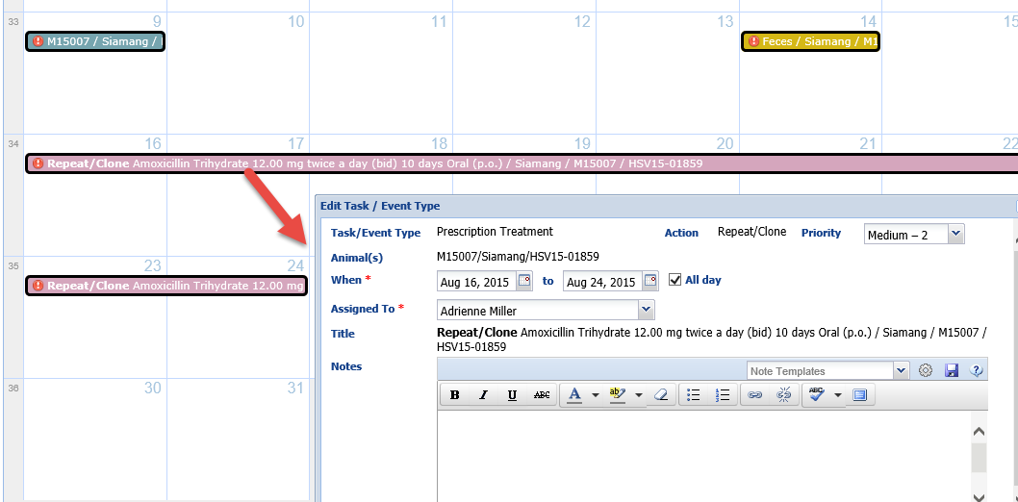
Prescription/Treatment Display
Prescription and Treatment tasks are generated from within the Full Prescription/
Treatment module. They can also be entered directly from the Calendar and do not
have to be sourced from the Medical module.

Slide 18
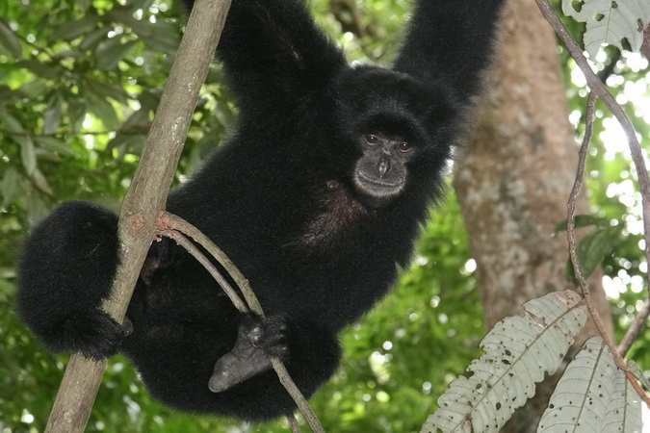
Animal Assessment Observation
After the treatment you want to be sure to re-evaluate the animal’s
health status.

Slide 19
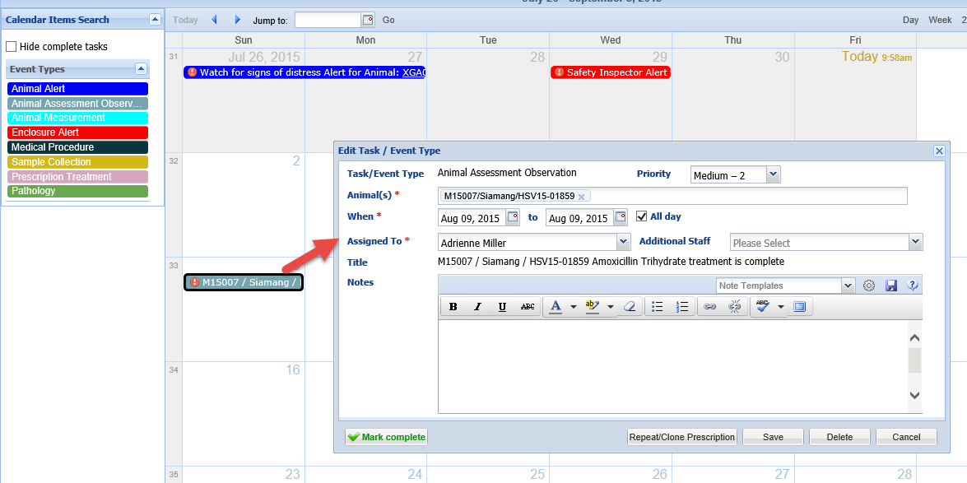
Animal Assessment Observation Display
Animal Assessment Observation is a system generated calendar task that is created on the last day of treatment for any treatment that goes longer than three days. The intent is to prompt the vet/staff to reassess the case to see if it improved, declined or stayed the same. This task can also be entered directly into the calendar and does not have to be generated by a treatment.

Slide 20
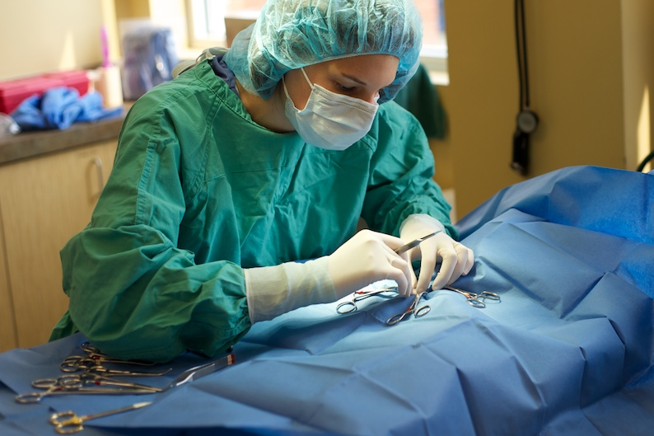
Medical Procedure
Your siamang appears to have a blockage and surgery has been
scheduled. This can appear as a task on the Calendar.

Slide 21
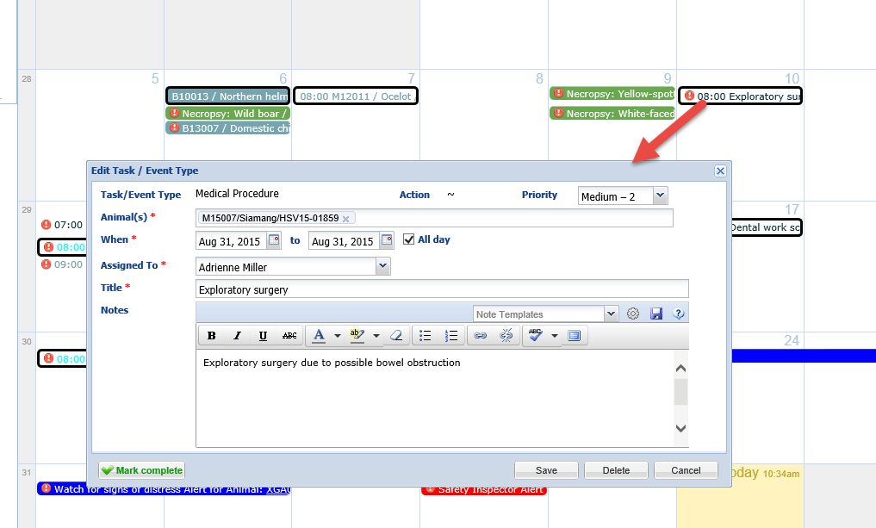
Medical Procedure
Medical Procedures can be added to the Calendar from the Calendar Tasks
side bar in the Medical module. They can also be added directly from the
Calendar.

Slide 22
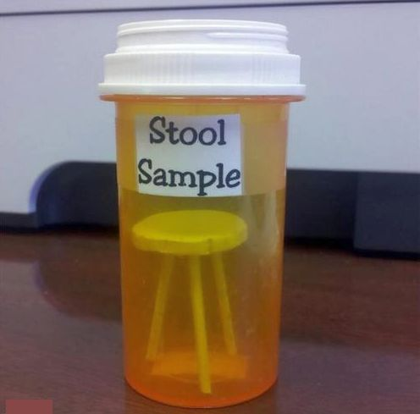
Sample Collection
The Calendar can also serve
as a reminder that samples
need to be collected. This is
helpful to keepers who are
often doing the actual
sample collection.

Slide 23
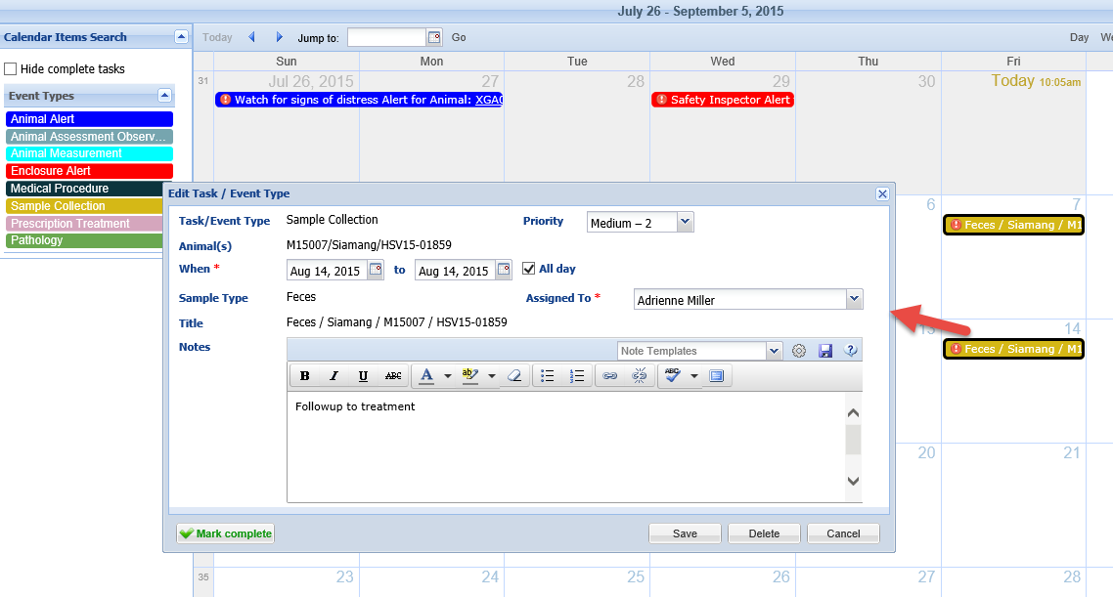
Sample Collection
Sample Collection tasks can be generated in the Samples module. They can
also be created from within the Calendar itself and does not require a
Medical module entry.

Slide 24
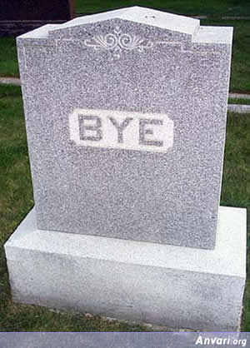
Pathology
Necropsy submissions
can also be tracked on the
Calendar and can serve as
a reminder to the Vet
staff to complete the
necropsy and submit
samples if needed.

Slide 25
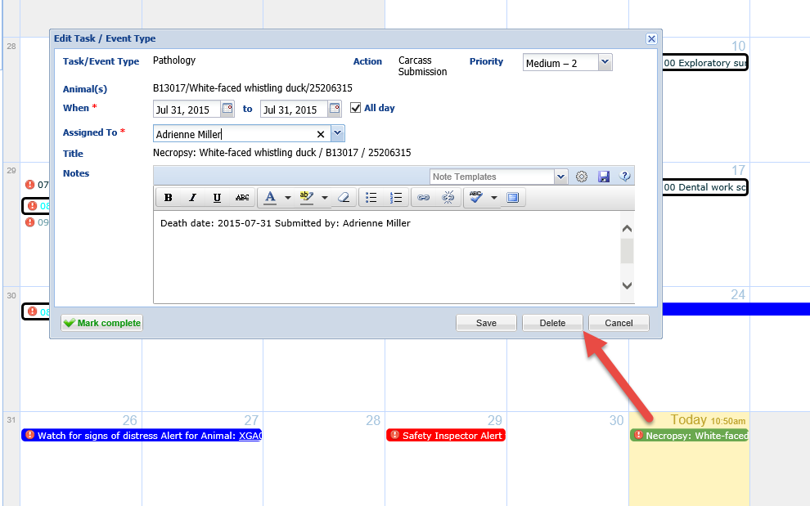
Pathology Display
A necropsy task cannot be scheduled from within the Calendar itself.
This task will only populate by being sourced from the Necropsy module
in ZIMS for Medical.

Slide 26
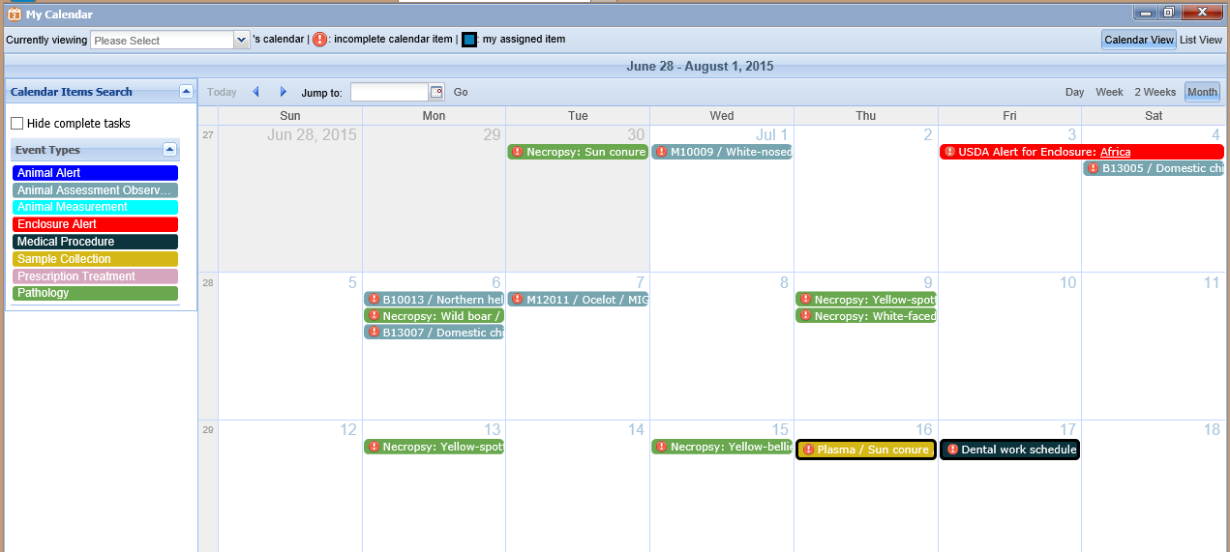
Managing My Calendar
The Calendar tasks are color coded so you can easily see what is an Animal
Alert versus a Prescription or Treatment.

Slide 27
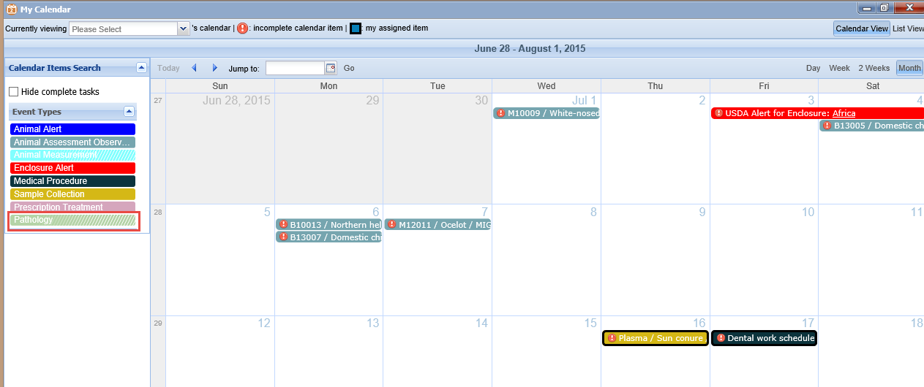
Managing My Calendar
You can chose not to see all types of tasks by left clicking on the appropriate
type on the left side. Here we have selected not to view Pathology records
so they have been removed from the Calendar. You know it has been
selected because the type is faded.

Slide 28
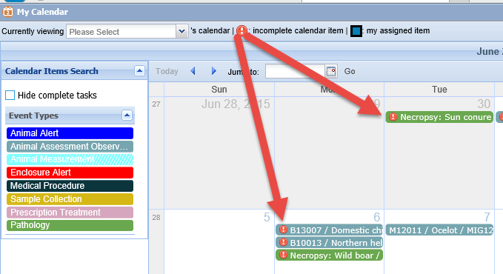
Incomplete Tasks
Tasks that have not been completed will display with a “!” to the left.
Once marked as Complete it goes away. Above we have four Incomplete
tasks and one that has been marked as Completed.

Slide 29
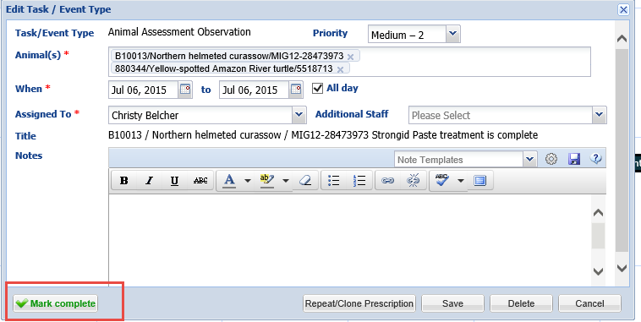
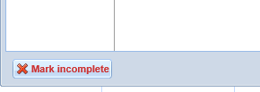
Mark Complete
To mark as Complete simply select the Mark Complete button. If you have
marked a task as Complete by mistake you can check the Mark Incomplete
button to make it active again.

Slide 30
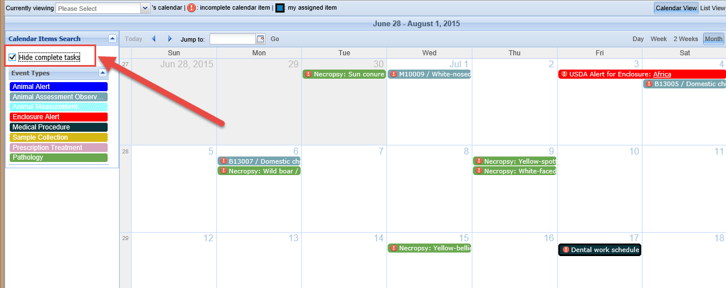
Hide Complete Tasks
You can chose to Hide Complete Tasks by checking the box in the upper
left hand corner. Now we are viewing only those tasks that need to be
addressed.

Slide 31
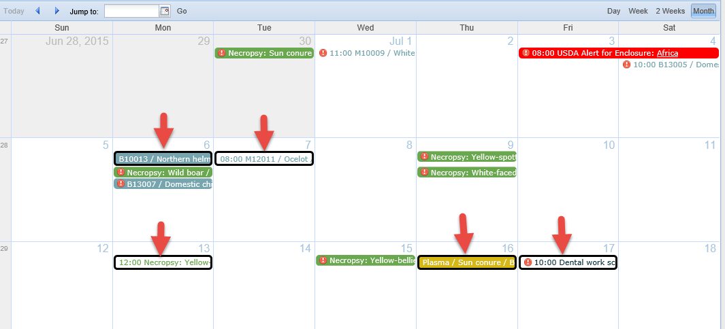
Your Assignments
If tasks are assigned to you they are marked with a black box around
them. I have five tasks assigned to me.

Slide 32
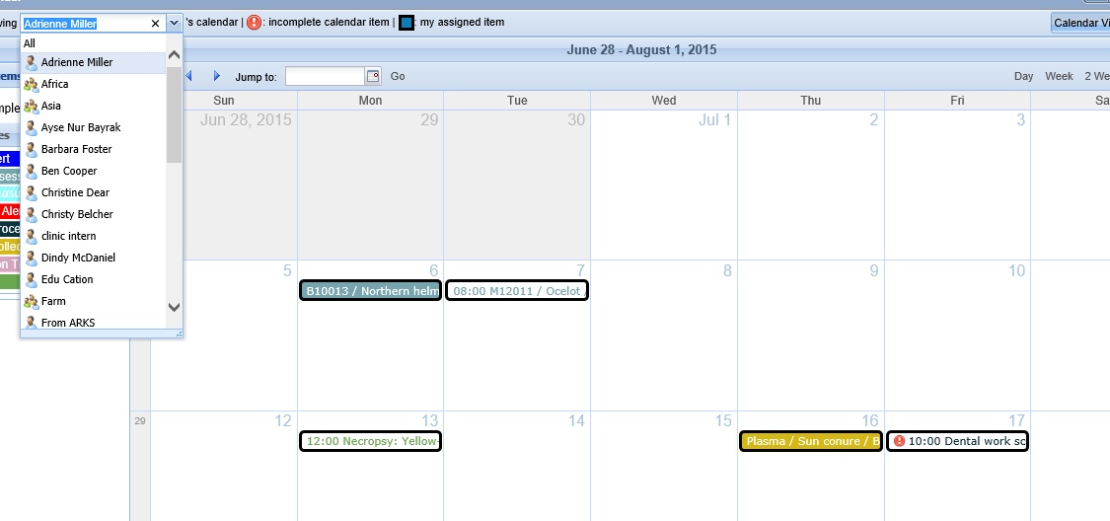
Limit the Tasks Viewed
You can also limit what tasks are viewed by selecting from
the staff list. Here I am viewing only those tasks assigned
to me. If you are a member of a Team and that Team is selected,
those tasks will display for you.

Slide 33
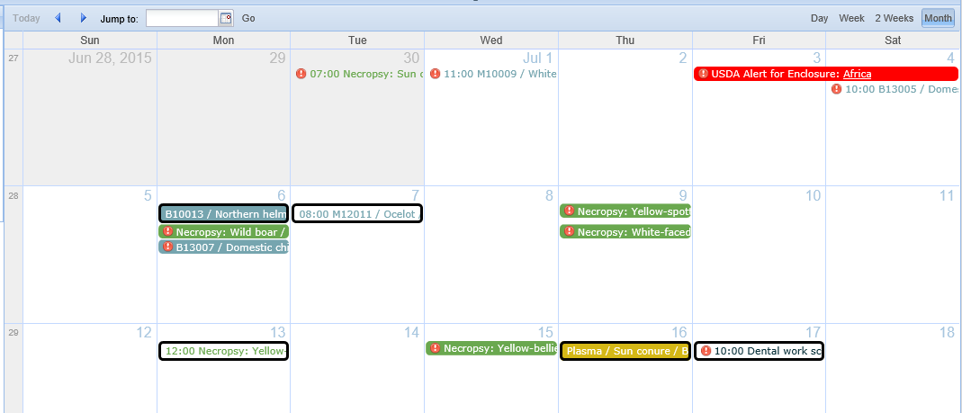
All Day versus Timed Tasks
For most tasks if there are times associated with it the text is displayed in
the appropriate color and it is not highlighted. If the task is for all day
then it is highlighted.

Slide 34
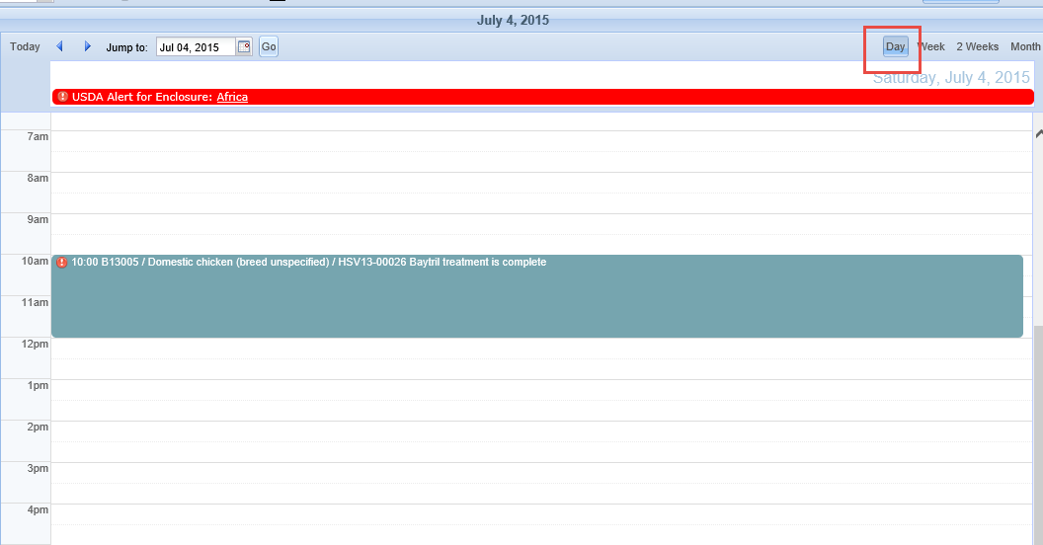
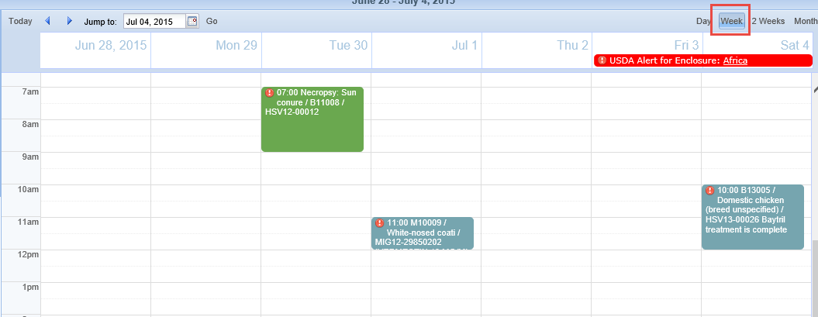
Calendar View
If you select to view the Calendar by the Day or Week any tasks with times
recorded will display in the appropriate time slot. Any all day tasks will display
across the top as the USDA Alert does.

Slide 35
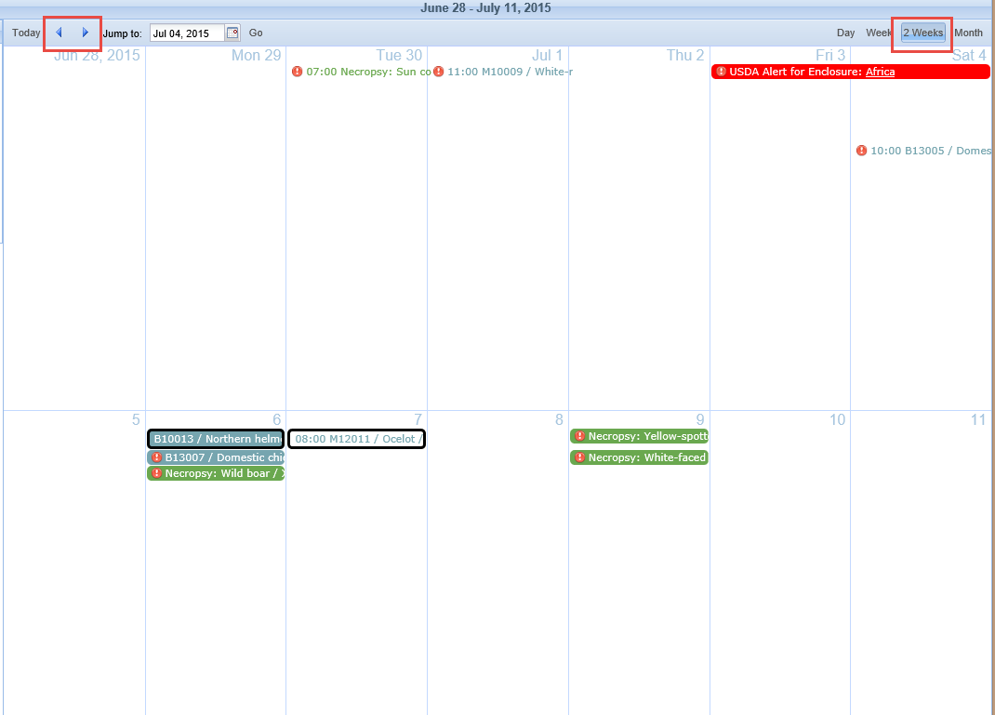
Calendar View
You can also select to view by 2 Weeks or a Month, as shown in
the earlier slides. Using the forward and backward arrows will
change the view in whatever time increment you have selected.

Slide 36
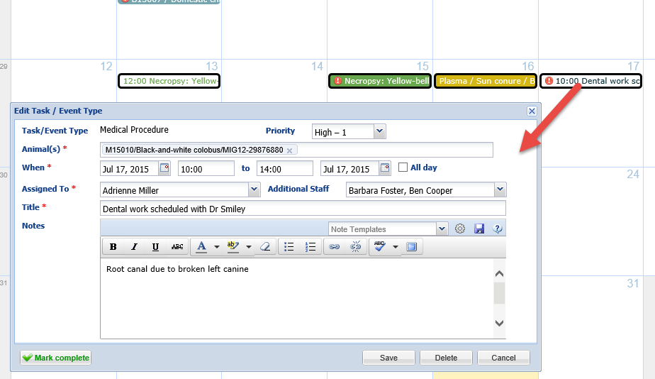
Editing From Calendar
You can view the task by left clicking on it. If you have Edit or Delete
Role access you can also edit or delete the task right from the
Calendar. If changed in the Calendar the task/alert will be edited or
deleted within the animal or enclosure record.

Slide 37
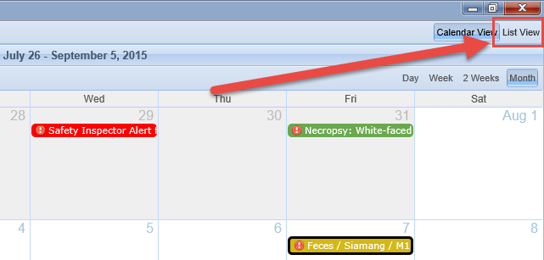
List View
You can also switch from a Calendar View to a List View by selecting
List View in the upper right hand corner. This will display as a sortable
list during the time frame selected for the calendar. You can open the
tasks to edit, mark as complete or delete from this list.

Slide 38
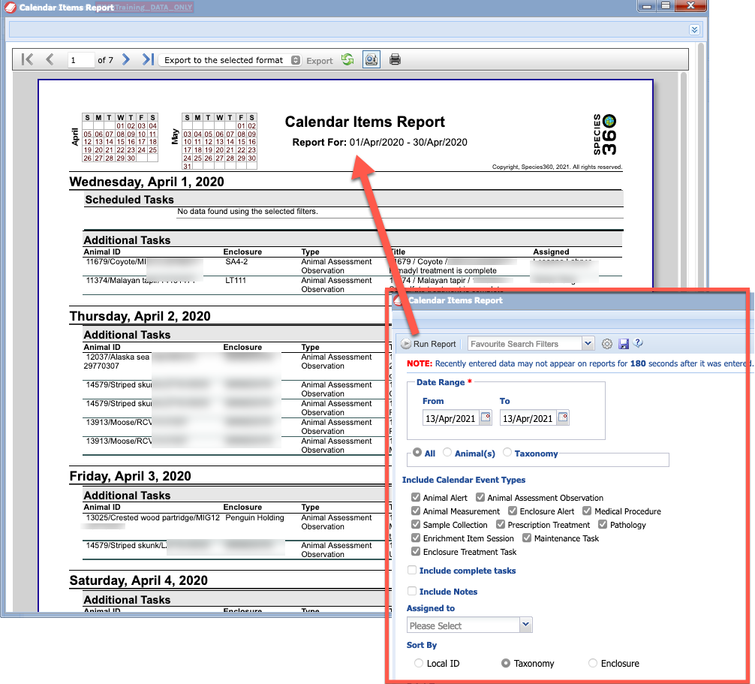
Reporting
Reporting on the calendar items
is only available via a report in ZIMS for Medical currently.

Slide 39
Any questions?
On My Calendar

