Slide 1
ZIMS for Directors
Animal and Institution Management

Slide 2
Some Questions To Ask About Your Animal Records
Does it capture data on OUR collection?
Does it provide global data that we may not have captured at our facility to help my Staff better manage and care for our collection?
Does it help our Studbook Keepers?
Does it help our Population Managers?
Does it help my Institution manage itself?
Is the data secure yet shareable if desired?

Slide 3
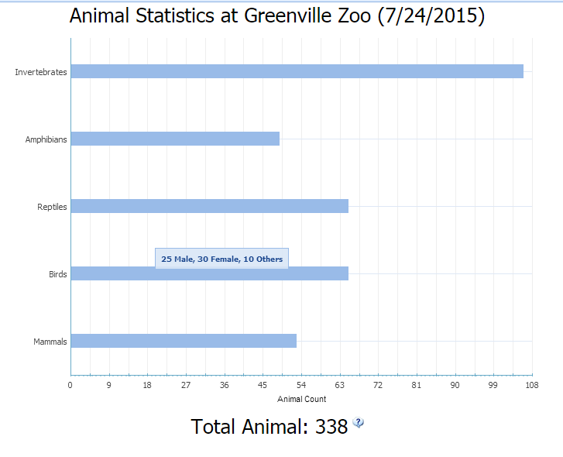
My Institution – Animal Statistics
One of the modules in ZIMS is
My Institution where you can get
statistics about your institution
at a glance. Here we are looking
at the Animal Statistics tab. This
displays the total count of animals
currently held at your facility. By
hovering over the bar you will see
a count by sex for that Class.

Slide 4
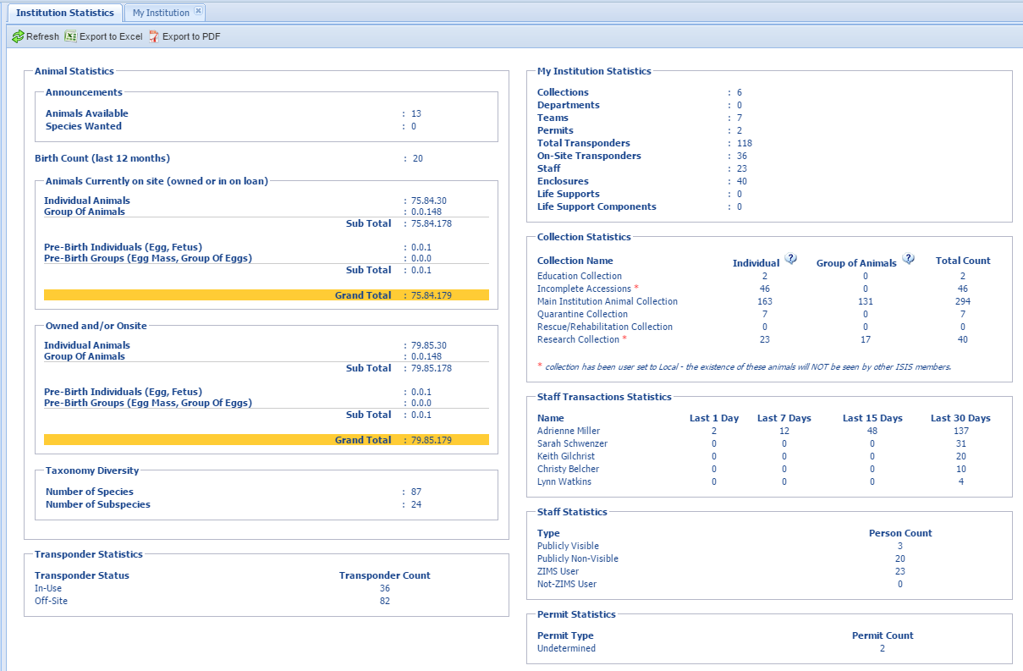
My Institution – Institution Statistics
The Institution Statistics screen
provides much more detail about
your institution as a whole. This
screen includes animal, staff and
institution information

Slide 5
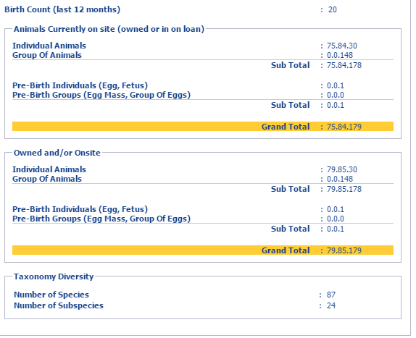
My Institution – Institution Statistics
The animal statistics presented
here are much more detailed
than in the graph shown previously.
You can see how many births you
have had in the last year and how
many animals are managed as groups
versus individuals. It displays the
number of animals physically at
your facility (owned or in on loan)
as well as the total number of
animals that you may have an
interest in (owned and/or onsite.
You can also view how taxonomically
diverse your collection is.

Slide 6
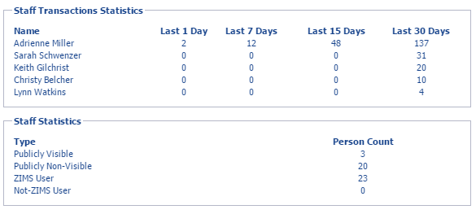
My Institution – Institution Statistics
Staff information on this screen includes Staff Transactions Statistics, or
what staff members have been entering data into ZIMS and, if so, how
many “transactions” (actually pieces of data) have they entered recently.
The Staff Statistics lets you know how many of your staff can be viewed
by other facilities and how many are ZIMS Users.

Slide 7
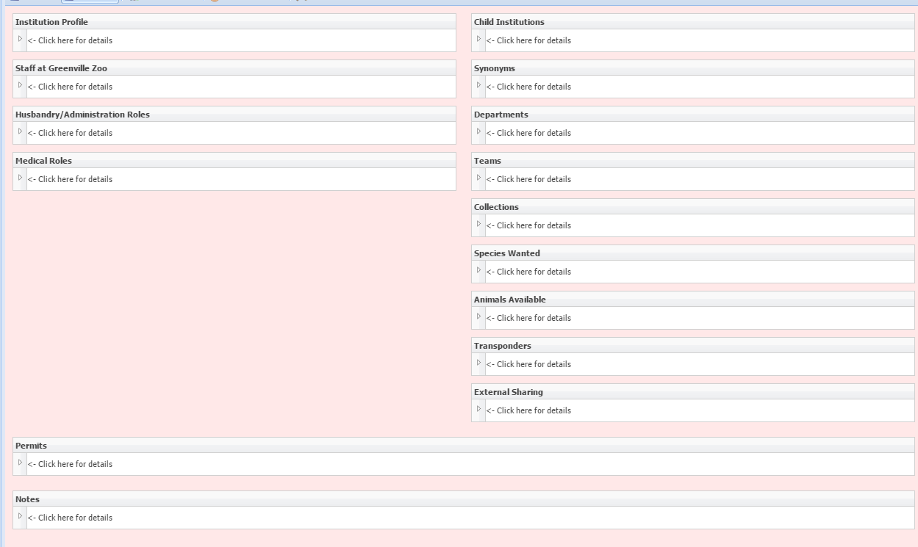
My Institution
The My Institution module itself
gathers a lot of information about
your facility. Some of this can be
viewed by others such as your
Profile, staff (if marked visible) and
permits (if marked global status).

Slide 8
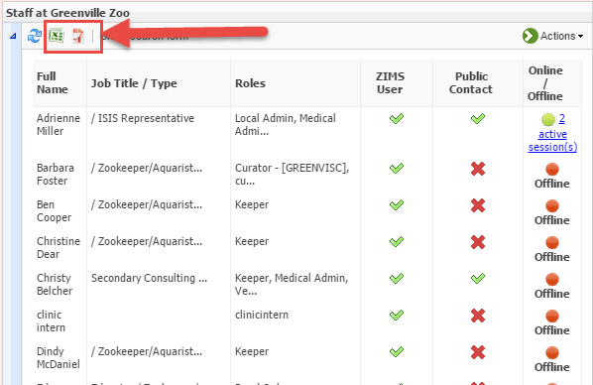
My Institution - Staff
You can keep track of your
staff members right within
ZIMS. If you check them as
visible outside your institution
your colleagues can quickly
find them when needed. The
entire staff list can be exported
to Excel or pdf. You can search
for staff members by using the
various filters available in the
staff search form. Here you can
find people who no longer work
at your facility, or quickly find
what staff members are actively
using ZIMS right now.

Slide 9
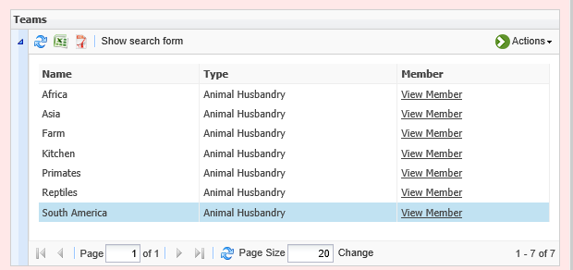
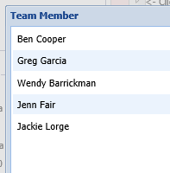
My Institution - Teams
Teams can be created and staff members assigned to them.
This can help you know who is assigned to what section of
your institution. Teams can be assigned as Responsible Parties
to further indicate who is responsible for specific animals or
enclosures.

Slide 10
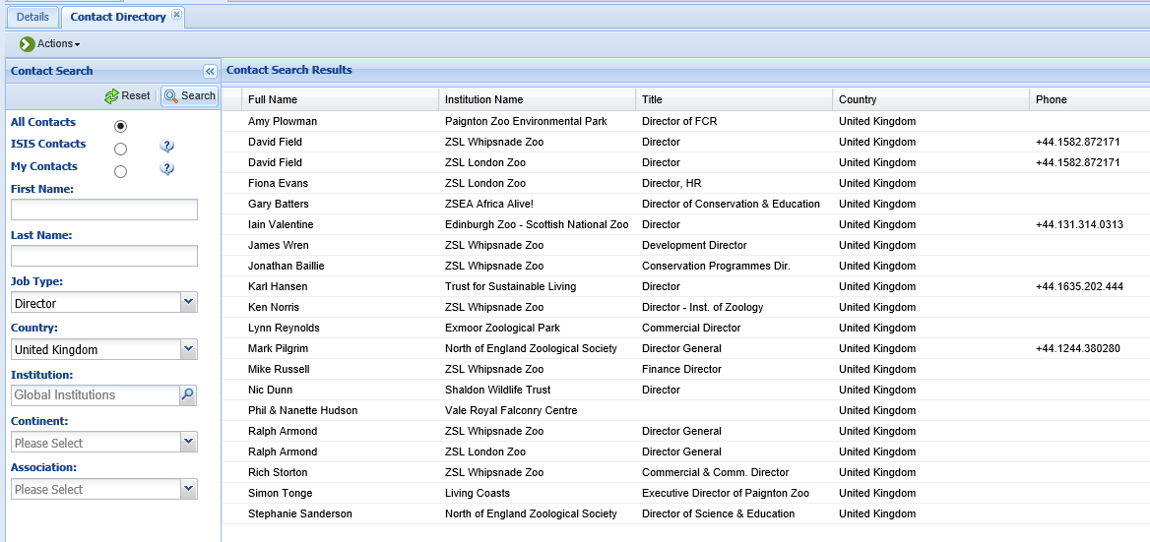
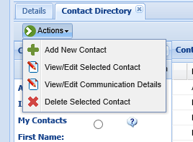
My Institution – Contact Directory
You can use the Contact Directory right in ZIMS
to find your colleagues through the world. Any
staff member that has been marked as Visible
Outside My Institution can be found here. In
addition, you can add your own local contacts.
Here we have searched for Directors in the
United Kingdom.

Slide 11
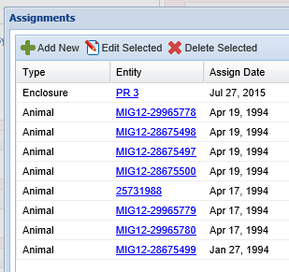
My Institution - Permits
You can easily view the permits that your institution has
in the Permits grid. Viewing the assignments shows you
what animals or enclosures the permit applies to. This
grid is also an easy way to keep updated as to what permits
are due to expire so they can be renewed in time.

Slide 12
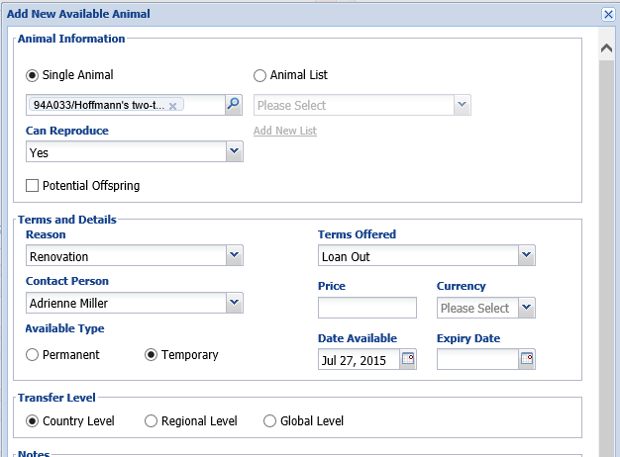
My Institution – Animals Available
If you have animals that are
surplus to your institution’s
needs you can place them on
the Animals Available list so
that other facilities can view
them. You can provide details
such as the reproductive status,
reason you wish to place the
animal, and the terms you
desire. You can also indicate
the transfer level

Slide 13
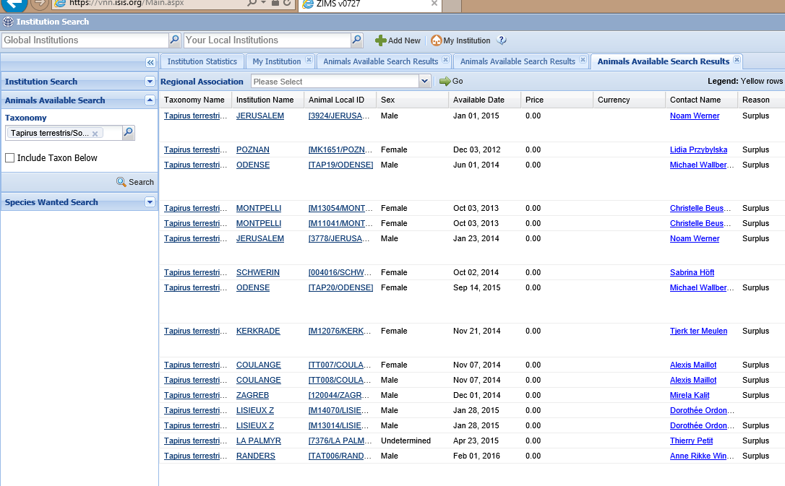
Animals Available
If you are looking to acquire a
species you can search the
Animals Available list to see if
any have been advertised as
being available by another
institution. The Animal Local
ID hyperlink will take you into
the global view of the record
so you can determine if this
may be an animal you are
interested in acquiring.

Slide 14
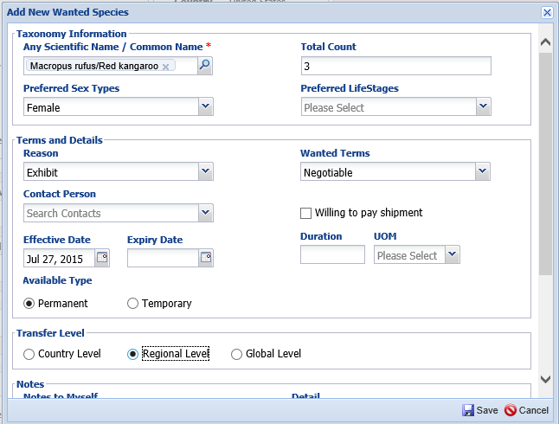
My Institution – Species Wanted
If you are looking for a
species to add to your
collection you can also
create a Species Wanted
record. You can request
specific sex types, terms
and transfer level.

Slide 15
Species Wanted
You can search for species that other institutions are looking for.
For example, if you had a red kangaroo that you wanted to place
at another facility you can easily see that six institutions are
looking to acquire red kangaroos. The yellow highlight indicates
the institution is in your country.

Slide 16
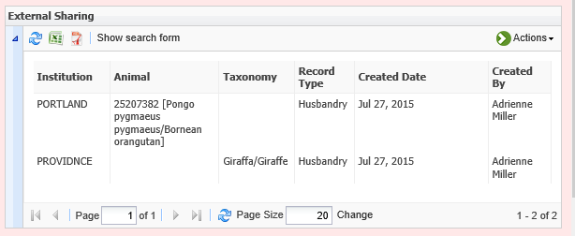
My Institution – External Sharing
By default, only a limited amount of the entire animal record can be
viewed globally. However, should you wish to share the entire record
with another facility you can do so. This is very helpful when you may
be acquiring an animal from elsewhere as it allows you to see everything
if the other institution selects to share the record with you. Entire
taxonomies or individual records can be shared with the specified
institution.

Slide 17
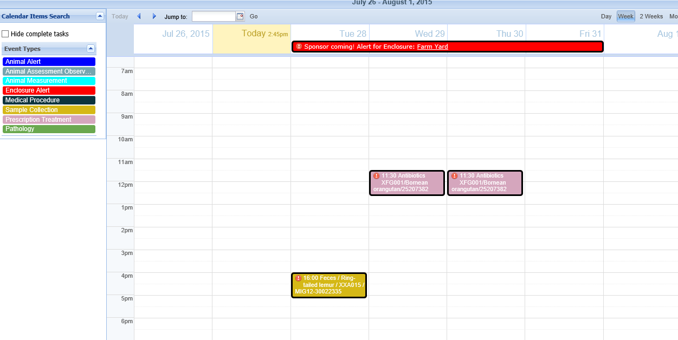
Staff Calendar
You can manage your staff’s responsibilities using the Calendar functionality.
Tasks can be assigned to individuals or Teams. When the individual or Team
member is logged in their tasks will display in My Calendar. Above we have an
all day Alert for an Enclosure, a reminder to collect a fecal sample on Tuesday,
and the need to give an antibiotic on Wednesday and Thursday.

Slide 18
Enclosures - Details
You can capture a lot of information regarding your enclosures such as
substrates, plants and furniture. Of special importance is the ability to
capture the dimensions of your barriers and what they are made of. This
information is often required in permit applications and facility inspections.
It can easily be exported to provide the information requested.

Slide 19
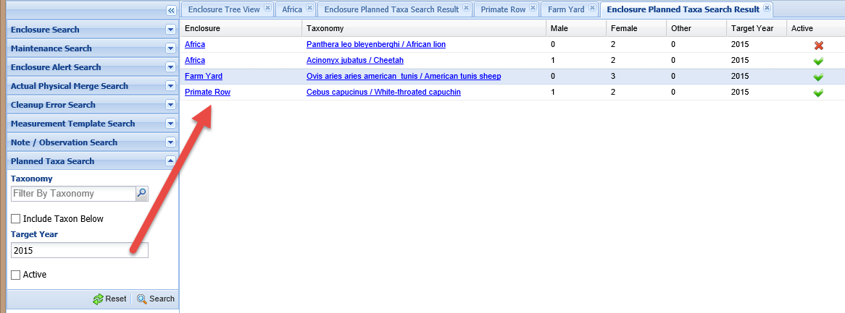
Enclosures – Planned Taxa
You can use the Enclosure module to help with collection planning.
Record within each exhibit, or a grouping of exhibits by recording into
the Parent enclosure, what species you are planning for. You can then
search by taxa or year and export the results for further review.

Slide 20
Local Reports – Detailed Inventory
Detailed Inventory Reports allow you to capture the count of animals
in your collection over time. It can include animals both physically at
your facility and owned by you, animals at your facility but not owned
by you, and animals owned by you but not physically at your facility.

Slide 21
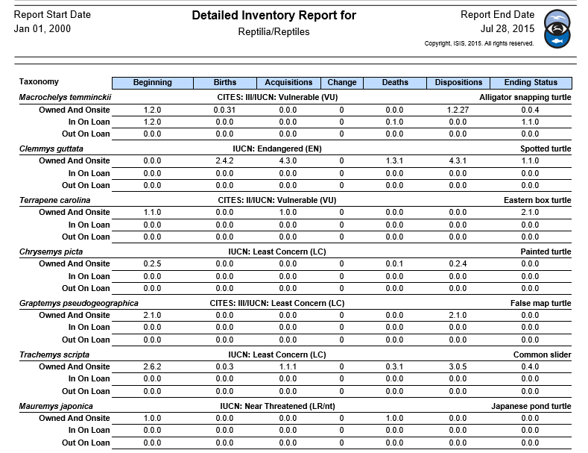
Detailed Inventory Report looks like…

Slide 22
Local Reports – Summary Inventory
For a Summary Inventory Report you must choose if you want the
report run for animals physically at your facility (you may or may not
own them), or animals that you own (they may or may not physically
be at your facility).

Slide 23
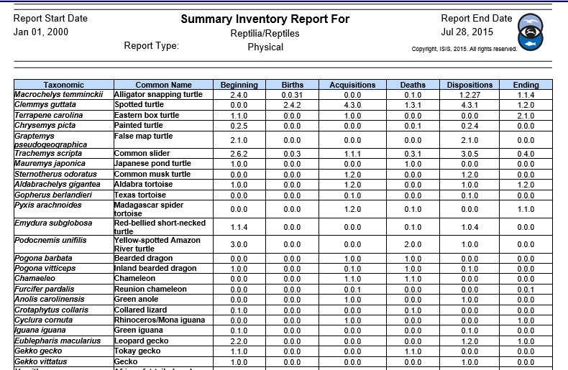
Summary Inventory Report looks like…

Slide 24
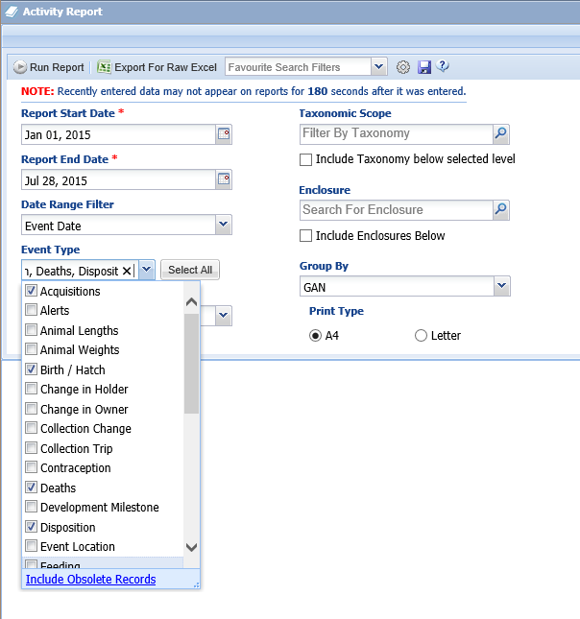
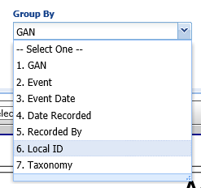
Local Reports - Activity
The Activity Reports captures information that has been
recorded for a specified date range. This is the pulse of
your institution’s activities. You can select all Event Types
or specific ones. You can also select how you want the
report to be grouped.

Slide 25
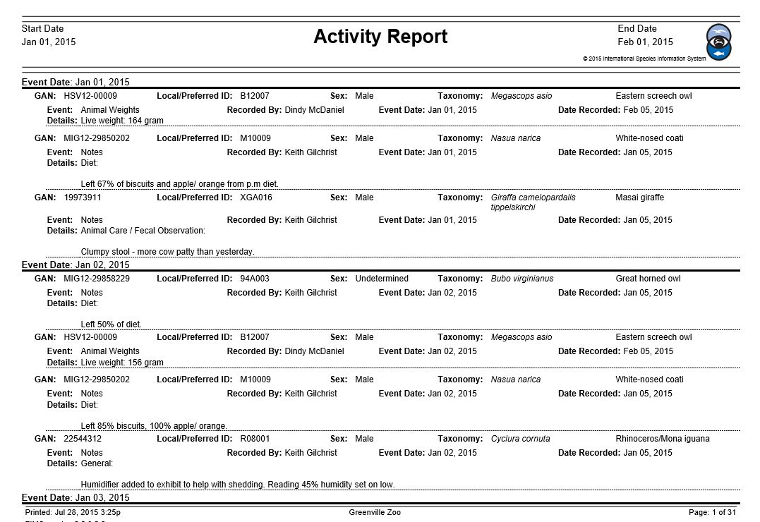
Activity Report looks like this if grouped by Event Date…

Slide 26
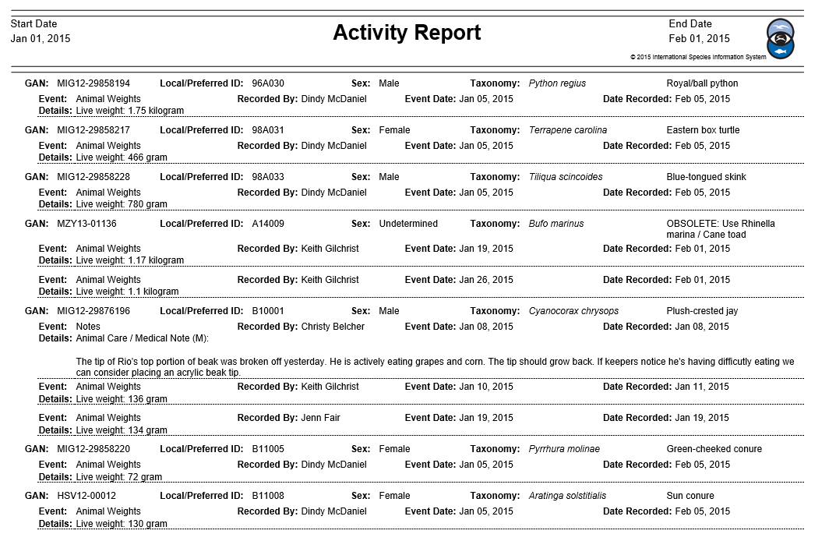
Or this is grouped by Local ID…

Slide 27
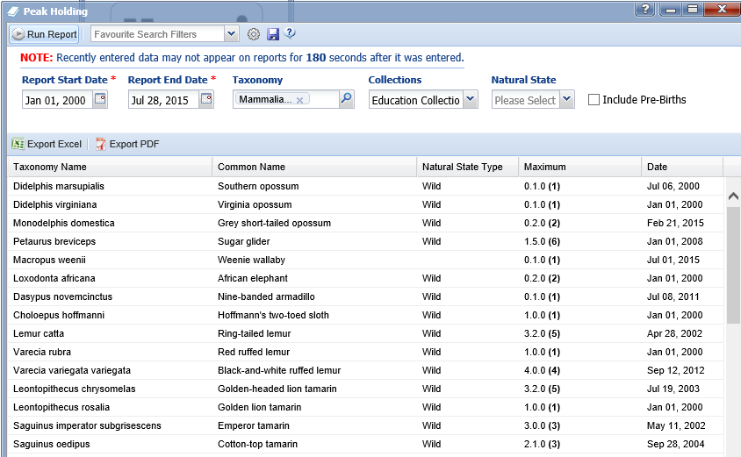
Local Reports - Peak Holding
The Peak Holding Report indicates when you held the most of a species
during a specified time range. Some government agencies require this
information for licenses.

Slide 28
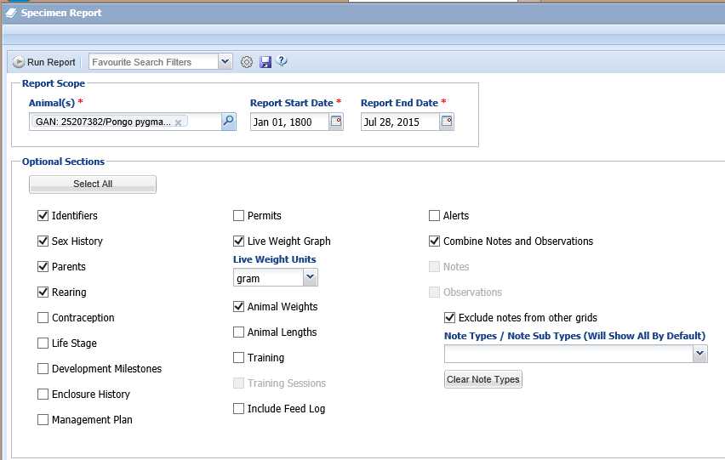
Local & Global Reports - Specimen
The Specimen Report captures
all of the information recorded
on a specific animal or group.
What you include in the report
is up to you. If you run this report
for an animal you never held or
owned, the information is limited
to only globally shared data.

Slide 29
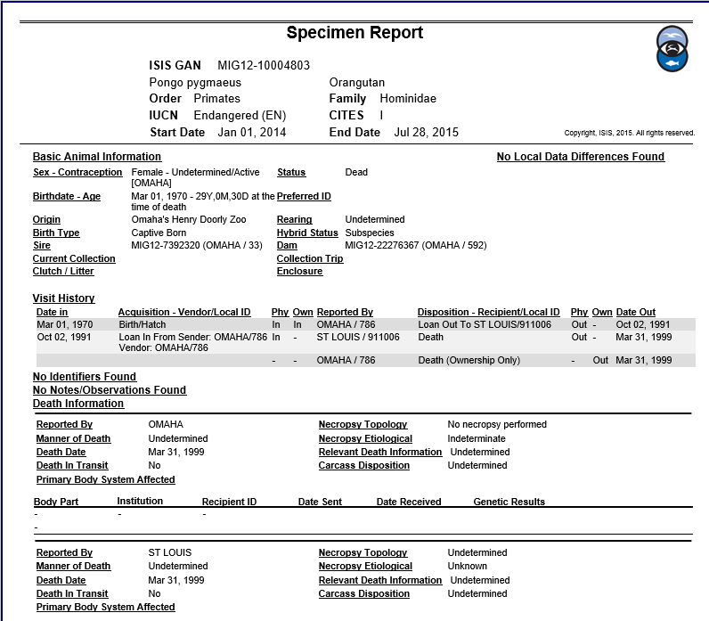
A Specimen Report looks like…

Slide 30
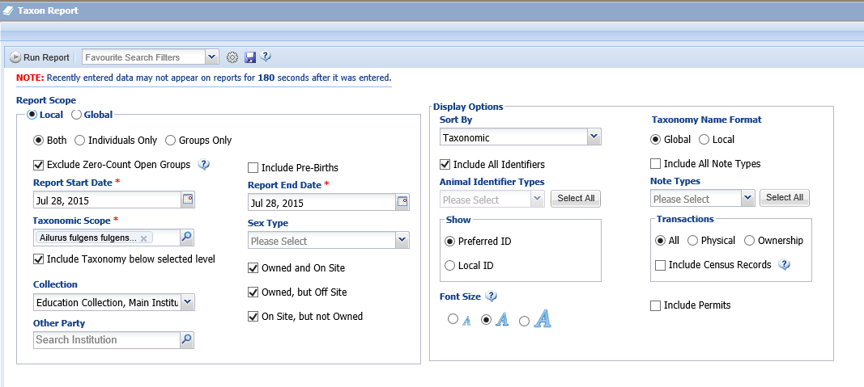
Local & Global Reports - Taxon
A Taxon Report gathers information for a specific taxa. You can run this
report at both the Local (your animals only) or the Global level. The data
shown for both a Local report and a Global report is the same and Global
is not filtered as the Specimen Report is.

Slide 31
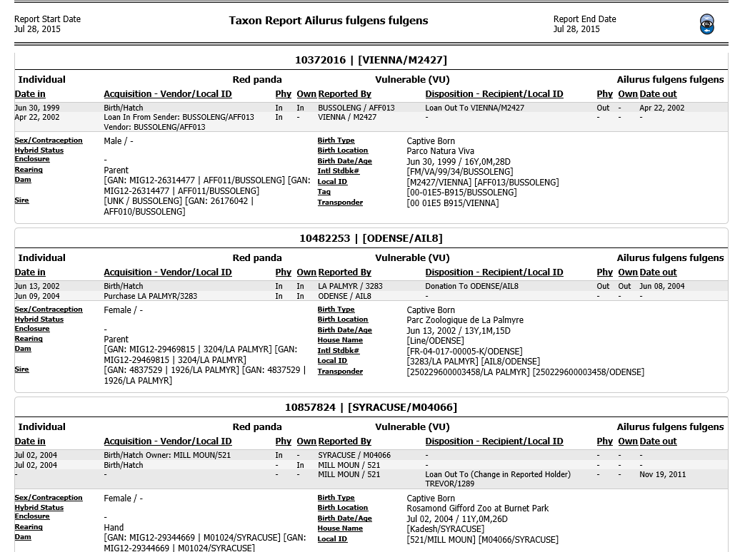
A Taxon Report looks like…

Slide 32
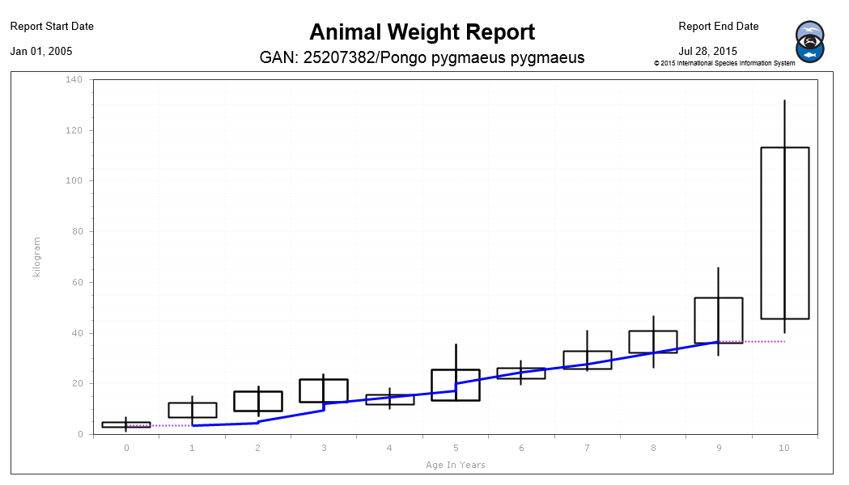
Global Reports – Weight Comparison
You can run a Weight Comparison Graph on your animal and
compare it to the global weights recorded for the same species
and sex. The boxes show one standard deviation from the median.
The whiskers are the Minimum and Maximum weights recorded.
Your animal is in blue. You can quickly see that this orangutan has
been on the low side of the median weight throughout his life.

Slide 33
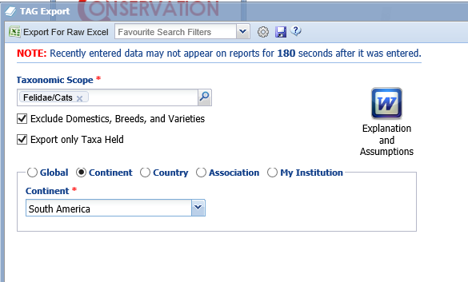
Global Reports – TAG Export
The TAG Export is being used by Population Managers throughout the world to
help with regional species planning. It can be run at the Global, Continent, Country,
Association or My Institution level. Reading the Explanation and Assumptions
document will help you to understand this report. It is exported for raw excel so
that the data can be manipulated for analysis.

Slide 34
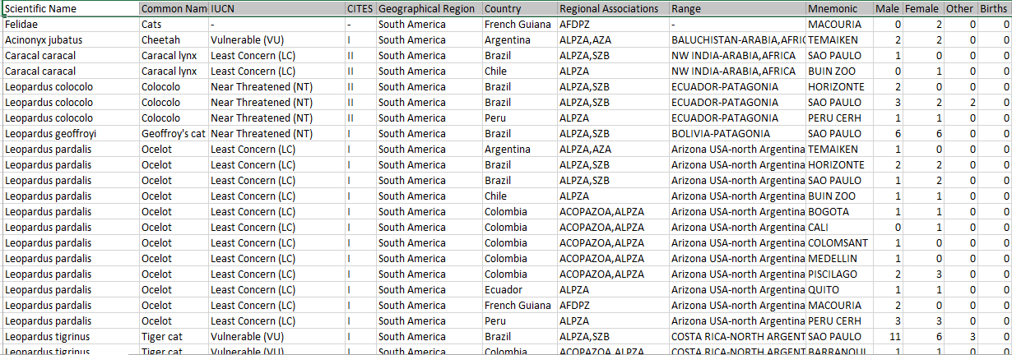
The TAG Export looks like…

Slide 35
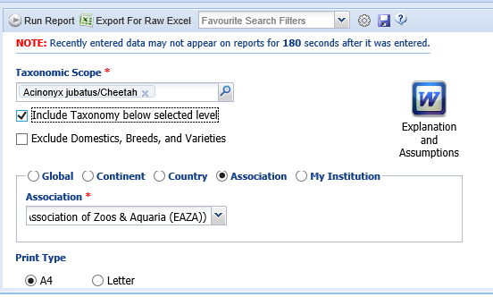
Global Reports – Population Overview
The Population Overview Report is a one-screen per taxa overview of the state of the animal population. It includes key metrics on genetics and demographics
and indicators of underlying data quality. It can be ran at several different levels.
Reading the Explanation and Assumptions document will help you to better
interpret this report.

Slide 36
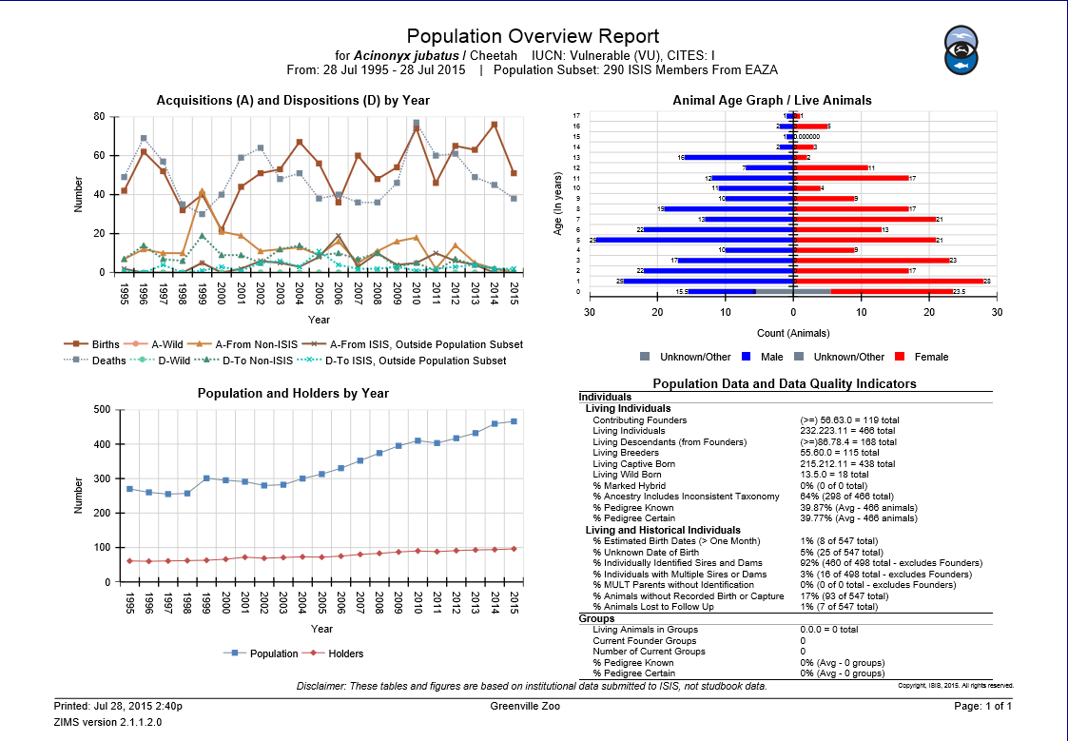
The Population Overview Report looks like...

Slide 37
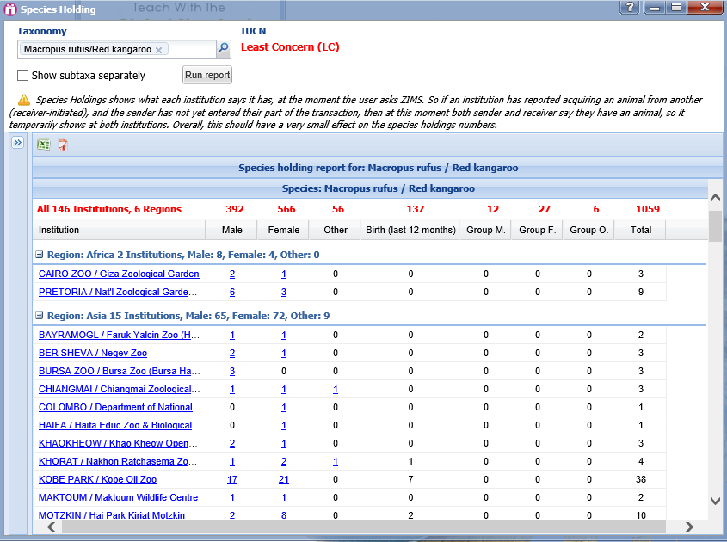
Global Tools – Species Holding
Species Holdings will display what each institution
says it has for a specified taxa at the moment that
the search was requested. The numbers are
hyperlinks that allow you to view the global record
for the Animal represented. The institution is a
hyperlink to the institution record.

Slide 38
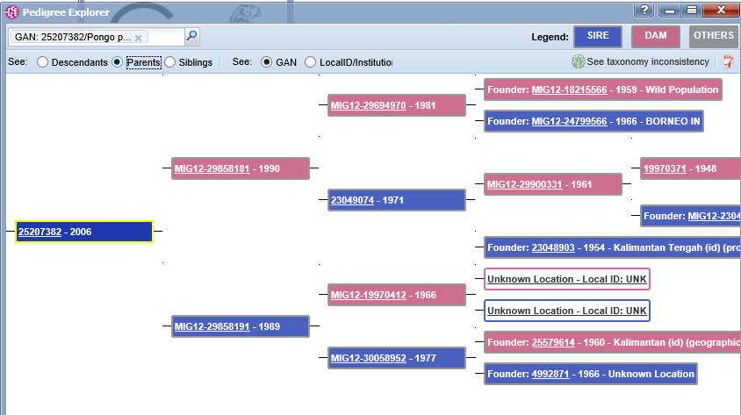
Global Tools – Pedigree Explorer
Pedigree Explorer allows you to graphically view the Ancestors, Siblings,
and Descendants for a specified animal. The GANs are hyperlinks to the
global view of the record.

Slide 39
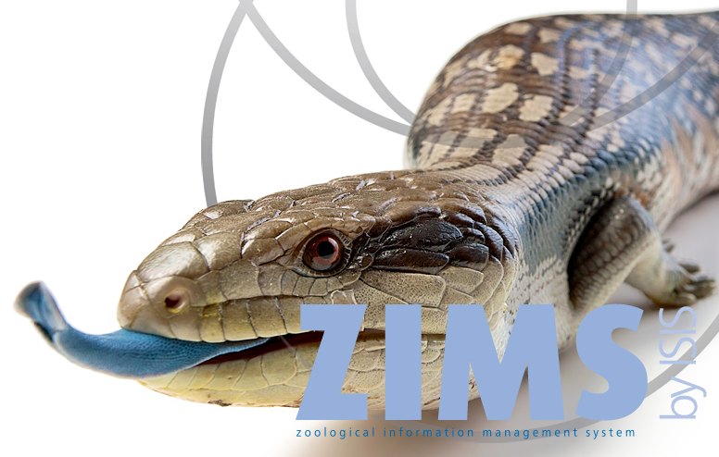
ZIMS for Directors
Information Made Easy!

