Slide 1
2001 Term, Treatment and Test Dictionaries
In ZIMS

Slide 2
ZIMS Updates!
This PowerPoint is up-to-date as of: May 20, 2019
ZIMS is developed in an “agile” method
This means that it is updated every two weeks, sometimes with additional releases in between!
Use the link below to see if there have been any updates to this topic since the date above:
http://training.species360.org/updates/

Slide 3
ZIMS Medical Dictionaries
There are three reference libraries in ZIMS:
Term Dictionary
Drives the data standard choices made in the Diagnosis and Procedure module
Treatment Dictionary
Drives the data standard choices made in the Prescription and Treatment module
Test Dictionary
Drives the data standard choices made in the Tests portion of the Samples/Tests and Results module

Slide 4
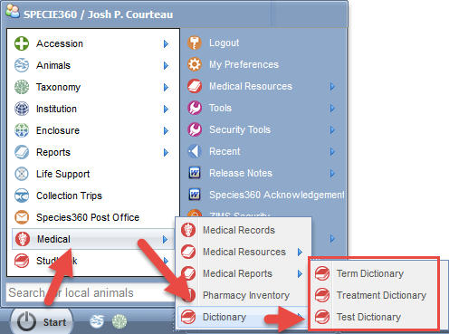
Dictionary Access
The Dictionaries are found under Start > Medical > Dictionary. Access to the reference dictionaries is controlled by the ZIMS Role editor. Permissions to these features will be granted by your local or medical administrator.
If you do not have access to the Dictionaries, contact your local admin for help or contact support@species360.org

Slide 5
Dictionary’s are Local & Global
You can add local values to the Term and Treatment Dictionaries
To request the addition of a new Test, use the Global Test Request Word document available in the Help Menu in ZIMS
When something is added locally it has a ‘house’ icon in the list:
Species360 added values are a globe icon. When something was added locally but has been promoted to global it has a globe:

Slide 6
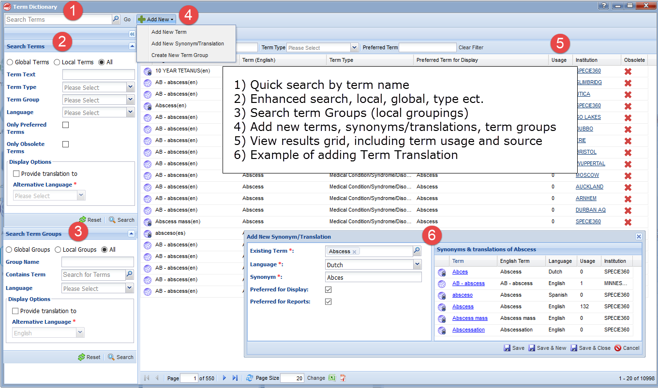
Terms

Slide 7
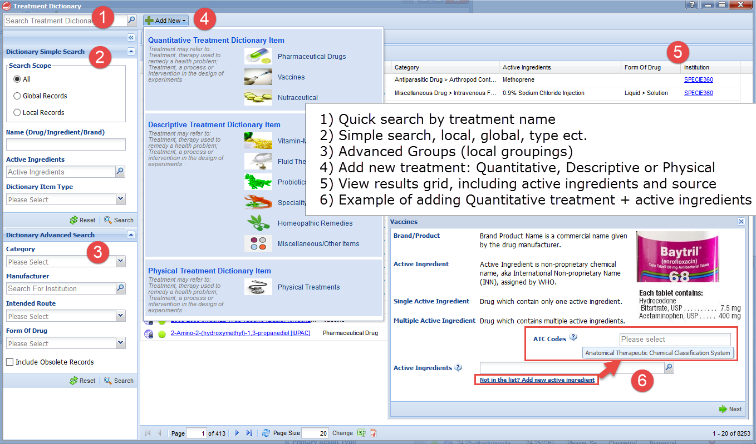
Treatment

Slide 8
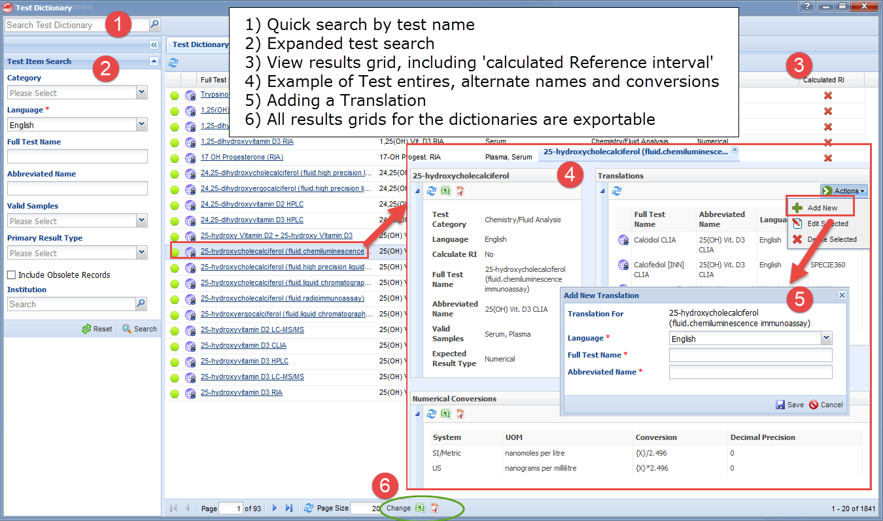
Test

Slide 9
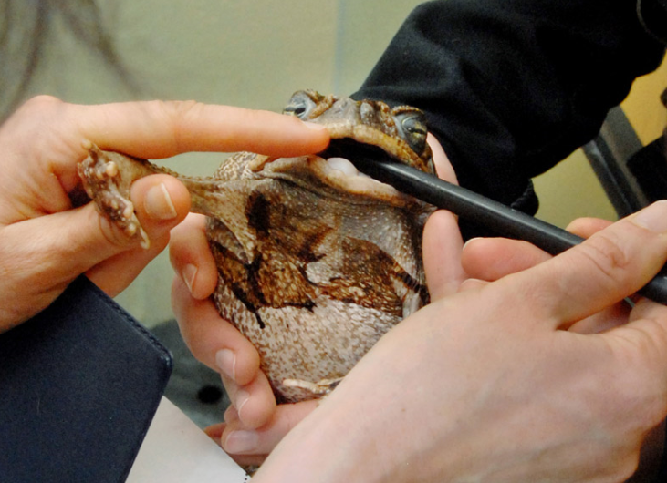
Treat Them Right!
Using ZIMS

