Slide 1
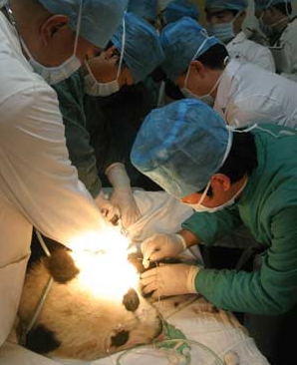
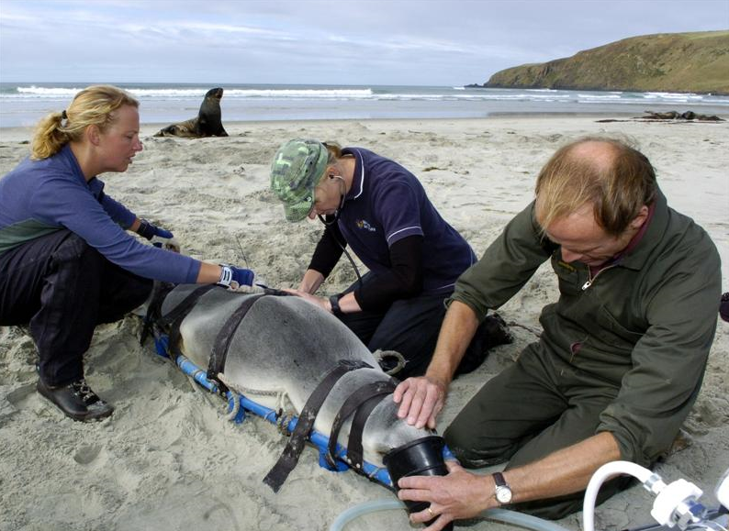
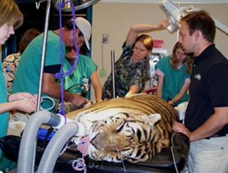
2001 - Medical Roles
Creating and Assigning Medical Roles

Slide 2
ZIMS Updates!
This PowerPoint is up-to-date as of: July 2 2019
ZIMS is developed in an “agile” method
This means that it is updated every two weeks, sometimes with additional releases in between!
Use the link below to see if there have been any updates to this topic since the date above:
http://training.species360.org/updates/

Slide 3
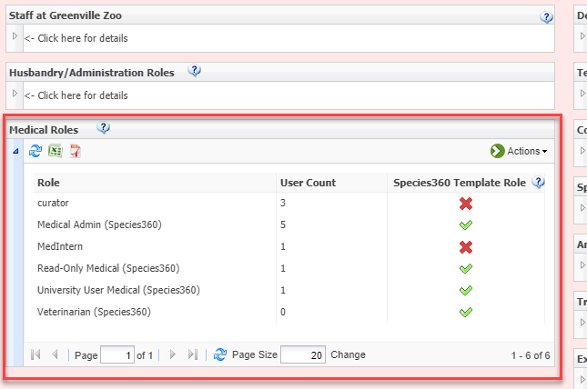
Medical Admin Role
Medical Roles are added, edited and assigned in the Animal Husbandry module under My Institution. As the default, your institution will not have any Medical Roles. The Species360 Global Administrator will give one person at your institution a Medical Admin Role. Usually this is your Local Admin, but let your Species360 representative know what staff member will be managing the Medical Roles at your institution so they can assign them this Role. Once the Medical Admin Role has been assigned, this person will see the Medical Roles grid.

Slide 4
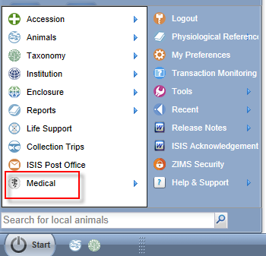
Medical Admin Role
Once you have been given a Medical Role the medical
module will appear in the Start menu.
Medical Admin is a Species360 Role and cannot be edited. Medical Admin has all rights to all
functionality of the ZIMS For Medical module.
It does not, however, provide any access to the
Animal Husbandry ZIMS module. That access will need to be assigned by your Local Admin. The Husbandry Role assigned is usually Vet-Husbandry (Species360).

Slide 5
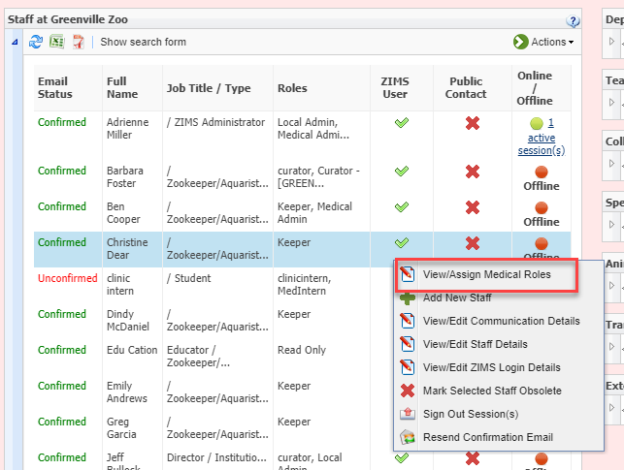
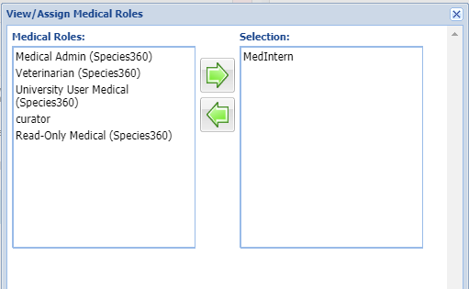
Assigning Medical Roles
The Medical Admin will then assign
other staff members appropriate
Medical Roles. To assign a Medical
Role, from the Staff grid highlight
the staff member and select
View/Assign Medical Roles (right).
Move the desired Role(s) into the right
hand box (below). This Role will be
assigned.

Slide 6
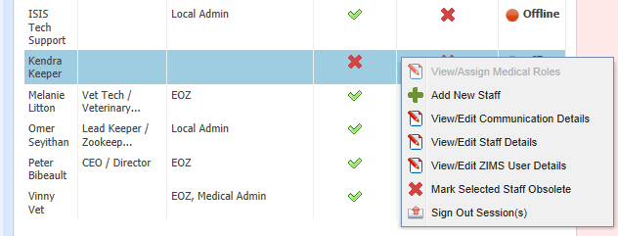
Assigning Medical Roles
It is important to note that a Medical Role
cannot be assigned to a staff member who
does not have any ZIMS Husbandry access.
In this example Kendra Keeper does not
have any access to ZIMS Husbandry, so
View/Assign Medical Roles is greyed out
and cannot be selected for her. At minimum,
a Read Only Husbandry Role should be
assigned by the Local Admin.

Slide 7
Species360 Medical Roles
There are four Species360 Medical Roles
The ZIMS access in these cannot be edited
Medical Admin
Access to Search/View, Add, Edit and Delete all Medical data
Ability to assign Roles to Staff and create custom Roles
Ability to select external Medical sharing
Veterinarian
Access to Search/View, Add, Edit and Delete all Medical data
Read-Only Medical
Access to Search/View all Medical data
University User Medical
Access to Search/View Anesthesia Summaries

Slide 8
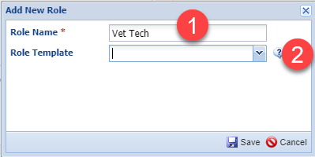
Custom Medical Roles
If the Species360 Roles don’t meet
your needs, you can create custom
Medical Roles. From the Medical Roles
grid select Actions > Add New. The
name must be unique (1). You can chose
to select an existing template or
leave it blank (2). If you select an
existing one, the Role’s functionality
will be copied over into the new Role.
This may save you time as you have
a head start and only need to add or
remove access as desired. If you leave
it blank you will need to select all the
access desired.

Slide 9
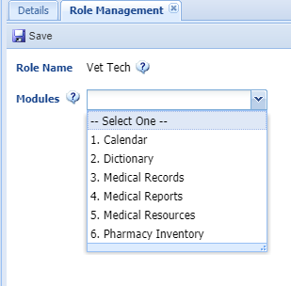
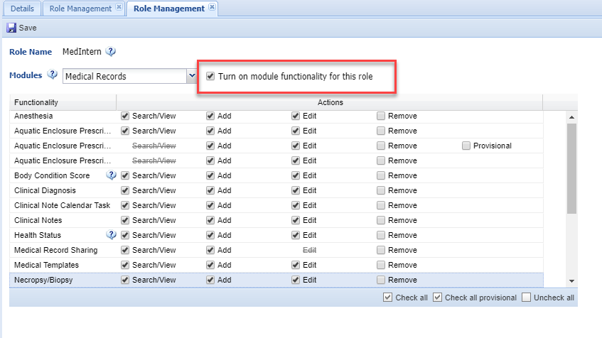
Custom Medical Roles
To assign the Role access select
the Role, Actions > Manage Role
Access. Select the module (top).
Check the box to turn on the
module functionality. Then check
(or uncheck) the access as desired.
Remember to Save between
modules. The Role is now available
to be assigned to staff members.

Slide 10
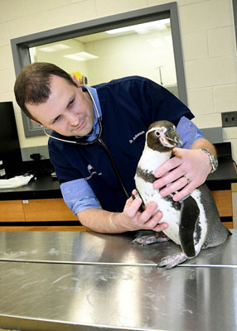
Roles for all your medical care staff

