Slide 1
Global Resources – Where the Data is Sourced From for the Husbandry and Medical Global Resources

Slide 2
Global Resources
The ZIMS Global Resources take the data entered by our members and provide valuable references to better manage the husbandry and health of the animals in our care.
It is important to note that if you have an animal in a Collection that is marked as Local, no data recorded in their record will be contributed to these Global Resources

Slide 3
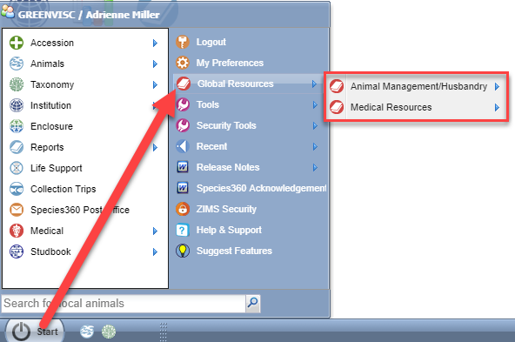
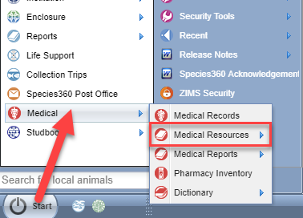
Navigation
The ZIMS Global Resources are found under Start > Global Resources. The
Medical Resources are also found under the Medical module.

Slide 4
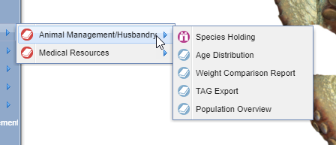
Topics Covered
The Resources are divided
into Animal Management/
Husbandry and Medical
Resources.

Slide 5
Data Not Included in Global Resources
Provisional records
Animals in Local Collections
Incomplete Accessions

Slide 6
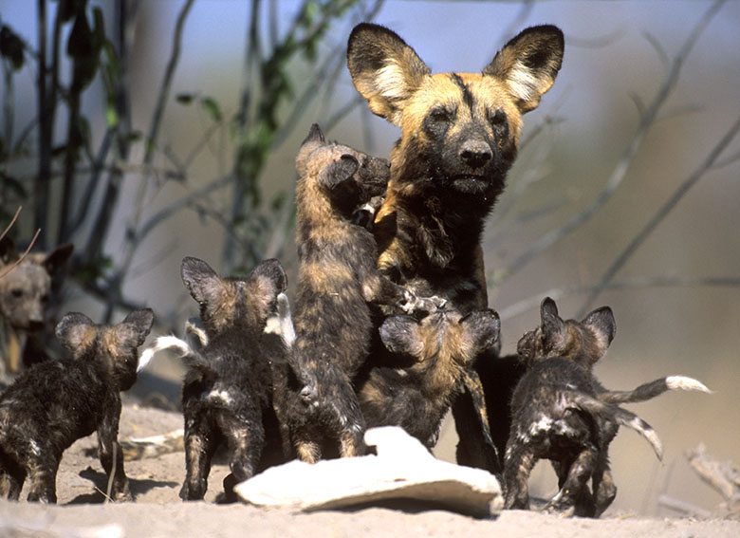
Your female African
Hunting dog is
confirmed pregnant.
This is her first litter
and also the first time
for you and your
institution. You want
to talk to someone at
a facility that has
successfully reproduced
the species.

Slide 7
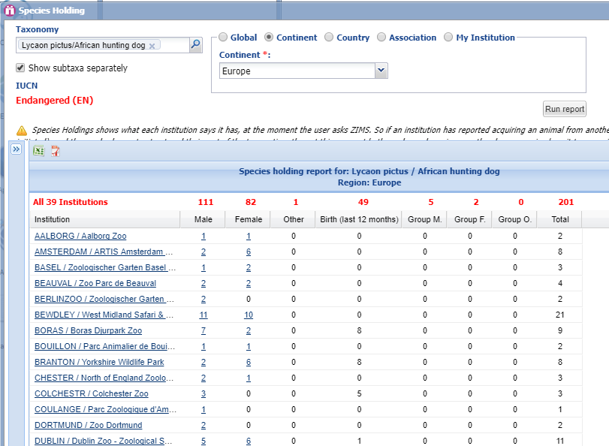
Species Holding
Using Species Holding
you enter the species
and chose to filter for
your continent (Europe)
as you want to talk to
someone at an institution
with similar environmental
conditions as yours. You
find several facilities
that have had births in
the last year. Using the
hyperlink to the institution
you find the contact info
for them.

Slide 8
Source of Species Holding
Currently living animals
Taken from what each institution says it is holding at the moment of the request from ZIMS
If an institution has performed a Receiver Initiated transfer and the Sender has not yet recorded sending, the animal will display at both facilities
This is a very small effect on the holding numbers

Slide 9
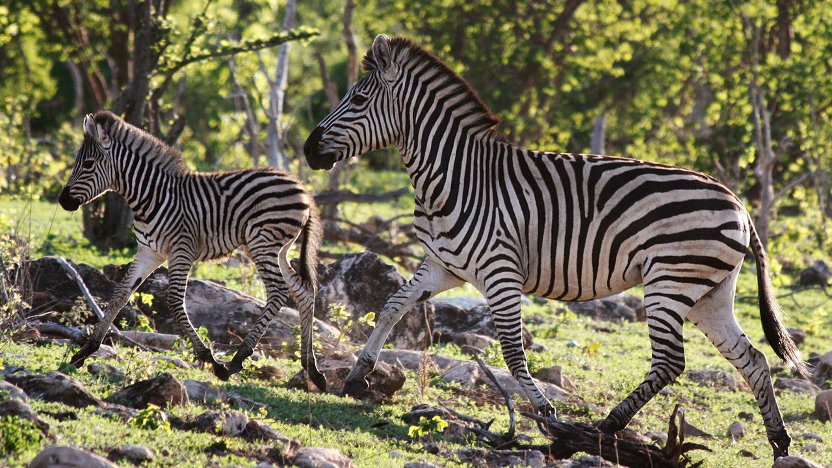
Just looking at the sex ratios for a population doesn’t really tell you the
reproductive potential of a population. The ages of the animals is also
a good indicator of their reproductive health. You are very interested
in acquiring some zebras so you check the Age Distribution in your region
for the various zebra species held in captivity.

Slide 10
Source of Age Distribution
Living animals as per selected scope
Global, Continent, Country, Association, My Institution
From the Birth/Hatch Date recorded by the first recorded entry into ZIMS (the Global date)
The number of animals with unknown birth/hatch dates, and thus excluded from the chart, is displayed at the bottom
Unknown includes all estimated dates, no matter how small the date range or variance

Slide 11
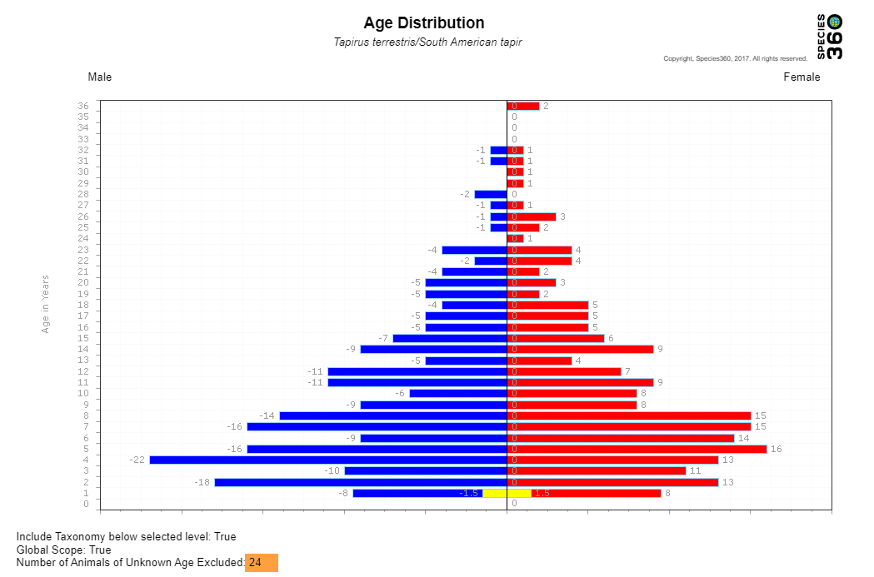
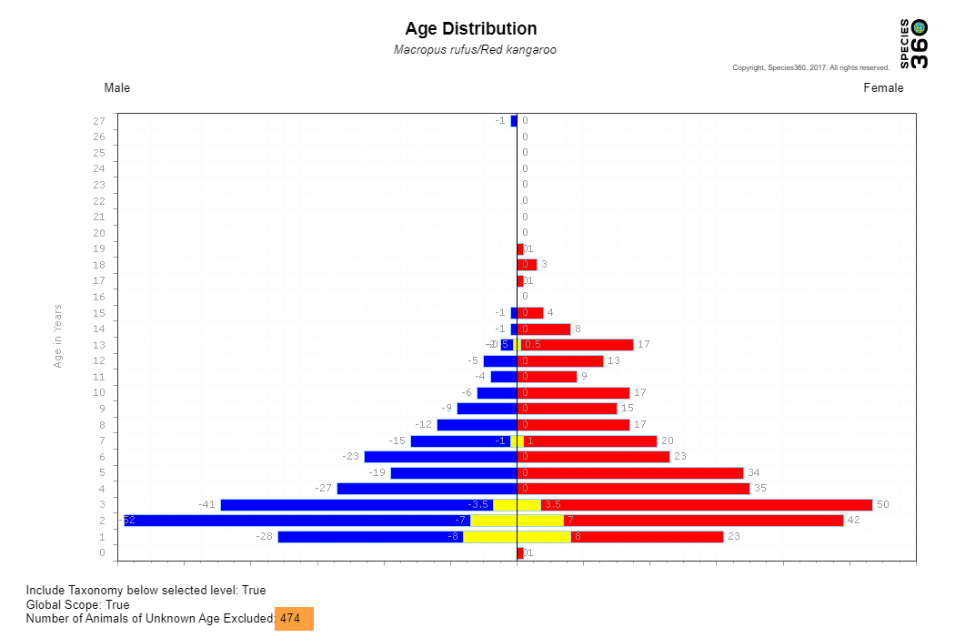
Age Distribution
For a good Age Distribution you want
to see lots of animals in the younger
ages pyramiding up to smaller numbers
in the geriatric ages. This indicates that
there are younger animals that will
come into reproductive age to keep the
population going. At first glance at these
two graphs the populations look fairly
healthy. However, only 5 % of the South
American tapir population (top) was
excluded due to unknown or estimated
birth dates. In the bottom graph almost
half (45%) of the red roo population was
excluded due to unknown or estimated
birth dates. You cannot really interpret
the potential reproductive health for
that species using Age Distribution since
half the population is not represented.

Slide 12
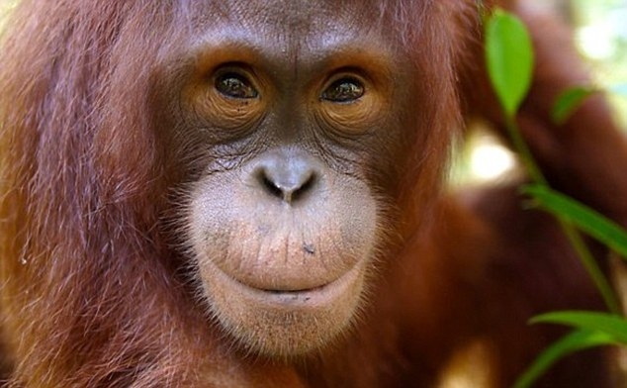
As a new veterinarian at your facility you are analyzing the health status of
all your collection. One member of your orangutan troupe, although otherwise
healthy, appears to be quite thin. The keepers say that he has always been
lighter than the rest.

Slide 13
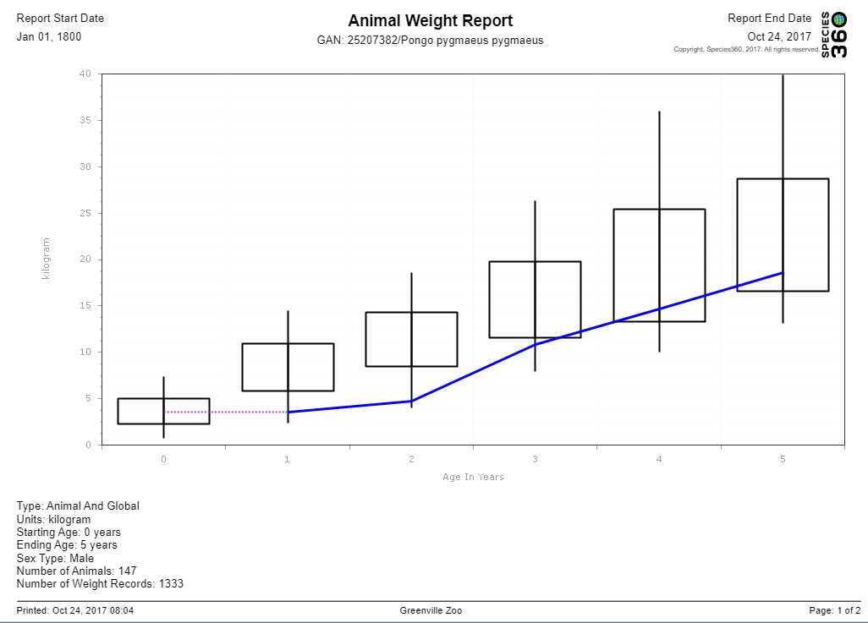
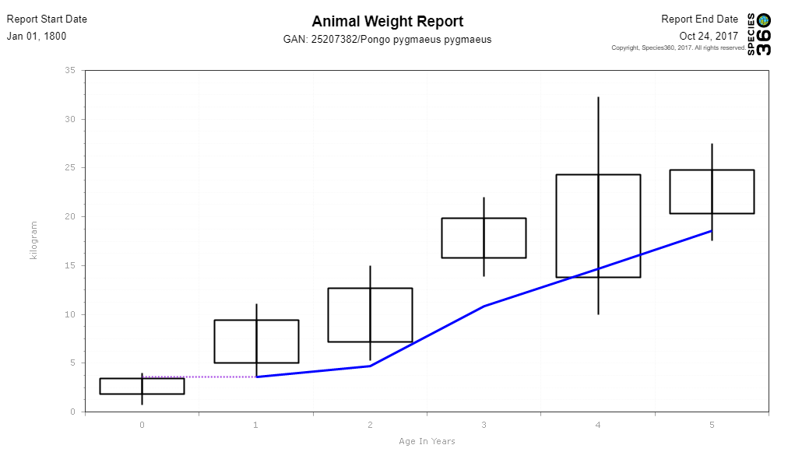
Weight Comparison
You first run a Weight Comparison
report for the orangutan that is
filtered by male but not filtered by
Continent (top). The results show
that he is, and always has been, on
the light side. You then filter by your
Continent (Europe) to account for
possible regional differences (below).
The results show that when compared
to other orangutans in the same region
he is quite a bit lighter than most.
You talk to your nutritionist about ways
to increase his caloric intake.

Slide 14
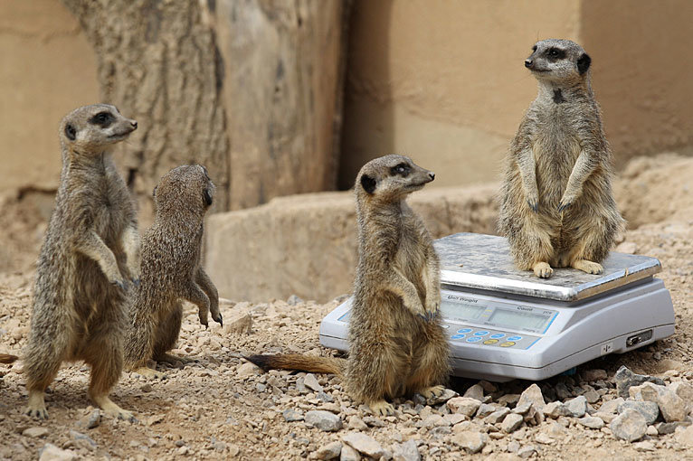
Source of Weight Comparison
Weights recorded in Husbandry and Medical module
Weights marked Estimate are automatically excluded
Weights marked Exclude from Norm are automatically excluded

Slide 15
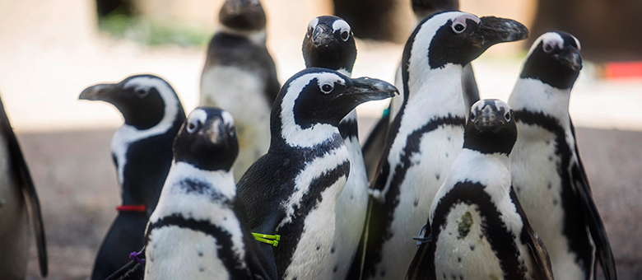
You are preparing for the annual penguin Taxon Advisory Group
meeting. To get your numbers together you run a TAG Export for
Spheniscus and filter by your Continent of North America.

Slide 16
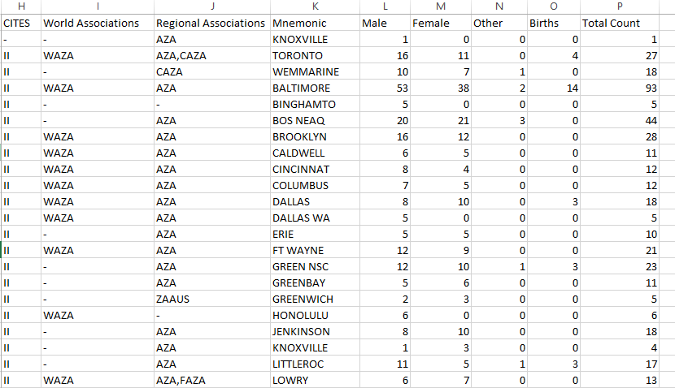
TAG Export
Selecting to Export
for Raw Excel you
can manipulate the
data so you see only
the information you
need for your meeting
(top). The IUCN
Summary sheet
(bottom) provides an
easy overview of the
various categories.

Slide 17
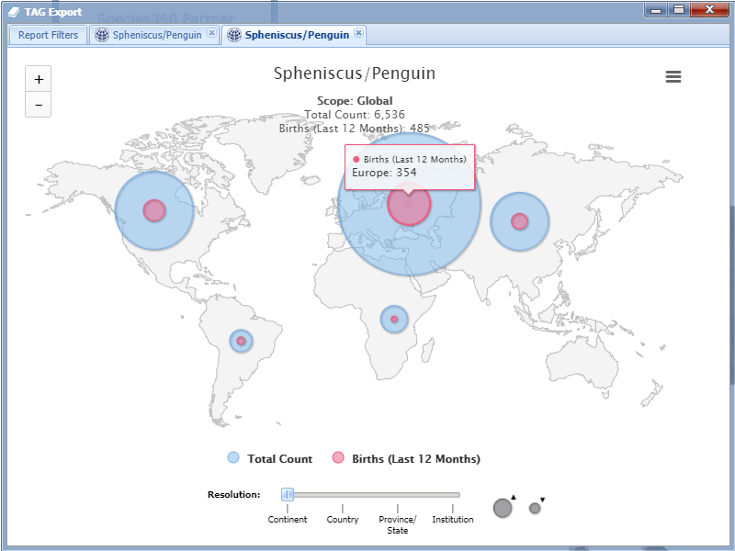
TAG Export
You can use the visual option
to View on Map for quick
comparison of holdings and
births/hatches for various
regions.

Slide 18
Source of TAG Export
Current holdings filtered by selected scope
Global, Continent, Country, Association, My Institution
IUCN status from Species360 assignments
Association information column as recorded by the World or Regional Associations
Natural Range column from Taxonomy module

Slide 19
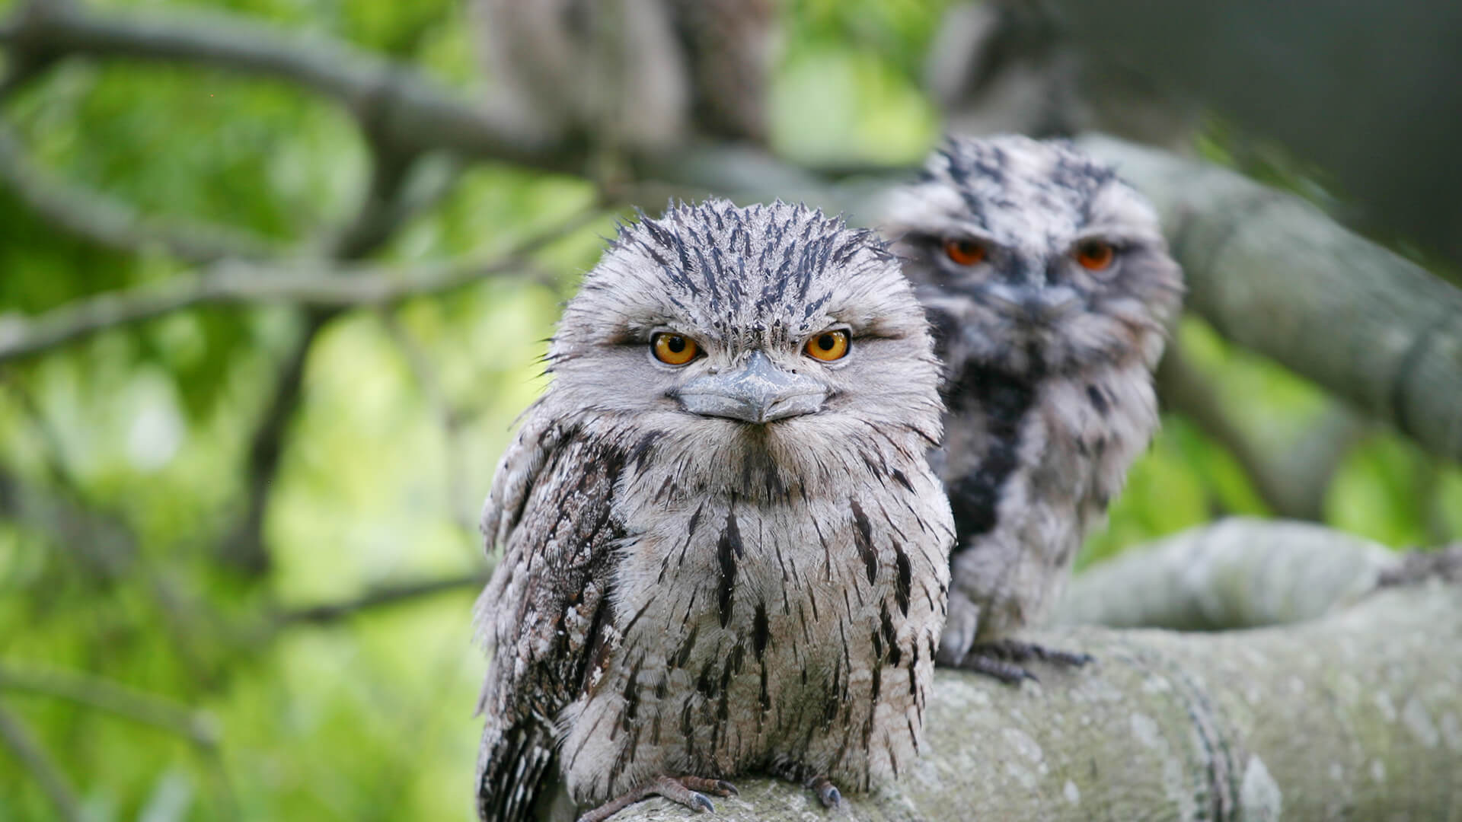
As the tawny frogmouth Studbook Keeper you have been asked to give an overview
of your responsibilities as a Studbook Keeper and the status of the species at the next
Board meeting. You run a Population Overview report by your studbook region to help
you prepare to discuss some of the differences between institutional data and studbook
data.

Slide 20
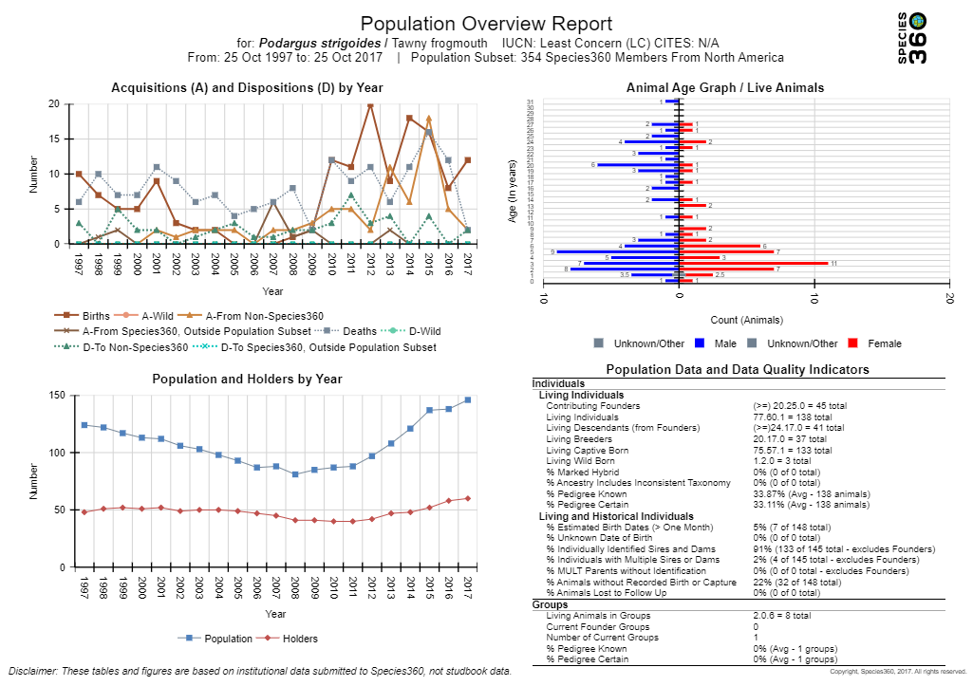
Population Overview
If you select to Run Report
a graphic view of the
species population will
display in four quadrants.
The Acquisitions and
Dispositions quadrant
displays specific transactions
and can help you to interpret
the simpler Population and
Holders by Year quadrant.
The Age Graph does not
indicate the number of
animals excluded due to
unknown/estimated hatch
dates as the Age Distribution
resource does. The lower
right side quadrant provides
detailed information that
helps define the population.
Population Overview can
also be exported to Raw Excel.

Slide 21
Source of Population Overview
Institutional data NOT studbook data
Last 20 years of data filtered by selected scope
Acquisitions and Dispositions by Year
Specific transactions entered by institutions in the selected scope
Population and Holders by Year
Living population size (individuals plus groups), census as of today’s date each year
Number of institutions physically holding the animals on these dates
Species360 current membership is used for the entire time period, not all current members may have entered data for 20 years so some positive census trends might be caused by more recent years being more comprehensive
Age Graph
Living population filtered by scope
Unknown/estimated ages are not included
Population Data and Data Quality Indicators
From all the data entered by institutions in the selected scope such as birth type and date, parentage and offspring and hybrid status

Slide 22
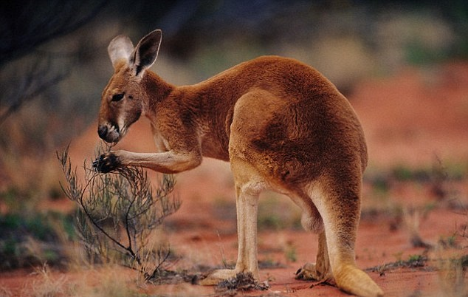
You need to anesthetize your red kangaroo for some dental work. You have
never anesthetized that species so you run an Anesthesia Summary to get an
idea of what drugs have been successfully used. You then check your Pharmacy
Inventory to see what you have on hand before consulting with a colleague
in Australia.

Slide 23
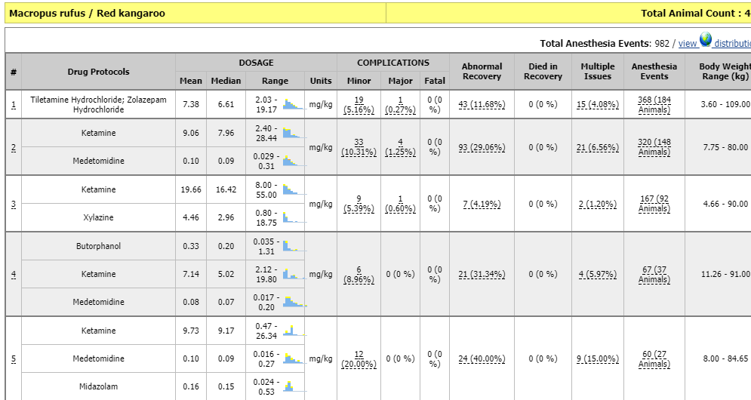
Anesthesia Summary
Anesthesia Summaries are not meant to be interpreted as a recommendation. The
information is provided to aid in choosing drug combinations and dosages that will
minimize risk and maximize safety. Responsibility lies with the clinician to consider
all relevant factors.

Slide 24
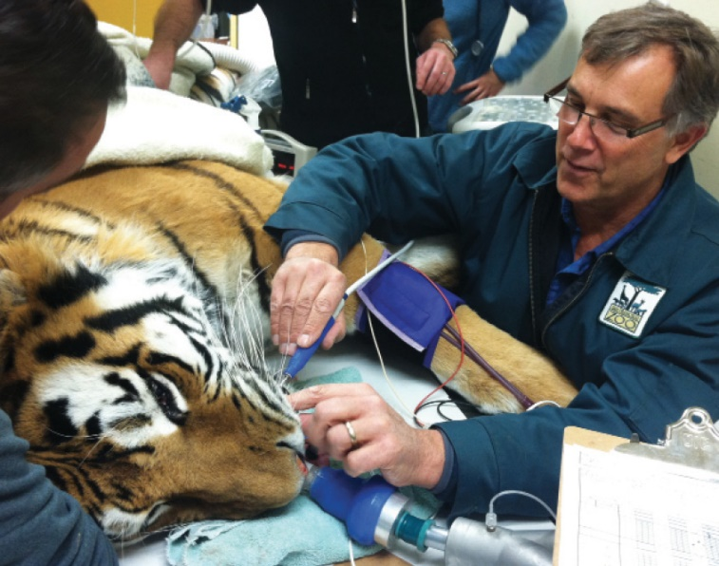
Source of Anesthesia Summaries
From the anesthesia event records
Drugs Given tab
Drug combinations used
Dosage
Recovery & Ratings tab
Complications
Recovery
Died in Recovery
Multiple Issues
A measure of linkage between Complications and Bad Recovery
Physiological Measurements tab
Body weight range

Slide 25
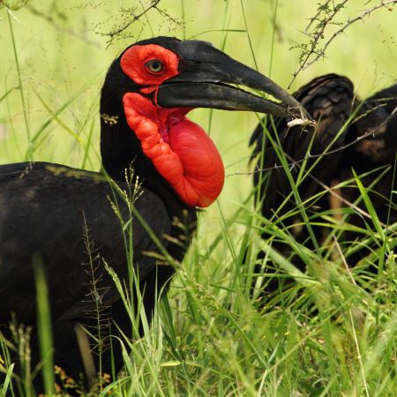
It is time to vaccinate your
ground hornbills for West
Nile virus. You just got the
species for the first time six
months ago so have no
previous vaccination records
to review. You run a Drug
Usage Extract.

Slide 26
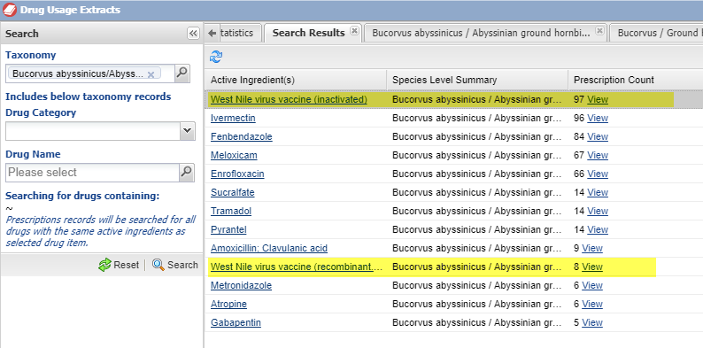
Drug Usage Extracts
You find two references
to West Nile virus
vaccinations. You select to
view them.

Slide 27
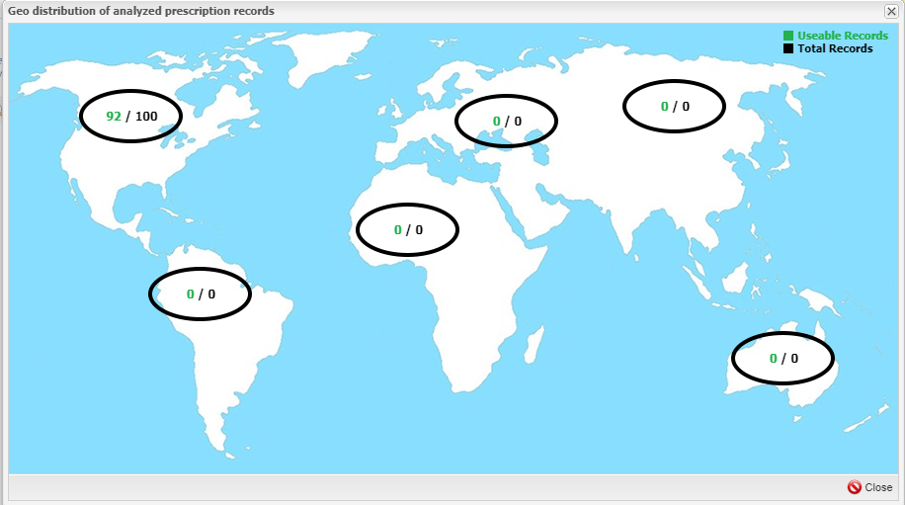
Drug Usage Extracts
You can also view what
regions the data is
sourced from by selecting
the View Distributions
link. This may help you
determine what drug to
use based on regional
preferences and use.

Slide 28
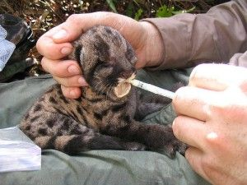
Source of Drug Usage Extracts
The Prescription records entered
Prescription tab
Drug
Dose
Route
Frequency
Duration
Treatment Response
Adverse Reactions

Slide 29
Important Notes!
There must be at least 10 Prescriptions written for a taxonomic group and recorded by at least 2 institutions. Why? To protect the anonymity of medical data for institutions with minimally held species. If you are the only institution who holds a species, and there is data in the global resources representing that species, it would be easy for members to determine whose records that data represents.
If you enter a prescription and have a repeated transcription error or misunderstanding it will not display in the global resource until at least one other institution reports the same thing. Example: if you administer ivermectin intranasally to address nasal mites and write IN- intranasal but your assistant enters IN-inhalant in the prescription record, that is an error we do not want to “publish”.

Slide 30
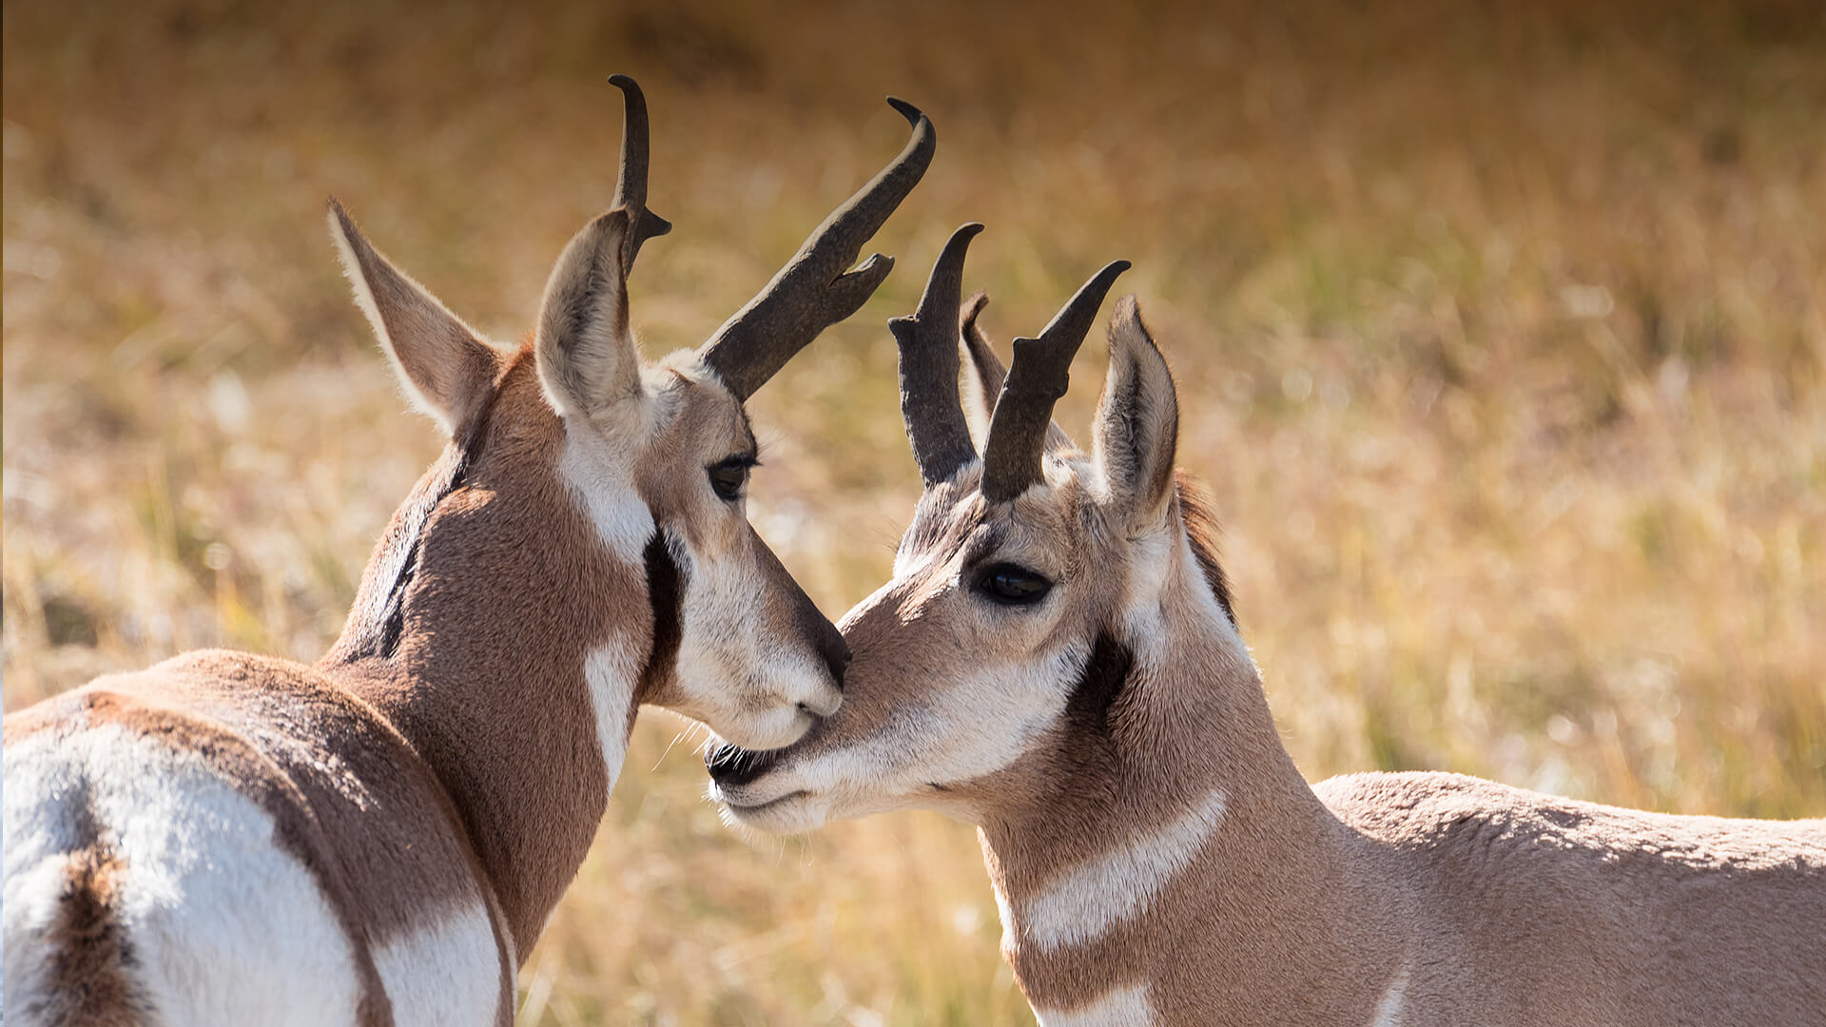
Some members of your pronghorn herd are looking unthrifty and there has been a low survival rate in your fawns. In the past a deficiency in Selenium caused the same issues. You run a Test Results – Expected Test Results to see what normal selenium ranges are in pronghorn. No Results are found! You then search by Test Results – Search by Test and find thirteen results.

Slide 31
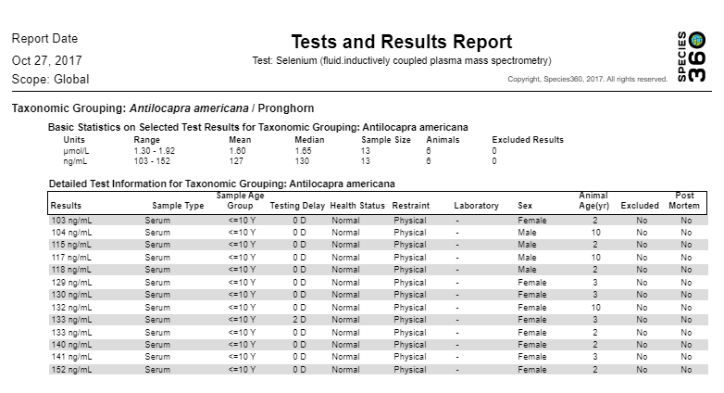
Test Results - Search by Test
Search by Test is not subject to the strict requirements that Expected Test Results are.
This resource will return information if there are fewer than fifteen results regardless
of if the sample was compromised.

Slide 32
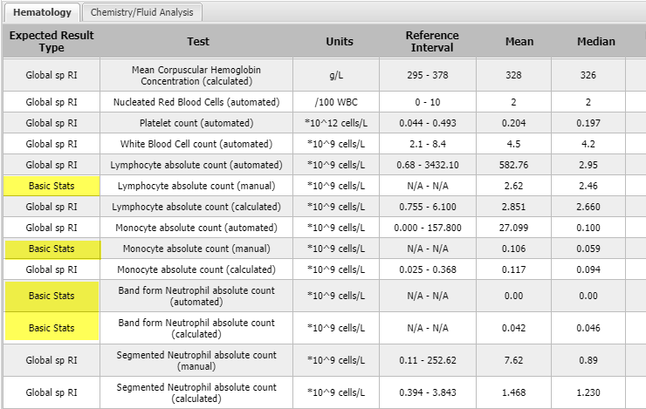
Test Results – Expected Test Results
Expected Test Results are reference
intervals essential for the interpretation
of test results. They are displayed as basic
expected results (Basic Stats) or Global
Reference Intervals (Global sp RI) .

Slide 33
Source of Test Results
Tests and Results module
Excluded from Expected Test Results
Health Status was abnormal at the time the sample was collected
Genus level taxonomy
Samples marked as frozen and stored
Samples marked as deteriorated
Marked as Exclude from RI
Basic Stats
15 to 39 results
Global Species Reference Interval
At least 40 results

Slide 34
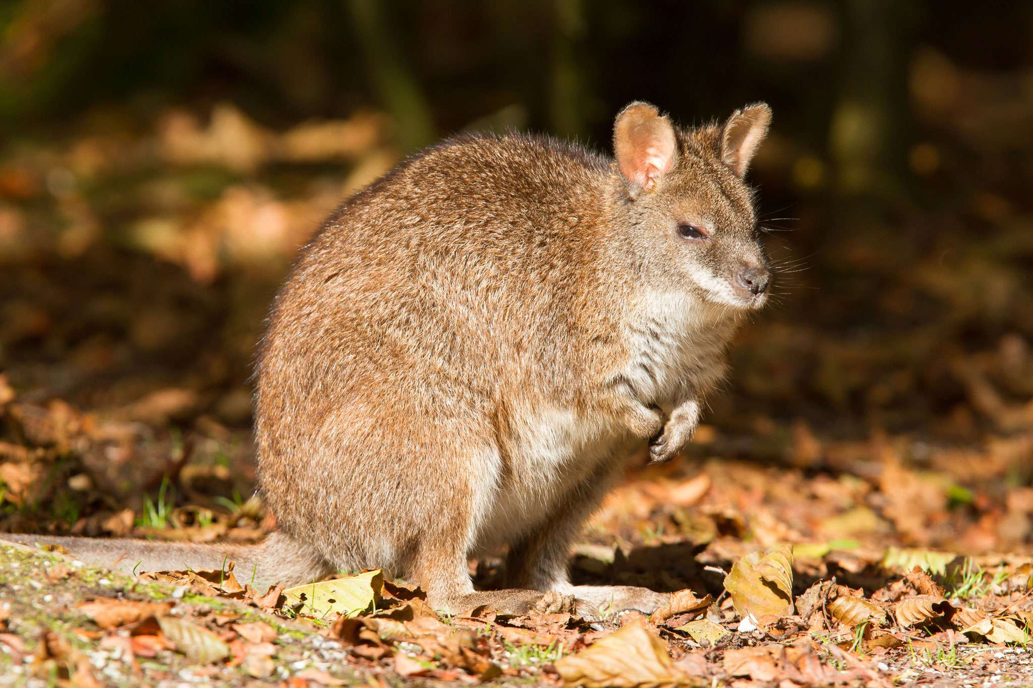
You are thinking of adding Parma wallabies to your collection. You run two
of the report options under Morbidity and Mortality Analysis to determine
potential health issues with the species.

Slide 35
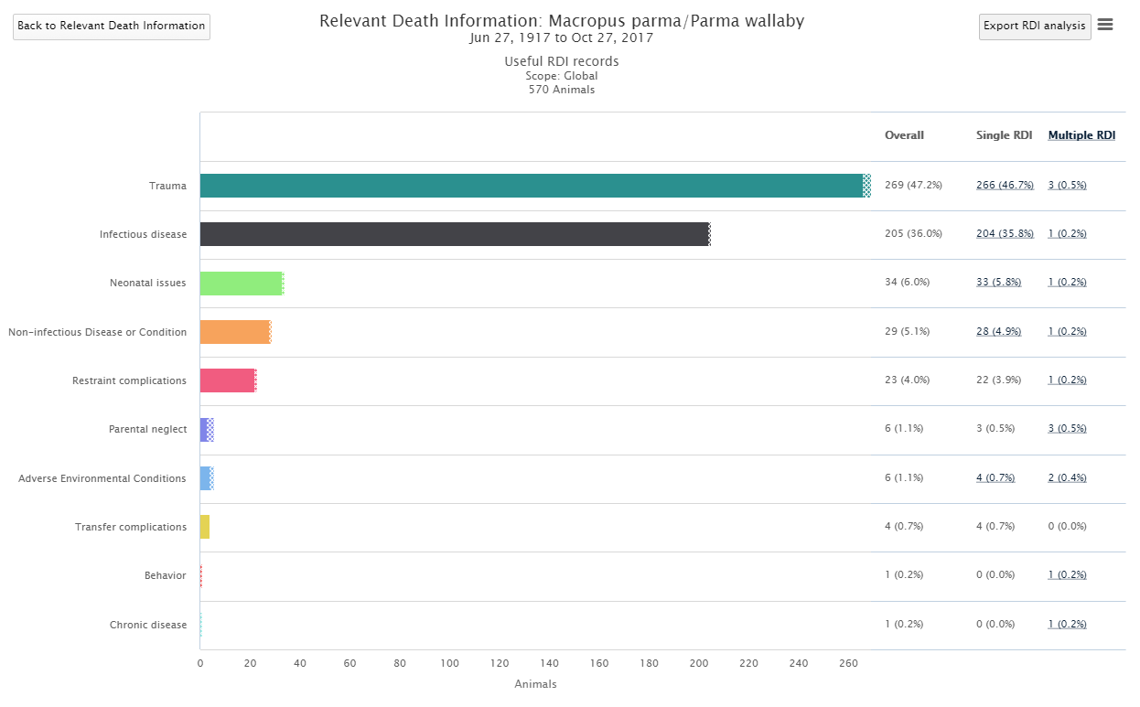
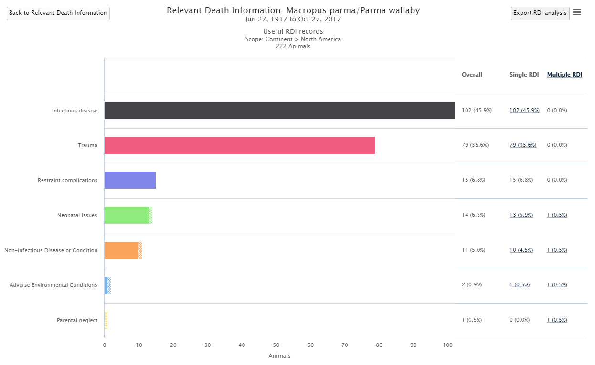
Morbidity & Mortality Analysis – Relevant Death Information
You then look at the
Relevant Death Info
report. Looking at
Global data, Trauma
is the most common
cause of death, with
Infectious Disease a
close second. However,
running the report just
for your Continent you
see the two are reversed.

Slide 36
Source of Relevant Death Information
Husbandry > My Transactions > Add Transaction > Disposition > Death > Relevant Death Info
Medical > Necropsy > Finalize tab > Relevant Death Info
Last RDI entry “wins” for this resource
Holder recorded RDI “wins” over Owner record

Slide 37
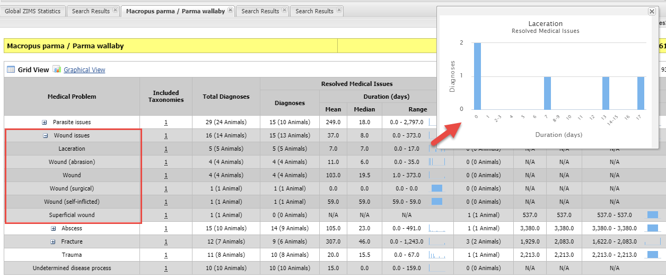
Morbidity & Mortality Analysis – Common Clinical Issues
The Common Clinical Issues indicate that wounds are a common problem.
You expand the Wound Issues to see further details about what type of
wounds are common. Hovering over the graphs will provide an enlarged view.

Slide 38
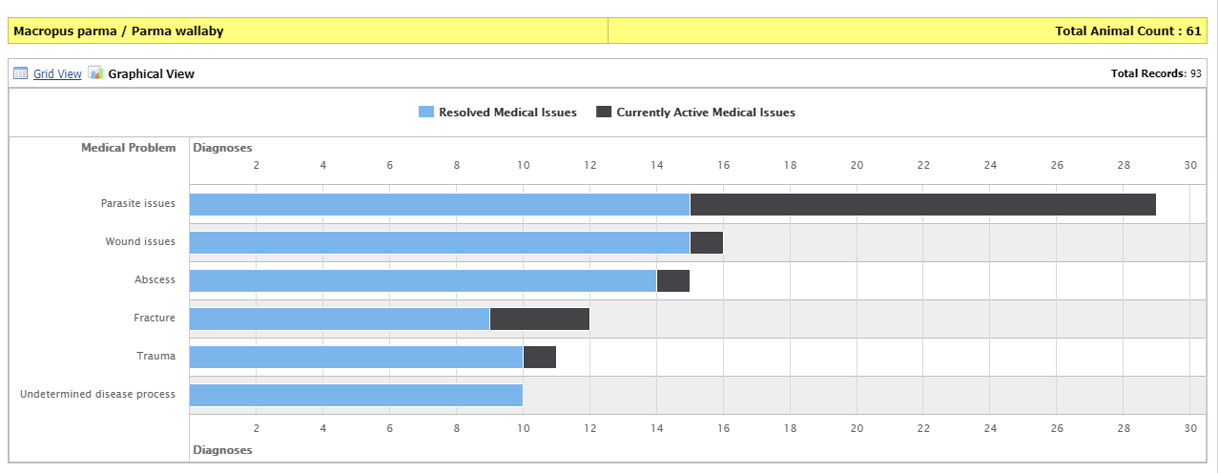
Common Clinical Issues - graph
This grid can also be viewed in a graphical view.

Slide 39
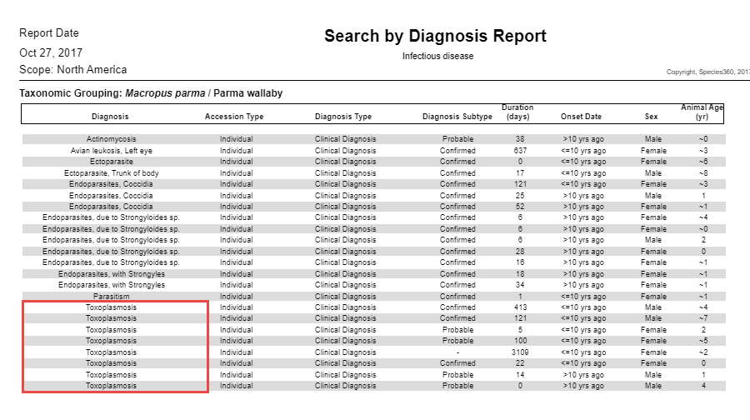
Morbidity & Mortality Analysis – Search by Diagnosis
The third report in Morbidity &
Mortality is Search by Diagnosis
and can only be run at the Local
level for your institution’s animals
only. You talk with several institutions
that have held parma wallabies and
they run the report for their facilities
and provide you with the results.
Toxoplasmosis is a very common
Diagnosis.

Slide 40
Source of Common Clinical Issues & Search by Diagnosis
From Diagnosis & Procedure Records
Discard the procedures records (example: examination), clinical sign records (example: cough) and the clinical finding records (example: elevated BUN level)
Only the “real” diagnosis are included in the resource and that is what is entered as a “Medical Condition/ Syndrome/ Disorder” under the Term Type field
For example: Lameness (a clinical sign) is a medical problem, but it is not important for diagnosis and treatment so not included. It is the reason for the lameness (strained ligament, infected joint, arthritis, sole abscess, broken bone) that is important. Knowing how often lameness” is reported in a species is not medically helpful, but knowing that “sole abscess” is the third most common clinical issue for a species is useful

Slide 41
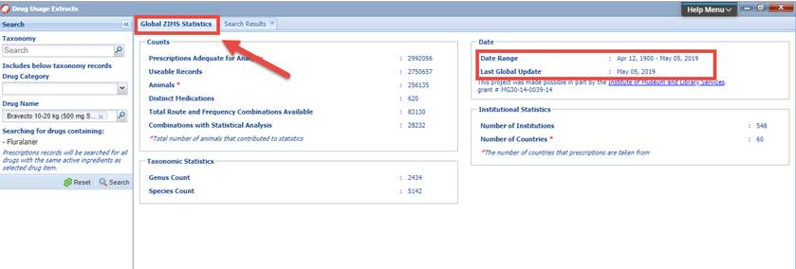
When are Resources Updated?
The Animal Management/Husbandry Resources are updated as soon as data is saved.
The Medical Resources are calculated regularly, some every other week and some monthly depending on the resource. Each last date of calculation is available on the Global ZIMS Statistics tab on the resource page.

Slide 42
And That is Where All the Data is Sourced From!
For the ZIMS Global Resources

