Slide 1
1005 Additional Animal Information
All the information you can enter on your individuals and groups

Slide 2
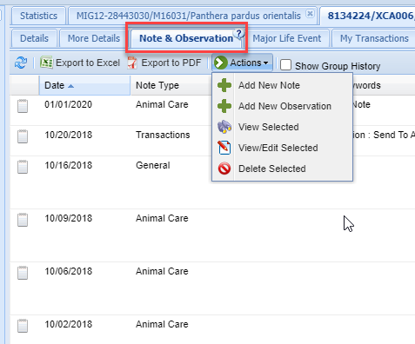
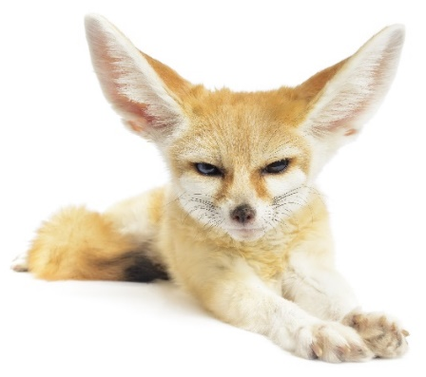
Tab-Note & Observation
The Note & Observation tab is
where you would add/edit/delete
your notes and observations. Notes
have a Date, Keyword option, Note
Type and Sub Type in addition to the
free text writing space. Observations
have those fields but also allow you
to capture more information
such as the Observer, Duration and
Quality of the Observation.

Slide 3
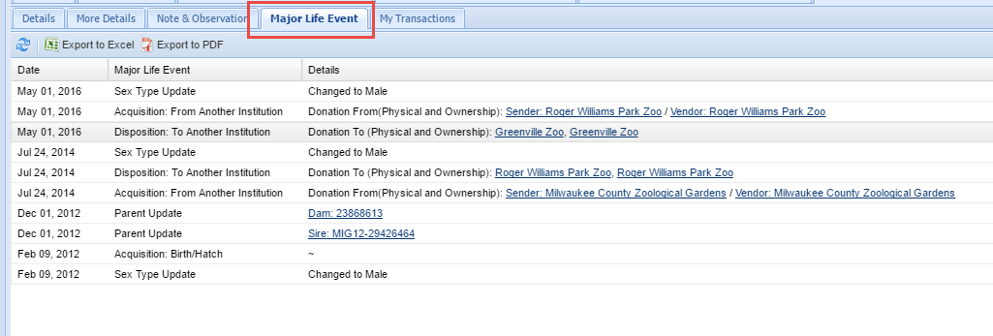
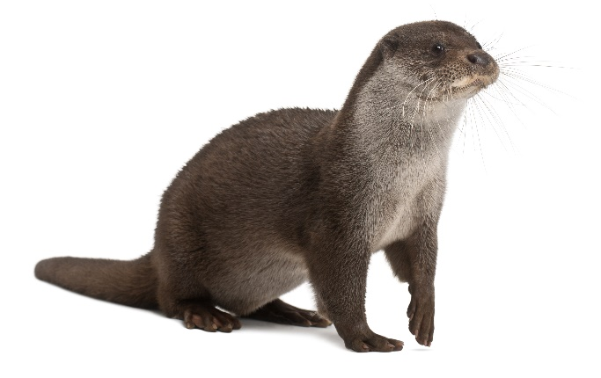
Tab-Major Life Event
At the top of the animal record there is a tab titled Major Life
Events. This is a quick view of major events for the animal. It
includes transactions, sex changes and parent updates in
addition to other life events if they have been recorded.
Nothing can be edited from this tab, it is only for your
information and the data is sourced from the specific topic
grids in the animal record. It will include information that you
have entered as well as information that other holders/owners
have entered.

Slide 4
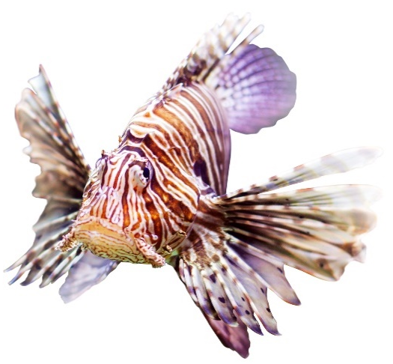
Tab-My Transactions
The My Transactions tab is where you would enter all of the
transactions or visits this animal has had with your facility.
The green arrows on the left indicate incoming and the red
arrows indicate outgoing transactions. The colored circles
indicate if the transaction has been confirmed by the other
institution involved if they are a Species360 member.

Slide 5
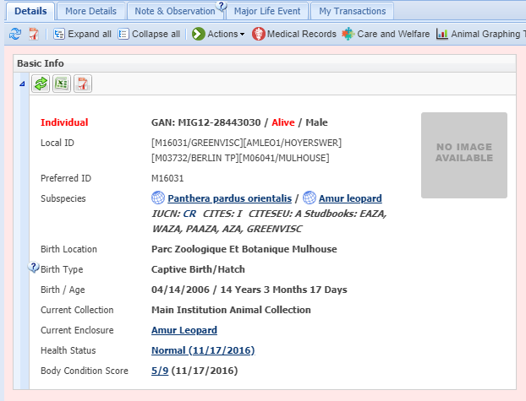
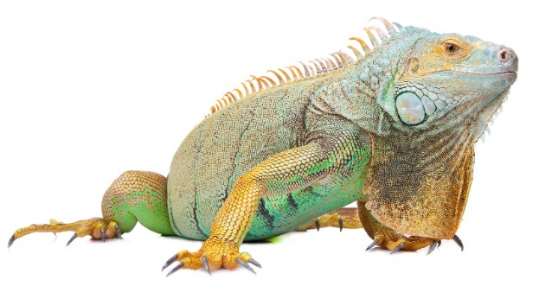
Details-Basic Info
The Basic Info grid provides a brief
overview of the animal in focus
including the entity (individual, group,
egg), the status (Alive or Dead, Open
or Closed for a Group), all Local IDs
assigned to it, species (hyperlink into
taxonomy record), listing status,
studbooks, birth location and type,
age (as of today or date of death),
current Collection and Enclosure (a
hyperlink into the Enclosure record),
and Health Status and Body Condition
Score (both hyperlinks).

Slide 6
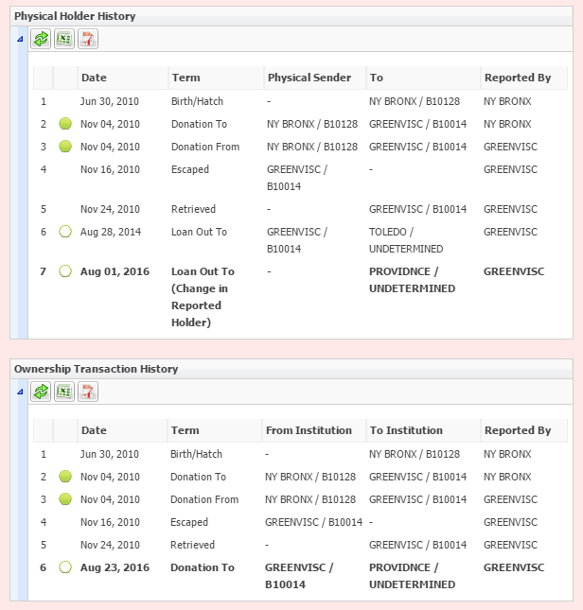
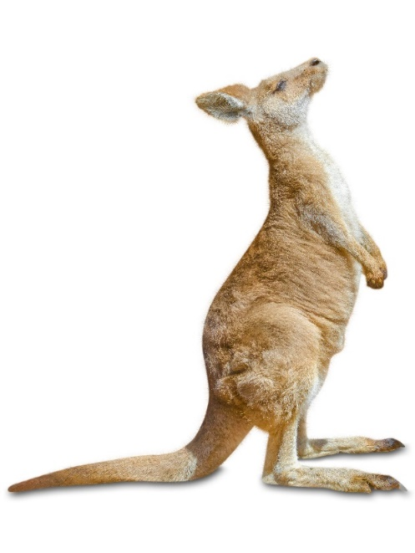
Details-Physical Holder/Ownership Transaction History
The Physical Holder History
and Ownership Transaction
History grids compile all the
information you have entered
into My Transactions plus
what other institutions have
entered for their transaction
history. You cannot edit
anything from these grids it is
simply for you to see the entire
physical and ownership thread
for the animal.

Slide 7
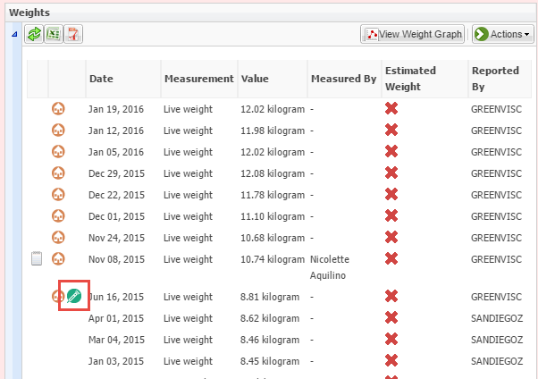
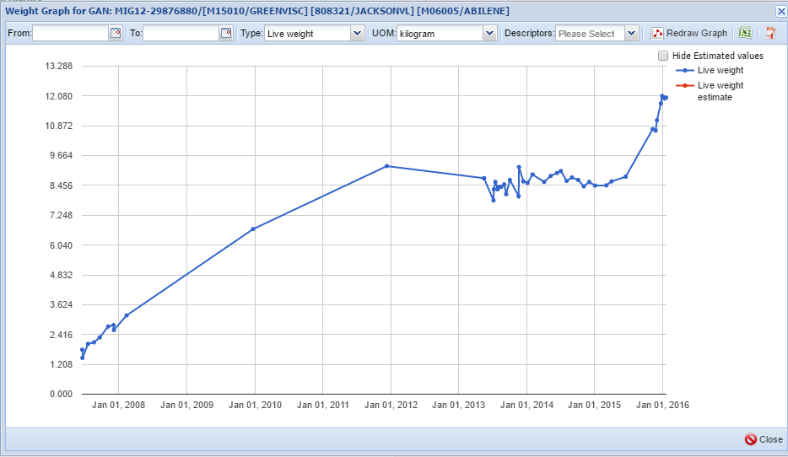
Details-Weights and Lengths
The Weights grid displays all weights recorded by all institutions. You can edit only those weights recorded by your facility. If a weight is sourced from the Medical module that is indicated by an icon. Any weights sourced from the Medical module cannot be edited or deleted from the Husbandry module and you must do so from the
source record in Medical. You can also select to view a weight graph for the animal. Viewing the graph can help you monitor the animal’s health and you can quickly see this animal is quickly gaining weight which could be good or bad. The graph also helps you see any incorrect Units of
Measure that may have been recorded so you can correct them. There is also a Lengths grid where you can record various size measurements and create graphs similar to the weight graph.

Slide 8
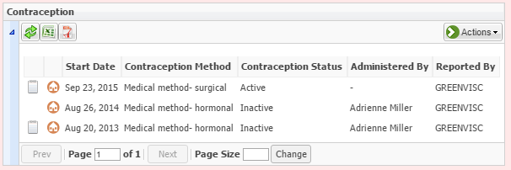
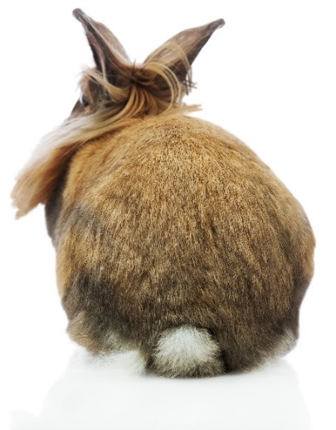
Details-Contraception
The Contraception grid lets you enter various methods of contraception
such as Animal Management and Medical (hormonal, immunological or
surgical). You can have more than one method Active at a time. The
details of the contraception are entered into the medical module but
the actual contraception status is recorded here.

Slide 9
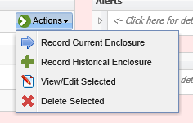
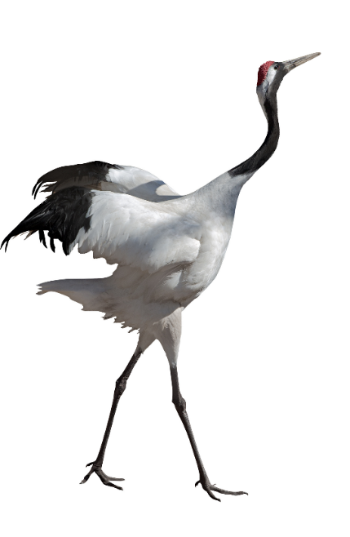
Details-Enclosures
Record Current Enclosure
Animal is in the enclosure you are moving it out of
A Moved Out Date will be automatically entered in the Enclosure it left
Record Historical Enclosure
An enclosure move sometime before the animal was moved into its current enclosure
You must record BOTH the Move In Date and the Move Out Date
Allow Multiple Enclosure Assignment
No automatic Move Out Date will be recorded for a Current move
You need to indicate what Enclosures the animal is moved out of.

Slide 10
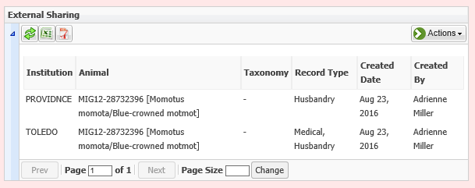
Details-External Sharing
If your institution has turned on the ability to share a record
with another institution the External Sharing grid will display
what institutions the record is shared with, and what is being
shared. This animal record is being shared with the Toledo Zoo
and both Husbandry and Medical records are being shared.
Only Husbandry records are being shared with Roger Williams
Park Zoo.

Slide 11
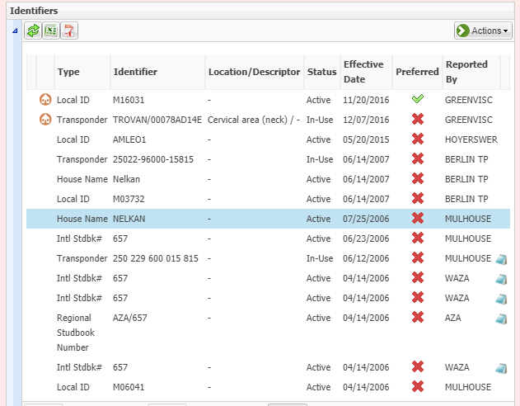
Details-Identifiers
The Identifiers grid allows you to record
all the Physical (those you can see),
Logical (those you cannot see) Identifiers
as well as Transponders. Transponders are
managed in an inventory from the My
Institution module. All Identifiers at all
institutions will be displayed but you can
only edit or delete those added by your
institution. If the animal has Identifiers
recorded by other institutions that you
want to record locally, this can easily be
done by selecting to “Accept as Local
Identifier”. This not only is a time saver
but can help guard against data entry error
by retyping.

Slide 12
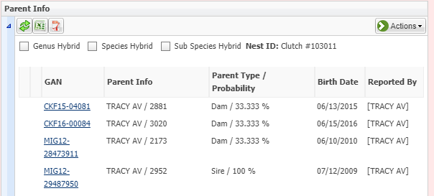
Details-Parent Info
The Parent Info grid captures the Parents and the percent probability that they are the
Parents. Above, there were 3 females who could have been the Dam. If you are recording
a Visit, the Parents will prefill and you do not have to re-enter them. If you are recording
an initial accession you will need to complete this information during the accession.

Slide 13
Details-Rearing
The Rearing grid lets you track the Rearing over time. The dam
was neglectful of the calf from 23 November to 30 November
so it was given supplemental feedings until the dam became
more responsive. While Rearing is not a mandatory field in
Husbandry, it is mandatory in Studbooks so try to record it
whenever possible.

Slide 14
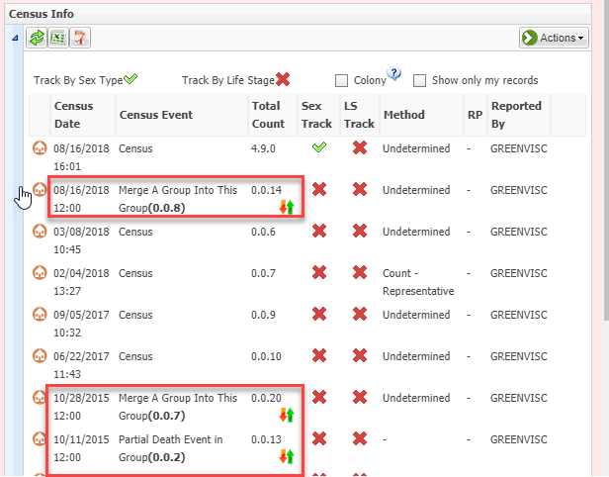
Details-Census Info (Groups only)
The Census grid is available in
Group records only. This is where
you would record the count of the
group members. In addition, any
transactions recorded in My
Transactions will be displayed here
(red boxes). To change the
tracking of a Group you will need
to record a Census. A Census acts
as a group count reset and any
subsequent ins or outs of the
Group will be added or subtracted
from this number.

Slide 15
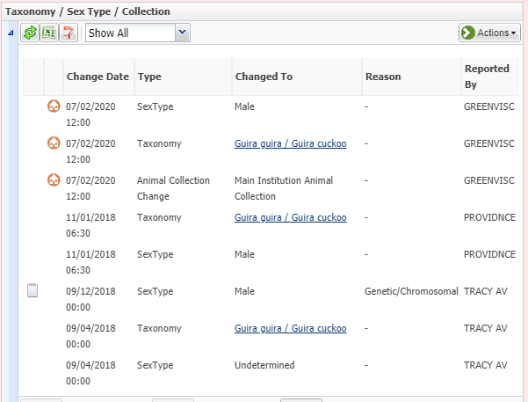
Details-Taxonomy/Sex Type/Collection
This grid allows you to update the
Sex, Taxonomy and Collection of
the Individual animal. In a Group
record this grid is Taxonomy /
Collection and Sex is captured by
tracking in the Census grid. As
for all data, you can only edit/delete
data entered by your institution.

Slide 16
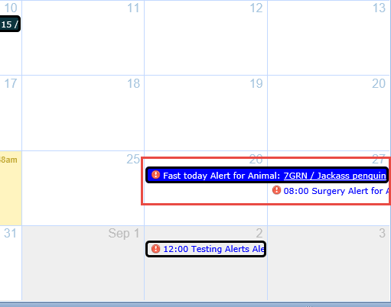
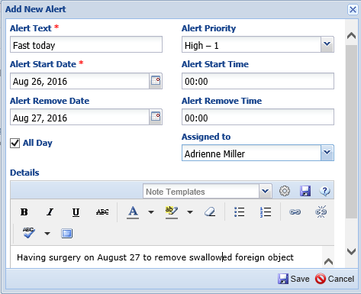
Details-Alerts
The Alerts grid allows you to assign future tasks
or heads up relating to the animal. This Alert
lets you know that the animal is scheduled for
surgery and needs to be fasted. The Alert Text
should be short and clear as this is what will
display on the Calendar. You can set priorities
from Urgent to Low and schedule times. On the
Calendar you can quickly see that the animal
needs to be fasted prior to surgery and the
surgery is scheduled for 8:00 am on 27 August.

Slide 17
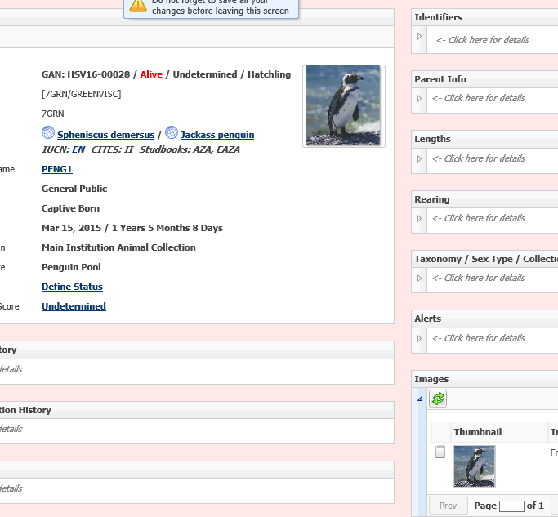
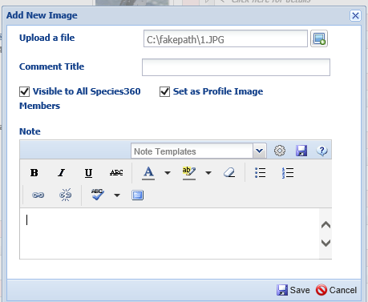
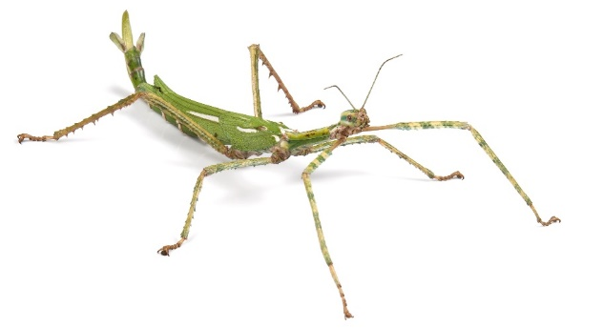
Details-Image
You can attach photos to the animal record using the Image grid.
Selecting Visible to all Species360 means that the image will be
viewed Globally. Selecting Set as Profile Image means it will display
in the Basic Info box. This can be very useful to make sure whoever
is entering the data is in the correct record. Images can also be used
to capture physical markings that help identify the animal.

Slide 18
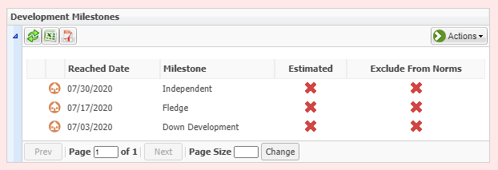
More Details-Development Milestones
Development Milestones are stages reached during development. Unlike Life Stages
that have beginning and ending dates, Development Milestones have only the date
when that milestone was reached and no updating is required when it reaches the next
milestone.

Slide 19
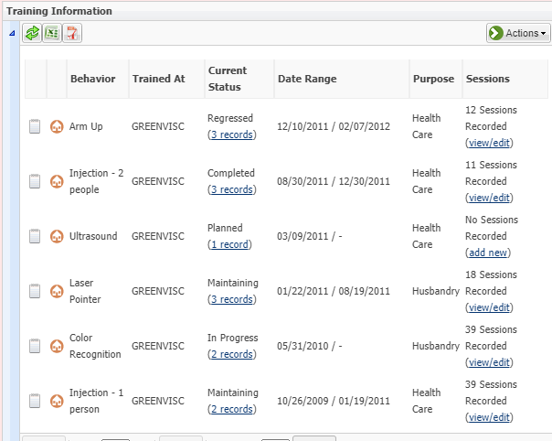
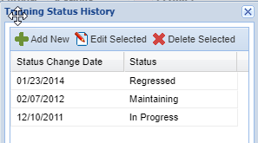
More Details- Training Information
The Training grid allows you to assign
desired behaviors to an animal and
track their learning by recording
Sessions. In addition, you can track
the Status of the Training from
Planned to Completed.

Slide 20
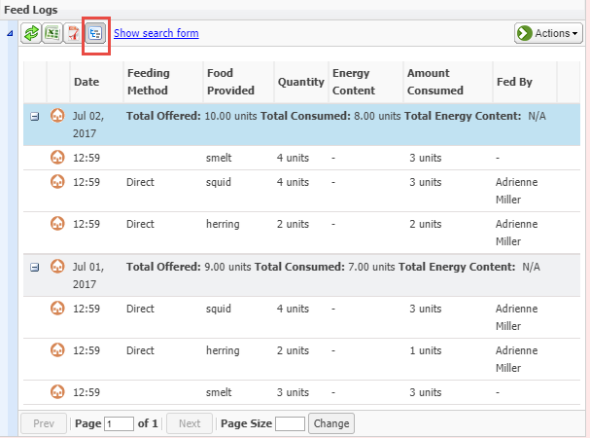
More Details-Feed Logs
The Feed Log grid allows you
to track what was fed, how much
was fed and how much was
consumed. This is especially
useful for tracking how much
is being consumed for hand
reared infants and individuals
whose diet is being closely
monitored for health reasons as
well as for routine diet tracking.

Slide 21
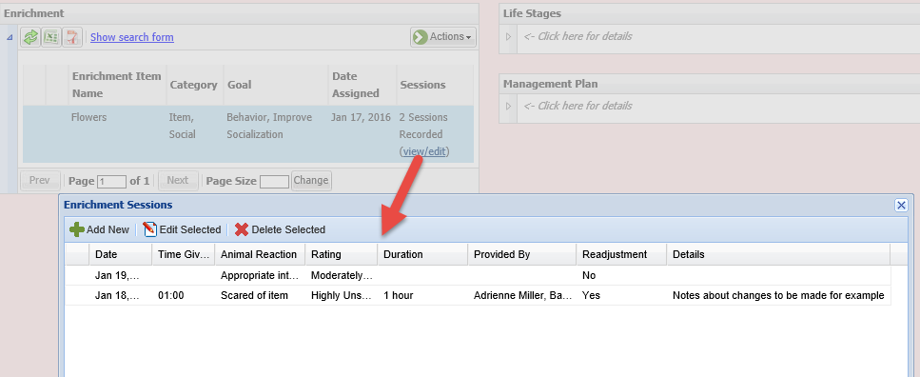
More Details- Enrichment
The Enrichment grid allows you to assign an Enrichment item to an
animal and track the response to it by recording Sessions. You can
capture the animal’s reaction using a cascading drop down list as well
as the success or failure of the Session.

Slide 22
More Details-Responsible Party
How you use Responsible Parties is up to your institution. In the example below,
a single person was responsible for the care and well being of the animal while
it was going through quarantine. Once it was released from quarantine and put
on exhibit, a Team then became responsible for it.

Slide 23
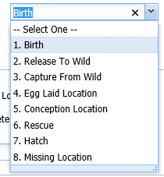
More Details-Birth/Hatch Date and Event Location
Event Locations are usually sourced from information entered
elsewhere. This animal had three events – a hatch, it went
missing (but was recovered) and then released to the wild.
Some of these fields can be edited in this grid if entered by
your institution. For example this is where you would edit
a birth/hatch date for an animal you received from a member
of the public. If the birth/hatch was the initial transaction you
entered, trying to edit it here would take you back to the My
Transactions screen to correct it. You can also add some
information not captured elsewhere such as Conception
Location and Capture Location for a wild caught animal that
you received from someone else.

Slide 24
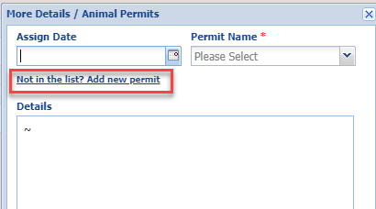
More Details-Permits
You can use the Permits grid to assign any Permits you have received that
relate to the animal. The actual Permits are managed under the My Institution
module but you can also add a Permit from the Assign Permit grid using the
hyperlink to open the Add New Permit grid.

Slide 25
More Details-Life Stages (Individuals only)
The Life Stage grid is available only for Individual records. Life Stages in Groups are
captured using the Census grid. Life stages have beginning and end dates whereas
Development Milestones have a single “reached at” date. One thing to note about
Life Stages should you choose to record them – they must be manually updated. If
you do not, you may have a 10 year old “infant” gorilla.

Slide 26
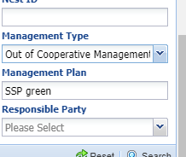
More Details-Management Plan
The Management Plan grid allows you to track any managed programs the animal
may be a part of. The Type is a short drop down of the status the animal is in the
program. The Plan is a free text field so you should develop a convention for how
to record it. The animal below was once a part of a green SSP program however it
was later removed from the program. Use the notes to indicate why. You can search
for animals in Management Plans under Animal Advanced Search options.

Slide 27
Additional Animal Information
On all the information you can enter on your individuals and groups

