Slide 1
Tips for Getting the Most out of your Enhancement Requests in ZIMS
Making your good ideas count!
Notes:
This session covers the additional information that you can enter on your animals. Some of the grids in the animal record have already been covered in previous sessions. We will cover the remaining grids that have not.

Slide 2
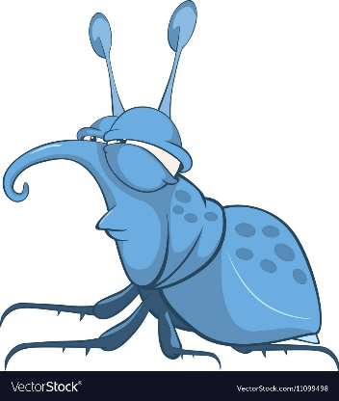
Enhancement versus Bug
An Enhancement is an idea or suggestion that will help make ZIMS work better for you
Make data entry faster
Make it easier to use
Add more functionality
And more!
Submit these right through ZIMS!
A Bug is something that is wrong
ZIMS does not function as designed
You cannot get part of your work done
Submit these to support@Species360.org
They may decide it is an Enhancement and ask you to submit through ZIMS
Notes:
This session covers the additional information that you can enter on your animals. Some of the grids in the animal record have already been covered in previous sessions. We will cover the remaining grids that have not.

Slide 3
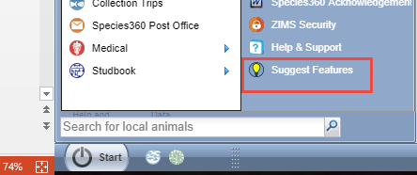
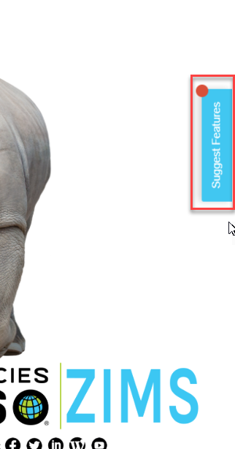
What is Pendo Feedback?
Pendo Feedback is a third party software
created specifically for feedback
management. Pendo Feedback allows
ZIMS Users to submit enhancements, vote
for their favorites and prioritize those
they have voted on. It allows the ZIMS
Enhancements to be transparent for all
Users to view and lets Species360 know
what is important to our members. To get
into Pendo Feedback simply select
“Suggest Features” under the Start menu
or the “Suggest Features” on the right hand
side of the ZIMS dashboard.
Notes:
When recording a move to a different enclosure you have two options – Record Current Move or Record Historical Move. Record Current Move means that the animal currently occupies the enclosure that they are being moved out of to go into another enclosure. Unless your institution allows multiple enclosure assignment ZIMS will automatically record a Move Out Date. Record Historical Enclosure means that you are recording a move sometime prior to the move into the current enclosure. You will be required to enter both a Move In Date and a Move Out Date for Historical moves.

Slide 4
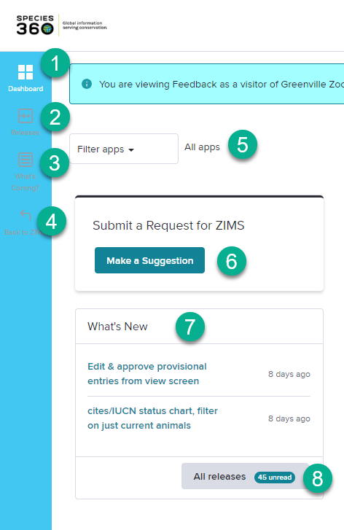
Dashboard – Left Side
This will open up your Pendo Feedback Dashboard. 1.Whenever you want to get back to the Dashboard select this icon.
2.To see a list of released Enhancements select this icon.
3.To see what is planned for the future and what is being built select this icon. Once opened, you can vote for or say you are not interested.
4.To get back in to ZIMS select this icon.
5.If you want to filter by certain modules (Husbandry/Aquatics, Medical or Studbook) select them here.
6.Select Make a Suggestion to add your request (more on this later).
7.What has been recently released is displayed here.
8.To view all that has been released (same results as for (2), select All Releases.
Notes:
The Contraception grid lets you enter various methods of contraception such as Animal Management and Medical (hormonal, immunological or surgical). You can have more than one method Active at a time. The details of the contraception are entered into the medical module but the actual contraception status is recorded here.

Slide 5
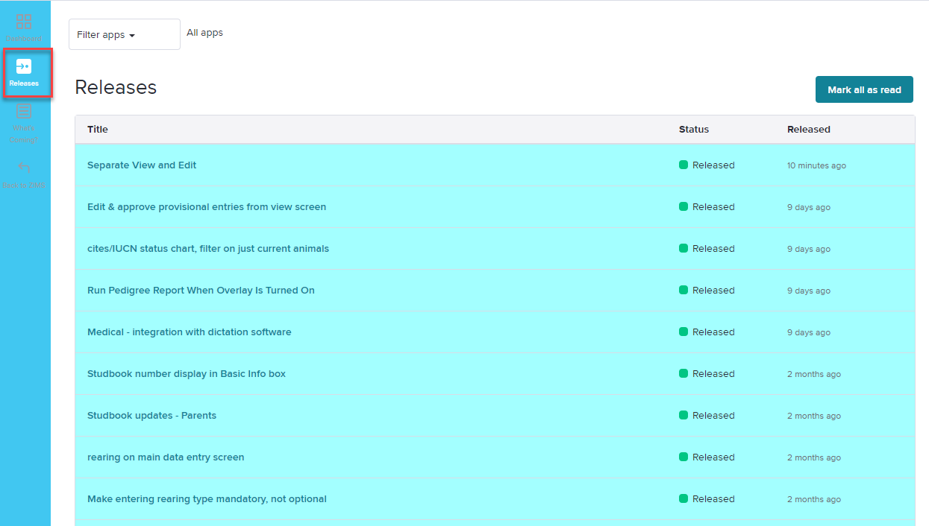
Releases
The Releases link will display any enhancements
that have actually been deployed into ZIMS. The
column on the right lets you know when it was
released.
Notes:
The Contraception grid lets you enter various methods of contraception such as Animal Management and Medical (hormonal, immunological or surgical). You can have more than one method Active at a time. The details of the contraception are entered into the medical module but the actual contraception status is recorded here.

Slide 6
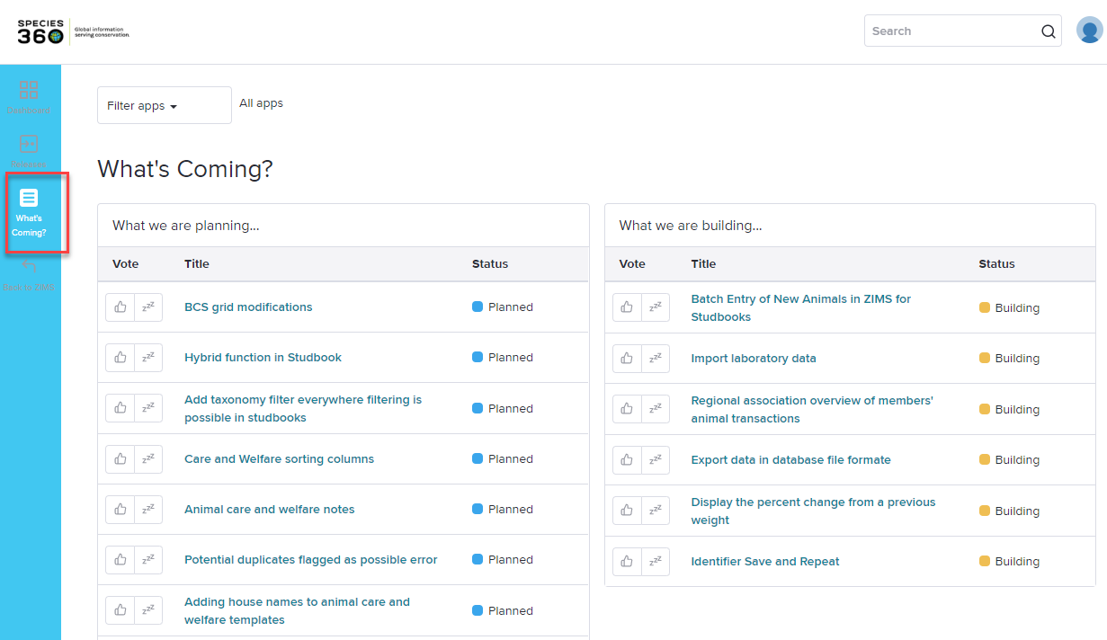
What’s Coming?
The What’s Coming link displays any features that are currently in development and any ones that are planned
to be developed.
Notes:
The Contraception grid lets you enter various methods of contraception such as Animal Management and Medical (hormonal, immunological or surgical). You can have more than one method Active at a time. The details of the contraception are entered into the medical module but the actual contraception status is recorded here.

Slide 7
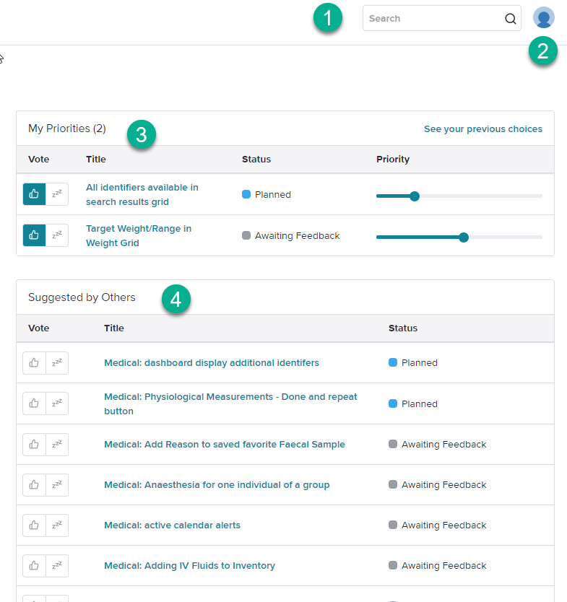
Dashboard – Right Side
1.You can search for features already
suggested.
2.You can update your profile.
3.You can view a list of the features
that you have voted on and their
Status. You can also adjust your
Priority for the feature using the slide
bars. Prioritization is a sliding scale,
so as you make one suggestion a
higher priority it will automatically
reduce the priority of the others.
You cannot make all of your requests
top priority!
4.You can view a list of features
suggested by others and their Status.
You can vote on them from here (thumb
up) or indicate that you are not interested
in them (Zzz).
Notes:
The Contraception grid lets you enter various methods of contraception such as Animal Management and Medical (hormonal, immunological or surgical). You can have more than one method Active at a time. The details of the contraception are entered into the medical module but the actual contraception status is recorded here.

Slide 8
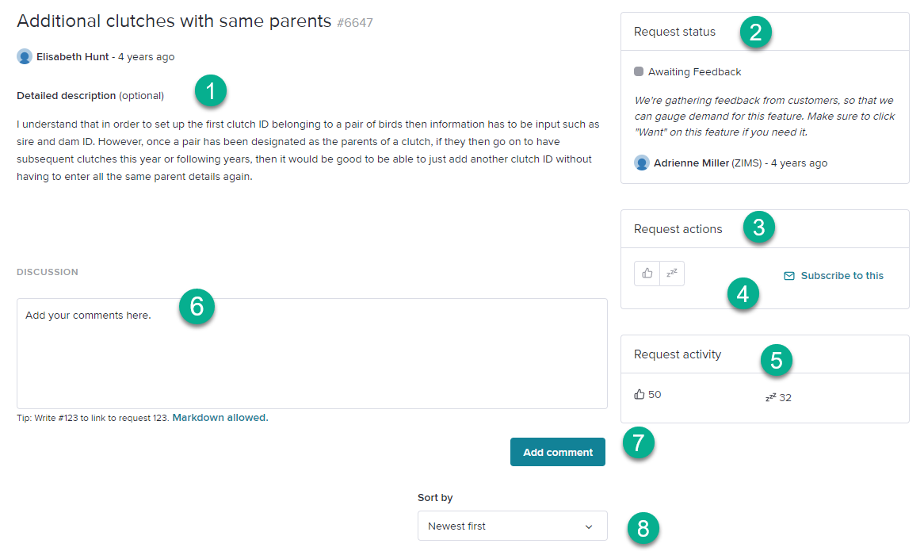
Get the Details
If you want more details on requests that were submitted by others simply select the description hyperlink.
1.View a full description of the request
2.See the Status of the request
3.Vote for it or indicate you are not interested
4.If you want email updates you can subscribe
5.View how many others have voted for it
6.Add your Comments
7.Submit your Comments
8.Sort the Comments
Notes:
The My Transactions tab is where you would enter all of the transactions or visits this animal has had with your facility. The green arrows on the left indicate incoming and the red arrows indicate outgoing transactions. The colored circles indicate if the transaction has been confirmed by the other institution involved if they are a Species360 member.

Slide 9
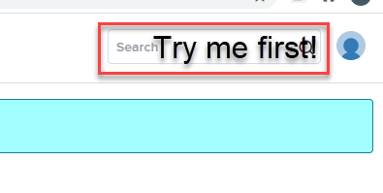
Good Idea? Search for it First!
Have a good idea that you would like to
submit? Search for it first!!! Why? Chances
are it has already been submitted and you
can add your vote and maybe a comment
to it without creating a duplicate that
might get lost in other requests. If you
don’t find it try various related words as
the submitter might not have used the
same terminology you might.
Notes:
The Contraception grid lets you enter various methods of contraception such as Animal Management and Medical (hormonal, immunological or surgical). You can have more than one method Active at a time. The details of the contraception are entered into the medical module but the actual contraception status is recorded here.

Slide 10
Search for it!
Here is an example. This User would like to be able to add floor plans to an
Enclosure record so they submitted a new request with their single vote.
Notes:
At the top of the animal record there is a tab titled Major Life Events. This is a quick view of major events for the animal. It includes transactions, sex changes and parent updates in addition to other life events if they have been recorded. Nothing can be edited from this tab, it is only for your information and the data is sourced from the specific topic grids in the animal record. It will include information that you have entered as well as information that other holders/owners have entered.

Slide 11
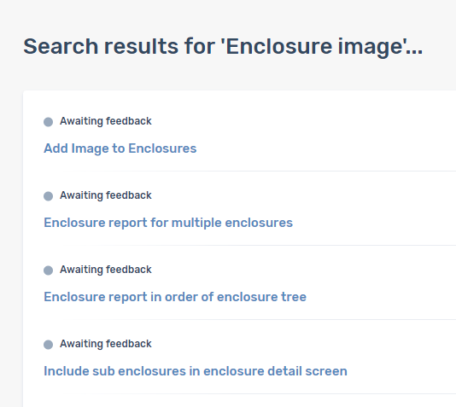
Search For It!
If they had first searched for related
requests, trying various different
terms, they would have found a
request for “Add Image to Enclosures”.
Notes:
The Contraception grid lets you enter various methods of contraception such as Animal Management and Medical (hormonal, immunological or surgical). You can have more than one method Active at a time. The details of the contraception are entered into the medical module but the actual contraception status is recorded here.

Slide 12
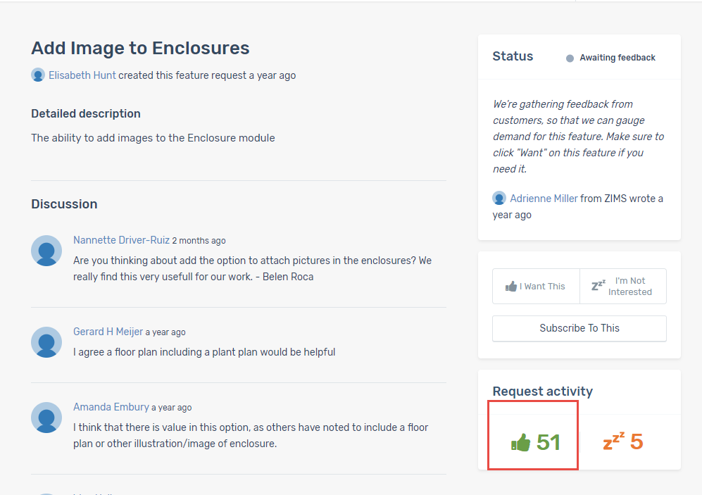
The More the Merrier!
Opening the request shows that 51 Users have already voted on this! And there have been comments added. Add your vote by selecting “I want this” (the little thumbs up icon) and add a comment to the discussion if
you want. You have added your voice to reinforce how important this is to many Users.
Notes:
The Contraception grid lets you enter various methods of contraception such as Animal Management and Medical (hormonal, immunological or surgical). You can have more than one method Active at a time. The details of the contraception are entered into the medical module but the actual contraception status is recorded here.

Slide 13
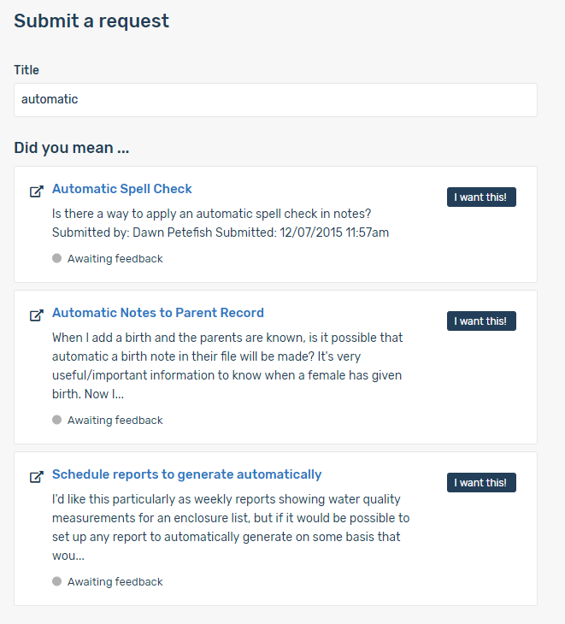
Can’t Find It? Suggest It!
Once you confirm that your idea has not
already been suggested, select the Make
a Suggestion button. When you start typing
Pendo Feedback will look for possible matches. Only the top 3 will display here, that is why you should use the more detailed Search first. If your idea happens to be one of the top 3 found, select the “I Want This” button – no need to submit a new one!
Notes:
The Physical Holder History and Ownership Transaction History grids compile all the information you have entered into My Transactions plus what other institutions have entered for their transaction/visit history. You cannot edit anything from these grids it is simply for you to see the entire physical and ownership thread for the animal.

Slide 14
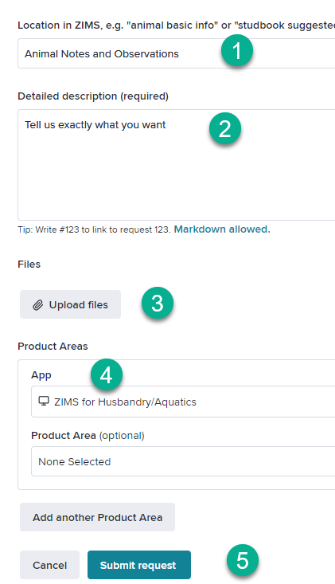
Can’t Find It? Suggest It!
If it is not one of the top 3 scroll down.
1.Enter the location in ZIMS so we can easily find where you are talking about.
2.Provide a detailed description of what it is that you want and why. Whereas as the title should be short, but clear, the description is
where you can provide details. For the title think of wording that others may use to help them find it to vote on it. 3.You can even upload a file for further clarity.
4.Select the module (Husbandry/Aquatics, Medical or Studbook).
5. Cancel or Submit the Request.
Notes:
The Physical Holder History and Ownership Transaction History grids compile all the information you have entered into My Transactions plus what other institutions have entered for their transaction/visit history. You cannot edit anything from these grids it is simply for you to see the entire physical and ownership thread for the animal.

Slide 15
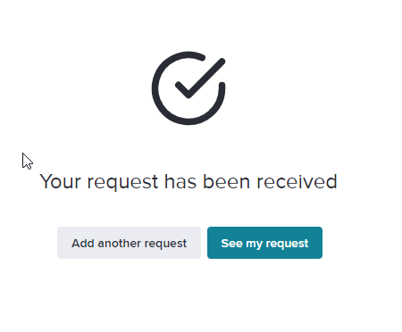
Request Received
You will get a message that your request has been received. You can view your request
or suggest another feature.
Notes:
The Physical Holder History and Ownership Transaction History grids compile all the information you have entered into My Transactions plus what other institutions have entered for their transaction/visit history. You cannot edit anything from these grids it is simply for you to see the entire physical and ownership thread for the animal.

Slide 16
Why Did My Title Change?
When your request is submitted it is reviewed
Possible Duplicate?
Is the request clear?
If not you will get an email asking for clarification
Should it be Accepted? (more on Declined later)
Having looked at over 2,000 suggested Enhancements we have an idea what terms are commonly used. Your title may be changed to use terms that will allow other Users to find it quicker.
Notes:
The Contraception grid lets you enter various methods of contraception such as Animal Management and Medical (hormonal, immunological or surgical). You can have more than one method Active at a time. The details of the contraception are entered into the medical module but the actual contraception status is recorded here.

Slide 17
What do the Terms Mean?
Not Reviewed
This is the status of new submissions
Awaiting Feedback
The request has been reviewed and accepted
Planned
The request has been approved for future development
Building
The request is in active development
Released
The request has been released!
Declined
The request will not be done
Notes:
At the top of the animal record there is a tab titled Major Life Events. This is a quick view of major events for the animal. It includes transactions, sex changes and parent updates in addition to other life events if they have been recorded. Nothing can be edited from this tab, it is only for your information and the data is sourced from the specific topic grids in the animal record. It will include information that you have entered as well as information that other holders/owners have entered.

Slide 18
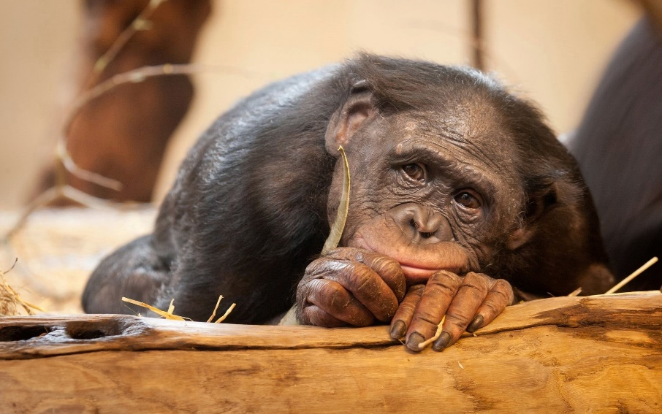
Declined???!!! But my idea was so good!
It breaks a Business Rule
ZIMS already does it
Training Opportunity
Already Submitted
Will add your vote to the current request
Resubmit
If you believe the request was misinterpreted
If you feel strongly enough
Notes:
At the top of the animal record there is a tab titled Major Life Events. This is a quick view of major events for the animal. It includes transactions, sex changes and parent updates in addition to other life events if they have been recorded. Nothing can be edited from this tab, it is only for your information and the data is sourced from the specific topic grids in the animal record. It will include information that you have entered as well as information that other holders/owners have entered.

Slide 19
How do we Decide Which Enhancements will be Developed?
From User Feedback
Popularity Versus Priority
Popularity is pulled from the number of User Votes
Take the time to Vote for your favorites!
Priority is pulled from User prioritizations
Make sure you prioritize!
It is important to prioritize your requested features because that helps us determine what requests are of the most value to our Users. There are two reports that we can run – one on Value and one on Popularity. The results are seldom the same. Reviewing both of these reports will help guide us for any future Enhancement development.
Notes:
The Physical Holder History and Ownership Transaction History grids compile all the information you have entered into My Transactions plus what other institutions have entered for their transaction/visit history. You cannot edit anything from these grids it is simply for you to see the entire physical and ownership thread for the animal.

Slide 20
How do we Decide Which Enhancements will be Developed?
From Developer Feedback
Effort versus Value
Effort is the amount of time/number of developers needed to develop the feature
Value is the benefit to our members that it would be
The developers also look at the requests from their
perspective to determine how much effort it would
take to create the feature. The best case scenario is
the Effort is low but the Value (priority) is high. If it is a high Effort but determined to be of low Value it
will probably not get done.
Notes:
The Physical Holder History and Ownership Transaction History grids compile all the information you have entered into My Transactions plus what other institutions have entered for their transaction/visit history. You cannot edit anything from these grids it is simply for you to see the entire physical and ownership thread for the animal.

Slide 21
And that is Pendo Feedback!
Capturing all your good ideas!
Notes:
This session covers the additional information that you can enter on your animals. Some of the grids in the animal record have already been covered in previous sessions. We will cover the remaining grids that have not.

