Slide 1
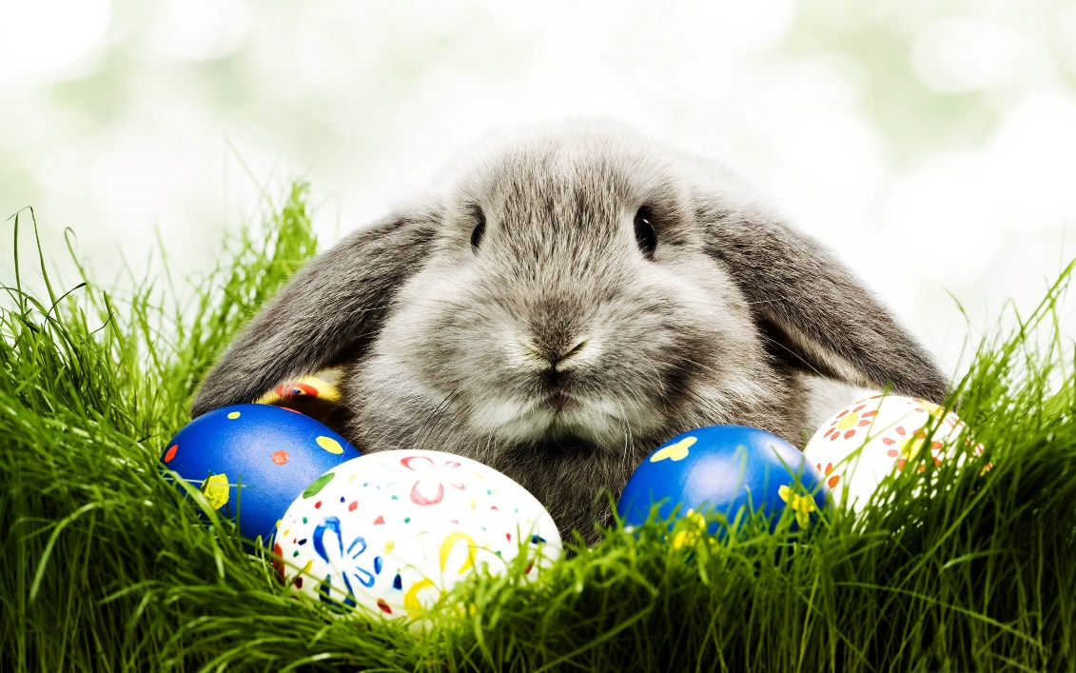
ZIMS and the Easter Bunny
March 2018 TNT: Recording Eggs and Fetuses and
the Events Associated with Them

Slide 2
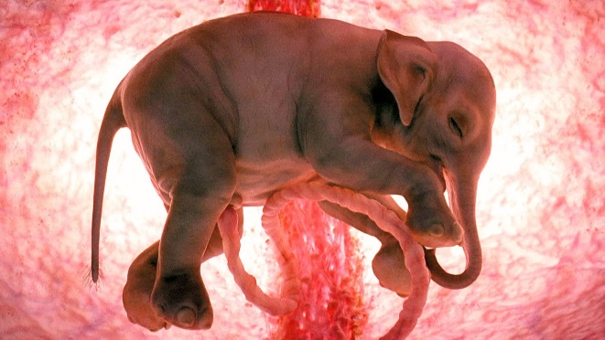
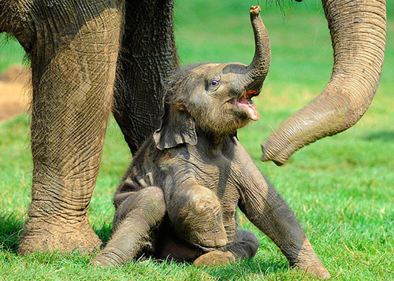
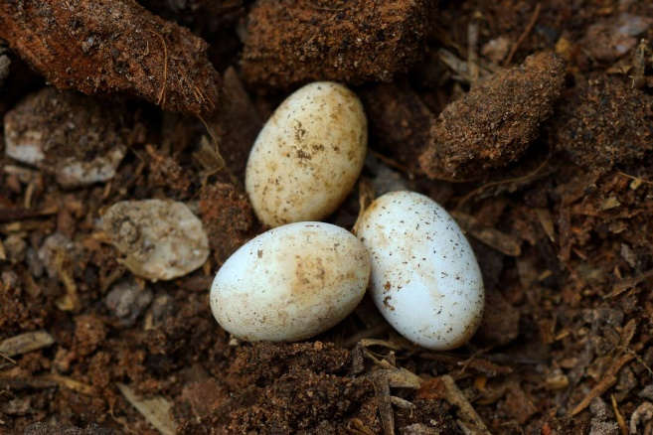
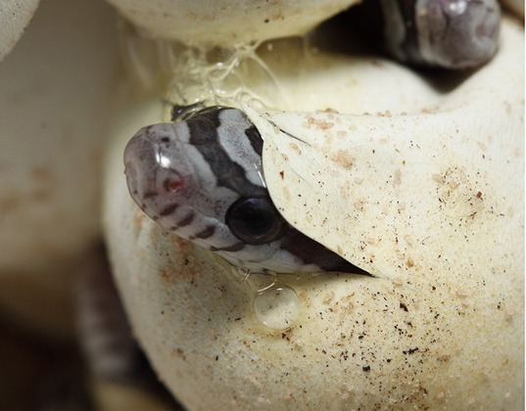
What is an Event?
When you record a
Fetus Identified or
Egg(s) From Lay, that record is the accession into the ZIMS database. If the fetus is born or the egg(s) hatch, that is an Event in ZIMS
Accession
Event

Slide 3
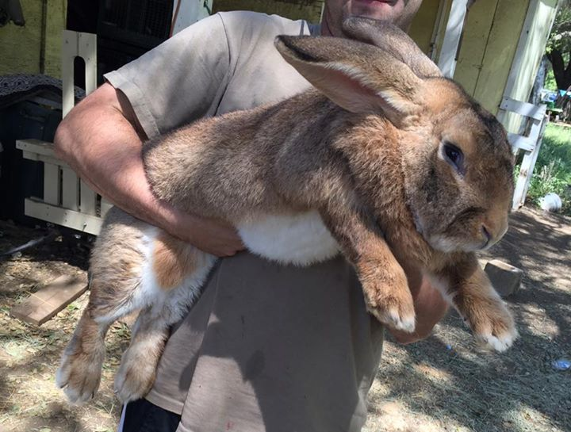
Let’s start with a Fetus
Your Flemish Giant Rabbit
has been gaining weight. You
so hope that she is pregnant
because other institutions
have expressed an interest
in offspring from her due to
her extremely gentle nature
and success as a program
animal. If she is indeed
pregnant you want to move
her into a pen where she will
have a quieter environment
to give birth.

Slide 4
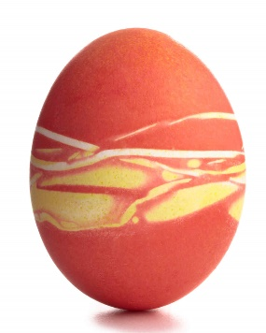
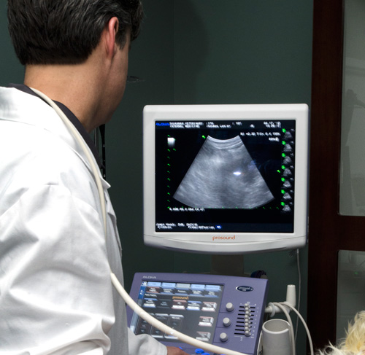
Three Fetuses!
An ultrasound confirms that
she is pregnant with three
fetuses. You move her from
the Children’s Petting area
to an indoor pen where she
can be closely monitored as
birth approaches. Then you
enter the three fetuses into
ZIMS.

Slide 5
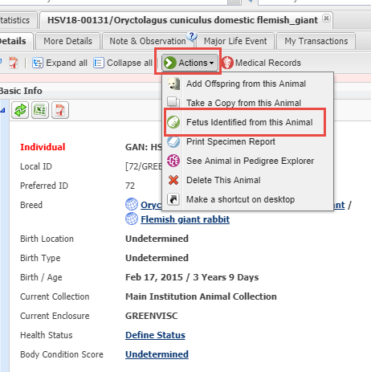
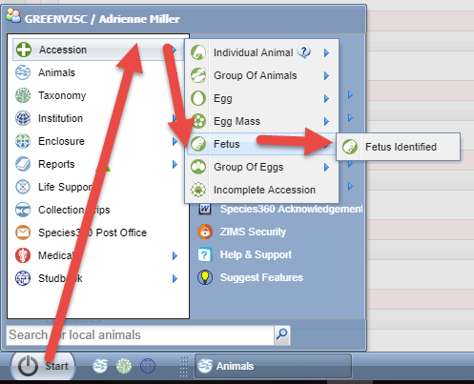
Record the Fetuses
The quickest and easiest way to
record a fetus is from the record
of the dam. Select Actions > Fetus
Identified from this animal. But you
can also do so from Start >
Accession > Fetus > Fetus Identified.

Slide 6
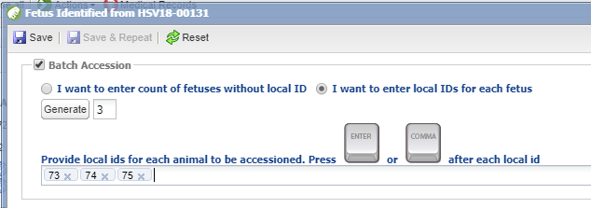
Record the Fetuses - Batch
Currently you cannot record a group of fetuses. To record the
three we will perform a Batch accession. Local IDs are not
required for a fetus. If you are
not assigning Local IDs check
that button (top). If you do want to assign them check the other button and enter the Local IDs. This institution (bottom) is auto-generating their Local IDs so they only had to indicate how many to generate and ZIMS automatically did so.

Slide 7
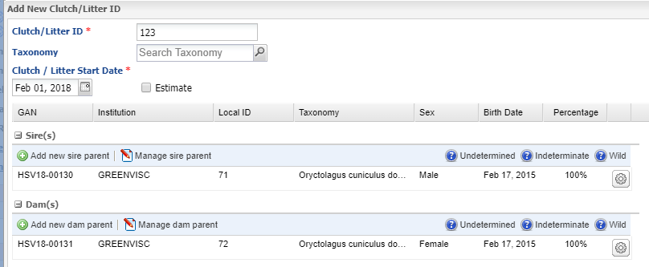
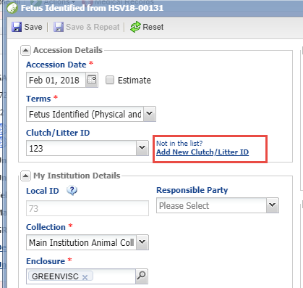
Litter ID
You can create a new Clutch/Litter
directly from this accession screen.
Once created, litters can be found by
searching for the litter number, either
or both parents and litter date range
using the Animal Clutch/Litter search.
Because you have selected NOT to
record Local IDs yet, having a litter
number to search by makes finding
these records again easier.

Slide 8
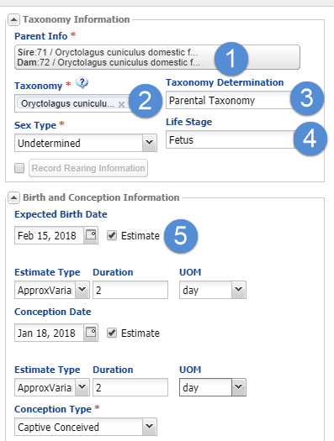
Some More Info
Because you selected Fetus
Identified From This Animal
that Parent information pre-
filled (1), as well as the taxa
(2). Because you created a litter
both Parents will prefill. The
Taxonomy Determination defaults
to Parental (3) but is editable.
The Life Stage defaults to Fetus (4)
but can be deleted. Remember, if
you accept this Life Stage you will
need to update it as the animal
ages or it will be a Fetus forever.
If you can calculate an Expected
Birth Date that can be entered here.

Slide 9
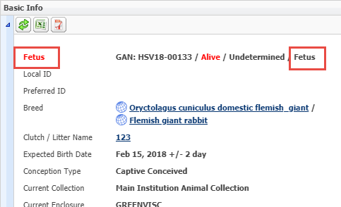
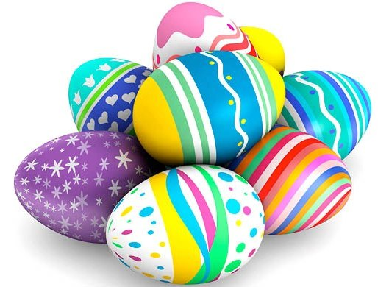
Basic Info Display
The Basic Info will
display an entity of
Fetus as well as a
Life Stage of Fetus
if you accepted it.

Slide 10
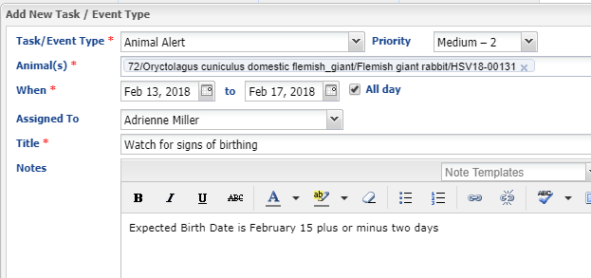
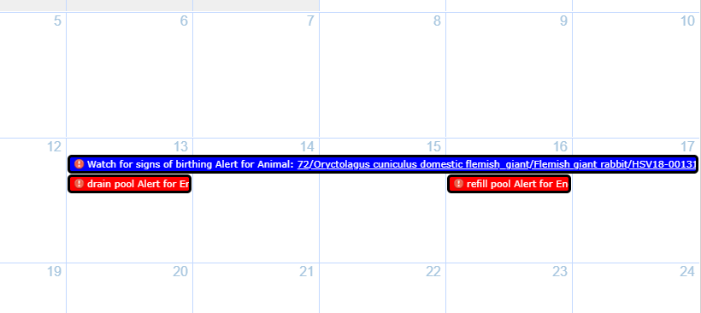
Calendar Alert!
Because you have an estimated birth date you can record an Animal Alert in
your Calendar to remind you to monitor the rabbit.

Slide 11
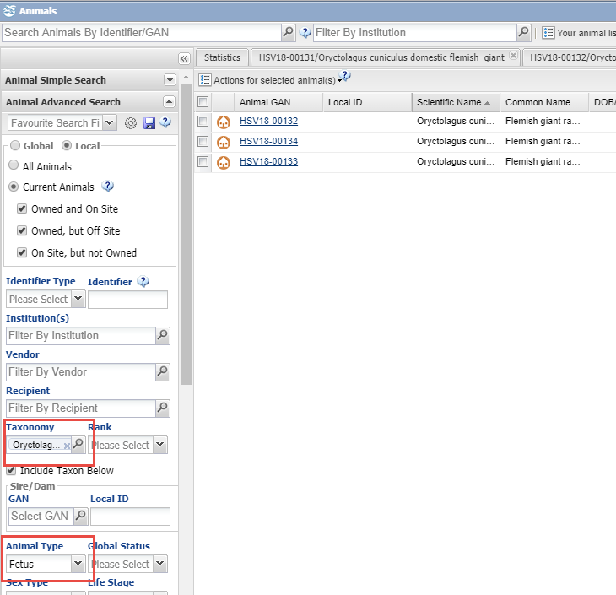
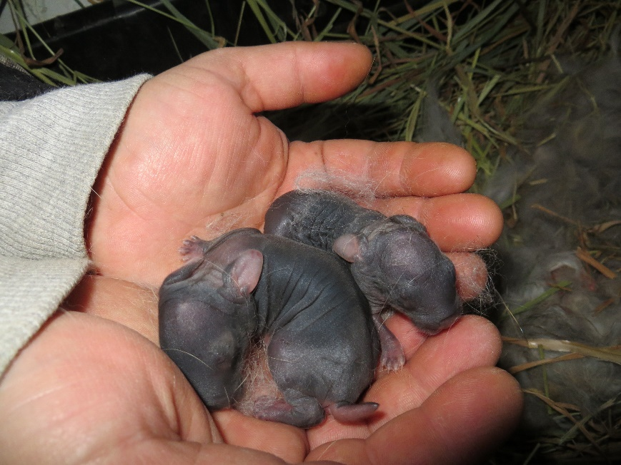
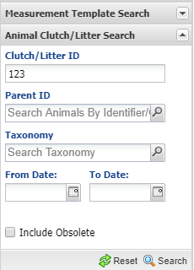
Find the Records
On 16 February you check
the nest box and find she has
given birth to two live kits and,
sadly, one dead one. Using
Advanced Animal Search, or
the Animal Clutch/Litter search
you find the records for the
fetuses.

Slide 12
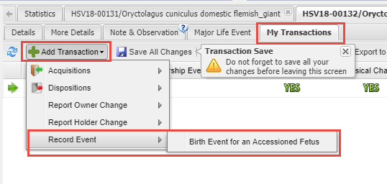
Record Birth Event
Currently you cannot record a Birth Event using Batch actions. In each of the two
successful birth records go to My Transactions > Add Transaction > Record Event >
Birth Event for an Accessioned Fetus.

Slide 13
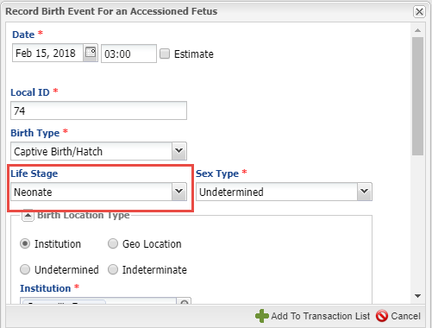
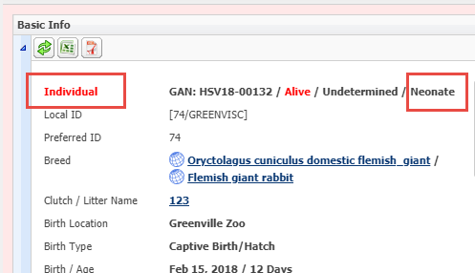
Record Birth Event
Complete the fields,
remembering to update
the Life Stage if you
accepted the Fetus
Life Stage during the
accession. With a Birth
Event you are now
required to enter a
Local ID if you did not
during the fetus accession.
The record now has an
entity of Individual and
the Life Stage has also
been updated.

Slide 14
Event Locations
In the Event Locations grid the Birth will now display, along with
the Conception Location and Date and the Expected Birth Date
since you recorded that during the accession.

Slide 15
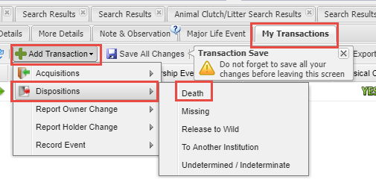
Record a Death
To record the Death go to My Transactions > Add Transaction > Dispositions >
Death. This is not an Event like the Births were.

Slide 16
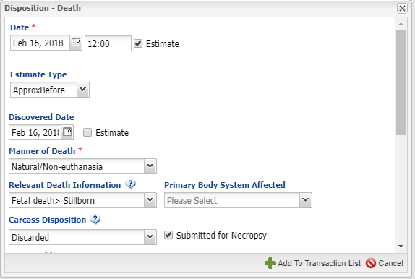
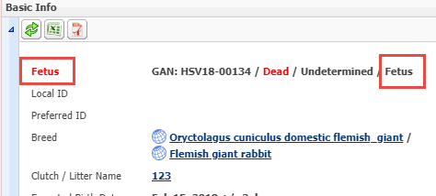
Record a Death
During the necropsy the Veterinarian
determined that the kit never breathed
so the actual Date of the Death was
recorded as sometime before when the
Discovered Date was. In the Basic Info
the Entity and the Life Stage remain as
a Fetus.

Slide 17
Record a Single Egg
Single eggs can be recorded
if only one is laid or if a
clutch is laid and you wish
to identify each egg. If you
are not identifying each egg
then you can record them
as a Group entity which is
covered later.

Slide 18
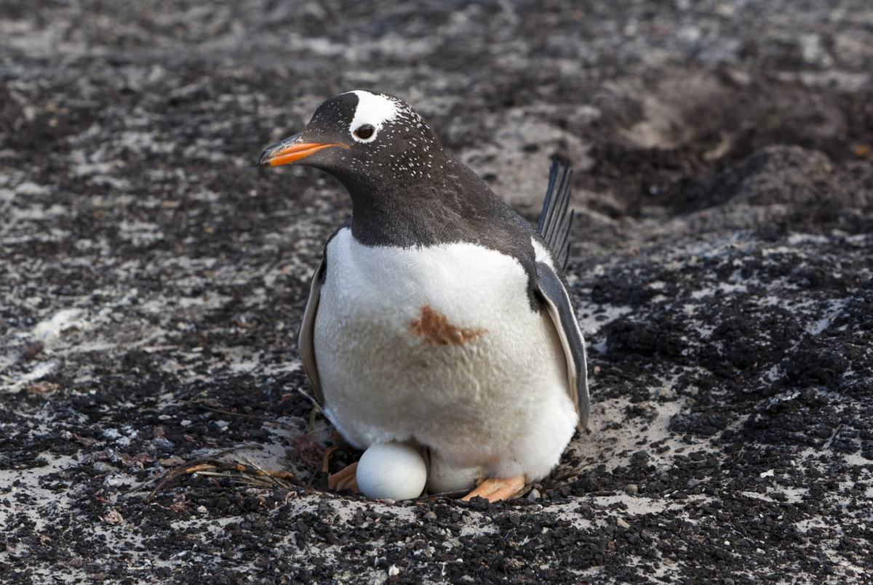
Eggs Laid
One of your Gentoo
penguin females has laid
two eggs, one on 2 October
and one on 4 October.
You were able to mark the
first egg with an “X” using
a non-toxic marker before
the second one was laid.
Because you can tell the
eggs apart you will record
them as Single Eggs.

Slide 19
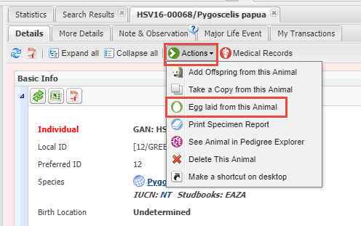
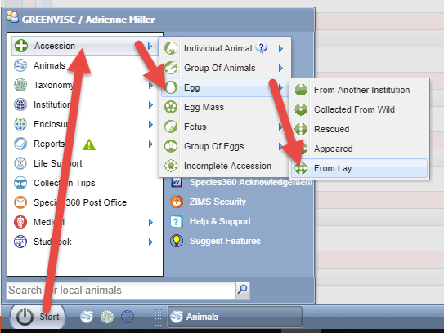
Record the First Egg
Just as for a Fetus, the easiest way
to record a Single Egg is from the
dam’s record Actions > Egg laid
from this Animal because the dam
parent and the taxonomy will prefill.
You can also go to Start > Accession >
Egg > From Lay (or however you got
the egg).

Slide 20
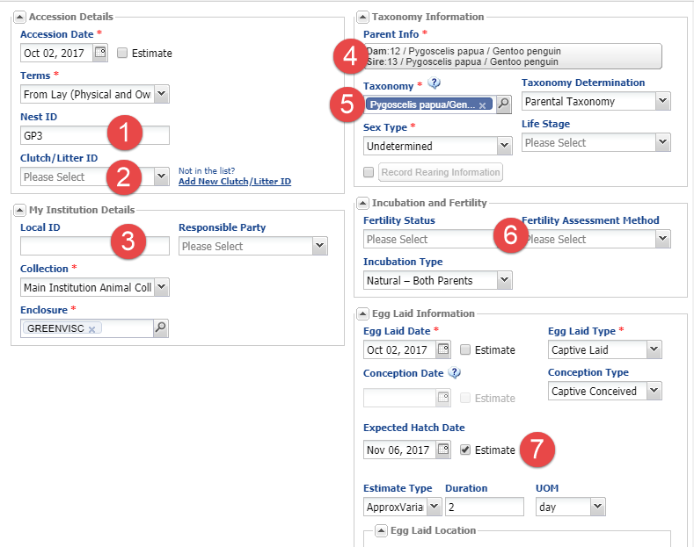
Record the First Egg
The Nest ID (1) is free text and is
searchable under Advanced Animal
Search. If you want to identify the
eggs as members of the same
clutch do that here (2). As for Fetus
a Local ID is not required for an
Egg (3). Because you recorded the
Egg from the dam’s record that
parent will prefill and you only need
to add the sire (4). The taxonomy (5)
defaults to that of the dam or the
lowest common denominator once
the sire is recorded. Fertility is unknown
so you can leave that blank (6). Create
an Animal Alert on your Calendar for
the estimated hatch dates.

Slide 21
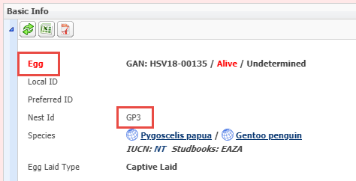
Record the Identifier
The entity will display as an Egg.
The Nest ID also displays in the
Basic Info. Because you identified
this egg with an “X” on the shell
you can record that in the
Identifier grid as an Egg ID.

Slide 22
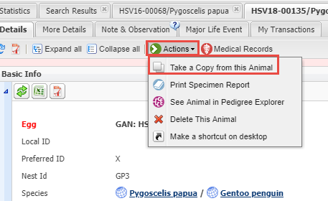
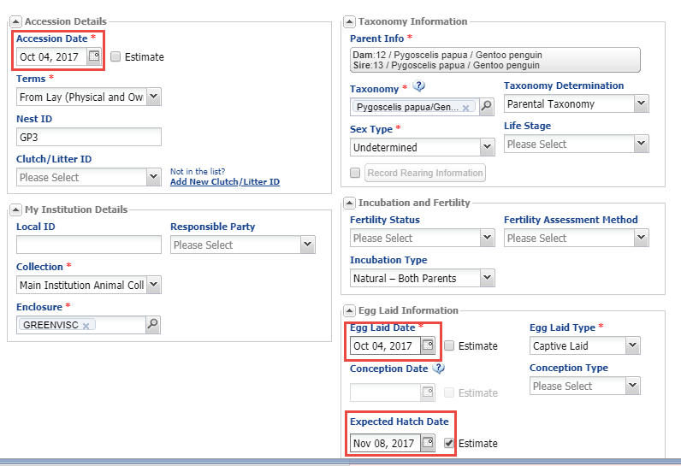
Record the Second Egg
The easiest way to record the
second egg is to open the
record for the first egg and
select Actions > Take a Copy
From this Animal. You need to
edit only the Accession, Egg
Laid and Expected Hatch Dates
since all of the other information
is identical to the first egg.

Slide 23
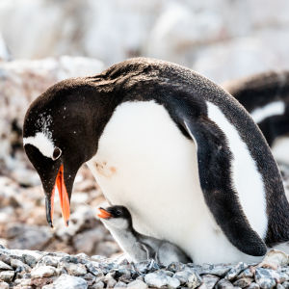
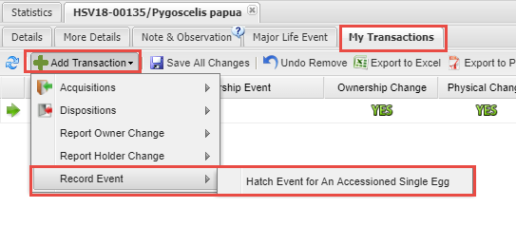
Record the Hatch Event
It is November 5 and the first egg has hatched! Go to My Transactions > Add
Transaction > Record Event > Hatch Event
For An Accessioned Single Egg.

Slide 24
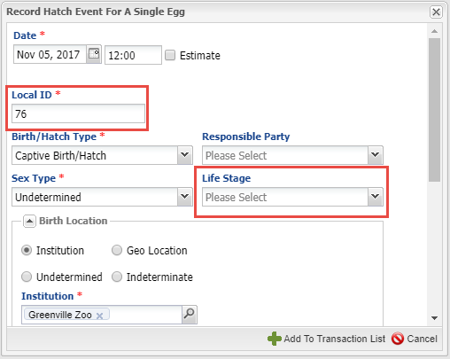
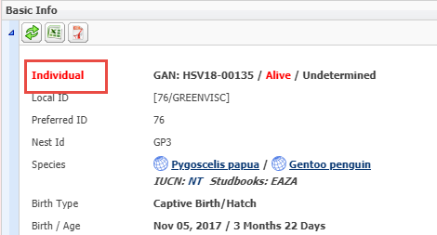
Record the Hatch
When recording a Hatch
Event you are now required
to enter a Local ID. Enter
Life Stage only if you intend
to keep up on it. The Egg is
now an Individual entity in
Basic Info.

Slide 25
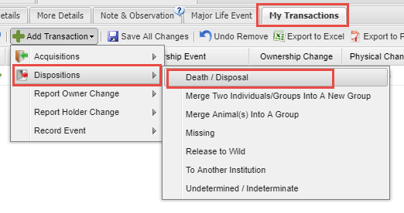
Record a Death in Shell
You wait several more days for
the other egg to hatch. When
you decide it will not hatch you
pull it and open it. Sadly you
find a late term dead in shell
chick. To record the death go
to My Transactions > Add
Transaction > Disposition >
Death/Disposal. Only the
hatching of the egg is an
Event. If you find the egg was
infertile this is also the screen
you would go to for recording
the disposition of the egg.

Slide 26
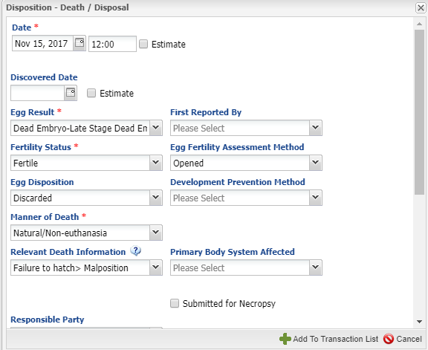
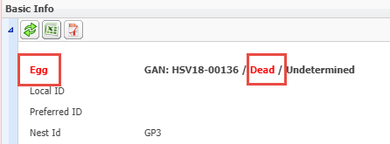
Record the Death
The Egg Result was a
late term dead embryo.
When you open the
egg you determine that
the chick was malpositioned and unable to pip. In the
Basic Info it remains an
Egg but the status is
Dead. You are not required to record a Local ID for a dead egg.

Slide 27
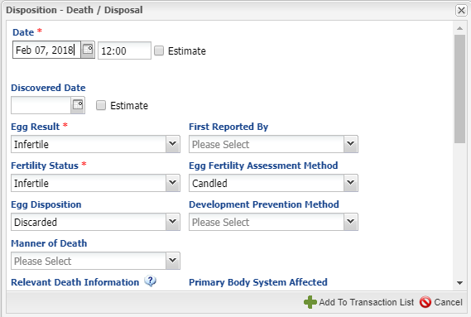
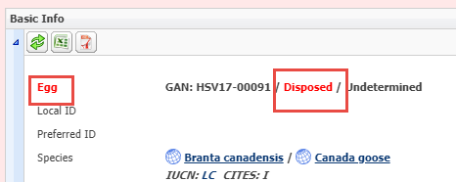
What if the Egg was Infertile?
As mentioned, if the egg is found to
be infertile you go to the same Death/
Disposal screen. Both Egg Results and
Fertility Status would be Infertile. The
Fertility Assessment Method is a
data standard with various options.
Here we candled the egg. A Local ID is also not required for an Infertile egg. The Basic Info still displays it as an Egg but it is not Dead, it is Disposed.

Slide 28
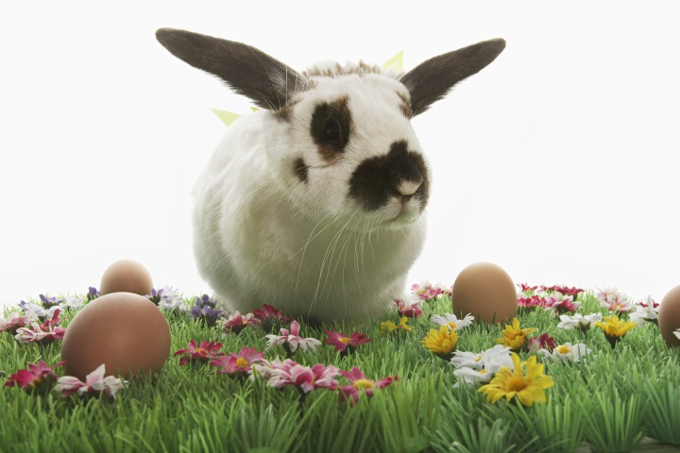
Record a Group of Eggs (or Egg Mass)
You would record the eggs
as a Group if you could
count them and they were
not individually identifiable.
You would record eggs as a
Mass if there were too many
to count. Often Egg Masses
are held together with a
gelatinous substance. The
functionality in ZIMS is the
same for Group of Eggs and
Egg Mass so we will cover
only Group of Eggs.

Slide 29
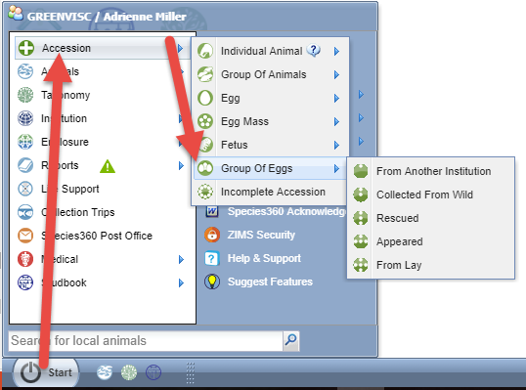
Must Start from Start
Unlike a Single Egg, you
cannot record a Group of
Eggs from within the dam
record. You must go to
Start > Accession > Group
of Eggs > Accession Type.
We are recording this Group
of Eggs From Lay.

Slide 30
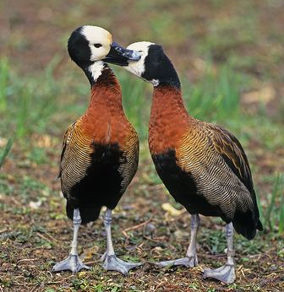
Three Options for Lay Date
Your pair of white-faced whistling ducks
have laid a clutch of 5 eggs. Depending on
how much you know about this clutch there
are three date options for recording the
Group of Eggs:
1)If you followed the clutch closely and know
each day an egg was laid, you can start with a
Group count of “1” and add each egg as
laid as Partial Acquisitions into the Group
2)If you know the date the first and last egg
was laid you could record the total number of
eggs and a range estimate for the lay date.
3)If you find the clutch in its entirety and do
not know any dates associated with the eggs
you can record a date estimate of Approximately
Before the date you found them.

Slide 31
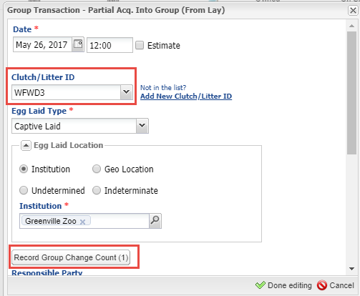
Option #1 – Egg by Egg
Here we have recorded each egg(s) as
they were laid. Remember to assign it
to the Clutch/Litter that was created
for the first egg if you created one.
Record the number of eggs in Record
Group Change Count. Your My
Transaction grid will look like the above.

Slide 32
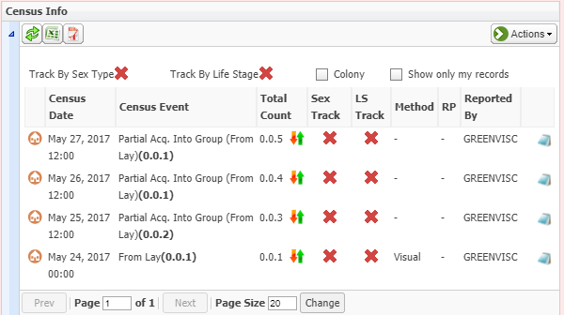
Census Grid for Option #1
Your Census grid will also reflect the addition of the egg(s) as Partial
Acquisitions Into the Group.

Slide 33
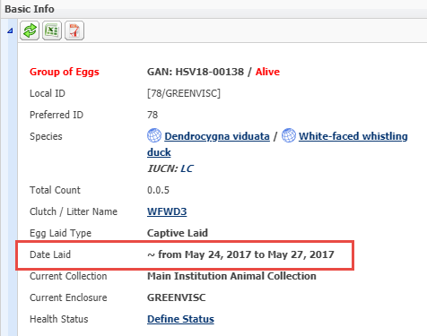
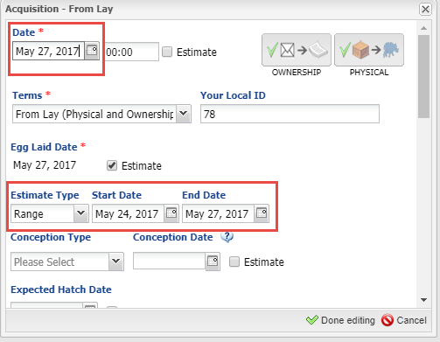
Option #2 - Range
When using a Date Range record
the date the last egg was laid as
the Date because that is when you
are accessioning the group. Record
the Range in the Egg Laid Date field.
Although My Transactions (lower left)
and the Census grid will display the
accession date, the Date Laid
will display as the range in Basic
Info.

Slide 34
Option #3 - ApproxBefore
If using ApproxBefore as the estimate
for the Egg Lay Date the Date would be
the date that the clutch was found,
in this example May 28, 2017. My
Transactions, Basic Info and Census
Grid will all display the same date
estimated as before this date.

Slide 35
The Hatching Scenario
The results for our clutch of eggs is:
One hatches on 22 June
Two hatch on 23 June
Remaining 2 eggs are opened on 28 June
One determined Early Term DIS
One determined Late Term DIS

Slide 36
Two Options for Hatching
You also have options for recording the
hatching (or death or infertility) of the eggs.
1)Wait until the entire clutch hatches or
is determined to be dead or infertile.
Record the dead and infertile eggs (if
any) first. Then record the hatching of
the remaining Group of Eggs. Once you
record an entire Group of Eggs as
hatched you cannot go back into the
record to record deaths/infertility.
2)Split off the eggs as they hatch and
record the hatch in that Single Egg record.

Slide 37
Why Can’t I Just Hatch Some of the Eggs?
You cannot hatch some of the eggs
because that would result in a
Group that was a mixed entity –
some eggs and some Individuals
or Group of Animals. At this time
ZIMS cannot handle Groups of
different entities.

Slide 38
Waiting for Entire Clutch
First record the Dead in Shell Eggs.
The Death Date would be estimated
using the information you can
determine from the condition of
the dead embryos. The Discovered
Date would be 28 June, the day you
opened the eggs. The Egg Result
would be Dead Embryo-Early Stage
for one and Late Stage for the other.
Once a Death is recorded the Fertility
Status will default to Fertile.

Slide 39
Now Hatch the Rest
Using Record Event > Hatch Event
for an Accessioned Group of Eggs
record the hatches. Because the
eggs did not hatch on the same
date check the All Eggs Did Not
Hatch on Same Date checkbox
prior to entering a date. You will be
able to record the date of the first
and last hatch and ZIMS will
record the first date for the Date.
This is slightly different from the
normal date estimate of Range
where ZIMS selects the mid-point
of a Range Estimate to be the Date.

Slide 40
Transaction Display
My Transactions will display as above.
In the Basic Info the group of eggs is
now a Group of Animals with a
count of 0.0.3 and a hatch date of
~from June 22. If you can identify
these ducklings in the future then
they should be split from the group
as Individuals

Slide 41
Splitting off Single Eggs
The first duckling hatched on 22 June.
Split that egg out of the group using
a Partial Disposition. Because two
hatched on 23 June you can select
a Batch Split from the Partial Group
Disposition screen. Do not record a
Birth Date, you will record that when
you record a Hatch Event. And only
enter Life Stage of you intend to keep
up with it. The Batch Split is shown
here.

Slide 42
Record the Deaths
The data entry screen for the Deaths are the same as previously shown. My Transactions will display as
above. When you Save the final Death you will receive the warning as shown on the left. This is because your entry for the final transaction that brought the group down to zero was a Partial Transaction. Only a Full Transaction will Close the group automatically (if you chose to).

Slide 43
Close the Group
If your last transaction was a Full Transaction and brings the count down to 0.0.0 the group will no longer display in searches and reports. However, if the last transaction that brought the group down to 0.0.0 was a Partial Transaction the group will continue to show as Open in Basic Info and continue to display as a count of 0.0.0 in reports and search result grids. To Close Out the group select a Full Disposition of Death /
Disposal / Close Out. You do not need to provide a reason for a group Close Out. Once the group is Closed Out it will display as Closed Out in Basic Info and will not show as 0.0.0 in reports and searches.

Slide 44
Hatch the Split Eggs
Select the hyperlinks in the group My Transaction
grid to open the records to hatch the single eggs
that were split out. This functionality a just like
covered previously for the single egg.

Slide 45
Any Questions?
On ZIMS and the Easter Bunny

