Slide 1
Collection Trips
Tracking your trip information and animals collected

Slide 2
ZIMS Updates!
This PowerPoint is up-to-date as of: May 10 2019
ZIMS is developed in an “agile” method
This means that it is updated every two weeks, sometimes with additional releases in between!
Use the link below to see if there have been any updates to this topic since the date above:
http://training.species360.org/updates/

Slide 3
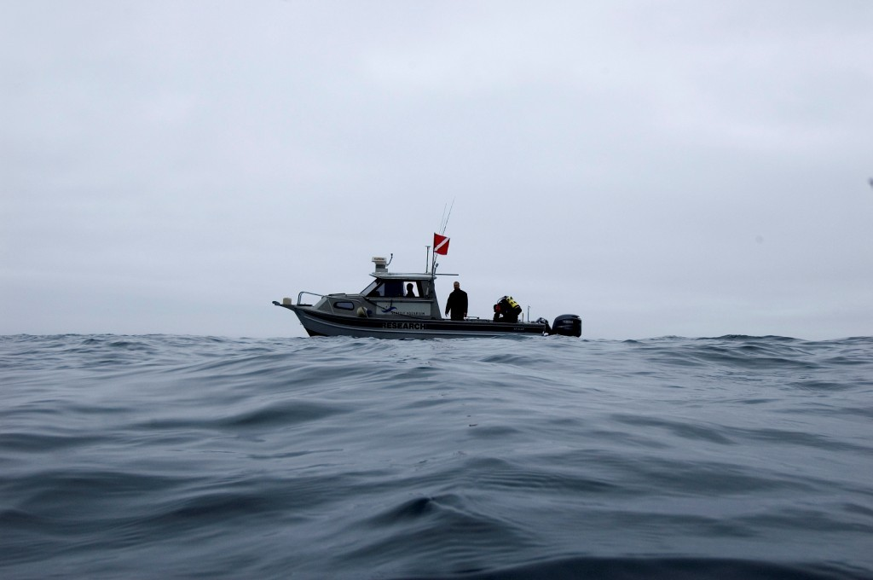
What is a Collection Trip?
The Collection Trip functionality
allows you to have all the
information in one place to help
track your trips and what animals
you collected. Although designed
primarily for aquarium use,
Collection Trips can also be used
for terrestrial trips for collecting
birds and herps. The following
information is captured….

Slide 4
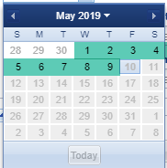
When was it?
A Start Date and End Date are entered
Collected animals can have an Accession Date only during the Date Range of the trip
All other dates are greyed out and not selectable

Slide 5
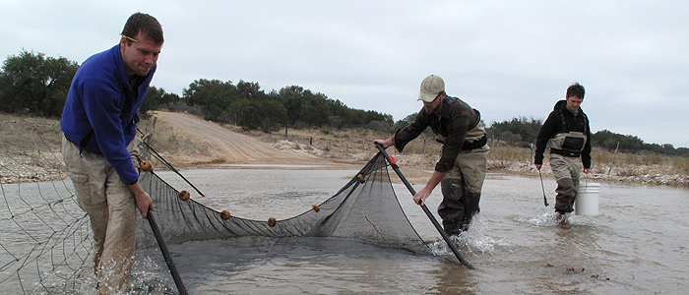
Who went on it?
You can record Staff and Volunteers who went on the trip
The Trip Lead will display in the Basic Info for the trip and you can search for trips led by this person
You can record other personnel as participants

Slide 6
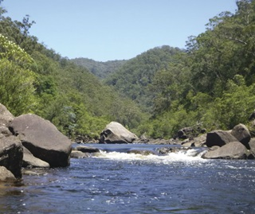
Where was it?
You can record a general area for the trip
The country, state or province
Even the latitude/longitude or GPS coordinates can be captured

Slide 7
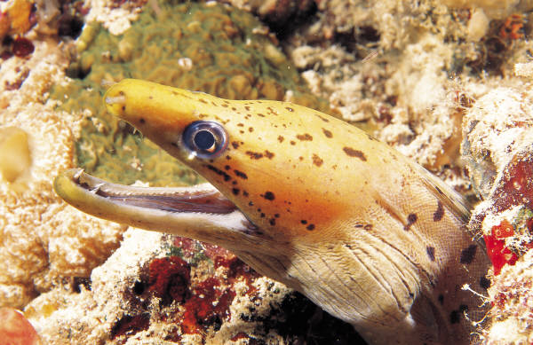
Was it legal?
You can associate any permits that you have recorded into the permit inventory to the trip
Makes it easy to make sure it was done legally, you don’t have to search for them if asked

Slide 8
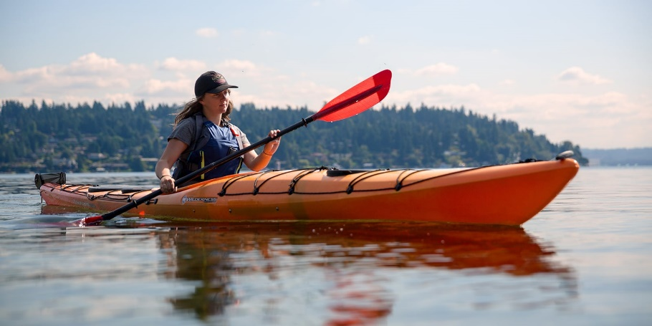
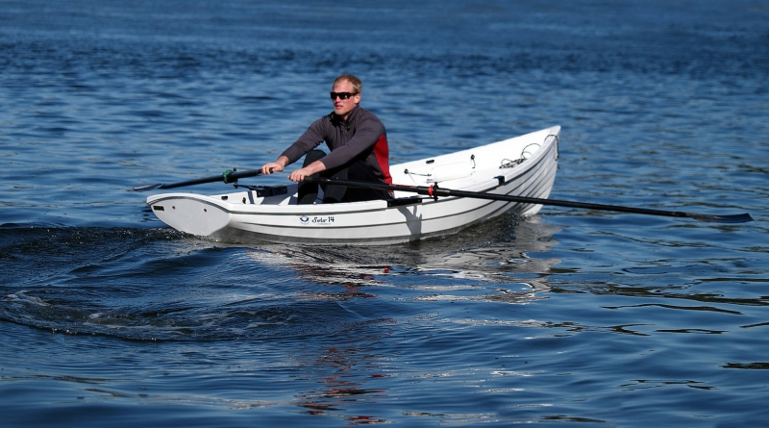
What vehicle(s) was used?
Record the vehicle used for collecting
This cascading dropdown lets you select simply “Boat”, or get more specific down to
“rowboat” or “kayak”

Slide 9
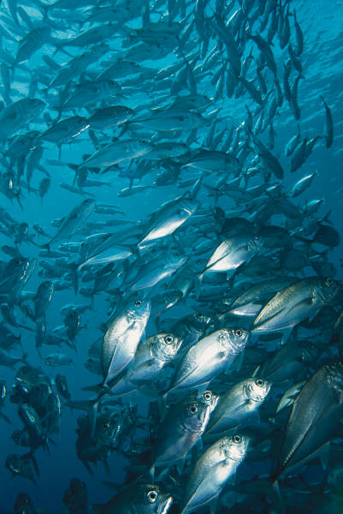
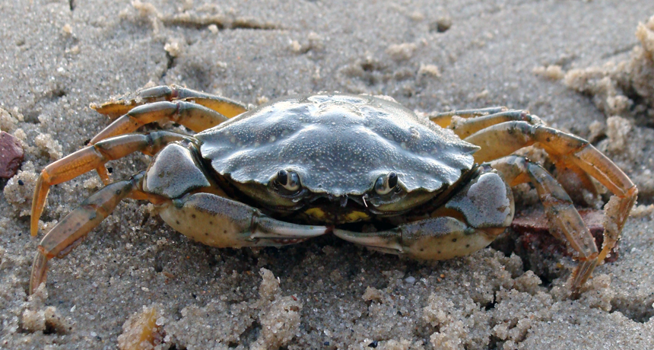
What did you collect?
For the animals collected there are 3 outcomes:
Caught and released – no record created
Died in transit – no record created
Accessioned – record created and GAN assigned

Slide 10
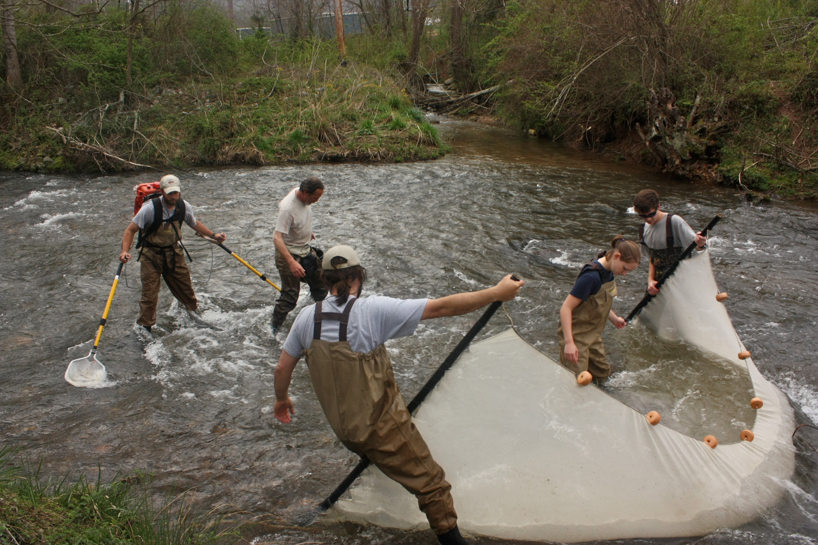
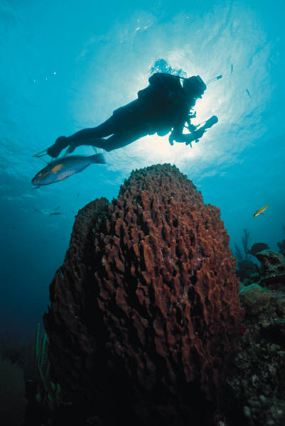
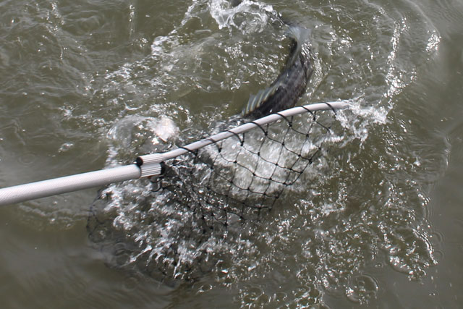
How did you collect it?
Collection Method allows you to capture how you collected it
Cascading dropdown lets you select “Net” or get very specific and select “Hand net” or “Butterfly net”

Slide 11
That is Collection Trips
in ZIMS
Notes:
Are there any questions?

