Slide 1
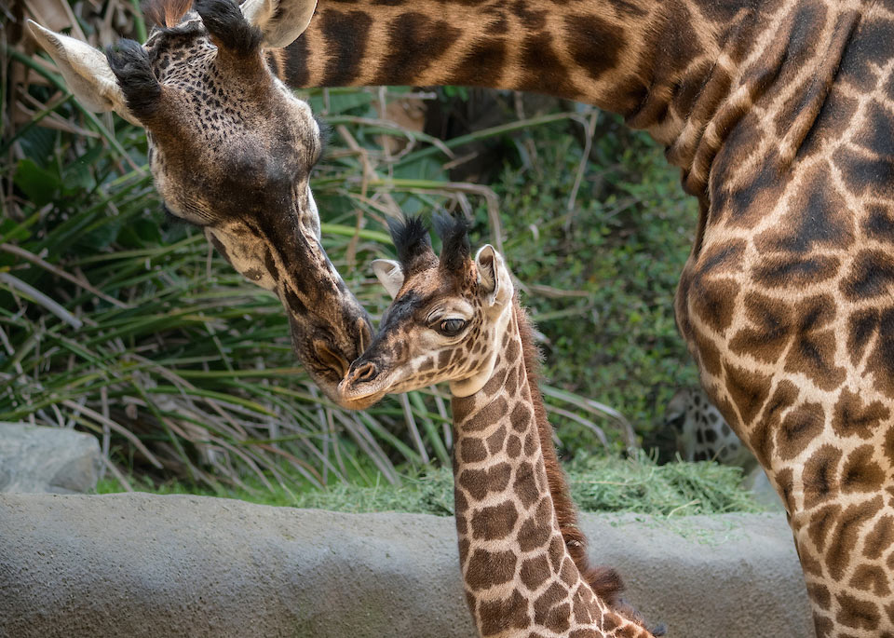
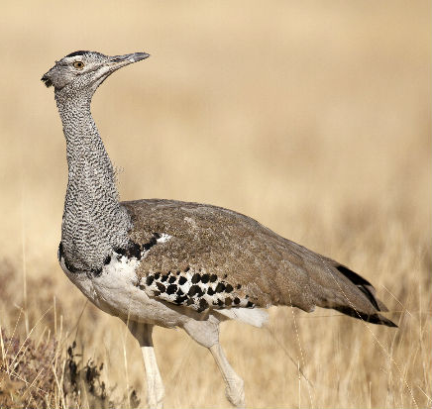
3000C – Taking Over an Existing Studbook in ZIMS

Slide 2
Managing a Studbook Already in ZIMS
This scenario would occur when a studbook that is in ZIMS is handed over to a new Studbook Keeper.
Studbook already exists in ZIMS:
Has been migrated from SPARKS or PopLink
Was created from ZIMS data
Deployment/Migration is not needed
New Studbook Keepers needs to learn how to use ZIMS to record and manage the studbook data

Slide 3
How is a Studbook Transferred to a new Studbook Keeper ?
The Regional Associations are responsible for assigning the Studbook Keeper to a studbook
They will record an end date for the previous Studbook Keeper
This will restrict access for the previous Studbook Keeper but retain the information that they were the Studbook Keeper during the recorded date range
The regional association will then assign the new Studbook Keeper with their starting date

Slide 4
Getting Help
Every institution has a designated support person to assist them with ZIMS.
This person will also be your contact for any questions/help with ZIMS Studbooks.
You can contact them at support@Species360.org
Your email will automatically be directed to your designated support person.
We suggest that you also copy your Regional Association contact on all emails during the transfer period.
Species360 can only advise on ZIMS functionality, contact your Regional Association for advice on Best Practices.

Slide 5
Some Suggestions
Communicate closely with your Species360 support person during the transition.
They can provide links for any training materials
They can answer your questions about data entry and system functionality.
Sign up for monthly Studbook Webinars
Use the Help Menu built into ZIMS and search the Studbook related topics (top right corner of the ZIMS screen).

Slide 6
Getting Started With Your Studbook
The following links will help you get started with your studbook:
ZIMS Studbook Navigation and Functionality
ZIMS Studbook Set Up
ZIMS Studbook Data Entry

Slide 7
To Get the Most From ZIMS Studbooks
The following links will help you get the most out of ZIMS Studbooks:
Data Quality Error Codes
ZIMS Studbook Reports, Tools and Data Tracking
Studbook Overlays
Suggested Animals and Pending Updates

Slide 8
Population Management Tools
The following links will help you work with ZIMS and SCTI/PMC tools
Data Migration Comparisons
Guide for Testing ZIMS PMx Exports
ZIMS for Studbooks PMx Export Documentation

Slide 9
Please contact support@Species360.org if you have any questions!

