Slide 1
Studbook Dashboard

Slide 2
ZIMS Updates!
This PowerPoint is up-to-date as of: 17 January 2019
ZIMS is developed using an “agile” method
This means that new ZIMS updates are delivered every two weeks.
Use the link below to check if there have been any updates to this topic since the date above:
http://training.species360.org/updates/

Slide 3
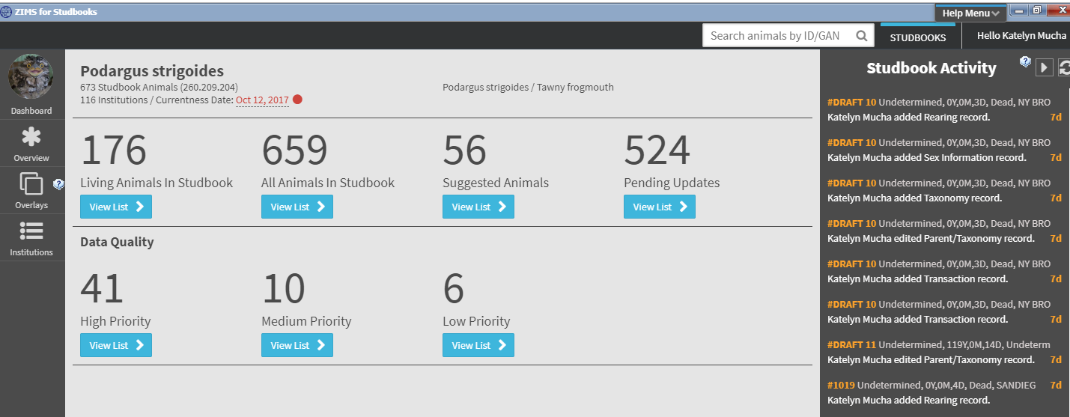
Studbook Dashboard
Studbook Dashboard: Selecting a studbook from the Studbook List will take you to the Dashboard. This is the main screen for accessing the studbook information and navigating to animals lists.
Main features include Studbook Activity and access to studbook Overview, Institution List, and Overlay functionality.

Slide 4
Studbook Dashboard
Quick Studbook Search: Search by Studbook ID or GAN to navigate directly to the Animal Detail Screen. Available throughout studbook.
Studbooks Button: Select this button to navigate back to the Studbook List screen. Button is available throughout the studbook.

Slide 5
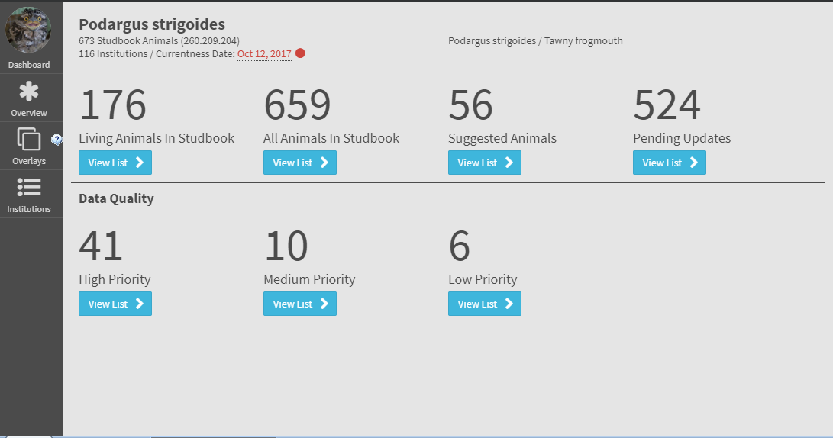
Studbook Dashboard
The studbook currentness date is displayed at the top of the screen.
This date is updated by the Studbook Keeper from within the Overview screen.
A data quality check is imbedded in the date. The check displays as follows:
Green indicates date is current as of 0 – 3 months ago
Yellow indicates date is current 3 – 6 months ago
Red indicates date is current greater than 6 months ago

Slide 6
Studbook Activity Steam
Studbook Activity Stream: List of all the record level changes (additions, deletions, edits) for studbook animals made by users in the studbook.
Animal record changes display in real-time on this stream as edits are made in the Animal Detail.
The Studbook ID is a hyperlink into the animal detail record.
Displays institutional reported identifiers for linked animals in yellow text.
Uses:
Assists studbooks with multiple users editing to track information.
Track last edits within the studbook.
Tracks identifiers that are added by Husbandry institutions to linked animals in the studbook.

Slide 7
Studbook Dashboard
Use the View List buttons to access the following lists:
Living Animals (animals currently living)
All Animals in Studbook (all animals living and deceased)
Suggested Animals (ZIMS records that are not yet in the Studbook)
Pending Updates (new institutional data entered for animals that are in Studbook)
Data Quality lists by priority

Slide 8
Studbook Dashboard
Use the View List buttons to access the following Screens:
Overview
Overlays
Institutions List
See supporting PowerPoints for information about these screens.

Slide 9
Contact Support@species360.org with any questions
www.Species360.org

