Slide 1
Studbooks Migration and Deployment

Slide 2
ZIMS Updates!
This PowerPoint is up-to-date as of: 17 January 2019
ZIMS is developed using an “agile” method
This means that new ZIMS updates are delivered every two weeks.
Use the link below to check if there have been any updates to this topic since the date above:
http://training.species360.org/updates/

Slide 3
Getting Help
Every institution has a designated support person to assist them with ZIMS
This person will also be your contact for any questions/help with Studbook Deployment/Migration
You can contact them at support@Species360.org
Your email will automatically be directed to your designated support person
We suggest that you also copy your Regional Association contact on all emails during deployment
Species360 can only advise on ZIMS functionality, contact your Regional Association for advice on Best Practices

Slide 4
Pre-deployment Checklist
Highest Priority – Please work with Regional Association on these prior to submitting backup!
Define Studbook Scope (Regional or International)
Create list of Studbook IDs included in each MULT ID
AZA required, EAZA excluded
Confirm the taxonomy matches the ZIMS taxonomy
Also for consideration: Historical taxonomies and subspecies.
High Priority - May reduce your time allotted to learn studbooks or delay deployment if not addressed
Have your Local Admin give you ZIMS access (User Name, Password, Role)
New Studbook role in husbandry grants access to viewing global data that is helpful for studbook keeping
A Husbandry Role is not required to be able to use the Studbook module
Create a Studbook backup and check for accuracy
Medium Priority – Will make your data match up with husbandry the most, reducing data entry
Identify any animals with multiple GANs or duplicate GANs for different animals (Species 360 will need to correct these)
Add any missing Identifiers
Correct any Incorrect data
Low Priority – if you have time, but can be just as easily handled after deployment
Update your Studbook with new animals

Slide 5
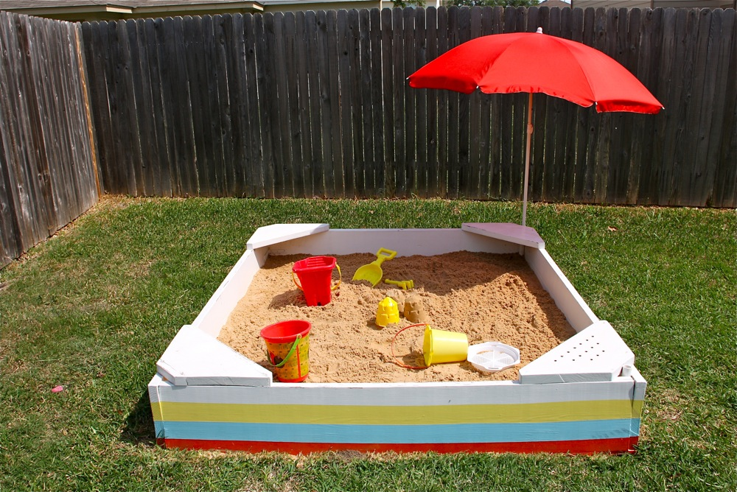
Studbook Testing Sandbox
Sign up anytime before deployment!
Get your feet wet and learn at your own pace
Contact your support person for the form

Slide 6
Deployment Schedule
You will receive emails with instructions for each week
Pre-Deployment – Preliminary Backup Due Thursday
Deployment Week 1- Data migrated mid-week. Can begin testing on Thursday.
A little longer so more time to learn Basic ZIMS and Studbook Training!
A link to training documents will be provided
Reminder to sign up for Studbook Webinar
How to use WalkMe training in ZIMS

Slide 7
Deployment Schedule
Week 2- Complete Data Validation checklist
If studbook from scratch (covered later), learn how the studbook creation process works
Week 3- ZIMS for Studbooks Quiz
Week 4 – Backup due Thursday. Suspend data entry in the legacy (SPARKS or PopLink) software

Slide 8
Post Deployment
Begin entering your studbook data into ZIMS!
Usually Monday after due date
Wait for Support’s email before beginning
Contact support@Species360.org if you have any questions

Slide 9
Training Documents
Copy the following link to find all the Studbook training documents!
http://training.species360.org/studbookmigration/

Slide 10
Studbooks From Scratch!
Brand new studbooks starting with ZIMS data

Slide 11
The Process
Regional Associations assign a new studbook to a studbook keeper
Regional Associations contact Species360 to do a ZIMS download for the species into the studbook module
Regional Associations work with Species360 to assign the proper Role access to the new studbook keeper
Species360 will notify the new studbook keeper once the ZIMS data has been downloaded into the studbook module
The studbook keeper will follow the one month process as for migrated studbooks but without the requirement for backup submissions

Slide 12
Some Things to Note
The ZIMS downloaded data will include only animals within the appropriate region
All Studbook From Scratch Studbook IDs are Temporary Numbers
True Studbook animals are those that have been at only one institution
Suggested Animals have been at more than one institution and will need to be approved before they become True Studbook animals

Slide 13
How To Request a Merge
Sometimes you will find records that are duplicated and need to be merged
Contact any holding institutions to get their agreement that the two different records (with different GANs) are indeed the same record
Contact support with the merge request and the agreement from any holding institutions

Slide 14
Contact Support@species360.org with any questions
www.Species360.org

