Slide 1
Studbook Institution List

Slide 2
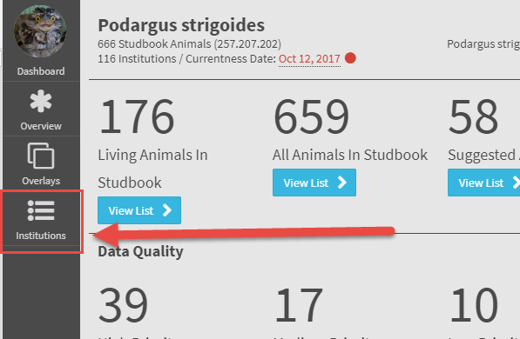
Institution List
Institution List: This list contains lists of global and local institutions and includes detailed information about the institutions.
To access this list, select Institutions from the left-hand navigation of the Dashboard
Notes:
Updated

Slide 3
Institution List
Species 360 member:
Red “x” = not a Species360 member
Green check = Species360 member
ZIMS Institution:
Red “x” = not using ZIMS
Green check = using ZIMS
If an institution is not using ZIMS, records for animals held at that institution will not automatically populate in the studbook.

Slide 4
Institution List – Search/Filter
Institution list search will narrow the list down to partial matches within the various institution lists

Slide 5
Institution List - Export
Export the list currently in view to excel
User can sort/filter and customize the columns prior to export and the list will export as displayed.

Slide 6
Institution List – Global List
Institution List screen defaults to Species360 global institution list.
This is the same institution list as in the ZIMS Institution Module (Husbandry).
Newly recognized global institutions will display in this list automatically as Species360 adds new institutions
User cannot manually add an institution to the Global List
However, you can request an addition to the list by contacting your support representative (support@Species360.org).

Slide 7
Institution List – Local List
Local institution list displays institutions that have been defined in your studbook but are not a Species360 globally recognized institution.
Local institutions are only visible to a single studbook. If you have multiple studbooks the local institution must be added to each studbook.
If a Suggested Animal or Pending Update record includes an Institution that is Local to Husbandry but not entered into your Studbook, you will not be able to accept the record until you add it to your Studbook Local Institution list.

Slide 8
Institution Migration
Any mnemonics in your studbook that are using a historic/obsolete mnemonic will be automatically mapped to the current mnemonic during migration.
Institutions that cannot be mapped to the Global List will be added as local institutions.
Institutions that were local institutions in the legacy studbook may be mapped to a global institution in ZIMS if the system can find a match.
These changes are documented in the Institution Location Mapping Report (under Tools).

Slide 9
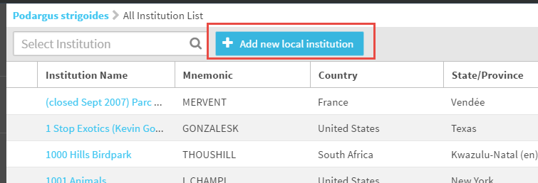
Add Local Institution
To add an institution that is not in the Global List, user can select “Add Local Institution” button.
Always remember to check with Species360 before adding a Local Institution.
The institution may already be in the Global database and they can direct you to it in the list.
Species360 can add it as a Global Institution for all users to access.
Contact support@species360.org for guidance on local institutions

Slide 10
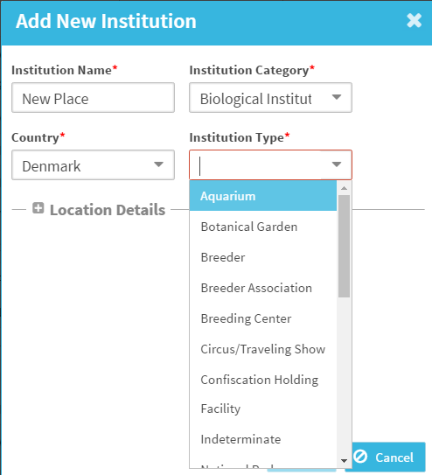
Add Local Institution
When adding a Local Institution:
All the fields are mandatory (red asterisk).
The Institution Name field is free text but the others are standardized dropdowns.
The Institution Category selected will drive the Institution Types that are available in the dropdown.
Duplicate names for institutions are not permitted.

Slide 11
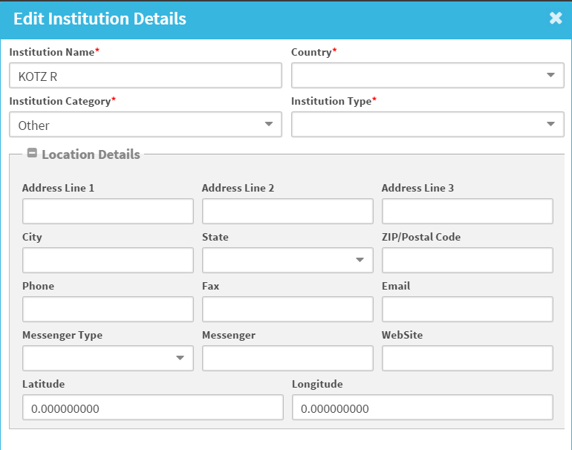
Add New Institution Details
By expanding the Location Details you can record additional information about the local institution, including email, phone number, website, messenger and latitude/longitude.
These are all optional fields

Slide 12
Institution List
Clicking the institution name hyperlink will take you to the Institution Profile.

Slide 13
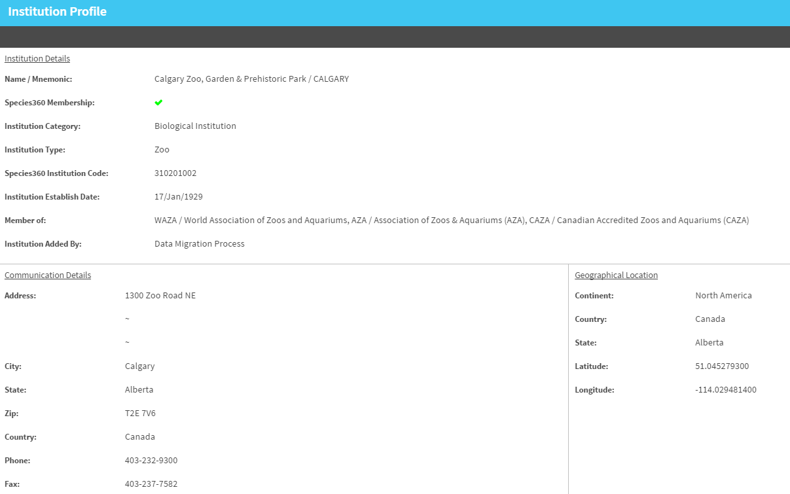
Institution Details & Profile
When you click on an institution in your list, it navigates to the institution details. Details include Profile, Synonyms, Contacts and Notes.
The institution profile is view only for global institutions and fully editable for local institutions. The profile is divided into 3 sections – details, communication details and geographic information.

Slide 14
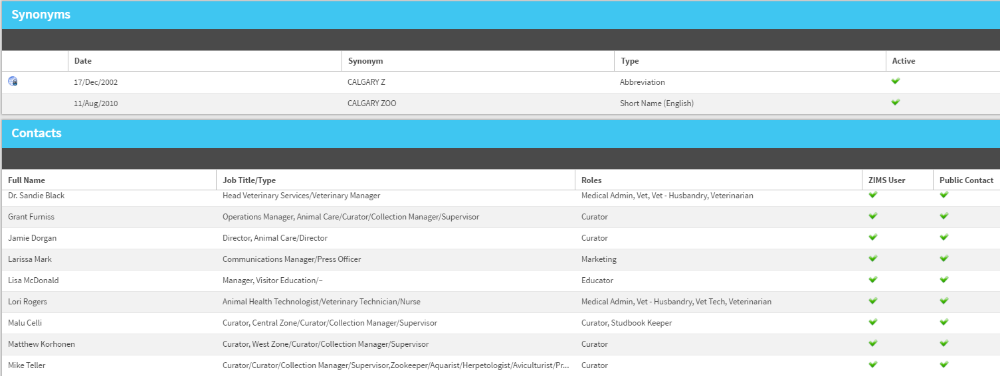
Institution Synonyms
Institution synonyms grid lists historic names or common misspellings of the institution.
Institution synonyms only appear for global institutions.

Slide 15
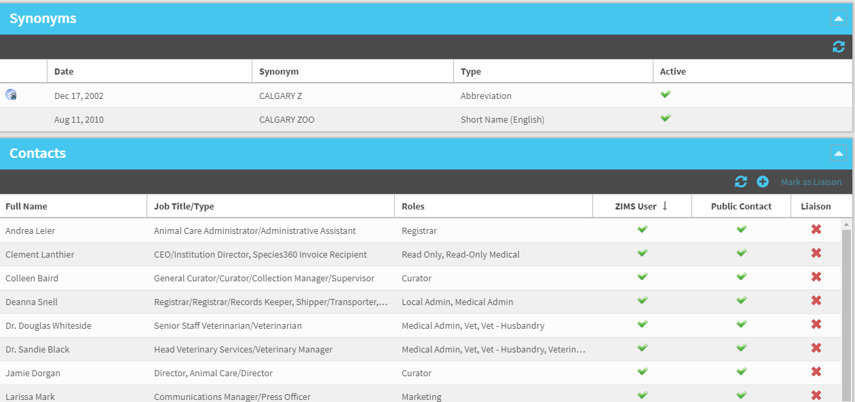
Institution Contacts
Institutional contacts that have been marked as globally shared in ZIMS by the institution will automatically display in the contact grid.
Users can add their own contacts to the grid by selecting the “+” icon.

Slide 16
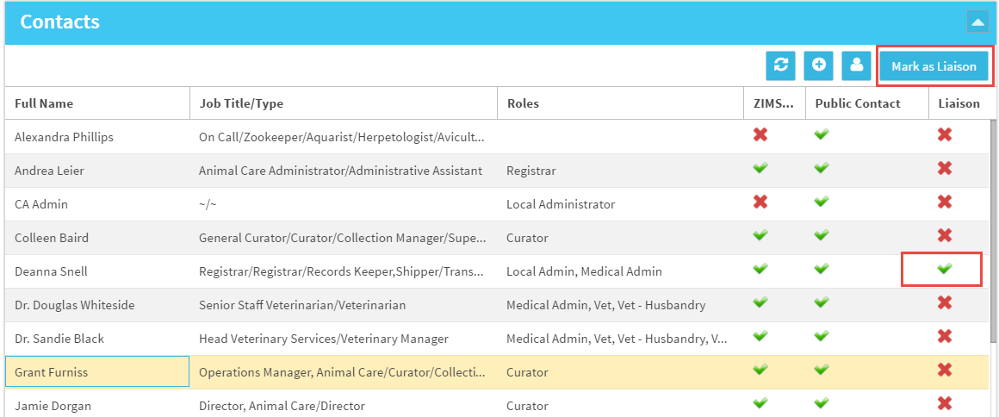
Mark Institution Contact as Liaison
In the Institution Contacts grid, if there is someone that you communicate often with, you can mark them as a Liaison by right clicking on the red “x”.
Users can mark a contact as a liaison in a Global and Local institution.

Slide 17
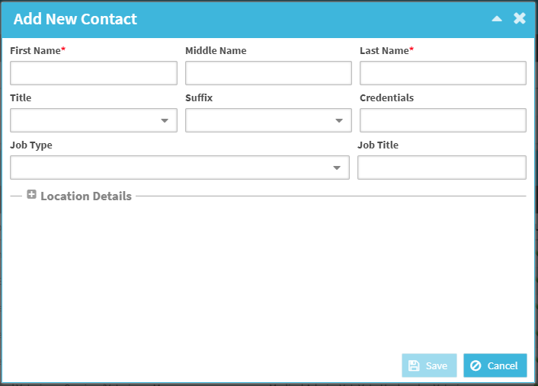
Add Institution Contact
Select the “+” icon in the institution Contact grid to add a contact to the institution.
First and last name are required, all other fields are optional.
Any contacts added to the institution list will only be visible within the studbook.
If you have multiple studbooks, you will have to add the contact to each studbook.

Slide 18
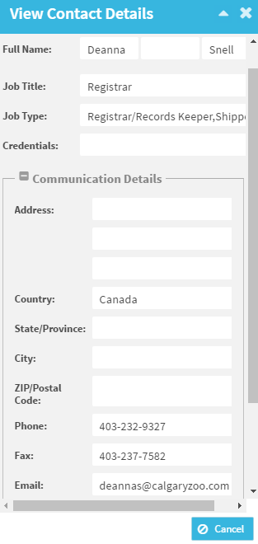
View Institution Contact Details
Double clicking a contact in the Contact List opens the contact’s detail information.
Globally shared contacts will be view only.
Local institutions will have edit/delete ability.

Slide 19
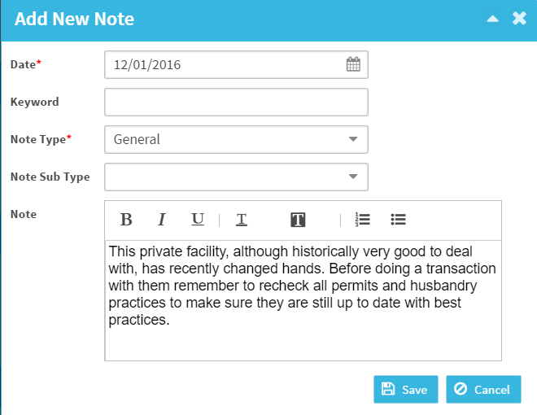
Add Institution Note
Inside each institution detail page is a note grid.
Notes entered in the studbook are private to the studbook. Only users with access to the institution list within the studbook can view them.
The institution the note is recorded on will not be able to view the note.
To add a note select the “+” icon in the note grid.
Notes can be added to both local and global institutions.

Slide 20
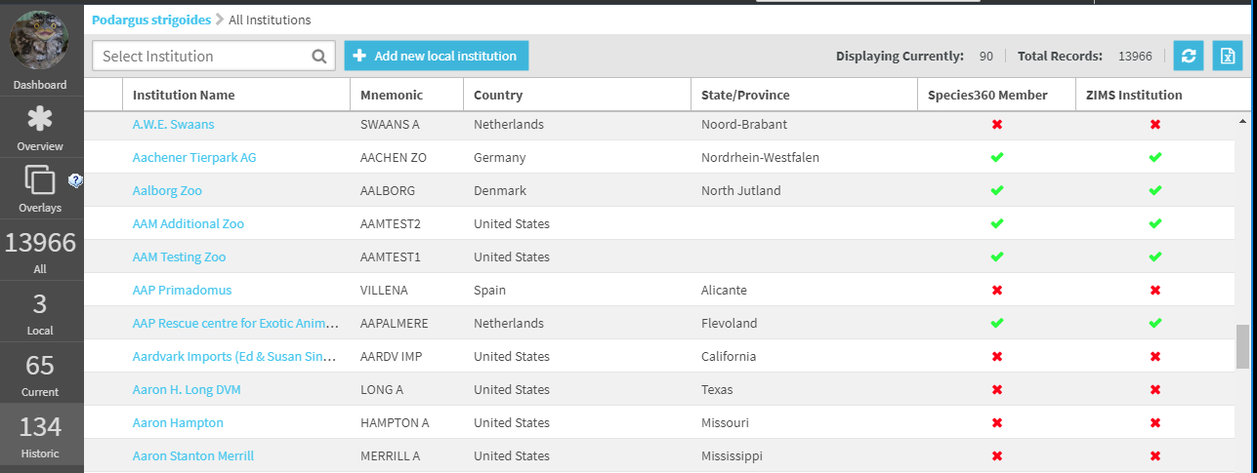
Historic and Current Institutions
Current Institution List: Filters the list to display the institutions currently holding animals in the studbook.
Historic Institution List: Filters the list to display all of the institutions that have held animals in the studbook.

Slide 21
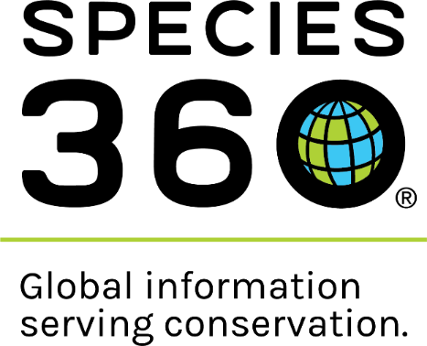
Contact Support@species360.org with any questions
www.Species360.org

