Slide 1
Studbook Animal Lists

Slide 2
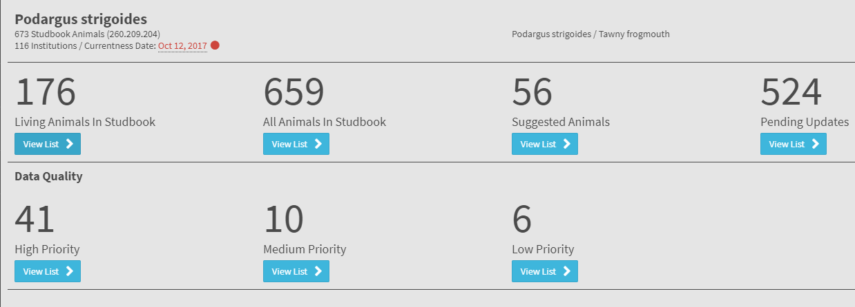
Animal Lists
Living Animal List: Navigates to list of all animals currently living in the studbook
All Animal List: Navigates to list of all animals (of any status) in the studbook.

Slide 3
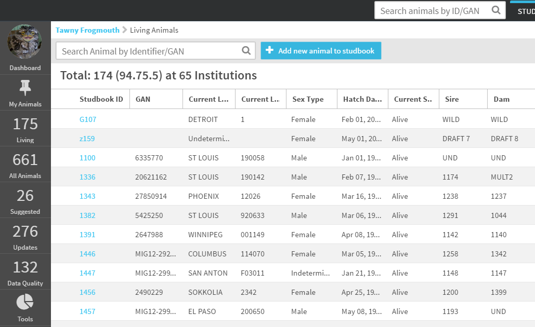
View List of Animals
User can quickly navigate between animal lists by using the left hand navigation.

Slide 4
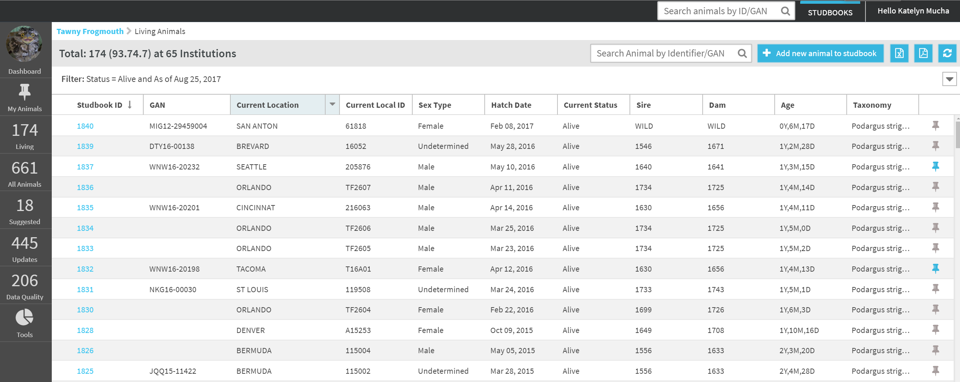
Animal List - Breadcrumbs
Breadcrumb navigation – can take user back to previous screen, in this case the dashboard.
Breadcrumbs are used throughout the system as a navigation tool back to previous screens.

Slide 5
Animal List
Animal’s Studbook ID – hyperlink to the Animal’s Detail Screen

Slide 6
Animal List
Animals that have a global accession number (GAN) are animals that are “linked” to animal in Husbandry. This means they will receive updates if any changes are made to their records in Husbandry.

Slide 7
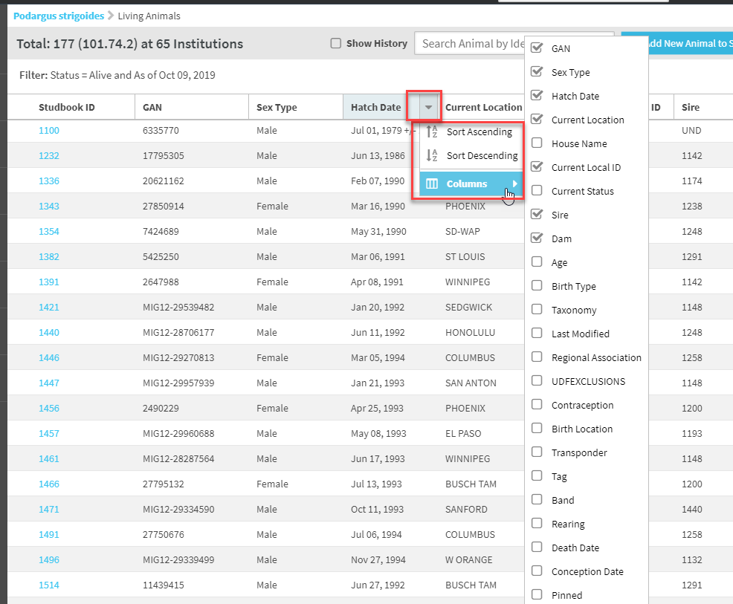
Sort/Customize Animal Lists
User can sort any columns on this list by clicking on the header
User can also customize what columns are displayed by selecting the arrow beside any column header, selecting columns and checking or unchecking as desired.
UDFs will list as column choices
Studbook ID and UDF are not optional columns in Suggested Animal List

Slide 8
Animal List – Quick Search
Studbook Global Quick Search – can search SB ID or GAN. Type ID then hit enter to be taken directly to animal detail screen.

Slide 9
Animal List Search
Animal List Search: Searched the animal list as it is currently filtered. This search will search for matches to the number entered in the Studbook ID, GAN, and Local ID.
The list filters down to potential matches based on the ID entered in the search bar.
When searching for an ID not visible on the screen (alternate or historic ID) a message will display saying identifier is visible when opening the animals record
The search by ID feature can be used in addition to the collapsible filter (right below search box) to further refine results

Slide 10
Filter Animal List
Select the arrow on the filter bar to open the filter screen options.

Slide 11
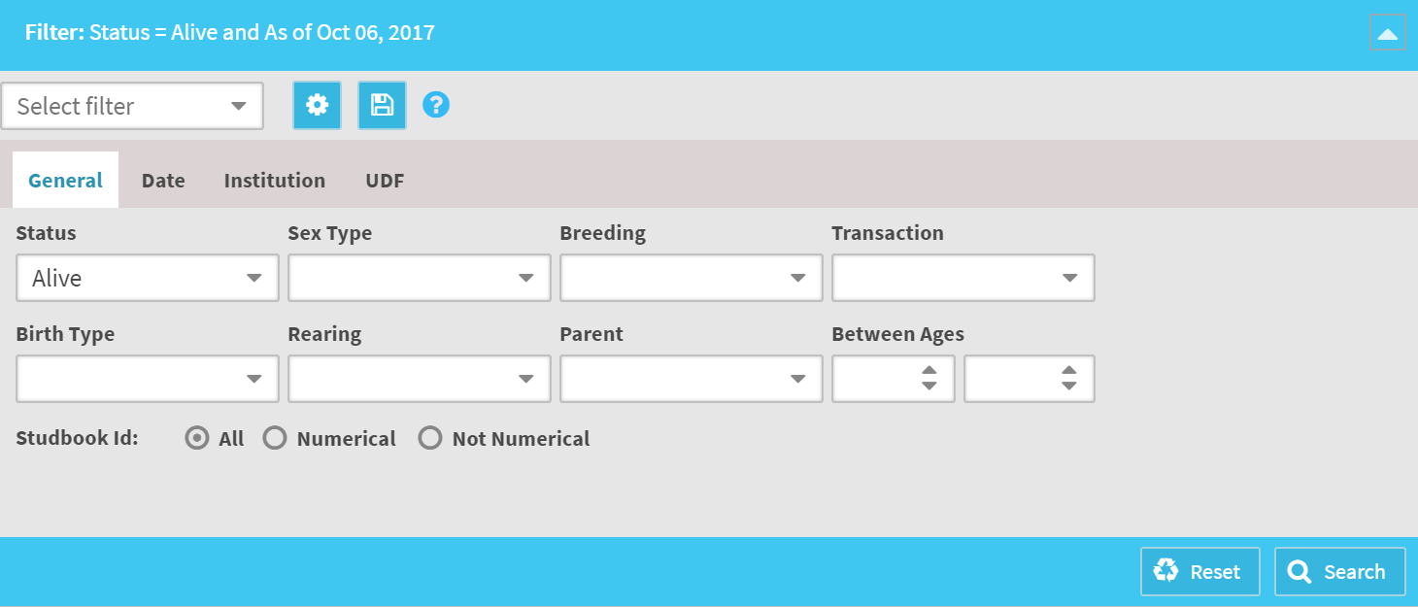
Animal List Filters
A variety of filters can be applied to the animal lists via the filter screen.
The Status box allows you to select multiple filters; all others are single select filters
Living Animal List filters by default are set for “Alive as of today’s date”
All Animal list has no filters by default

Slide 12
Date Filters
Date Filter Options:
As of end date: Shows record types selected as of the date entered.
Date Range: Shows record types selected during the date range selected.
No Restriction: No date restriction applied to the record types selected.

Slide 13
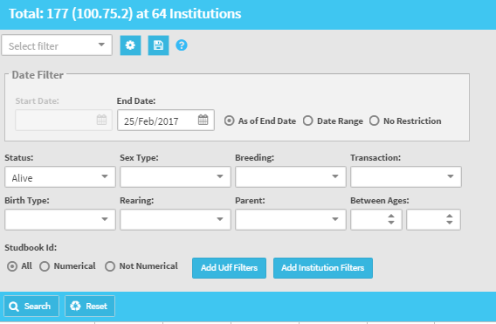
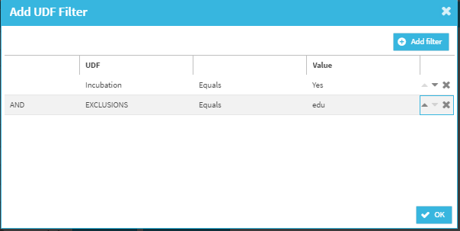
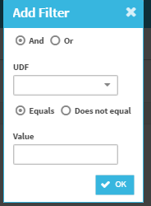
UDF Filters
User can apply UDF filtering to the list by selecting the Add UDF Filters button
User can select one or multiple UDF types to filter the animal list
‘and” “or” options allow user to specify and add multiple UDF filters at the same time.

Slide 14
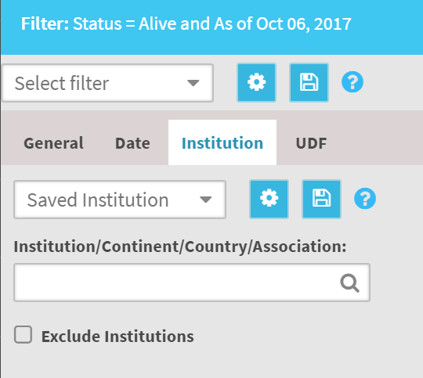
Institution Filters/Fed File Filters
Institution filters replace legacy FED files
Species360 keeps the institution list up-to-date, users no longer need to receive new fed filters to keep their institution list up-to-date!
User can create institution/region filters by typing in the name of the location they want to filter by.
If there are institutions within the filter they chose that need to be excluded, the “exclude institution” box should be selected and user types institution to exclude it from the filter.
See the following slides for examples

Slide 15
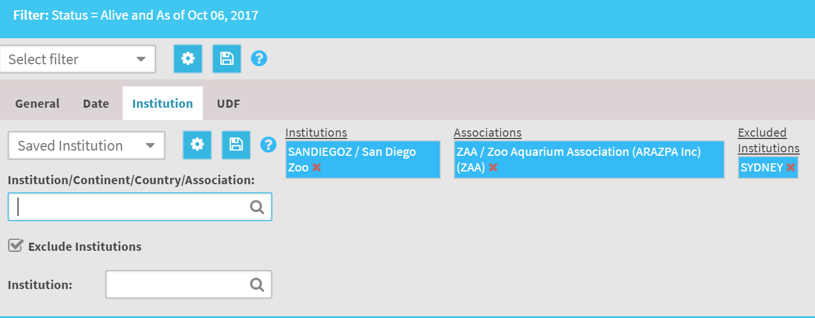
Institution Filters
In this example: The institution list is filtered by ZAA and San Diego included. Then SYDNEY was excluded from the filter.
When this filter is run, all animals that are at ZAA institution (excluding SYDNEY) and San Diego will display in the animal list.

Slide 16
Save Institutional Filters
Inside the institution filter tab, there is an option to save the institution filters.
To save a filter, select the disk icon to save a filter you created – must build the filter before you can save.
When you select save the system will ask you to name the filter – the name must be unique, the system will not allow duplicate institution filter names.

Slide 17
Edit/Delete Institutional Filters
To manage filters select the gear icon – user can view and delete filters from this screen.
To edit filter, user must apply the filter and then make the changes they wish. User then saves the filter as the same name as the filter they want to replace – the system will give a warning, select yes to save over original filter.

Slide 18
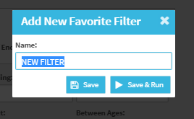
Saved Filters
Saved filters work similar to Institution filters.
Using the save filter from this screen will create a saved filter with all categories selected – general, date, UDFs, and institutions.
When user saves, they have the option to just save or save and apply the filter to the list.
Once filter is saved it will show in the dropdown and will be available to the studbook to apply throughout the system.

Slide 19
Animal List - Export
Export to Excel or PDF – user can export the list as it is filtered/sorted to excel of PDF.
Customize columns before exporting to include data not currently in view
Depending on the number of animals in this list, the report may take a moment to export.
The export can be found in your downloaded files folder.

Slide 20
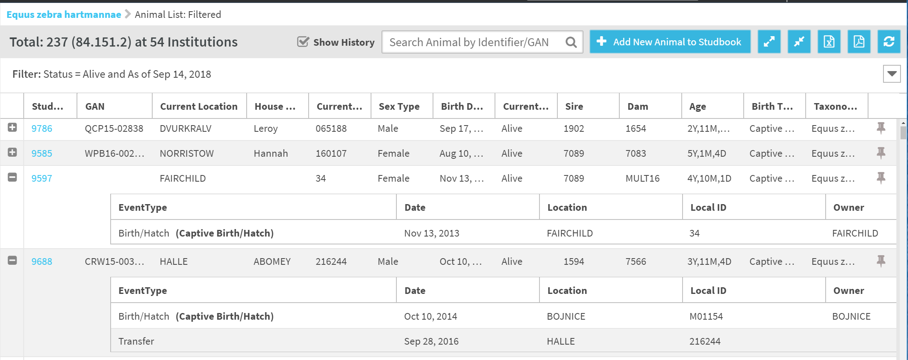
View Animal History Filter
Animal History Filter - Filter that displays the transaction history of individuals from within the animal lists.
Available in all animal lists: living, all animals, pedigree lists and can be applied with other filters selected.
Click on the “+” icon to see the transaction history.
User can apply this filter and export to view the history of all animals selected within the animal list.

Slide 21
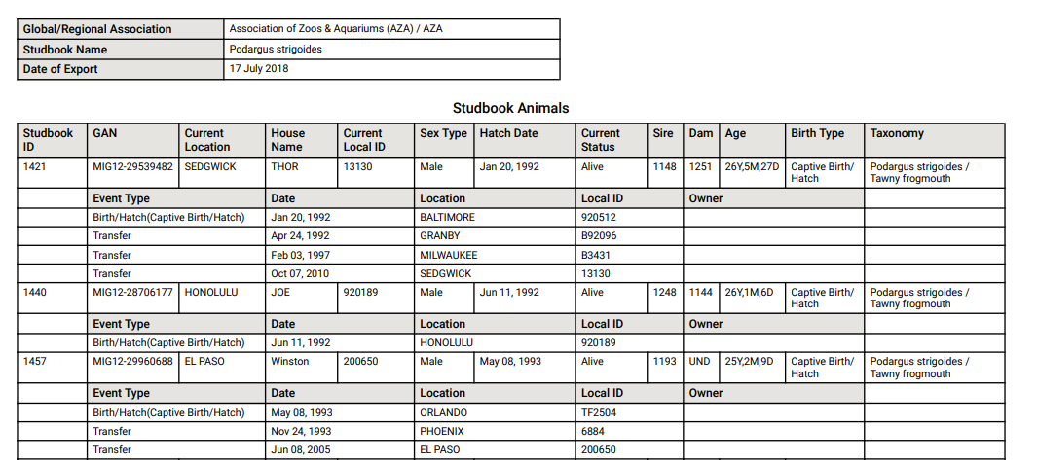
Export Animal History
If the Show History box is checked and the user selects the animals list export the animal history will display in the export.
This feature replaces the legacy Studbook Report functionality.

Slide 22
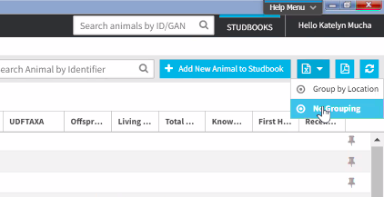
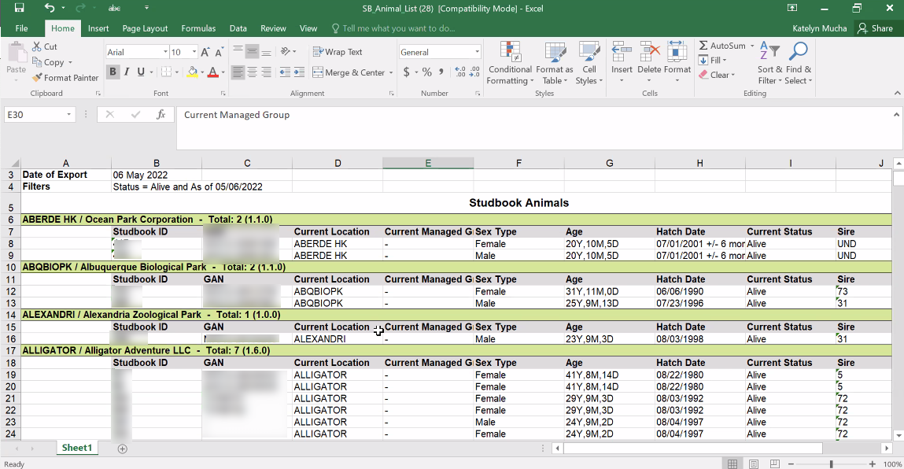
Export Living List Grouped
Export options on ‘Living Animals’ list- down arrow shows grouping options:
Currently you can ‘group by location’ or ‘no grouping’

Slide 23
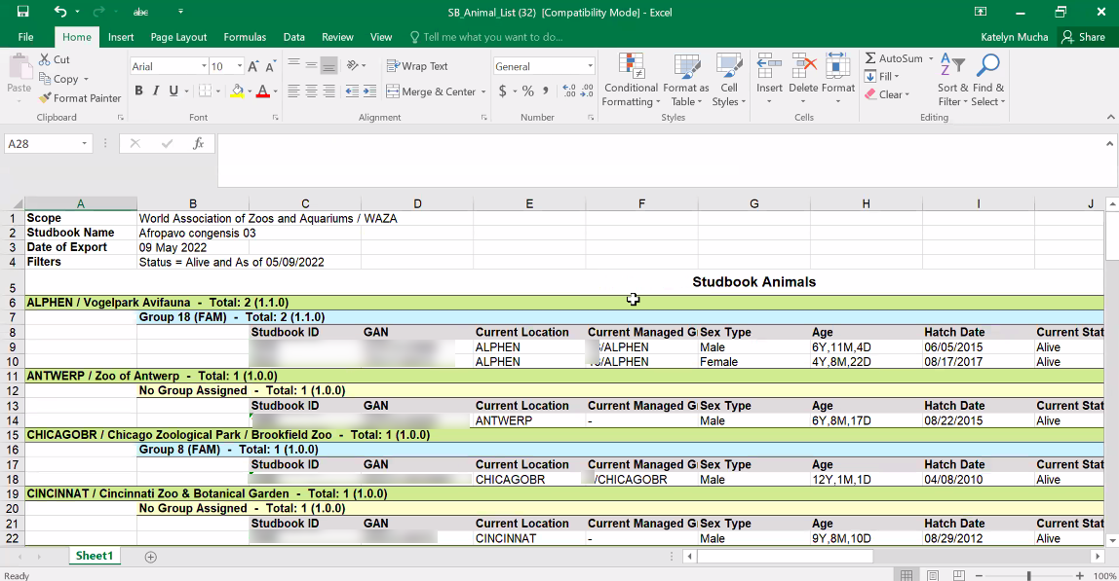
Export Living List Grouped
Export options on ‘Living Animals’ list- down arrow shows grouping options:
When managed groups are enabled you can ‘group by location and managed group’

Slide 24
My Animals

Slide 25
My Animals
My Animals is an option in the left hand navigation.
From this list you can access the following information:
Pinned animals
Recent animals
Draft animals

Slide 26
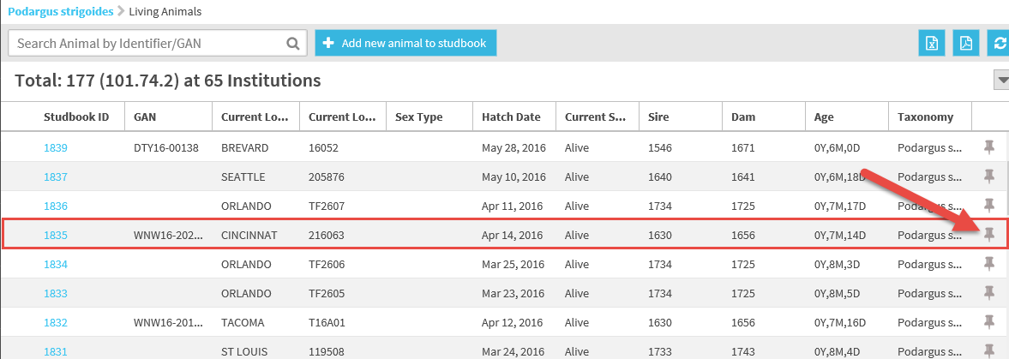
Pin Animal
If there are animals whose records you access frequently or need to revisit, you can “Pin” them to the My Animals list by selecting the pin icon to the right of the animals list (or inside the animal detail screen).

Slide 27
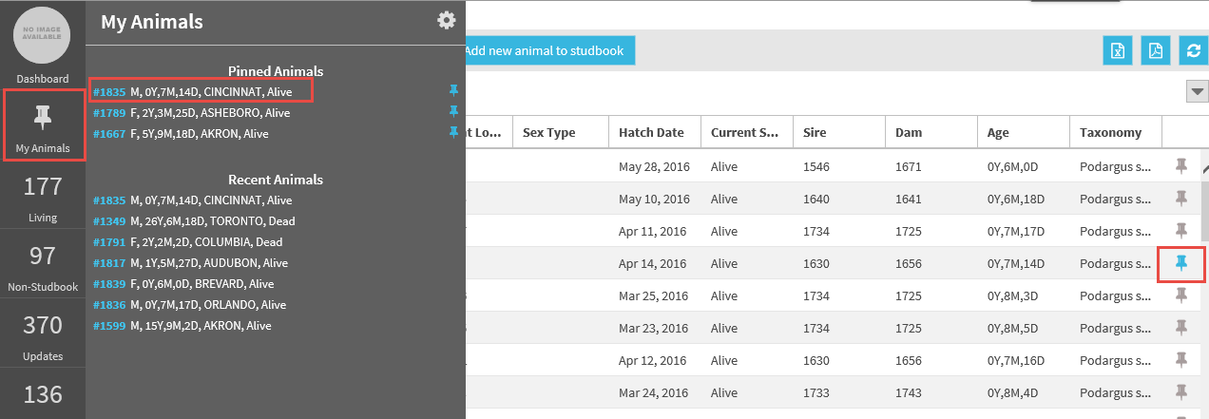
Pin Animal
Pinned animals can be quickly viewed under the My Animals list.
Selecting the Studbook ID will navigate directly to the Animal Detail screen for that individual.
To remove the animal from the pinned list, select the blue pin icon from the My Animal list or the Animal list.

Slide 28
Recent Animals
The last 20 animals that have been recently accessed will be displayed in the Recent Animal view of the My Animal List.
Selecting the Studbook ID will navigate the use to the animal detail screen.

Slide 29
Draft Animals
Draft animals only display in the My Animal list.
Once draft animals are promoted to permanent animals they will no longer display on this list.
Selecting the Studbook ID will navigate to the animal detail screen.

Slide 30
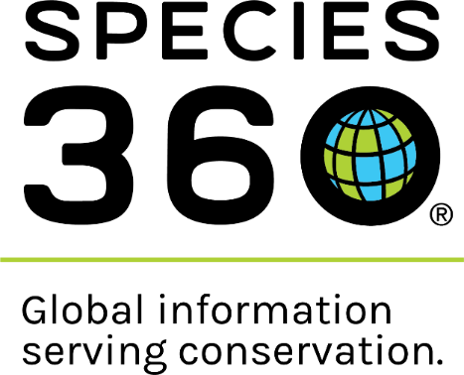
Contact Support@species360.org with any questions
www.Species360.org

