Slide 1
Population Overview Report
An overview of the state of an Species360 population per Species including key metrics on genetic and demographic data
Notes:
The Population Overview report is intended to be a one-screen per taxon (species or subspecies level) overview of the state of the animal population as recorded in the Species360 database. This includes key metrics on genetics and demographics and indicators of the underlying data quality.

Slide 2
ZIMS Updates!
This PowerPoint is up-to-date as of: November 12th 2018
ZIMS is developed in an “agile” method
This means that it is updated every two weeks, sometimes with additional releases in between!
Use the link below to see if there have been any updates to this topic since the date above:
http://training.species360.org/updates/

Slide 3
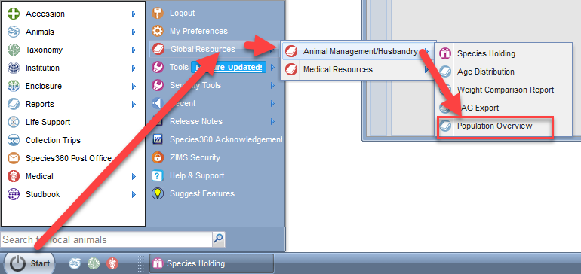
Navigation
Notes:
To run a Population Overview Report go to Start>Reports>Population Overview.

Slide 4
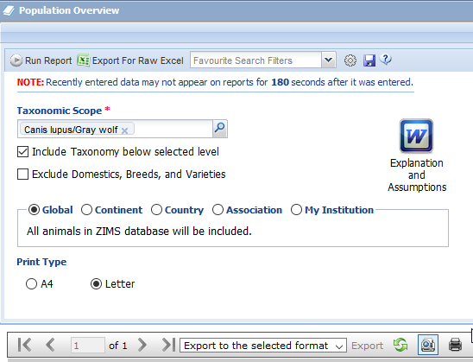
Report Filters
Notes:
You first need to select the taxonomic scope of the report. This can be at species or sub-species level. You cannot filter by anything above the species level. Species can be found by common or scientific name.
>There are two checkboxes for further filtering. If “Include Taxonomy below selected level” is checked then any sub-species of the species selected will be included in the report. If it is not checked they will not be included.
You also have the ability to exclude domestics, breeds and varieties. There are hundreds of entries for domestic breeds in the database. Many of these are rare and endangered farm species that institutions display in their farmyards as well as common domestics used for education. This means if you search for grey wolves (Canis lupus), if this is checked you will not also get the hundreds of various domestic dog breeds such as Chihuahuas (Canis lupus familiaris chihuahua).
>You can further filter the report by Global, Continent, Country or Association. If you select Association there are dozens of zoological associations to select from from AAZA (Arabian Zoo and Aquarium Association) to ZSOP (Zoological Society of Pakistan).
>You can select your page size. This can be set in Preferences if the default is not what you want. Additionally you can select your report output types from the drop down at the top of the output report.
>If you are not a population manager you will need to read the Explanation and Assumptions document to interpret the report. We will be going through this document during this PowerPoint.
>Select Run Report once you have selected all of your desired filters. Alternately, if you wish to work with ‘the raw data’ you can export your filtered selected to excel.

Slide 5
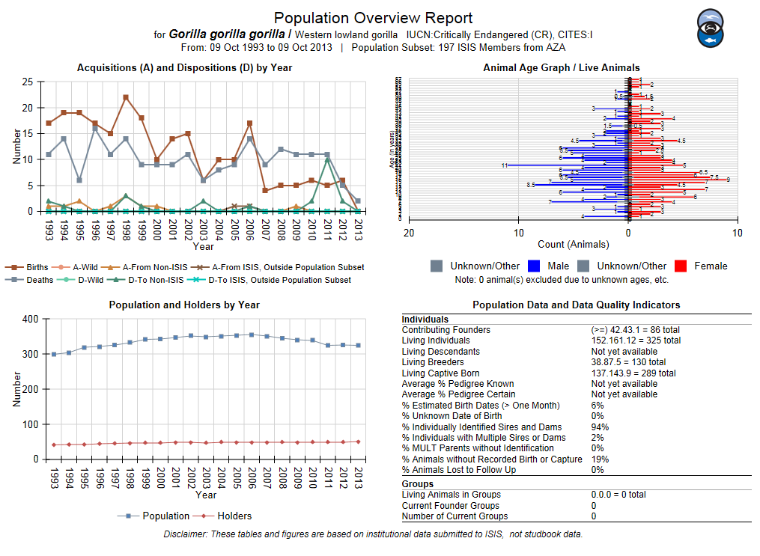
The Report
Notes:
The report is made up of a banner, four quadrants and a disclaimer. The upper left quadrant plots acquisitions and dispositions. The lower left plots numbers in the population and numbers of holders. The upper right graphs the age of living animals. The last quadrant displays some population metrics. We will look at each of these in detail.

Slide 6
The Banner
Notes:
The banner provides information on the species. This is a report for Western lowland gorillas. The IUCN and CITES statuses are noted. Lowland gorillas are Critically Endangered by IUCN and are a CITES I species. The date range of the report is shown. These reports run for the last 10 years. It also lets you know the population subset and here ZIMS looked at records in 197 Species360 members in AZA to complete the report.

Slide 7
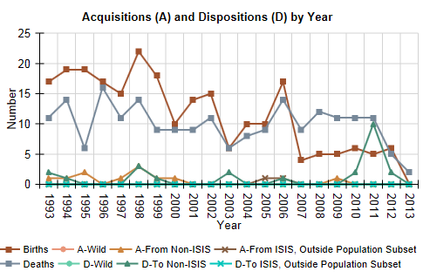
Acquisitions/Dispositions
Notes:
The upper left quadrant graph plots 6 – 8 “basic vital rates” of the species population. These include Births, Deaths, Acquisitions from non-Species360 member sources, Dispositions to non-Species360 member holders, acquisitions directly from the wild and releases directly from the wild. It also includes acquisitions and dispositions to other Species360 members that are outside the scope set for the report if it is set to smaller than global scope. Each point indicates a count of the events of that kind by year. This report covers the last 10 years. The net result of all of these basic rates should explain the population changes that are shown in the lower left quadrant that we will look at next. Actual acquisitions from the wild and releases to the wild may be undercounted as those transactions may have actually been recorded as to/from wildlife agencies, etc. rather than directly from the wild. Current Species360 membership is used for the entire time period. This means that if an institution dropped their Species360 membership in 2010, none of their data for previous years is included.

Slide 8
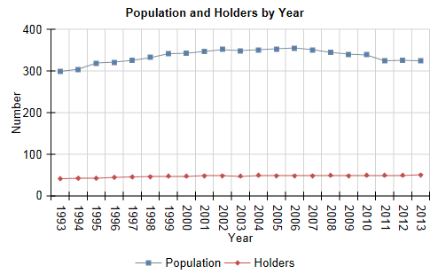
Population and Holders
Notes:
The lower left graph plots two variables. The top line is the living population size in Species360 by year. This number is the count as of the report date of each year. It also graphs the number of institutions physically holding the animals on those dates. Species360’ current membership is used for the entire time period to hold the institution scope constant on this graph also. This means that no data is shown from previous Species360 members who have dropped their membership. In addition, not all current members may have entered data for 20 years ago, so some positive census trends might be caused by recent years being more comprehensive in their record-keeping in recording all species and not just their mega-vertebrate crowd pleasers as was first often done when Species360 fee was based on the number of animal records you submitted.

Slide 9
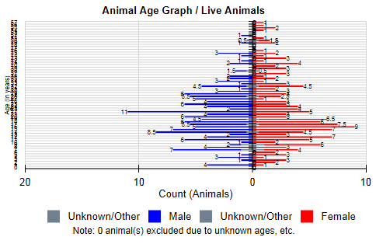
Live Age Graph
Notes:
The upper right graph is an Age Pyramid graph. Only living individual animals are displayed here. Occasionally, a data entry error generates an apparently very long-lived animal, stretching the vertical axis. These graphs are a convenient way for Species360 to identify these possible errors and notify the institution to correct unless it is true. In general, a healthy age pyramid is broad at the bottom, indicating lots of young animals, and small at the top, indicating fewer older animals. If it is upside down the species population may be in trouble.

Slide 10
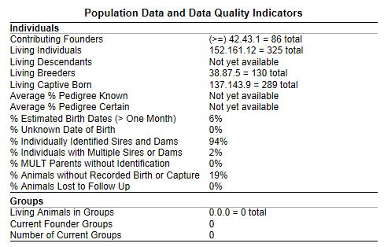
Metrics
Notes:
The lower right quadrant presents calculated metrics on the data available for the population. Some measures provide demographic information. Demographics are the quantifiable statistics of a population such as gender and age. It also displays some genetic, or hereditary, information. Some of the other metrics are indicators of the quality of the data in the Species360 database for the species. Due to potential missing institutional information such as institutions that are not Species360 members and historical data weaknesses, some of these calculated parameters may be lower numbers than are truly represented in the actual population.

Slide 11
Contributing Founders
A count of the number of unique (wild-caught) animals that can be traced in the pedigree to today’s living population.
Any non-reporting institutions or missing parental data breaks the link.
More Contributing Founders may be identified if more complete histories are filled in for today’s living population.
Notes:
The number of Contributing Founders is a count of the number of unique, often wild caught, animals that can be traced in Species360 data from the base of the population pedigree to today’s living population. Founder’s are related only to their siblings or offspring. To count this, Species360 traces each living animal back through each institution that held it, finds it parents, follows them back through all their institution moves as far as possible, hopefully to the original wild caught ancestors.
>Any non reporting institutions, or missing parental data along the way, means the path will break. This means that Species360 may under count the actual number of founder animals that contributed genes to today’s living population.
>More founders may be identified if more complete histories and pedigrees are filled in for today’s living animal population.

Slide 12
Living Individuals
The number of live individual animals as reported by current members
Pending/In transit animals are not counted
Groups are reported separately
Notes:
Living Individuals are the number of live individual animals currently on inventory as reported by current Species360 members.
>Animals pending or in transit are not counted because no institution reports having them at the moment. Pending are transactions that are waiting to be confirmed or denied by the institutions involved. They cannot be counted as the sender says they do not have the animal anymore, but the receiver has not yet said that they do.
>Animals held in Groups are reported separately
>The next metric, Living Descendents, is still under development and not yet available.

Slide 13
Living Breeders
The number of animals who have reproduced
Notes:
Living Breeders is the number of living animals who have produced offspring. The offspring may or may not still be alive.

Slide 14
Living Captive Born
Living animals that were born/hatched in captivity
Notes:
Living Captive Born is the number of animals alive that were born in captivity. This does not assume that conception was also in the wild as a pregnant or gravid animal could have been removed from the wild and given birth or laid eggs in captivity.
>The next two terms regarding percent of pedigree known and percent of pedigree certain are still under development and not yet available.

Slide 15
Percent Estimated Birth Dates
An indicator of demographic data quality
Total number of individuals = denominator
Number with significant Birth Date estimates = numerator
Only estimates of =/- one month or more are used
Notes:
Percent Estimated Birth Dates is an indicator of demographic data quality.
>To calculate the percent with estimated birth dates, the total number of individual animals, living or dead, is the denominator, or the number below the fraction line.
>The number of individuals that have significantly estimated birth dates is the numerator, the number above the fraction line.
>Only birth date estimates of plus or minus one month or more are considered in the calculations. Estimates to within a few days have little or no demographic impact.

Slide 16
Percent Unknown Birth Date
Percent of all individuals with Undetermined or Indeterminate Birth Dates
Undetermined = don’t know at this time
Indeterminate = impossible to be known
Notes:
The percent Unknown Birth Dates is all individual animals, living or dead, with a recorded birth date of undetermined or indeterminate. You want this percent to be low.
>Undetermined means you do not know the information at this time but you may in the future.
>Indeterminate means you do not know the information, you have done everything you can to find it, but it will never be known, hence impossible.

Slide 17
Percent Individually Identified Sires and Dams
Percent of the individuals who have a single Sire or Dam recorded
Twice the number of captive born individuals = denominator
Sum of Sire and Dam fields with an ID = numerator
Notes:
The percent individually identified sires and dams is the number of individuals who have a single Sire or Dam recorded for them. This is the best case scenario where a single animal is known for each parent. You want this percent to be high.
>To calculate this the denominator is twice the number of captive born individuals, living or dead. It is twice the number to represent both Sire and Dam.
>The numerator is the sum of the Sire and Dam fields that have a single animal ID in them.

Slide 18
Percent Individuals with Multiple Sires or Dams
Individuals with more than one Sire or Dam recorded
ZIMS allows recording percent probability
Twice the number of captive born individuals = denominator
Number of individuals with multiple entries for parents = numerator
Notes:
Some times you cannot limit a Sire or Dam to a single individual but there may be multiple possibilities. The percent individuals with multiple sires or dams indicates the number of individuals where these multiple possibilities are recorded.
>ZIMS also allows recording the percent probability that each animal recorded is the parent. An example is a gorilla group with a silverback male but a juvenile male offspring who is approaching sexual maturity. You can assume that the silverback is most likely the sire of an offspring, but there is also a small chance that the young upstart could be. You could record a 90% probably for the silverback and a 10% probability for the young male until you get DNA proof of parentage.
>As in the previous metric the denominator is twice the number of captive born individuals
>And the numerator is the number of individuals with multiple parents recorded

Slide 19
Percent Individuals with MULT Parents
Parents recorded simply as MULT
Data migrated from legacy ARKS System
MULT results in a break in the pedigree trace
Notes:
Percentage Individuals with MULT parents are those individuals with Sires and/or Dams recorded only as MULT with no individuals identified as candidates under the MULT label. You want this percent to be low.
>This is only for animals migrated from the ARKS legacy systems which did not require identification of parents.
>Individuals with MULT parents will cause a break in the pedigree trace back to founders.

Slide 20
Percent Animals without Recorded Birth or Capture
Best case scenario for start of an animal record is a Birth or Capture from Wild.
Acquisition from a non-Species360 member
Number of animals in the dataset = denominator
Number of animals which cannot be traced back = numerator
Notes:
Starting an animal record with a Birth or a Capture is the best case scenario.
>However this is not the case when an animal is acquired from a non-Species360 member as the record will actually start with that acquisition in such a scenario.
>To calculate the percent the denominator is the total number of animals, living or dead, in the dataset.
>The numerator is the count of the number of animals which cannot be traced back to birth or wild capture. You want this percent to be low.

Slide 21
Percent Animals Lost to Follow Up
Animals Transferred to a location for which there is no further information
Institution was never an Species360 member
Institution was a previous member who dropped their membership
Loans Out to non-Species360 members are not Lost to Follow Up
Notes:
The percent of animals Lost to Follow Up refers to those animals that are transferred to a location from which there is no further information contributed to Species360.
>This can be an institution who was never a member of Species360
>Or it can be an institution who has dropped their Species360 membership.
>If an animal is transferred to one of these facilities in a Loan Out situation then it is not a Lost to Follow Up situation. This is because the Species360 member retains legal ownership of the animal, even though it is held physically elsewhere, as the Species360 Owner can still record information on behalf of the non-member as what we call an “audit” institution.

Slide 22
Group Information
Living Animals in Groups
Number of living animals held in groups
Current Founder Groups
Number of current founder groups
Number of Current Groups
Number of non-zero groups currently held
Notes:
Groups are a number of the same species that are maintained in a single record. Usually the members of a group are not individually identifiable. There are three metrics collected for groups. The number of living animals in groups is usually a subset of the total number of living animals because even for species normally held in groups, there are often some maintained as individuals.
>The Current Founder Groups are the number of wild-caught origin groups that are still in existence.
>The number of current groups is the number of non-zero count groups currently recorded. ZIMS allow you to take a group count down to zero but keep the record as Open in case you want to add more members to the same record. An example might be a goldfish pond you restock every summer and wish to keep all on one record even though the actual count gets down to zero in the winter. These zero count groups are not included here.

Slide 23
Disclaimer
These tables and figures are based on institutional data submitted to Species360, not studbook data
Notes:
It is very important to note that this report is not a studbook report. Studbook contain data from institutions who are not members of Species360. These tables and figures are based only on institutional data that has been submitted to Species360. If an institution dropped Species360 at some point during the date range, none of their information is included in these reports. Only information from current Species360 members is considered.

Slide 24
Any Questions?
On the Population Overview Report

