Slide 1
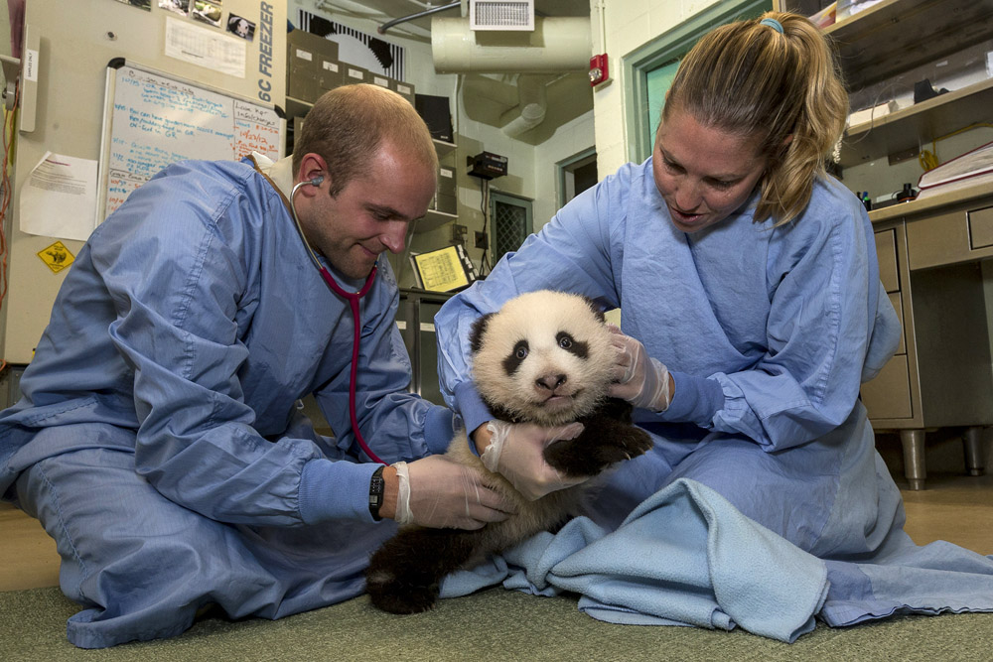
Medical Reports in ZIMS
How to get all of that data you entered back out again

Slide 2
ZIMS Updates!
This PowerPoint is up-to-date as of: August 20 2019
ZIMS is developed in an “agile” method
This means that it is updated every two weeks, sometimes with additional releases in between!
Use the link below to see if there have been any updates to this topic since the date above:
http://training.species360.org/updates/

Slide 3
It’s About the Output
Getting a lot of data entered regarding your animals is not the goal – but getting it back out again in a useable format to help you manage your animal collection is the goal
Under Medical Reports there are 17 Reports available help you to get this data back out to answer questions and help you with better medical care for your animals
Medical Reports are available at the Local level only. Other institutions cannot run these reports on your collection
In addition, in ZIMS you are able to display and sort data inside the application (and often export to print) and this functionality allows you to create almost limitless “report” type documents
Exporting the results of your endless search option can also be considered as filtered reports

Slide 4
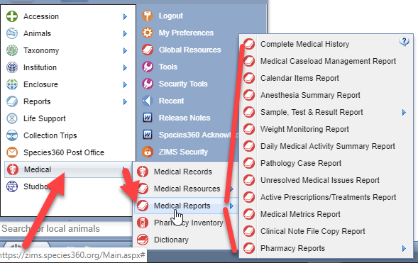
Finding the Medical Reports
There are three ways to
find the Medical reports.
The first is Start > Medical >
Medical Reports.

Slide 5
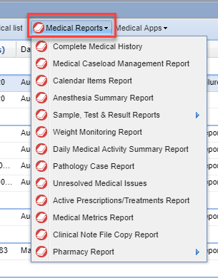
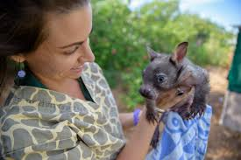
Finding the Medical Reports
You can also find the Medical
Reports when you are in the
Medical module at the top of
the Medical Dashboard.

Slide 6
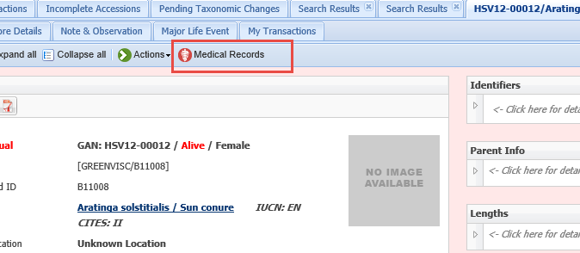
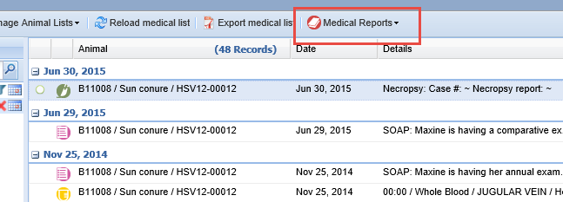
Finding the Medical Reports
If you are in the Husbandry Record for an animal you can also select Medical
Records from the Details tab. This will open any Medical records for that animal
and Medical Reports is available at the top of the Dashboard. You will still need
to select an animal for the Report even though you have an animal in focus.

Slide 7
Recent Data
When running your Reports it is important to take into consideration
that recently entered data may not appear on reports for 3 minutes
after it was entered. This is because most reports are on different servers
than the ZIMS data entry server. Different servers are used so when reports
are run they do not affect the speed of ZIMS and it may take this time for
the request to be uploaded to the report server. Your report results may
not be accurate if you do not allow that time for processing.

Slide 8
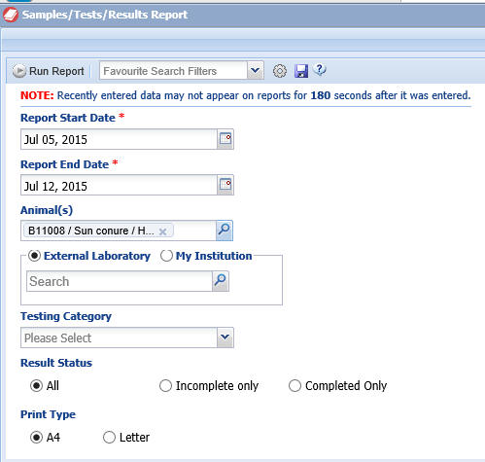
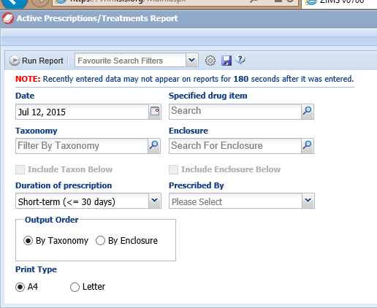
Look at the Report Filters!
It is very important to look at all the filters available for your Reports. Common filters are dates and taxonomy, but many reports have multiple fields to help you filter the report to obtain the desired information without a lot of information that you do not need. You can see above that the filters for the Samples/Tests/Results Report on the left has different filters than the Active Prescription/Treatments Report on the right. If you do not correctly filter your reports the results may be misleading and incorrect.

Slide 9
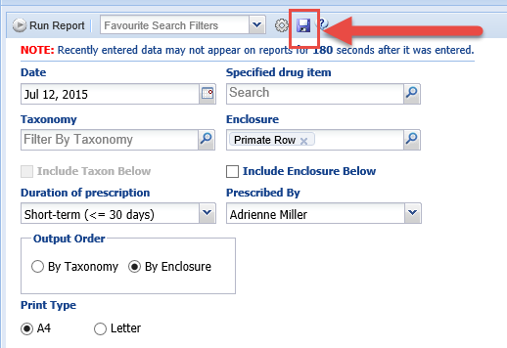
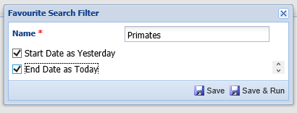
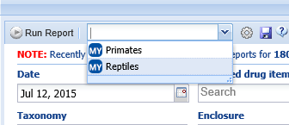
Favourite Search Filters
A great time saver is to create Favourite Search Filters for commonly selected
filters for your Reports. Complete the filters as desired and select the Save icon.
Name the filter as you wish. It can then be selected from the dropdown list and
your desired filters will prefill but can be edited.

Slide 10
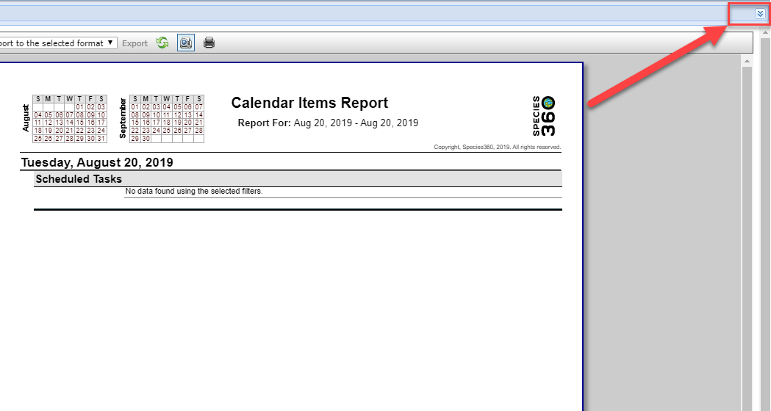
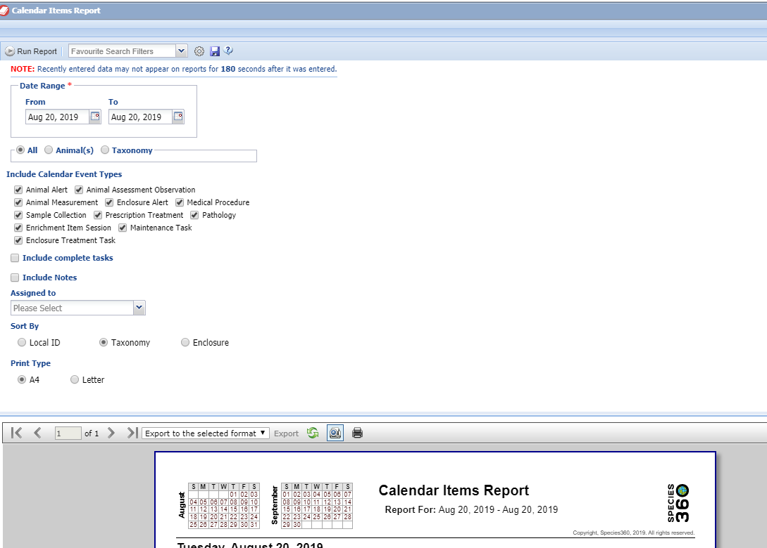
Re-running a Report
After running a Report you can easily select to re-run it with
different filters by expanding the report filter screen by using
the double arrows to the right. The Report screen will expand
and you can change filters and re-run as desired.

Slide 11
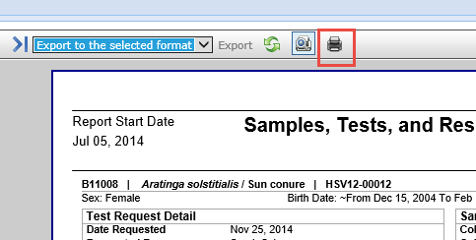
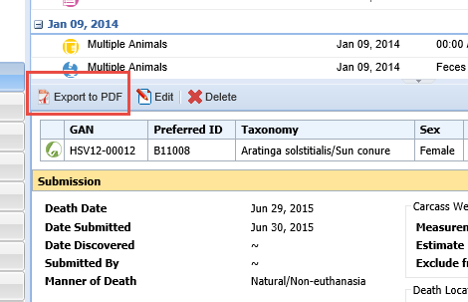
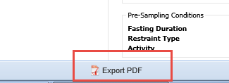
Printing and Exporting Reports
Once the Report has been
run, most can be printed
directly from the screen by
selecting the Print icon.
Or, you can select to export
to various formats to save
and email or print later.
Many Reports have the
option to Export to PDF at
the bottom of the report.
Many of the grids within the
modules also have the
ability to Export to PDF,
thus creating “Reports”
from within the record.

Slide 12
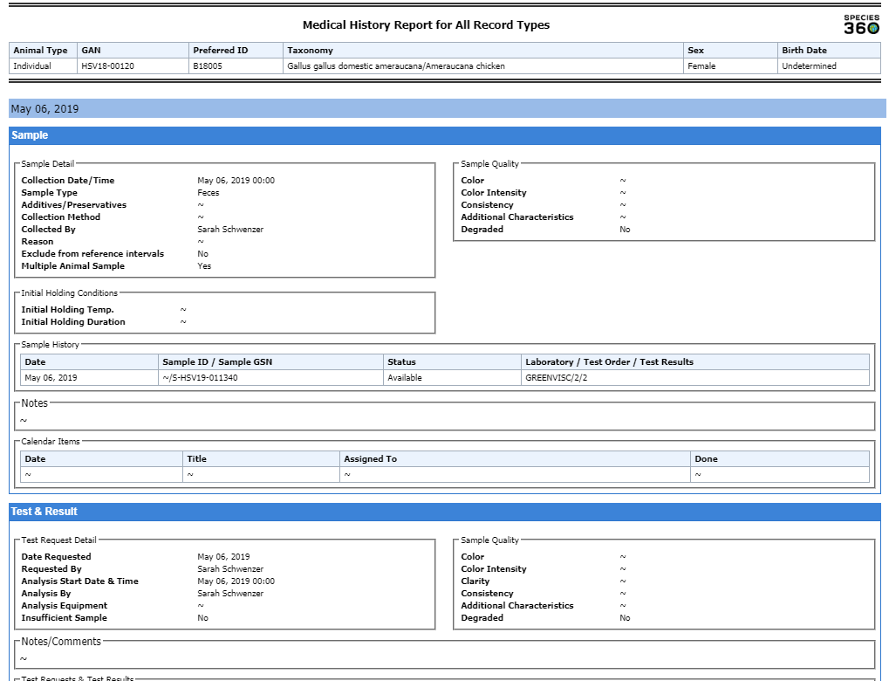
Complete Medical History Report
This Report is the comprehensive history of the
complete medical record of an animal or group.
If you have opted not to actually share the medical
record with another institution, this Report would
be what you would provide at the time of transfer.
By default all Record Types are checked but you can
limit this Report to specific topics by unchecking
them. The Report is organized chronologically with
the most recent entries displaying first. NOTE: this
can be a very large report!

Slide 13
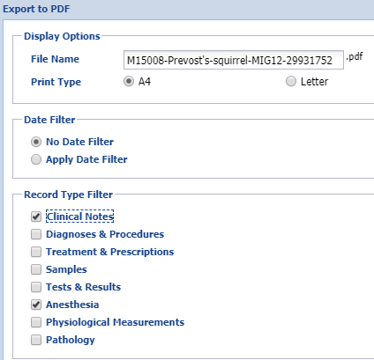
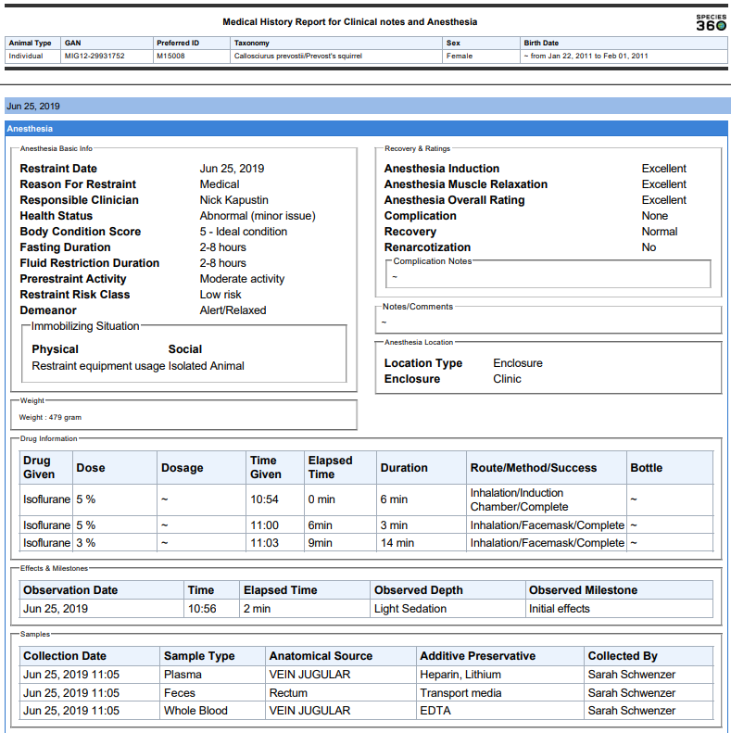
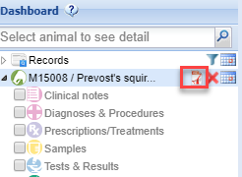
From Dashboard
You can also create the Report by
selecting the “pdf” icon from the left
hand dashboard. Records that are
displayed in the main dashboard for
the animal will be checked by default
but you can add other record types.

Slide 14
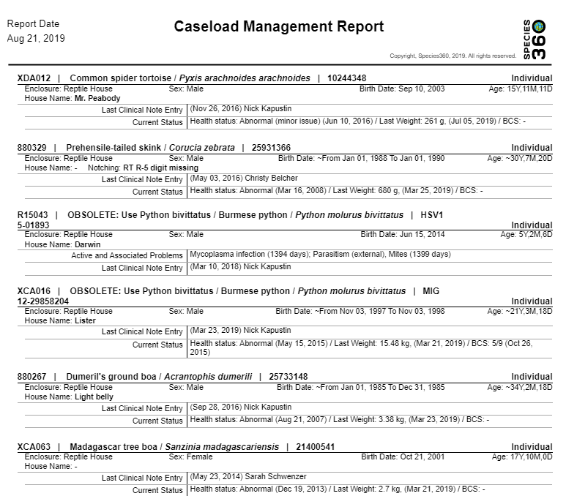
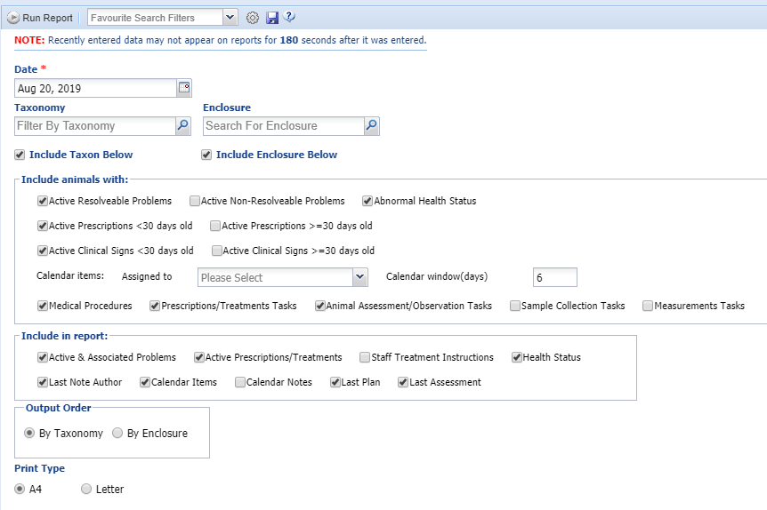
Medical Caseload Management Report
This Report allows you to pull up all
Active medical issues for a single day.
The many options in this Report
allow you to filter to specific types of
issues so it is important that you look
at all the filters available.

Slide 15
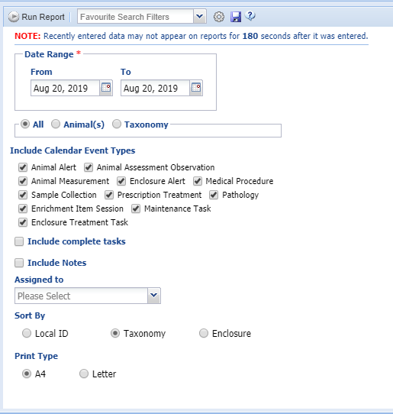
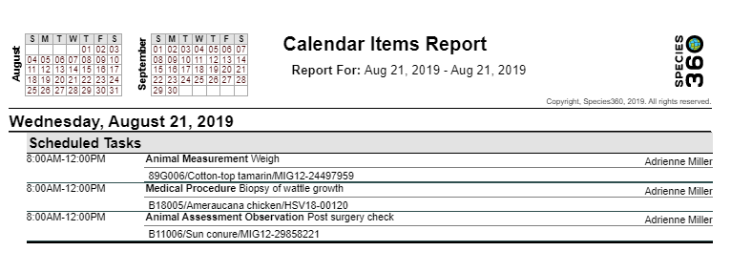
Calendar Items Report
The Calendar Items Report allows you to see
any upcoming scheduled tasks. By default all
Event Types are checked but you can limit the Report
to specific topics or who the task is assigned to.
You also have three sort options depending on the
order that you want to see the report organized.

Slide 16
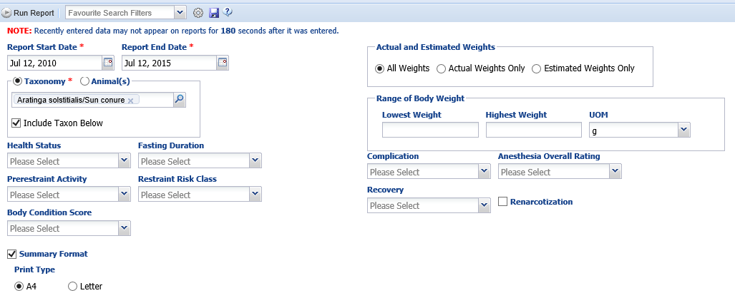
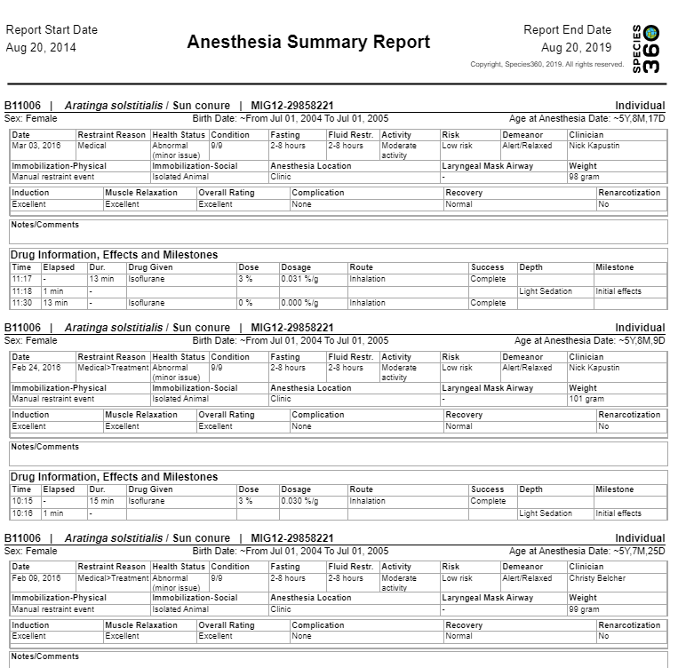
Anesthesia Summary Report
The Anesthesia Summary Report allows
you to see the effectiveness of an anesthetic
event for a particular animal or for an entire
taxonomy. The filters allow you to fine tune
the report. For example, you could run the
report only for animals with Health Status =
Abnormal and Body Condition Score =
Emaciated.

Slide 17
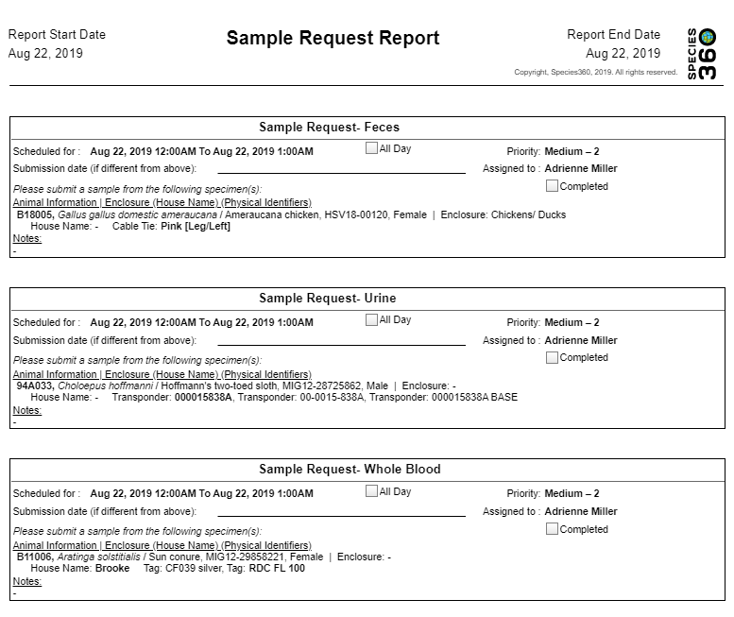
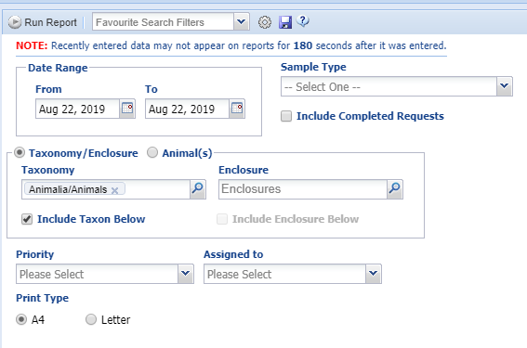
Sample Request Report
Sample Requests can be generated from
My Calendar or from within the Sample
record itself. The Sample Request Report
allows you to find these requests. You
can limit to specific Sample Type as well
as by Taxonomy or Enclosures.

Slide 18
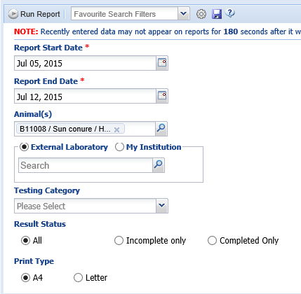
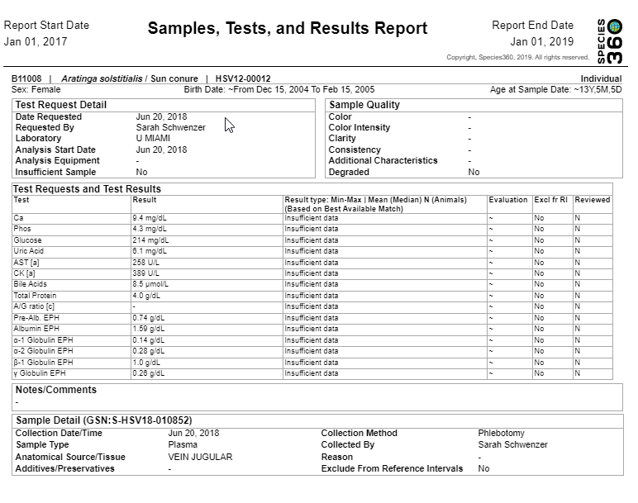
Samples/Tests/Results Report
The Samples/Tests/Results Report will list
Samples and Test Results from specific
patients. You can select specific labs the
samples were sent to, find samples of
specific testing categories, or search for
Incomplete or Completed tests.

Slide 19
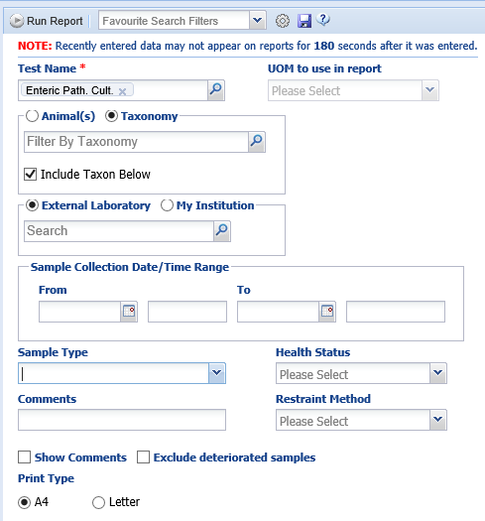
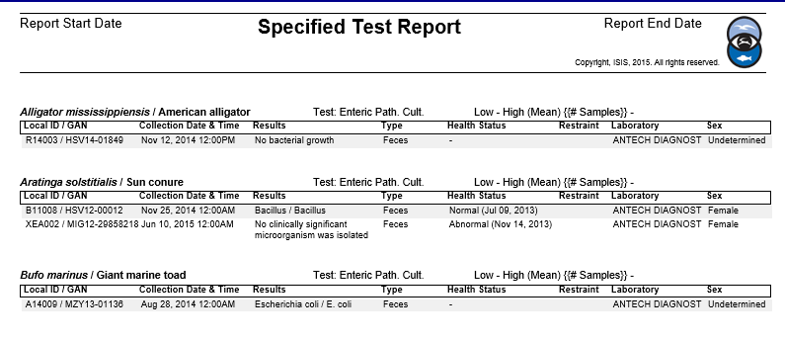
Specified Test Report
The Specified Test Report allows you to search
by a specific test and not just a Test Category.
The filters allow you to be very specific and
restrict the specified test to certain Sample Types
or Date Ranges and you can Exclude Deteriorated
Samples to point out a few of the filters.

Slide 20
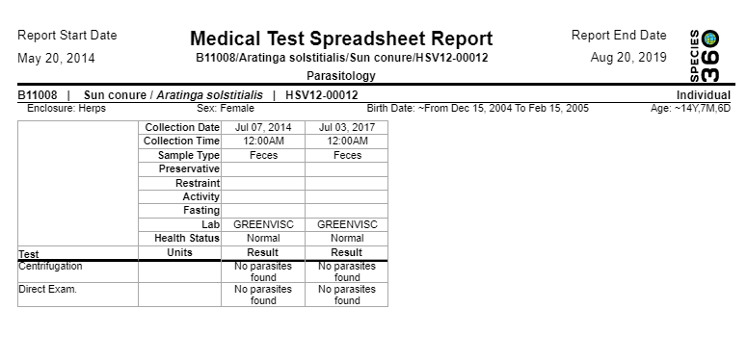
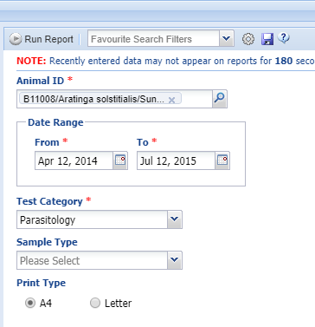
Medical Test Spreadsheet Report
This Report allows you to look for specific
Test Categories and Sample Type for a single
animal or group record.

Slide 21
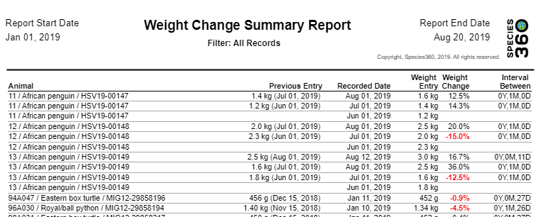
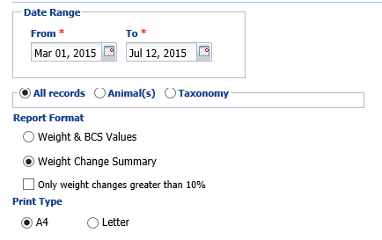
Weight Monitoring Report
The Weight Monitoring Report allows you to monitor weight and Body Condition
Score values by All records, specific Animals or by Taxonomy. You can select to show
only those records with weight changes greater than 10%. Weight changes are displayed
in red for easy referencing.

Slide 22
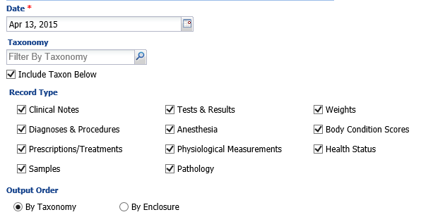
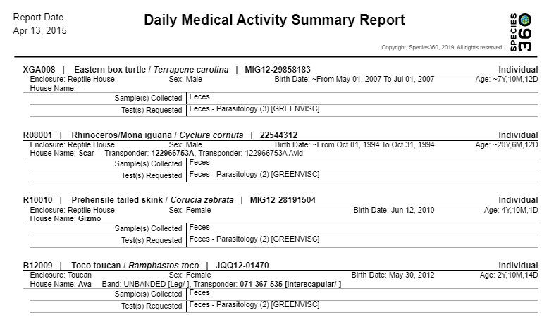
Daily Medical Activity Summary Report
The Daily Medical Activity Summary
Report shows you selected record
types for a specific date. You can sort by Taxonomy or Enclosure. All
Record Types are checked by default.

Slide 23
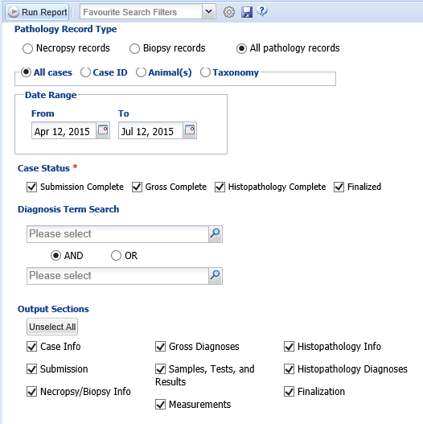
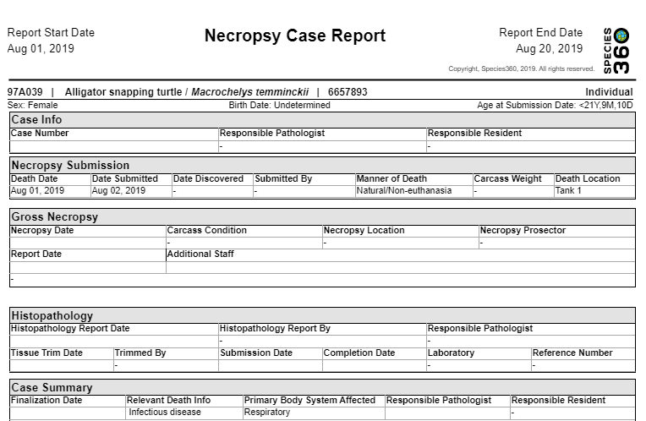
Pathology Case Report
The Pathology Case Report will provide all of the
details recorded for a Necropsy or Biopsy, depending
on what is selected. You can filter by All Cases, Case
ID, single Animal Record or Taxonomy. By default all
Case Statuses are checked but you can choose to
select only specific ones. This is also true for Output
Sections.

Slide 24
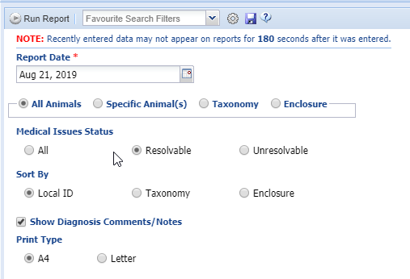
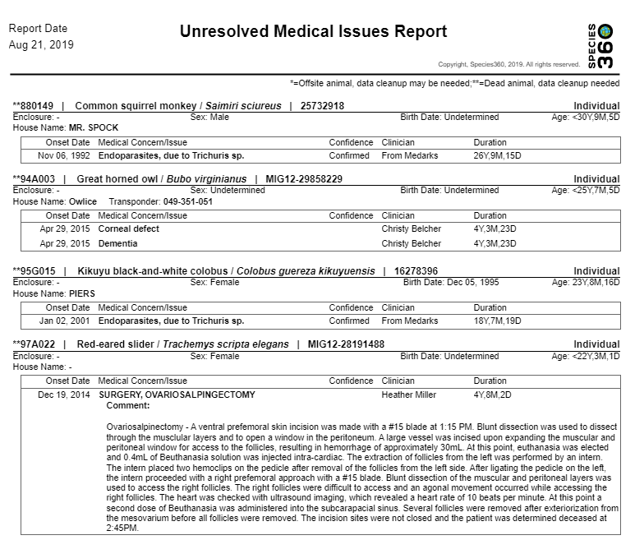
Unresolved Medical Issues Report
The Unresolved Medical Issues report shows you all the currently unresolved
issues with powerful sorting options. By selecting only “Resolvable”
and top level enclosure (remember to keep Include Enclosures Below
checked) you can produce a “rounds report” that gives you a clear
picture of the issues that you can attend to while walking the grounds.

Slide 25
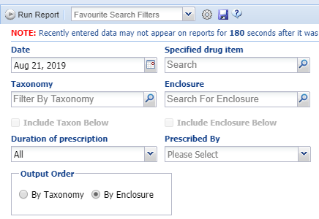
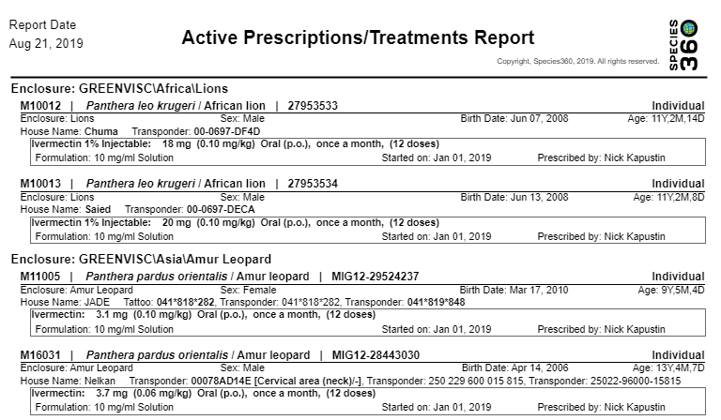
Active Prescriptions/ Treatments Report
The Active Prescription/Treatments Reports
lets you find what animals are actively under
treatment. If you sort By Enclosure you can
quickly see what ongoing treatments are
enclosure by enclosure. Other useful filters
are Duration (<=30 days or > 30 days) and
Prescribed By.

Slide 26
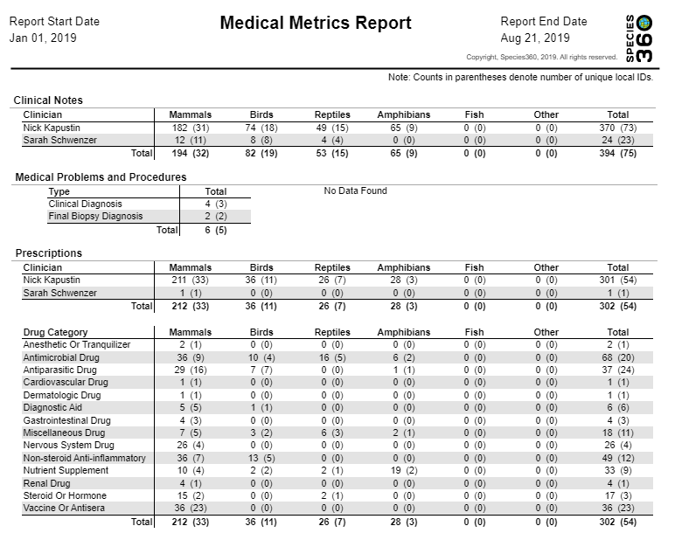
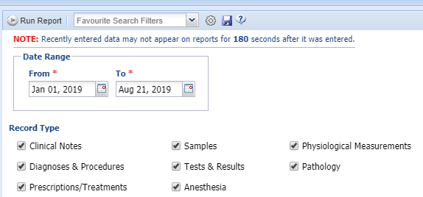
Medical Metrics Report
The Medical Metric Report
captures the medical
activity at your institution.
By default all Record Types
are checked but these can
be filtered to specific types
if desired. This report can
be very helpful to assist in
preparing year end reporting
of medical metrics.

Slide 27
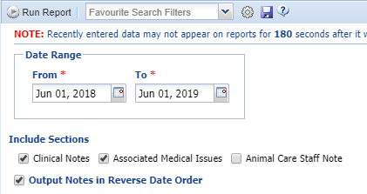
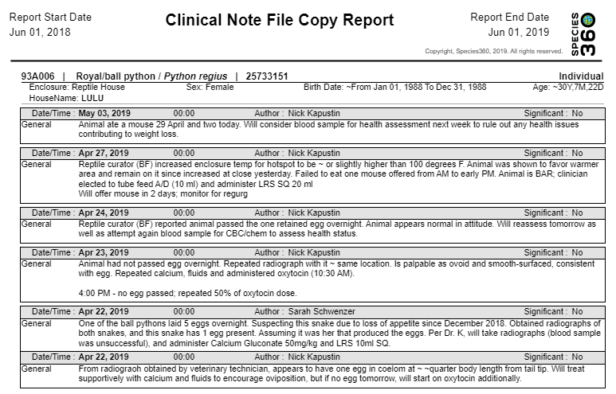
Clinical Note File Copy
The Clinical Note File Copy Report will
display all Clinical Notes (and Associated
Medical Issues if selected) that were
recorded during the specified Date Range.
The default is to display the notes with the
oldest note first but you have the option to
display the most recent notes first by
selecting Output Notes in Reverse Date
Order. The Report displays each animal on
its own page.

Slide 28
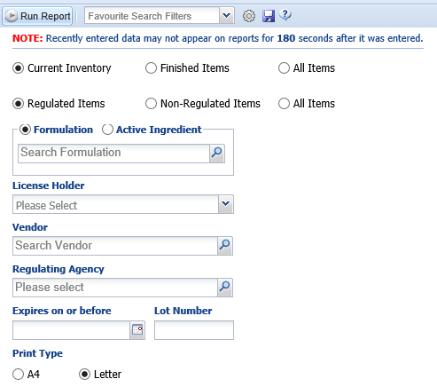
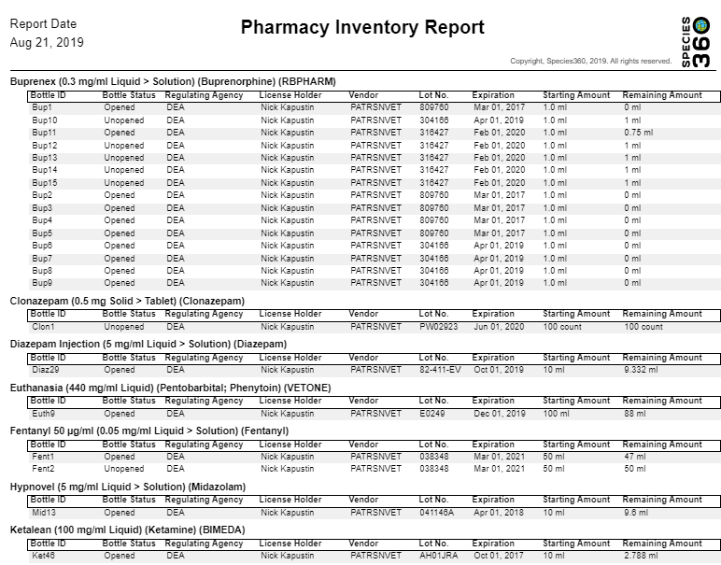
Pharmacy Inventory Report
The Pharmacy Inventory Report can be especially
helpful for monitoring your Regulated Drugs. It
can also help you identify what drugs are due to
expire soon. You can also filter by specific
Formulations or Active Ingredients.

Slide 29
Drug Usage by Bottle ID Report
The Drug Usage by Bottle ID Report allows
you to track usage of a specific Bottle ID, by
Status (Opened or Finished) and Formulation
or Active Ingredient. Each bottle has its own
page in the Report.

Slide 30
ZIMS Medical Reports

