Slide 1
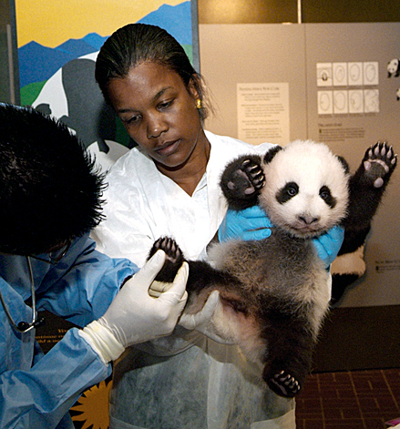
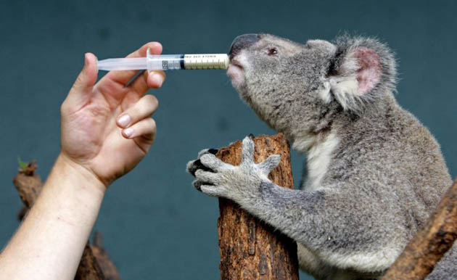
2000 Medical and Animal Husbandry Interface

Slide 2
Working Together
Although they are managed as separate modules in ZIMS, some information recorded in the Husbandry module is displayed in the Medical module and some information recorded in the Medical module is displayed in the Husbandry module.
In most instances the data can only be edited or deleted from the module in which it was entered, but not always.

Slide 3
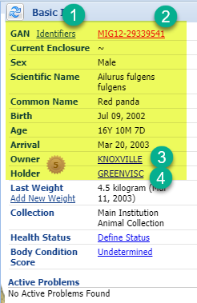
Medical View of Husbandry Data – Basic Info
On the right side of the Medical
dashboard is the Basic Info
regarding the animal that is
sourced from the Husbandry
Module. From here there are
links to:
Active Identifiers
Husbandry record
Owner institution
Holder institution
This information is only editable
in the Husbandry module.

Slide 4
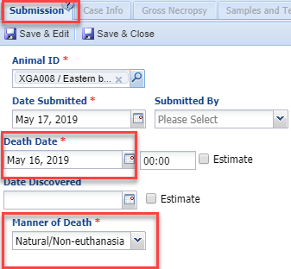
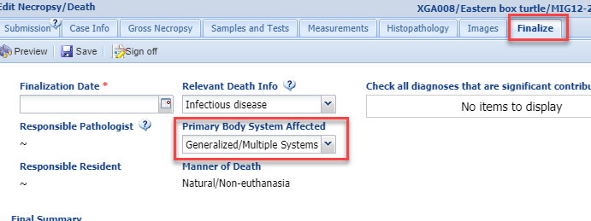
Medical View of Husbandry Data – Necropsy
When a death is recorded in Husbandry
before a Necropsy is submitted in Medical,
the Death Date and Manner of Death will
copy over into that field in the Submission
tab (right). The Primary Body System Affected
will copy over into that field in the Finalize tab
(below). All of this information is editable in
both the Medical and Husbandry modules.

Slide 5
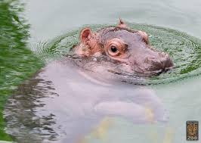
Husbandry View of Medical Data
When some information entered in the Medical module is displayed in the Husbandry module, you will be given an indication that the data was sourced from the Medical module
You will not be able to edit this information from the Husbandry module

Slide 6
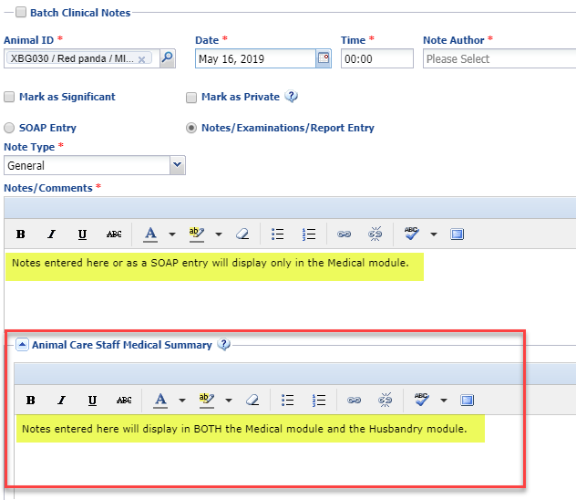
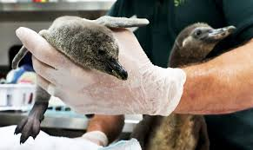
Animal Care Staff Medical Summary
Any information recorded in the Animal
Care Staff Medical Summary will display
in the Husbandry module Notes/Observation grid, as well as within the Medical module. This is the display in
the Medical module.

Slide 7
Husbandry View of Medical Summary
Below is the Husbandry view of the Animal Care Staff Medical Summary information
from the previous slide. You can tell this note was entered on the Medical module
as the title is Clinical Medical Summary Note. You cannot edit or delete this note.
Those actions can only be done from the Medical module because it was entered there.

Slide 8
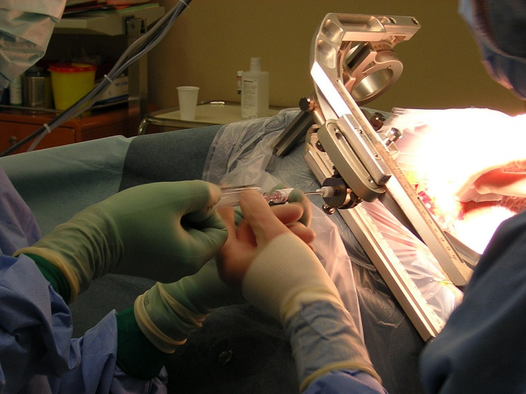
Notes from other Modules
The Notes recorded in the following Medical modules will also display in the Husbandry Notes section:
Biopsy – Case Info and the Finalize tab
Biopsy Case Info for Husbandry Staff
Necropsy – Case Info and the Finalize tab
Necropsy Case Info for Husbandry Staff

Slide 9
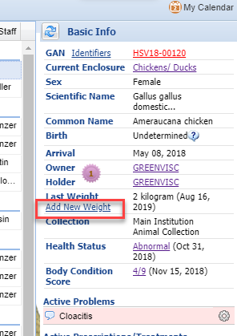
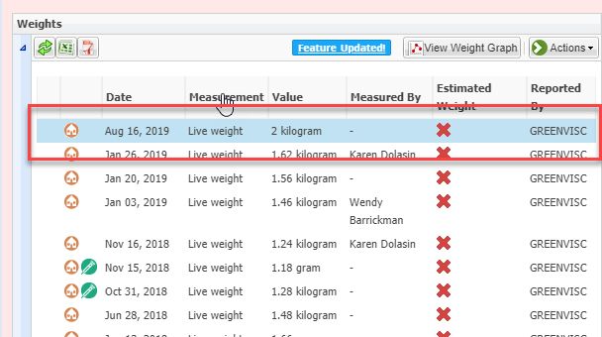
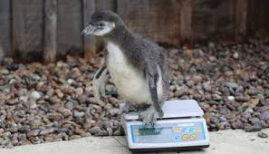
Animal Weights
From the Basic Info in the Medical
record you can add a new weight
(top). This hyperlink will open the
Husbandry module’s Add New Weight
screen. This weight will display in the
Husbandry module and it can be
edited from there (bottom). There is no
indication that the weight was entered
via the Medical module.

Slide 10
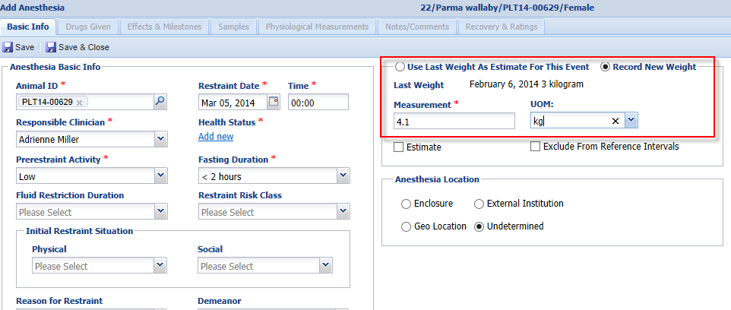
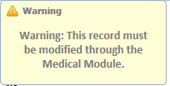
Animal Weights
When recording an anesthesia or treatment event, the Veterinarian has the option to use the last weight recorded which is usually sourced from the Husbandry module weight grid. They also have the option to record a new weight for the animal. If a new weight is recorded, this information is copied into the weight grid in the Husbandry animal record. If this is an estimated weight recorded during a Prescription it is NOT copied into the Husbandry module. This weight cannot be edited from the Husbandry module and can only be edited from within the Medical record. You can see the weight recorded on 14 August was sourced from a treatment record. If you do NOT want weights
recorded in the Medical module you can do so under
Institution Preferences > ZIMS Accessibility.

Slide 11
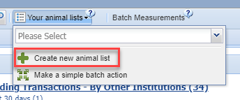
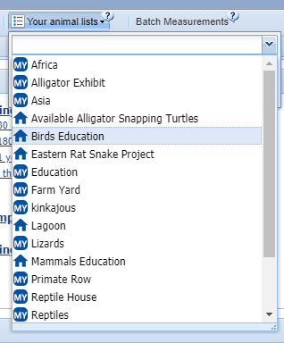
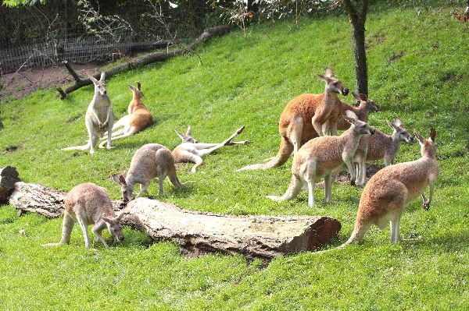
Animal Lists
Animal Lists can be created in both
the Husbandry and the Medical
modules and are available for use
in each module (if marked as Shared),
regardless of which one they were
created in.

Slide 12
Health Status and BCS
Health Status and Body Condition Scores display in, and can be updated in, both the Husbandry and the Medical modules.
In Husbandry find them in the Basic Info grid in the Details tab of the animal record.
In Medical, find them in the right hand Basic Info area.
In addition, Health Status can be updated in both the Anesthesia and the Diagnosis & Prescriptions modules.

Slide 13
Medical Data in Data Entry Monitoring and Activity Report
Data Entry Monitoring
All medical entries can be viewed and rolled back by Local Admin
Weights that are recorded during Anesthesia or Treatment do not display as separate entries so they cannot be rolled back
Weights recorded from Basic Info can be rolled back
Activity Report
Weights recorded (including estimated weights)
Animal Care Staff Medical Summary note
Other medical entries are not displayed

Slide 14
Incomplete Accession
Allows Veterinary Staff to record medical data before the animal is fully accessioned
When the Registrar creates a full accession they will link that record to the Incomplete Accession record
All medical data recorded will be copied into the full accession record
The Incomplete Accession will go away and the GAN assigned to it will become an “Old Accession Number” identifier

Slide 15
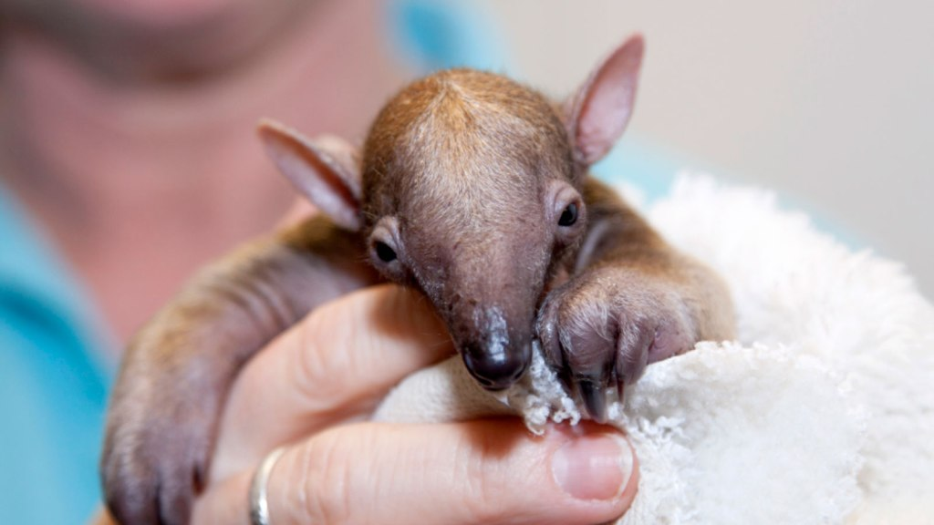
Incomplete Accession Display
Incomplete Accessions allow for data
entry into a record before a Full
Accession is recorded. An Incomplete
Accession created by Veterinary Staff
will display in the Animal Statistics tab
in the Husbandry module under
Incomplete Accessions.

Slide 16
Incomplete Disposition
Allows the ‘death record’ to be started from a Necropsy submission
Guarantees that Husbandry staff will have the ability to confirm death information linked to formal medical necropsy record
If details are not in agreement between the Husbandry and Medical staff these changes can be noted and corrected

Slide 17
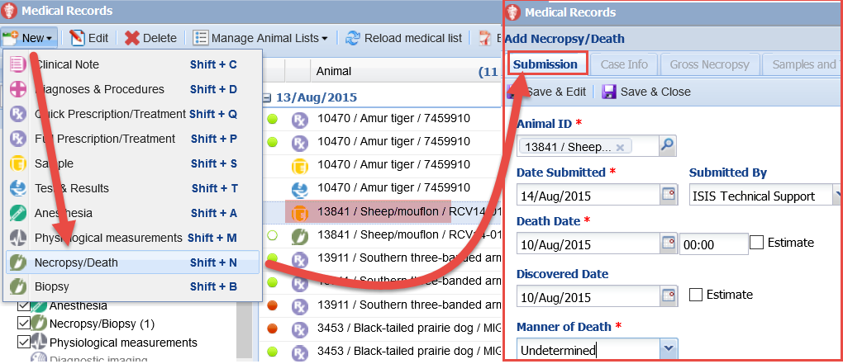
Starting an Incomplete Disposition
Creating a submission under a Necropsy record in ZIMS Medical will trigger the creation of an ‘Incomplete Disposition’ in the Husbandry side workflow. This submission will also create a calendar note to the responsible pathologist defined in your institutional preferences that a full necropsy is waiting to be
performed.

Slide 18
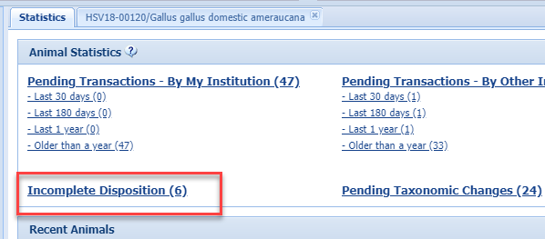
Managing Incomplete Dispositions
Incomplete Dispositions display under the
Statistics tab in the Animals module. Clicking on the GAN hyperlink GAN will take you to the My Transactions tab of the animal’s record where you will see a Death transaction pending.
You are allowed to Confirm/Edit the death record, Deny or Delete it or state that No Info is Available or that the record will Not be Recorded in ZIMS.

Slide 19
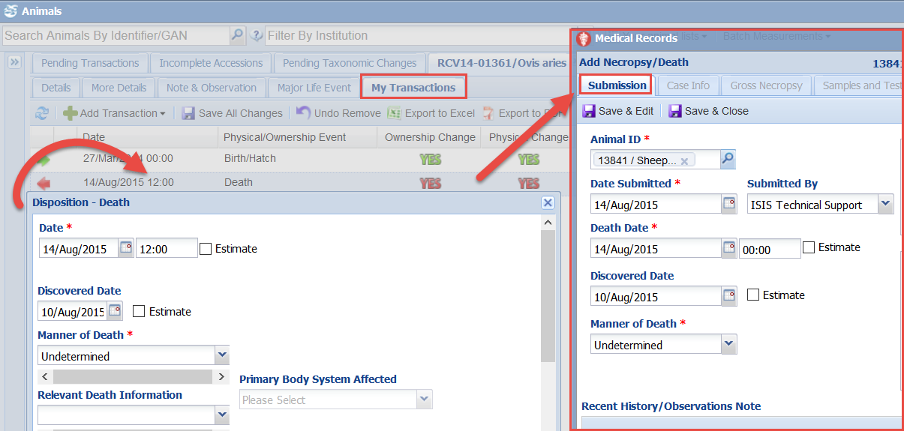
Managing Incomplete Dispositions
If the death transaction is first added in the Husbandry My Transactions tab of the animal’s Husbandry record, no Incomplete Disposition is created. As noted previously, some of the information entered in the Husbandry death record will prefill into the Necropsy record.

Slide 20
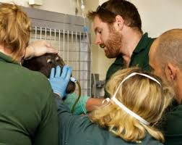
Husbandry and Medical
Working Together

