Slide 1
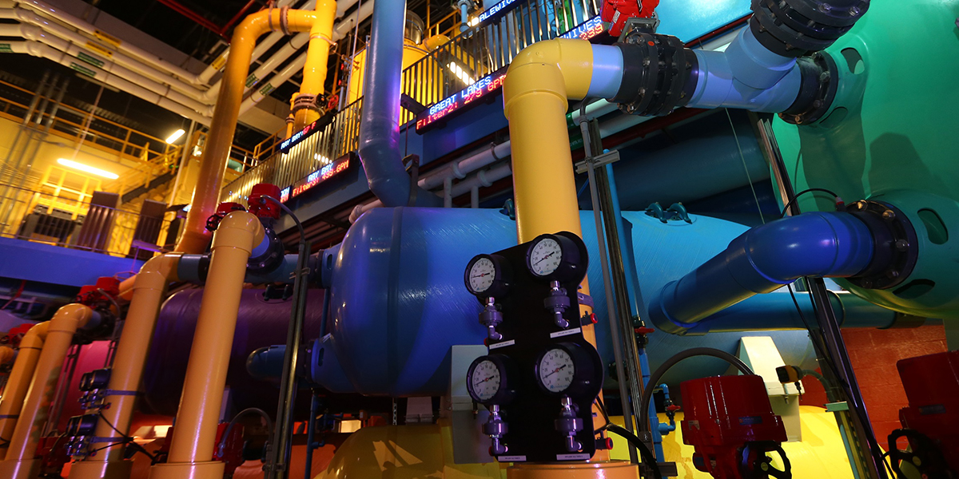
1004 Enclosure and Life Support Management
Adding Enclosures, Managing Trees, Creating Life Supports

Slide 2
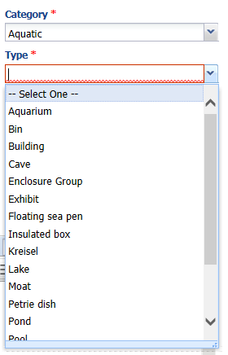
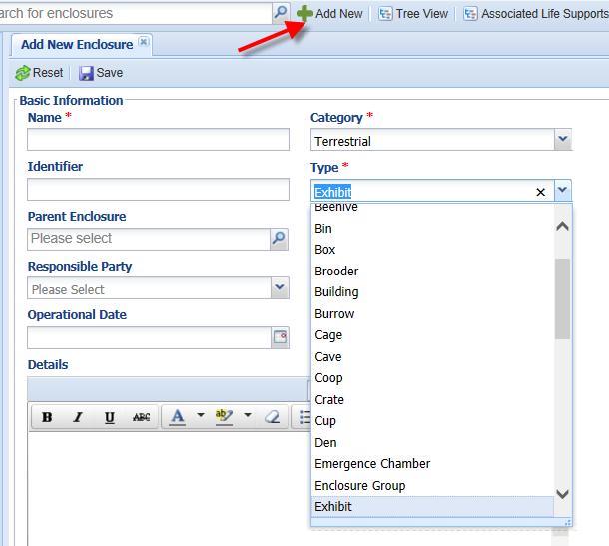
Enclosure Add New
To add a new enclosure select the Add New button. The Name
must be unique and it is recommended not to use species names
as occupants often change. The Category will drive the selections
available under the Type. You can set your preferred default
Category and Type using My Preferences. Details can be used to
further identify the enclosure and can help others later.

Slide 3
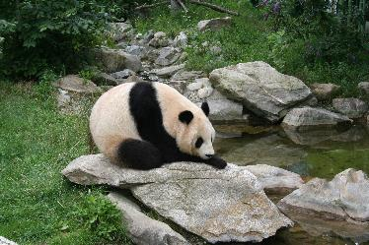
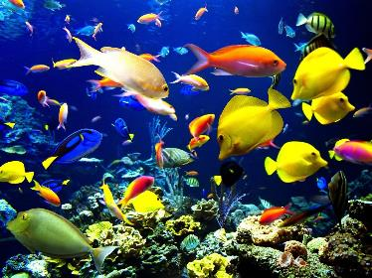
Enclosure Category
A Terrestrial Enclosure is mainly land. You can take Environmental
Measurements such as air temperature and humidity. You can record Water Bodies such as the pond in this panda exhibit but you cannot take Water Quality measurements on these water
bodies.
An Aquatic Enclosure is all water. If
an Aquatic category is selected an additional field is available to record the Water Type. You can take Water Quality measurements on Aquatic Enclosures.

Slide 4
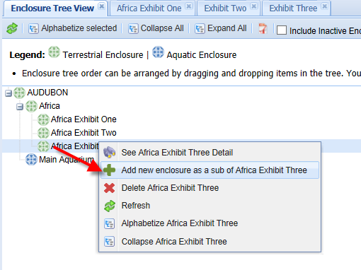
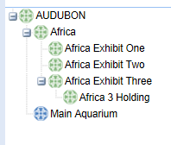
Add New from Tree
You can also add a new
enclosure directly from the
Enclosure Tree. Right click on
the enclosure that you want to
add the new enclosure under
and select Add New as a Sub.
The Parent Enclosure will
prefill when adding a new
enclosure this way.
Here we have added a
holding enclosure for Africa
Exhibit Three.

Slide 5
The Icons
The enclosure Category is displayed in the
Enclosure Tree by an icon, allowing you to easily
identify the Category. The top icon is a Generic
Enclosure and is what is displayed on the desktop.
The blue icon indicates an Aquatic Enclosure.
The green icon indicates a Terrestrial Enclosure.

Slide 6
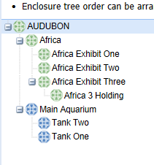
Enclosure Tree – the Parent and Child Relationship
The Enclosure Tree displays the Parent
and Child (sub) enclosure relationship.
The top level enclosure is your institution
and it is a Parent to all other enclosures.
Africa is a Child to AUDUBON but is a
Parent to the three Africa Exhibits. This
relationship is very important as it impacts
how information can be retrieved in reports.
When setting up your Tree think about how
you want to get that information out. In this
Tree if I run a report for Africa and select to
“Include sub-enclosures” I will get a report
with all of the animals in any of the Africa
related enclosures. If I select Africa Exhibit
Three and do not select to include sub-
enclosures I will get only those animals
occupying Africa Exhibit Three and not those
in Africa 3 Holding.

Slide 7
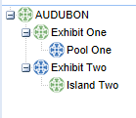
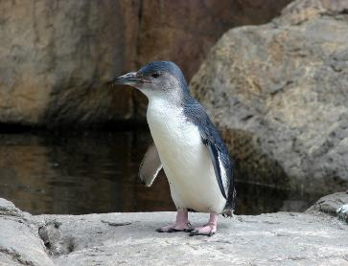
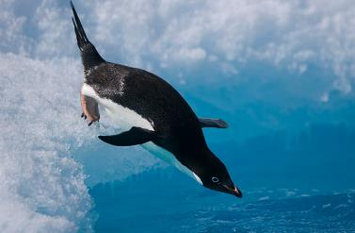
Combination Enclosures - Multi Use
Sometimes there are enclosures that contain both Terrestrial
and Aquatic features and the animals can go back and forth
between them. Exhibit One is mainly land so that has been
created as the Parent enclosure. A child Aquatic enclosure, Pool One, has been created so that Water Quality Measurements can be taken. Exhibit Two is mainly water with a small island so the Parent enclosure is Aquatic. The island is a child enclosure and Environmental Measurements can be taken on it. In both examples the animals would be recorded as occupying the Parent enclosure.

Slide 8
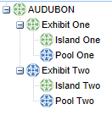
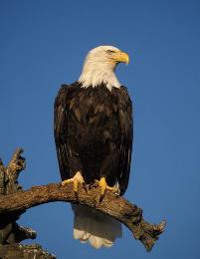
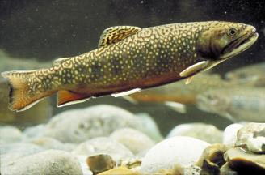
Combination Enclosures - Separate Use
For exhibits that have both land and water but the
occupants do not go back and forth, such as this
eagle exhibit that has a native fish pool as a front
barrier, you have another option for your tree. You
can create a Parent exhibit that you don’t actually
put animals into. Then create the Child exhibits, one
for the land and the other for the water. If you run a
report for the Parent enclosure you will be able to
include all animals recorded into both Child enclosures.
The important thing is that you set up your tree in a way
that you can get the occupant information back out
in the way that you want to.

Slide 9
Changing Enclosure Category
You can change the Category of an Enclosure by editing the Details
The Measurement grid will change
Environmental Measures to Water Quality Measures and vice versa
Any measurements recorded for the old Category will be retained
However, this is not recommended as a Best Practice!

Slide 10
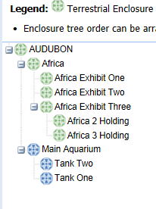
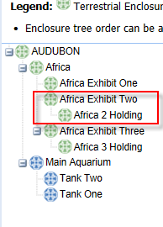
Drag and Drop
If the Parent and Child relationship is not correct
you can clean up your Enclosure Tree by
dragging and dropping enclosures into their proper
location. In this example Africa 2 Holding has
been incorrectly recorded as a Child of Africa
Exhibit Three. By left clicking, holding and dragging
we have moved it into its proper location in the tree.
This type of move is not tracked and there will be no
history kept of the previous place in the tree.

Slide 11
Enclosure Merge
There are two kinds of Enclosure Merges. Merge Enclosures (cleanup
errors) would be used to help clear your Tree of duplicated or incorrect
entries. Merge Enclosures (actual physical merge) is used when two
enclosures become one larger single enclosure. There are different
screens and different results for each type of merge.

Slide 12
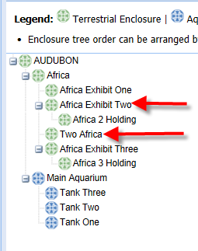
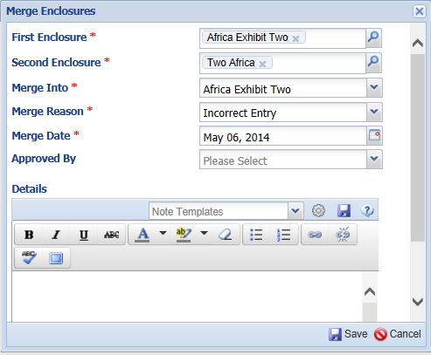
Merge Enclosures (cleanup errors)
In this example Africa Exhibit Two and Two
Africa are actually the same exhibit. Africa
Exhibit Two is the correct name. You would
select Merge Enclosures (cleanup errors).
The enclosure that you select to “Merge Into”
will be the one that is retained in the Tree. Two
Africa will disappear from the Tree. All animals
that were recorded as being in Two Africa will
automatically have their enclosure record
edited to Africa Exhibit Two and a note will
be generated associated with the enclosure
record noting why the enclosure changed.

Slide 13
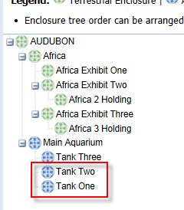
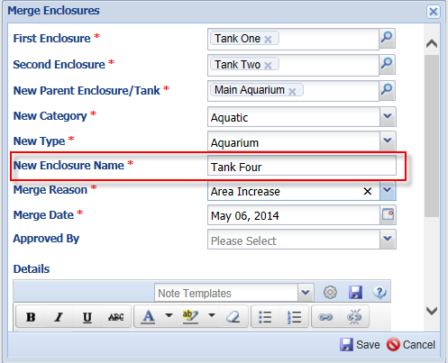
Merge Enclosures (actual physical merge)
In this example we are removing a barrier
between Tank One and Tank Two, creating a
larger tank. You would select Merge Enclosures
(actual physical merge). In this type of merge
a new enclosure is created instead of retaining
the name of one of the merged enclosures.
Tank One and Tank Two will disappear from the
Tree and Tank Four will appear. As of the merge
date any animals occupying either Tank One or
Tank Two will be automatically moved into Tank
Four and a note generated associated with that
move that the two enclosures were physically
merged.

Slide 14
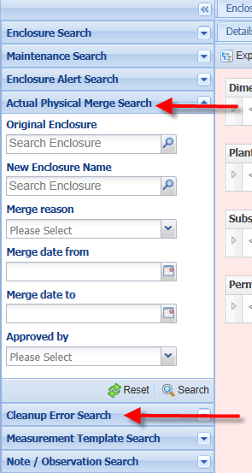
Finding Merged Enclosures
You can search for any merged
enclosures using the left hand
search box and selecting
Actual Physical Merge Search
or Cleanup Error Search.

Slide 15
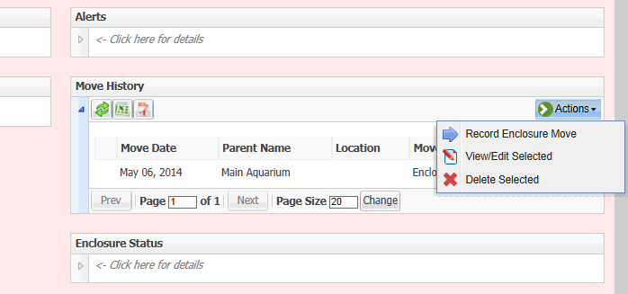
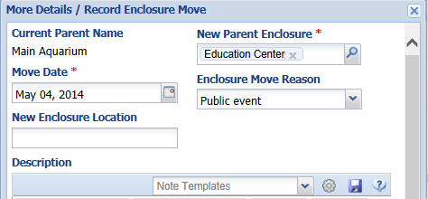
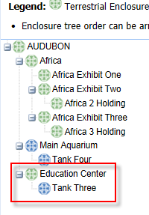
Enclosure Move
An Enclosure Move (under the More Details tab) would be used if an enclosure was actually moved from one location to another. Here we are moving Tank Three from the Main Aquarium into the Education Center for a public event.
This move will be reflected in the Tree by a change in the Parent enclosure. The move will also be tracked in the
Move History grid.

Slide 16
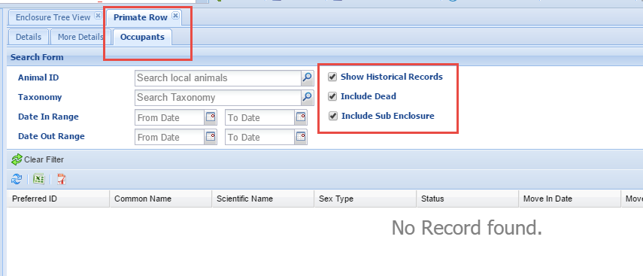
Enclosure Occupants
The animals held in the Enclosure are found under the Occupants tab. No Records are found because Primate Row is a Parent enclosure for all of the Primate exhibits. By checking Show Historical Records, Include Dead and Include Sub Enclosure we will get results for all animals that have ever been held in the Primate Row enclosures.

Slide 17
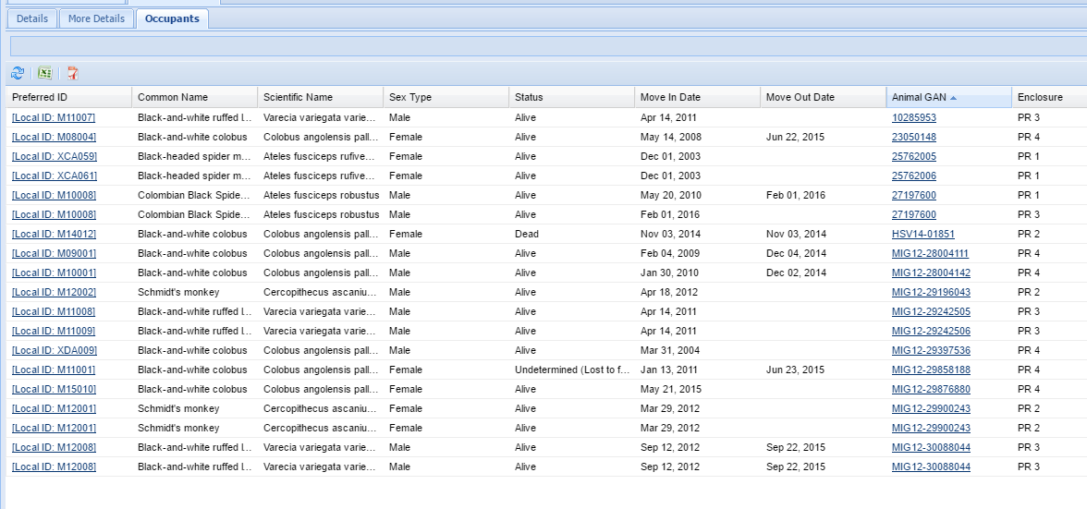
Enclosure Occupants
Now we see all of the current and historical occupants with the child enclosure noted and any Move In and Move Out Dates.

Slide 18
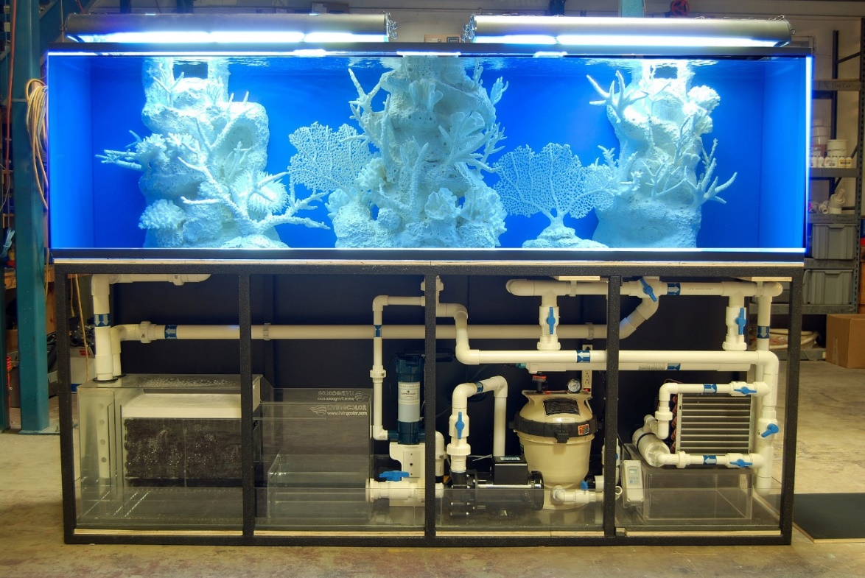
What is a Life Support?
A Life Support helps sustain life or improves the quality of life for
the animals in our care. Terrestrial enclosures can have Life
Supports but it is the Aquatic enclosures that rely more heavily
on them.

Slide 19
A Life Support is made up of components that are attached together
to form a single system. The Life Support can then be attached to one
or more enclosures or tanks.
Pump
Chiller
Filter
Aquatic Life Support
Tank 1
Tank 2

Slide 20
Life Support
A Complete Life Support
Add Components to Inventory
Create a Life Support
Attach Components
Attach to Enclosures(s)
A Simplified Life Support
Create a Life Support
Attach to Enclosure(s)
A complete life support is made up of components in an inventory and then attached to an enclosure(s) as on the top.
You may want to start in a simpler manner by just creating a Life Support and attaching it to the enclosure(s). Later, when you are more comfortable, you can create and attach the components.

Slide 21
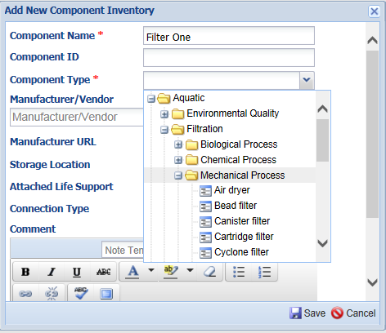
Component Inventory
To add a new component
open the Life Support module and select Add New Component under the Actions button. The Name must be unique. The Component Type is a cascading List that you can select at any level. Name and Type are the only mandatory fields. If you have already
created a Life Support you can
attach the Component to it
from this screen.

Slide 22
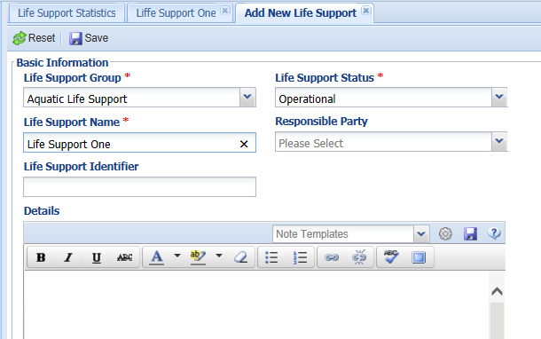
Creating a Life Support
To create a Life Support
open the Life Support
module and select Add
New Life Support under
the Actions button. What
you select for the Group
is very important as you can
only attach like to like. For
example, this is an Aquatic
Group which means only
Aquatic components can
be attached and it can only
be attached to Aquatic
enclosures.

Slide 23
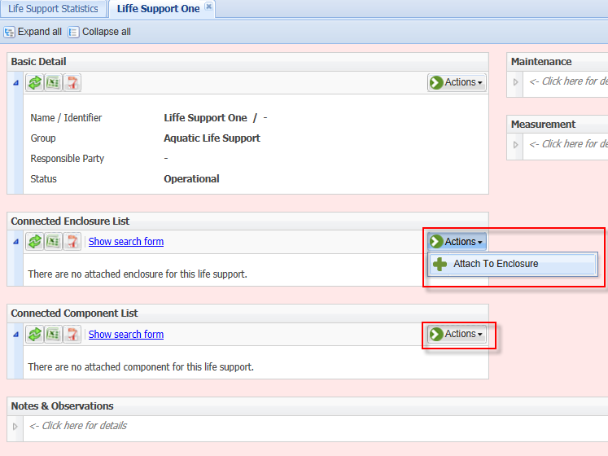
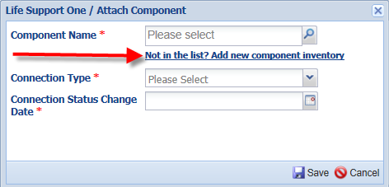
Attaching Components and Enclosures
To attach the Components
and attach the Life Support
to the Enclosure(s) open the
Life Support record and select Attach to Enclosure or Attach Components under the Actions button. If the Component is not yet in the inventory it can be added directly from the Attach Component grid.

Slide 24
Reports to Retrieve Your Data
Activity Report
Can be filtered by a single Enclosure
Daily Report
Can be run by Enclosure, Enclosure List, Life Support and Life Support Lists
Enclosure Activity Report
Events happening in an Enclosure
Enclosure Occupants Summary
Animal counts by Species, specific records not identified
Enclosure Report
Specific records identified, in and out dates

Slide 25
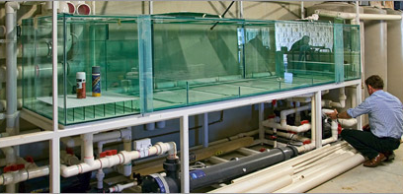
That is Managing Enclosures and Life Support in ZIMS
Notes:
Any questions?

