Slide 1
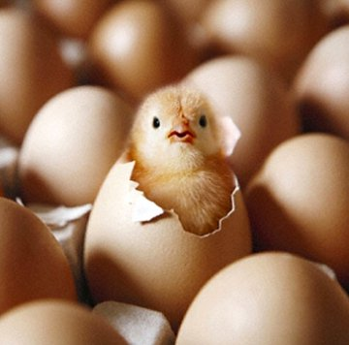
Hatching a Group of Eggs
The options available

Slide 2
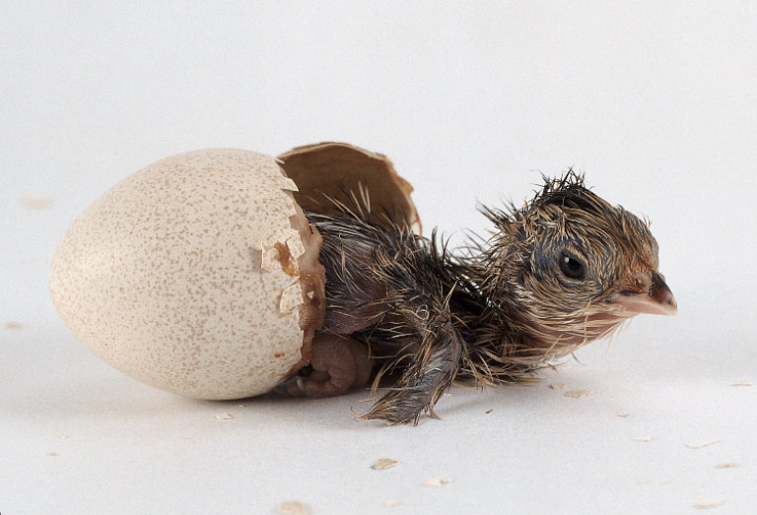
Things You Need to Consider
Not all clutches have to be handled the same way
You may only want to record hatched eggs and don’t care about capturing information on deaths or infertile eggs
In addition to hatches, you may want to record information on eggs from the clutch that did not hatch
You may want to associate an actual hatch date with an egg

Slide 3
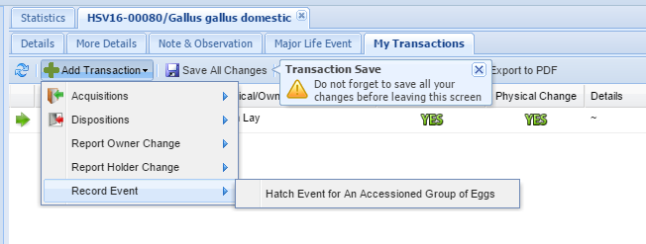
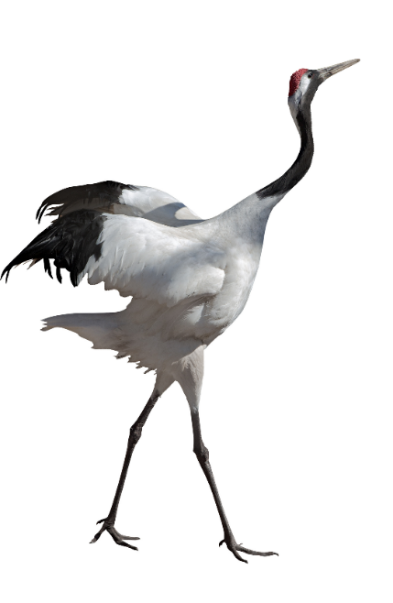
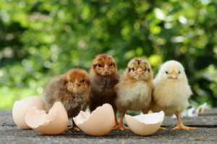
Scenario A: The eggs hatch on the same day. You do not want to record information on any that died in shell or were infertile.
This is the easiest scenario. From
the record for the group of eggs
select My Transactions > Record Event >
Hatch Event for an Accessioned
Group of Eggs.

Slide 4
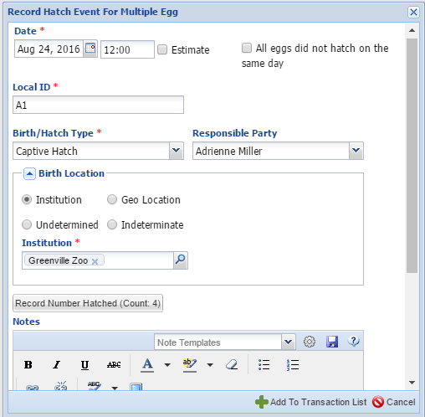
Scenario A continued
Complete the screen. Do
NOT check “All eggs did not
hatch on the same day”.
If you did not provide a
Local ID for the Group of
Eggs you will need to do
so now. If you did it will
prefill. Record the number
that hatched. The number
may or may not be the
same as the number of
eggs that were in the clutch.

Slide 5
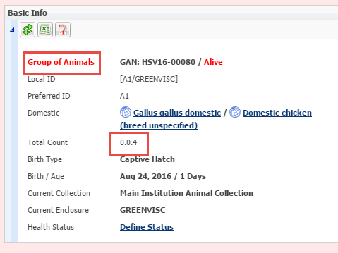
Scenario A continued
When you Save the transaction the
record will now be for a Group of
Animals with the count you recorded as
Hatching. You will not be able to record
any deaths against any embryos that died
in shell or any infertile eggs after the Hatch
Event is recorded.

Slide 6
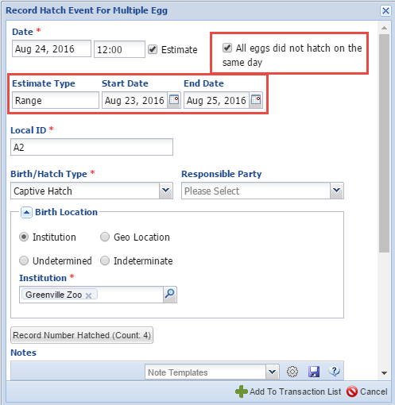
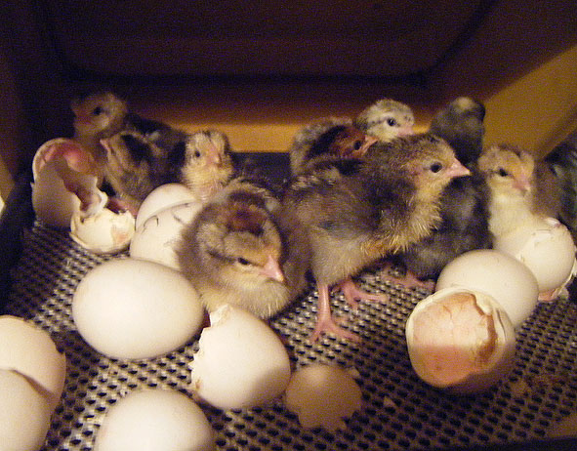
Scenario B: The eggs hatched on different days. You do not want to record any information on any that died in shell or were infertile.
For this scenario you will also select to Record
Hatch Event for an Accessioned Group of Eggs.
This time you will check the “All eggs did not hatch on the same day” checkbox. This will bring
up the Range Estimate box. Enter the date the first one hatched and the date the last one
hatched. Record the number hatched.

Slide 7
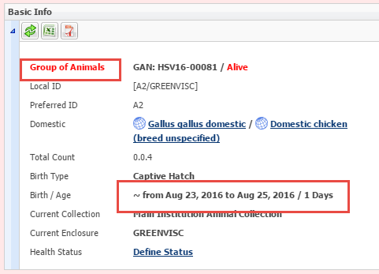
Scenario B continued
When you Save you will have
a Group of Animals with an
estimated Hatch Date Range.
If you later split out Individuals
they will have this estimated Hatch
Date associated with them. You
cannot enter any information on
death in shell or infertile once the
Hatch Event is recorded.

Slide 8
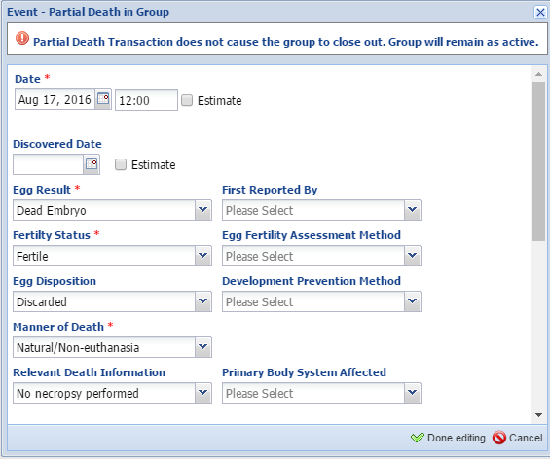
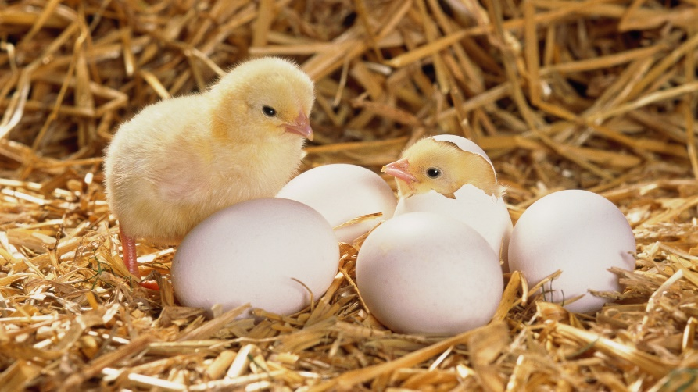
Scenario C: For either of the two previous scenarios you DO want to capture any infertile or dead in shell eggs.
Any dead in shell or infertile eggs will
need to be recorded PRIOR to recording
the Hatch Event. Go to My Transactions >
Dispositions > Partial Disposition > Death/
Disposal. Here we recorded a dead
embryo in one of the eggs.

Slide 9
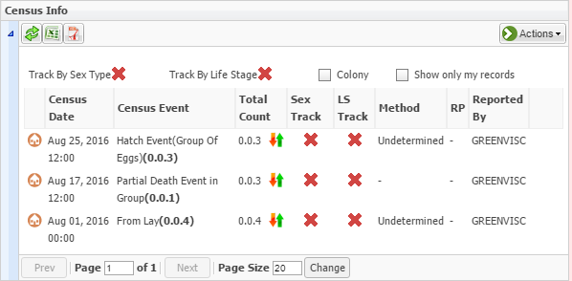
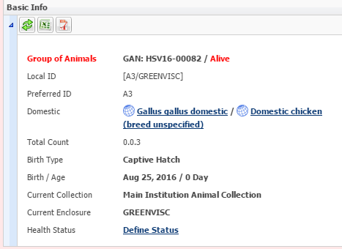
Scenario C continued
My Transactions will display the dead in shell.
We can then record a Hatch Event for the
remaining 3 eggs. Remember the death needs
to be recorded BEFORE the Hatch Event.

Slide 10
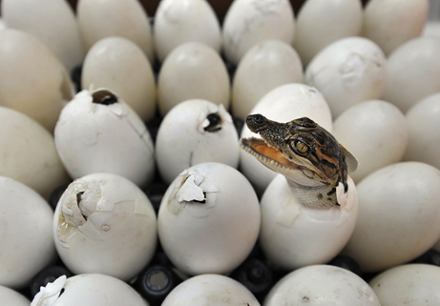
Scenario D: You want to record hatches as they happen and dead in shell or infertile as they are found, even after the clutch is done hatching
This is the most timing consuming
method but it provides you with
the most details on your group as it
allows for specific hatching dates
for individuals and the ability to
capture dead in shells or infertile eggs
found after the rest of the clutch hatched.

Slide 11
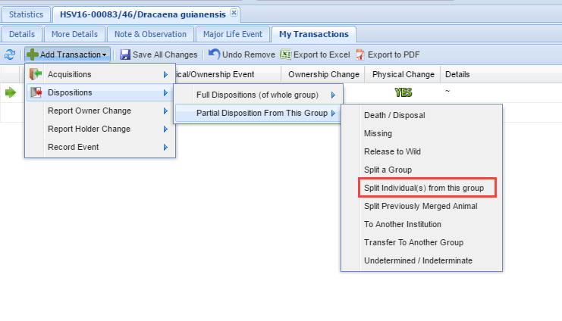
Scenario D continued
One egg was found missing on
3 August, you record that
Transaction. Two of the eggs
hatched on 22 August. You split
these two eggs out of the group
by selecting a Partial Disposition
of Split Individual(s) from this
Group.

Slide 12
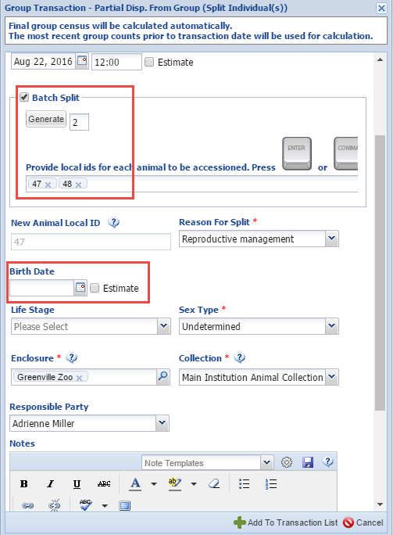
Scenario D continued
Complete the fields. Because
two hatched you can select
a Batch split. This
Institution has selected to
auto-generate Local IDs so
ZIMS asks how many you
would like generated. If not
auto-generating you would
fill them in manually. The
Birth Date should be left
empty.

Slide 13
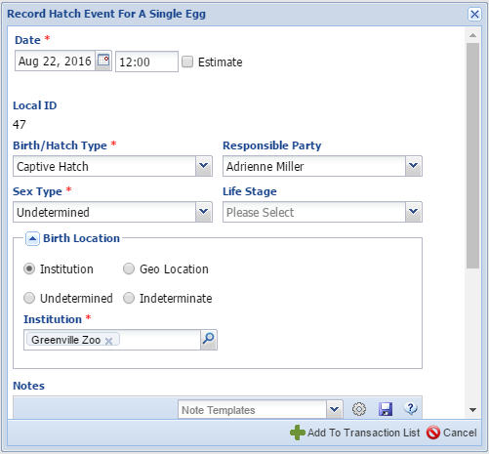
Scenario D continued
When you Save the two splits will display. Select one
of the hyperlinks, go to My Transactions and record a
Hatch Event for an Accessioned Egg. You may need to
change the time for this Hatch Event as ZIMS will
note that you already have a transaction on this day
and time.

Slide 14
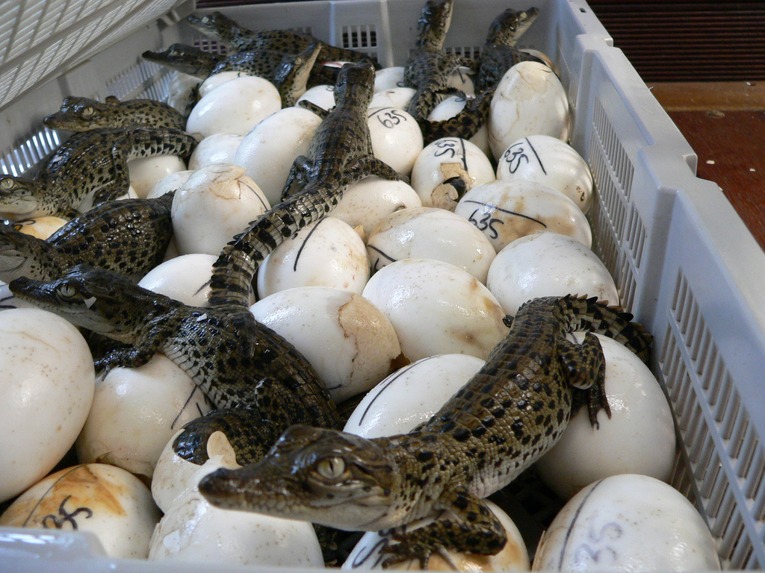
Scenario D continued
As the eggs hatch, continue to
split them out and record a Hatch
Event. If any dead in shell are
found record them as a Partial
Group Death. If you want to collect
Individual information on why that
particular egg resulted in a dead in
shell you should split out that egg
and record a death.

Slide 15
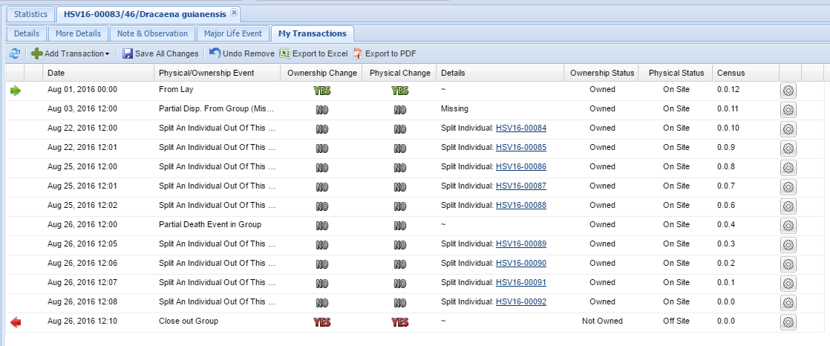
Scenario D continued
Continue to record splits as the eggs hatch, or deaths/infertile
eggs as they are found. If the final transaction is a Full Transaction
the group will automatically be Closed Out. If it is a Partial
Transaction you will need to Close Out the group so that it will
not continue to appear in reports. Close Out is found under Full
Disposition options.

Slide 16
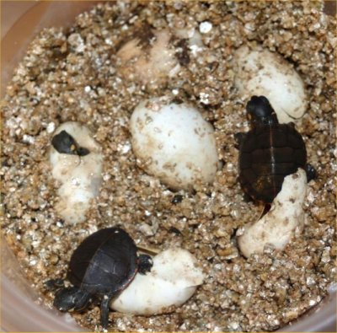
These are your options for hatching a group of eggs

